Slide 1

War and Punishment
Deuteronomy 20-26
And if any nation, tongue, or people should proclaim war against them, they should first lift a standard of peace unto that people, nation, or tongue;
And if that people did not accept the offering of peace, neither the second nor the third time, they should bring these testimonies before the Lord;
Then I, the Lord, would give unto them a commandment, and justify them in going out to battle against that nation, tongue, or people.
Doctrine and Covenants 98:34-36

Slide 2

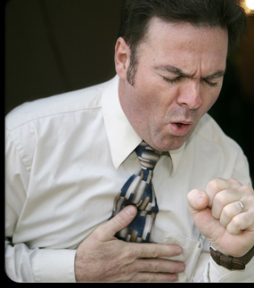

Would you still want to eat the food if someone coughed on it?
What might happen if you chose to eat the food?
What are some ways to keep infectious diseases from spreading?

Slide 3


Spiritual Sickness
As the Israelites prepared to enter the promised land, God wanted to prevent from spreading among them a kind of spiritual sickness that would have had eternal consequences.
The Lord had designated the promised land as holy, but it had been occupied for hundreds of years by people who refused to obey God’s commandments.
The Lord did not want those people’s wickedness to infect the Israelites and spread among them.
Lesson 70

Slide 4
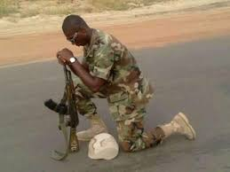
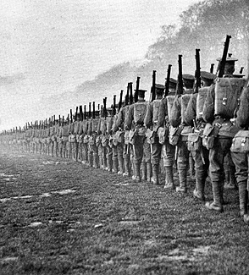
Military Laws
“When wars are fought in terms of a defense of justice and the suppression of evil, and in defense of the homeland against an enemy, they are a part of the necessary work of restitution or restoration, and they are therefore spoken of in Scripture as the wars of the Lord (Num. 21:14).
The preparation of the soldiers involved a religious dedication to their task (Josh. 3:5).
1
2013 war to battle Islamist sect
“All able-bodied men twenty years old and up were eligible for military service.
This standard long prevailed and was, for example, the basis of operation in the American War of Independence.
2
World War I
Deuteronomy 20:1-3, Num. 21:14; Num. 1:2, 3, 18, 20, 45; 26:2, 3; Num. 31:3-6.
(1)

Slide 5
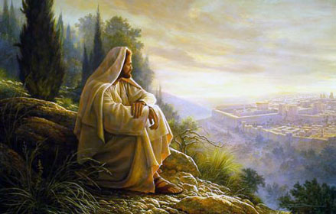
Warfare Against Evil
3
“Since warfare against evil is godly and serves God’s task of restoration, God promised to protect His men if they moved in terms of faith and obedience. …
“In the battle against Midian, cited above, 12,000 Israelite soldiers burned all the cities of Midian and slew their men, brought back 675,500 sheep, 72,000 head of cattle, 61,000 asses, and 32,000 unmarried women, without any loss of life. Out of this, a tithe or portion was given to the Lord.”
“Thus, where a war is waged in terms of God’s law and in faith and obedience to His law-word, there men can count on His protecting and prospering care even as Israel experienced it.”
Deuteronomy 20:1-3
(1)

Slide 6
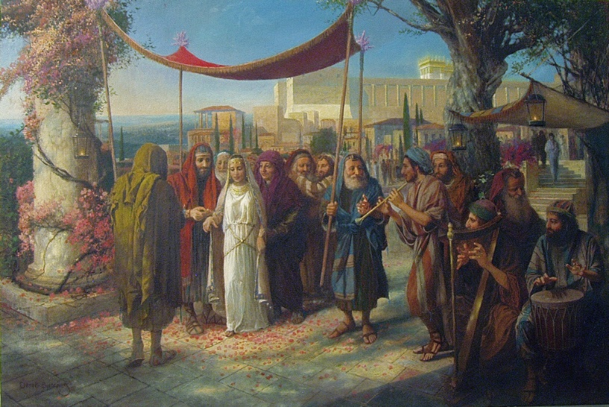
Military Exemptions
4
“Exemption from military service was provided by law. The purpose of an army should be to fight God’s battles without fear. Exemptions were given to several classes of men:
those who had built a new house and had not dedicated nor enjoyed it;
those who had planted a vineyard and had not yet enjoyed its fruit;
and those who have ‘betrothed a wife, and hath not taken her’; such men would have a divided mind in battle;
all who were ‘fearful and faint-hearted’ were excused as dangerous to army morale, ‘lest his brethren’s heart melt as his heart’.
The Levites were exempt from a draft, but they often fought
“The exemption of the newlywed men was mandatory according to Deuteronomy, ‘When a man taketh a new wife, he shall not go out in the host, neither shall he be charged with any business; he shall be free at home one year, and shall cheer up his wife, whom he hath taken.’ “
Family has a priority over warfare
Deuteronomy 20:1-9; 24:5
(1)

Slide 7


Military Cleanliness
5
“The Military required cleanliness in the camp. A latrine outside the camp is required, and a spade ‘to cover up your filth’.
‘For the Eternal your God moves within your camp, to rescue you and to put your enemies into your power; hence your camp must be sacred—that he may not see anything indecent among you and turn away from you’.
The pit toilet seen here is constructed from local rubble just below the summit of Mount Sinai
“Another general principle appears from this law as well as the first and third laws (above), namely, that it is not enough for the cause to be holy: not only the cause, but the people of the cause, must be holy, both spiritually and physically.’’
Deuteronomy 20:1-9; 23:9-14
(1)

Slide 8
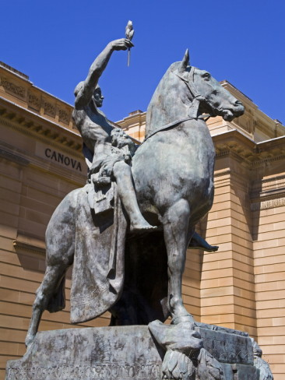
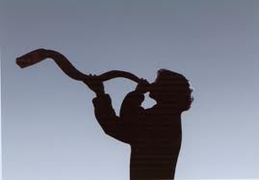
Offer of Peace
6
“Military law requires that, prior to an attack, or rather, a declaration of war, an offer of peace be extended to the enemy. The offer of peace cannot be an offer to compromise.
The cause, if it be just, must be maintained; the enemy must yield to gain peace.
A ‘sneak attack’ after a declaration, in Gideon’s manner, is legitimate: hostilities are in progress. But, prior to a declaration of war, an attempt to negotiate with honor to the cause is required. [This position is supported also in latter-day scripture;
The formal blowing of trumpets, both before war and in rejoicing at the time of victory, placed the cause before God in expectancy of victory and in gratitude for it.”
The Offerings of Peace Statue Outside Art Gallery of New South Wales
Read
1 Nephi 17:33-35
Deuteronomy 20:1-9; 23:9-14, D&C 98:33-36, Alma 43:46; 48:14-16, Num. 10:9, 10
(1)

Slide 9
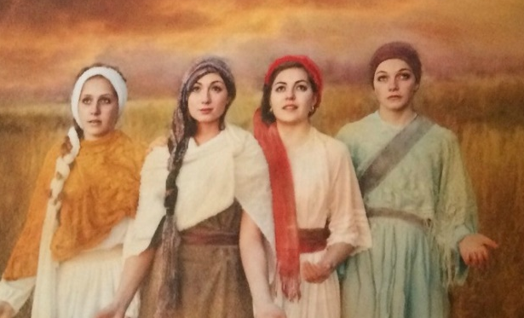
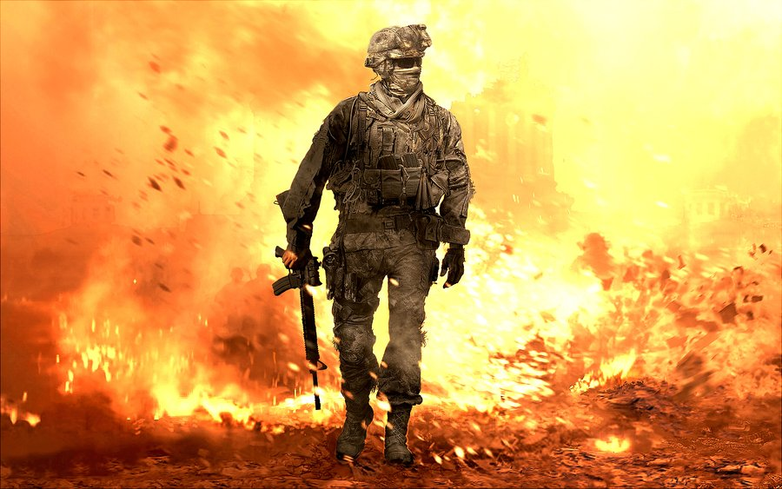
Warfare is Serious
7
“Warfare is a grim and ugly if necessary matter. The Canaanites against whom Israel waged war were under judicial sentence of death by God. They were spiritually and morally degenerate.
Virtually every kind of perversion was a religious act: and large classes of sacred male and female prostitutes were a routine part of the holy places.
Thus, God ordered all the Canaanites to be killed, both because they were under God’s death sentence, and to avoid the contamination of Israel.”
“Any woman taken prisoner from a foreign country could be married, but could not be treated as a slave or as a captive, clearly indicating the difference in national character between Canaanites and other peoples.
These laws were not applicable to all peoples but only to the most depraved. They assert a still valid general principle: if warfare is to punish and/or to destroy evil, the work of restoration requires that this be done, that an evil order be overthrown, and, in some cases, some or many people be executed. …”
Deuteronomy 2:34; 3:6; 20:16-18; 21:10-12; Josh. 11:14
(1)

Slide 10

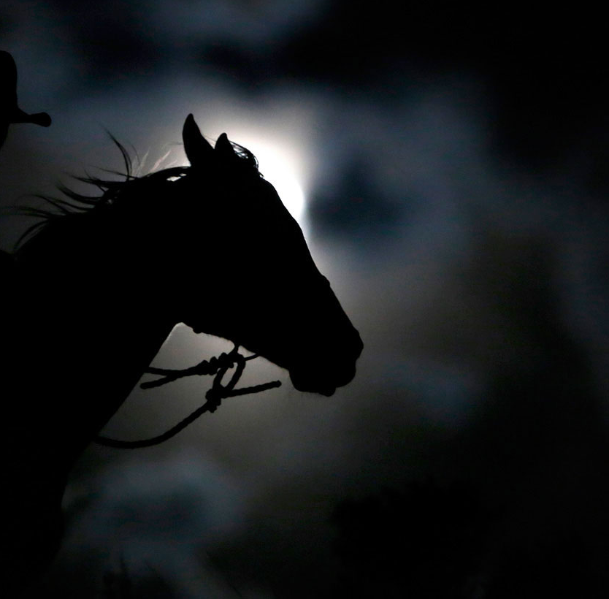
Warfare Horses
8
“The normal purpose of warfare is defensive; hence, Israel was forbidden the use of more than a limited number of horses, since horses were the offensive weapon of ancient warfare. …”
Deuteronomy 17:16
(1)

Slide 11

Besiege A City
9
‘When thou shalt besiege a city a long time, in making war against it to take it, thou shalt not destroy the trees thereof by forcing an axe against them: for thou mayest eat of them, and thou shalt not cut them down (for the tree of the field is man’s life) to employ them in the siege: Only the trees which thou knowest that they be not trees for meat, thou shalt destroy and cut them down; and thou shalt build bulwarks against the city that maketh war with thee, until it be subdued.’
“In other words, war is not to be waged against the earth, but against men. But, even more centrally, life must go on, and the fruit tree and the vineyard represent at all times an inheritance from the past and a heritage for the future: they are not to be destroyed. Other trees can be cut down, but only as needed to ‘build bulwarks against the city.’”
Wanton destruction is not permitted. …
Deuteronomy 20:19, 20; 1 Nephi 17:33-35
(1)

Slide 12
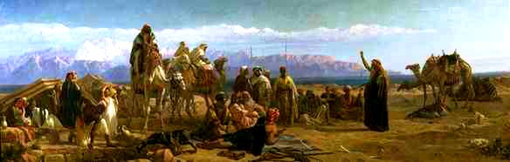
Laws of Booty
10
“The laws of booty provided a reward to the soldiers (Num. 31:21–31, 29, 30, 42; Deut. 20:14), so that there is legal ground not only for soldiers’ pay but also a pension, a reward for their services.
War indemnity was an aspect of the penalty imposed on an enemy as penalty for their offense, and to defray the costs of the war.”
“In terms of Scripture, in a sinful world, war is ugly, but it is a necessity if evil is to be overcome.”
Numbers 31:21-31, 29, 30, 42; Deut. 20:14; 2 Kings 3:4
(1)

Slide 13
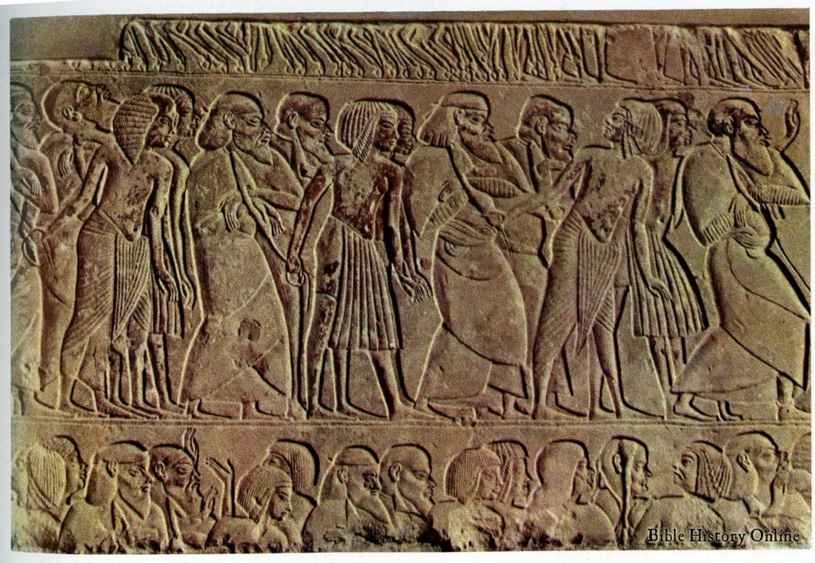
Battling Spiritual Sickness
The people who inhabited the promised land had become spiritually and morally corrupt—like the people in the days of Noah. They participated in acts of perversion, immorality, and even human sacrifice as part of their social and religious practices.
God may destroy the wicked to prevent their sins from spreading to others
The people had received more than one warning to repent of their sins and had refused to do so.
Deuteronomy 20:12

Slide 14
Other Laws
The law required to return the property to others.
“Finders keepers, losers weepers” was not in effect
Forcible Rape-the man alone was to die, and nothing was to be done to the girl.
Tithing will go to the Levites, the stranger, the fatherless, and the widow.
Deuteronomy 22:1-4 | Deuteronomy 22:5 | Deuteronomy 22:25-27 | Deuteronomy 24:19-22 | Deuteronomy 26:12-13
Laws about returning others’ property | Laws about dress and appearance | Laws protecting the victims of sexual assault | Laws about caring for those in need | Law of tithing
The way one clothes oneself is important to the Lord. A special prohibition in the law of Moses forbade men and women to wear each other’s clothing. When this practice is tolerated by society, it produces great confusion. The Lord expressly forbade a unisex society. Any attempt to erase the obvious distinctions between men and women is unnatural and an abomination to the Lord.
Things left in the field shall be for the poor and needy

Slide 15
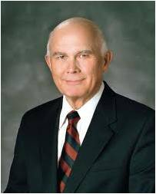

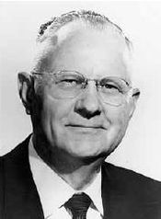
“It is not enough for anyone just to go through the motions. The commandments, ordinances, and covenants of the gospel are not a list of deposits required to
be made in some heavenly account. The gospel
of Jesus Christ is a plan that shows us how to
become what our Heavenly Father desires us to
become.”
We can be the Lord’s peculiar and holy people if we obey His commandments with all our heart and soul
To love God with all one's heart implies the presence of sincere, profound inner feelings of the soul, inspired from a divine source.
Trust in the LORD with all thine heart; and lean not unto thine own understanding. Proverbs 3:5
The word heart is used in scripture as the core of life and strength; hence it includes mind, spirit, and soul, and one's entire emotional nature and understanding.
One of the dictionary definitions states:
"Heart is the center of the total personality with reference to intuition, feeling, or emotion: the center of emotion, in contrast to the head as the center of the intellect."
Deuteronomy 26:16
(2,3)

Slide 16

Walk in His Ways
Moses gave one of the finest statements of a covenant found anywhere in scripture. Israel promised to keep the Lord’s commandments, and the Lord “avouched” (promised) to honor Israel and make of her a holy nation.
Deuteronomy 26:17
(1)

Slide 17
Sources:
(Rushdoony, Institutes of Biblical Law, pp. 277–81.) in Old Testament Institute Manual
Elder Dallin H. Oaks (“The Challenge to Become,” Ensign, Nov. 2000, 32).
Presentation by ©http://fashionsbylynda.com/blog/
3. Elder Delbert L. Stapley To Love God 1968 October Gen. Conf

Slide 18
Deuteronomy
Deuteronomy 1-13 | Deuteronomy 14-19 | Deuteronomy 20-26 | Deuteronomy 27-34
Preparing Israel to enter the Promised Land | The Lord’s Laws and Feasts | War and Punishments | Obedience and Disobedience Moses’ Final Sermon
Deuteronomy 20 | Deuteronomy 21-22 | Deuteronomy 23 | Deuteronomy 24 | Deuteronomy 25 | Deuteronomy 26
Law of Warfare | Social Laws: Unknown murders, Family, marriage Rebellious sons Brother’s property Separation | Law of Acceptance into Congregation Harmony in the Nation | Laws are given concerning divorce, newly married persons, making merchandise of men, taking pledges, leprosy, oppression of servants, and leaving gleanings of crops. | Punishments Laws for marriage Just weights and measures Blot out Amalekites | Law of Tithes Covenants

Slide 19
Were Parents Really Required to Have Their Rebellious Children Executed? Deut. 21:18-21
This requirement, like all else in the Mosaic law, was given by the Lord, who was the premortal Jesus. It is consistent with all other aspects of His nature.
The law was not speaking of just disobedient children but of incorrigible children, those to whom no counsel or guidance was meaningful.
Almost certainly, these were children who had reached maturity. (The charge of drunkard is evidence for this view.) Small children would not qualify as incorrigible.
The parents have tried all other means of correction (see v. 18), and all have failed.
Although the parents had to bring charges against their own child, they were not required to execute him, as were the witnesses in other capital crimes.
Since the family is the basic unit of society and the most important means of transmitting righteousness from generation to generation, the child who utterly rejected parental authority threatened the very order of society. Thus, like the idolator, he must be put to death (see Reading 20-2).
7. A parent who upheld his child in crime became a contributor to crime in society.
“To deny the death penalty is to insist on life for the evil; it means that evil men are given the right to kill, kidnap, rape, and violate law and order, and their life is guaranteed against death in the process. The murderer is given the right to kill without losing his life, and the victim and potential victims are denied their right to live. Men may speak of unconditional love, and unconditional mercy, but every act of love and mercy is conditional, because, in granting it to one man, I am affirming the conditions of his life and denying others in the process. If I am loving and merciful to a murderer, I am unloving and merciless to his present and future victims. Moreover, I am then in open contempt of God and His law, which requires no mercy to a man guilty of death.”
“If the parents refused to complain against their son, they were then guilty of condonation and/or participation in his crimes. Their role was thus a formal but necessary one: would the family align itself with justice or stand in terms of blood ties? In view of the strong nature of family loyalties, the parental participation was necessary in order to ensure freedom from feud and also to place the family firmly against its criminal members. A parent refusing to file a complaint in such a case would become a party to the offense and a defender of crime. The principle required was clear-cut: not blood but law must govern. …
“Clearly then, the intent of this law is that all incorrigible and habitual criminals be executed. If a criminal son is to be executed, how much more so a neighbor or fellow Hebrew who has become an incorrigible criminal? If the family must align itself with the execution of an incorrigibly delinquent son, will it not demand the death of an habitual criminal in the community?
“That such is the intent of the law appears from its stated purpose, ‘so shalt thou put evil away from among you; and all Israel shall hear, and fear.’ The purpose of the law is to eliminate entirely a criminal element from the nation, a professional criminal class. The family is not permitted the evil privilege of saying, ‘We will stand behind our boy, come what may’; the family itself must join the war on crime.” (Institutes of Biblical Law, pp. 187–88.)
8. Think for a moment of how strongly parents would strive to turn their children from sin, knowing that if they failed, they would have to go through the horror of taking them to the judges for execution. Surely they would chasten them in every possible way to see that such an event never happened (see v. 18). In a world of permissive child rearing and the ensuing destruction of righteousness, the lesson of this passage has great meaning. (Rushdoony, Institutes of Biblical Law, p. 78.) From Old Testament Institute Manual

Slide 20
Heart and Soul:
1. Can one truly say he loves God and then break the commandments which are given for the salvation and glory of his children?
2. Can one say he loves the Lord and fail to pray and give thanks for his bounteous blessings?
3. Can a person who is dishonest in his dealings with his fellowmen love the Lord?
4. Does a person love the Lord when he fails to pay an honest tithe?
5. Can one love the Lord and not observe the Word of Wisdom?
6. Can one love the Lord and be morally unclean?
7. Can one love the Lord and be disloyal and unfaithful to his or her family by committing licentious acts, desertion, or willful neglect of loved ones?
8. Can one truly love the Lord and disregard the teachings and counsel of his anointed prophet, seer, and revelator?
Elder Delbert L. Stapley of the quorum of twelve To Love God Oct. 1968 Gen. Conf.
The wrath of God:
Elder Dallin H. Oaks of the Quorum of the Twelve Apostles explained how even God’s justice on the wicked is evidence of His love and concern for His children:
“We read again and again in the Bible and in modern scriptures of God’s anger with the wicked and of His acting in His wrath against those who violate His laws. How are anger and wrath evidence of His love? Joseph Smith taught that God ‘institute[d] laws whereby [the spirits that He would send into the world] could have a privilege to advance like himself’ [Teachings of Presidents of the Church: Joseph Smith (2007), 210].
God’s love is so perfect that He lovingly requires us to obey His commandments because He knows that only through obedience to His laws can we become perfect, as He is. For this reason, God’s anger and His wrath are not a contradiction of His love but an evidence of His love” (“Love and Law,” Ensign or Liahona, Nov. 2009, 27).

