Slide 1
Heavenly
Father
protects
me
Heavenly
Father
protects
me
Heavenly
Father
protects
me
Heavenly
Father
protects
me
Heavenly
Father
protects
me
Heavenly
Father
protects
me
Heavenly
Father
protects
me
Heavenly
Father
protects
me
Heavenly
Father
protects
me
Heavenly
Father
protects
me
Heavenly
Father
protects
me
Heavenly
Father
protects
me

Slide 2
Heavenly
Father
protects
me
Heavenly
Father
protects
me
Heavenly
Father
protects
me
Heavenly
Father
protects
me
Heavenly
Father
protects
me
Heavenly
Father
protects
me
Heavenly
Father
protects
me
Heavenly
Father
protects
me
Heavenly
Father
protects
me
Heavenly
Father
protects
me
Heavenly
Father
protects
me
Heavenly
Father
protects
me

Slide 3
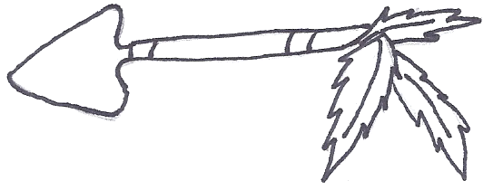
Sadness
Sadness
Bad
feelings
Bad
feelings
Wrong
choices
Wrong
choices
anger
anger

Slide 4
sadness
sadness
Wrong
choices
Wrong
choices
Bad
feelings
Bad
feelings
anger
anger

Slide 5
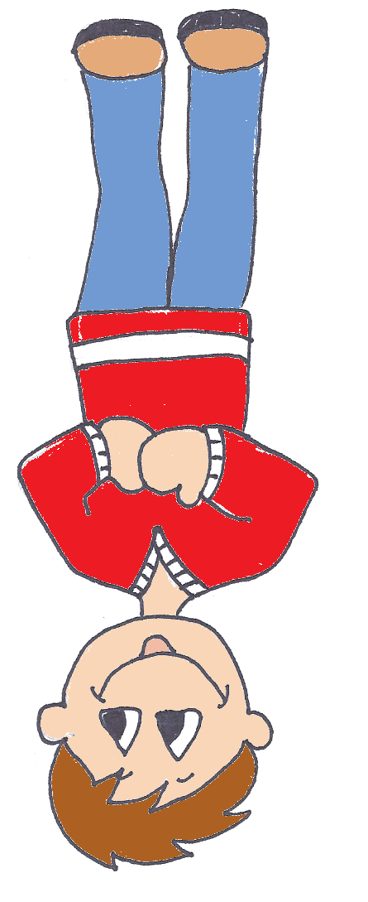
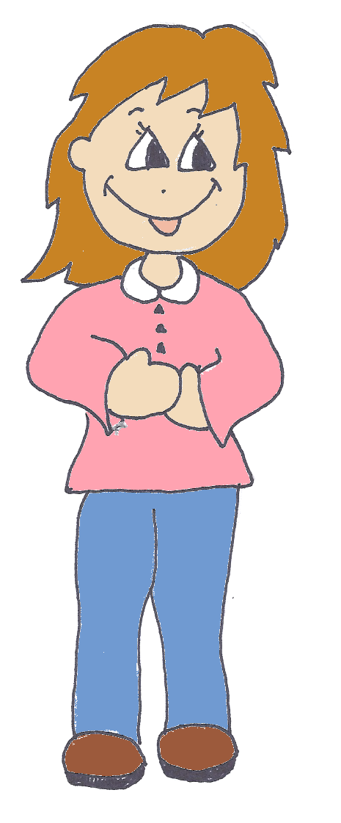
Heavenly
Father
protects
me
sadness
Wrong
choices
Bad
feelings
anger

Slide 6
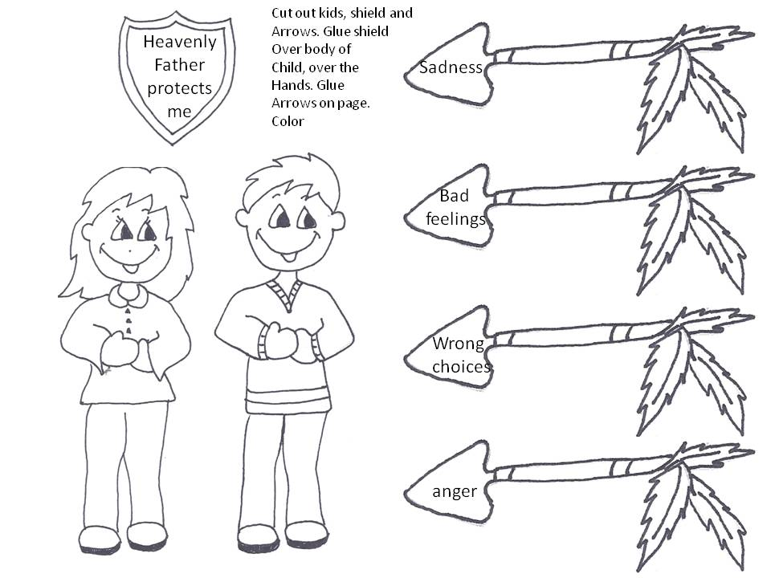

Slide 7
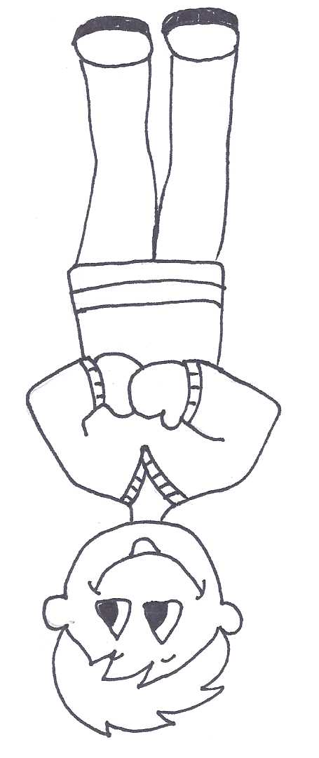

Slide 9
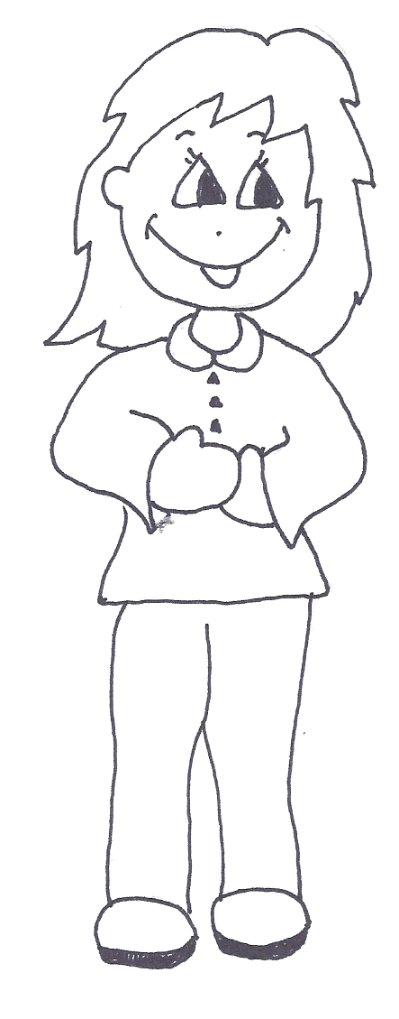

Slide 11
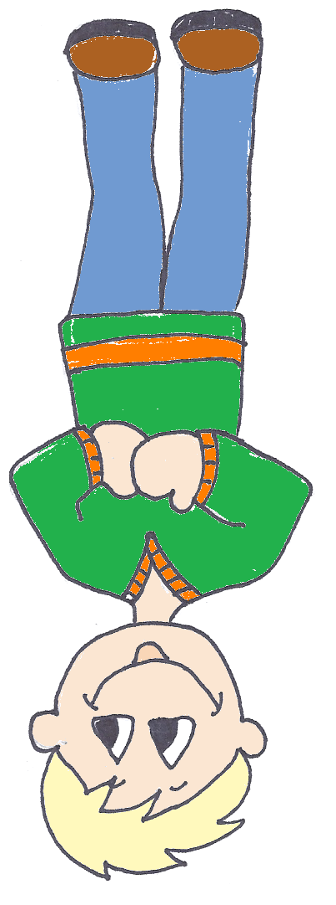
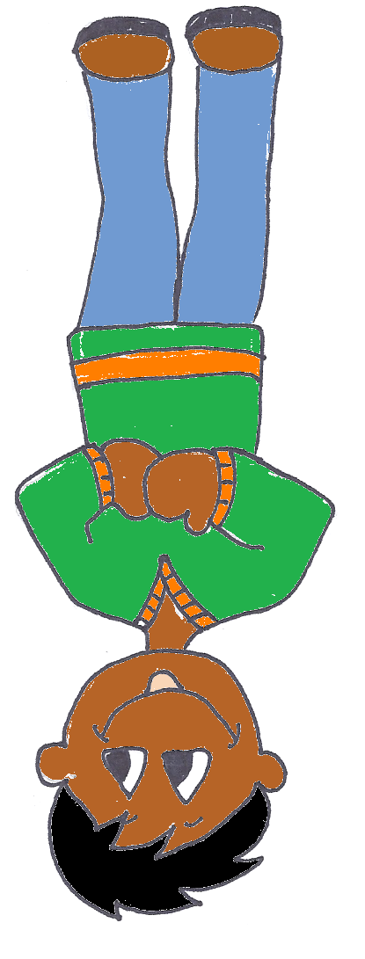

Slide 12
Heavenly
Father
protects
me
Heavenly
Father
protects
me
Heavenly
Father
protects
me
Heavenly
Father
protects
me
Heavenly
Father
protects
me
Heavenly
Father
protects
me

