Slide 1
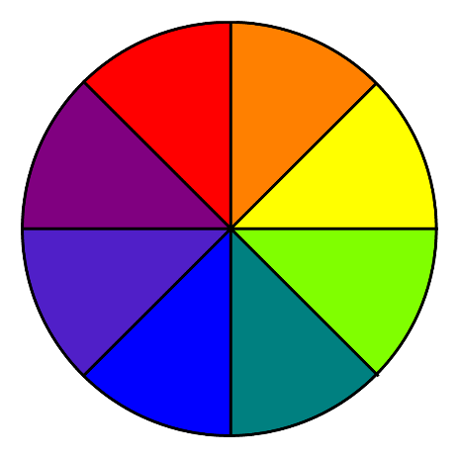
Circle Fun Part 7
Compass
Blast From the Past
Free Printable Downloads
Color Wheel

Slide 2
Blast from the Past

Slide 3
Compass

Slide 4
Stairway to Heaven

Slide 5
Color Wheel

Slide 6
Come On, Get Happy

Slide 7
Time

Slide 8
Four Ways

Slide 9
Heart in Chains

