Slide 1
Satan

Slide 2
A

Slide 3
A

Slide 4
A

Slide 5
A
Anna
Sapphira
Ananias
Andrew

Slide 6
A
Annas, father in law to Caiaphas
Ananias---paul’s conversion

Slide 7
A
King Aggripa

Slide 8
Thomas
John
Simon
Peter
James
Philip
Matthew
Jude
James
Andrew
Judas
Nathanael (Bartholomew)

Slide 9
James (apostle)
Andrew
Philip

Slide 10
New Testament
James
Jude

Slide 11
A

Slide 12
A

Slide 14
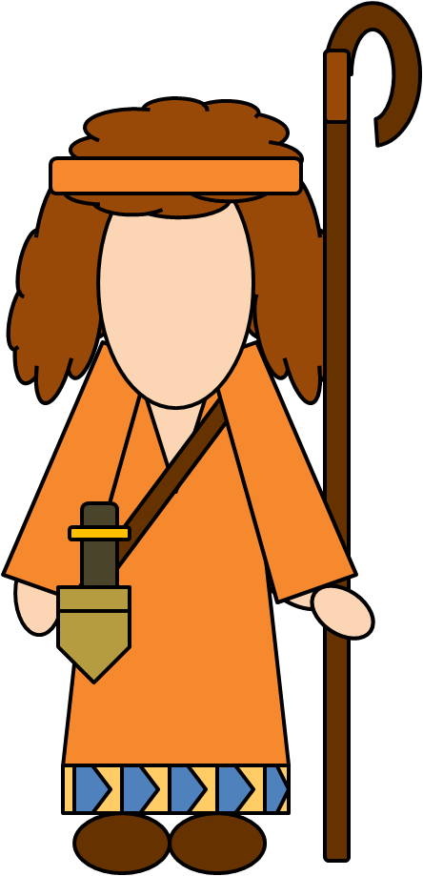
New Testament

Slide 16
A
New Testament
Matthew
Luke
John
Mark

Slide 17
A
Judas Iscariot
Philip
Nathanael

Slide 18
B
Bartimaeus
Blind man healed by Jesus
Barnabas, Pauls companion 1st mission
Barabbas

Slide 19
C
Caiaphas
Caesar

Slide 20
C
Chief Captain

Slide 21
F
Felix
Festus

Slide 22
H
Hezekiah
Hoshea

Slide 23
H
Herod

Slide 24
J

Slide 25
J
Word Of God

Slide 26
J

Slide 27
J

Slide 28
J

Slide 29
Could be Heavenly Father

Slide 30
J
John the Baptist
John the beloved

Slide 31
J
John the Baptist
Judas--Basabas

Slide 32
J
Judas Iscariot
James (apostle)
Jairus and book of mormon Helam

Slide 33
Luke
Julius--centurion

Slide 34
M
Martha
Mary Magdeline
Mary , Lazarus’ sister and Martha’s sister, same as anointment of Jesus’ feet

Slide 35
M
Mark-barnabas’ companion
Malachi

Slide 36
M
Matthew
Mark
Matthias

Slide 37
M
New Testament

Slide 39
N

Slide 43
Dispensations
Noah
3100 BC
Moses
1400 BC
Joseph Smith
AD 1830
Adam
4000 BC
Apostasy
Enoch
3300 BC
Flood
Jesus
AD 1
Abraham
2000 BC

Slide 46
N
Nicodemus
Nicodemus the Pharisee
Nathanael

Slide 47
N
Nero

Slide 48
O
Onesimus
Slave Onesimus or Philemon
New Testament

Slide 49
P
Philemon
Peter
Paul for both

Slide 50
P
Philip
Philip in Acts
Pekah

Slide 51
P
Pilate

Slide 52
P
A sower
A nobleman

Slide 53
P

Slide 54
P

Slide 55
P

Slide 56
P

Slide 57
P

Slide 58
P

Slide 59
servant
Parable
certain man planted vineyard

Slide 60
P

Slide 61
P
Certain rich man

Slide 62
P

Slide 63
P
judge
vb

Slide 64
Parable

Slide 65
R
Remaliah
Rezin

Slide 66
S

Slide 67
S
Sapphira
Ananias

Slide 68
S
Stephen
Simon the Zealot
Silas

Slide 69
S
Simeon

Slide 70
T
New Testament
titus
Timothy
Thomas

Slide 71
S

Slide 72
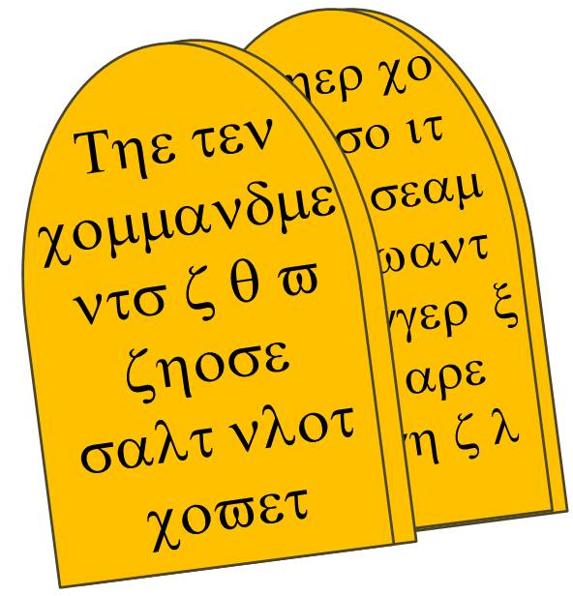
The Brass Plates of Laban
The Book Of Mormon
The Book of Mormon

Slide 73
W

Slide 74
W
Woman at the well

Slide 75
W
Martha
Mary Magdeline
Mary , Lazarus’ sister and Martha’s sister, same as anointment of Jesus’ feet

Slide 76
W
ב
ד
w
O
B
V
ל
x
V
ר
w
.
Y
ג
M
א
E
w
I
E
U
z
z
E
Widow’s Mite

Slide 77
Z
Zacharias
Elizabeth

