Slide 7
c

Slide 8
All scripture is given by inspiration of God
2 Timothy 3:16
Becoming contaminated by the sins of the world can prevent us from being a blessing to others.
As we come unto Jesus Christ with our burdens, He will give us rest

Slide 27
Give a man a fish and you feed him for a day.
Teach a man how to fish and you feed him for a lifetime.
-Lao Tzu

Slide 28
5
25
1
10
1
1

Slide 34
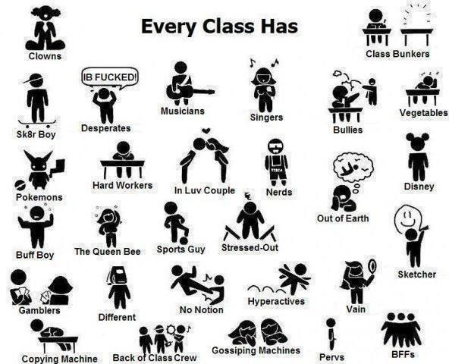

Slide 36
?

Slide 41
Go on a mission
Get baptized
Get Job
Go to college
Get married in temple
Have children

Slide 42
Yes
No

