Slide 1
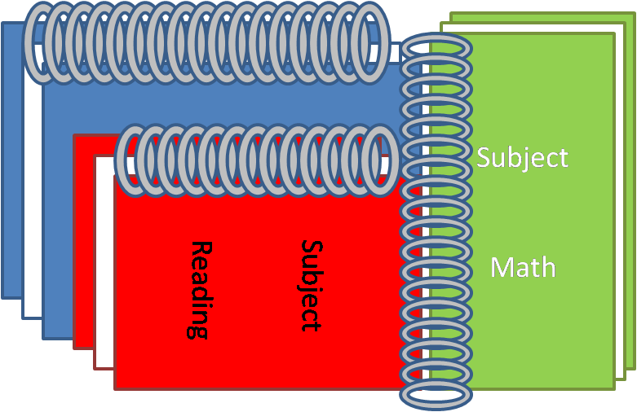
Dear
The Book of Mormon

Slide 2

All scripture is given by inspiration of God
2 Timothy 3:16
Becoming contaminated by the sins of the world can prevent us from being a blessing to others.
As we come unto Jesus Christ with our burdens, He will give us rest

Slide 3


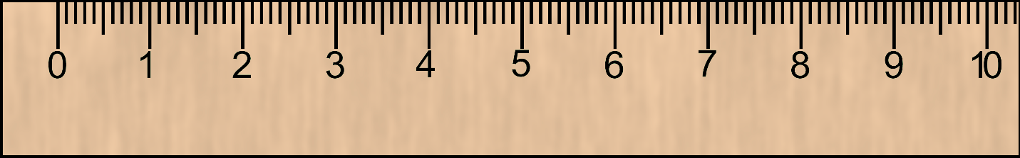
Hyrum M. Smith and Janne M. Sjodahl Doctrine and Covenants Commentary
Joseph Fielding McConkie and Craig J. Ostler Revelations of the Restoration
L.G. Otten and C.M. Caldwell Sacred Truths of the Doctrine and Covenants
Doctrine and Covenants Student Manual Religion 324-325 Section
Old Testament Who’s Who by Ed J. Pinegar and Richard J. Allen pg.
B.H. Roberts A Comprehensive History of the Church Vol.
Richard D. Draper, S. Kent Brown, Michael D. Rhodes The Pearl of Great Price Verse by Verse Commentary
H. Donl Peterson The Pearl of Great Price, The History and Commentary

Slide 4


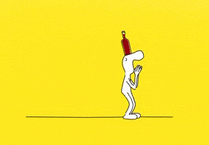


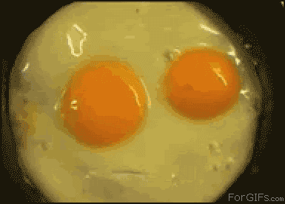
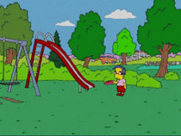

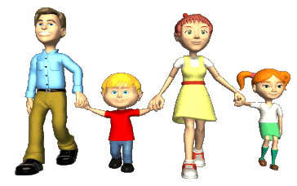


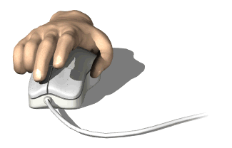

Slide 5

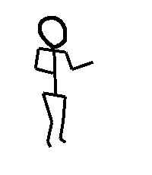
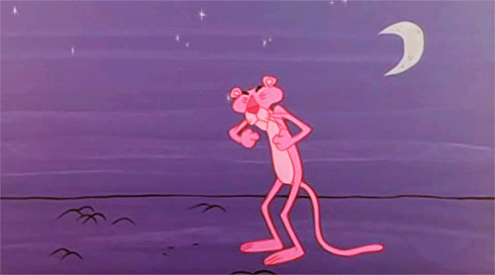
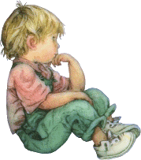
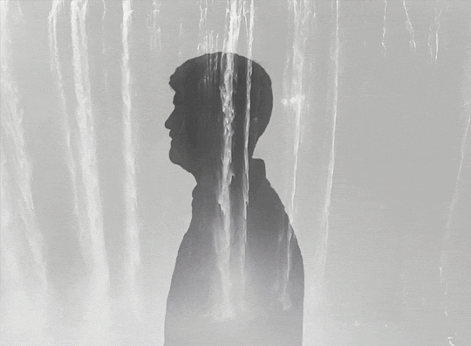



Slide 6
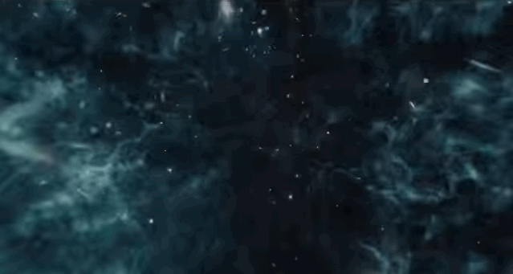
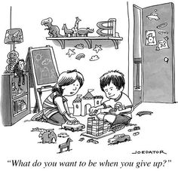
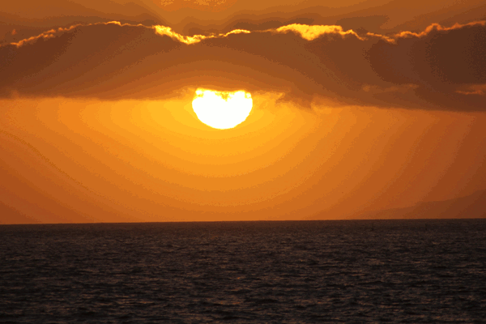
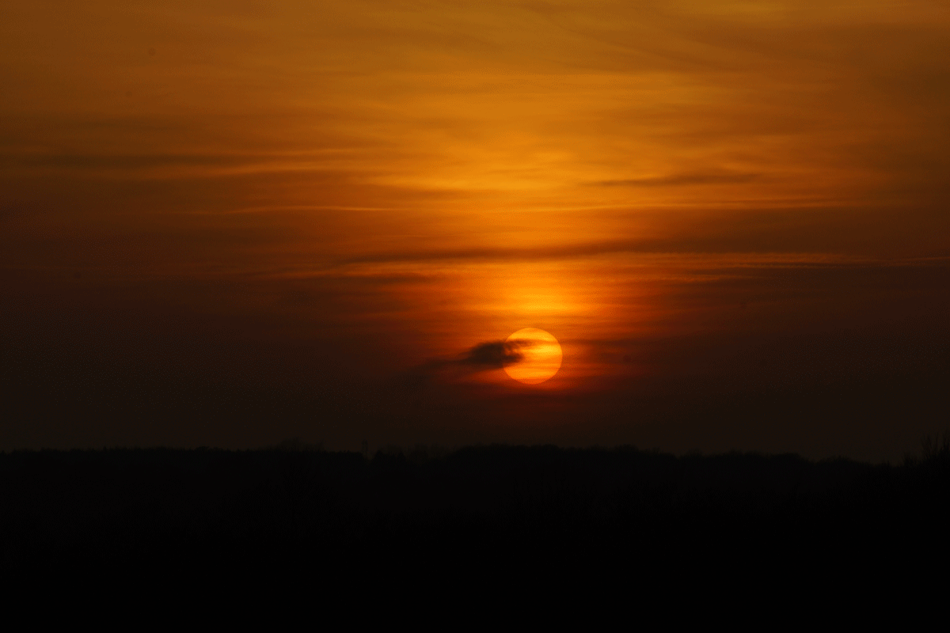

Slide 7




Slide 8
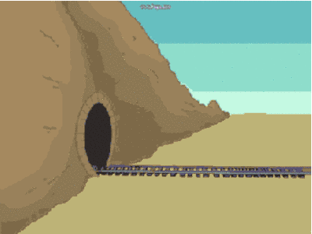
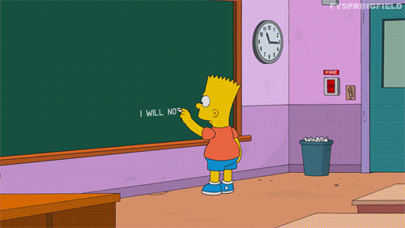

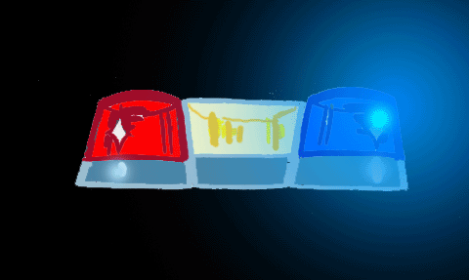

Slide 9







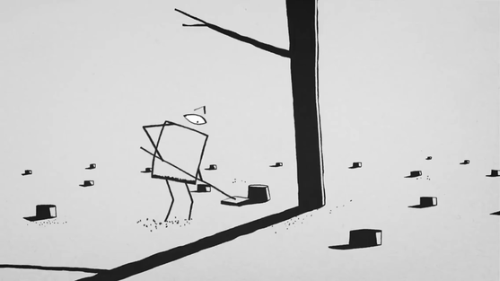


Slide 10



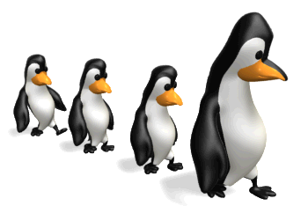




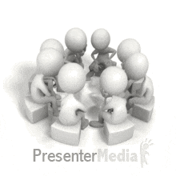

Slide 11

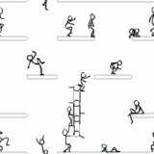



Slide 12
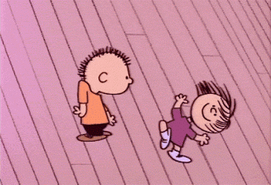



Slide 13
As we learn to see how the Old Testament testifies of Jesus Christ, our faith in Jesus Christ will increase
As we learn to see how the Old Testament testifies of Jesus Christ, our faith in Jesus Christ will increase
“without blemish”
Free of flaws or imperfections

Slide 14

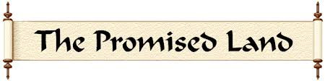
By turning aside from the Lord and His commandments, we corrupt ourselves

Slide 15



Conditions of the World

Slide 16

Genesis
Exodus
Leviticus
Deuteronomy
Numbers

Slide 17
Jerusalem News
Page 1
Judas Iscariot
Jesus of Nazareth is Sentenced
Nephi, a Fugitive?
Nephi, son of Lehi of Jerusalem, secretly obtains the “Brass Plates” from Laban, a man of great wealth and possessions. The Brass Plates contained the genealogy of his father, Lehi. Under the command of God, Nephi obeys his father and while in a drunken state, Laban dies by his own sword. With the plates Nephi returns to his father.
It is sited that Nephi returns to Jerusalem and leaves with Ishmael and his daughters.
Nephi, a son of Lehi of Jerusalem, records the history of his people in the Americas on what is called the “Brass Plates”. This history includes the Nephites (called after Nephi) and the Lamanites (call after Laman), which divided their people because of religious differences. This history of this people is now found in “The Book Of Mormon”. The plates were hidden for many thousand of years by a man named Moroni, and a young man named Joseph Smith obtained the plates on September 22, 1827.

Slide 18
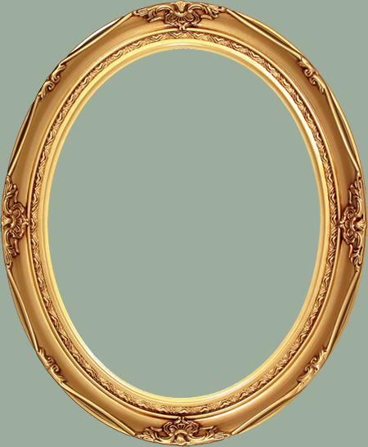
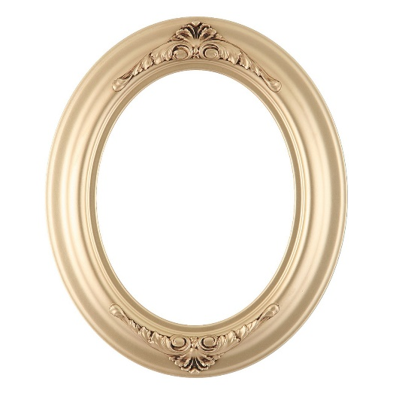
By studying the revelations in the Doctrine and Covenants, we can strengthen our testimonies of Jesus Christ.

Slide 19



Slide 20




Slide 21
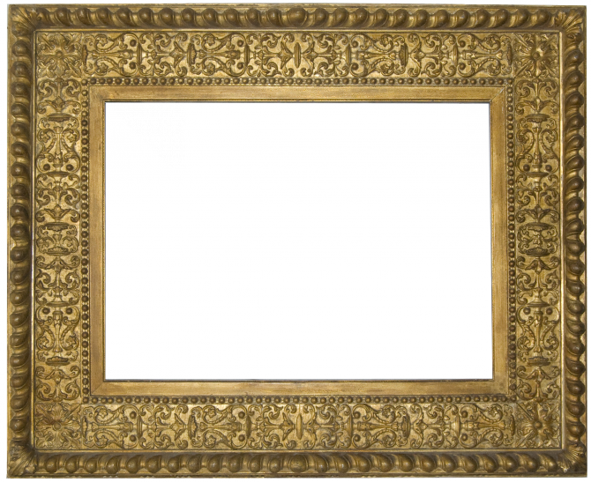
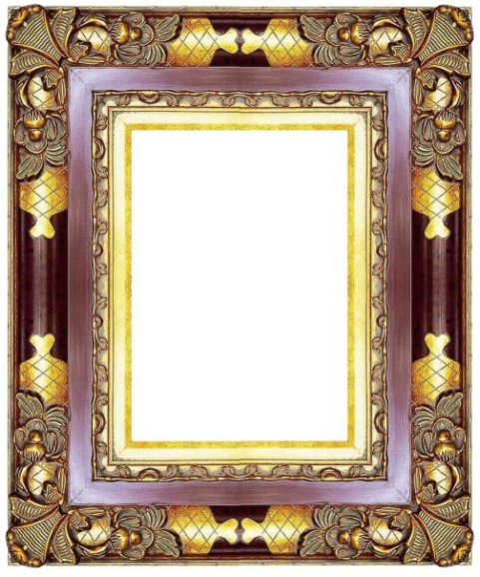



Slide 22
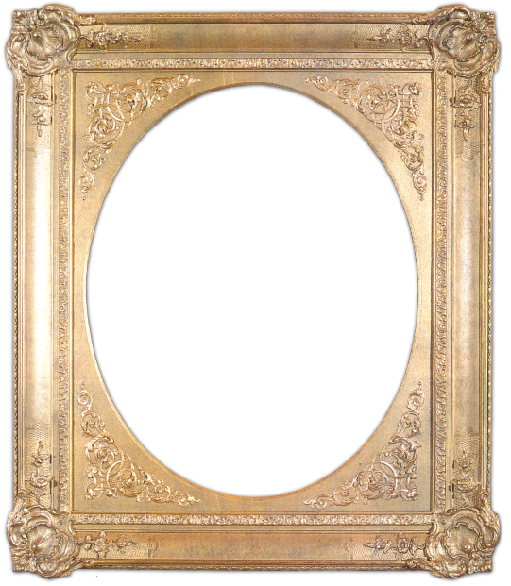

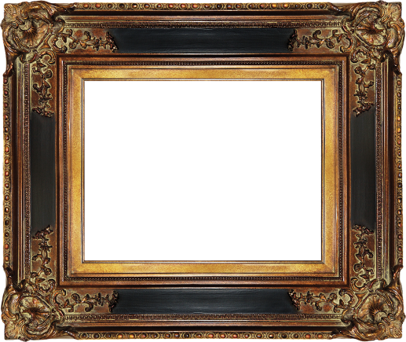
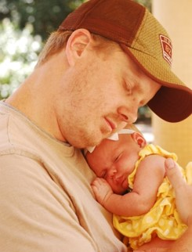
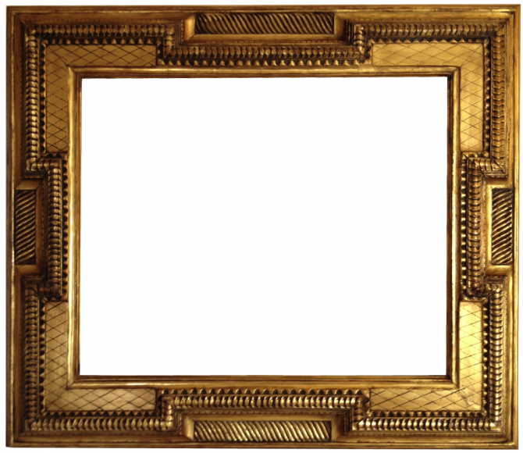
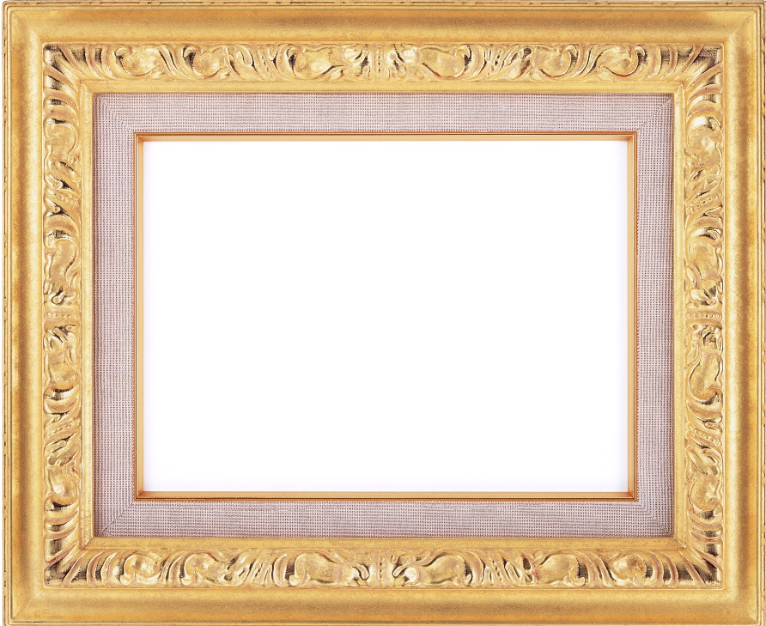

Slide 23
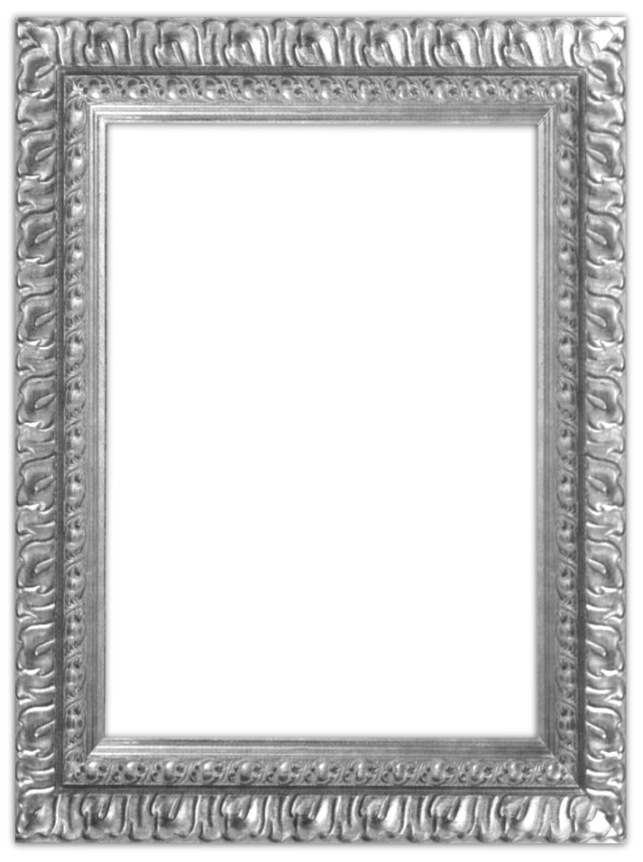

Slide 25


Slide 27
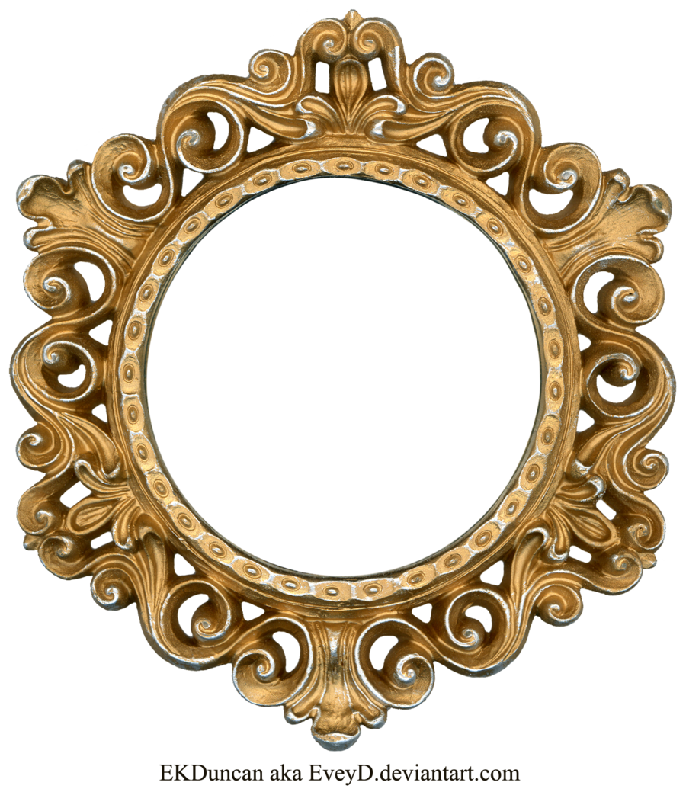


Slide 28
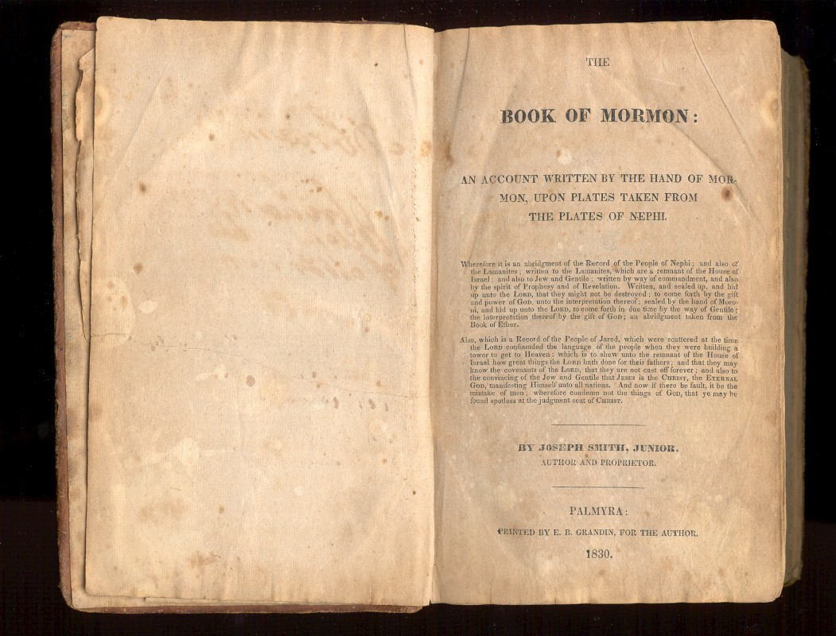

Slide 29




Slide 30
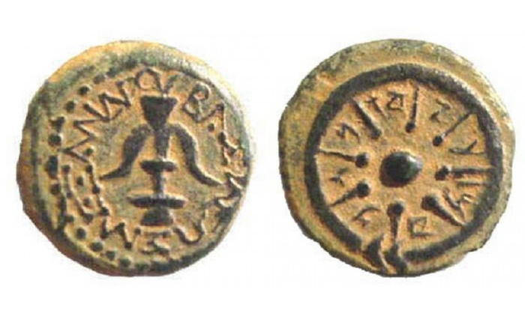
ב
ד
w
O
B
V
ל
x
V
ר
w
.
Y
ג
M
א
E
w
I
E
U
z
z
E

Slide 31

Pay to the order of____________________
_______________________________________Dollars
____________________
Asd ghjkl;

Slide 32
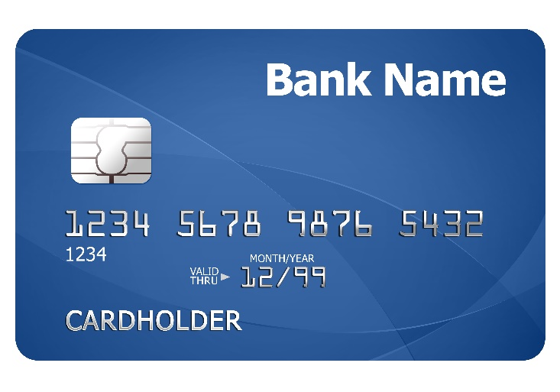
 | Budget
Income
Expenses
abc
Bank Name
1234 5678 9810 5555
CARDHOLDER

Slide 33

3 NEPHI 21:1
Scripture
Mastery
Doctrine and Covenants
Doctrine
And
Covenants
Book of Mormon
Holy Bible
Apostles and Prophets
Jesus Christ

Slide 34
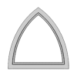

Slide 35
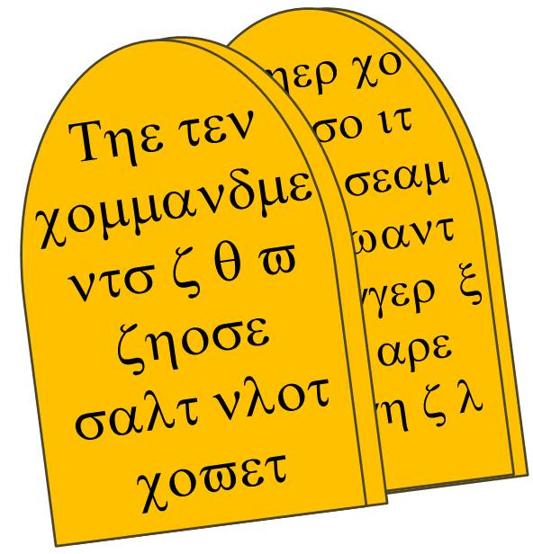
Old Testament
Old Testament
New Testament

Slide 36
Holy Bible
The
Book
of
Mormon
Scripture
Mastery
ANOTHER TESTAMENT
OF JESUS CHRIST
Scripture
Mastery
The
Book
of
Mormon
N
The
Book
of
Mormon
ANOTHER TESTAMENT
OF JESUS CHRIST
ANOTHER TESTAMENT
OF JESUS CHRIST

Slide 38

Holy Bible
The
Book
of
Mormon
The
Book
of
Mormon
The
Book
of
Mormon
Doctrine
And
Covenants
ANOTHER TESTAMENT
OF JESUS CHRIST
ANOTHER TESTAMENT
OF JESUS CHRIST
עברית
עברית
Holy Bible
The
Book
of
Mormon
Doctrine
And
Covenants
ANOTHER TESTAMENT
OF JESUS CHRIST

Slide 39
The Brass Plates of Laban
The Large Plates of Nephi
The Book of Enos
Law
of Consecration
The Small Plates of Nephi
The Plates of Mormon

Slide 41


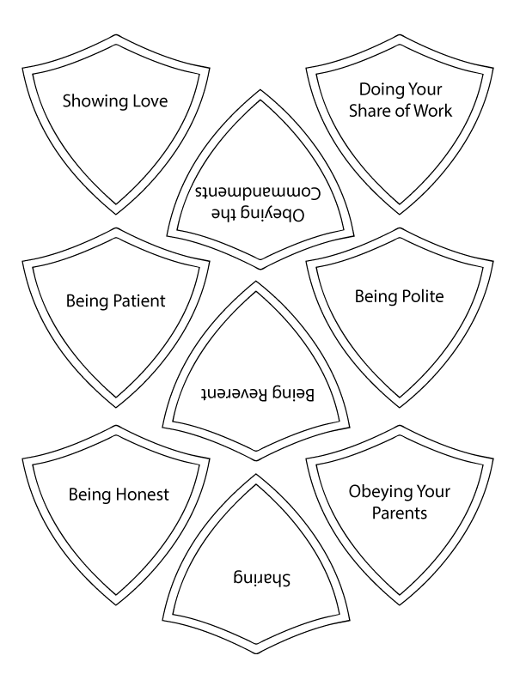


Kirtland

Slide 42

Good Advice For All

Slide 43
Chastity
Mission
Putting the Lord First
Honesty
Service

Slide 44
The Book of Alma
1-33
0….5...10…15…20...25...30...35….
0….5...10…15…20...25...30...35….

Slide 45
Thoughts and Actions
Thoughts and Actions

Slide 48
Sunday
Monday
Tuesday
Wednesday
Thursday
Friday
Saturday

Slide 49


Slide 53



Chewy Gum

Slide 54


Slide 55
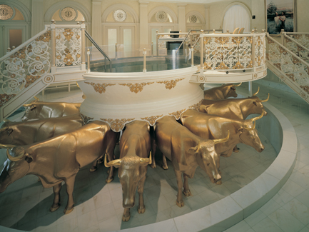

Slide 57


Slide 58
Cookies
Cookies
v
Food

Slide 59
R
X
Righteousness

Slide 60
Yeast
Salt

Slide 63



Slide 65
MILK

Slide 66
Falling in Love

Slide 68




Slide 69
Zibeon
Anah
Hagar
Abraham
Sarah
Aholibamah
Ishmael
Nebaioth
Massa
Jeush
Kedar
Hadad
Jaalam
Adbeel
Temur
Korah
Mibsam
Jetur
Mishma
Naphish
Dumah
Kedemah

Slide 70
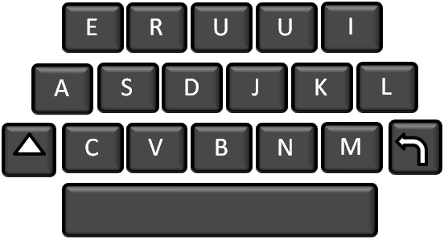
E
R
U
U
I
A
S
D
J
K
L
C
V
B
N
M
X
zZ

Slide 71
The Book Of Mormon

Slide 72
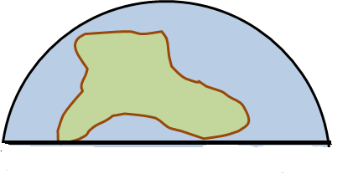

Slide 74
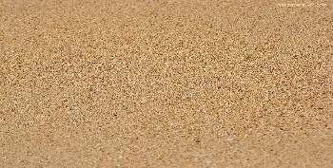



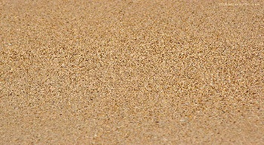
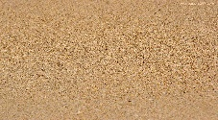

Slide 80
2 Chronicles
Judges
1 Chronicles
Joshua
Ruth
1 Kings
2 Kings
2 Samuel
1 Samuel
Nehemiah
Ezra
Esther
1 Chronicles
Judges
2 Kings
2 Chronicles
Joshua
Ruth
1 Kings
2 Samuel
1 Samuel
Nehemiah
Ezra
Esther

Slide 85


Slide 88
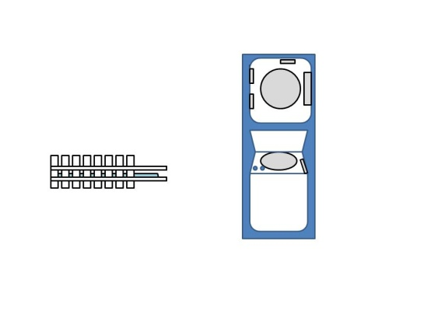

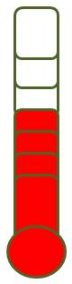
Mission
Education
Career
Marriage

Slide 90
36.5

Slide 91

SCENE TAKE TIME
DATE

Slide 96
By studying the revelations in the Doctrine and Covenants, we can strengthen our testimonies of Jesus Christ.

Slide 97


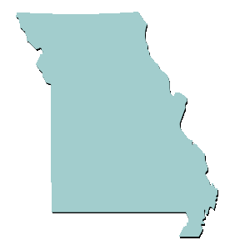



Slide 100

c

Slide 101



Slide 103
Cookies
1
2
3

Slide 108
1
2
3
600 BC
500 BC
400 BC
300 BC
200 BC
100 BC
AD 1
100 AD

Slide 109
?
?
HOW ?

Slide 111
Flower Seeds

Slide 113



Slide 114

10
10
10
The Church of Jesus Christ of Latter-Day Saints
Elder ________________
לא יהיה לך אלוקים אחר על פני

Slide 115
1
2
3
4
5
6
7
8
9
0

Slide 116

1
v
v
v
v

Slide 117



Slide 119
REJECT

Slide 120

Knowledge
Ignorance

Slide 121
Ι χαν βε οβεδιεντ βψ κεεπινγ τηε χομμανδμεντσ

Slide 123


Slide 126
5
25
1
10
1
1

Slide 129
Jacob 4:13

Slide 132


Slide 133


Slide 134
HYMNS
HYMNS
HYMNS

Slide 135
c

Slide 136


Slide 137
R.I.P.

Slide 139


Slide 141


Terah
Abraham
Lot
Isaac
Daughter 1
Jacob
Moab
Israelites
(12 Tribes)
Moabites

Slide 142
C F

Slide 143


Slide 145




Slide 149

Reuben, Simeon, Judah, Issachar, Zebulun, Benjamin, Dan, Naphtali, Gad,Asher, Ephraim and Manasseh.
Reuben, Simeon, Judah, Issachar, Zebulun, Benjamin, Dan, Naphtali, Gad,Asher, Ephraim and Manasseh.
Aaron
Naphtali
Issachar
Benjamin
Reuben
Simeon
Judah
Zebulon
Dan
Gad
Asher
Joseph

Slide 150



Slide 152
Mt. Carmel
Mt. Tabor
Mt. Gilboa
Jerusalem
Mt. Nebo
Bethlehem
Azekah

Slide 156



Slide 159
Ammonihah
Aaron
ELIJIAH

Slide 160






GO

Slide 161


Slide 163


Slide 164



Shambala

Slide 165


Slide 166
Saturday | Sunday | Monday | Tuesday | Wednesday | Thursday | Friday

Slide 167
Sunday | Monday | Tuesday | Wednesday | Thursday | Friday | Saturday

Slide 169
Prayer is the key that unlocks the truth

