Slide 1
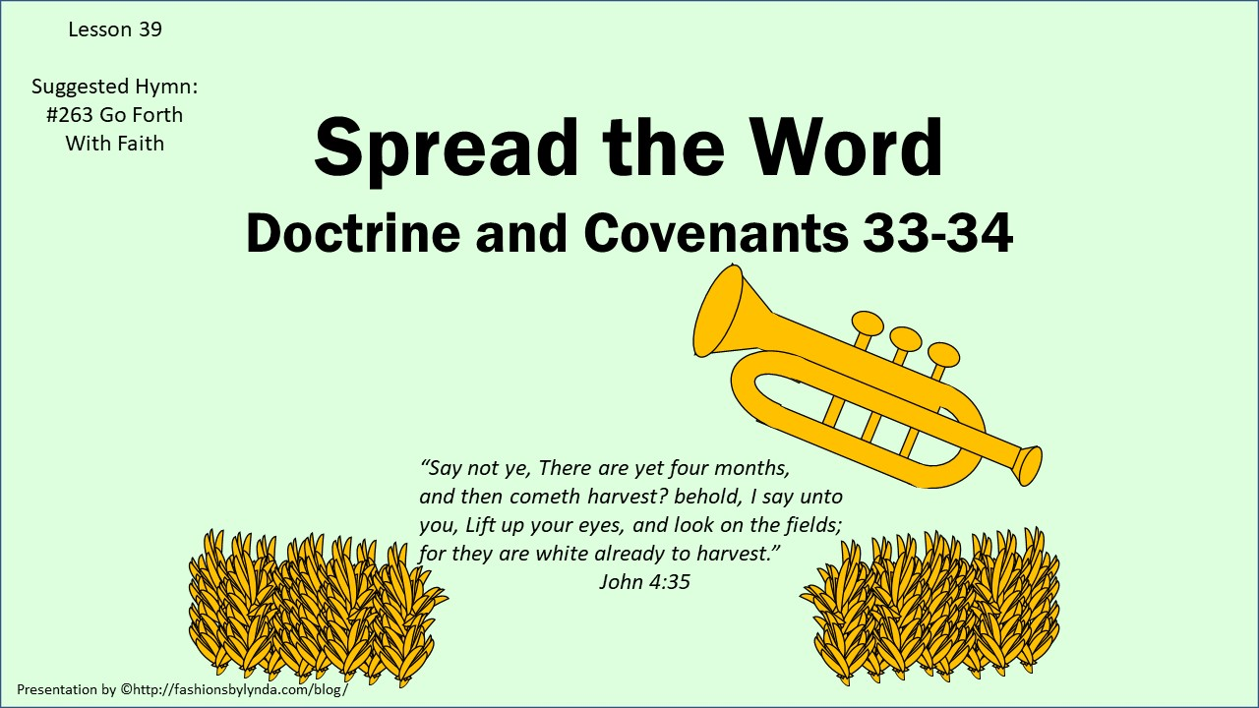

Slide 2

Ezra Thayre
He was born on October 14, 1791, at Randolph, Vermont
He was a builder of bridges, dams, and mills in Palmyra
He was converted through the teaching of Hyrum Smith and baptized by Parley P. Pratt in October 1830
Along with Northrop Sweet, he was called on a mission and many joined the church through his services
He was ordained a high priest in June 1831 but failed to heed the Lord’s direction to go on another mission (D&C 52:22). He was called to repentance
Ezra was called and obeyed another mission call (D&C 75:31)
He participated in Zion’s Camp and later served on high council in Adam-ondi-Ahman, Missouri
He eventually moved to Rochester, NY and then Michigan
After the Prophets death he became a member of the Reorganized Church of Jesus Christ of Latter-day Saints in August 1860
Who’s Who

Slide 3
Northrop Sweet
He was born in 1802 in Cambridge, New York
He was baptized by Parley P. Pratt in October 1830 and ordained an Elder the following June
He was called with Ezra Thayre on a mission
He soon fell away from the church (claiming that Joseph Smith was a false prophet) and formed a church of his own in Kirtland (Pure Church of Christ)
He married Elathan (Elethan) Harris before 1828, second wife, Clorinda Mecham (1855) then third wife Eunice Hammer (1861) and had 10 children
When his church failed to prosper, he moved to Ohio and then later to Michigan
He was appointed justice of peace in Batavia, Michigan in 1859-1863 then moved to Bethal, Branch Co.
He died in February 1881
Who’s Who

Slide 4


How could these relate to Missionary Work?

Slide 5
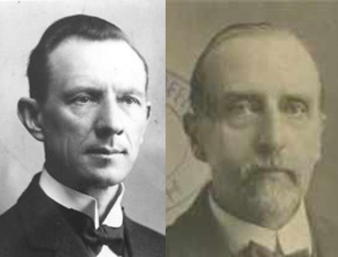
Open Your Ears
“Only he whose ears are open to hear the voice of God and who is willing to obey, is qualified to be a messenger of the Almighty. God’s ambassadors must be in touch with Him and know His will at all times.”
Smith and Sjodahl
Quick—meaning living or alive
Two-edged sword—God’s word can cut through to the very heart of a person (symbolically)
Soul and Spirit—The union of the spirit and body=
Life
D&C 33:1

Slide 6
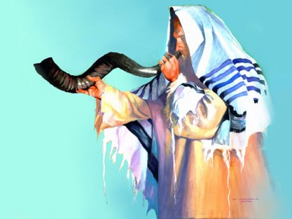
Lift Up Your Voices
The Lord often uses familiar objects, such as the trumpet, as symbols to teach His gospel and to help us understand eternal truths.
Shofar—trumpet sounded in traditional Jewish culture
D&C 33:2

Slide 7
The Eleventh Hour
Matthew 20:6 “And about the eleventh hour he went out, and found others standing idle, and saith unto them, Why stand ye here all the day idle?”
Parable of the Laborers: His servants should have a great reward, but those who are called last will receive just as much as the first.
The time we live in is the 11th hour.
Those who obey the call now will receive just as much as the laborers of former dispensation.
This is the final dispensation of the gospel and the last time the Lord will set up His kingdom on earth before His Second Coming.
D&C 33:3

Slide 8
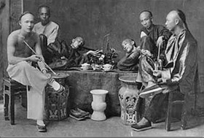
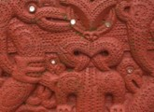
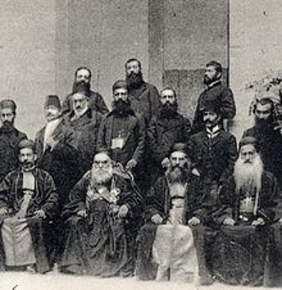
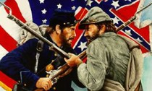
Condition of the World in 1830’s
Every whit--There is not one spot in all the world that has not been affected by the apostasy
1835 – A force of 500 Māori people invade and enslave the peoples of the Chatham Islands
The decade witnessed a rapid rise in the sale of opium in China--First Opium War
1832 – The Egyptians, aided by Maronites, seize Acre from the Ottoman Empire after a 7-month siege
1830 – The Polish insurrection begins in Warsaw against Russian rule. 1831 – Battle of Warsaw: The Russians take the Polish capital and crush resistance.
Morrison Incident of 1837 occurred when the American merchant ship, Morrison headed by Charles W. King, was driven away from "sakoku” (isolationist) Japan by cannon fire.
Events leading up to the Civil War (1861-1865)
D&C 33:4

Slide 9
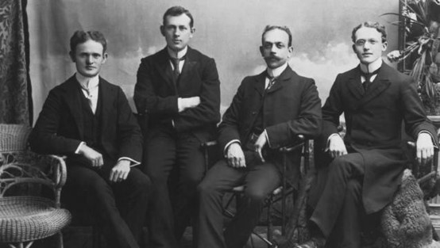

Gathering “Mine Elect”
Those who will believe in Him
The Lord requires the “will,” the “desire” of man. Many are prevented from believing and obeying the gospel, by ignorance or prejudices.
But they are honest, even in their mistakes and error. Such will eventually be brought to a knowledge of the truth. All who will believe and obey are the “elect.”
Out of the Wilderness
This imagery is drawn from the book of Revelation where the Church of Jesus Christ, symbolized as a woman, is driven into the wilderness, or apostasy, by the great dragon who is Satan.
Therefore, to call the Church from out of the wilderness refers to the Restoration of the Church upon the earth after centuries of apostasy.
D&C 33:5-6—Smith and Syodahl

Slide 10
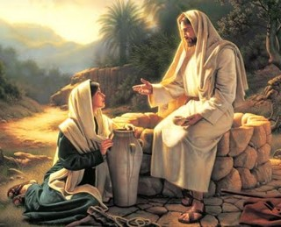
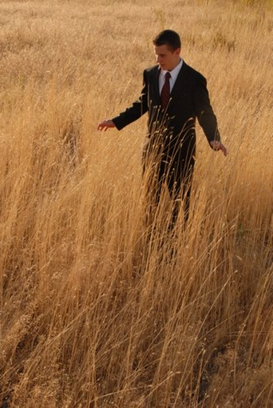
The Field is White
Already to harvest
Jesus was sitting at the famous well, near Sychar. He had a gospel conversation with a Samaritan woman and she had gone to tell the people about that conversation.
The Samaritans were coming over the fields, and called attention of the disciples to the approaching multitude…
This was the beginning of an abundant harvest of souls.
D&C 33:7-8 and John 4:27-42

Slide 11
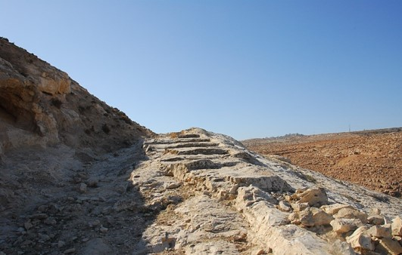
Open Your Mouths-Prepare the Way
Eastern potentates, when traveling from one part of the kingdom to another, would proclaim their coming and order their subjects to prepare the way for them, by building roads where there were none, if necessary; by leveling hills.
If we open our mouths to declare the gospel, the Lord will inspire us with what to say.
In order to prepare the way of the Lord we need to prepare the path by acknowledging Him and making preparations to receive him. He will not come to reign until all necessary preparations for his coming have been made
D&C 33:7-10 Smith and Sjodahl

Slide 12
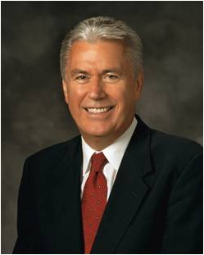

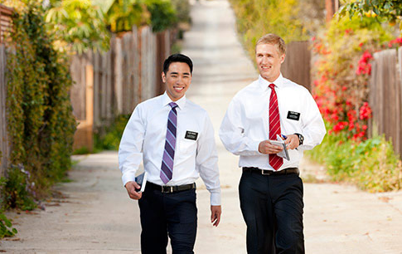
Understand that it’s not your job to convert people. That is the role of the Holy Ghost.
Your role is to share what is in your heart and live consistent with your beliefs.
So, don’t be discouraged if someone does not accept the gospel message immediately.
It is not a personal failure.
That is between the individual and Heavenly Father.
Yours is to love God and love your neighbors, His children.
Believe, love, do.
Follow this path, and God will work miracles through you to bless His precious children.
Dieter F. Uchtdorf

Slide 13
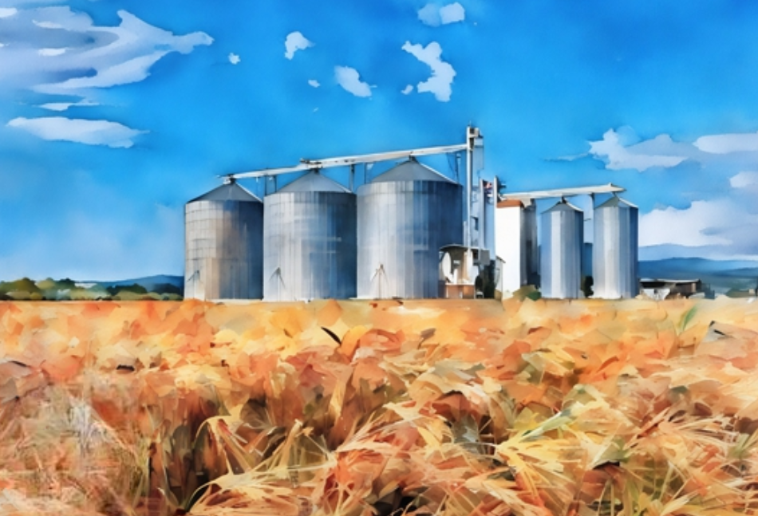
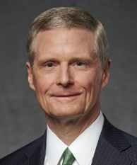
Laden With Sheaves Upon Your Back
The sheaves [grain] in this analogy represent newly baptized members of the Church.
The garners [places where grain is stored] are the holy temples.
Elder Neal A. Maxwell explained: “Clearly, when we baptize, our eyes should gaze beyond the baptismal font to the holy temple.
The great garner into which the sheaves should be gathered is the holy temple” (John L. Hart).
This instruction clarifies and emphasizes the importance of sacred temple ordinances and covenants—that the sheaves may not be wasted.
David A. Bednar

Slide 14

To Be Saved
Repent and Be Baptized
Water and Fire
…be baptized even by water, and then cometh the baptism of fire and of the Holy Ghost.
We cannot obtain eternal life without exercising faith in Him, repenting, and receiving the ordinances of His gospel
D&C 33:10-12

Slide 15
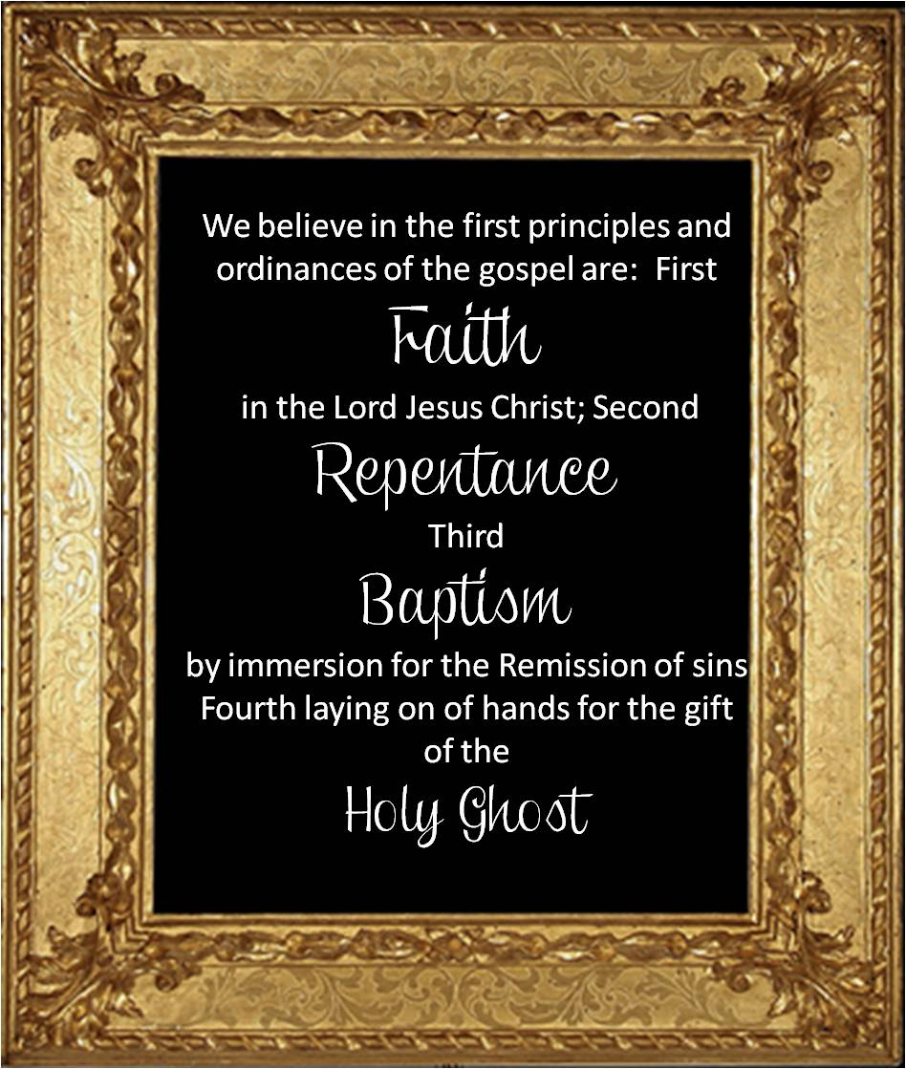
4th Article of Faith
Throughout the scriptures we read about Faith, Repentance, Baptism for the remission of sins, and receiving the Holy Ghost.
Whenever you see these words in verses, they are the essence of the Gospel..it embraces the entire Gospel
The Doctrine of Christ
D&C 33:11-15

Slide 16
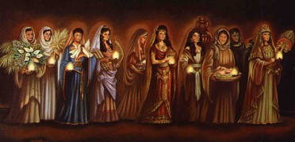
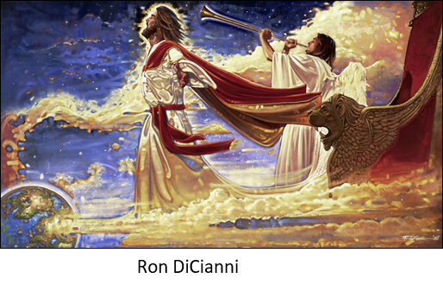
Have Your Lamps Trimmed
To be spiritually prepared and ready at all times for the Second Coming of Jesus Christ
Gayla Prince
When the hour of the bridegroom’s coming arrived, the virgins arose and trimmed, or prepared, their lamps. It was then that the five foolish virgins discovered they had no oil. This admonition is clearly a warning for the Saints to maintain a state of spiritual readiness as the coming of the Lord draws ever closer.
Parable of the 10 Virgins Matthew 25:1-13
D&C 33:17-18

Slide 17
Orson Pratt
He was born September 19, 1811 in Hartford, New York, younger brother of Parley P. Pratt, and son of Jared and Charity Dickenson Pratt
He was baptized by Parley P. Pratt September 19, 1830
He served a mission in Missouri in September 1830 and also called to serve with his brother to the eastern state (D&C 75:14)
He participated in Zion’s Camp in 1834 and fill the office of apostle in the Quorum of Twelve in 1835. He was also a teacher of Hebrew
Because of a lapse into apostasy, he was excommunicated, but repented and was rebaptized in 1843
He was one of the first individuals to view Salt Lake Valley and also served in the Quorum of Twelve in Utah
He crossed the Atlantic Ocean 16 times on missionary work to the British Isles
He was historian and general recorder for the Church beginning in 1874
He was the last surviving member of the original Council of the Twelve and passed away on October 3, 1881
עברית
Who’s Who

Slide 18
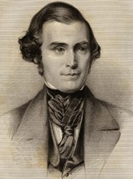

Orson Pratt’s Own Words
“From the age of ten to nineteen I saw much of the world, and was tossed about without any permanent abiding place; but through the grace of God, I was kept from many of the evils to which young people are exposed; the early impressions of morality and religion, instilled into my mind by my parents, always remained with me; and I often felt a great anxiety to be prepared for a future state; but never commenced, in real earnest, to seek after the Lord, until the autumn of 1829.
I then began to pray very fervently, repenting of every sin. In the silent shades of night, while others were slumbering upon their pillows, I often retired to some secret place in the lonely fields or solitary wilderness, and bowed before the Lord, and prayed for hours with a broken heart and contrite spirit; this was my comfort and delight.
The greatest desire of my heart was for the Lord to manifest His will concerning me”
D&C 34:1

Slide 19
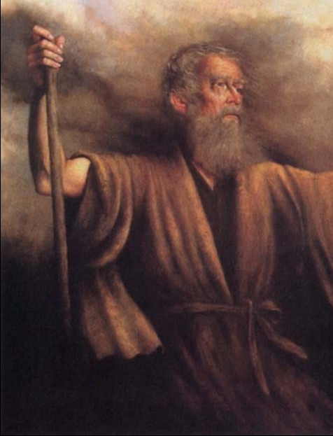
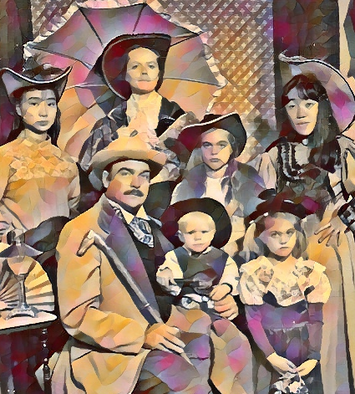
“My Son”
The Lord’s calling Orson Pratt “my son” is one example of the many times he has taught that all mankind may come unto him and become his sons and daughters
“And, behold, thou art my son; wherefore look, and I will show thee the workmanship of mine hands…”
Moses 1:4
“And now, because of the covenant which ye have made ye shall be called the children of Christ, his sons, and his daughters; for behold, this day he hath spiritually begotten you; for ye say that your hearts are changed through faith on his name; therefore, ye are born of him and have become his sons and his daughters.”
Mosiah 5:7
“The Spirit itself beareth witness with our spirit, that we are the children of God:”
Romans 8:16
D&C 34:1

Slide 20

Blessings Bestowed
Doubly blessed is he who accepts the Redeemer, through faith, and who is called to proclaim Him to the world. Living faith must precede the call to the ministry. God does not call unbelievers to preach the gospel.
Orson Hyde, a member of the Quorum of the Twelve Apostles of The Church of Jesus Christ of Latter-day Saints, visited Austria in 1841. More than 20 years later, Apostle Orson Pratt and missionary William W. Ritter arrived in Austria to begin missionary work.
The first Austrian convert in Austria was Paul Haslinger in 1883. He was baptized by missionary Paul Hammer in Lambach in Upper Austria. As the Church began to develop, a small congregation was organized in 1901 in Haag am Hausruck, and a second congregation was created in Vienna in 1909. In another part of the country, Austrian Latter-day Saints were able to attend weekly worship services in a meetinghouse in the Michelmeierhof in Rottenbach (Upper Austria). However, government restrictions forced the Church to stop its missionary work for a time.
Austria granted official government recognition to The Church of Jesus Christ of Latter-day Saints on 27 September 1955. Total members today: 4,469
MormonNews Room
D&C 34:4-5

Slide 21
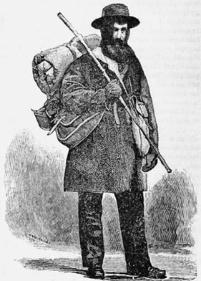
Blessings Bestowed
Orson Pratt lifted up his voice to share the gospel. Shortly after receiving this revelation, Orson Pratt embarked on a mission to Colesville, New York. On another mission a few years later, Orson traveled “on foot near 4000 miles, attended 207 meetings, … baptized 104 persons, and organized several new Branches of the Church”
Those who diligently teach the gospel will do so by the power of the Holy Ghost
D&C 34:6-11

Slide 22
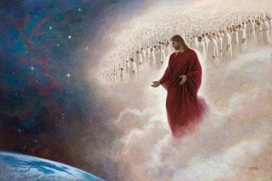
I Come Quickly
“I come quickly” ---the nearness of the Second Coming of Jesus Christ and is found in at least thirteen sections of the Doctrine and Covenants.
Although over 170 years have passed since some of these revelations were given, that is a relatively short period of time when compared to the nearly 6,000 years that the earth has existed in a telestial condition.
The fulfillment of many of the prophecies pertaining to the Second Coming indicates that that event is indeed near.
D&C 34:11-12

Slide 23
Sources:
Videos:
We Rejoice in Christ (2:36)
Missionary Mindset (4:10)
Doctrine and Covenants Who’s Who by Ed J. Pinegar and Richard J. Allen pgs. 116-117, 156-157, 159-160
Hyrum M. Smith and Janne M. Sjodahl Doctrine and Covenants Commentary pg. 172-175
Missionary photo: The 10th President of The Church of Jesus Christ of Latter-day Saints, Joseph Fielding Smith, when he served as a missionary in Great Britain, May 1901. Smith is second from the left.
Presentation by ©http://fashionsbylynda.com/blog/
(in The Orson Pratt Journals, comp. Elden J. Watson [1975], 8–9).
http://www.mormonnewsroom.org/facts-and-statistics/country/austria
(Orson Pratt, “History of Orson Pratt,” Millennial Star, Feb. 4, 1865, 72
(Dieter F. Uchtdorf, “Missionary Work: Sharing What Is in Your Heart,” Ensign or Liahona, May 2019, 17)
John L. Hart, “Make Calling Focus of Your Mission,” Church News, Sept. 17, 1994, 4; David A. Bednar, “Honorably Hold a Name and Standing,” Ensign or Liahona, May 2009, 97)
Presentation by ©http://fashionsbylynda.com/blog/

Slide 24
Shofar:
By Jewish tradition, a person who has not listened to the shofar has not observed the day. Hearing the shofar means obedience to one of God's 248 positive commandments to Israel found in the Pentateuch, or Torah. Rabbis have said that themitzvah (commandment) is not fulfilled by merely hearing the shofar, as if by accident, but that the hearer must listen with the specific kavanah (intention) of fulfilling the biblical commandment.
The word "trumpets" does not appear in the Hebrew text but is implied. Nor does the word shofar ever appear in the Hebrew text of the Torah in connection with the holiday Jewish people call Rosh Hashanah. In the passage quoted above, the holiday is simply called Yom T'ruah, a day of blowing. However, it means more than simply "blowing" a trumpet or ram's horn.
Jewish believers in Y'shua the kavanah, or central theme upon hearing the shofar, is joy in the knowledge that we have already allowed the seriousness of our sins to alarm us; we have heard and received the good news—that God has atoned for sin, and that He delivers us from calamity through the sacrifice of our righteous Messiah.
http://www.cbn.com/spirituallife/BibleStudyAndTheology/jewishroots/Hearing_Shofar_Jews_For_Jesus.aspx
President Joseph Fielding Smith explained:
“There are many debts which we owe to the Lord. There is the debt of preaching this gospel to a wicked and a perverse generation. …
“The Lord has given unto men their agency. They may act for themselves, they can choose to do good, or they can choose to do evil. The Lord said that men love darkness rather than light because their deeds are evil. Yet our mission, I say, is, so far as it is within our power, to regenerate, to bring to repentance, just as many of the children of our Father in heaven as it is possible for us to do. That is one of our debts; that is an obligation the Lord has placed upon the Church, and more particularly upon the quorums of the priesthood of the Church, and yet this obligation belongs to every soul.
“It is the duty of every member of this Church to preach the gospel by precept and by example.” (Doctrines of Salvation, 1:307–8.)
The phrase “the eleventh hour” seems to refer to the parable of the ten virgins (see Matthew 25:1–13). The bridegroom came at midnight, catching unaware half of those waiting. Thus, to say that it is the eleventh hour is to imply that the time of the coming of the Bridegroom is drawing near.
President Joseph Fielding Smith showed how the phrase is also related to another parable given by the Master: “The time in which we live is compared to the eleventh hour, and so it is in the Lord’s reckoning, for we are in the closing scenes of the present world. Elder Orson F. Whitney referred to our dispensation as the ‘Saturday night’ of time. And, according to the parable of the men employed in the vineyard [Matthew 20:1–16], we who labor in this hour will be rewarded if we are faithful, with equal compensation with those who labored in the previous hours, or dispensations, in the history of mankind.” (Church History and Modern Revelation, 1:153.)
Corrupt in verse 4:
“Let me explain, when I use the term ‘corrupt’ with reference to these ministers of the gospel, that I use it in the same sense that I believe the Lord used it when he made that declaration to Joseph Smith, the Prophet, in answer to the Prophet’s prayer. He did not mean, nor do I mean, that the ministers of religion are personally unvirtuous or impure. I believe as a class they, perhaps, in personal purity, stand a little above the average order of men. When I use the term ‘corrupt’ I mean, as I believe the Lord meant, that they have turned away from the truth … and have turned to that which is false. A false doctrine is a corrupt doctrine; a false religion is a corrupt religion; a false teacher is a corrupt teacher. Any man who teaches a false doctrine, who believes in and practices and teaches a false religion is a corrupt professor, because he teaches that which is impure and not true.” (Hyrum M. Smith In Conference Report, Oct. 1916, p. 43.)

Slide 25
Orson Pratt acted as Church Historian and Recorder from 1874 until his death. He edited many church periodicals and helped divide editions of the Book of Mormon and Doctrine and Covenants into verse format and provided appropriate cross references.
Science publications by Orson Pratt
Pratt was known as an accomplished mathematician and had a strong interest in astronomy. He offered science-based lectures on these topics to early LDS audiences in Utah and published two related books. New and Easy Method of Solution of the Cubic and Biquadratic Equations was published in 1866, and Key to the Universe was published in 1879.
President Lorenzo Snow wrote a poem about the doctrine of becoming sons and daughters of God.
Hast thou not been unwisely bold,
Man’s destiny to thus unfold?
To raise, promote such high desire,
Such vast ambition thus inspire?
Still ’tis no phantom that we trace
Man’s ultimatum in life’s race;
This royal path has long been trod
By righteous men, each now a God:
As Abra’m, Isaac, Jacob, too,
First babes, then men—to gods they grew.
As man now is, our God once was;
As now God is, so man may be,—
Which doth unfold man’s destiny.
. … . … . … . …
The boy, like to his father grown,
Has but attained unto his own;
To grow to sire from state of son,
Is not ’gainst Nature’s course to run.
A son of God, like God to be,
Would not be robbing Deity;
And he who has this hope within,
Will purify himself from sin.
(Lorenzo Snow, “Man’s Destiny,” Improvement Era, June 1919, pp. 660–61.)
I come Quickly:
President Joseph Fielding Smith explained the phrase and its significance:
“‘I come quickly.’ This is a scriptural expression that occurs frequently, especially in the book of Revelation. This is ‘speaking after the manner of the Lord.’ (D. & C. 63:53.) This does not mean that immediately the Lord will make his appearance, but when he does come, he will come suddenly, when he is least expected. He told his disciples that the day would come when men were unawares, as the thief in the night. For this reason, we should watch and pray, ‘For as a snare shall it come on all them that dwell on the face of the whole earth.’ (Luke 21:34–35.) There is no excuse for any of us, then, not to be prepared, for we have been fully and frequently warned.” (Church History and Modern Revelation, 1:157.)

