Slide 1
Doctrine and Covenants 38:17-42
A Vessel Unto the Lord
“…Behold the glory of the King of all the earth; and also the King of heaven shall very soon shine forth among all the children of men.:
Alma 5:50
Presentation by ©http://fashionsbylynda.com/blog/

Slide 2
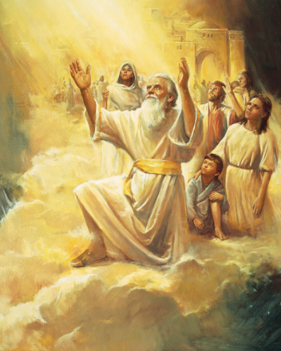
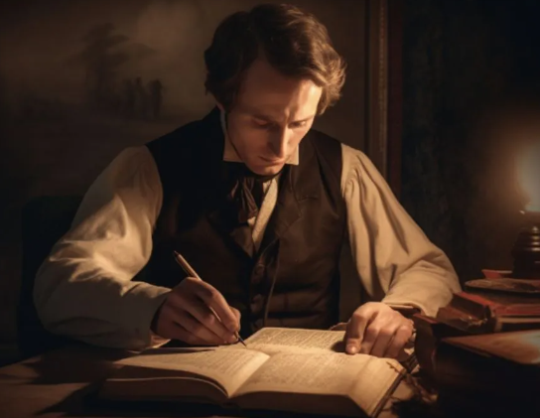
Background
In December of 1830, Joseph Smith was working on the inspired revision of the Bible and had received what is now Moses 6–7 in the Pearl of Great Price.
These chapters give an account of a prophet named Enoch and his people.
Because of their righteousness and unity, the Lord called these people Zion.

Slide 3
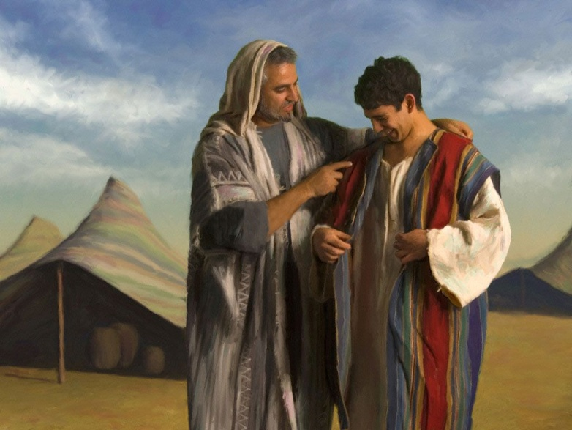
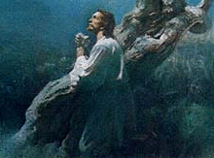
An Inheritance
Inheritance-- is the practice of passing on property, titles, debts, rights and obligations upon the death of an individual.
Because Adam and Eve did fall, we have temptation, trials, and death as our universal inheritance.
However, our loving Heavenly Father gave us the gift of His Beloved Son, Jesus Christ, as our Savior.
That great gift and blessing of the Atonement of Jesus Christ brings a universal inheritance:
the promise of the Resurrection and the
possibility of eternal life to all who are born.
President Henry B. Eyring

Slide 4
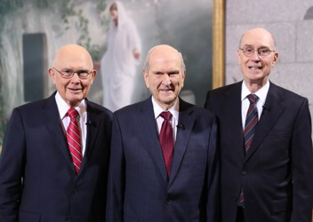
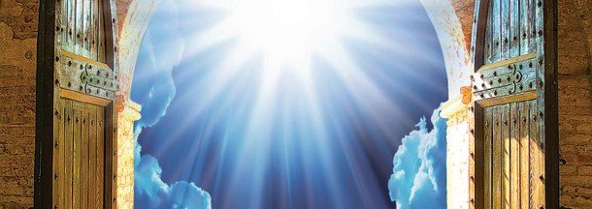
Eternal Inheritance
The greatest of all the blessings of God, eternal life, will come to us only as we make covenants offered in the true Church of Jesus Christ by His authorized servants…
…with the help of the Light of Christ and the Holy Ghost, we can keep all the covenants we make with God, especially those offered in His temples. Only in that way, and with that help, can anyone claim his or her rightful inheritance as a child of God in a family forever.
President Henry B. Eyring

Slide 5
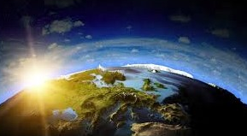
Edenic Earth--Terrestrial
“Edenic earth. Following its physical creation, the earth was pronounced good.
It was a terrestrial or paradisiacal state.
There was no death either for man or for any form of life, and ‘all the vast creation of animated beings breathed naught but health, and peace, and joy.”
D&C 38:17-20 Bruce R. McConkie

Slide 6
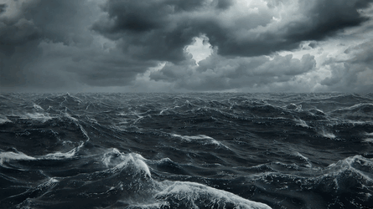
Telestial Earth
“When Adam fell, the earth fell also and became a mortal sphere, one upon which worldly and carnal people can live.
This condition was destined to continue for a period of 6,000 years, and it was while in this state that the earth was baptized in water.
D&C 38:17-20 Bruce R. McConkie

Slide 7
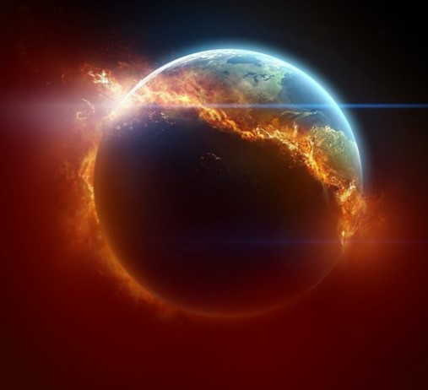
Earth Burned--Earth Restored
“Terrestrial Earth…‘We believe … that the earth will be renewed and receive its paradisiacal glory.’
Thus, the earth is to go back to the primeval, paradisiacal, or terrestrial state that prevailed in the days of the Garden of Eden.
Accompanying this transition to its millennial status the earth is to be burned, that is, receive its baptism of fire.
It will then be a new heaven and a new earth, and again health, peace, and joy will prevail upon its face.”
D&C 38:17-20 Bruce R. McConkie

Slide 8
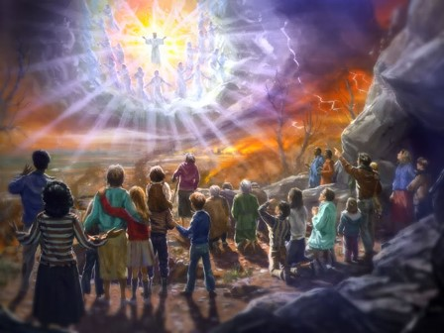
During the Millennium
“No curse on the land”-- when the Lord comes to the terrestrial earth during the Millennium,
The promise that the Saints will possess it during eternity reflects the earth’s eventual celestial state.
D&C 38:18

Slide 9
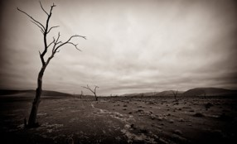
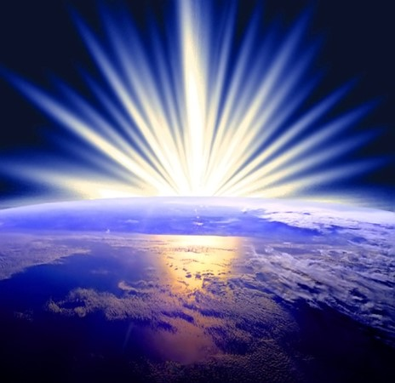
Celestial Earth
“Celestial earth… Following the millennium plus ‘a little season’ the earth will die, be resurrected, and becoming like a ‘sea of glass’ attain unto ‘its sanctified, immortal, and eternal state.’
Then the poor and the meek—that is, the god fearing and the righteous—shall inherit the earth; it will become an abiding place for the Father and the Son, and celestial beings will possess it forever and ever. ”
D&C 38:17-19 Bruce R. McConkie

Slide 10
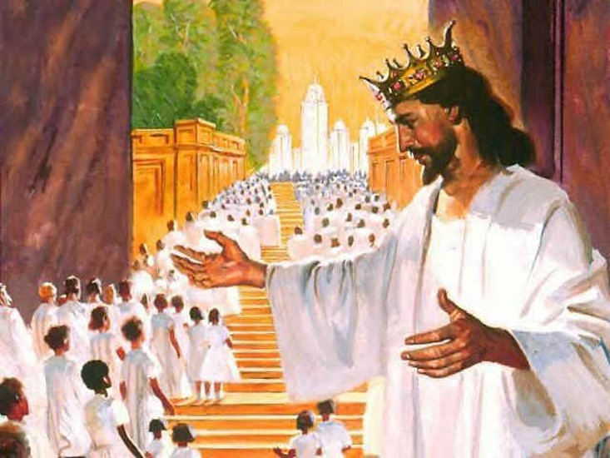
“I Will Be Your King”
“Christ is the King.
By this is meant that he is the Ruler, Lawgiver, and Sovereign in whom all power rests.
As King he rules over the heavens and the earth and all things that are in them (Alma 5:50); and also, in a particular sense, he rules over the kingdom of God on earth which is the Church and over the kingdom of God in heaven which is the celestial kingdom.”
D&C 38:21-22 Bruce R. McConkie

Slide 11
Be as One
What part of this house is most essential?
How can the parts of a building be compared to the people in a family or to the people in a ward or branch?
Just as each part of a building is important, each person in a family or ward or branch is valuable and can serve a vital role.
D&C 38:23-27

Slide 12
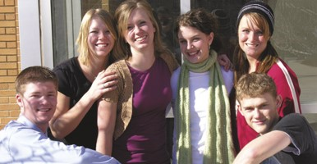
If We Are Not One
“If we are not united, we are not His.
Here unity is the test of divine ownership as thus expressed. If we would be united in love and fellowship and harmony, this Church would convert the world, who would see in us the shining example of these qualities which evidence that divine ownership.
Likewise, if in that Latter-day Saint home the husband and wife are in disharmony, bickering, and divorce is threatened, there is an evidence that one or both are not keeping the commandments of God…
D&C 38:27 manual

Slide 13
If We Are Divided
“If we, in our wards and our branches, are divided, and there are factions not in harmony, it is but an evidence that there is something wrong. If two persons are at variance, arguing on different points of doctrine, no reasonable, thinking persons would say that both were speaking their different opinions by the Spirit of the Lord. …
D&C 38:27 manual

Slide 14
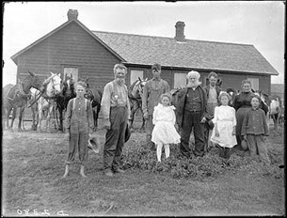
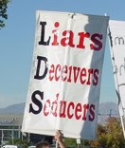
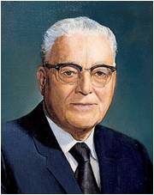
Enemies Fight Against Principles
“If it is so important, then, that this people be a united people, we might well expect that upon this principle the powers of Satan would descend for their greatest attack.
We might well expect, also, that if there be those of apostate mind among us, they would be inclined to ridicule and to scorn this principle of oneness and unity as being narrow-minded or as being unprogressive.
We would likewise expect that those who are enemies would also seek to fight against that principle.”
Elder Harold B. Lee
D&C 38:27

Slide 15
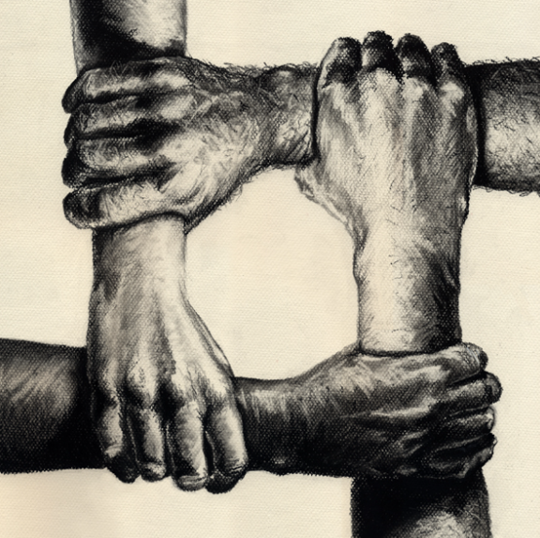
A Greater Unity
We will become of one heart and one mind as we individually place the Savior at the center of our lives and follow those He has commissioned to lead us.
We cannot permit any racism, tribal prejudice, or other divisions to exist in the latter-day Church of Christ. The Lord commands us, “Be one; and if ye are not one ye are not mine”
We should be diligent in rooting prejudice and discrimination out of the Church, out of our homes, and, most of all, out of our hearts. As our Church population grows ever more diverse, our welcome must grow ever more spontaneous and warm.
We need one another.
D&C 38:27 D. Todd Christofferson

Slide 16
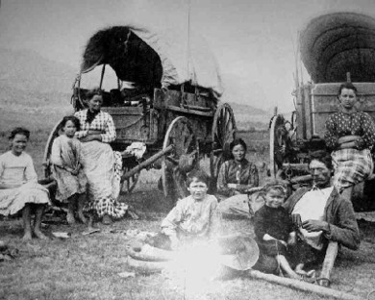
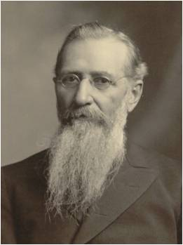
The Reason to Gather in Ohio
We should not be surprised if the world would oppose the kingdom and try to prevent the work of God
The devil will not lose sight of the power of God vested in man—the Holy Priesthood. He fears it, he hates it, and will never cease to stir up the hearts of the debased and corrupt in anger and malice towards those who hold this power, and to persecute the Saints, until he is bound.”
Joseph F. Smith
D&C 38:28-30

Slide 17
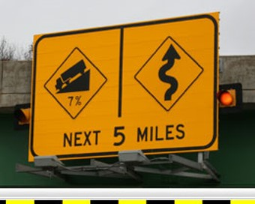
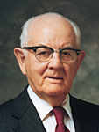
Recognizing the Danger
To know where the danger is and to be able to recognize it in all of its manifestations provides protection.
[Lucifer] will use his logic to confuse and his rationalizations to destroy. He will shade meanings, open doors an inch at a time, and lead from purest white through all the shades of gray to the darkest black.
D&C 38:28-30 President Spencer W. Kimball

Slide 18
Preparation Against the Adversary
He who has greater strength than Lucifer, he who is our fortress and our strength, can sustain us in times of great temptation. While the Lord will never forcibly take anyone out of sin or out of the arms of the tempters, he exerts his Spirit to induce the sinner to do it with divine assistance. And the man who yields to the sweet influence and pleadings of the Spirit and does all in his power to stay in a repentant attitude is guaranteed protection, power, freedom and joy.
It is extremely difficult, if not impossible, for the devil to enter a door that is closed. He seems to have no keys for locked doors. But if a door is slightly ajar, he gets his toe in, and soon this is followed by his foot, then by his leg and his body and his head, and finally he is in all the way.
If we are prepared, we shall not fear.
D&C 38:28-30 President Spencer W. Kimball

Slide 19
Preparing in Advance
One of the basic tasks for each individual is the making of decisions.
A dozen times a day we come to a fork in the road and must decide which way we will go.
Some alternatives are long and hard, but they take us in the right direction toward our ultimate goal; others are short, wide, and pleasant, but they go off in the wrong direction.
It is important to get our ultimate objectives clearly in mind so that we do not become distracted at each fork in the road by the irrelevant questions:
D&C 38:28-30 President Spencer W. Kimball

Slide 20
Deciding Before
Which is the easier or more pleasant way?
or, Which way are others going?
Right decisions are easiest to make when we make them well in advance, having ultimate objectives in mind; this saves a lot of anguish at the fork, when we’re tired and sorely tempted.
D&C 38:28-30 President Spencer W. Kimball

Slide 21
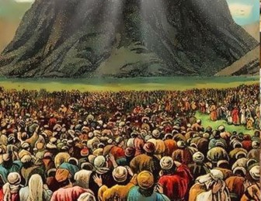
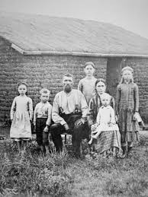
Be United—Take Care of the Poor
The Law of Consecration
When the Saints attempted to live the law of consecration in Missouri, they were unsuccessful because they “[did] not impart of their substance … to the poor” and they were “not united” (D&C 105:3–5).
“And the Lord called his people Zion, because they were of one heart and one mind, and dwelt in righteousness; and there was no poor among them.”
Moses 7:18
“And they had all things common among them; therefore there were not rich and poor, bond and free, but they were all made free, and partakers of the heavenly gift.”
4 Nephi 1:3
D&C 38:27, 33-36

Slide 22
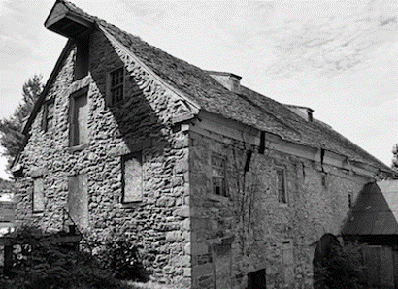
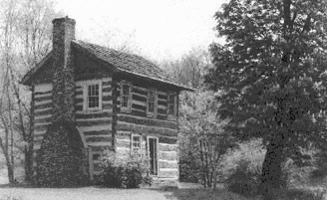
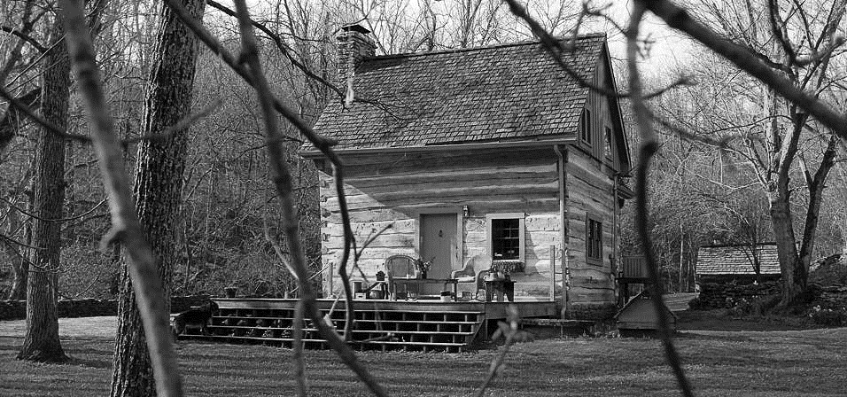
Relocation for the Saints—a loss
The Lord provided some commandments and counsel to the Saints that would assist them in their relocation to Ohio.
He explain that for many of the Saints, their only source of livelihood was their farms.
.
With so many members of the Church selling their property at the same time, many of the Saints faced the prospect of losing money on their farms or not being able to sell them at all.
The abundant supply of land for sale would drive prices down and allow buyers to purchase the Saints’ farms at a steep discount.
D&C 38:34-42

Slide 23
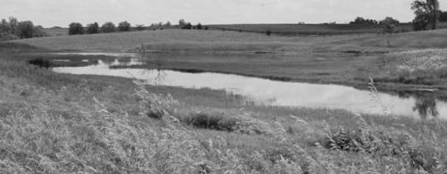
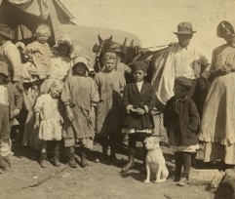
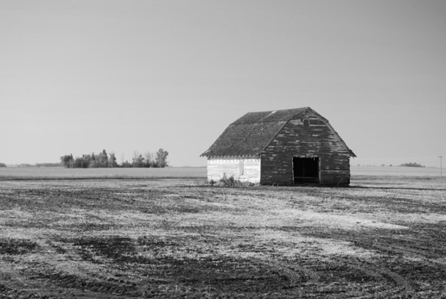
Riches of Eternity or Riches of the Earth
Some of the Saints did have difficulty selling their farms after this commandment was given.
Some sold their farms at a loss; others could not sell their property at all.
Some faithful members simply left their unsold homes and property and went to Ohio anyway.
D&C 38:39

Slide 24
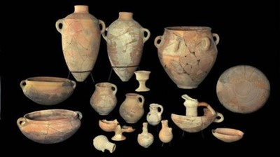
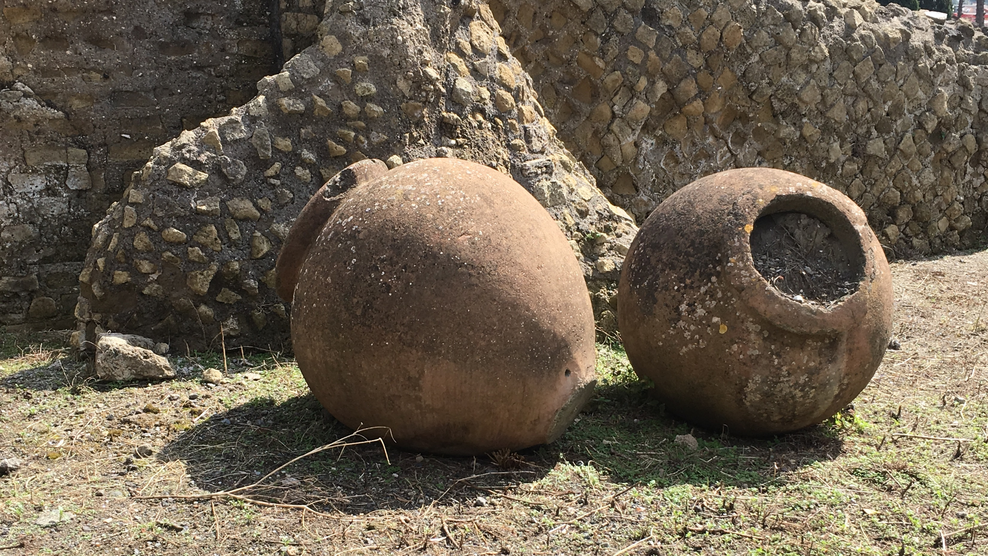
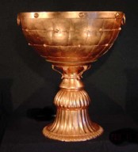
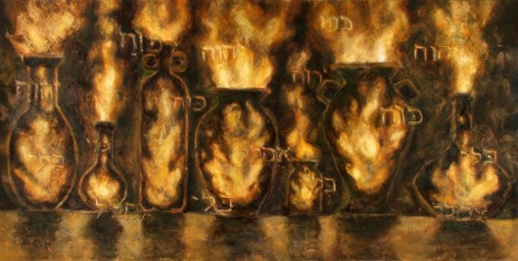
Bear the Vessels of the Lord
In ancient Israel, certain vessels (bowls, urns, vases, and other containers) and utensils were used in religious feasts and ceremonies.
The vessels that were to be used in the temple had special significance and were handled only by those who were worthy and authorized and who had properly prepared themselves.
In a somewhat similar manner, the Lord has indicated that his saints should come ‘out from among the wicked’ and leave the worldliness of Babylon so they will be worthy to ‘bear the vessels of the Lord’”
Ludlow
“Go ye out from Babylon. Be ye clean that bear the vessels of the Lord.”
D&C 133:5
D&C 38:42

Slide 25
Sources:
Videos:
“Let God Prevail” (18:51; watch from time code 10:40 to 13:01)
“One in Christ” (4:48)
“Be One”
“We Don’t Need to Be the Same to Be One”
We Come Together and Unite As One (6:19)
President Henry B. Eyring A Priceless Heritage of Hope April 2014 Gen. Conf.
Bruce R. McConkie Voice of Warning, pp. 89–91.
Man: His Origin and Destiny, pp.380–397, 415–436, 460–466
Mormon Doctrine, p. 211, 414
Presentation by ©http://fashionsbylynda.com/blog/
Elder Harold B. Lee (In Conference Report, Apr. 1950, pp. 97–98.)
Joseph F. Smith (In Journal of Discourses,19:24.)
Teachings of Spencer W. Kimball Chapter 10 “Fortifying Ourselves against Evil Influences”
Ludlow, Companion, 2:317.
Log Home: Upper St. Clair, Pennsylvania 1830
Pots : finds from what is thought to be King David's Palace in Khirbet QuiyafaAit/Israel Antiquities Authority) - See more at: http://destination-yisrael.biblesearchers.com/destination-yisrael/treasures-of-solomons-and-herods-temple/#sthash.UH2goHyX.dpuf
D. Todd Christofferson, “Come to Zion,” Ensign or Liahona, Nov. 2008, 38; “The Doctrine of Belonging,” Liahona, Nov. 2022, 53)
Presentation by ©http://fashionsbylynda.com/blog/

Slide 26
Checklist
Response Key: 1 = never; 2 = sometimes; 3 = often; 4 = almost always; 5 = always
I feel a sincere desire for the eternal welfare and happiness of other people. (Mosiah 28:3)
I try to understand others’ feelings and see their point of view. (Jude 1:22)
I forgive others who have offended or wronged me. (Ephesians 4:32)
I try to help others when they are struggling or discouraged. (Mosiah 18:9)
When appropriate, I tell others that I love them and care about them. (John 13:34–35)
I look for opportunities to serve other people. (Mosiah 2:17)
I say positive things about others. (Doctrine and Covenants 42:27)
I am kind and patient with others, even when they are hard to get along with. (Moroni 7:45)
I find joy in others’ achievements. (Alma 17:2–4)

Slide 27
Inheritance:
You should know that our adversary is prepared to spend such time, effort, and money as is necessary to deprive you of your inheritance. They have already expended untold millions of dollars in preparing their case against each of you. They have hired gifted, talented, and experienced people to work for them. They intend to win!
The Ultimate Inheritance—An Allegory
CREE-L KOFFORD
Oct 1991 Gen. Conf
“I Will Be Your King”:
Though Jesus is King by right and authority, President Joseph Fielding Smith taught that at the council of Adam-ondi-Ahman, Christ will be crowned the actual, political ruler of the world. President Smith further explained that the kingdom of God includes both political and spiritual aspects, for “when our Savior comes to rule in the millennium, all governments will become subject unto his government, and this has been referred to as the kingdom of God, which it is; but this is the political kingdom which will embrace all people whether they are in the Church or not. Of course, when every kindred, tongue and people become subject to the rule of Jesus Christ such will be in that political kingdom. We must keep these two thoughts in mind. But the kingdom of God is the Church of Jesus Christ, and it is the kingdom that shall endure forever. When the Savior prayed, ‘Thy kingdom come,’ he had reference to the kingdom in heaven which is to come when the millennial reign starts.
“When Christ comes, the political kingdom will be given to the Church. The Lord is going to make an end to all nations; that means this nation as well as any other. The kingdom of God is the Church, but during the millennium, the multitudes upon the face of the earth who are not in the Church will have to be governed, and many of their officers, who will be elected, may not be members of the Church.” (Doctrines of Salvation, 1:229–30.)
The Enemy D&C 38:13, 28
Elder Bruce R. McConkie made this observation in general conference:
“Nor are the days of our greatest sorrows and our deepest sufferings all behind us. They too lie ahead. We shall yet face greater perils, we shall yet be tested with more severe trials, and we shall yet weep more tears of sorrow than we have ever known before. …
“The way ahead is dark and dreary and dreadful. There will yet be martyrs; the doors in Carthage shall again enclose the innocent. We have not been promised that the trials and evils of the world will entirely pass us by.
“If we, as a people, keep the commandments of God; if we take the side of the Church on all issues, both religious and political; if we take the Holy Spirit for our guide; if we give heed to the words of the apostles and prophets who minister among us—then, from an eternal standpoint, all things will work together for our good.
“Our view of the future shall be undimmed, and, whether in life or in death, we shall see our blessed Lord return to reign on earth. We shall see the New Jerusalem coming down from God in heaven to join with the Holy City we have built. We shall mingle with those of Enoch’s city while together we worship and serve the Lord forever.” (In Conference Report, Apr. 1980, pp. 98–100; or Ensign, May 1980, pp. 71, 73.)
Pride and Riches of the Earth: D&C 38:39
Elder George Q. Cannon said: “There is something in the human heart of that character that when human beings are prospering they are apt to be lifted up in pride and to forget the cause or the source of their prosperity; they are apt to forget God, who is the fountain of all their blessings, and to give glory to themselves. It requires a constant preaching of the word of God, a constant pleading with the people, a constant outpouring of the Spirit of God upon the people to bring them to a true sense of their real condition. … Is it right that we should be prudent, that we should take care of those gifts and blessings which God has given unto us, that we should husband our resources, that we should be economical, and not extravagant? Certainly; this is right, this is proper, we should be culpable if we were not so. But with this there is also something else required, and that is, to keep constantly in view that the management and care of these things is not the object that God had in sending us here, that is not the object of our probation. … I have been in reduced circumstances; been on missions when I did not know where to get a mouthful to eat; turned away by the people who dare not entertain me because of the anger that was kindled against us. I could stand by and weep, being a boy and away from all my friends. But I, nevertheless, was happy. I never enjoyed myself in my life as I did then. I know that happiness does not consist in the possession of worldly things. Still it is a great relief when people can have the means necessary for the support of themselves and families. If they possess these things and the Spirit of God with them, they are blessed.” (In Journal of Discourses, 22:100–101.)

Slide 28
D&C 38:27 Unity requires effort. It develops when we cultivate the love of God in our hearts and we focus on our eternal destiny. We are united by our common, primary identity as children of God and our commitment to the truths of the restored gospel. In turn, our love of God and our discipleship of Jesus Christ generate genuine concern for others. We value the kaleidoscope of others’ characteristics, perspectives, and talents. If we are unable to place our discipleship to Jesus Christ above personal interests and viewpoints, we should reexamine our priorities and change.
We might be inclined to say, “Of course we can have unity—if only you would agree with me!” A better approach is to ask, “What can I do to foster unity? How can I respond to help this person draw closer to Christ? What can I do to lessen contention and to build a compassionate and caring Church community?”
When love of Christ envelops our lives, we approach disagreements with meekness, patience, and kindness. We worry less about our own sensitivities and more about our neighbor’s. We “seek to moderate and unify” [Dallin H. Oaks, “Defending Our Divinely Inspired Constitution,” Liahona, May 2021, 107]. We do not engage in “doubtful disputations,” judge those with whom we disagree, or try to cause them to stumble [see Romans 14:1–3, 13, 21]. Instead, we assume that those with whom we disagree are doing the best they can with the life experiences they have. (Dale G. Renlund, “The Peace of Christ Abolishes Enmity,” Liahona, Nov. 2021, 84)
Esteem and Value Others:
Often we can, usually unwittingly, be quite insensitive to the circumstances and difficulties of those around us. We all have problems, and ultimately each individual has to take responsibility for his or her own happiness. None of us is so free of difficulty ourselves or so endowed with time and money that we can do nothing but tend “the wounded and the weary” (“Lord, I Would Follow Thee,” Hymns, no. 220). Nevertheless, in looking to the Savior’s life for an example, I suspect we can probably find a way to do more of that than we do. …
… I wish I could go back to my youth and there have another chance to reach out to those who, at the time, didn’t fall very solidly onto my radar scope. Youth want to feel included and important, to have the feeling they matter to others. … It is the associations I didn’t have, the friends I didn’t reach, that cause me some pain now all these years later. (Jeffrey R. Holland, “Come unto Me,” Ensign, Apr. 1998, 21)

