Slide 1

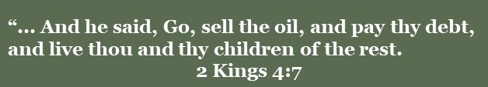
Doctrine and Covenants 104
Staying Out of Debt
Presentation by ©http://fashionsbylynda.com/blog/

Slide 2
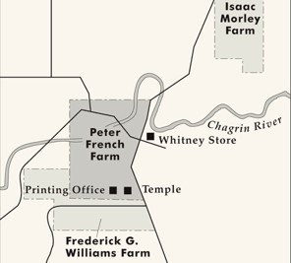
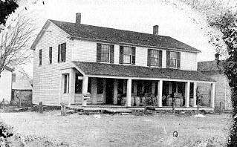
Background
Date | Meeting | Debt | Purpose
April 1832 | United Firm | 15,000 for 5 years | Goods for Newel K. Whitney store in Kirtland and possibly A. Sidney Gilbert store in Independence
April 1832 | United Firm |  | Peter French farm in Kirtland and possibly land in Jackson County
Profits from Church owned businesses and consecrated funds from the Saints were to pay off these debts
McConkie and Ostler

Slide 3
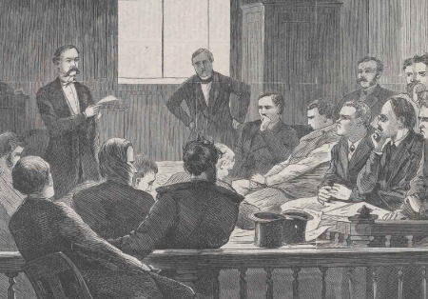
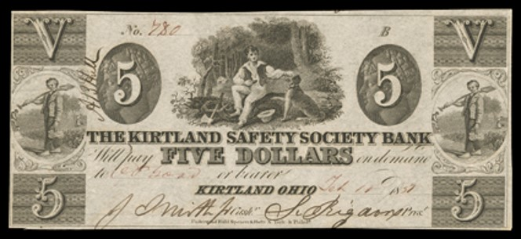
Difficulties
Fall of 1833---Missouri Saints unable to contribute financially due to mob persecution
Apostate Philastus Hurlburt brought lawsuit against Hyrum Smith to obtain property owned by the United Firm…draining the United Firm’s funds
Prophet’s decision—not to go to Missouri and head up Zion’s Camp and take care of matters in Ohio
“if I do not go [to Missouri], it will be impossible to get my brethren in Kirtland, any of them, to go.” HC
Sufficient funds would not be raised to pay the notes
McConkie and Ostler

Slide 4
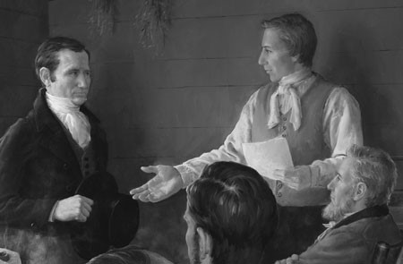
Decision and Prayer
“Bishop Whitney, Elder Frederick G. Williams, Oliver Cowdery, Heber C. Kimball, and myself, met in the council room, and bowed down before the Lord, and prayed that he would furnish the means to deliver the Firm from debt, that they might be set at liberty;”
Prophet Joseph Smith
They agreed to dissolve ‘the Order’…so that the creditors would have claim on property held by the United Firm, not on property owned by individuals
“This move was not made to escape responsibility for paying debts but rather to give the Church more time to gather needed funds and to allow the Prophet to travel with Zion’s Camp to Missouri.”
McConkie and Ostler

Slide 5
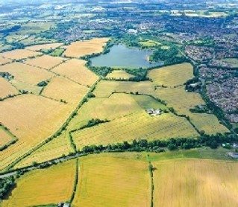
Division of Property
The property division was postponed for two weeks in the hopes that the United Firm would not dissolve.
On April 23, 1834 The Lord confirmed by revelation that he approved their decision to assign properties to individuals, but rather than allow the council to dissolve the United Firm, the Lord commanded that they reorganize into two separate orders in Ohio and Missouri.
He also gave instructions regarding the Church’s assets and the obligations of member of the United Firm to pay their debts.
This Revelation is in D&C 104
McConkie and Ostler

Slide 6
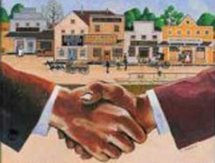
United Firm/Order
The term “United Firm” was later replaced with “United Order” in this revelation
The Lord explained that the United Order was established for the benefit of the Church and the “salvation of men” until the Second Coming of Christ
To enter the United Order required an individual enter into a solemn covenant to accept the law of consecration
The law of consecration is the law of the celestial kingdom, and those who entered into the order were bound by a covenant, obedience to which would bring eternal exaltation and neglect of which would bring severe judgments.
D&C 104:1-3

Slide 7
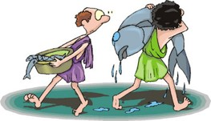
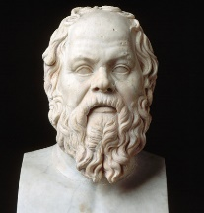
Broken Covenants
Covetousness-- a selfish desire to possess something, usually something that belongs to someone else.
The kingdom of God can only be built on the principles of selflessness and sacrifice
False words are not only evil in themselves, but they infect the soul with evil—
Socrates
Feigned words—words spoken falsely for personal gain
Cursed them– God’s law dictates prosperity for those who keep the commandments; for those who disobey He warned:
“Instead of blessings, ye, by your own works, bring cursings, wrath, indignation, and judgments upon your own heads…” (D&C 124:48)
D&C 104:4-10

Slide 8
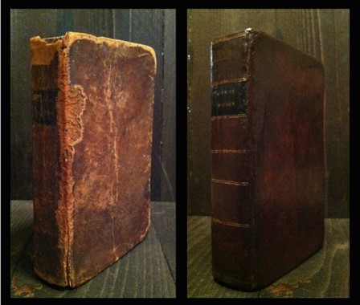
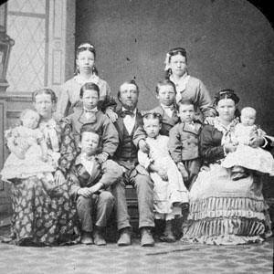
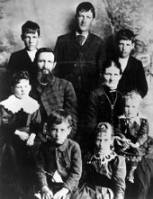
Organize and Establish
Each person was accountable to make his stewardship profitable
The income from the Church-owned property was used for printing scriptures and purchasing lands
D&C 104:11

Slide 9

Search Out The Heavens
The Lord created the earth, and all things in it are His
Thus saith God the Lord, he that created the heavens, and stretched them out; he that spread forth the earth, and that which cometh out of it; he that giveth breath unto the people upon it, and spirit to them that walk therein:
Isaiah 42:5
I have made the earth, and created man upon it: I, even my hands, have stretched out the heavens, and all their host have I commanded.
Isaiah 45:12
D&C 104:14

Slide 10
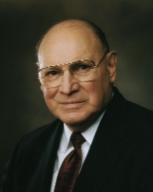
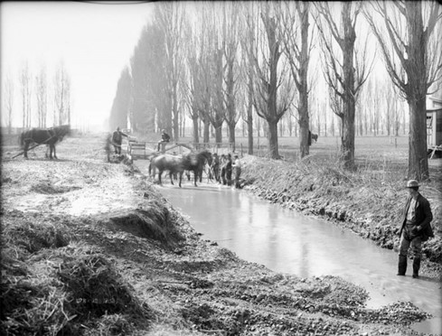
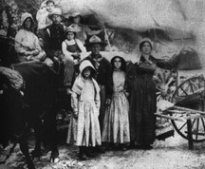
Provide in His Own Way
Established in February 1831
“The Lord’s way consists of helping people help themselves.
The poor are exalted because they work for the temporary assistance they receive, they are taught correct principles, and they are able to lift themselves from poverty to self-reliance.
The rich are made low because they humble themselves to give generously of their means to those in need.”
Elder Joseph B. Wirthlin
Law of the Church
The Saints were commanded to consecrate all their property to the Lord and to receive stewardships from the bishop of the Church. The portion of the Lord’s law governing earthly property is known as the law of consecration and stewardship.
D&C 104:15-16

Slide 11

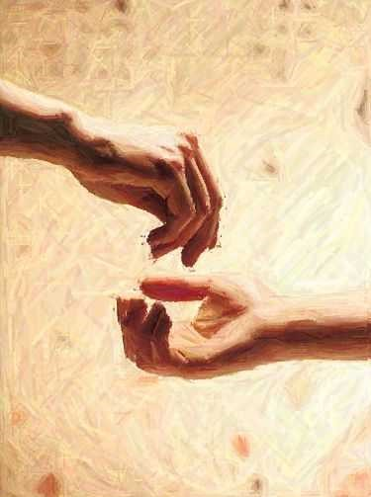
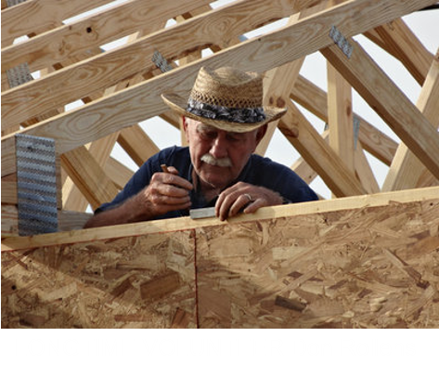
The Poor and Needy
Not only those who need financial assistance but also those who need spiritual, emotional, mental, and social assistance.
Likewise, we can think of our abundance as more than just the money or material possessions we have.
Our abundance includes our time, talents, knowledge, testimonies, and skills.
D&C 104:17-18

Slide 12


We are accountable to use what the Lord has given us to help others
D&C 104:17-18

Slide 13
Specific Instructions
Sidney Rigdon is given charge of the tannery. He had, at one time, been engaged in the very useful business of a tanner and was competent in this stewardship
Given for stewardships
Oliver Cowdery and Frederick G. Williams are given charge of the printing office.
Martin Harris, who was a successful farmer, is given charge of a piece of land. He was also to manage a publication business, under the direction of the Prophet.
Joseph Smith is given charge of the Temple lot. He is also to take care of his father, for the Lord recognizes the duty of children to provide for their parents, as well as the duty of parents to care for their children.
John Johnson is to be a real estate agent.
Newel K. Whitney is assigned to the mercantile establishment.
D&C 104:19-45 Smith and Sjodahl

Slide 14
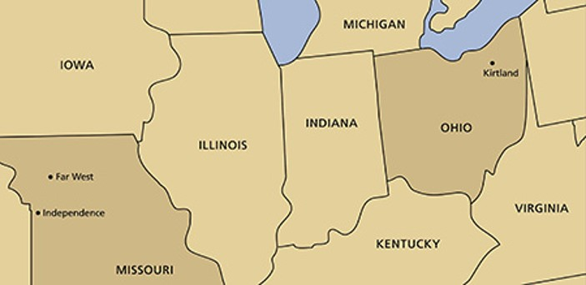

Separation
“[The] distance was too great between [Kirtland and Jackson County] for unity of purpose in all things.
Each order was to be organized in the names of the brethren residing in each place, and to do business in their own names.
This separation and dissolving of the former order came about also because of transgression and covetousness on the part of some.
They were to understand that all the properties were the Lord’s, otherwise their faith was vain, and therefore they were stewards before the Lord.
All of this was to be done for the purpose of building up the Church and Kingdom of God on the earth, and to prepare the people for the time when the Lord should come to dwell upon the earth.”
President Joseph Fielding Smith
D&C 104:47-53

Slide 15
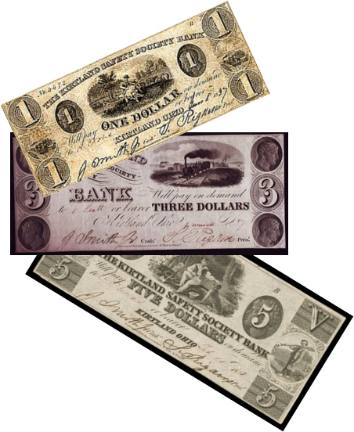
Two Treasuries
General funds of the Church
“…The Sacred Treasury, into which was put ‘the avails of the sacred things in the treasury, for sacred and holy purposes.
While it is not clear, it would seem that into this treasury were to be put the surpluses which were derived from the publication of the revelations, the Book of Mormon, … and other similar things, the stewardship of which had been given to Joseph and others.”
“… ‘Another Treasury,’ and into that other treasury went the general revenues which came to the Church, such as gifts of money and those revenues derived from the improvement of stewardships as distinguished from the residues of the original consecrations and the surpluses which came from the operation of their stewardships.”
“Thus you will see, brethren, that in many of its great essentials, we have, as the Welfare Plan has now developed, the broad essentials of the United Order.”
President J. Reuben Clark Jr.
D&C 104:60-70

Slide 16
Basic Common Consent
“Members of the United Firm placed profits they earned from managing Church-owned properties into the second treasury.
No individual had any claim to the profits generated from these stewardships.
Members of the United Firm determined, as a council, the use of the treasury funds.
The funds were used to improve the church’s properties or for further purchases made in behalf of the Church.”
D&C 104:67-77 McConkie and Ostler

Slide 17
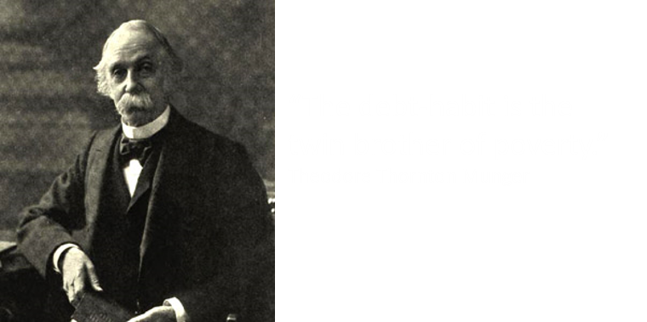
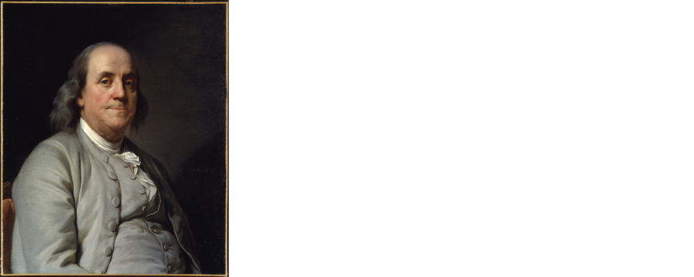
Pay All Debts
Though the debts must have seemed almost insurmountable to them, the leaders were commanded to “obtain this blessing by your diligence and humility and the prayer of faith
If they would do that, the Lord would keep His promise to “soften the hearts” of those to whom they were in debt
D&C 104:78-83

Slide 18
Getting Out And Staying Out
Live within your income
Pay to the order of____________________
_______________________________________Dollars
____________________
Asd ghjkl;
 | Budget
Income
Expenses
Prepare and use short-and long-term budgets
Regularly save a part of your income
Use your credit wisely, if it is necessary to use it at all—home or education
Preserve and utilize what you have to the max---my own idea
Bank Name
1234 5678 9810 5555
“Eat it up, wear it out, make it do, or do without.”
CARDHOLDER
D&C 104:78-83 Elder Franklin D. Richards :

Slide 19
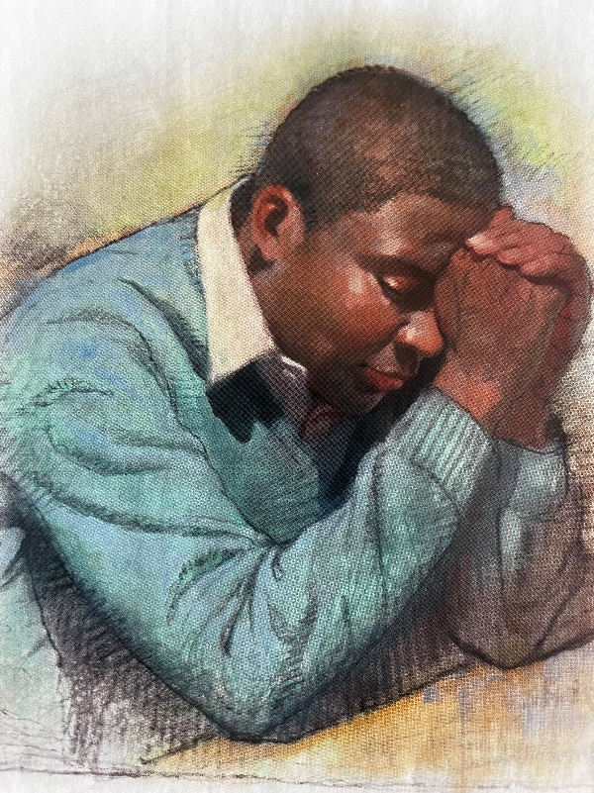

If we are humble and faithful and call upon the Lord’s name, then He will help us accomplish what He has asked us to do
D&C 104:78

Slide 20
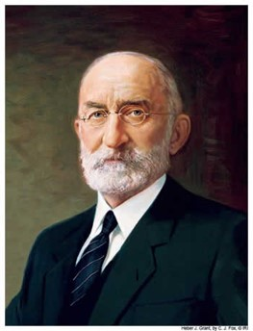
“If there is any one thing that will bring peace and contentment into the human heart, and into the family, it is to live within our means, and if there is any one thing that is grinding, and discouraging and disheartening it is to have debts and obligations that one cannot meet.”
President Heber J. Grant

Slide 21
Sources:
Videos:
Pay Off Debts as Quickly as You Can (1:31)
The Miracle of the Roof (3:54)
Joseph Fielding McConkie and Craig J. Ostler Revelations of the Restoration pgs. 756, 765
Prophet Joseph Smith, History of the Church 2:47-48
Presentation by ©http://fashionsbylynda.com/blog/
Elder Joseph B. Wirthlin (“Inspired Church Welfare,” Ensign, May 1999, 77).
Hyrum M. Smith and Janne M. Sjodahl Doctrine and Covenants Commentary pg. 673
President Joseph Fielding Smith (Church History and Modern Revelation, 1:489–90.)
President J. Reuben Clark Jr. (In Conference Report, Oct. 1942, pp. 56–58.)
Elder Franklin D. Richards In Conference Report, Oct. 1979, p. 120; or Ensign, Nov. 1979, pp. 81–82.)
President Heber J. Grant (Relief Society Magazine, May 1932, p. 302).” (In Conference Report, Apr. 1979, p. 56; or Ensign, May 1979, p. 39.)
Presentation by ©http://fashionsbylynda.com/blog/

Slide 22
D&C 104:9
Elder Bruce R. McConkie wrote that “to be turned over to the buffetings of Satan is to be given into his hands; it is to be turned over to him with all the protective power of the priesthood, of righteousness, and of godliness removed, so that Lucifer is free to torment, persecute, and afflict such a person without let or hindrance. When the bars are down, the cuffs and curses of Satan, both in this world and in the world to come, bring indescribable anguish typified by burning fire and brimstone. The damned in hell so suffer.
“Those who broke their covenants in connection with the United Order in the early days of this dispensation were to ‘be delivered over to the buffetings of Satan until the day of redemption.’ (D. & C. 78:12; 82:20–21; 104:9–10.) A similar fate (plus destruction in the flesh) is decreed against those who have been sealed up unto eternal life so that their callings and elections have been made sure and who thereafter turn to grievous sin. (D. & C. 131:5, 132:19–26.)” (Mormon Doctrine, p. 108.)
Staying out of Debt
President J. Reuben Clark’s classic statement on interest bears repeating:
“Interest never sleeps nor sickens nor dies; it never goes to the hospital; it works on Sundays and holidays; it never takes a vacation; it never visits nor travels; it takes no pleasure; it is never laid off work nor discharged from employment; it never works on reduced hours; it never has short crops nor droughts; it never pays taxes; it buys no food; it wears no clothes; it is unhoused and without home and so has no repairs, no replacements, no shingling, plumbing, painting, or whitewashing; it has neither wife, children, father, mother, nor kinfolk to watch over and care for; it has no expense of living; it has neither weddings nor births nor deaths; it has no love, no sympathy; it is as hard and soulless as a granite cliff. Once in debt, interest is your companion every minute of the day and night; you cannot shun it or slip away from it; you cannot dismiss it; it yields neither to entreaties, demands, or orders; and whenever you get in its way or cross its course or fail to meet its demands, it crushes you.” (in Conference Report, Apr., 1938, p. 103.)
LONGTIME VOLUNTEER Don Rollens has been giving his time, energy and talents to Habitat for Humanity of Cleveland Inc. for 23 years. He has had a direct hand in helping build all 113 Habitat houses in Cleveland and Bradley County. And, the U.S. Forest Service retiree doesn’t plan on slowing down anytime soon. Contributed photo
Rollens explained his motivation with a smile, stating, “It’s been sort of a labor of love, you might say. I just enjoy working with the other volunteers, working with my hands and seeing [our] accomplishments.”
Read more: Cleveland Daily Banner - After 113 Habitat houses 23 year volunteer Don Rollens still working
“President Kimball has given this thought-provoking counsel:
“‘The Lord has blessed us as a people with a prosperity unequaled in times past. The resources that have been placed in our power are good, and necessary to our work here on the earth. But I am afraid that many of us have been surfeited with flocks and herds and acres and barns and wealth and have begun to worship them as false gods, and they have power over us. Do we have more of these good things than our faith can stand? Many people spend most of their time working in the service of a self-image that includes sufficient money, stocks, bonds, investment portfolios, property, credit cards, furnishings, automobiles, and the like to guarantee carnal security throughout, it is hoped, a long and happy life. Forgotten is the fact that our assignment is to use these many resources in our families and quorums to build up the kingdom of God’ (Ensign, June 1976, p. 4).
“A major reason why there is famine in some parts of the world is because evil men have used the vehicle of government to abridge the freedom that men need to produce abundantly.
“True to form, many of the people who desire to frustrate God’s purposes of giving mortal tabernacles to his spirit children through worldwide birth control are the very same people who support the kinds of government that perpetuate famine. They advocate an evil to cure the results of the wickedness they support.” Ezra Taft Benson (In Conference Report, Apr. 1969, p. 12.)

Slide 23
Pay Thy Debt, and Live
In the book of Kings we read about a woman who came weeping to Elisha, the prophet. Her husband had died, and she owed a debt that she could not pay. The creditor was on his way to take her two sons and sell them as slaves.
By a miracle Elisha enabled her to acquire a goodly supply of oil. Then he said to her: “Go, sell the oil, and pay thy debt, and live thou and thy children of the rest.” (See 2 Kgs. 4:1–7.)
…True, times have changed since Franklin’s day, but the principles of truth and wisdom never change. Our inspired leaders have always urged us to get out of debt, live within our means, and pay as we go.
Our own pioneer forefathers have left us a heritage of thrift, of saving, of freedom from debt. Surely they would counsel us today: “Pay thy debt, and live.”
Many people do not believe that serious recession will ever come again. Feeling secure in their expectations of continuing employment and a steady flow of wages and salaries, they obligate their future income without thought of what they would do if they should lose their jobs or if their incomes were stopped for some other reason. But the best authorities have repeatedly said that we are not yet smart enough to control our economy without downward adjustments. Sooner or later these adjustments will come.
Another reason for increase in debt is even deeper and causes greater concern. This is the rise of materialism, as contrasted with commitment to spiritual values. Many a family, in order to make a “proper showing,” will commit itself for a larger and more expensive house than is needed, in an expensive neighborhood. Almost everyone would, it seems, like to keep up with the Joneses. With the rising standard of living, that temptation increases with each new gadget that comes on the market. The subtle, carefully planned techniques of modern advertising are aimed at the weakest points of consumer resistance. As a result, there is a growing feeling, unfortunately, that material things should be had now, without waiting, without saving, without self-denial.
Worse still, a large proportion of families with personal debt have no liquid assets whatsoever to fall back upon. What troubles they invite if their income should be suddenly cut off or seriously reduced! We all know of families who have obligated themselves for more than they could pay. There is a world of heartache behind such cases.
Yes, there is a tendency for all of us to want to keep up with our neighbors, even if our income is low. Sadly, in this respect, we have plenty of company.
In the long run, it is easier to live within our income and resist borrowing from future reserves except in cases of necessity—never for luxuries. It is not fair to ourselves or our communities to be so improvident in our spending that the day our income stops we must turn to relief agencies or the Church for financial aid.
Do not, I solemnly urge you, tie yourselves to payment of carrying charges that are often exorbitant. Save now and buy later, and you will be much further ahead. You will spare yourselves high interest and other payments, and the money you save may provide opportunity for you to buy later at substantial cash discounts.
If you must incur debt to meet the reasonable necessities of life—such as buying an automobile, a house, or furniture—then I implore you, as you value your solvency and happiness, buy within your means and use credit wisely. Resist the temptation to plunge into property far more pretentious or spacious than you really need.
How much better off you will be, especially young families just starting out, if first you buy a small house which you can expect to pay for in a relatively short time. Such a house in a neighborhood where values are increasing will usually provide the basis for a very large down payment on a bigger home when you are ready for it.
True, you can sometimes buy with little or no down payment, and on long terms. But these terms mean that a very large part of your total payments will go to pay interest charges, not to retire the principal of the debt. Remember, interest never sleeps or takes a holiday. Such payments of interest can easily become a tremendous burden, especially when you add to them taxes and repair costs.
Do not leave yourself or your family unprotected against financial storms. Forgo luxuries, for the time being at least, to build up savings. How wise it is to provide for the future education of your children and for your old age.
The smaller the family income, the more important it is that every dollar be used wisely. Efficient spending and saving will give the family more security, more opportunities, more education, and a higher standard of living.
My brothers and sisters, let us heed the counsel of the leadership of the Church. Get out of debt! Let us pay first our obligations to our Heavenly Father. Then we will more easily pay our debts to our fellowmen. Let us heed the counsel of President Brigham Young, who said: “Pay your debts, … do not run into debt any more. … Be prompt in everything, and especially to pay your debts.” (Discourses of Brigham Young, comp. John A. Widtsoe, Salt Lake City: Deseret Book Co., 1954, p. 303.)
…Brothers and sisters, peace and contentment come into our hearts when we live within our means. God grant us the wisdom and the faith to heed the inspired counsel of the priesthood to get out of debt, to live within our means, and to pay as we go—in short, to “pay thy debt, and live.”
Excerpts from June 1987 Ensign First Presidency Message by President Ezra Taft Benson Pay Thy Debt, and Live

