Slide 1

The Family Is Central to The Creator’s Plan
Genesis 1:28-31; Moses 2:1-25
We, the First Presidency and the Council of the Twelve Apostles of The Church of Jesus Christ of Latter-day Saints, solemnly proclaim that marriage between a man and a woman is ordained of God and that the family is central to the Creator’s plan for the eternal destiny of His children.
Presentation by http://fashionsbylynda.com/blog/

Slide 2
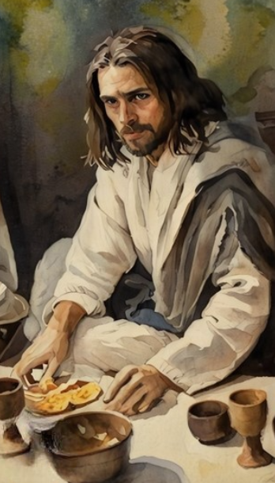
Sabbath Day-A Day of Rest
Thus the heavens and the earth were finished, and all the host of them.
And on the seventh day God ended his work which he had made; and he rested on the seventh day from all his work which he had made.
And God blessed the seventh day, and sanctified it: because that in it he had rested from all his work which God created and made.
We can keep the Sabbath day holy as we rest from our labors and focus on sacred things.
Genesis 2:1-3

Slide 3
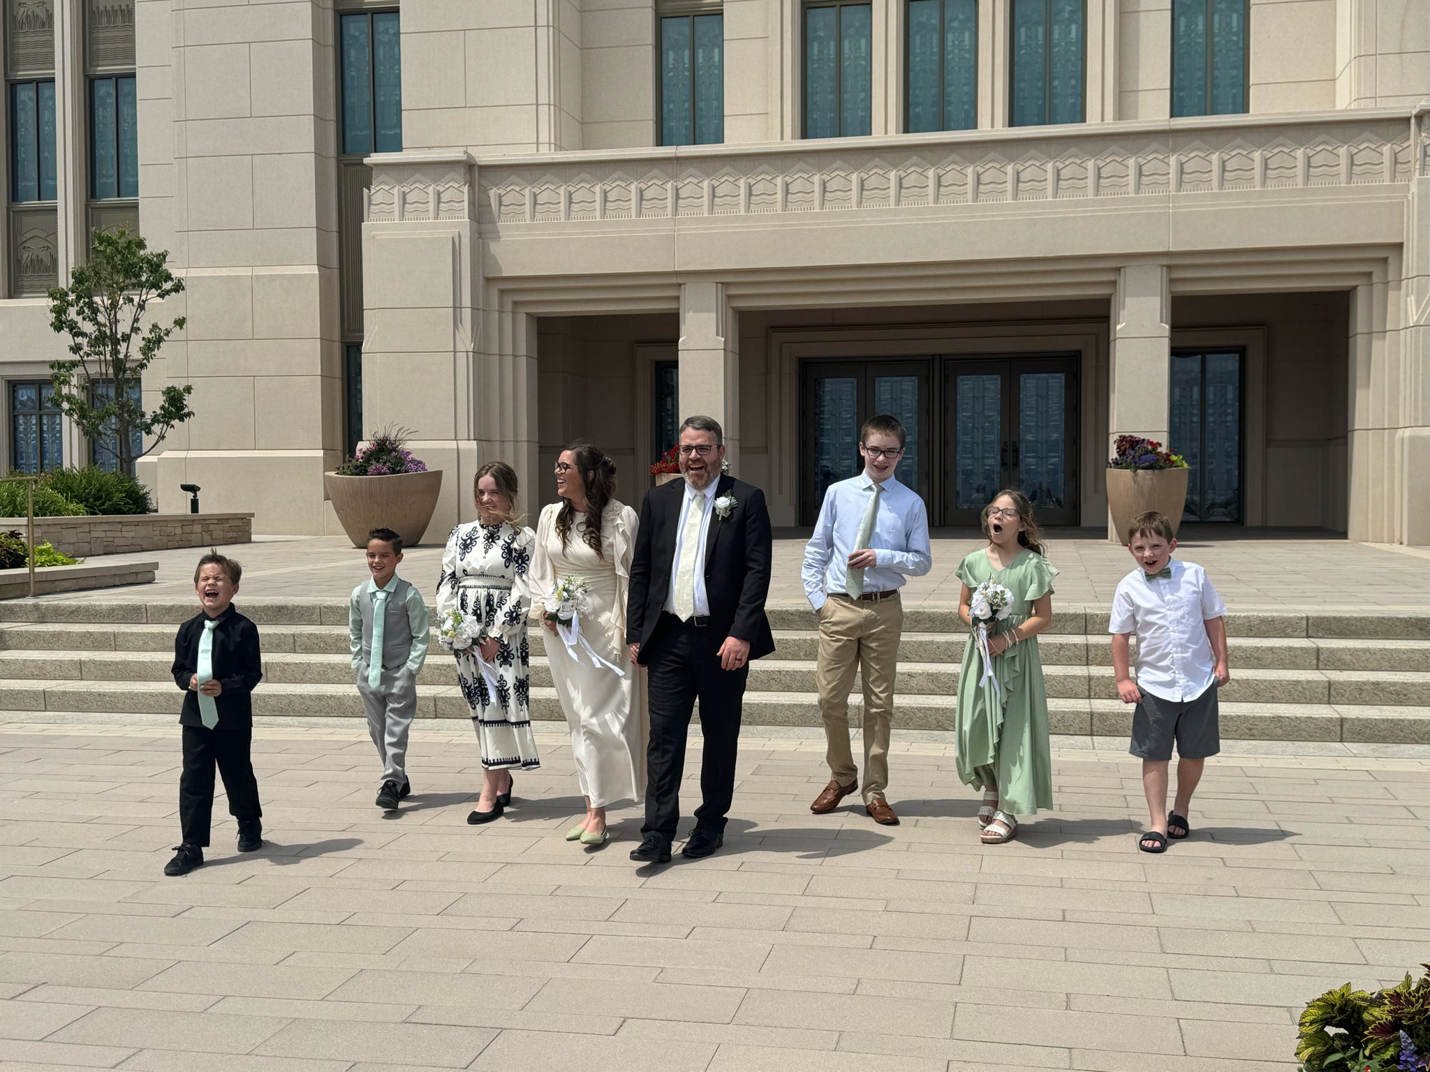
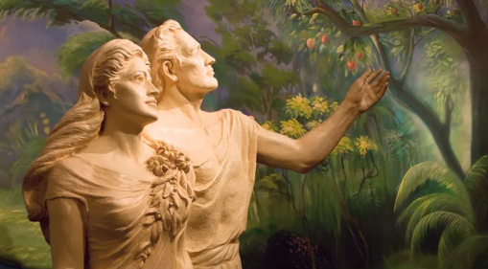
Together in Marriage
After the creation of Adam and Eve, Heavenly Father joined them together in marriage. He commanded them to multiply and replenish the earth and to cleave to one another.
God has commanded husbands and wives to have children
Husband and wife are to be one and act as equal partners
Marriage between a man and a woman is ordained of God
The earth was created to provide a place where God’s children could be born into families and progress together
Genesis 1:28; 2:18,24; Doctrine and Covenants 49:15; 49:16-17

Slide 4
Doctrinal Mastery
Genesis 2:24
Therefore shall a man leave his father and his mother, and shall cleave unto his wife: and they shall be one flesh.

Slide 5
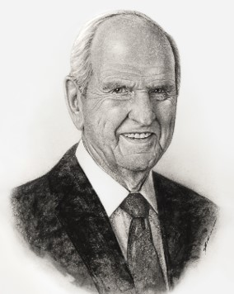
Doctrinal Mastery
“Grand as it is, planet Earth is part of something even grander—that great plan of God.
Simply summarized, the earth was created that families might be.
Scripture explains that a husband and wife “shall be one flesh, and all this that the earth might answer the end of its creation.”
President Russell M. Nelson
Doctrine and Covenants 49:16

Slide 6

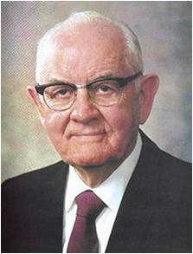
The Commandment to Adam and Eve
“The Lord [brought] together Adam and Eve, his first male and first female on this earth, and perform[ed] a holy marriage ceremony to make them husband and wife.
They were quite different in their makeup, with different roles to play. Hardly had he performed the ceremony than he said to them: ‘Multiply, and replenish the earth, and subdue it: and have dominion.’”
President Spencer W. Kimball
Genesis 1:28; Moses 2:28

Slide 7
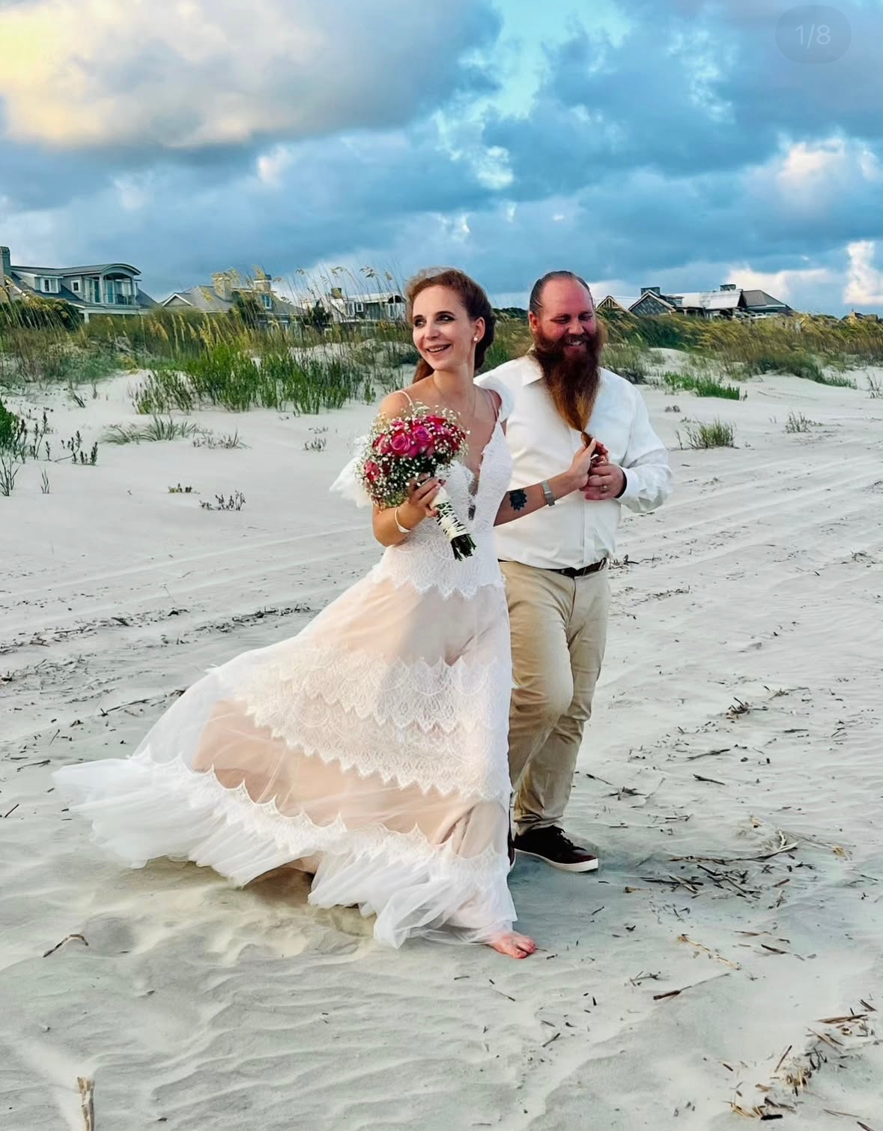
Adam’s Rib-Partnership
The rib, coming as it does from the side, seems to denote partnership.
The rib signifies neither dominion nor subservience, but a lateral relationship as partners, to work and to live, side by side.
President Russell M. Nelson
Genesis 2:21-22

Slide 8
Help Meet—A Woman
Moses 3:18
Abraham 5:14
Genesis 2:18
And I, the Lord God, said unto mine Only Begotten, that it was not good that the man should be alone; wherefore, I will make an help meet for him.
And the Gods said: Let us make an help meet for the man, for it is not good that the man should be alone, therefore we will form an help meet for him.
And the Lord God said, It is not good that the man should be alone; I will make him an help meet for him.
The Rib--symbolizes the side-by-side partnership of equality of Adam and Eve and all married couples.
Marriage is honourable in all,
Hebrews 13:4
Marriage is ordained of God unto man.
D&C 49:15
Adam and Eve were married for eternity by the Lord. Such a marriage extends beyond the grave. All peoples should call for this kind of marriage.
President Spencer W. Kimball

Slide 9



Equal Partners
The natures of male and female spirits complete and perfect each other, and therefore men and women are intended to progress together toward exaltation. …
… The unique combination of spiritual, physical, mental, and emotional capacities of both males and females were needed to implement the plan of happiness. Alone, neither the man nor the woman could fulfill the purposes of his or her creation. …
By divine design, both a man and a woman are needed to bring children into mortality and to provide the best setting for the rearing and nurturing of children.
… Marriage between a man and a woman is the authorized channel through which premortal spirits enter mortality.
Elder David A. Bednar
Genesis 2:18, 24

Slide 10

Sacred Partners
“When you are married, you and your spouse should discuss your sacred responsibility to bring children into the world and nurture them in righteousness. …
“As you discuss this sacred matter, remember that sexual relations within marriage are divinely approved. While one purpose of these relations is to provide physical bodies for God’s children, another purpose is to express love for one another—to bind husband and wife together in loyalty, fidelity, consideration, and common purpose.”
True to the Faith

Slide 11
Sources:
Video:
“What Is the Purpose of Family?” (1:17).
“Having Children in Faith” (2:25).
President Russell M. Nelson (“The Creation,” Ensign, May 2000, 85); (“Lessons from Eve,” Ensign, Nov. 1987, 87)
President Spencer W. Kimball (Teachings of Presidents of the Church: Spencer W. Kimball [2006], 192); President Spencer W. Kimball The Blessings and Responsibilities of Womanhood March 1976 Ensign
Presentation by http://fashionsbylynda.com/blog/
Elder David A. Bednar (“Marriage Is Essential to His Eternal Plan,” Ensign, June 2006, 83, 84)
True to the Faith: A Gospel Reference[2004], 26.

