Slide 1
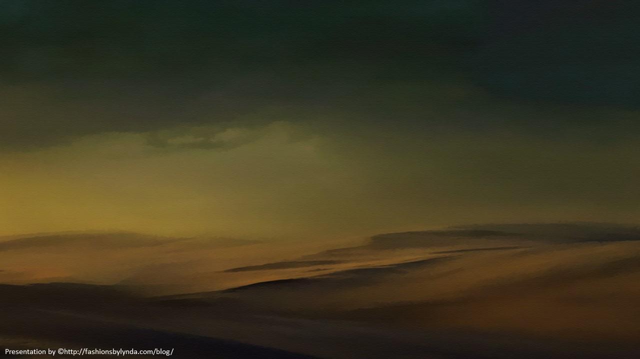



Famine in Canaan
Genesis 42-43
Behold, I have heard that there is corn in Egypt: get you down thither, and buy for us from thence; that we may live, and not die.
Genesis 42:2

Slide 2
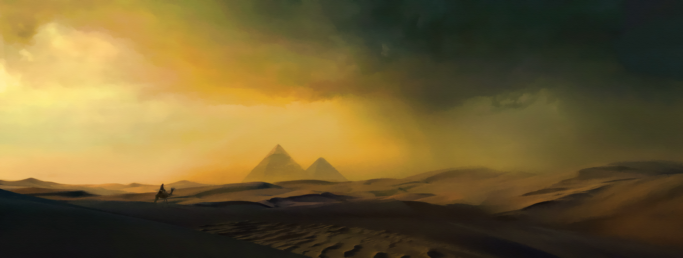
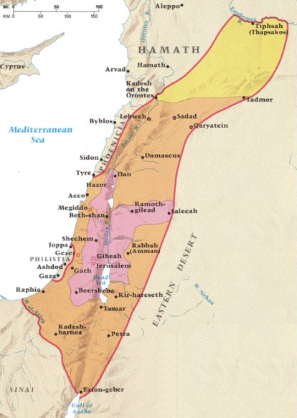
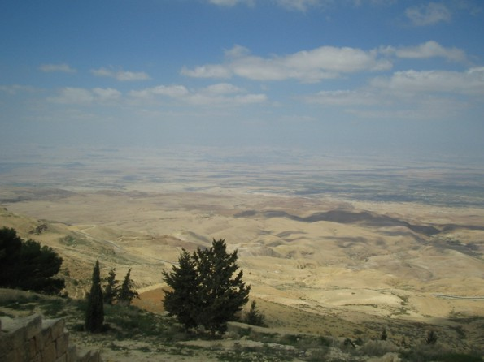
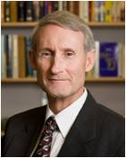
The Land Bridge
Canaan
Many of history’s greatest civilizations immediately surround it:
Egypt to the southwest;
Babylonia, Assyria, Aram, and Persia-Media to the east; Phoenicia and Anatolia to the north;
and Macedonia, Greece, and Rome to the northwest.
The story of this Holy Land is essentially a history of the struggle among these mightier civilizations to control this land bridge.
Canaan itself had little to offer the bigger neighboring nations, yet it did serve as a “probation location”—God’s testing ground of obedience—for his chosen people
“God did not choose the people for the place’s sake, but the place for the people’s sake” (2 Maccabees 5:19).
(1)

Slide 3
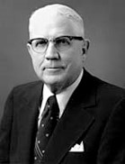
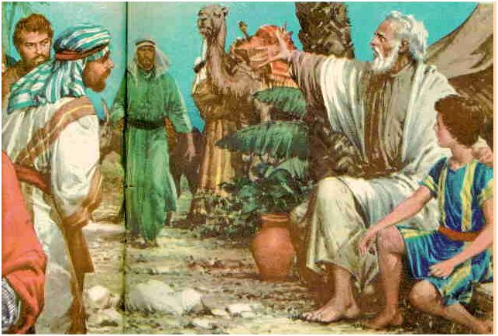
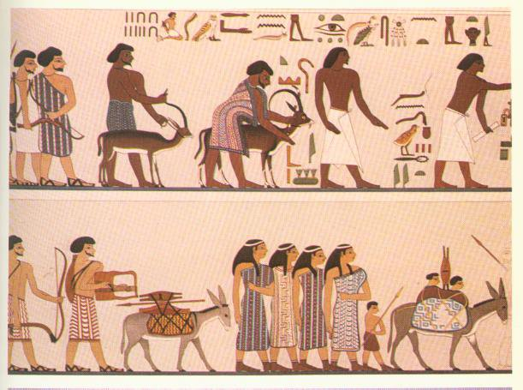
Go To Egypt
Biblical Egypt served both as a refuge and as a threat to the Lord’s people in Old Testament and New Testament times
Famine generally meant no rain
When the famine began, Joseph opened the granaries. Thus, with one good idea, two nations were saved from starvation. However, this idea of storing up food for the future always has been and probably always will be one of our greatest ideas. To begin with, in one way or another these alternating periods of feast and famine continue to come with some regularity as an important part of life. (2)
Genesis 42:1-5

Slide 4
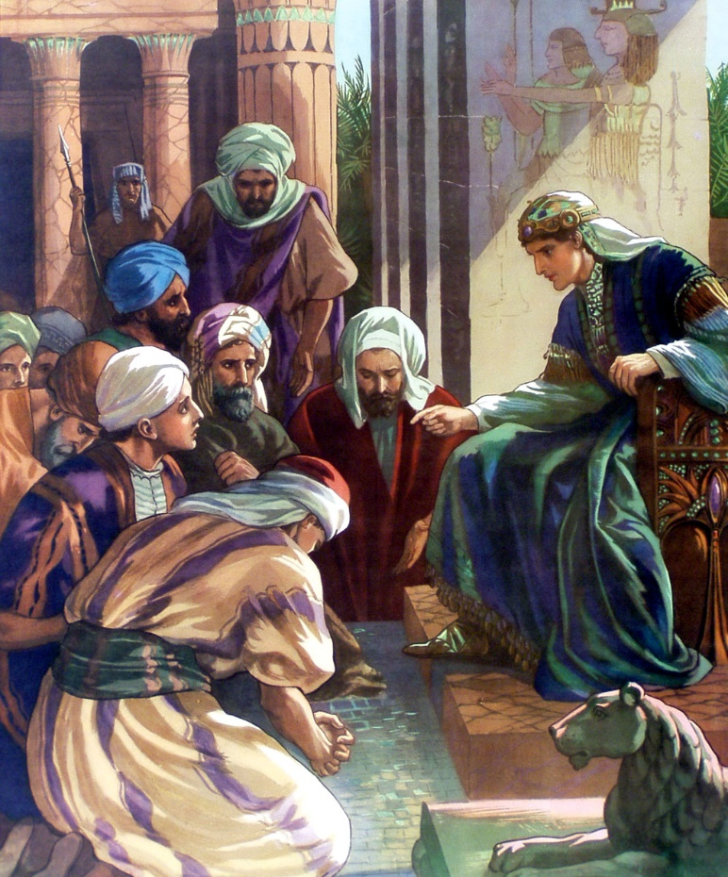
Joseph—The Governor
It had been twenty-two years since the sons of Jacob had last seen Joseph—thirteen years of slavery and prison for Joseph, seven years of plenty, and two years of famine (see Genesis 45:11)—before Jacob’s family was forced to go to Egypt for grain.
Joseph was a teenager when his family had last seen him. Now he was a mature, middle-aged man. And, even if Joseph still looked very much as he did when he was younger, who would believe that a brother who was sold as a slave to a caravan of Arabians would have become the second most powerful man in Egypt?
Genesis 42:6-8
(3)

Slide 5
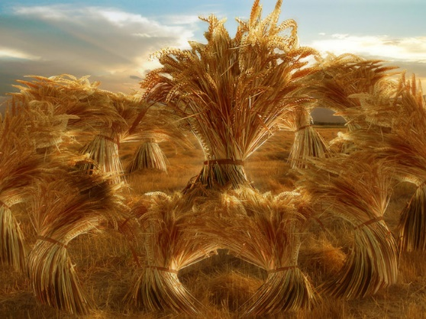
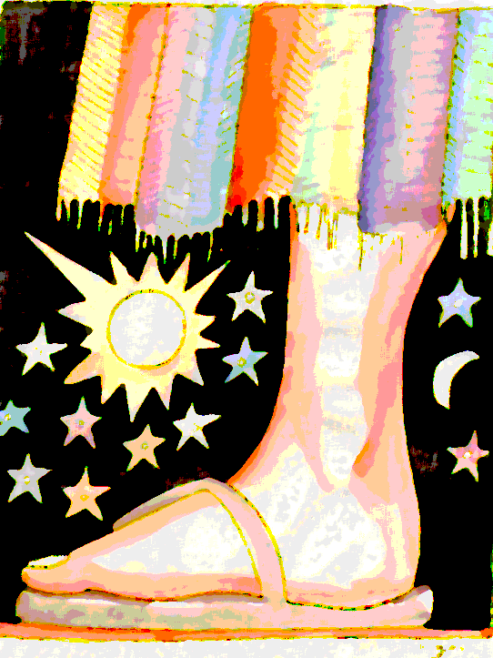
Dreams Remembered
God’s words or prophecies given through His servants are fulfilled according to His will
Joseph accused them of being spies and put them into prison for 3 days
Genesis 42:9
(3)

Slide 6
Burden of Guilt
In order to prove their innocence, they needed to bring Benjamin to Egypt. However, their father Jacob had already indicated that he did not want Benjamin to go to Egypt.
Why do you think Joseph’s brothers would have felt guilt about what they had done to Joseph so many years earlier?
They had not fully repented, so their guilt remained
Guilt accompanies sin. Guilt can cause us to regret our sins.
Genesis 42:19-23

Slide 7
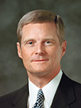
“All of us have experienced the pain associated with a physical injury or wound. When we are in pain, we typically seek relief and are grateful for the medication and treatments that help to alleviate our suffering.
Consider sin as a spiritual wound that causes guilt. … Guilt is to our spirit what pain is to our body—a warning of danger and a protection from additional damage.”
Genesis 42:19-23
(4)

Slide 8
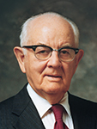
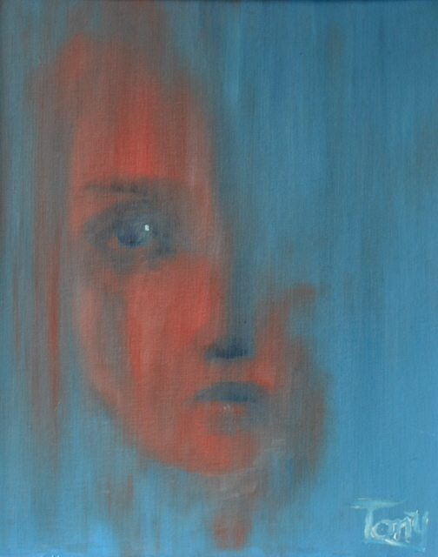

“… personal suffering ‘is a very important part of repentance. One has not begun to repent until he has suffered intensely for his sins. … If a person hasn’t suffered, he hasn’t repented.”
Antonie H. Los
“… We must endure personal suffering in the process of repentance—and for serious transgressions, that suffering can be severe and prolonged.”
(5)

Slide 9
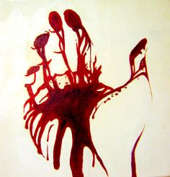
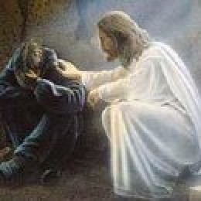
Guilt Protects and Motivates
Guilt protects us from further spiritual damage by alerting us when we have done something wrong. Guilt can also motivate us to make changes that will help us avoid future mistakes.
“The Savior is often referred to as the Great Physician, and this title has both symbolic and literal significance. … From the Atonement of the Savior flows the soothing salve that can heal our spiritual wounds and remove guilt.
However, this salve can only be applied through the principles of faith in the Lord Jesus Christ, repentance, and consistent obedience. The results of sincere repentance are peace of conscience, comfort, and spiritual healing and renewal.”
(4)

Slide 10
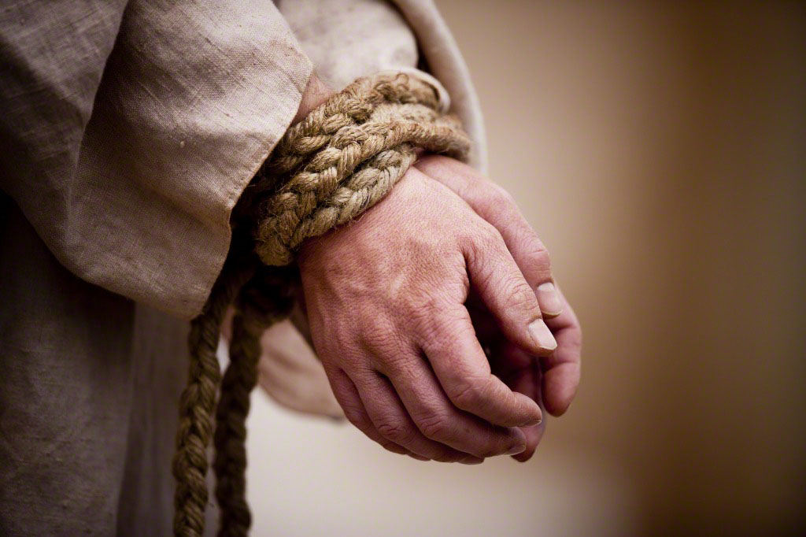
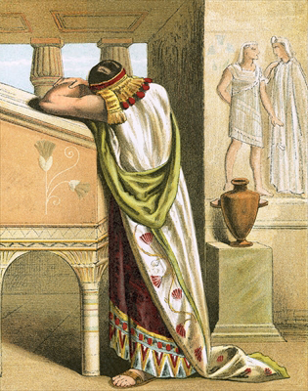
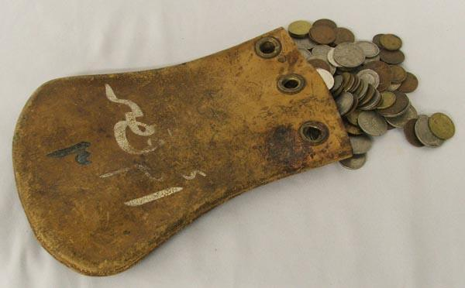
Joseph’s Reaction to Confession
Joseph’s reaction was one of inward forgiveness
However Joseph takes Simeon as a hostage until the brothers return to Egypt with their younger brother Benjamin.
Joseph imprisoned Simeon, he sent the other
brothers home with grain. But before they left,
he commanded his servants to hide the money they used to purchase the grain in the brothers’ sacks of
grain. When they later discovered the money
in their sacks, they were afraid.
Genesis 42:24-35

Slide 11

Bereaved
To lose or be deprived of something or someone.
Jacob mourns the loss of his sons, Joseph, Simeon, and soon to be Benjamin
Rueben and Judah step up to take Benjamin to Egypt, and protect him
If it must be so now, do this; take of the best fruits in the land in your vessels, and carry down the man a present, a little balm, and a little honey, spices, and myrrh, nuts, and almonds:
And take double money in your hand; and the money that was brought again in the mouth of your sacks, carry it again in your hand; peradventure it was an oversight:
Genesis 42:36-38; 43:1-14

Slide 12
Return to Egypt
When Joseph saw that they had brought Benjamin with them, he instructed his servant to bring them to his house.
The brothers feared that Joseph would put them in bonds because of the money that had been returned to their sacks of grain during their previous visit.
Genesis 43:16-34

Slide 13
Sources:
1. D. Kelly Ogden The Testing Ground for the Covenant People September 1980 Ensign
2. Sterling W. Sill (Principles, Promises, and Powers [Salt Lake City: Deseret Book Co., 1973], 267)
3. Old Testament Institute Manual
Presentation by ©http://fashionsbylynda.com/blog/
4. Elder David A. Bednar (“We Believe in Being Chaste,” Ensign or Liahona, May 2013, 44).
5. Spencer W. Kimball The Teachings of Spencer W. Kimball (1982), 88, 99.] and (“Sin and Suffering,” Ensign, July 1992, 72, 73).

Slide 14
Egypt:
The emphasis in the Bible consistently falls not on Egyptians as persons but on Egypt as a place. Only rarely are individuals native to Egypt mentioned by name (see, for example, Gen. 41:50; 2 Kgs. 23:29; Jer. 44:30). Thus, when in later Christian scripture Egypt is used as a symbol of spiritual bondage, we note that the writers use the place as a symbol understood by the Jews and not a charge against the people. In the book of Revelation, for instance, Egypt is equated with Sodom, and both are used as names or symbols for a wicked Jerusalem of the latter days (Rev. 11:8). But this use of Egypt only partially reflects the attitudes of the ancient Israelites toward that place. While it was often a place of testing or bondage, it was also a frequent haven from their troubles.
We must bear in mind that Egypt was a transformer of cultures. Almost every culture that came into contact with Egypt sooner or later adopted Egyptian qualities in the most fundamental ways.
Biblical Egypt: S. Kent Brown Land of Refuge, Land of Bondage September 1980 Ensign
Biography by Antonie H. Los (artist)
I was born in Deventer, Holland, in 1946. As a child, I saw wartime destruction represented in fields of broken brick and odd artifacts of the German occupation. Also, I well remember the stories told by my relatives. Death was a subject learnt at a young age and, from that understanding, came forth a deliberate lifelong study of theology and philosophy.
In 1954, my parents brought me to Canada as my father decided, after being involved in two wars (WWII and the Indonesian Colonial Revolution), that Europe was an inherently unhealthy place to raise a son. Language being a bit of an issue, I did have some problems adapting to English, as I only knew two words; cowboy and OK.
My very first drawings were airplanes and the earliest criticism I received, at age seven, made a lasting impression on me. A school teacher pointed out mistakes in perspective regarding the placement of the wings in relation to the fuselage of an airplane drawing. I am deeply indebted to her observation since it had dual effects:
It convinced me she thought enough of my drawings to supply helpful criticism.
I was able to understand and change from that criticism.
During the intervening years, from those early beginnings to my first real taste of the ‘Art World,’ my parents supplied me with sketch pads, oil paints, books and assorted materials in order to promote my art. Without these encouragements, painting may never have become a lifelong interest. My enrollment into H.B. Beal’s art program in London, Ontario (1968) precipitated my serious attempts at painting. The vibrant art scene that prevailed there during the late 60’s, peaked my interest even further. An earlier ‘hobby’ had become a serious endeavour.
Art must reflect life as the artist sees it, balanced within the material and inner worlds

