Slide 1
Matthew 27; Mark 15; Luke 23; John 19
Including: John 18:33-40
Including: The Trial of Jesus from a lawyer’s Standpoint—James E. Talmage
Presentation by ©http://fashionsbylynda.com/blog/

Slide 2
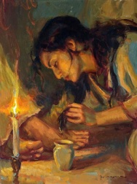
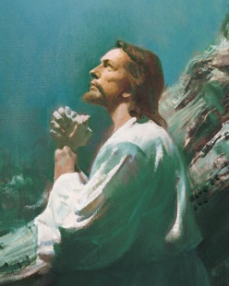
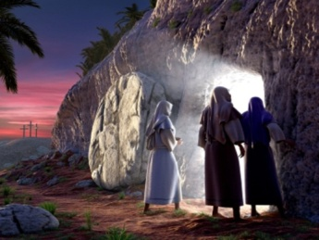
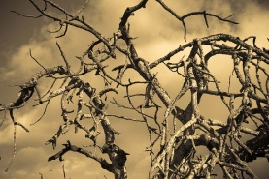
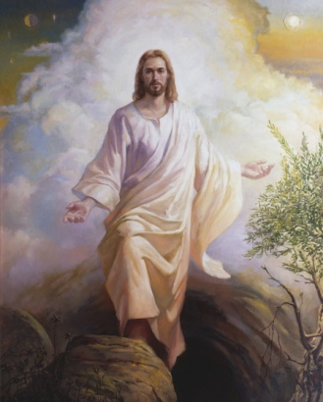
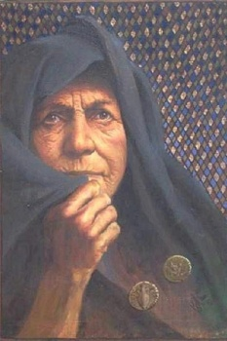
Timeline—Jesus’ Final Week
Sunday
Nisan 9
Monday
Nisan 10
Tuesday
Nisan 11
Wednesday
Nisan 12
Thursday
Nisan 13/14
Friday
Passover
Saturday
Nisan 15
Sunday
Nisan 16
Judas Betrays
Jesus taken before Annas Caiaphas, condemned to death, sent to Pilate, Herod, back to Pilate
Jesus is Crucified
3 hours of darkness (noon to 3 PM)
Fig Tree Withered
Priests, scribes, and elders challenge Jesus Authority
(Mark 11:27-28)
Judas seeks to Betray
Triumphal entry into Jerusalem
Women come to tomb
“He is Risen”
Jesus arrives at Bethany
(6 days before Passover)
Mary Anoints Jesus’ feet
Jesus Curses Fig Tree
(Mark 11:12-14)
Jesus Cleanses Temple and teaches about Widow’s Mite
Jesus instructs disciple to prepare for the Passover
(Luke 22:7-13)
Jesus Washes Disciples Feet
Sacrament
Judas leaves
Atonement at Garden of Gethsemane
Christ is resurrected
(5)

Slide 3
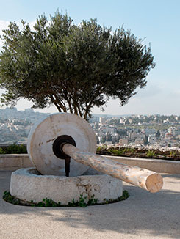
Suffering In Gethsemane
Jesus Christ suffered our pains, afflictions, temptations, sicknesses, infirmities, and sorrows so that He would know how to succor us. Jesus Christ suffered for our sins so that He could blot out our transgressions.
The Savior’s suffering for the sins of mankind began in Gethsemane and continued through and culminated in His Crucifixion on the cross.
Gethsemane comes from an Aramaic word meaning “oil press,” and it appears that Gethsemane was an olive orchard where olives were pressed to produce oil.

Slide 4
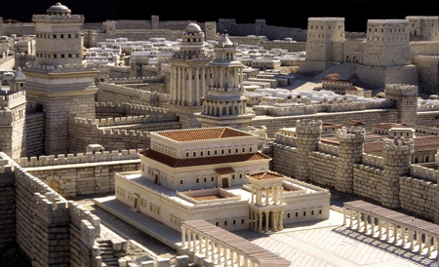
Jesus to Pilate
The hypocrisy of the Jewish leaders was put on display when they led Jesus to Pilate to be judged.
They would not enter into the hall of judgment, which was a Gentile structure, because doing so would make them ritually unclean and they desired to eat the Passover meal the next day.
Yet at the same time, they were willing to falsely accuse Jesus before Pilate and seek His death. (1)
This model of first-century Jerusalem depicts the palace (foreground) that was probably “the hall of judgment” (John 18:28) where Pilate questioned Jesus. It also depicts the Antonia Fortress (background on right), another possible site of the trial before Pilate.
John 18:28-36

Slide 5
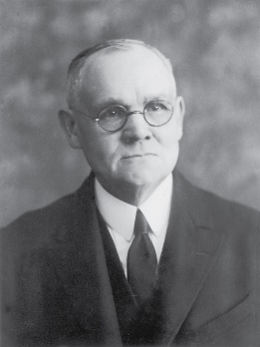
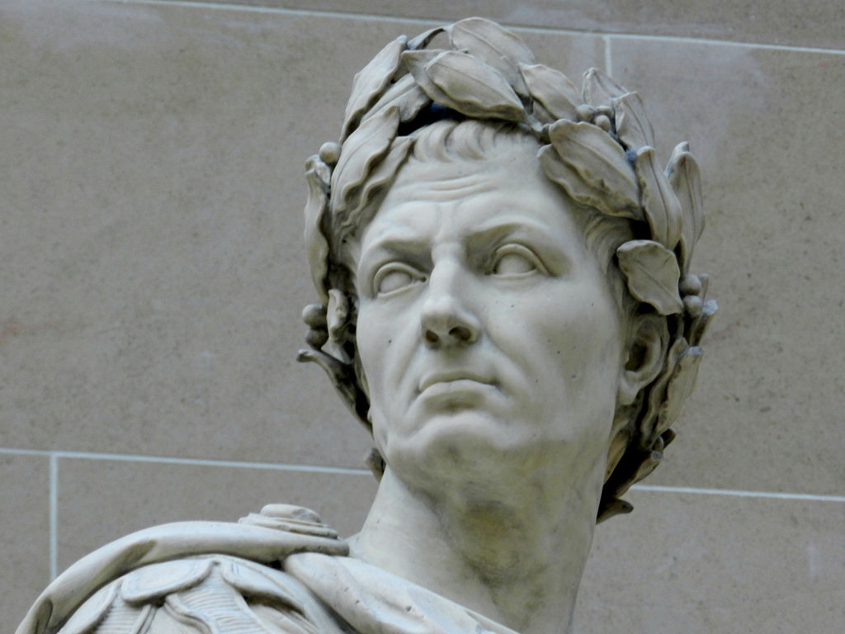
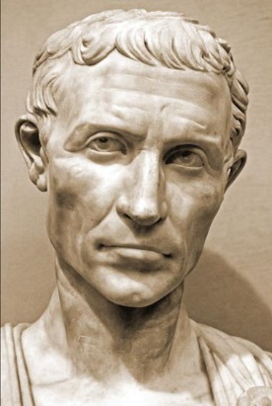
Who Was Pontius Pilate
Caesar was the Roman emperor who had granted Pilate his position as Judea’s governor.
On several previous occasions, Pilate had ordered Roman soldiers to slaughter Jews, and he had defiled some of their sacred religious traditions.
Pilate’s actions had been reported to Caesar, and Caesar had rebuked Pilate.

Slide 6
Tried Before Pilate
My kingdom is not of this world: if my kingdom were of this world, then would my servants fight, that I should not be delivered to the Jews: but now is my kingdom not from hence.
Art thou the King of the Jews?
Sayest thou this thing of thyself, or did others tell it thee of me?
Art thou a king then?
Thou sayest that I am a king. To this end was I born, and for this cause came I into the world, that I should bear witness unto the truth.
Am I a Jew Thine own nation and the chief priests have delivered thee unto me; what hast thou done?
Every one that is of the truth heareth my voice.
John 18:33-37

Slide 7
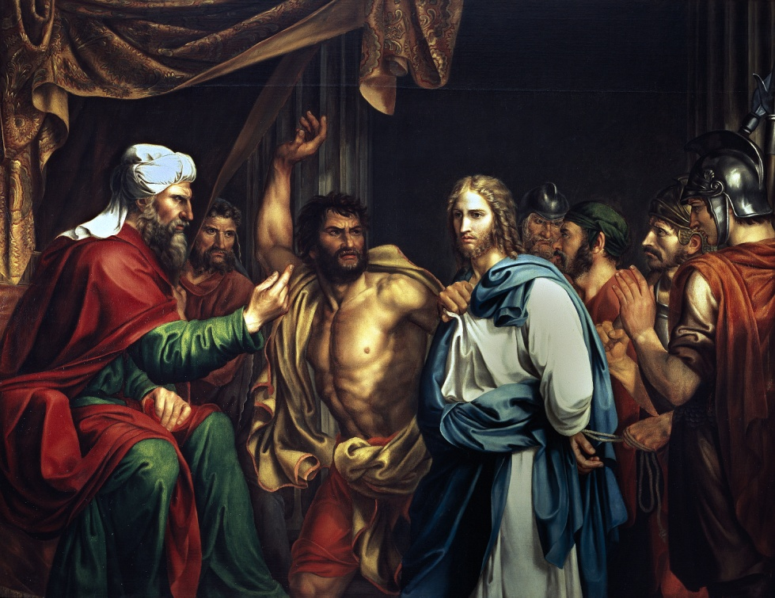
3 Charges Brought Against Jesus
After Jesus had suffered in Gethsemane, the chief priests arrested Him and condemned Him to die.
1. “perverting” or causing disruption to the nation.
2. Teaching Roman subjects not to pay tribute to Caesar.
3. Claiming to be a king of a competing earthly kingdom.
These would have been considered acts of treason, for which the penalty was death. Jesus Christ, of course, was innocent of these trumped-up charges.
Jose Madrazo, 1803.
(1)

Slide 8
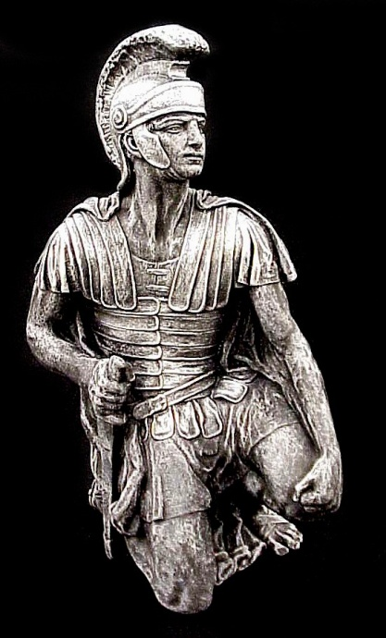
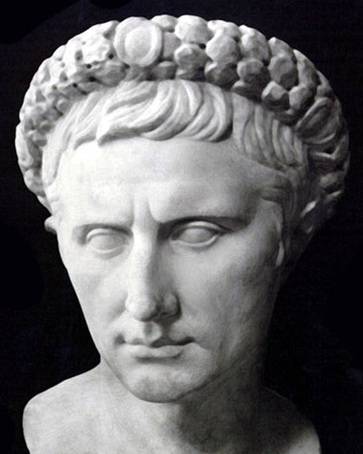
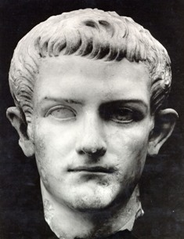
Judgment and Mistreatment
Pontius Pilate
Herod Antipas
Roman Soldiers
The presence of Roman forces in Judea was brought about by a treaty between Judas Maccabaeus (the Jewish head of state) and Rome about 160 BC.
“The soldiers of the Governor…” The term here (stratiwtai/stratiotai) is the regular term for soldier.
This is the same term used to describe the people who carried out all of the brutal and violent acts attributed to soldiers in the New Testament. (7)
A Roman ruler in the territory of Judea, which included the capital city of Jerusalem.
Ruled the territories of Galilee and Perea under Roman authority—had also put John the Baptist to death.
(1)

Slide 9
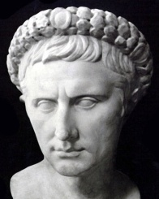
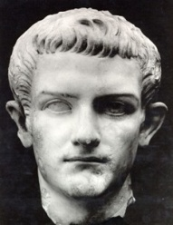
Savior’s Trial
Pontius Pilate
Herod Antipas
Roman Soldiers
Herod and his men-at-arms made sport of the suffering Christ, ‘set him at nought and mocked him’; then in travesty they ‘arrayed him in a gorgeous robe and sent him again to Pilate’
Pilate began looking for a way to dismiss the case against Him.
When Pilate learned that Jesus was a Galilean, he sent Him to Herod Antipas.
Herod was eager to see Jesus, hoping to witness a miracle of some sort.
“Herod began to question the Prisoner; but Jesus remained silent.
As far as we know, Herod is … the only being who saw Christ face to face and spoke to Him, yet never heard His voice. … For Herod the fox He had but disdainful and kingly silence.
Herod had found nothing in Jesus to warrant condemnation” (3)
Luke 23:1-12
(1)

Slide 10
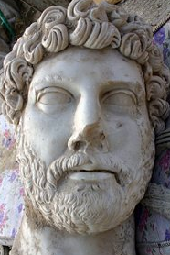
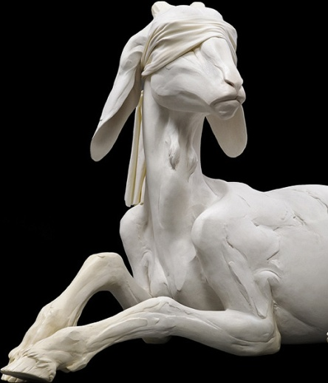
Release of a Prisoner
Pontius Pilate
The law of Moses taught that once a year, on the Day of Atonement, the high priest selected two goats. One goat became the scapegoat and was released alive into the wilderness, while the other was “for the Lord” and was killed as an offering for the sins of the people.
The high priest then took blood from the slain goat into the Holy of Holies of the tabernacle. He sprinkled it on the lid of the ark of the covenant (called the mercy seat), symbolically making atonement for the sins of Israel.
Barabbas
Neither Pilate nor Herod could find fault with Jesus, so Pilate told the multitude that he would punish Jesus and release Him.
Pilate asked the Jews in attendance three times why they wanted Jesus crucified and then, finally giving in to popular pressure, released Barabbas
According to the Greek to Matthew, Barabbas’s first name was Jesus.
Jesus Barabbas was a thief, murderer, and traitor, while Jesus the Christ was perfect.
Luke 23:12-25; Matthew 27:26; Leviticus 16:8-10
(1)

Slide 11
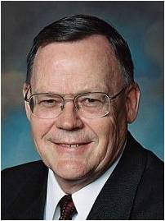
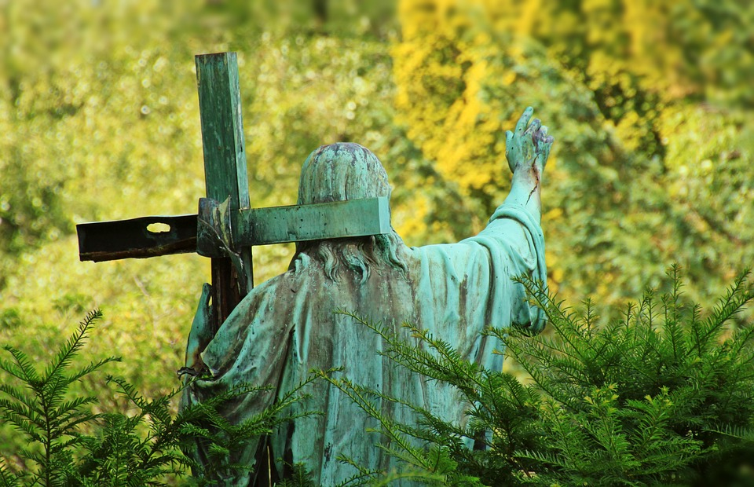
“Christ, as the lamb of Jehovah as well as High Priest, shed his own blood to enter the heavenly Holy of Holies where that blood ransomed from their sins those who would believe in him and obey his commandments.”
Heb. 9:11–14, 24–28; 10:11–22; D&C 45:3–5.
(6)

Slide 12
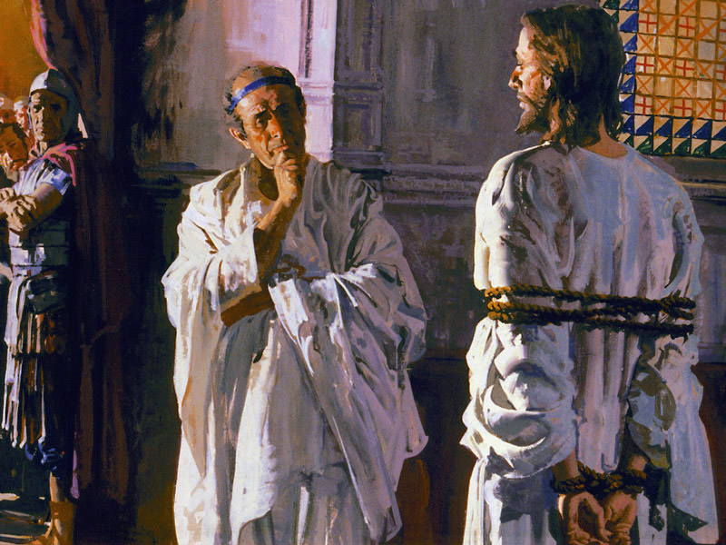
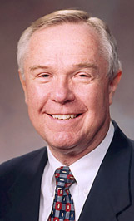
“My Kingdom is Not of this World”
Jesus’ statements are consistent with His refusal throughout His ministry to present Himself as an earthly king, while openly declaring that He was the Messiah.
When Jesus therefore perceived that they would come and take him by force, to make him a king, he departed again into a mountain himself alone. John 6:15
“With these few words, Jesus declares His kingdom independent and distinct from this world. The Savior’s teachings, doctrine, and personal example lift all who truly believe in Him to a
divine standard that requires
both eye and mind be single to
the glory of God.” (3)
John 18:28-36

Slide 13
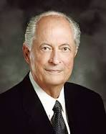
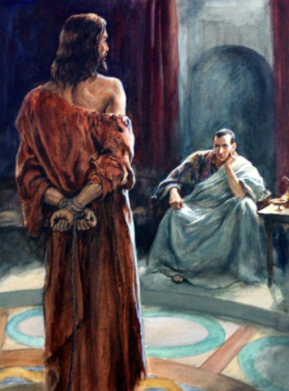
Christlike Character
To respond in a Christlike way cannot be scripted or based on a formula.
The Savior responded differently in every situation. When He was confronted by wicked King Herod, He remained silent.
When He stood before Pilate, He bore a simple and powerful testimony of His divinity and purpose. …
Some people mistakenly think responses such as silence, meekness, forgiveness, and bearing humble testimony are passive or weak.
But to “love [our] enemies, bless them that curse [us], do good to them that hate [us], and pray for them which despitefully use [us], and persecute [us]” takes faith, strength, and, most of all, Christian courage.
(8)
Matthew 4:44; 1 Nephi 19:9

Slide 14
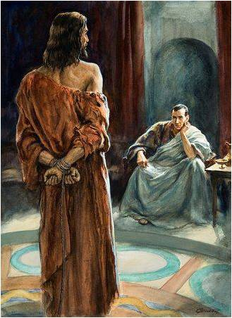
What is Truth?
Perhaps, afraid to learn the truth, Pilate left before Jesus responded. Most likely, Pilate did not want to face the truth.
"'What is truth?' From the time Pilate asked this in the New Testament until the heavens were opened again in the day of the Restoration, the scriptures are silent on the Lord's response to that question.
"We don't know if Pilate waited to hear the Savior's reply. We are told only that, after he asked his question, Pilate 'went out again unto the Jews, and saith unto them, I find in him no fault at all.'
'Ye were also in the beginning with the Father; that which is Spirit, even the Spirit of truth;
And truth is knowledge of things as they are, and as they were, and as they are to come;
And whatsoever is more or less than this is the spirit of that wicked one who was a liar from the beginning.
The Spirit of truth is of God. I am the Spirit of truth, and John bore record of me, saying: He received a fulness of truth, yea, even of all truth...' (D&C 93:23-30.)
John 18:37-39
(5)

Slide 15
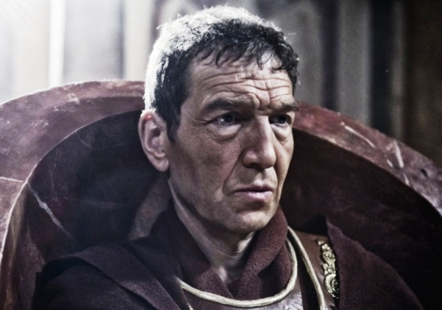
Finding No Fault
The Jewish leaders accused Jesus of claiming to be the king of the Jews because if Jesus claimed to be a king, He could be charged with sedition, or treason, against the Roman government, a crime that was punishable by death.
Pilate initially resisted the entreaty of Jewish leaders to get involved with the case against Jesus and thereafter sought repeatedly to release Jesus.
Pilate had a troubled history with the Jewish population he governed during an 11-year appointment in Judea—which included several violent clashes with the Jewish people and an official reprimand from the emperor. So his eventual capitulation to the crowd is no surprise.
To quell a possible riot and avoid allegations of political disloyalty Pilate consented to crucify Jesus of Nazareth. For additional insights about Pontius Pilate.
John 18:38; John 19:12; Matthew 27:24
(1)

Slide 16
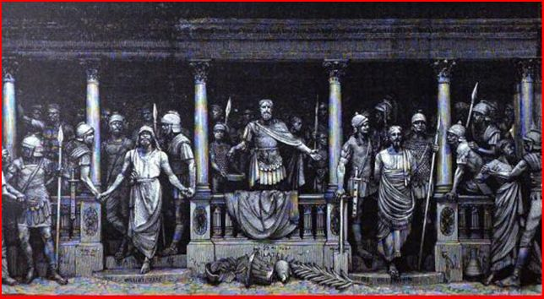
Not This Man, But Barabbas
Ecclesiastical and political rejection became more personal when the citizenry in the street turned against Jesus as well.
It is one of the ironies of history that sitting with Jesus in prison was a real blasphemer, a murderer and revolutionary known as Barabbas, a name or title in Aramaic meaning "son of the father."
Free to release one prisoner in the spirit of the Passover tradition, Pilate asked the people, "Whether of the twain will ye that I release unto you?"
They said, "Barabbas."
So one godless "son of the father" was set free while a truly divine Son of His Heavenly Father moved on to crucifixion.
John 18:40, Matthew 27:21
(2)

Slide 17
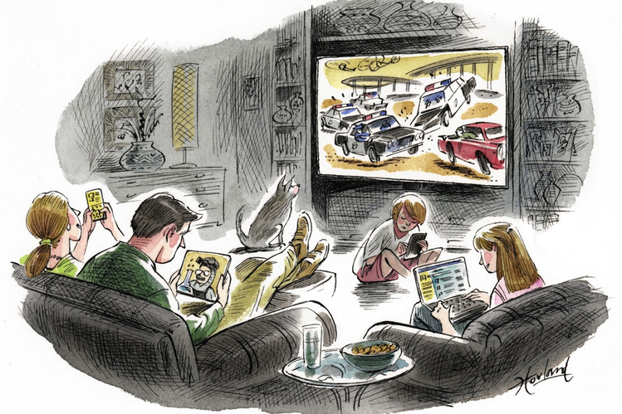
Pilate’s Concerns
himself; his position and power.
Placing our own interests ahead of doing what is right will lead us to sin
What are some situations in which we might be tempted to place our own interests ahead of doing what is right?
What can we do to overcome the temptation to place our own interests ahead of doing what is right?
John 18:40
(2)

Slide 18
Pilot Washes His Hands
Pontius Pilate
One provision of the Mosaic law stated that if a person was found to have been killed, the elders of the city could wash their hands to signify that they were not responsible.
Pilate recognized that Jesus was innocent of the accusations made against Him; even his wife had warned him of Jesus Christ’s innocence.
There are also examples in Greek and Roman literature of washing oneself as a symbolic gesture of absolving oneself of responsibility for shedding another’s blood. Thus, when Pilate washed his hands, he may have been claiming innocence in a way the Jewish leaders would have understood.
“Pilate’s freshly washed hands could not have been more stained or more unclean” (2)
Luke 23:19-24; Matthew 27:19-24
(1)

Slide 19
Sources:
New Testament Institute Student Manual Chapter 27
Elder Jeffrey R. Holland This Do In Remembrance of Me Oct. 1995 Gen. Conf. And ("None Were with Him" Ensign, May 2009, 86) , Elder Jeffrey R. Holland (“None Were with Him,” Ensign or Liahona, May 2009, 86, 88).
Elder Dennis B. Neuenschwander (“Holy Place, Sacred Space,” Ensign or Liahona, May 2003, 71).
Elder Alexander B. Morrison (“For This Cause Came I into the World,” Ensign, Nov. 1999, 25–26).
Elder Bruce R. McConkie (Doctrinal New Testament Commentary, 1:566; 1:817).
Elder Gerald Lund Jesus Christ, Key to the Plan of Salvation[1991], 67
Bible.org article The Roman Military in the New Testament by John Hopkins
Robert D. Hales, “Christian Courage: The Price of Discipleship,” Ensign or Liahona, Nov. 2008, 72
Presentation by ©http://fashionsbylynda.com/blog/

Slide 20
Pilates Error on Truth John 18:37-39:
"Simply put, truth is eternal. When all else has passed away, truth will remain. Man might try to turn his back on it, close his eyes to it, refuse to hear it, or cover it up, but he cannot make truth go away.
"Truth and error have always been, and always will be, at opposite ends of the spectrum.
"The biblical account of Pilate's brief pursuit of truth gives a glimpse of a major flaw in his character. He claimed that he sought the truth. Yet, he obviously wanted to find the most expedient solution to a difficult situation-what to do with this man, Jesus of Nazareth, in whom he found no fault but whose life the mob demanded. Pilate bowed before custom as he conceded to the will of the throng that Barabbas, a robber, should be released rather than Jesus. (See John 18:39-40.)" (What Is Truth?, LDS Church News, 1996, 09/21/96 .)
Pilate:
Pilate knew what was right but lacked the moral courage to do it. He was afraid of the Jews, and more afraid of hostile influence at Rome. He was afraid of his conscience, but more afraid of losing his official position. It was the policy of Rome to be gracious and conciliatory in dealing with the religions and social customs of conquered nations. Pontius Pilate had violated this liberal policy from the early days of his procuratorship. In utter disregard of the Hebrew antipathy against images and heathen insignia, he had the legionnaires enter Jerusalem at night, carrying their eagles and standards decorated with the effigy of the emperor. To the Jews this act was a defilement of the Holy City. In vast multitudes they gathered at Cæsarea, and petitioned the procurator that the standards and other images be removed from Jerusalem.
For five days the people demanded and Pilate refused. He threatened a general slaughter, and was amazed to see the people offer themselves as victims of the sword rather than relinquish their demands. Pilate had to yield (Josephus, Antiquities, xviii, chap. 3:1; also Wars, ii, chap. 9:2, 3). Again he gave offense in forcibly appropriating the Corban, or sacred funds of the temple, to the construction of an aqueduct for supplying Jerusalem with water from the pools of Solomon. Anticipating the public protest of the people, he had caused Roman soldiers to disguise themselves as Jews; and with weapons concealed to mingle with the crowds. At a given signal these assassins plied their weapons and great numbers of defenseless Jews were killed or wounded (Josephus, Antiquities, xviii, chap. 3:2; and Wars, ii. chap. 9:3, 4).
On another occasion, Pilate had grossly offended the people by setting up in his official residence at Jerusalem, shields that had been dedicated to Tiberius, and this “less for the honor of Tiberius than for the annoyance of the Jewish people.” A petition signed by the ecclesiastical officials of the nation, and by others of influence, including four Herodian princes, was sent to the emperor, who reprimanded Pilate and directed that the shields be removed from Jerusalem to Cæsarea (Philo. De Legatione ad Caium; sec. 38).
These outrages on national feeling, and many minor acts of violence, extortion and cruelty, the Jews held against the procurator. He realized that his tenure was insecure, and he dreaded exposure. Such wrongs had he wrought that when he would have done good, he was deterred through cowardly fear of the accusing past.
James E. Talmage 648-649 Notes #7
Barabbas Matthew 27:26 and John 18:40:
The name Barabbas ironically means “son of the father.” The crowd, most of whom were stirred up by the chief priests and elders, called for the release of Barabbas while rejecting the true Son of the Father. In one sense, we are all like Barabbas—we are the sinful sons set free because the true Son of the Father was condemned to death. According to the Greek text of Matthew 27:26, Barabbas’s first name was Jesus. Jesus Barabbas was a thief, murderer, and traitor, while Jesus the Christ was perfect. Those who condemned the Savior to death were presented with a clear choice, and they chose evil.
The Scapegoat Leviticus 16:8-10
The law of Moses provided a foreshadowing of Barabbas’s release centuries before it happened. The law of Moses taught that once a year, on the Day of Atonement, the high priest selected two goats. One goat became the scapegoat and was released alive into the wilderness, while the other was “for the Lord” and was killed as an offering for the sins of the people (see Leviticus 16:8–10). The high priest then took blood from the slain goat into the Holy of Holies of the tabernacle. He sprinkled it on the lid of the ark of the covenant (called the mercy seat), symbolically making atonement for the sins of Israel.
New Testament Institute Manual Chapter 10

Slide 21
The Sign John 19:20:
The sign was read by many people because the Crucifixion took place “nigh to the city”.
Crucifixion in the Roman Empire was for punishment and also for deterrence of crime. The Roman writer, Marcus Quintilian, explained why crucifixions took place where many people could see them: “Whenever we crucify the guilty, the most crowded roads are chosen, where the most people can see and be moved by this fear. For penalties relate not so much to retribution as to their exemplary effect” (cited in The Anchor Bible Dictionary [1992], “Crucifixion”).
Scourging John 19:1:
"Flogging was a preliminary to every Roman execution, and only women and Roman senators or soldiers (except in cases of desertion) were exempt. The usual instrument was a short whip (flagrum or flagellum) with several single or braided leather thongs of variable lengths, in which small iron balls or sharp pieces of sheep bones were tied at intervals. Occasionally, staves also were used. For scourging, the man was stripped of his clothing, and his hands were tied to an upright post...As the Roman soldiers repeatedly struck the victim's back with full force, the iron balls would cause deep contusions, and the leather thongs and sheep bones would cut into the skin and subcutaneous tissues. Then as the flogging continued, the lacerations would tear into the underlying skeletal muscles and produce quivering ribbons of bleeding flesh. Pain and blood loss generally set the stage for circulatory shock. The extent of blood loss may well have determined how long the victim would survive on the cross.
"At the Praetorium, Jesus was severely whipped...The Roman soldiers, amused that this weakened man had claimed to be a king, began to mock him by placing a robe on his shoulders, a crown of thorns on his head, and a wooden staff as a scepter in his right hand. Next, they spat on Jesus and struck him on the head with a wooden staff. Moreover, when the soldiers tore the robe from Jesus back, they probably reopened the scourging wounds.
"The severe scourging, with its intense pain and appreciable blood loss, most probably left Jesus in a preshock state. Moreover, hematidrosis (bleeding from the pores of the skin) had rendered his skin particularly tender. The physical and mental abuse meted out by the Jews and the Romans, as well as the lack of food, water, and sleep, also contributed to his generally weakened state. Therefore, even before the actual crucifixion, Jesus' physical condition was at least serious and possibly critical." (Edwards, et al, "On the Physical Death of Jesus Christ," Journal of the American Medical Association, Mar. 21, 1986, Vol. 255, No. 11, pp. 1457-58)
It is Finished John 19:30:
“Jesus chose not to be released from this world until He had endured to the end and completed the mission He had been sent to accomplish for mankind. Upon the cross of Calvary, Jesus commended His spirit to His Father with a simple statement, ‘It is finished’ (John 19:30). Having endured to the end, He was released from mortality.
“We, too, must endure to the end. The Book of Mormon teaches, ‘Unless a man shall endure to the end, in following the example of the Son of the living God, he cannot be saved’ (2 Ne. 31:16)” Elder Robert D. Hales (“The Covenant of Baptism: To Be in the Kingdom and of the Kingdom,” Ensign, Nov. 2000, 6).
Two Messianic Prophecies Fulfilled John 19:31-37
While Matthew and Mark pointed out that the Savior’s death fulfilled certain prophecies (see Matthew 27:35; Mark 15:28), John mentioned two details that other Gospel writers did not:
First, not one of Jesus' bones was broken. Soldiers sometimes broke the leg bones of crucifixion victims to hasten death, but they did not do this with Jesus. Without realizing it, they fulfilled an important part of the symbolism of Passover, for the Lord had instructed that the Passover lamb—which symbolized the Savior—was not to have any broken bones (see Exodus 12:46; Numbers 9:12). This also fulfilled the messianic prophecy found in Psalm 34:20: “He keepeth all his bones: not one of them is broken.”
Second, Jesus Christ’s side was pierced with a spear. This fulfilled the prophecy of Zechariah: “They shall look upon me whom they have pierced, and they shall mourn for him, as one mourneth for his only son, and shall be in bitterness for him, as one that is in bitterness for his firstborn” (Zechariah 12:10). (1)
Jesus Remains Submissive John 19:11:
"During all of the taunting, the abuse, the scourging, and the final torture of crucifixion, the Lord remained silent and submissive. Except, that is, for one moment of intense drama which reveals the very essence of Christian doctrine. That moment came during the trial. Pilate, now afraid, said to Jesus: 'Speakest thou not unto me? knowest thou not that I have power to crucify thee, and have power to release thee?' (John 19:10).
"One can only imagine the quiet majesty when the Lord spoke. 'Thou couldest have no power at all against me, except it were given thee from above' (John 19:11).
"What happened thereafter did not come because Pilate had power to impose it, but because the Lord had the will to accept it.
"'I lay down my life,' the Lord said, 'that I might take it again. No man taketh it from me, but I lay it down of myself. I have power to lay it down, and I have power to take it again' (John 10:17-18).
"Before the Crucifixion and afterward, many men have willingly given their lives in selfless acts of heroism. But none faced what the Christ endured." Boyd K. Packer ("Atonement, Agency, Accountability," Ensign, May 1988, 69)

Slide 22
Mocking
What are some common situations in which a teenager may be mocked, falsely accused, or mistreated?
What are some ways a typical teenager might respond to such treatment?
Mistreated

Slide 23
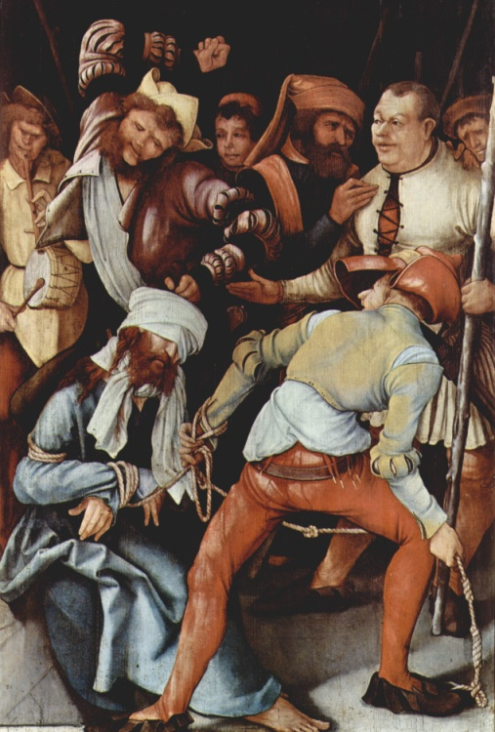
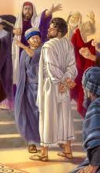
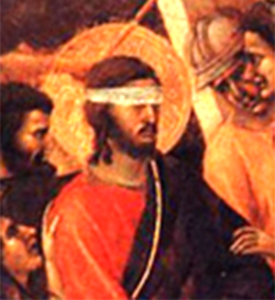
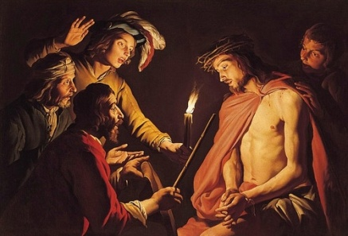
Mistreatment
Luke 23 Matthew 26-27 Mark 15 John 19
Mocked
Smote
Blindfolded
Struck on the face

Slide 24
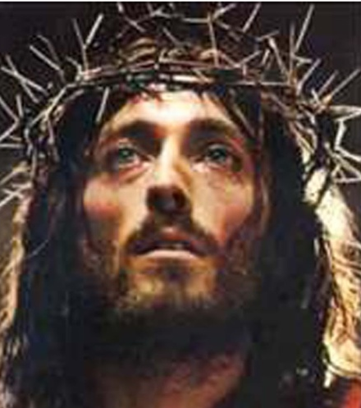
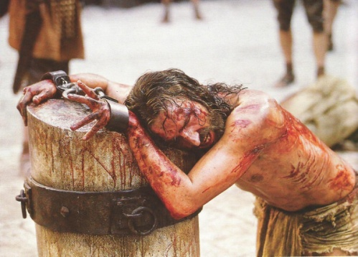
Mistreatment
Luke 23 Matthew 26-27 Mark 15 John 19
Scourged
Stripped
Scarlet robe
Crown of thorns
Mocked
Smote
Blindfolded
Struck on the face

Slide 25
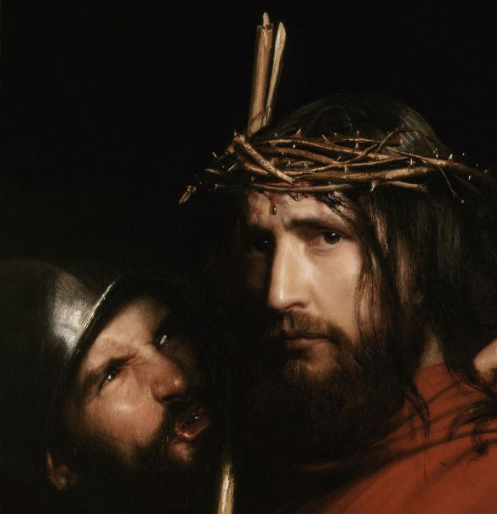
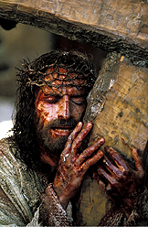
Mistreatment
Luke 23 Matthew 26-27 Mark 15 John 19
With reed smote him
Spit upon
Carried cross
Scourged
Stripped
Scarlet robe
Crown of thorns
Mocked
Smote
Blindfolded
Struck on the face

Slide 26
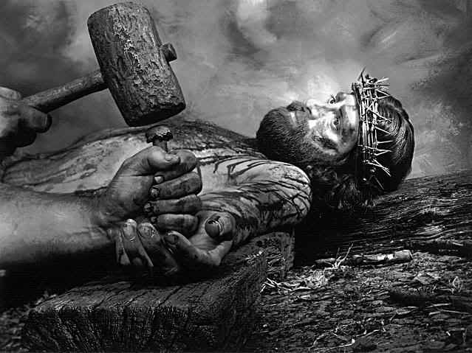
Mistreatment
Luke 23 Matthew 26-27 Mark 15 John 19
Antonio Ciseri
Took robe
Put on raiment
Nailed hands and feet
With reed smote him
Spit upon
Carried cross
Scourged
Stripped
Scarlet robe
Crown of thorns
Mocked
Smote
Blindfolded
Struck on the face

Slide 27
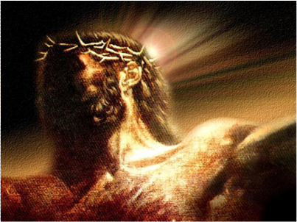
Mistreatment
Luke 23 Matthew 26-27 Mark 15 John 19
ὁ βασιλεὺς τῶν Ἰουδαίων
Crucified Him
Took robe
Put on raiment
Nailed hands and feet
With reed smote him
Spit upon
Carried cross
Scourged
Stripped
Scarlet robe
Crown of thorns
Mocked
Smote
Blindfolded
Struck on the face

Slide 28
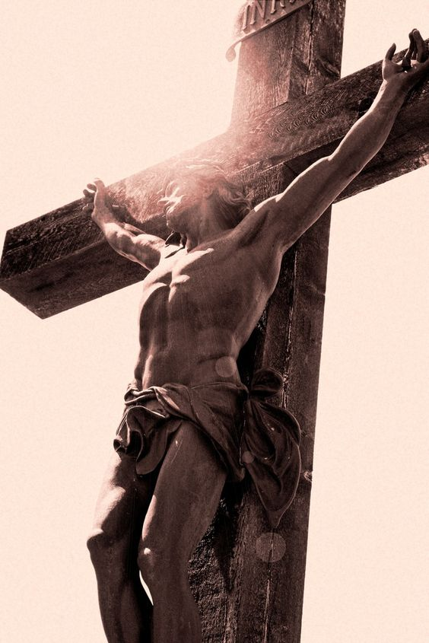
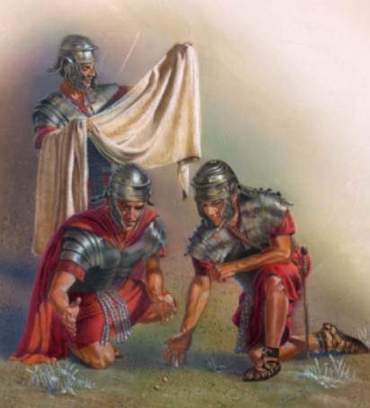
Mistreatment
Luke 23 Matthew 26-27 Mark 15 John 19
Pierced His side
ὁ βασιλεὺς τῶν Ἰουδαίων
Cast lots
Sat and watched
Vinegar to drink
Parted garments
Took robe
Put on raiment
Nailed hands and feet
With reed smote him
Spit upon
Carried cross
Scourged
Stripped
Scarlet robe
Crown of thorns
Mocked
Smote
Blindfolded
Struck on the face

Slide 29
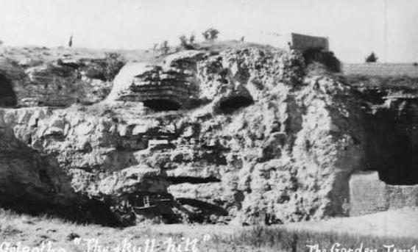
The second phase of His atonement was effected on the cross. …
Pilate delivered the Lamb of God to be crucified at the same time Paschal lambs nearby were being prepared for sacrifice.
The Crucifixion took place at a hill called Golgotha (Greek) or Calvary (Latin) meaning “the skull.”
The skull symbolized death.
At a place such as this, the atoning sacrifice was completed. On the cross, the Savior of the world was lifted up over death in the greatest of all possible significance—the realization and reality of the Lord’s power over death.
(10)
John 19:13–14

Slide 30
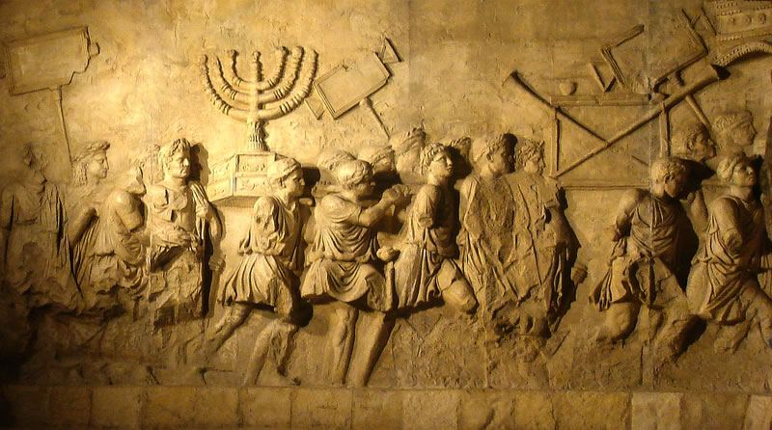
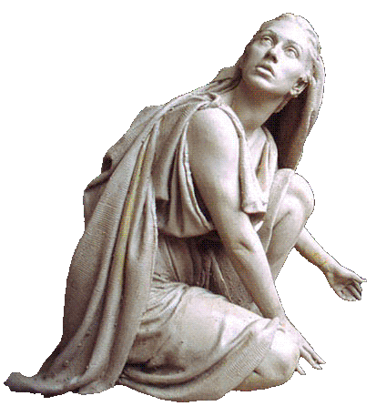
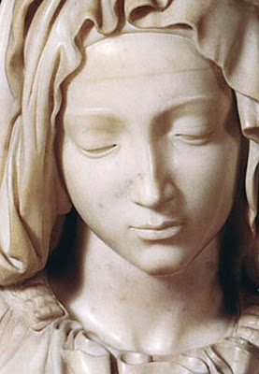
Daughters of Jerusalem
After Pilate sentenced the Savior to be crucified, many sorrowful people followed Him as He was led away. Luke particularly mentioned that women were members of this group—one of his numerous references to faithful women who revered Jesus Christ. At least some of them had followed Jesus from Galilee to Jerusalem.
The Lord’s warning to these women, whom He called “daughters of Jerusalem” referred to the future destruction of Jerusalem in A.D. 70:
“It was the Lord’s last testimony of the impending … destruction that was to follow the nation’s rejection of her King.
Although motherhood was the glory of every Jewish woman’s life, yet in the terrible scenes which many of those there weeping would live to witness, barrenness would be accounted a blessing; for the childless would have fewer to weep over, and at least would be spared the horror of seeing their offspring die of starvation or by violence” (3)
Luke 23:27-31, 49, 55
(1)

Slide 31
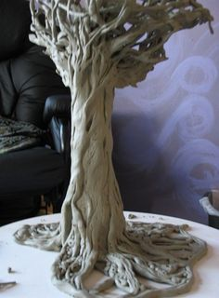
Green and Dry Tree
For if they do these things in a green tree, what shall be done in the dry?
The “green tree” = the time of Jesus Christ’s mortal ministry.
The Savior’s statement implied that if the oppressors of the Jewish people could carry out such evil acts at a time when Jesus was among them, they would do much worse things to the Jewish people after He was gone—a time represented by the “dry tree.”
The Joseph Smith Translation adds a sentence to this verse which describes the destruction that would occur after the Savior’s death.
Footnote b: This he spake, signifying the scattering of Israel, and the desolation of the heathen, or in other words, the Gentiles.
Luke 23:31 (JST)
(1)

Slide 32
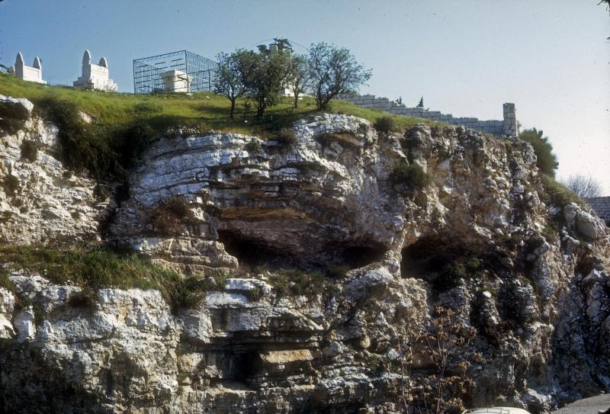
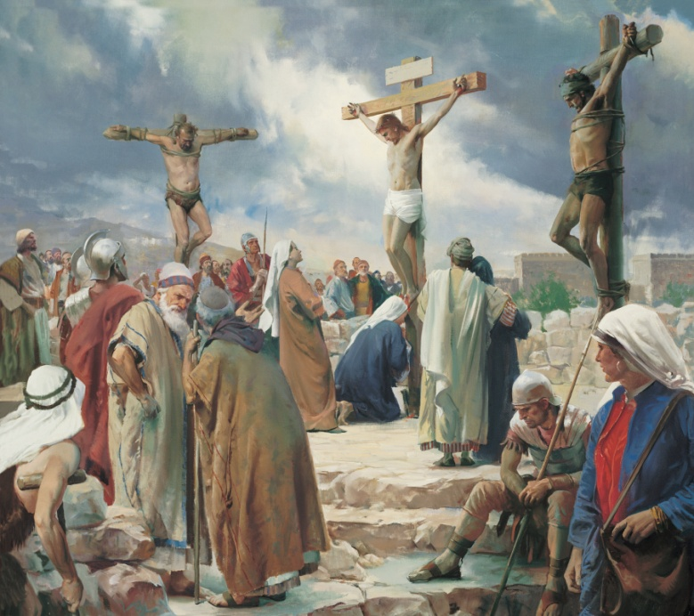
Jesus Crucified Between Two Thieves
Calvariae (in English, Calvary) is the Latin translation of the Greek word that means “skull.”
The other Gospel writers called the place of execution Golgotha, which comes from the Hebrew gulgoleth and the Aramaic gulgutha, both of which mean “skull.”
…and the malefactors, one on the right hand, and the other on the left.
Luke 23:33
(1)

Slide 33
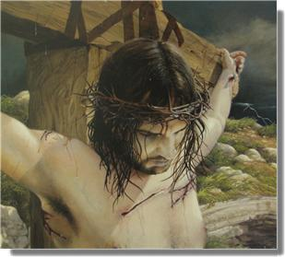
Forgiveness
The Joseph Smith Translation clarifies that the Savior spoke of the soldiers who crucified Him when He prayed, “Father, forgive them”:
“Then said Jesus, Father, forgive them; for they know not what they do (Meaning the soldiers who crucified him,)
Forgiving others does not mean that those who sin against us should not be held accountable for their actions. Nor does it mean that we should put ourselves in situations in which people can continue to mistreat us. Rather, forgiveness means to treat with love those who have mistreated us and to harbor no resentment or anger toward them. (6)
“I plead with you to ask the Lord for strength to forgive. … It may not be easy, and it may not come quickly. But if you will seek it with
sincerity and
cultivate it, it
will come” (7)
Luke 23:34
(1)

Slide 34
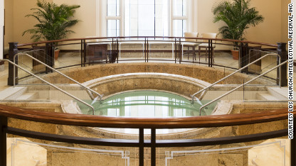
Paradise
Designates a place of peace and happiness in the postmortal spirit world, reserved for those who have been baptized and who have remained faithful.
Those in spirit prison have the opportunity to learn the gospel of Jesus Christ, repent of their sins, and receive the ordinances of baptism and confirmation through the work we do in temples. When they do, they may enter paradise.
“A second use of the word paradise is found in Luke’s account of the Savior’s Crucifixion. … The Prophet Joseph Smith explained that … the Lord actually
said that the thief would be with
Him in the world of spirits.”
The spirits of all people enter the spirit world at the time of their death
Luke 23:39-43; Alma 40:12; Moroni 10:34; D&C 138:30-35
(1,8)

Slide 35
Spirit Prison
“The Savior graciously answered and gave him hope. This criminal likely did not understand that the gospel would be preached to him in the spirit world or that he would be given an opportunity to live according to God in the spirit.
Truly the Savior cared for the thief who hung beside Him; surely He cares greatly for those who love Him and strive to keep His commandments!”
Under Jesus Christ’s direction, righteous messengers teach the gospel to those in spirit prison
Luke 23:43; D&C 138:30-35; 1 Peter 4:6
(9)

Slide 36
To Be Redeemed
What would the thief, or any other spirit in spirit prison, need to do in order to be redeemed?
What will happen to those spirits who repent and accept the temple ordinances performed on their behalf?
Spirits “who repent will be redeemed, through obedience to the ordinances of the [temple],” be cleansed through the Atonement, and “receive [their] reward”
What can we do to help those spirits who, like the thief, need to be redeemed?
We can complete family history work and participate in temple ordinances for the dead.
Luke 23:43; D&C 138:58-59

Slide 37
Behold Thy Mother
“How is it that a human being can love a child so deeply that you willingly give up a major portion of your freedom for it?
How can mortal love be so strong that you voluntarily subject yourself to responsibility, vulnerability, anxiety, and heartache and just keep coming back for more of the same?
What kind of mortal love can make you feel, once you have a child, that your life is never, ever your own again? Maternal love has to be divine.
There is no other explanation for it.
What mothers do is an essential element of Christ’s work. Knowing that should be enough to tell us the impact of such love will range between unbearable and transcendent, over and over again, until with the safety and salvation of the very last child on earth, we can [then] say with Jesus, ‘[Father!] I have finished the work which thou gavest me to do.’
(Oct. Conference 2015 Elder Jeffrey R. Holland)

Slide 38
As part of His Atonement, Jesus Christ was crucified for the sins of the world.
The suffering the Savior began in the Garden of Gethsemane was completed on the cross at Golgotha.
If the Savior had not died for our sins, we would not be able to return to our Father in Heaven.

Slide 39
“Into Thy Hands I Commend My Spirit”
“When the uttermost farthing had then been paid, when Christ’s determination to be faithful was as obvious as it was utterly invincible, finally and mercifully, it was ‘finished’.
Against all odds and with none to help or uphold Him, Jesus of Nazareth, the living Son of the living God, restored physical life where death had held sway and brought joyful, spiritual redemption out of sin, hellish darkness, and despair.
With faith in the God He knew was there, He could say in triumph, ‘Father, into thy hands I commend my spirit.’”
Luke 23:46; John 19:30
(5)

Slide 41
 | Mark | Luke | Matthew | John
Verse | 15:26 | 23:38 | 27:37 | 19:19-20
Greek Inscription | ὁ βασιλεὺς τῶν Ἰουδαίων | ὁ βασιλεὺς τῶν Ἰουδαίων οὗτος | οὗτός ἐστιν Ἰησοῦς ὁ βασιλεὺς τῶν Ἰουδαίων | Ἰησοῦς ὁ Ναζωραῖος ὁ βασιλεὺς τῶν Ἰουδαίων
English translation | The King of the Jews | This is the King of the Jews | This is Jesus, the King of the Jews | Jesus of Nazareth, the King of the Jews
Languages | [none specified] | Hebrew, Latin, Greek | [none specified] | Hebrew, Latin, Greek
Full verse in KJV | And the superscription of His accusation was written over, THE KING OF THE JEWS. | And a superscription also was written over Him in letters of Greek, and Latin, and Hebrew, THIS IS THE KING OF THE JEWS. | And set up over His head His accusation written, THIS IS JESUS THE KING OF THE JEWS | And Pilate wrote a title, and put it on the cross. And the writing was JESUS OF NAZARETH THE KING OF THE JEWS.
Name Plaque on the cross
Wikipedia

Slide 42
It is Finished
Then the heavens grew black.
Darkness covered the land for the space of three hours, as it did among the Nephites.
There was a mighty storm, as though the very God of Nature was in agony.
And truly he was, for while he was hanging on the cross for another three hours, from noon to 3:00 P.M., all the infinite agonies and merciless pains of Gethsemane recurred.
(11)
John 19:28–30; Luke 23:46

Slide 43
Physical Events on the Earth
At the time of Jesus’s death there was an earthquake and other physical manifestations, including damage to the temple.
The ancient temple had two rooms separated by a veil, or curtain.
Once a year, on the Day of Atonement, the high priest passed from the Holy Place through the veil of the temple and entered the Holy of Holies.
This room represented God’s presence. In this room, the high priest sprinkled the blood of a sin offering on the altar to atone for the sins of Israel.
Matthew 27:50-51; Leviticus 16

Slide 44
The Holy of Holies is now open to all, and all, through the atoning blood of the Lamb, can now enter into the highest and holiest of all places, that kingdom where eternal life is found. …
[All people] become eligible to pass through the veil into the presence of the Lord to inherit full exaltation.
(11)

Slide 45
Burial of Jesus
The women had prepared spices and ointments to finish preparation of the body of Jesus because his burial had been done in haste.
Yet, the women strictly observed the Sabbath (on Saturday) “according to the commandment” before they went back to the tomb on Sunday to finish their task.
Even in the midst of their great tragedy, they kept the Sabbath commandment. The Greek word for “spice” is aroma. Spices and ointments were usually scented and were used for funerary, cosmetic, and medicinal purposes.
Luke 23:54-56; Matthew 27:57-60
(1)

Slide 46
The Burial
Matthew 27:57-66
Mark 15:42-47 Mark 16:1
Luke 23:50-56
John 19:38-42

Slide 47
Joseph of Arimathea, though not an open follower of Christ, showed compassion and bravery by asking for the body of Jesus. The tomb, or sepulchre, that Joseph provided for the Savior’s body was excavated out of stone, likely at great expense.
…besought Pilate that he might take away the body of Jesus…”
John 19:38

Slide 48
Joseph of Arimathæa:
Honorable disciple
A man of wealth
Fearful of the Jews
Property owner of burial place
John 19:38

Slide 49
“Then took they the body of Jesus, and wound it in linen clothes with the spices…
Myrrh is a fragrant dried sap used to prepare the body of the deceased.
The amount of myrrh and aloes brought by Nicodemus to anoint the Savior’s body was similar to that used in royal burials.
“And laid it in his own tomb, which was hewn out in the rock; and he rolled a great stone to the door of the sepulchre, and departed.
John 19:40; Matthew 27:60

Slide 50
“…also Nicodemus, which at the first came to Jesus by night,…
…and brought a mixture of myrrh and aloes…”
John 19:39

Slide 51
Nicodemus:
Was with Jesus three years earlier
Protested unlawful condemnation of Jesus without a hearing
John 19:39

Slide 52
“Now in the place where he was crucified there was a garden;…
…and in the garden a new sepulchre, wherein was never man yet laid.”
John 19:40

Slide 53
“There laid they Jesus therefore because of the Jews’ preparation day, for the sepulchre was nigh at hand.”
The women had prepared spices and ointments to finish preparation of the body of Jesus because his burial had been done in haste.
Because of the nearness of the Sabbath the internment had to be made with haste.
John 19:40

Slide 54
The preparation day extended from sunset on Thursday to the beginning of the Sabbath at sunset on Friday.

Slide 55
“And the women also, which came with him from Galilee, followed after,…
“And they returned, and prepared spices and ointments; and rested the sabbath day according to the commandments.”
Luke 23:55-56

Slide 56
“Mary Magdalene and Mary the mother of Joses beheld where he laid.”
These women watched the entombment from a distance, and when it was completed, they returned with prepared spices and ointments, then rested the Sabbath day.
Mark 15:47; Luke 23:56

Slide 57
It is evident that Pilate and others remembered Jesus’ predictions of an assured resurrection on the third day after His death.
They went to see the sealed door.
He placed guards so that his disciples could not steal the body.
Matthew 27:60-66

Slide 58
“So they went, and made the sepulcher sure, sealing the stone, and setting the watch.”
Matthew 27:60-66

Slide 59
Sources:
New Testament Institute Student Manual Chapter 10 (Scapegoat) and 19
Bible.org article The Roman Military in the New Testament by John Hopkins
Elder James E. Talmage Jesus the Christ p. 636
Elder Gerald Lund Jesus Christ, Key to the Plan of Salvation[1991], 67
Elder Jeffrey R. Holland (“None Were with Him,” Ensign or Liahona, May 2009, 86, 88).
Forgiveness: Guide to the Scriptures
President Gordon B. Hinckley (“Of You It Is Required to Forgive,” Ensign, June 1991, 5).
(True to the Faith: A Gospel Reference [2004], 111; see also History of the Church, 5:424–25).
Brother Alain A. Petion (“Words of Jesus: On the Cross,” Ensign, June 2003, 34).
Russell M. Nelson, “Why This Holy Land?,” Ensign, Dec. 1989, 18–19
Bruce R. McConkie, “The Purifying Power of Gethsemane,” Ensign, May 1985, 10; Holy of Holies Bruce R. McConkie, Doctrinal New Testament Commentary, 3 vols. [1965–73], 1:830
Presentation by ©http://fashionsbylynda.com/blog/

Slide 60
The Savior had the power to deliver Himself from the humiliating and brutally painful experience on the cross (see Matthew 26:52–54), but He did not. | Why the Savior Submitted to Crucifixion? | What are the Blessings available to us because He did submit?
Doctrine and Covenants 35:2
Doctrine and Covenants 76:40–42
Romans 5:6–9
2 Corinthians 5:21
Colossians 1:20
1 Peter 2:24
3 Nephi 27:13–14

Slide 61
The Week of Atonement
Event | Matthew | Mark | Luke | John
First Appearance Before Pilate | 27:2, 11-14 | 15:1-5 | 23:1-7 | 18:28-38
Jesus Before Herod |  |  | 23:8-12
Pilate Pleads for Jesus | 27:23 | 15:14 | 23:23 | 19:4-15
Pilate Preleases Barabbas and Delivers Jesus to Be Crucified | 27:24-26 | 15:5 | 23:24, 25 | 19:16
Jesus Mocked and led to Golgotha and Crucified | 27:31-34, 38 | 15:20-23, 25, 27, 28 | 23:26-33 | 19:16-18
Superscription: “This Is Jesus The King of the Jews” | 27:37 | 15:26 | 23:38 | 19:19-22
“Father, Forgive Them” |  |  | 23:34a
Soldiers Cast lots for His Garments | 27:35, 36 | 15:24 | 23:34b | 19:23, 24
Further Mocking by the People | 27:39-43 | 15:29-32 | 23:35-37
Words to the Thief | 27:44 | 15:32 | 23:39-43
Darkness from the 6th to the 9th Hour | 27:45 | 15:33 | 23:4-45
Final Words and Death of Jesus | 27:46-50 | 15:34-37 | 23:47 | 19:28-30
Veil of the Temple Torn from Top to Bottom | 27:51 | 15:38 | 23:45
Testimony of Witnesses | 27:54-56 | 15:39-41 | 23:47-49

Slide 62
The Week of Atonement
Event | Matthew | Mark | Luke | John
Pilate Pleads for Jesus | 27:23 | 15:14 | 23:23 | 19:4-15
Pilate Preleases Barabbas and Delivers Jesus to Be Crucified | 27:24-26 | 15:5 | 23:24, 25 | 19:16
Jesus Mocked and led to Golgotha and Crucified | 27:31-34, 38 | 15:20-23, 25, 27, 28 | 23:26-33 | 19:16-18
Superscription: “This Is Jesus The King of the Jews” | 27:37 | 15:26 | 23:38 | 19:19-22
Soldiers Cast lots for His Garments | 27:35, 36 | 15:24 | 23:34b | 19:23, 24
Further Mocking by the People | 27:39-43 | 15:29-32 | 23:35-37
Words to the Thief | 27:44 | 15:32 | 23:39-43
Darkness from the 6th to the 9th Hour | 27:45 | 15:33 | 23:4-45
Final Words and Death of Jesus | 27:46-50 | 15:34-37 | 23:47 | 19:28-30
Veil of the Temple Torn from Top to Bottom | 27:51 | 15:38 | 23:45
Testimony of Witnesses | 27:54-56 | 15:39-41 | 23:47-49
The Burial of Jesus | 27:57-61 | 15:42-47 | 23:50-56 | 19:38-42
John Taylor (Mediation and Atonement 1882 149-50)
“ The suffering of the Son of God was not simply the suffering of personal death; for in assuming the position that He did in making an atonement for the sins of the world He bore the weight, the responsibility, and the burden of the sins of all men, which, to us, in incomprehensible.

Slide 63
Pontius Pilate:
Christians tend to regard Pontius Pilate negatively, but he does not seem to have been regarded that way by Rome. His ten or eleven year term as governor (AD 25-36) in Judea was relatively long by the standards of the day. He was of the equestrian class. Equestrians were the class just below the Senatorial class. They had been gaining importance for some decades before his birth. Julius Caesar had employed equestrians as his principle advisors.
The Jewish historian Josephus portrayed him as a harsh administrator who failed to understand the religious convictions and national pride of the Jews. Many Christian commentators take the same view. Commentator Frank Stagg takes it as a given based, primarily, on the Jewish writers. He cites Pilate’s recall in AD 36 as proof of Rome’s displeasure with him. Tiberius was dying when Pilate was recalled. He had, in fact, died when Pilate arrived. It had been Tiberius who had appointed Pilate. We may never know for sure why he was recalled.
Some traditions maintain that Pilate became a Christian. He is considered a martyr of the Coptic Church. His feast day is June 25
Forgiveness:
“We must forgive and bear no malice toward those who offend us. The Savior set the example from the cross: ‘Father, forgive them; for they know not what they do’ (Luke 23:34). We do not know the hearts of those who offend us” Pres. Henry B. Eyring (“That We May Be One,” Ensign, May 1998, 68).
Spices for Jesus’ Body: Luke 23:55-56
Were more spices and ointment necessary to finalize the embalming process? The historical record is vague on this point. However, we know that the women who prepared the spices felt it was necessary to apply more spices and ointment to the body, either as an additional show of honor and respect or out of necessity in order to finalize the process. See Mk.16:1‑2; Lk.24:1.
Some biblical researchers assume that there was not enough time between the time of Jesus' death and sunset for the women to purchase and prepare spices for the anointing of Jesus' body on the day after the Sabbath. Others assume that the spices were purchased before or after Jesus' death and prepared after the Sabbath. The following shows a number of problems with both assumptions:
These women had purchased the spices in preparation to anoint Jesus' body; however, this account does not say when the spices were purchased. Any assumption that the scriptures show that the spices were purchased and prepared before or after the Sabbath is not supported by the Greek text. The Greek text does not reveal a specific time of purchase or any spice preparation; it merely states the fact that the spices had been purchased and that the women brought the spices with them.
A logical assumption is that the spices were not purchased on the weekly Sabbath which was also the first day of the Festival of Unleavened Bread that year. Therefore, it seems logical that the spices were purchased on the preparation day before the Sabbath or after sunset at the end of the Sabbath, which is the first day of the week.
Many believe that it took a considerable amount of time and effort for the women to purchase and prepare the spices; however, nowhere in the biblical record are we told the quantity or type of spices purchased by the women. Therefore, any assumption as to the length of time and the effort required to prepare these materials has no basis in fact. Remember also that Jesus' body had already been prepared for burial using the extremely large quantity of embalming materials provided by Nicodemus; therefore, since his body had already been prepared, it would seem that any additional anointing of the body would have been minimal.
Bible Search.org
Herod Antipus:
Herod The death of Herod the Great did not eliminate Rome’s need for a government in Judea. Herod’s will left various parts of his territory to successors. This touched off internal squabbles which left Judea directly in the hands of Rome. This would be Pilate’s jurisdiction in A.D. 25.
Kings like Herod and their governments were considered ‘members and parts of the empire’ Rome deemed them buffers between the empire and the barbarians outside.
Roman Soldiers:
Matthew refers to Jesus being brought before the governor’s troops. He uses the termspeira/speira to refer to the size of the body of soldiers involved. The Greek speira meant literally anything round or whatever might be wrapped around a thing. It is usually used to refer to a body of soldiers. The New American Standard Bible and Net Bible translate it as “cohort”, KJV and RSV as “band”, and NIV as “company” Cohort is the Latin term (cohortes) simply brought into English largely untranslated. John describes the unit sent to arrest Jesus in John 18: 3 and 12 as a speira. The term itself is imprecise. A cohort consists six centuries of eighty men each. As the name implies, the century was originally one hundred men each. The organization of the army went through changes about 100 B.C. which included the reduction of the number of troops in a century to eighty. A cohort would then be four hundred eighty soldiers. I do not believe that the entire cohort was sent as it would represent a major portion of Pilate’s force.
A substantial number of troops, but less than a full legion was consistent with the equestrian rank that Pilate held. The above articles from: The Roman Military in the New Testament Bible.org by John Hopkins

Slide 64
In Chandler’s excellent work (vol. 1, “The Hebrew Trial”), the record of fact in the case, and the Hebrew criminal law bearing thereon are exhaustively considered. Then follows an elaborate “Brief,” in which the following points are set forth in order.
“Point 1: The arrest of Jesus was illegal,” since it was effected by night, and through the treachery of Judas, an accomplice, both of which features were expressly forbidden in the Jewish law of that day.
“Point 2: The private examination of Jesus before Annas or Caiaphas was illegal”;—for (1) it was made by night; (2) the hearing of any cause by a ‘sole judge’ was expressly forbidden; (3) as quoted from Salvador, ‘A principle perpetually reproduced in the Hebrew scriptures relates to the two conditions of publicity and liberty.’
“Point 3.—The indictment against Jesus was, in form, illegal. ‘The entire criminal procedure of the Mosaic code rests upon four rules: certainty in the indictment; publicity in the discussion; full freedom granted to the accused; and assurance against all dangers or errors of testimony’—Salvador, p. 365. ‘The Sanhedrin did not and could not originate charges; it only investigated those brought before it.’—Edersheim, vol. 1, p. 309. ‘The evidence of the leading witnesses constituted the charge. There was no other charge; no more formal indictment. Until they spoke and spoke in the public assembly, the prisoner was scarcely an accused man.’—Innes, p. 41. ‘The only prosecutors known to Talmudic criminal jurisprudence are the witnesses to the crime. Their duty is to bring the matter to the cognizance of the court, and to bear witness against the criminal. In capital cases they are the legal executioners also. Of an official accuser or prosecutor there is nowhere any trace in the laws of the ancient Hebrews.’—Mendelsohn, p. 110.
“Point 4: The proceedings of the Sanhedrin against Jesus were illegal because they were conducted at night. ‘Let a capital offense be tried during the day, but suspend it at night.’—Mishna, Sanhedrin 4:1. ‘Criminal cases can be acted upon by the various courts during daytime only, by the Lesser Sanhedrions from the close of the morning service till noon, and by the Great Sanhedrion till evening.’—Mendelsohn, p. 112.
“Point 5: The proceedings of the Sanhedrin against Jesus were illegal because the court convened before the offering of the morning sacrifice. ‘The Sanhedrin sat from the close of the morning sacrifice to the time of the evening sacrifice.’—Talmud, Jeremiah San. 1:19. ‘No session of the court could take place before the offering of the morning sacrifice.’—MM. Lemann, p. 109. ‘Since the morning sacrifice was offered at the dawn of day, it was hardly possible for the Sanhedrin to assemble until the hour after that time.’—Mishna, Tamid, ch. 3.
“Point 6: The proceedings against Jesus were illegal because they were conducted on the day preceding a Jewish Sabbath; also on the first day of unleavened bread and the eve of the Passover.—‘They shall not judge on the eve of the Sabbath nor on that of any festival.’—Mishna, San. 4:1. ‘No court of justice in Israel was permitted to hold sessions on the Sabbath or any of the seven Biblical holidays. In cases of capital crime, no trial could be commenced on Friday or the day previous to any holiday, because it was not lawful either to adjourn such cases longer than over night, or to continue them on the Sabbath or holiday.’—Rabbi Wise, ‘Martyrdom of Jesus,’ p. 67.
“Point 7: The trial of Jesus was illegal because it was concluded within one day. ‘A criminal case resulting in the acquittal of the accused may terminate the same day on which the trial began. But if a sentence of death is to be pronounced, it cannot be concluded before the following day.’—Mishna, San. 4:1.
“Point 8: The sentence of condemnation pronounced against Jesus by the Sanhedrin was illegal because it was founded upon His uncorroborated confession. ‘We have it as a fundamental principle of our jurisprudence that no one can bring an accusation against himself. Should a man make confession of guilt before a legally constituted tribunal, such confession is not to be used against him unless properly attested by two other witnesses.’—Maimonides, 4:2. ‘Not only is self-condemnation never extorted from the defendant by means of torture, but no attempt is ever made to lead him on to self-incrimination. Moreover, a voluntary confession on his part is not admitted in evidence, and therefore not competent to convict him, unless a legal number of witnesses minutely corroborate his self-accusation.’—Mendelsohn, p. 133.
“Point 9: The condemnation of Jesus was illegal because the verdict of the Sanhedrin was unanimous. ‘A simultaneous and unanimous verdict of guilt rendered on the day of the trial has the effect of an acquittal.’—Mendelsohn, p. 141. ‘If none of the judges defend the culprit, i.e., all pronounce him guilty, having no defender in the court, the verdict of guilty was invalid and the sentence of death could not be executed.’—Rabbi Wise, ‘Martyrdom of Jesus,’ p. 74.
“Point 10: The proceedings against Jesus were illegal in that: (1) The sentence of condemnation was pronounced in a place forbidden by law; (2) The high priest rent his clothes; (3) The balloting was irregular. ‘After leaving the hall Gazith no sentence of death can be passed upon any one soever.’—Talmud, Bab. ‘Of Idolatry’ 1:8. ‘A sentence of death can be pronounced only so long as the Sanhedrin holds its sessions in the appointed place.’—Maimonides, 14. See further Levit. 21:10; compare 10:6. ‘Let the judges each in his turn absolve or condemn.’—Mishna, San. 15:5. ‘The members of the Sanhedrin were seated in the form of a semi-circle, at the extremity of which a secretary was placed, whose business it was to record the votes. One of these secretaries recorded the votes in favor of the accused, the other those against him.’—Mishna, San. 4:3. ‘In ordinary cases the judges voted according to seniority, the oldest commencing; in a capital case the reverse order was followed.’—Benny, p. 73.
“Point 11: The members of the Great Sanhedrin were legally disqualified to try Jesus. ‘Nor must there be on the judicial bench either a relation or a particular friend, or an enemy of either the accused or of the accuser.’—Mendelsohn, p. 108. ‘Nor under any circumstances was a man known to be at enmity with the accused person permitted to occupy a position among the judges.’—Benny, p. 37.
“Point 12: The condemnation of Jesus was illegal because the merits of the defense were not considered. ‘Then shalt thou enquire, and make search, and ask diligently.’—Deut. 13:14. ‘The judges shall weigh the matter in the sincerity of their conscience.’—Mishna, San. 4:5. ‘The primary object of the Hebrew judicial system was to render the conviction of an innocent person impossible. All the ingenuity of the Jewish legists was directed to the attainment of this end.’—Benny, p. 56.”
Walter M. Chandler’s masterly statements of fact and his arguments on each of the foregoing points are commended to the investigator. The author tersely avers: “The pages of human history present no stronger case of judicial murder than the trial and crucifixion of Jesus of Nazareth, for the simple reason that all forms of law were outraged and trampled under foot in the proceedings instituted against Him.” (p. 216.) The Trial of Jesus from a lawyer’s Standpoint
From James E. Talmage’s Jesus the Christ pp. 645-648

Slide 65
The Trial of Jesus from a lawyer’s Standpoint
Walter M. Chandler’s
Found in James E. Talmage’s
Jesus the Christ pp. 645-648
Online Reading Chapter 34

Slide 66
Point 1
The arrest of Jesus was illegal,” since it was effected by night, and through the treachery of Judas, an accomplice, both of which features were expressly forbidden in the Jewish law of that day.

Slide 67
Point 2
The private examination of Jesus before Annas or Caiaphas was illegal”;—for (1) it was made by night;
(2) the hearing of any cause by a ‘sole judge’ was expressly forbidden;
(3) as quoted from Salvador, ‘A principle perpetually reproduced in the Hebrew scriptures relates to the two conditions of publicity and liberty.’

Slide 68
Point 3
The indictment against Jesus was, in form, illegal. ‘The entire criminal procedure of the Mosaic code rests upon four rules: certainty in the indictment; publicity in the discussion; full freedom granted to the accused; and assurance against all dangers or errors of testimony’—Salvador, p. 365.
‘The Sanhedrin did not and could not originate charges; it only investigated those brought before it.’—Edersheim, vol. 1, p. 309.
‘The only prosecutors known to Talmudic criminal jurisprudence are the witnesses to the crime. Their duty is to bring the matter to the cognizance of the court, and to bear witness against the criminal. In capital cases they are the legal executioners also. Of an official accuser or prosecutor there is nowhere any trace in the laws of the ancient Hebrews.’—Mendelsohn, p. 110.
‘The evidence of the leading witnesses constituted the charge. There was no other charge; no more formal indictment. Until they spoke and spoke in the public assembly, the prisoner was scarcely an accused man.’—Innes, p. 41.

Slide 69
Point 4
The proceedings of the Sanhedrin against Jesus were illegal because they were conducted at night. ‘Let a capital offense be tried during the day, but suspend it at night.’—Mishna, Sanhedrin 4:1.
‘Criminal cases can be acted upon by the various courts during daytime only, by the Lesser Sanhedrions from the close of the morning service till noon, and by the Great Sanhedrion till evening.’—Mendelsohn, p. 112.

Slide 70
Point 5
‘No session of the court could take place before the offering of the morning sacrifice.’—MM. Lemann, p. 109.
The proceedings of the Sanhedrin against Jesus were illegal because the court convened before the offering of the morning sacrifice. ‘The Sanhedrin sat from the close of the morning sacrifice to the time of the evening sacrifice.’—Talmud, Jeremiah San. 1:19.
‘Since the morning sacrifice was offered at the dawn of day, it was hardly possible for the Sanhedrin to assemble until the hour after that time.’—Mishna, Tamid, ch. 3.

Slide 71
Point 6
The proceedings against Jesus were illegal because they were conducted on the day preceding a Jewish Sabbath; also on the first day of unleavened bread and the eve of the Passover.—‘They shall not judge on the eve of the Sabbath nor on that of any festival.’—Mishna, San. 4:1.
‘No court of justice in Israel was permitted to hold sessions on the Sabbath or any of the seven Biblical holidays. In cases of capital crime, no trial could be commenced on Friday or the day previous to any holiday, because it was not lawful either to adjourn such cases longer than over night, or to continue them on the Sabbath or holiday.’—Rabbi Wise, ‘Martyrdom of Jesus,’ p. 67.

Slide 72
Point 7
The trial of Jesus was illegal because it was concluded within one day. ‘A criminal case resulting in the acquittal of the accused may terminate the same day on which the trial began.
But if a sentence of death is to be pronounced, it cannot be concluded before the following day.’—Mishna, San. 4:1.

Slide 73
Point 8
The sentence of condemnation pronounced against Jesus by the Sanhedrin was illegal because it was founded upon His uncorroborated confession. ‘We have it as a fundamental principle of our jurisprudence that no one can bring an accusation against himself. Should a man make confession of guilt before a legally constituted tribunal, such confession is not to be used against him unless properly attested by two other witnesses.’—Maimonides, 4:2.
‘Not only is self-condemnation never extorted from the defendant by means of torture, but no attempt is ever made to lead him on to self-incrimination. Moreover, a voluntary confession on his part is not admitted in evidence, and therefore not competent to convict him, unless a legal number of witnesses minutely corroborate his self-accusation.’—Mendelsohn, p. 133.

Slide 74
Point 9
The condemnation of Jesus was illegal because the verdict of the Sanhedrin was unanimous. ‘A simultaneous and unanimous verdict of guilt rendered on the day of the trial has the effect of an acquittal.’—Mendelsohn, p. 141.
‘If none of the judges defend the culprit, i.e., all pronounce him guilty, having no defender in the court, the verdict of guilty was invalid and the sentence of death could not be executed.’—Rabbi Wise, ‘Martyrdom of Jesus,’ p. 74.

Slide 75
Point 10
The proceedings against Jesus were illegal in that:
(1) The sentence of condemnation was pronounced in a place forbidden by law;
(2) The high priest rent his clothes; (3) The balloting was irregular.
‘After leaving the hall Gazith no sentence of death can be passed upon any one so ever.’—Talmud, Bab. ‘Of Idolatry’ 1:8.
‘A sentence of death can be pronounced only so long as the Sanhedrin holds its sessions in the appointed place.’—Maimonides, 14. See further Levit. 21:10; compare 10:6. ‘Let the judges each in his turn absolve or condemn.’—Mishna, San. 15:5.
‘The members of the Sanhedrin were seated in the form of a semi-circle, at the extremity of which a secretary was placed, whose business it was to record the votes. One of these secretaries recorded the votes in favor of the accused, the other those against him.’—Mishna, San. 4:3. ‘In ordinary cases the judges voted according to seniority, the oldest commencing; in a capital case the reverse order was followed.’—Benny, p. 73.

Slide 76
Point 11
The members of the Great Sanhedrin were legally disqualified to try Jesus. ‘Nor must there be on the judicial bench either a relation or a particular friend, or an enemy of either the accused or of the accuser.’—Mendelsohn, p. 108.
Tissot
‘Nor under any circumstances was a man known to be at enmity with the accused person permitted to occupy a position among the judges.’—Benny, p. 37.

Slide 77
Point 12
The condemnation of Jesus was illegal because the merits of the defense were not considered. ‘Then shalt thou enquire, and make search, and ask diligently.’—Deut. 13:14.
‘The judges shall weigh the matter in the sincerity of their conscience.’—Mishna, San. 4:5.
‘The primary object of the Hebrew judicial system was to render the conviction of an innocent person impossible. All the ingenuity of the Jewish legists was directed to the attainment of this end.’—Benny, p. 56.”

Slide 78
The Authors
Samuel James Andrews, Life of Our Lord
Samuel James Andrews (July 31, 1817, in Danbury, Connecticut– October 11, 1906, in Hartford, Connecticut) was an Irvingite divine. He graduated from Williams College in 1839 and practiced law for some years, but turned his attention to theology, and was a Congregational clergyman from 1848 to 1855. In 1856 he became pastor of the Catholic and Apostolic Church (Irvingite) at Hartford, Connecticut.
Alfred Edersheim,
;
(7 March 1825 – 16 March 1889) was a Jewish convert to Christianity and a Biblical scholar known especially for his book The Life and Times of Jesus the Messiah (1883).
Edersheim was born in Vienna of Jewish parents of culture and wealth. English was spoken in their home, and he became fluent at an early age. He was educated at a local gymnasium and also in the Talmud and Torah at a Hebrew school, and in 1841 he entered the University of Vienna. His father suffered illness and financial reversals before Alfred could complete his university education, and he had to support himself.
M. Dupin The Trial of Jesus Before Caiaphas and Pilate
Online Reading
https://archive.org/details/trialofjesusbefo00dupi

Slide 79
The Authors
Alexander Taylor Innes (1833–1912)
The Trial of Jesus Christ
He was a lawyer, writer, biographer and church historian
Online Reading
https://archive.org/details/trialjesuschris00innegoog
Joseph Salvador (1779–1873) was a scholar from a Sephardi Jewish family in the south of France. Salvador was born in Montpellier. His family had fled to Southern France from Spain in the 15th century in the wake of the Spanish Inquisition where they acculturated to life in France. Salvador's mother was a Roman Catholic. At his personal request, he was buried in the Protestant cemetery of Le Vigan, near Montpellier. Wrote Institutions of Moses
Benny, Philip Berger. The Criminal Code of the Jews, According to the Talmud. Originally published: London: Smith, Elder, & Co. 1880. 133 pp. Reprinted 2006 by The Lawbook Exchange
This study goes beyond the statutes of the Mosaic Pentateuch to the jurisprudence of the Talmud to create a nuanced description of Jewish criminal law. Beginning with a history of the Mosaic code and an overview of the prescriptions of the Talmud, this study goes on to examine the constitution of the courts, procedure, rules of evidence, perjury, methods of punishment and execution, the treatment of murder, adultery and idolatry and cities of refuge.
Samuel Mendelsohn, Criminal Jurisprudence of the Ancient Hebrews
(1850-1922)
Online reading
https://archive.org/details/criminaljurispru00mend

Slide 80
The Author
Moshe ben Maimon (Hebrew: משה בן מימון‎‎ Moshe ben Maymon), or Mūsā bin Maymūn ("Rabbeinu Moshe Ben Maimon", "Our Rabbi/Teacher Moses Son of Maimon"), and Graecized (and subsequently Latinized) Moses Maimonides), a preeminent medieval Sephardic Jewish philosopher and astronomer,]became one of the most prolific and influential Torah scholars and physicians of the Middle Ages. Born in Cordova, Almoravid Empire (present-day Spain) on Passover Eve, 1135 or 1138, he died in Egypt on December 12, 1204, whence his body was taken to the lower Galilee and buried in Tiberias, He worked as a rabbi, physician, and philosopher in Morocco and Egypt.
During his lifetime, most Jews greeted Maimonides' writings on Jewish law and ethics with acclaim and gratitude, even as far away as Iraq and Yemen, and although Maimonides rose to become the revered head of the Jewish community in Egypt, there were also vociferous critics of some of his writings, particularly in Spain. Nonetheless, he was posthumously acknowledged as among the foremost rabbinical arbiters and philosophers in Jewish history, and his copious work comprises a cornerstone of Jewish scholarship. His fourteen-volume Mishneh Torah still carries significant canonical authority as a codification of Talmudic law. He is sometimes known as "ha Nesher ha Gadol" (the great eagle) in recognition of his outstanding status as a bona fide exponent of the Oral Torah.
Aside from being revered by Jewish historians, Maimonides also figures very prominently in the history of Islamic and Arab sciences and is mentioned extensively in studies. Influenced by Al-Farabi (ca. 872–950/951), Avicenna (c. 980 – 1037), and his contemporary Averroes (1126–1198), he in his turn influenced other prominent Arab and Muslim philosophers and scientists. He became a prominent philosopher and polymath in both the Jewish and Islamic worlds.
Moshe ben Maimon ("Maimonides")
Sanhedrin; MM. Lemann, Jesus before the Sanhedrin
1135

Slide 81
The Author
Born on December 8, 1867, near Yazoo City, Mississippi, Chandler attended public schools, the University of Virginia at Charlottesville, and the University of Mississippi at Oxford. He taught school for a time and then graduated from the University of Michigan at Ann Arbor in 1897. He studied history and jurisprudence at the University of Berlin and the University of Heidelberg in Germany.
He established his law practice in Dallas, Texas, and three years later moved to New York City, where he continued the practice of law and engaged in writing and lecturing.
In 1912, Chandler was elected to Congress to the first of two terms as a Progressive. In 1916, he was elected to a third term to Congress as a Republican. He was an unsuccessful candidate for reelection in the heavily Republican year of 1918.
In 1920, Chandler was elected to a fourth nonconsecutive term as a Republican to the Sixty-seventh Congress (March 4, 1921 – March 3, 1923). He was an unsuccessful candidate for reelection in 1922 and thereafter unsuccessfully contested the election of Sol Bloom to fill a congressional vacancy. He was again an unsuccessful candidate in 1924, even as U.S. President Calvin Coolidge won the electors of New York State.
He served as member of the faculty and lecturer at the American Expeditionary Force University at Beaune, France, during World War I.
After he left Congress early in 1923, he resumed the practice of law in New York City, where he died twelve years later.
He died on March 16, 1935. Chandler was interred in the West Evergreen Cemetery in Jacksonville, Florida.
Walter M. Chandler, of the New York Bar, The Trial of Jesus from a Lawyer’s Standpoint

