Slide 1
Jacob 1-4

Slide 2
Sacred Truths and Labors of Love
Jacob 1
and
Jacob 2:1-11

Slide 3
Jacob
Jacob, the fifth son of Sariah and Lehi, wrote this book. He was born in the wilderness during his family’s journey to the promised land.
Lehi promised Jacob that God would “consecrate [his] afflictions for [his] gain” and that he would spend his days “in the service of [his] God”.
In his youth, Jacob “suffered afflictions and much sorrow, because of the rudeness of [his] brethren”.
Nephi consecrated Jacob to be a priest and teacher of the Nephites, and later entrusted him with the small plates of Nephi.
2 Nephi 2:1-32 Nephi 5:26; Jacob 1:1-4

Slide 4
Jacob’s Later Years
As a faithful priesthood leader and teacher, Jacob labored diligently to persuade his people to believe in Christ
He received revelations concerning the Savior, experienced the ministering of angels, and heard the voice of the Lord
see Jacob 7:5
He saw his Redeemer (see 2 Nephi 11:2–3)
Jacob was the father of Enos, to whom he entrusted the plates before his death.
Jacob wrote this while living in the land of Nephi around the year 544 BC and concluded nearly at the end of Jacob’s life.
Jacob 1:7

Slide 5
For The People
Nephi instructed Jacob to record sacred teachings, revelations, and prophecies “for Christ’s sake, and for the sake of our people”
(Jacob 1:4).
Jacob obeyed this instruction and preserved writings that he “considered to be most precious” Jacob 1:2
“We labor diligently to engraven these words upon plates, hoping that our beloved brethren and our children will receive them with thankful hearts. … For this intent have we written these things, that they may know that we knew of Christ, and we had a hope of his glory many hundred years before his coming”.
Jacob 4:3-4
Central theme of his writings:
“Why not speak of the atonement of Christ, and attain to a perfect knowledge of him … ?” (Jacob 4:12).

Slide 6
The Book of Jacob
The Book of Jacob begins in approximately 544 BC, when Nephi entrusted Jacob with the small plates.
The Book contains information concerning the Nephite government following Nephi’s death..
Nephi anointed a man to succeed him as king and ruler of the people, while Jacob and his brother Joseph continued as spiritual leaders of the Nephites
Jacob’s condemnation of the unauthorized practice of plural marriage. The only reference to this subject in the Book of Mormon occurs in Jacob 2..
The Book of Jacob also includes the longest chapter in the Book of Mormon, Jacob 5, which contains Zenos’ allegory of the olive trees.
…And the first appearance of an anti-Christ (Sherem) among the Nephites.
Jacob 1:7

Slide 7
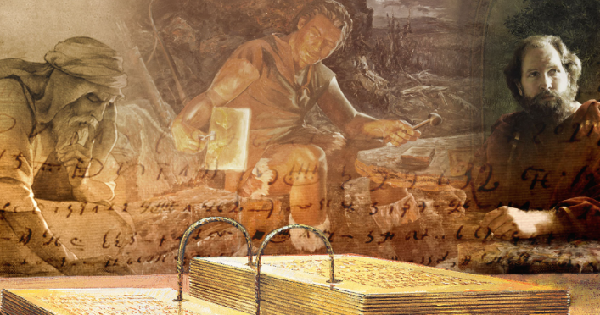
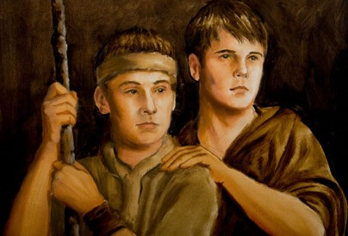
Recording Sacred Truths
Jacob was a noble and righteous man…a man filled with the spirit
The Book of Mormon is a Spiritual Record with the soul purpose to bring men unto Christ; an invitation.
Usually, records were passed from Father to son.
James Fullmer
The Nephite prophets desired above all else that their people “taste of the richness and goodness” and avoid “bitter fruits of disobedience.”
The Lord showed Jacob and Joseph what would happen to the Nephites in the future, and He revealed details about the coming of Christ.
Jacob 1:1-4

Slide 8
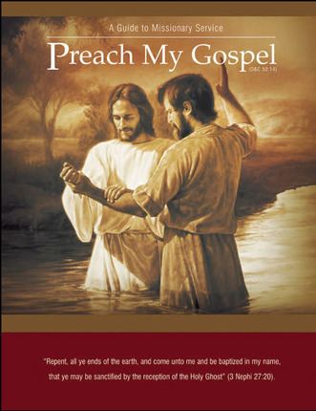
Come Unto Christ
To come unto Christ, a person “must have faith in Him unto repentance—making the necessary changes to bring their life into agreement with His teachings.”
Knowing of Jesus Christ and His kingdom can motivate us to labor diligently to help others come unto Him.
Jacob 1:7-8; (Preach My Gospel: A Guide to Missionary Service [2004], 2).

Slide 9
Partake of the Goodness
…an invitation to receive God’s blessings through obedience to the commandments and ordinances of the gospel.
Priesthood leaders labor diligently to persuade us to come unto Christ and partake of the goodness of God
If we come unto Christ and partake of the goodness of God, then we will enter into God’s rest
Jacob 1:7-8

Slide 10
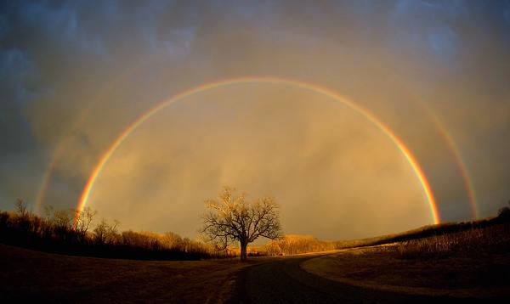
Enter Into His Rest
Enjoying peace in this life and receiving “the fulness of [God’s] glory” in the next life (D&C 84:24)
To Qualify for the “rest” through faith and obedience
“Suffer his cross”—Our willingness to deny ourselves of ungodliness and worldly lusts and to keep the Lord’s commandments (Our willingness to endure and sacrifice as we follow the Savior).
“Bear the shame of the world”—keeping the commandments despite the worldly pressure, humiliation, and opposition that often come to disciples of Jesus Christ.
JST Matthew 16:24; Luke 9:23; 2 Nephi 9:18
Jacob 1:8

Slide 11
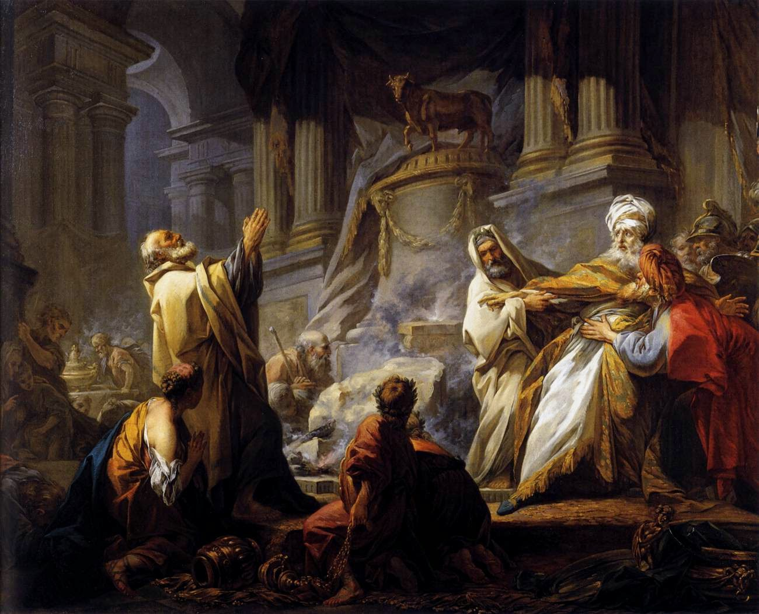
Provocation In The Days of Temptation
In the day of the ancient Israelites who provoked God’s anger by rebelling against Him in the wilderness
Jacob 1:7-8

Slide 12
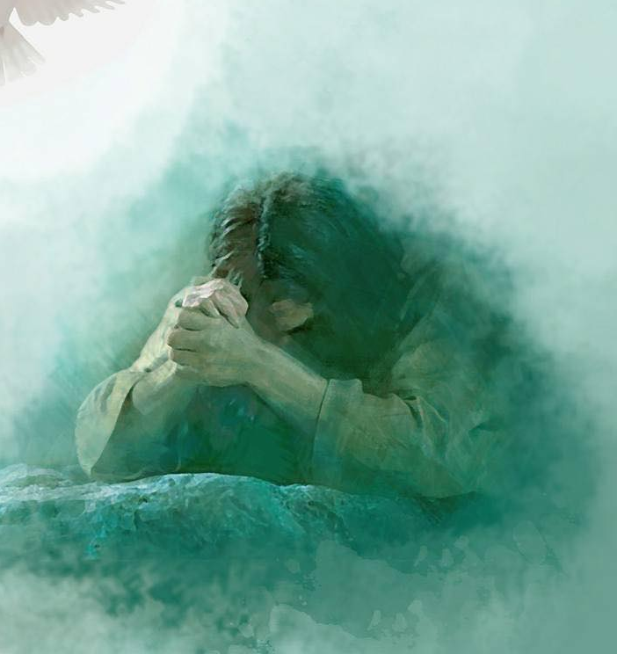
View Christ’s Death
When Jacob wrote that he wanted to persuade people to “believe in Christ, and view his death,” he may have meant that he wanted them to examine the Atonement of Jesus Christ attentively, realize its importance, and gain a personal testimony of it.
Yongsung Kim
Jacob 1:7-8

Slide 13
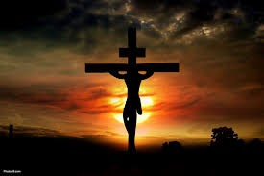
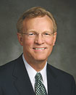
Suffer His Cross
Our willingness to deny ourselves of ungodliness and worldly lusts and to keep the Lord’s commandments
“We may wonder why we Latter-day Saints don’t place a cross on our churches or wear a cross to show that we are Christians, thereby making it easier for others to identify in whom we believe. Is the cross important to our faith?
The answer is an unequivocal yes! The Redeemer’s suffering on the cross is vitally important to us and is an inseparable part of the Atonement, through which He suffered and died for our sins and thereby provided us with a clear path to salvation and exaltation.
The Savior was clear when He stated that in following Him we should take upon ourselves a cross—not the Roman cross that was the instrument of death but our own cross, whereby we present a sacrifice to the Lord of our own heart to be obedient to His commandments.
“And he that taketh not his cross, and followeth after me,” Jesus said, “is not worthy of me” (Matthew 10:38).
“The message of the gospel of Jesus Christ includes what happened on the cross, but this message and meaning is within each of us and requires no external symbol to manifest our faith. Our cross is the giving up of
worldly sins and following the
Savior with a humble heart and
an obedient spirit.”
Gregory A. Schwitzer
Jacob 1:8

Slide 14
Bare The Shame of the World
Keeping the commandments despite the worldly pressure, humiliation, and opposition that often come to disciples of Jesus Christ.
Jacob 1:7-8

Slide 15
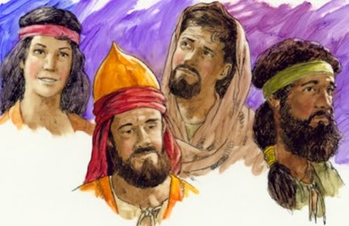
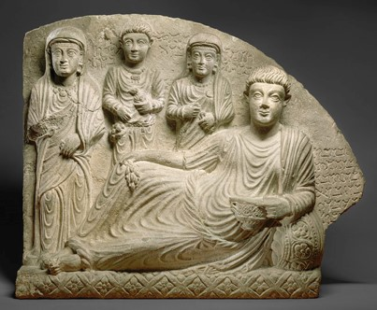
The Nephite Dynasty
To retain Nephi’s name in remembrance they established a Nephite monarchy…Second Nephi Dynasty, third Nephi and so on.
Nephi had been appointed as king by the voice of the people and chose another king to reign in his stead.
This was much like the system used by the Egyptians and the Romans with their Pharaohs and Caesars.
The Nephite Dynasty continued for almost 500 years, in which a system of judges was established. (Mosiah 29)
Jacob 1:9-12; 2 Nephi 5:18; 62

Slide 16
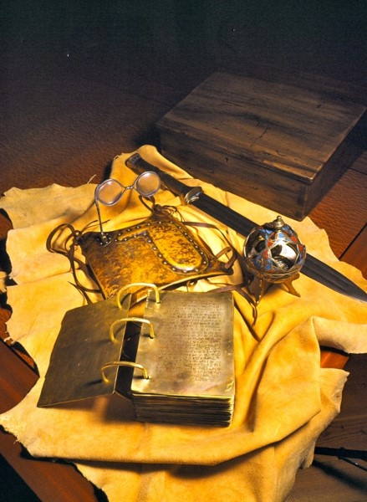
Anointed King and Sword
From ancient times it was the practice and tradition among the people of the Lord, at times when they had a monarchical government, to anoint their kings. The anointing, a symbol of the outpouring of the spirit, was a sacramental charge, one in which the king effectually covenanted to lead his people in righteousness. Prophets, priest, and kings—all of which were anointed—thus became messianic testimonies of the King of kings.
Wielding the sword of “Laban”
The sword was emblematic of the arm of the Lord, a promise that He would strengthen and bless them. It was a reminder that there was a price to be paid, even the shedding of blood, that the world of God might be had and honored.
The Three Witness—were promised they would see the sword of Laban, as well as the gold plates, the breastplate, and the Urim and Thummim
D&C 17:1
Jacob 1:9

Slide 17
All In A Name
Nephites
Lamanites
Lemuelites
Ishmaelites
Jacobites
Josephites
Zoramites
Nephites
Those people who chose to follow the Savior.
Those who believed in the commandments of God and the traditions of their fathers.
Lamanites
Those people who rebelled against righteousness and against the things of God.
Those who seek to destroy the people of Nephi.
Jacob 1:13-14

Slide 18
Warnings
Why do Church leaders warn us against sin?
Jacob recorded that after the death of his brother Nephi, the people began to indulge in certain wicked practices
Immorality
Worldliness
Pride
Jacob 1:15-16

Slide 19
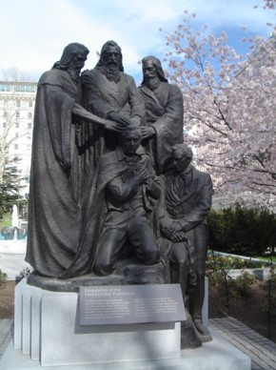
Errand of the Lord
We believe that a man must be called by prophecy, and by laying on of hands by those who are in authority, to preach the Gospel and administer in the ordinances thereof”
Article of Faith 1:5
”Again I say unto you, that it shall not be given to any one to go forth to preach my gospel, or to build up my church, except he be ordained by some one who has authority, and it is known to the church that he has authority and has been regularly ordained by the heads of the church.” (D&C 42:11)
Jacob 1:17-19

Slide 20
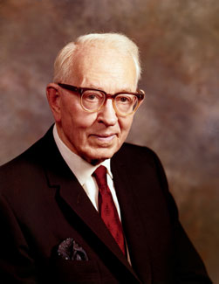
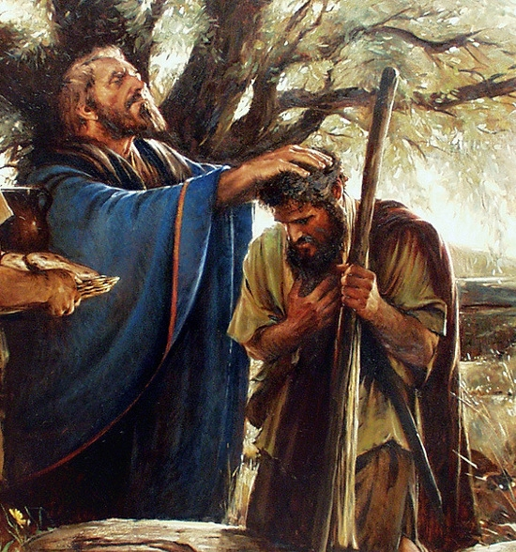
Consecrated Priests and Teachers
“The Nephites officiated by virtue of the Melchizedek Priesthood from the days of Lehi to the days of the appearance of our Savior among them. It is true that Nephi ‘consecrated Jacob and Joseph’ that they should be priests and teachers over the land of the Nephites, but the fact that plural terms priests and teachers were used indicates that this was not a reference to the definite office in the priesthood in either case, but it was a general assignment to teach, direct, and admonish the people.”
Joseph Fielding Smith
Jacob 1:18

Slide 21
“Perhaps you already know (but if you don’t you should) that with rare exception, no man or woman who speaks [in general conference] is assigned a topic.
Each is to fast and pray, study and seek, start and stop and start again until he or she is confident that for this conference, at this time, his or hers is the topic the Lord wishes that speaker to present regardless of personal wishes or private preferences. … Each has wept, worried, and earnestly sought the Lord’s direction to guide his or her thoughts and expression.”
Jeffrey R. Holland
Fast
Pray
Study
Seek
Priesthood leaders have a divinely given responsibility to teach the word of God and warn against sin.

Slide 22
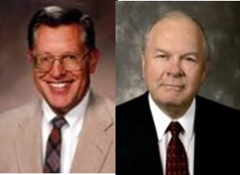
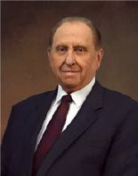
Magnify
“A person’s errand is his or her assignment, his or her calling—the task to be undertaken.
A member of the Church is able to proceed in the magnification of a calling much more powerfully when he or she knows that the call came from God, that the word of prophecy, the spirit of inspiration, was the directing influence in knowing full well that with the assignment will come also the needed strength and direction for accomplishment of labor.”
JFM and RLM
“What does it mean to magnify a calling? It means to build it up in dignity and importance, to make it honorable and commendable in the eyes of all men, to enlarge and strengthen it, to let the light of heaven shine through it to the view of other men.
“And how does one magnify a calling? Simply by performing the service that pertains to it. An elder magnifies the ordained calling of an elder by learning what his duties as an elder are and then by doing them. As with an elder, so with a deacon, a teacher, a priest, a bishop, and each who holds office in the priesthood” Thomas S. Monson

Slide 23
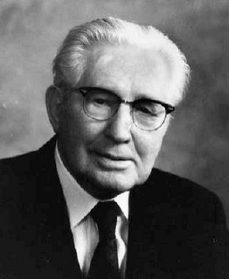
Sins Upon Our Head If We Don’t Teach
“For behold, this is my work and my glory—to bring to pass the immortality and eternal life of man.”
Moses 1:39
Those who have leadership duties in the Church bear a sobering responsibility. Jacob taught that when leaders neglect to teach the word of God to those whom they are called to lead, they become partly responsible for the people’s sins.
“If you do not magnify your callings, God will hold you responsible for those whom you might have saved had you done your duty.” John Taylor
“This is a challenging statement. If I by reason of sins of commission or omission lose what I might have had in the hereafter, I myself must suffer and, doubtless, my loved ones with me. But if I fail in my assignment as a bishop, a stake president, a mission president, or one of the General Authorities
of the Church—if any of us fail to teach, lead, direct, and help to save
those under our direction and within our jurisdiction, then the Lord
will hold us responsible if they are lost as the result of our failure.”
Hugh B. Brown

Slide 24
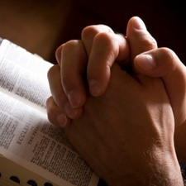
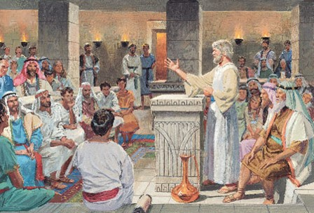
Calling People to Repentance
Jacob’s message is not his message, but a message from God
How does Jacob feel toward calling his people to repentance?
Just like our prophets and general authorities—the messages are from God
Parents all to frequently mourn out their days because of the mistakes of loved one.
There are no heavier burdens in life than those associated with sin. It is not the sinner alone..often the burden of sin rests upon the righteous.
Although Jacob found this responsibility difficult, he carried it out because he cared about the people and because he wanted to obey God’s commands.
Jacob 2:1-3

Slide 25
The Gift of Discernment
All powerful Creator
The gift of discernment, as well as the spirit of prophecy and revelation, is the rightful province of those on the Lord’s errand.
“And Jesus, perceiving the thought of their heart, took a child, and set him by him,”
Luke 9:47
“Now when the king had heard these words, he marveled again, for he beheld that Ammon could discern his thoughts; ”
Alma 18:18
Concerning our thoughts
“He comprehendeth all things, and all things are before him, and all things are round about him; and he is above all things, and in all things, and is through all things, and is round about all things; and all things are by him, and of him, even God, forever and ever.”
D&C 88:41
“Yea, I tell thee, that thou mayest know that there is none else save God that knowest thy thoughts and the intents of thy heart.
D&C 6:16
Jacob 2:5

Slide 26
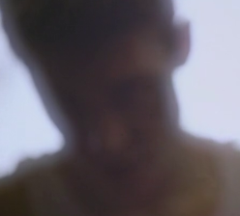
Shrink With Shame
Jacob cannot recommend his people to God. He is ashamed and embarrassed that the deeds of those he has been called to serve are so offensive to their Maker.
Jacob must teach the consequences of sin with boldness
“No doubt many of the mothers and children were already aware of the abominations of their husbands and fathers.
…Many of Jacob’s words would revive many memories, poignant and painful memories, cold and bleak memories know only to those whose confidence and trust have been shattered by the callous infidelity of one with whom sacred covenants had been made.”
JFM and RLM
Jacob 2:6, 7-10

Slide 27
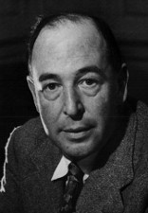
Healeth the Soul
Moroni 10:5—“And by the power of the Holy Ghost ye may know the truth of all things.”
When new information is confusing or bothersome to gospel learners, it is better for them to seek answers from God, who knows all things, than to conduct a general search on the Internet or turn to anti-Mormon material. Going directly to God for answers shows our faith in Him and allows us to receive answers through the Holy Ghost.
We should also turn to the scriptures and the words of latter-day apostles and prophets, which can answer difficult questions and heal wounds.
Will the Lord do for us to help heal our souls?
“[God] has infinite attention to spare for each one of us. He does not have to deal with us in the mass. You are as much alone with Him as if you were the only being He had ever created. When Christ died, He died for you individually just
as much as if you had been the only man
[or woman] in the world.”
C.S. Lewis
James 1:5–6—“If any of you lack wisdom, let him ask God, … and it shall be given him. But let him ask in faith.”
Jacob 2:6, 7-10

Slide 28
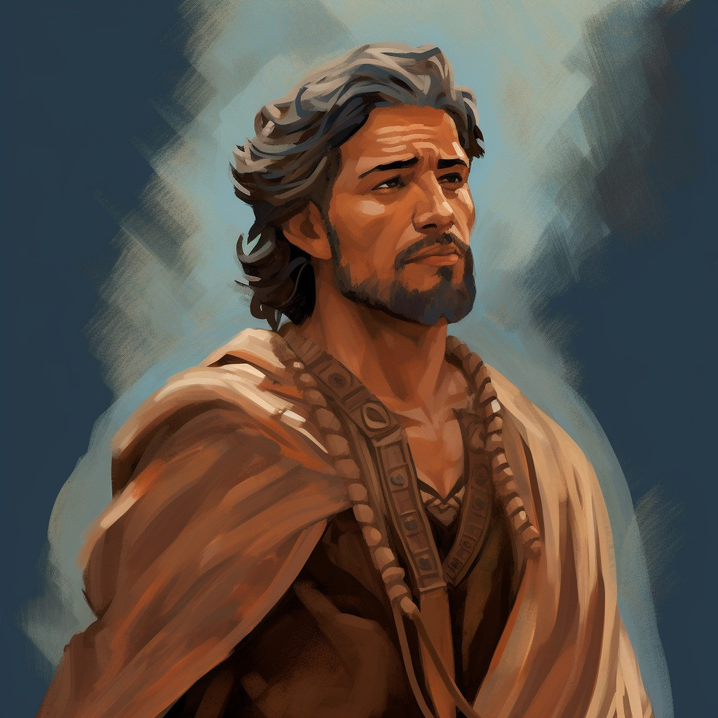
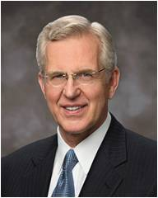
Boldly—Strict Commands
Jacob
“But, notwithstanding the greatness of the task, I must do according to the strict commands of God, and tell you concerning your wickedness and abominations, in the presence of the pure in heart, and the broken heart, and under the glance of the piercing eye of the Almighty God.”
Dieter F. Uchtodorf
“And, to be perfectly frank, there have been times when members or leaders in the Church have simply made mistakes. There may have been things said or done that were not in harmony with our values, principles, or doctrine.
I suppose the Church would be perfect only if it were run by perfect beings. God is perfect, and His doctrine is pure. But He works through us—His imperfect children—and imperfect people make mistakes.”
Henry B. Eyring
D. Todd Christofferson
“My plea to women and girls today is to protect and cultivate the moral force that is within you. Preserve that innate virtue and the unique gifts you bring with you into the world. Your intuition is to do good and to be good, and as you follow the Holy Spirit, your moral authority and influence will grow. To the young women I say, don’t lose that moral force even before you have it in full measure. Take particular care that your language is clean, not coarse; that your dress reflects modesty, not vanity; and that your conduct manifests purity, not promiscuity. You cannot lift others to virtue on the one hand if you are entertaining vice on the other.”
“You young men cannot know what acts of priesthood service the Lord is preparing you to give. But the greater challenge for every priesthood holder is to give spiritual help. All of us have that charge. It comes with being a member of a quorum. It comes with being a member of a family. If the faith of anyone in your quorum or your family is attacked by Satan, you will feel compassion. Much like the service and mercy given by the Samaritan, you will also minister to them with healing balm for their wounds in their time of need.”
Jacob 2:10

Slide 29
What About Today?
?
?
What have Church leaders of today taught you?
How can you apply these teachings in your life?
How can you apply what you have learned in your callings such as priesthood quorums or class presidencies?
Jacob 2:10

Slide 30
Sources:
Joseph Fielding McConkie and Robert L. Millet Doctrinal Commentary on the Book of Mormon vol. 2 pg. 2-13
Elder Gregory A. Schwitzer The Meaning of the Cross for Latter-day Saints July Ensign 2011
Jeffrey R. Holland (“An Ensign to the Nations,” Ensign or Liahona, May 2011, 111).
Joseph Fielding Smith (Answers to Gospel Questions, comp. Joseph Fielding Smith Jr., 5 vols. [1957–66]
Thomas S. Monson (“The Sacred Call of Service,” Ensign or Liahona, May 2005, 54).
John Taylor (Teachings of Presidents of the Church: John Taylor [2001], 164).
Hugh B. Brown (in Conference Report, Oct. 1962, 84).
C.S. Lewis (Mere Christianity [1943], 131).
Dieter F. Uchtodorf Come, Join with Us Oct. 2013 Conference
D. Todd Christofferson The Moral Force of Women Oct. 2013 Conference
Henry B. Eyring Bind Up Their Wounds Oct. 2013 Conference
Presentation by ©http://fashionsbylynda.com/blog/

Slide 31
Two Prevalent Sins
Jacob 2:12-35

Slide 32
Comes from Heavenly Father
Money
Friends
Blessings
Intelligence
Gospel Knowledge
Talents

Slide 33
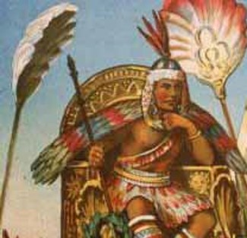
Wealth = Pride
Whenever any group chose to keep the commandments of God, he blessed and prospered them. ..Most of the people in the Book of Mormon (Nephite and Jaredites alike) lost sight of the source of their blessings. Wealth became the end in life rather than a means to accomplishment of good…
…Things became more important than people, then it was only a matter of time before class distinctions, caste systems, and the persecution of the poor followed.
JFM and RLM
Jacob 2:12-13

Slide 34
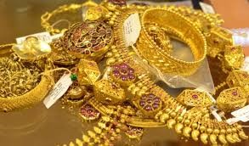
Gold Diggers
Many of the blessed people started to seek riches that were in abundance on the land:
Gold, silver, precious ores
Providence = God
“Pride is a sin that can readily be seen in others but is rarely admitted in ourselves.” Ezra Taft Benson
Pride began to be their occupation.
Things became more important than service to fellow men.
Selfishness overcame their characters
“At its core, pride is a sin of comparison, for though it usually begins with ‘Look how wonderful I am and what great things I have done,’ it always seems to end with ‘Therefore, I am better than you.’ …
“… This is the sin of ‘Thank God I am more special than you.’ At its core is the desire to be admired or envied. It is the sin of self-glorification.” Dieter F. Uchtdorf
Pride Can Destroy Our Souls
Jacob 2:12-13

Slide 35
Power to Destroy Souls
Satan seeks to destroy the righteous by using things of this world. Things that are obtainable.
“Keeping up with the Joneses”
This is an idiom in many parts of the English-speaking world referring to the comparison to one's neighbor as a benchmark for social caste or the accumulation of material goods. To fail to "keep up with the Joneses" is perceived as demonstrating socio-economic or cultural inferiority. Wikipedia
It is a phrase of one who has to have what his neighbor has and more…then more…then more.
Jacob 2:14-16

Slide 36
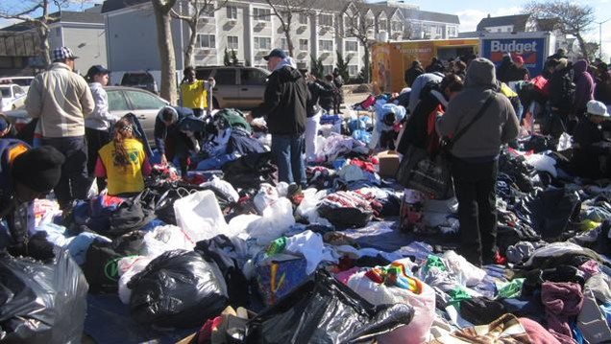
Material Wealth
What are some inappropriate attitudes toward wealth?
What are some appropriate attitudes toward Wealth?
”And after ye have obtained a hope in Christ ye shall obtain riches, if ye seek them; and ye will seek them for the intent to do good—to clothe the naked, and to feed the hungry, and to liberate the captive, and administer relief to the sick and the afflicted.”
To Do = Action
Jacob 2:19

Slide 37
Think of Others
Jacob exhorts them to think of others rather than themselves. Look upon their brethren equally as themselves
“Think of your brethren like unto yourselves, and be familiar with all and free with your substance, that they may be rich like unto you.
But before ye seek for riches, seek ye for the kingdom of God.”
Seek for the riches of God…not the world
Jacob 2:17-18

Slide 38
The Parable of the Foolish Rich Man
Luke 12:16-21

Slide 39
What shall I do, because I have no room where to bestow my fruits?

Slide 40
I will pull down my barns, and build greater; and there will I bestow all my fruits and my goods

Slide 41
Soul, thou hast much goods laid up for many years; take thine ease, eat, drink, and be merry

Slide 42
“My power and the might of mine hand hath gotten me this wealth. But thou shalt remember the Lord thy God; for it is he that giveth thee power to get wealth”
(Deuteronomy 8:17-18)
“Seek Not after riches nor the vain things of this world; for behold, you cannot carry them with you”
(Alma 39:14)
As in the movie Spaceballs:
“Take only what you need to survive”

Slide 43
Other Violations
Jacob rebukes people who have violated the law of chastity
“The plaguing sin of this generation is sexual immorality. This, the Prophet Joseph said, would be the source of more temptations, more buffetings, and more difficulties for the elders of Israel than any other.”
Ezra Taft Benson
Jacob 2:19

Slide 44
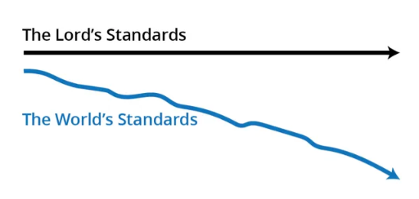
How would you describe what this diagram shows about the Lord’s standards and the world’s standards?
In what ways do you see the world’s standards moving away from the Lord’s standards?
“It takes faith to live a chaste life when the world shouts that God’s law of chastity is now outmoded.”
Russell M. Nelson

Slide 45
Chastity
The Lord’s law of chastity is clear and unchanging. “Chastity is sexual purity”.
Those who are chaste are morally clean in their thoughts, words, and actions.
Chastity means not having any sexual relations before marriage.
It also means complete fidelity between husband and wife during marriage”
For I, the Lord God, delight in the chastity of women. And whoredoms are an abomination before me; thus saith the Lord of Hosts.
Jacob 2:22-28

Slide 46
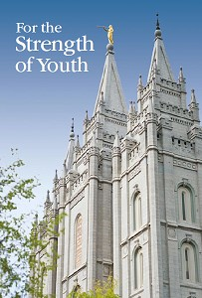
Avoidance of Grosser Crimes
Whoredoms = Sexual Sins
“The Lord’s standard regarding sexual purity is clear and unchanging. Do not have any sexual relations before marriage and be completely faithful to your spouse after marriage. …
“Never do anything that could lead to sexual transgression. Treat others with respect, not as objects used to satisfy lustful and selfish desires. Before marriage, do not participate in passionate kissing, lie on top of another person, or touch the private, sacred parts of another person’s body, with or without clothing. Do not do anything else that arouses sexual feelings. Do not arouse those emotions in your own body.”
Jacob 2:22-28
(For the Strength of Youth [booklet, 2011], 35–36).

Slide 47
Excuses
How do people sometimes seek to excuse sexual immorality today?
“It is a free country, and I can do what I like, when I like with my body”
“We need to see if we are sexually compatible with each other”
“I can repent of it later and be okay”
“Everyone else is doing it”
“We love each other”
Jacob 2:23-24

Slide 48
Avoiding Temptations
What are some things you can do to avoid being overcome by sexual temptations?
Praying for strength
Associating with good friends
Choosing wholesome entertainment
Avoiding situations and places where temptation is likely
“Nothing good comes from staying up past 12:00 at night while dating”
Jacob 2:23-24

Slide 49
One Man One Wife
One of the sins of the Nephite’s appears to have been the unauthorized practice of plural marriage
Concubine = a woman who was legally married to a man but who had a lower status than a wife
The Lord has commanded that a man should be married to one wife
“And again, verily I say unto you, that whoso forbiddeth to marry is not ordained of God, for marriage is ordained of God unto man.
Wherefore, it is lawful that he should have one wife, and they twain shall be one flesh, and all this that the earth might answer the end of its creation;
D&C 49:15-16
Jacob 2:27-30

Slide 50
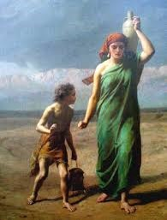
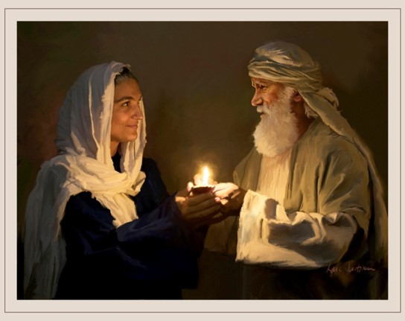
Many Wives
When are the Lord’s people authorized to practice plural marriage?
When the Lord commands it.
Certain times in the history of the world, the Lord has commanded His people to practice plural marriage.
For example, plural marriage was practiced in Old Testament times by Abraham and Sarah (see Genesis 16:1–3; D&C 132:34–35, 37)
and by their grandson Jacob (see D&C 132:37),
and it was practiced for a time during the early days of
the restored Church, beginning with Joseph Smith
(see D&C 132:32–33, 53).
Jacob 2:30

Slide 51
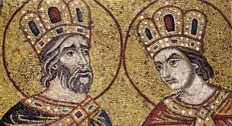
Plural Marriage
In Jacob’s day, some Nephites had begun to participate in plural marriage, saying that they were following the examples of David and Solomon. Jacob condemned this practice for at least two reasons:
The Lord, through the prophet Lehi, had commanded this people not to participate in plural marriage
2. David and Solomon were not worthy examples. Although they had married some plural wives in compliance with the Lord’s commandments in their day, they had also committed serious sexual sins (see Jacob 2:24; D&C 132:38–39).
Jacob 2:24-27

Slide 52
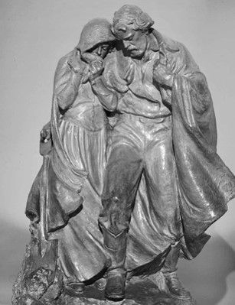
A Short Period of Time
“If I will … raise up seed unto me, I will command my people; otherwise they shall hearken unto these things”
In other words, the Lord’s general command is to not participate in plural marriage. However, He may command His people to participate in plural marriage for a time when He deems it necessary to “raise up seed” unto Him—in other words, when He wants His people to, in a short period of time, bring more children into the world who will be born in the covenant and raised in gospel-centered homes.
In obedience to direction from God through a revelation to the Prophet Joseph Smith, some Latter-day Saints followed this practice for years during the 1800s (see D&C 132). In 1890, when conditions had changed in the Church and in the laws of the United States, the Lord withdrew His approval of the practice in a revelation to President Wilford Woodruff, who was then serving as President of the Church (see D&C, Official Declaration 1).

Slide 53
Practice—Not Approved
Since that time, plural marriage has not been approved by the Lord or authorized by The Church of Jesus Christ of Latter-day Saints. Any Latter-day Saint who adopts this practice is subject to losing his or her membership in the Church. President Gordon B. Hinckley taught:
“I wish to state categorically that this Church has nothing whatever to do with those practicing polygamy. They are not members of this Church. Most of them have never been members. They are in violation of the civil law. They know they are in violation of the law. They are subject to its penalties. …
“If any of our members are found to be practicing plural marriage, they are excommunicated, the most serious penalty the Church can impose. Not only are those so involved in direct violation of the civil law, they are in violation of the law of this Church. An article of our faith is binding upon us. It states, ‘We believe in being subject to kings, presidents, rulers, and
magistrates, in obeying, honoring, and sustaining the law’
(A of F 1:12). …

Slide 54
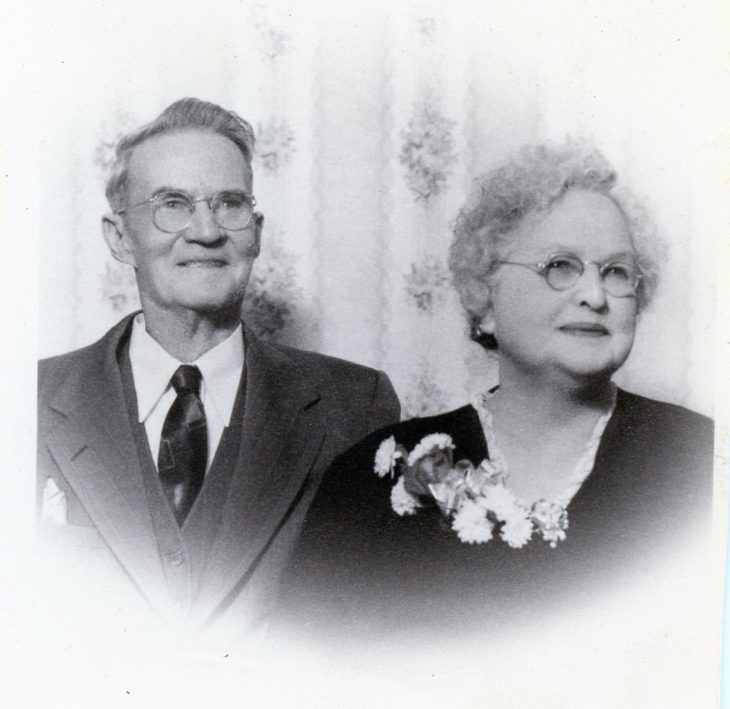
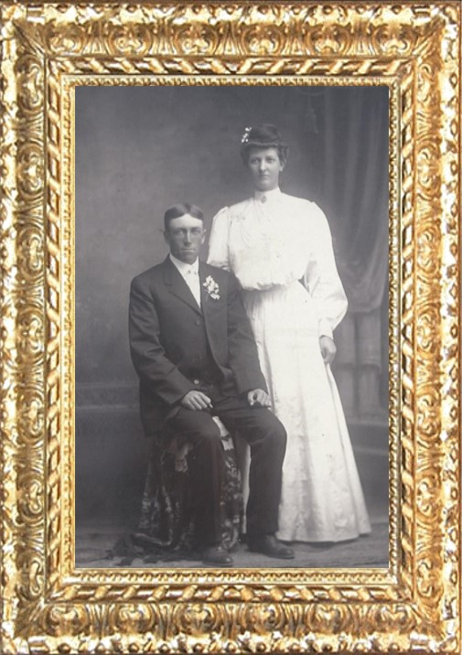
Discontinued…
“More than a century ago God clearly revealed unto His prophet Wilford Woodruff that the practice of plural marriage should be discontinued, which means that it is now against the law of God. Even in countries where civil or religious law allows polygamy, the Church teaches that marriage must be monogamous and does not accept into its membership those practicing plural marriage.”
Gordon B. Hinckley
Unless the Lord commands otherwise, He has ordained that marriage is to be between one man and one woman.

Slide 55
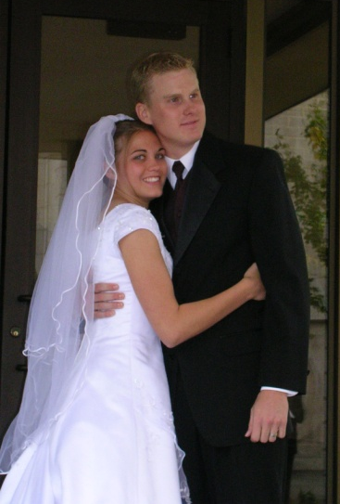
Families Affected by Immorality
Sexual immorality has a destructive influence on families:
“the Lord, have seen the sorrow, and heard the mourning of the daughters …because of the wickedness… of their husbands.”
“The cries of the fair daughters of this people.”
What are the Consequences of immorality for women and men?
Some (young) people rationalize that they can break the law of chastity because their actions do not hurt anyone else.
“Nothing shatters hope and destroys feelings of warmth and self-worth in members of a family like sexual infidelity on the part of a mother or father.”
JFM and RLM
The gift of procreation: An authorized matrimony union of a man and a woman.
Jacob 2:31-35

Slide 56
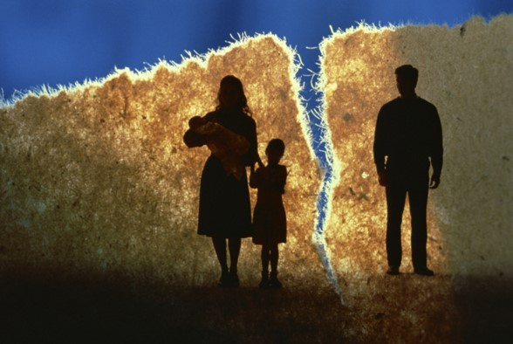
Consequences of Immorality in Marriage
“Clearly, unchastity and infidelity bring serious consequences such as the rippling, even haunting, effects of illegitimacy and fatherlessness, along with disease and the shredding of families.
So many marriages hang by a thread or have already snapped.
This quiet but deep crisis coexists with vexing international crises in our time, including war. Jesus spoke of latter days when there would be “distress of nations, with perplexity” and how all things would be in commotion.”
Elder Neal A. Maxwell
Luke 21:25; see also D&C 88:91; D&C 45:26).”

Slide 57
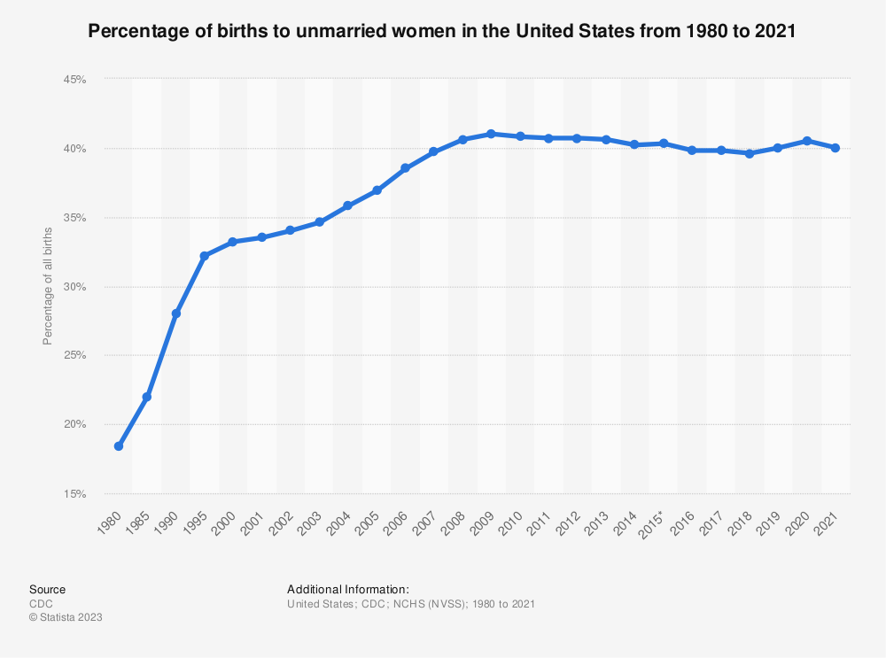
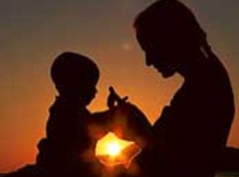
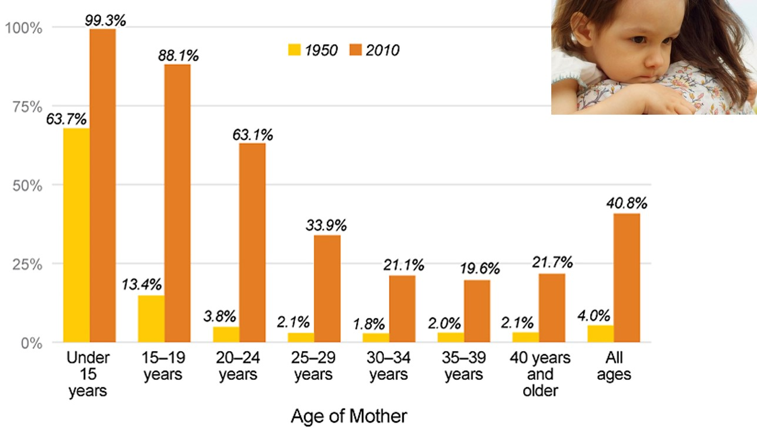
Unwed Mothers
Today, nearly nine in 10 children born to teenage mothers are born outside of marriage - a more than six-fold increase since 1950. The increase among mothers in their early twenties was especially pronounced: a 16-fold jump. The increase among unwed mothers’ age 30 and older is at least 10-fold.
Unwed Mother’s Chart

Slide 58
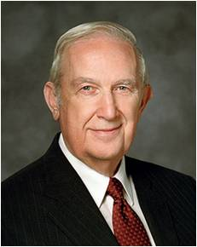
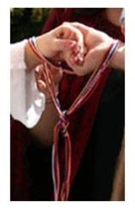
Making the Right Choices
“Those intimate acts (sexual immorality) are forbidden by the Lord outside the enduring commitment of marriage because they undermine His purposes. Within the sacred covenant of marriage, such relationships are according to His plan. When experienced any other way, they are against His will. They cause serious emotional and spiritual harm. Even though participants do not realize that is happening now, they will later. Sexual immorality creates a barrier to the influence of the Holy Spirit with all its uplifting, enlightening, and empowering capabilities. It causes powerful physical and emotional stimulation. In time that creates an unquenchable appetite that drives the offender to ever more serious sin.”
Richard G. Scott

Slide 59
Blessings From Living the Law of Chastity
Physical intimacy between husband and wife is beautiful and sacred. It is ordained of God for the creation of children and for the expression of love between husband
and wife. God has commanded that sexual intimacy be reserved for marriage.
When you are sexually pure, you prepare yourself to make and
keep sacred covenants in the temple. You prepare yourself to
build a strong marriage and to bring children into the world as
part of an eternal and loving family. You protect yourself from
the spiritual and emotional damage that come from sharing
sexual intimacy outside of marriage. You also protect yourself
from harmful diseases. Remaining sexually pure helps you to be
confident and truly happy and improves your ability to make
good decisions now and in the future.
For the Strength of Youth Pamphlet

Slide 60
Sources:
Joseph Fielding McConkie and Robert L. Millet Doctrinal Commentary on the Book of Mormon Vol. 2 pg. 13
Dieter F. Uchtdorf Pride and the Priesthood Ensign or Liahona, Nov. 2010, 56
Wikipedia http://en.wikipedia.org/wiki/Keeping_up_with_the_Joneses
Ezra Taft Benson(The Teachings of Ezra Taft Benson [1988], 277). Pride: Teachings of Presidents of the Church: Ezra Taft Benson [2014], 235
Chastity in an Unchaste World see Oct. 2012 for more information on Chastity— in the eyes of the youth.
Gordon B. Hinckley What Are People Asking about Us? Ensign, Nov. 1998, 71–72
Unwed Mother’s chart http://www.familyfacts.org/charts/207/unwed-childbearing-has-increased-dramatically-regardless-of-mothers-age
Neil A. Maxwell The Seventh Commandment: A Shield Jan. 2002 Liahona
Richard G. Scott Making the Right Choices Ensign, Nov. 1994, 38
For the Strength of Youth Pamphlet Pg 35
Russell M. Nelson, “Christ Is Risen; Faith in Him Will Move Mountains,” Liahona, May 2021, 104
Presentation by ©http://fashionsbylynda.com/blog/

Slide 61
Free With Your Substance Jacob 2:17:
“How much should we pay in fast offerings? My brothers and sisters, the measure of our offering to bless the poor is a measure of our gratitude to our Heavenly Father. Will we, who have been blessed so abundantly, turn our backs on those who need our help? Paying a generous fast offering is a measure of our willingness to consecrate ourselves to relieve the suffering of others.
“Brother Marion G. Romney, who was the bishop of our ward when I was called on a mission and who later served as a member of the First Presidency of the Church, admonished: ‘Be liberal in your giving, that you yourselves may grow. Don’t give just for the benefit of the poor, but give for your own welfare. Give enough so that you can give yourself into the kingdom of God through consecrating of your means and your time’ [“The Blessings of the Fast,” Ensign, July 1982, 4]” (Joseph B. Wirthlin, “The Law of the Fast,” Ensign, May 2001, 75).
Jacob 2:25-28
The power of procreation is spiritually significant. Misuse of this power subverts the purposes of the Father’s plan and of our mortal existence. Our Heavenly Father and His Beloved Son are creators and have entrusted each of us with a portion of Their creative power. Specific guidelines for the proper use of the ability to create life are vital elements in the Father’s plan. How we feel about and use that supernal power will determine in large measure our happiness in mortality and our destiny in eternity. …
The Church of Jesus Christ of Latter-day Saints has a single, undeviating standard of sexual morality: intimate relations are proper only between a man and a woman in the marriage relationship prescribed in God’s plan. Such relations are not merely a curiosity to be explored, an appetite to be satisfied, or a type of recreation or entertainment to be pursued selfishly. They are not a conquest to be achieved or simply an act to be performed. Rather, they are in mortality one of the ultimate expressions of our divine nature and potential and a way of strengthening emotional and spiritual bonds between husband and wife. We are agents blessed with moral agency and are defined by our divine heritage as children of God—and not by sexual behaviors, contemporary attitudes, or secular philosophies. (David A. Bednar, “We Believe in Being Chaste,” Ensign or Liahona, May 2013, 41–42)
“Chastity is sexual purity, a condition that is ‘pleasing unto God’ (Jacob 2:7). To be chaste, you must be morally clean in your thoughts, words, and actions. You must not have any sexual relations before you are legally married. When you are married, you must be completely faithful to your husband or wife.
“Physical intimacy between husband and wife is beautiful and sacred. It is ordained of God for the creation of children and for the expression of love within marriage” (True to the Faith: A Gospel Reference [2004], 29).
Is Sexual Sin Forgiven?
To you is extended the peace and renewal of repentance available through the atoning sacrifice of the Lord Jesus Christ. In such serious matters the path of repentance is not easily begun nor painlessly traveled. But the Savior of the world will walk that essential journey with you. He will strengthen you when you waver. He will be your light when it seems most dark. He will take your hand and be your hope when hope seems all you have left. His compassion and mercy, with all their cleansing and healing power, are freely given to all who truly wish complete forgiveness and will take the steps that lead to it. (Jeffrey R. Holland, “Personal Purity,” Ensign or Liahona, Nov. 1998, 78)
“Never do anything that could lead to sexual transgression. Treat others with respect, not as objects used to satisfy lustful and selfish desires. Before marriage, do not participate in passionate kissing, lie on top of another person, or touch the private, sacred parts of another person’s body, with or without clothing. Do not do anything else that arouses sexual feelings. Do not arouse those emotions in your own body. …
“Avoid situations that invite increased temptation. … Do not participate in discussions or any media that arouse sexual feelings. Do not participate in any type of pornography. The Spirit can help you know when you are at risk and give you the strength to remove yourself from the situation” (For the Strength of Youth [booklet, 2011], 36).
Overcoming Pornography sites:
Dallin H. Oaks, “Recovering from the Trap of Pornography,” Ensign or Liahona, October 2015, 32–38
AddressingPornography.ChurchofJesusChrist.org

Slide 62
Comfort and Promises
Jacob 3-4

Slide 63
Advice
What Advice would you give?
1. A young woman is striving to live righteously but suffers because her father is addicted to alcohol.
2. A young man does his best to live the gospel but experiences trials because of his parents’ divorce.
3. A young woman diligently tries to love her family but struggles at home because of her sister’s selfishness and inconsiderate actions.
“But behold, I, Jacob, would speak unto you that are pure in heart. Look unto God with firmness of mind, and pray unto him with exceeding faith, and he will console you in your afflictions, and he will plead your cause, and send down justice upon those who seek your destruction.
O all ye that are pure in heart, lift up your heads and receive the pleasing word of God, and feast upon his love; for ye may, if your minds are firm, forever.”
Jacob 3:1-2

Slide 64
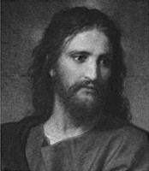
Pure in Heart
Look unto God with firmness of mind
Pray unto him with exceeding faith
Lift up your heads and receive the pleasing word of God
Feast upon His love.
Eyes single to the glory of God, walking in the light through the mists of darkness. A constant determination—steadfast in Christ
The assuredly that your prayers will be answered
Those who daily live worthy of the peace of the spirit shall eventually gain the ultimate peace
Partake freely of the powers of the Savior’s atonement and the blessings of His gospel
Jacob 3:1-2

Slide 65
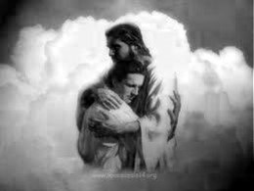
Console
God will console the pure in heart in their afflictions.
Comfort someone who is sad or troubled
How has the Lord consoled you?
How has praying with faith helped you during a time of trial?
When has God’s word helped you feel His love?
“Behold, I say unto you, go forth as I have commanded you; repent of all your sins; ask and ye shall receive; knock and it shall be opened unto you.
Behold, I will go before you and be your rearward [your guard from behind]; and I will be in your midst, and you shall not be confounded.”
D&C 49:26-27
If we look unto God with firmness of mind and pray with exceeding faith, He will console us in our afflictions
Jacob 3:1-2

Slide 66
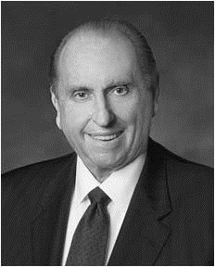
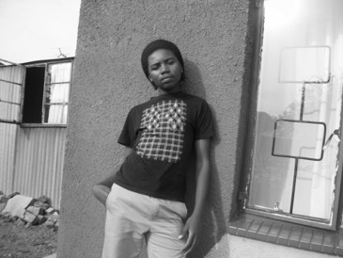
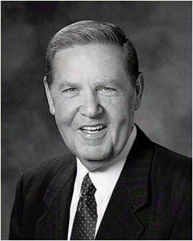
Challenges
“We live at a time in the world’s history when there are many difficult challenges but also great opportunities and reasons for rejoicing. There are, of course, those times when we experience disappointments, heartaches, and even tragedies in our lives. However, if we will put our trust in the Lord, He will help us through our difficulties, whatever they may be. The Psalmist provided this assurance: “Weeping may endure for a night, but joy cometh in the morning.” Psalms 30:5
^{Thomas S. Monson}
How do we overcome challenges and trials?
1. “Live as faithfully as we possibly can. … We must not be paralyzed just because [of events] ahead of us somewhere.”
2. “Never let fear and the father of fear (Satan himself) divert us from our faith and faithful living.”
3. “Be faithful. God is in charge. He knows your name and He knows your need.”
Jeffrey R. Holland

Slide 67
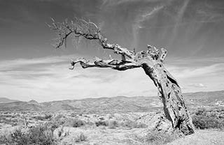
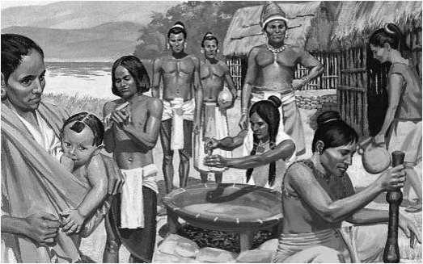
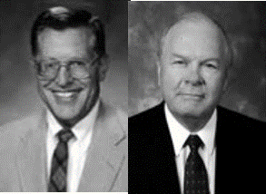
The Unrepentant
Those who are not repentant:
Land will be cursed
Sore cursing and even destruction
Those unrighteous will possess your lands and all righteousness will ‘lead away’ from among you.
Lamanites more righteous?
“The Lamanites, despite their dark and lowly existence in the days of Jacob, still are faithful to their wives and children, and, in this sense, are more righteous than many of the Nephites who—professing membership in the church--revel in immorality and unauthorized plural marriages.” JFM and RLM
Jacob 3:3-5

Slide 68
Withdrawn
The protective hand of the Lord is withdrawn from any people who revel in whoredoms.
Promises to the Lamanites:
“For there are many promises which are extended to the Lamanites; for it is because of the traditions of their fathers that caused them to remain in their state of ignorance; therefore the Lord will be merciful unto them and prolong their existence in the land.
And at some period of time they will be brought to believe in his word, and to know of the incorrectness of the traditions of their fathers; and many of them will be saved, for the Lord will be merciful unto all who call on his name.”
Alma 9:16-17
Jacob 3:6

Slide 69
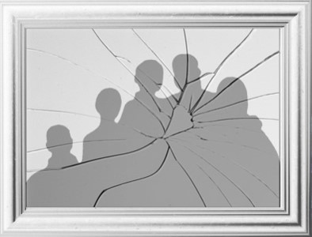
Behaviors Inherited
Husbands and wives are to love one another, and parents are to love their children
What are some consequences that can result when family members fail to love one another and do not fulfill their family responsibilities?
Behavioral patterns and attitudes frequently continue from generation to generation. Posterity is often beholden to ancestry for their views of god, man, and the purposes of life.
“And again, inasmuch as parents have children in Zion, or in any of her stakes which are organized, that teach them not to understand the doctrine of repentance, faith in Christ the Son of the living God, and of baptism and the gift of the Holy Ghost by the laying on of the hands, when eight years old, the sin be upon the heads of the parents.”
D&C 68:25
Jacob 3:7

Slide 70
Revile
Why did some of the Nephites revile against the Lamanites?
Because of the Lamanites’ filthiness and the darkness of the Lamanites’ skin.
Also, filthiness of sin.
Rather than criticizing others for their sins, we are to recognize and repent of our own sins
“God loves all of His children and makes salvation available to all. God created the many diverse races and ethnicities and esteems them all equally. As the Book of Mormon puts it, ‘all are alike unto God.”
Jacob 3:9; 2 Nephi 26:33; (“Race and the Priesthood,” Gospel Topics, topics.lds.org).

Slide 71
Nephite’s Punishments
“O my brethren, I fear that unless ye shall repent of your sins that their skins will be whiter than yours, when ye shall be brought with them before the throne of God.”
Revile against—To despise, to regard as vile, or to physically or verbally abuse, all of which are alien to the Spirit of God.
“And thou shalt do it with all humility, trusting in me, reviling not against revilers.”
D&C 19:30
Bring your children unto destruction:
Taking away the light through disobedience
”The glory of God is intelligence, or, in other words, light and truth. Light and truth forsake that evil one.
And that wicked one cometh and taketh away light and truth, through disobedience, from the children of men, and because of the tradition of their fathers.” D&C 93:36-37, 39
Is it important to set good examples for your family members?
Jacob 3:8-10

Slide 72
Hearken—Jacob’s Warning
“arouse the faculties of your souls” -- the need to wake up spiritually.
“shake yourselves”
“Awake from slumber”
“loose yourselves from the pains of hell”
“Do not become angels to the devil”—the second death
“fornication and lasciviousness” -- sexual sins.
The best way to receive the promises of Heavenly Father is to always be pure in heart
Those who have committed sexual sins can seek help from their bishop or branch president, who will help them repent, become clean through the Atonement of Jesus Christ, and receive the blessing promised to the pure in heart.
Jacob 3:11-12

Slide 73
A Hundredth Part
Knowing that only a small portion of the doings and teachings of the Nephites is found in our present Book of Mormon.
“Wherefore, I chose these things, to finish my record upon them, which remainder of my record I shall take from the plates of Nephi; and I cannot write the hundredth part of the things of my people.”
Words of Mormon 1:5
“These plates are called the plates of Jacob, and they were made by the hand of Nephi. And I make an end of speaking these words.”
It would appear that the plates were named after their keepers. See 1 Nephi 9:2; Omni 1:4
JFM and RLM
Jacob 3:13-14

Slide 74
Difficulty of Writing
“Writing upon metal plates was a burden which proved to be a blessing. No doubt many of the writers were, like Jacob, prevented from expounding at length upon various matters.”
The record keepers would have chosen their words carefully for their audience. They knew that the things they would write must be kept from corrosion, the perils of handling and repeated use so it could be available for future generations.”
Scripture requires the spirit of revelation to properly expound and expand the meaning intended by its authors.”
Jacob 4:1-2
JFM and RLM

Slide 75
Precious and Lost Truths
“Surely the most plain and precious of all truths lost from the Bible, particularly the Old Testament, are the clear and unequivocal declarations of the mission of Jesus Christ, his foreordained role as Messiah and Savior of the world, and the covenantal elements of his gospel, which have been taught from Adam down through each succeeding dispensation.
Thus the Book of Mormon’s highest purpose is to restore to the universal family of God that crucial knowledge of Christ’s role in the salvation of every man, woman, and child who now lives, has ever lived, or will yet live upon the earth.” Jeffrey R. Holland
Jacob 4:4

Slide 76
Staying Focused
Knowing of Christ—Worshipping the Father in His name (Moses 5:8)—
Emulate--His example and seek to pattern our lives after His. (D&C 18:40)
Hope in His glory and all holy prophets before us (Numbers 11:29)
Keeping the law of Moses (Alma 34:14)
Remembering the sacrifice of Isaac, a similitude of Christ’s Atonement
Receiving revelations and the spirit of prophecy. Obtaining hope and faith (Moroni 7:41)
Are You Able To Stay Focused?
Jacob 4:4-6

Slide 77
Strengthening Your Muscles
How is the process of strengthening your muscles similar to the process of strengthening your faith in Jesus Christ?
Both require consistent effort on our part
Both require consistent effort on our part

Slide 78
We can strengthen our faith in Jesus Christ by choosing to believe in Him and by worshipping the Father in His name
We can strengthen our faith in Jesus Christ by choosing to search the words of the prophets
We can strengthen our faith in Jesus Christ by choosing to take counsel from His hand
We can strengthen our faith in Jesus Christ by choosing to be reconciled to God through the Atonement of Christ
Jacob 4:5

Slide 79
Weaknesses
“Nevertheless, the Lord God showeth us our weakness that we may know that it is by his grace, and his great condescensions unto the children of men, that we have power to do these things.”
Weaknesses: the Lord often provides reminders to his servants of the ever-present need to rely upon him.
(Ether 12:27)
That they may humble themselves before me…
Will make weak things strong.
Jacob 4:7

Slide 80
God’s Nature VS Man’s Nature
“…And no man knoweth of his ways save it be revealed unto him; wherefore, brethren, despise not the revelations of God.”
The Mysteries
God is infinite and man is finite.
God is immortal and man is mortal
God is all powerful and man is impotent in contrast with omnipotence.
God is limitless and knows all things while man is still growing, still floundering, still grappling with his own survival.
Jacob 4:8

Slide 81
Seek Not…
“Wherefore, brethren, seek not to counsel the Lord, but to take counsel from his hand. For behold, ye yourselves know that he counseleth in wisdom, and in justice, and in great mercy, over all his works.”
When we follow our own whims, we fail to take the counsel of our own prophets
“Remember, remember that it is not the work of God that is frustrated, but the work of men;
For although a man may have many revelations, and have power to do many mighty works, yet if he boasts in his own strength, and sets at naught the counsels of God, and follows after the dictates of his own will and carnal desires, he must fall and incur the vengeance of a just God upon him.”
D&C 3:3-4
Jacob 4:10

Slide 82
“I do not think that many members of the Church consciously [follow] the persuasions of men or their own counsel instead of heeding the Lord’s.
However, when we do not keep ourselves advised as to what the counsel of the Lord is, we are prone to substitute our own counsel for His.
As a matter of fact, there is nothing else we can do but follow our own counsel when we do not know the Lord’s instructions.”
Jacob 4:10
Marion G. Romney

Slide 83
Reconcile
Bring into harmony.
How does the Atonement help us come into harmony with our Heavenly Father?
Jacob reminded us of the importance of teaching about the Atonement, by asking,
“Why not speak of the atonement of Christ … ?”
Following this principle—
Sharing our Testimonies—with the Spirit
The Holy Ghost is the “Spirit of Truth”
D&C 93:24-26
Jacob 4:11-13

Slide 84
Beyond the Mark
I invite us to identify the time-wasting distractions in our lives that may need to be figuratively ground into dust. We will need to be wise in our judgment to ensure that the scales of time are correctly
balanced to include the Lord, family, work, and wholesome
recreational activities.
Ian S. Ardern

Slide 85
If we center our lives on anything other than the Savior and His gospel, then we will become blind to the truth and we will stumble and fall spiritually.

Slide 86
Reject the Stone
“Tradition holds that at the time of the construction of the second temple, the builders rejected and discarded a chief cornerstone by mistake (Psalm 118:22; Isaiah 8:14-15)
All men and women who turn a deaf ear to the message or messengers of Jesus Christ—shatter the very foundation upon which they might have built their house of faith. (Helaman 5:12)
Jacob is aware that Jesus will eventually be the rock and chief cornerstone for the house of Judah and for all.
Jacob 4:15-18

Slide 87
Sources:
Thomas S. Monson Until We Meet Again April 2013
Jeffrey R. Holland This, the Greatest of All Dispensations Ensign July 2007; Christ and the New Covenant: The Messianic Message of the Book of Mormon [1997], 6–7).
Joseph Fielding McConkie and Robert L. Millet Doctrinal Commentary on the Book of Mormon Vol. 2 pgs 24-48
Ian S. Ardern A Time to Prepare Oct 2011 Ensign
Marion G. Romney Seek Not to Counsel the Lord, Ensign, Aug. 1985, 5
Presentation by ©http://fashionsbylynda.com/blog/

