Slide 1
T
U
Doctrine and Covenants
Popsicle Stick Figures
The T and U List

Slide 2
T
John Taylor
3rd Pres. Of church
D&C 118:6; 135; 138:53
Ezra Thayre
D&C 3;5, 52:22; 75:31
Robert Thompson
D&C 124:12-14

Slide 3
U
Uriah
D&C 132:39; Samuel 2:11

Slide 4
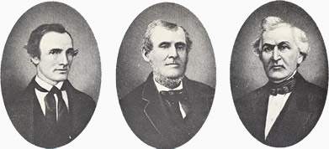
Three Witnesses of Book of Mormon
T
See individual files
Oliver Cowdery
Martin Harries
David Whitmer

Slide 5
T
John Taylor
3rd Pres. Of church
D&C 118:6; 135; 138:53
Ezra Thayre
D&C 3;5, 52:22; 75:31
Robert Thompson
D&C 124:12-14

Slide 6
U
Uriah
D&C 132:39; Samuel 2:11

