Slide 1
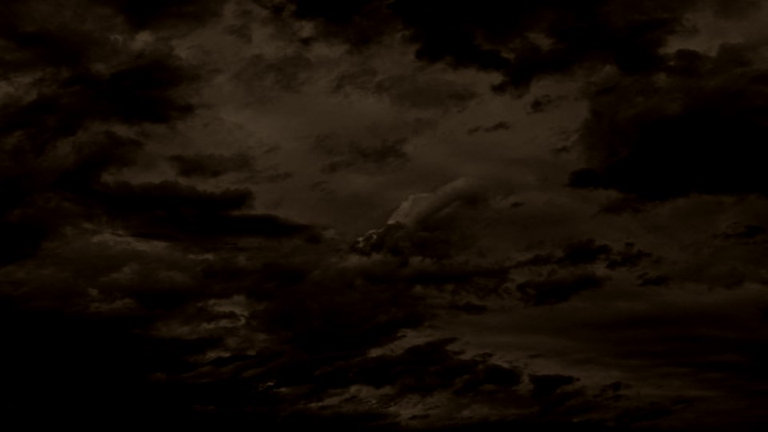
The Great Apostasy, Restoration, and Intro to Doctrine and Covenants
Presentation by http://fashionsbylynda.com/blog/

Slide 2
The Missing Part
What happens when the chain of a bike is missing or broken?

Slide 3
Essential Elements of Jesus Christ's church
Those of the household of God:
And are built upon the foundation of the apostles and prophets, Jesus Christ himself being the chief corner stone;
In whom all the building fitly framed together groweth unto an holy temple in the Lord:
In whom ye also are builded together for an habitation of God through the Spirit.
Apostles and prophets form the foundation of the Church of Jesus Christ.
Apostles and Prophets
Jesus Christ
Ephesians 2:19-22

Slide 4
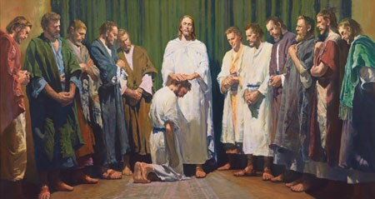
Apostles and prophets
“And he goeth up into a mountain, and calleth unto him whom he would: and they came unto him.
And he ordained twelve, that they should be with him, and that he might send them forth to preach,”
Priesthood authority is necessary to receive the ordinances and covenants of salvation.
Jesus Christ gave His Apostles the authority to direct the Church and act in God’s name for the salvation of His children.
Mark 3:13-14

Slide 5
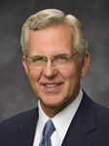
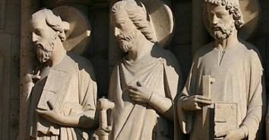
“The truths and doctrine we have received have come and will continue to come by divine revelation.
In some faith traditions … doctrinal matters may become a contest of opinions. …
But in the Church today, just as anciently, establishing the doctrine of Christ or correcting doctrinal deviations is a matter of divine revelation to those the Lord endows with apostolic authority”
Elder D. Todd Christofferson
The apostles and prophets establish correct doctrine through divine revelation.

Slide 6
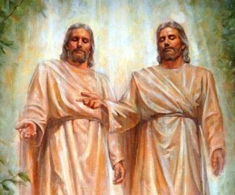
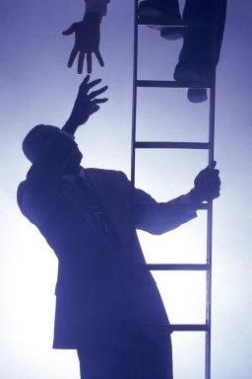
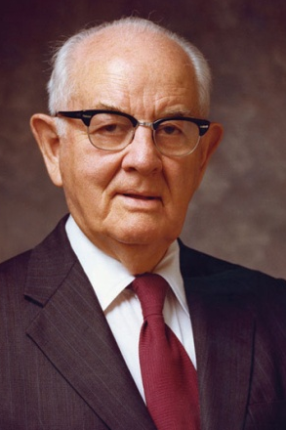
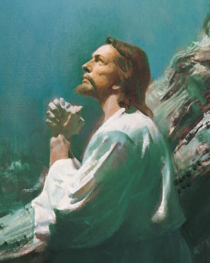
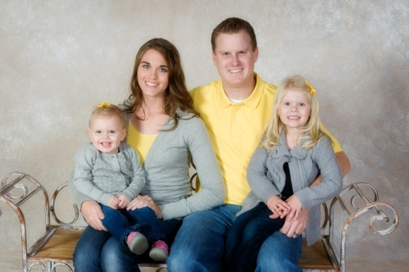
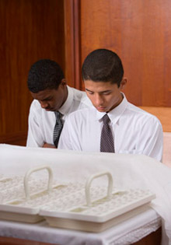
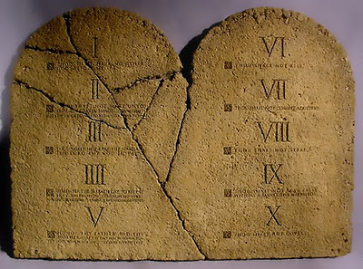
Basic Doctrine
Godhead
Plan of Salvation
Dispensation, Apostasy, and Restoration
Atonement
Prophets and Revelations
Priesthood and Priesthood Keys
Marriage and Family
Ordinances and Covenant
Commandments

Slide 7
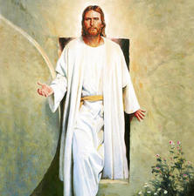
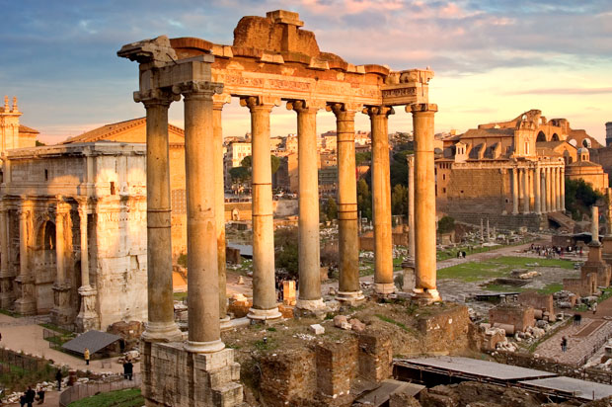
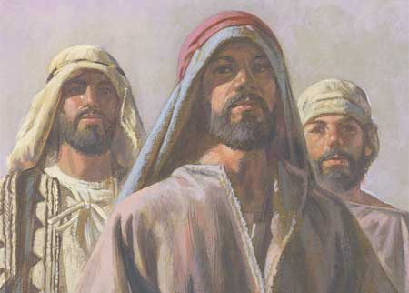
After Christ's Death
After Jesus Christ died, He was resurrected, and He ascended into heaven.
He was no longer physically present to lead the Church on the earth.
Even though He is not physically on the earth, Jesus Christ leads and guides His Apostles through revelation.
Under the leadership of His Apostles, the ancient Church spread quickly and thousands were baptized.
Congregations of Saints were formed throughout much of the Roman Empire.
Elders, bishops, deacons, priests, teachers, and evangelists (patriarchs) were called and given priesthood authority by the Apostles.

Slide 8
A Falling Away--Apostasy
Apostasy occurs when people turn away from the true doctrine of the gospel and reject the Lord’s authorized servants.
Following the deaths of the Savior’s Apostles, the principles of the gospel were corrupted and unauthorized changes were made in Church organization and to priesthood ordinances.
James was killed in Jerusalem by Herod. Peter and Paul died in Rome. Tradition holds that Philip went to the East. Much more than this we do not know.
“They scattered; they taught, testified, and established the Church. And they died for their beliefs, and with their deaths came the dark centuries of apostasy…
“The most precious thing lost in the Apostasy was the authority held by the Twelve—the priesthood keys. For the Church to be His Church, there must be a Quorum of the Twelve who hold the keys and confer them on others.”
Boyd K. Packer

Slide 9
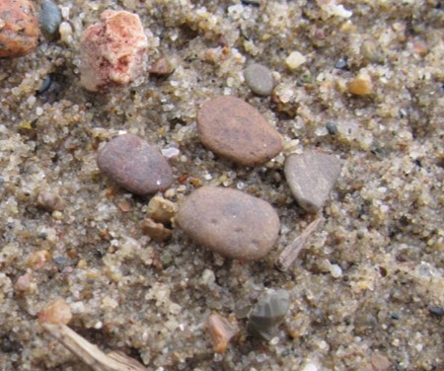
The Loss of the Priesthood
“As the centuries passed, the flame flickered and dimmed. Ordinances were changed or abandoned. The line was broken, and the authority to confer the Holy Ghost as a gift was gone. The Dark Ages of apostasy settled over the world”
Boyd K. Packer

Slide 10
Before the 2nd Coming of Christ
A warning
“Now we beseech you, brethren, by the coming of our Lord Jesus Christ, and by our gathering together unto him,
That ye be not soon shaken in mind, or be troubled, neither by spirit, nor by word, nor by letter as from us, as that the day of Christ is at hand.
Let no man deceive you by any means: for that day shall not come, except there come a falling away first, and that man of sin be revealed, the son of perdition;”
Although there will not be another general apostasy from the truth, we must each guard against personal apostasy by keeping covenants, obeying the commandments, following Church leaders, partaking of the sacrament, and constantly strengthening our testimonies through daily scripture study, prayer, and service.
2 Thessalonians 2:1–3

Slide 11
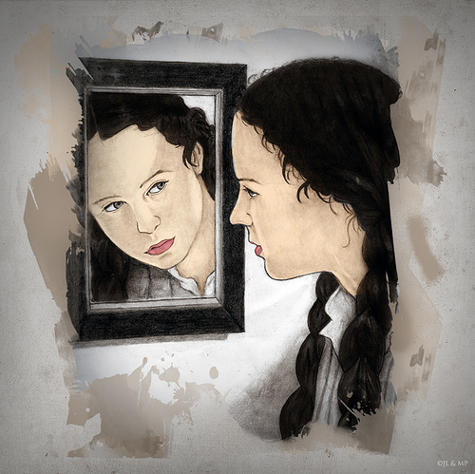
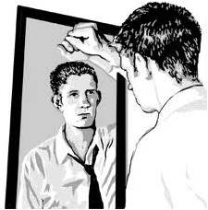
“God’s people have not always been worthy of the marvelous experience we have shared today. The Apostles, after the Ascension of Christ, continued to exercise the keys He left with them. But because of disobedience and loss of faith by the members, the Apostles died without the keys being passed on to successors.
We call that tragic episode ‘the Apostasy.’ Had the members of the Church in those days had the opportunity and the will to exercise faith as you have today, the Lord would not have taken the keys of the priesthood from the earth. So this is a day of historical significance and of eternal importance in the history of the world and to the children of our Heavenly Father.
“Now our obligation is to remain worthy of the faith necessary for us to fulfill our promise to sustain those who have been called. The Lord was well pleased with the Church at the beginning of the Restoration, as He is today. But He cautioned the members then, as He does now, that He cannot look upon sin with the least degree of allowance. For us to sustain those who have been called today, we must examine our lives, repent as necessary, pledge to keep the Lord’s commandments, and follow His servants.
The Lord warns us that if we do not do those things, the Holy Ghost will be withdrawn, we will lose the light which we have received, and we will not be able to keep the pledge we have made today to sustain the Lord’s servants in His true Church”
President Henry B. Eyring

Slide 12
Restoration
The restoration of Jesus Christ’s doctrine and authority was necessary to overcome the effects of the Great Apostasy
Why are apostles and prophets essential?
Why is priesthood authority needed in the Church?
How can we receive and maintain correct doctrine?
What role does revelation play in the Church?

Slide 13
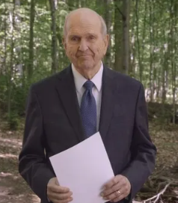
Monument of Words
We wondered if a monument should be erected. But as we considered the unique historic and international impact of that First Vision, we felt impressed to create a monument not of granite or stone but of words—words of solemn and sacred proclamation—written, not to be carved in “tables of stone” but rather to be etched in the “fleshy tables” of our hearts.
President Russel M. Nelson

Slide 14
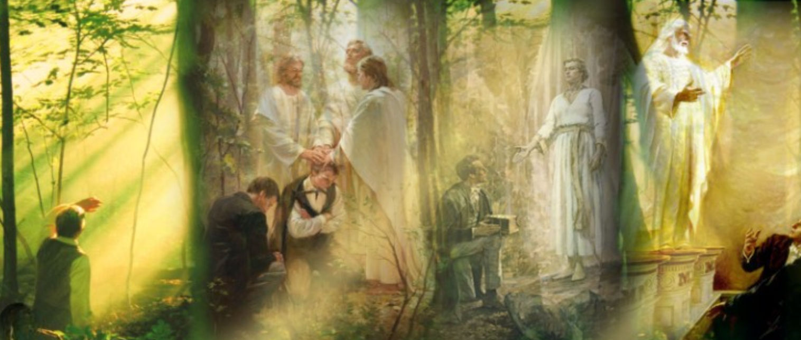
The Fulness of the Gospel
Heavenly Father and Jesus Christ began restoring the fulness of the gospel through the Prophet Joseph Smith, and the Restoration of the gospel of Jesus Christ continues in our day.

Slide 15
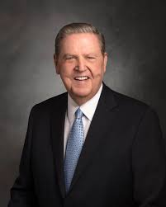
Sometimes we think of the Restoration of the gospel as something that is complete, already behind us—Joseph Smith translated the Book of Mormon, he received priesthood keys, the Church was organized. In reality, the Restoration is an ongoing process; we are living in it right now.
It includes “all that God has revealed, all that He does now reveal,” and the “many great and important things” that “He will yet reveal” [Articles of Faith 1:9].
Brethren [and sisters], the exciting developments of today are part of that long-foretold period of preparation that will culminate in the glorious Second Coming of our Savior, Jesus Christ.
Dieter F. Uchtdorf
I testify that the future is going to be as miracle-filled and bountifully blessed as the past has been. We have every reason to hope for blessings even greater than those we have already received because this is the work of Almighty God, this is the Church of continuing revelation, this is the gospel of Christ’s unlimited grace and benevolence.
Jeffrey R. Holland

Slide 16
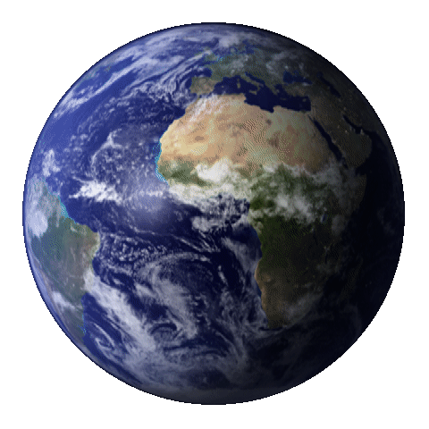
Restoration for Us Today
…but the Restoration is not only for those of us who rejoice in it today. The revelations of the First Vision were not for Joseph Smith alone but are offered as light and truth for any who “lack wisdom” [James 1:5].
The Book of Mormon is the possession of mankind.
The priesthood ordinances of salvation and exaltation were prepared for every individual, including those who no longer dwell in mortality.
The Church of Jesus Christ of Latter-day Saints and its blessings are intended for all who want them.
The gift of the Holy Ghost is meant for everyone.
The Restoration belongs to the world, and its message is especially urgent today.
D. Todd Christofferson

Slide 17
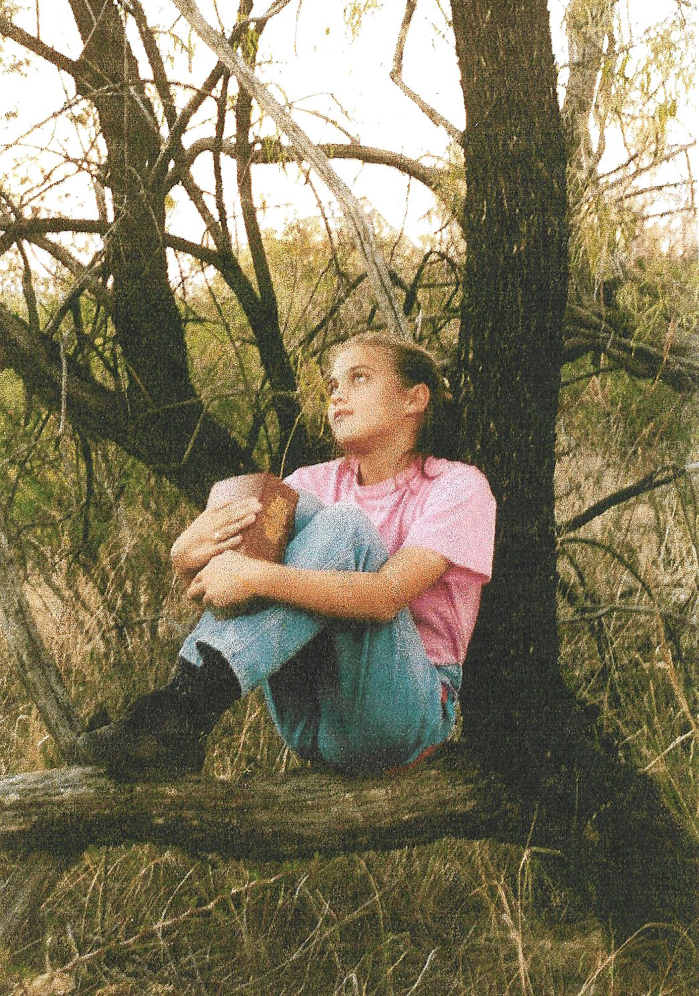
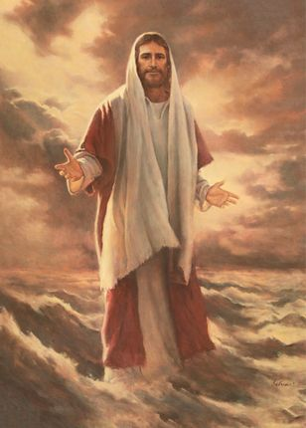
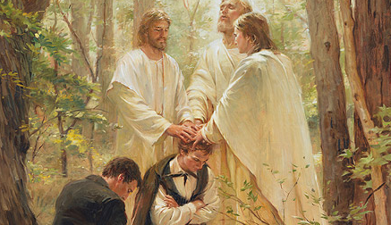
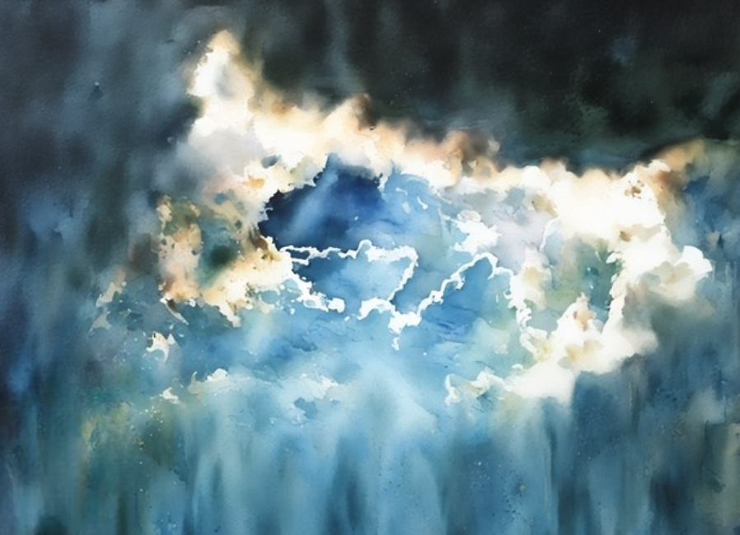
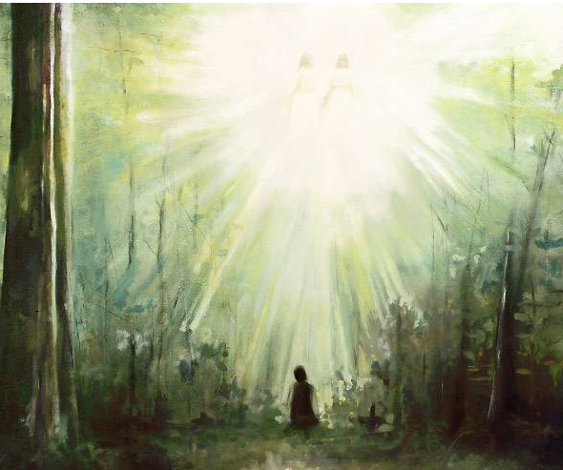
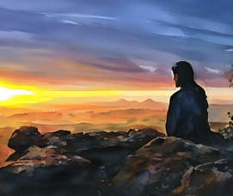
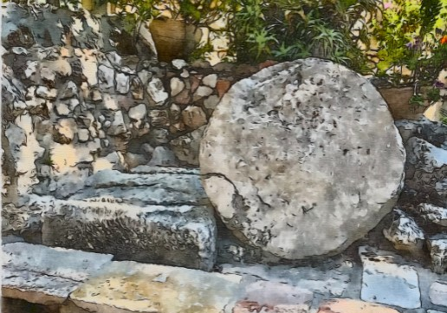
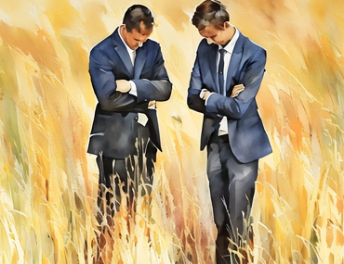
John 3:16
James 1:5
Joseph Smith—History 1:15–20
Doctrine and Covenants 27:12–13
Mormon 8:16
3 Nephi 27:20–21
Doctrine and Covenants 65:2
Ephesians 1:10
Matthew 28:19–20

Slide 18
Sources:
Related Videos:
The Great Apostasy (Wilford Woodruff’s search for truth)
Foundation (1:45)
Elder D. Todd Christofferson (“The Doctrine of Christ,” Ensign or Liahona, May 2012, 86).
President Boyd K. Packer [“Little Children,” Ensign, Nov. 1986, 17].)
(“The Twelve,” Ensign or Liahona, May 2008, 84).
(“The Cloven Tongues of Fire,” Ensign, May 2000, 8).
Presentation by ©http://fashionsbylynda.com/blog/
President Henry B. Eyring (“The True and Living Church,” Ensign or Liahona, May 2008, 21).
President Russell M. Nelson, “Hear Him,” Ensign or Liahona, May 2020, 90
Dieter F. Uchtdorf, “Are You Sleeping through the Restoration?,” Ensign or Liahona, May 2014, 59.
Jeffrey R. Holland, “A Perfect Brightness of Hope,” Ensign or Liahona, May 2020, 83–84.
D. Todd Christofferson, “Sharing the Message of the Restoration and the Resurrection,” Ensign or Liahona, May 2020, 110)
Presentation by ©http://fashionsbylynda.com/blog/

Slide 19
We solemnly proclaim that God loves His children in every nation of the world. God the Father has given us the divine birth, the incomparable life, and the infinite atoning sacrifice of His Beloved Son, Jesus Christ. By the power of the Father, Jesus rose again and gained the victory over death. He is our Savior, our Exemplar, and our Redeemer.
Two hundred years ago, on a beautiful spring morning in 1820, young Joseph Smith, seeking to know which church to join, went into the woods to pray near his home in upstate New York, USA. He had questions regarding the salvation of his soul and trusted that God would direct him.
In humility, we declare that in answer to his prayer, God the Father and His Son, Jesus Christ, appeared to Joseph and inaugurated the “restitution of all things” (Acts 3:21) as foretold in the Bible. In this vision, he learned that following the death of the original Apostles, Christ’s New Testament Church was lost from the earth. Joseph would be instrumental in its return.
We affirm that under the direction of the Father and the Son, heavenly messengers came to instruct Joseph and re-establish the Church of Jesus Christ. The resurrected John the Baptist restored the authority to baptize by immersion for the remission of sins. Three of the original twelve Apostles—Peter, James, and John—restored the apostleship and keys of priesthood authority. Others came as well, including Elijah, who restored the authority to join families together forever in eternal relationships that transcend death.
We further witness that Joseph Smith was given the gift and power of God to translate an ancient record: the Book of Mormon—Another Testament of Jesus Christ. Pages of this sacred text include an account of the personal ministry of Jesus Christ among people in the Western Hemisphere soon after His Resurrection. It teaches of life’s purpose and explains the doctrine of Christ, which is central to that purpose. As a companion scripture to the Bible, the Book of Mormon testifies that all human beings are sons and daughters of a loving Father in Heaven, that He has a divine plan for our lives, and that His Son, Jesus Christ, speaks today as well as in days of old.
We declare that The Church of Jesus Christ of Latter-day Saints, organized on April 6, 1830, is Christ’s New Testament Church restored. This Church is anchored in the perfect life of its chief cornerstone, Jesus Christ, and in His infinite Atonement and literal Resurrection. Jesus Christ has once again called Apostles and has given them priesthood authority. He invites all of us to come unto Him and His Church, to receive the Holy Ghost, the ordinances of salvation, and to gain enduring joy.
Two hundred years have now elapsed since this Restoration was initiated by God the Father and His Beloved Son, Jesus Christ. Millions throughout the world have embraced a knowledge of these prophesied events.
We gladly declare that the promised Restoration goes forward through continuing revelation. The earth will never again be the same, as God will “gather together in one all things in Christ” (Ephesians 1:10).
With reverence and gratitude, we as His Apostles invite all to know—as we do—that the heavens are open. We affirm that God is making known His will for His beloved sons and daughters. We testify that those who prayerfully study the message of the Restoration and act in faith will be blessed to gain their own witness of its divinity and of its purpose to prepare the world for the promised Second Coming of our Lord and Savior, Jesus Christ.
This proclamation was read by President Russell M. Nelson as part of his message at the 190th Annual General Conference, April 5, 2020, in Salt Lake City, Utah.
Elder M. Russell Ballard of the Quorum of the Twelve Apostles taught that even during times of darkness and apostasy, Heavenly Father does not turn His back on His children:
“In the relatively short span of years covered by the New Testament … the people turned against Christ and His Apostles. The collapse was so great we have come to know it as the Great Apostasy, which led to the centuries of spiritual stagnation and ignorance called the Dark Ages.
“Now, I need to be very clear about these historically reoccurring periods of apostasy and spiritual darkness. Our Heavenly Father loves all of His children, and He wants them all to have the blessings of the gospel in their lives. Spiritual light is not lost because God turns His back on His children. Rather, spiritual darkness results when His children turn their collective backs on Him. It is a natural consequence of bad choices made by individuals, communities, countries, and entire civilizations. This has been proven again and again throughout the course of time. One of the great lessons of this historical pattern is that our choices, both individually and collectively, do result in spiritual consequences for ourselves and for our posterity” (“Learning the Lessons of the Past,” Ensign or Liahona, May 2009, 32).

Slide 20
We solemnly proclaim that God loves His children in every nation of the world. God the Father has given us the divine birth, the incomparable life, and the infinite atoning sacrifice of His Beloved Son, Jesus Christ. By the power of the Father, Jesus rose again and gained the victory over death. He is our Savior, our Exemplar, and our Redeemer.
Two hundred years ago, on a beautiful spring morning in 1820, young Joseph Smith, seeking to know which church to join, went into the woods to pray near his home in upstate New York, USA. He had questions regarding the salvation of his soul and trusted that God would direct him.
In humility, we declare that in answer to his prayer, God the Father and His Son, Jesus Christ, appeared to Joseph and inaugurated the “restitution of all things” (Acts 3:21) as foretold in the Bible. In this vision, he learned that following the death of the original Apostles, Christ’s New Testament Church was lost from the earth. Joseph would be instrumental in its return.
We affirm that under the direction of the Father and the Son, heavenly messengers came to instruct Joseph and re-establish the Church of Jesus Christ. The resurrected John the Baptist restored the authority to baptize by immersion for the remission of sins. Three of the original twelve Apostles—Peter, James, and John—restored the apostleship and keys of priesthood authority. Others came as well, including Elijah, who restored the authority to join families together forever in eternal relationships that transcend death.
We further witness that Joseph Smith was given the gift and power of God to translate an ancient record: the Book of Mormon—Another Testament of Jesus Christ. Pages of this sacred text include an account of the personal ministry of Jesus Christ among people in the Western Hemisphere soon after His Resurrection. It teaches of life’s purpose and explains the doctrine of Christ, which is central to that purpose. As a companion scripture to the Bible, the Book of Mormon testifies that all human beings are sons and daughters of a loving Father in Heaven, that He has a divine plan for our lives, and that His Son, Jesus Christ, speaks today as well as in days of old.
We declare that The Church of Jesus Christ of Latter-day Saints, organized on April 6, 1830, is Christ’s New Testament Church restored. This Church is anchored in the perfect life of its chief cornerstone, Jesus Christ, and in His infinite Atonement and literal Resurrection. Jesus Christ has once again called Apostles and has given them priesthood authority. He invites all of us to come unto Him and His Church, to receive the Holy Ghost, the ordinances of salvation, and to gain enduring joy.
Two hundred years have now elapsed since this Restoration was initiated by God the Father and His Beloved Son, Jesus Christ. Millions throughout the world have embraced a knowledge of these prophesied events.
We gladly declare that the promised Restoration goes forward through continuing revelation. The earth will never again be the same, as God will “gather together in one all things in Christ” (Ephesians 1:10).
With reverence and gratitude, we as His Apostles invite all to know—as we do—that the heavens are open. We affirm that God is making known His will for His beloved sons and daughters. We testify that those who prayerfully study the message of the Restoration and act in faith will be blessed to gain their own witness of its divinity and of its purpose to prepare the world for the promised Second Coming of our Lord and Savior, Jesus Christ.
This proclamation was read by President Russell M. Nelson as part of his message at the 190th Annual General Conference, April 5, 2020, in Salt Lake City, Utah.
The Restoration of the Fulness of the Gospel of Jesus Christ
A Bicentennial Proclamation to the World

Slide 21
Introduction to the Doctrine and Covenants

Slide 22
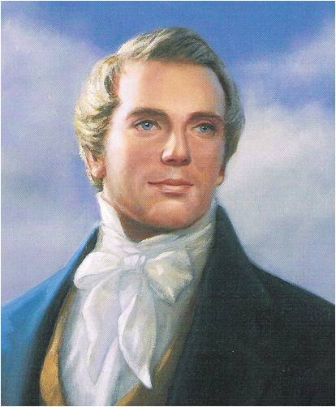
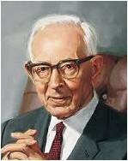
Foundation of the Church
“[The Doctrine and Covenants is] the foundation of the Church in these last days, and a benefit to the world, showing that the keys of the mysteries of the kingdom of our Savior are again entrusted to man”
Joseph Smith
“It is worth more to us than the riches of the earth”
Joseph Fielding Smith

Slide 23
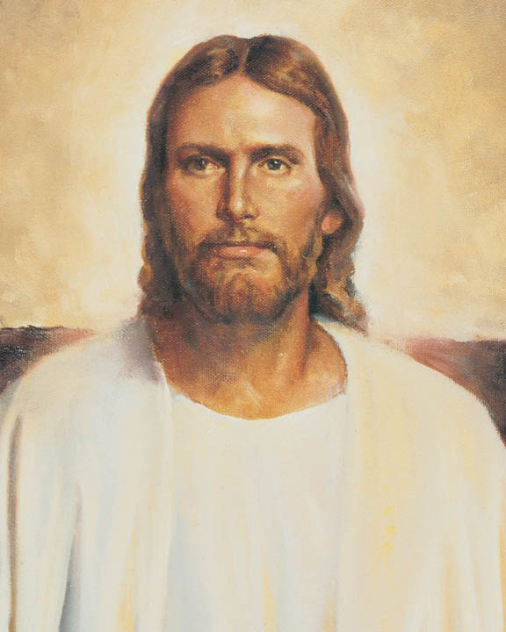
Truth and Revelation
Doctrine--- a fundamental, eternal truth of the gospel of Jesus Christ
Covenant--- a sacred agreement between God and His children; and revelation is communication from God to His children

Slide 24
What is in the D&C?
Doctrine and Covenants include:
The nature of the Godhead
Origin of man
Reality of Satan
Purpose of mortality
Necessity for obedience
Need for repentance
Workings of the Holy Spirit
How to pertain salvation
The destiny of the earth and future conditions of man
The 2nd Coming of Christ, His judgment and Resurrection
The nature of the family and eternal marriage
Also:
The gradual unfolding of the administrative structure of the Church is shown with the calling of bishops, the First Presidency, the Council of the Twelve, and the Seventy and the establishment of other presiding offices and quorums.
The testimony that is given of Jesus Christ—His divinity, His majesty, His perfection, His love, and His redeeming power

Slide 25
How Can I increase My Testimony?
“These words are not of men nor of man, but of me; wherefore, you shall testify they are of me and not of man;
For it is my voice which speaketh them unto you; for they are given by my Spirit unto you, and by my power you can read them one to another; and save it were by my power you could not have them;
Wherefore, you can testify that you have heard my voice, and know my words.”
D&C 18:34-36
By studying the revelations in the Doctrine and Covenants, we can strengthen our testimonies of Jesus Christ.
As we study the Doctrine and Covenants, we can hear the voice of the Savior.

Slide 26
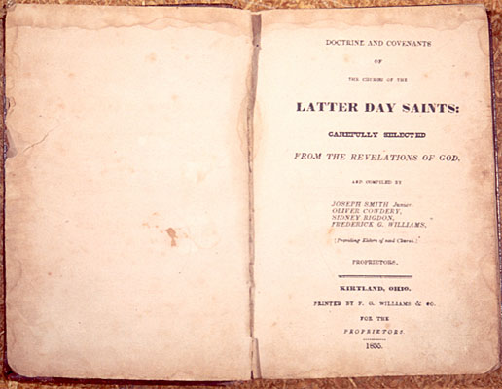
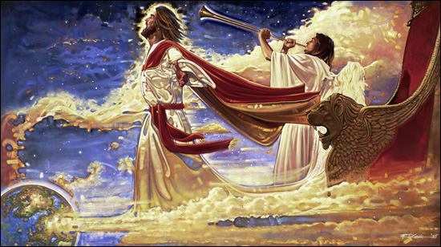
Through the Voice of Jesus Christ
Jesus Christ is the God of this world
The Doctrine and Covenants is unique because it is not a translation of an ancient document but is of modern origin and was given of God through His chosen prophets for the restoration of His holy work and the establishment of the kingdom of God on the earth in these days.
In the revelations, one hears the tender but firm voice of the Lord Jesus Christ, speaking anew in the dispensation of the fulness of times; and the work that is initiated herein is preparatory to His Second Coming, in fulfillment of and in concert with the words of all the holy prophets since the world began.

Slide 27
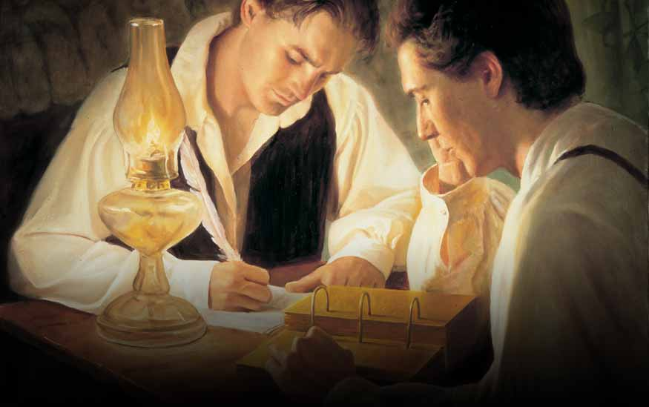
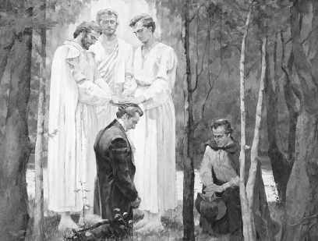
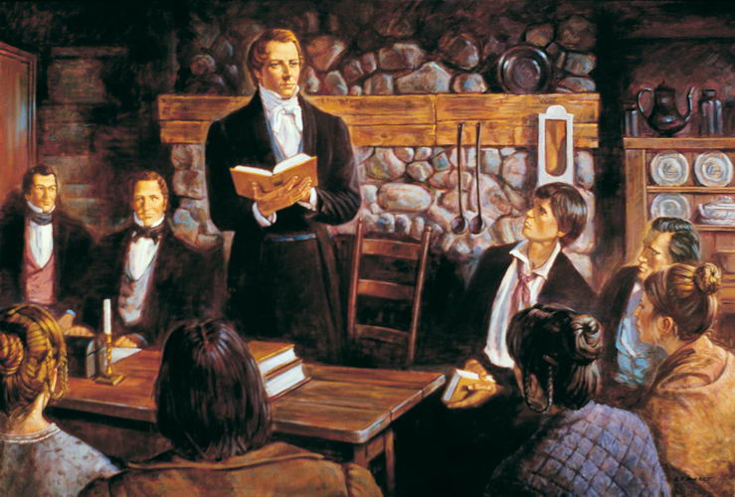
A Restoration of Divine Authority
In the course of time, Joseph Smith was enabled by divine assistance to translate and publish the Book of Mormon.
In the meantime, he and Oliver Cowdery were ordained to the Aaronic Priesthood by John the Baptist in May 1829 (see D&C 13), and soon thereafter they were also ordained to the Melchizedek Priesthood by the ancient Apostles Peter, James, and John
(see D&C 27:12).
Other ordinations followed in which priesthood keys were conferred by Moses, Elijah, Elias, and many ancient prophets.
(see D&C 110; 128:18, 21).
These ordinations were, in fact, a restoration of divine authority to man on the earth. On April 6, 1830, under heavenly direction, the Prophet Joseph Smith organized the Church, and thus the true Church of Jesus Christ is once again operative as an institution among men, with authority to teach the gospel and administer the ordinances of salvation.
(See D&C 20 and the Pearl of Great Price, Joseph Smith—History 1.)

Slide 28
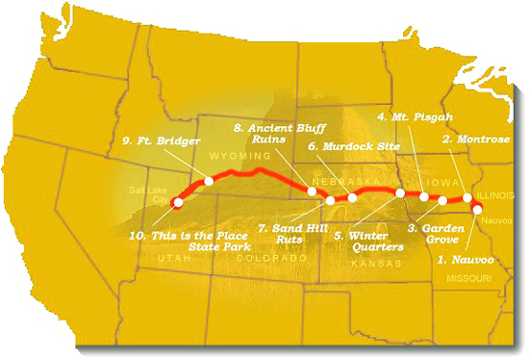
Real-life Situations—Real People
These sacred revelations were received in answer to prayer, in times of need, and came out of real-life situations involving real people.
The Prophet and his associates sought for divine guidance, and these revelations certify that they received it. In the revelations, one sees the restoration and unfolding of the gospel of Jesus Christ and the ushering in of the dispensation of the fulness of times.
The westward movement of the Church from New York and Pennsylvania to Ohio, to Missouri, to Illinois,
and finally to the Great
Basin of western America
and the mighty struggles
of the Saints in attempting
to build Zion on the earth
in modern times are also
shown forth in these revelations.
If we pray for help in our times of need, then the Lord will give us guidance.

Slide 29
Testimony of the Twelve
The Testimony of the Witnesses to the Book of the Lord’s Commandments, which commandments He gave to His Church through Joseph Smith, Jun., who was appointed by the voice of the Church for this purpose:
We, therefore, feel willing to bear testimony to all the world of mankind, to every creature upon the face of the earth, that the Lord has borne record to our souls, through the Holy Ghost shed forth upon us, that these commandments were given by inspiration of God, and are profitable for all men and are verily true.
We give this testimony unto the world, the Lord being our helper; and it is through the grace of God the Father, and His Son, Jesus Christ, that we are permitted to have this privilege of bearing this testimony unto the world, in the which we rejoice exceedingly, praying the Lord always that the children of men may be profited thereby.

Slide 30
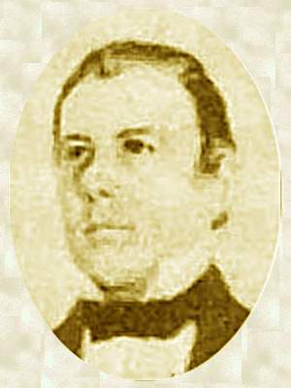
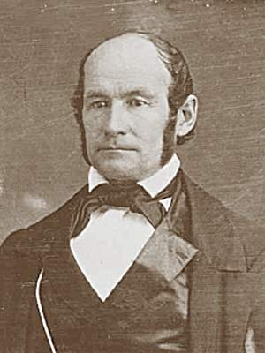
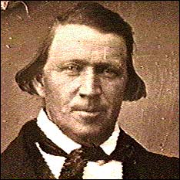
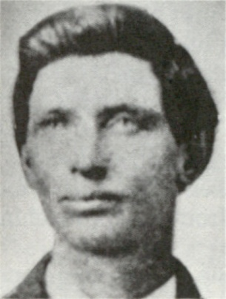
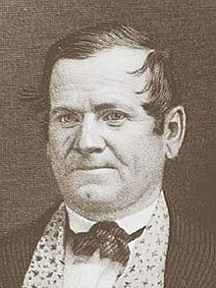
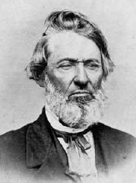
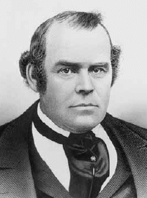
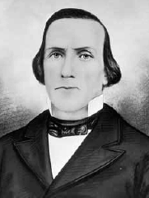
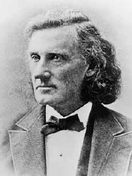
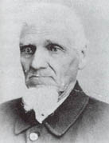
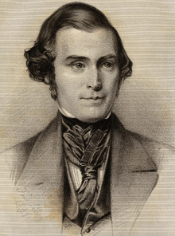
Thomas B. Marsh
Brigham Young
Heber C. Kimball
David W. Patten
The Twelve
Orson Hyde
William E. McLellin
Luke S. Johnson
Parley P. Pratt
John F. Boynton
Orson Pratt
Lyman E. Johnson
William Smith

Slide 31
The Eight Witnesses
"Be it known unto all nations, kindreds, tongues, and people, unto whom this work shall come: That Joseph Smith, Jun., the translator of this work, has shown unto us the plates of which hath been spoken, which have the appearance of gold; and as many of the leaves as the said Smith has translated we did handle with our hands; and we also saw the engravings thereon, all of which has the appearance of ancient work, and of curious workmanship. And this we bear record with words of soberness, that the said Smith has shown unto us, for we have seen and hefted, and know of a surety that the said Smith has got the plates of which we have spoken. And we give our names unto the world, to witness unto the world that which we have seen. And we lie not, God bearing witness of it." July 1829

Slide 32
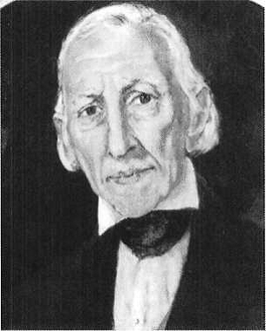
The Eight Witnesses
Joseph Smith, Sen.
Jacob Whitmer
John Whitmer
Samuel H. Smith
Hyrum Smith
Missing: Hirum Page, Christian Whitmer, and Peter Whitmer

Slide 33
The Three Witnesses

Slide 34
“The Book of Mormon and the Doctrine and Covenants are bound together as revelations from Israel’s God to gather and prepare His people for the second coming of the Lord. …
“The Book of Mormon and the Doctrine and Covenants testify of each other. You cannot believe one and not the other. …
“The Doctrine and Covenants is the binding link between the Book of Mormon and the continuing work of the Restoration through the Prophet Joseph Smith and his successors. …
“The Book of Mormon brings men to Christ. The Doctrine and Covenants brings men to Christ’s kingdom, even The Church of Jesus Christ of Latter-day Saints, ‘the only true and living church upon the face of the whole earth’ [D&C 1:30]. I know that.
“The Book of Mormon is the ‘keystone’ of our religion, and the Doctrine and Covenants is the capstone, with continuing latter-day revelation. The Lord has placed His stamp of approval on both the keystone and the capstone”
Ezra Taft Benson

Slide 35
Sources:
Related Video:
Overview of Church History (10:34)
Why Study the Doctrine and Covenants? (2:34)
Joseph Smith (Teachings of Presidents of the Church: Joseph Smith [2007], 194).
Joseph Fielding Smith (Doctrines of Salvation, comp. Bruce R. McConkie, 3 vols. [1954–56], 3:199).
Ezra Taft Benson (“The Book of Mormon and the Doctrine and Covenants,” Ensign, May 1987, 83).
Presentation by ©http://fashionsbylynda.com/blog/

Slide 36
From revelation to publication: Different editions of the Doctrine and Covenants
In November 1831 the Prophet Joseph Smith met with elders in Hiram, Ohio. The group decided to compile and publish some of the revelations that the Prophet had received. They selected 65 revelations and titled the compilation the Book of Commandments. By the summer of 1833 most of the compilations had been printed, but a mob destroyed nearly all of the copies. As a result, very few copies exist today. Another edition was approved and published in 1835. This edition contained the Lectures on Faith (see the introduction to the Doctrine and Covenants) and 103 revelations. This edition, therefore, was the first with the title Doctrine (the lectures) and Covenants (the revelations). (See History of the Church, 2:243–251.)
A few more editions (each adding new revelations or making slight improvements to the organization) were printed periodically until 1981, when the Church published a new edition of the triple combination, in English, with expanded footnotes and cross-references and a new index. At that time, the Prophet Joseph Smith’s 1836 vision of the celestial kingdom and President Joseph F. Smith’s 1918 vision of the redemption of the dead, both canonized by the Church in 1976 and originally added to the Pearl of Great Price, were added to the Doctrine and Covenants as sections 137 and 138. The 1981 edition has 138 sections and two official declarations: the Manifesto, issued in 1890 by President Wilford Woodruff, and the declaration on priesthood, issued in 1978 by President Spencer W. Kimball. On March 1, 2013, the First Presidency announced a new edition of the English scriptures. Most of the adjustments that were made in this edition are in the study helps or the headings of the Doctrine and Covenants or entail minor spelling corrections to the text. (For more detailed information about the different editions, see the Revelations Correspondence Chart in “Corresponding Section Numbers in Editions of the Doctrine and Covenants, ”JosephSmithPapers.org/reference/library .)

