Slide 1
Joseph Smith History 1:1-26
Presentation by ©http://fashionsbylynda.com/blog/

Slide 2
At a young age, Joseph Smith desired to follow Jesus Christ and sought to know which church was right and which he should join.
His search led him to a grove near his home to ask God.
In answer, Heavenly Father and Jesus Christ appeared to Joseph and began the Restoration of God’s true Church to the earth.
After sharing this experience of the First Vision, Joseph became the target of persecution.
This, however, did not diminish his conviction that Heavenly Father and Jesus Christ had appeared to him.
Manual

Slide 3
At a young age, Joseph Smith desired to follow Jesus Christ and sought to know which church was right and which he should join. However, there were multiple churches teaching different things, and young Joseph found it difficult to discern the truth. This lesson can help students follow Joseph Smith’s example in their efforts to learn truth from God.
Joseph Smith was concerned for the welfare of his soul. Within the community, and even within the Smith family, there were differing opinions about which church contained the truths necessary for salvation.

Slide 4
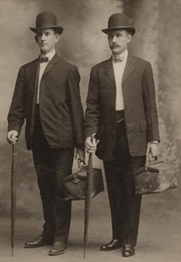
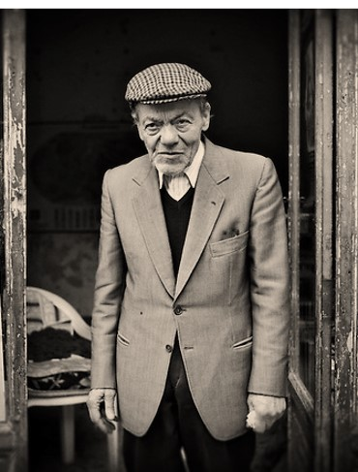
“Two [missionaries] called at the home of Mr. Elmer Pollard. … They presented their message and asked if he would join in prayer. He agreed, on the provision that he could offer the prayer.
“The prayer he offered astonished the missionaries. He said, ‘Heavenly Father, bless these two unfortunate, misguided missionaries, that they may return to their homes and not waste their time telling the people of Canada about a message which is so fantastic and about which they know so little.’
If you were one of those missionaries, what would you have said to Mr. Pollard?
How can someone know for themselves that Joseph Smith was a prophet of God?
President Thomas S. Monson

Slide 5
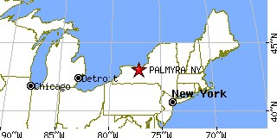
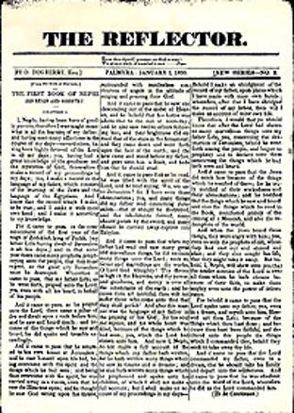
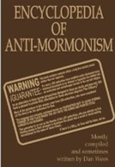
Why Joseph Writes About His Vision
Many false reports which were meant to turn people against the Church
Joseph Smith wanted provide the public with a reliable and accurate account of the events of the First Vision and the Restoration
Still today there are many who continue to spread false or misleading information about the Church with the intent to undermine faith.
Joseph Smith--History 1:1-2

Slide 6
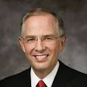
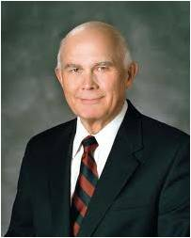
“There have always been a few who want to discredit the Church and to destroy faith. Today they use the Internet.
“Some of the information about the Church, no matter how convincing, is just not true”
Elder Neil L. Andersen
“Latter-day Saint readers should … be … sophisticated in their evaluation of what they read. …
“Our individual, personal testimonies are based on the witness of the Spirit, not on any combination or accumulation of historical facts. If we are so grounded, no alteration of historical facts can shake our testimonies.
Our Heavenly Father gave us powers of reason, and we are expected to use them to the fullest. But he also gave us the Comforter, who he said would lead us into truth and by whose power we may know the truth of all things. That is the ultimate guide for Latter-day Saints who are worthy and willing to rely on it”
Elder Dallin H. Oaks
Those who sincerely want the truth should diligently seek out credible sources of information about the Church and its history rather than simply accept any information they hear, including whatever comes up as a result of an Internet search
Joseph Smith--History 1:1-2

Slide 7
Accounts of the First Vision
Joseph Smith wrote this account of the First Vision in 1838 as part of an official history of the Church to be published to the world.
4 written or dictated by Joseph Smith and
5 written by others retelling his experience.
2. The 1835 Account
On 9 November 1835 Joseph related his early vision to a visiting Jewish minister named Robert Matthews, alias Robert Matthias, who said his priestly name was Joshua.
1. The 1832 Account
The earliest known written account of the First Vision was included in an autobiography Joseph wrote in 1832.
3. The 1838 Account
The third known account of the First Vision recorded by the Prophet was included in his “History of the Church.” Although Joseph Smith commenced dictating this history in 1838, the earliest known manuscript of this work is in the handwriting of James Mulholland, who was serving as scribe for the Prophet in 1839, thus indicating that the manuscript was probably copied by Mulholland in that year.
4. The 1842 Account
The last known account of the First Vision written by Joseph Smith was included in what is known as the Wentworth Letter.
Milton V. Backman Jr

Slide 8
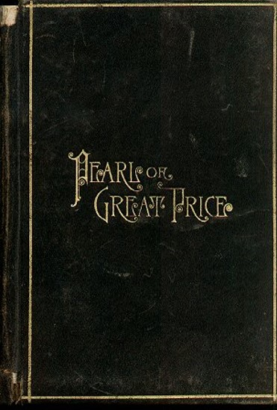
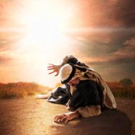
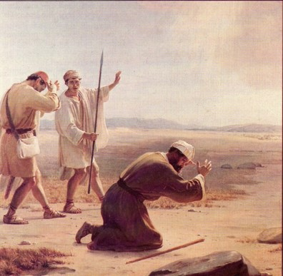
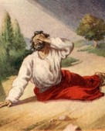
Different Accounts for Different Audiences
In these accounts, Joseph Smith emphasized different aspects of his experience of the First Vision, but the accounts all agree in the essential truth that Joseph Smith did indeed have the heavens opened to him and see divine messengers, including God the Father and the Lord Jesus Christ.
Because the 1838 account was part of Joseph Smith’s official history and testimony to the world, it was included in the Pearl of Great Price as scripture.
Paul’s Records 3 Accounts of his vision of the Lord
Acts 9:1–9
Acts 22:5–11
Acts 26:12–20

Slide 9
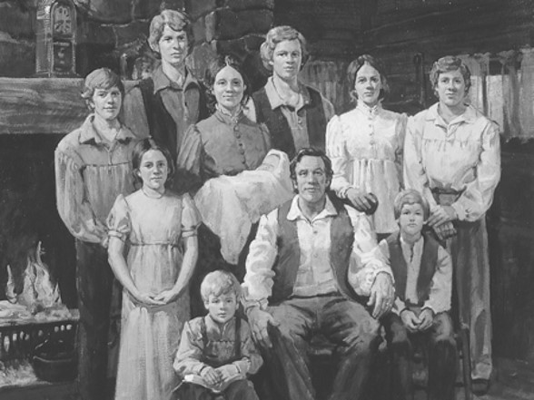
History
1805
December 23—Joseph Smith Jun. is born to Joseph Smith Sen. and Lucy Mack Smith
1815
The Smith’s move from Vermont to New York, Palmyra
1819
The Smith family move into Manchester south of Palmyra
Alvin, Hyrum, Joseph Jun., Ephraim (living only 11 days)Samuel Harrison, William, Don Carlos,
Sophronia, Catherine, and Lucy
1823
Alvin Smith died in the 26th year of age
1820
Joseph is concerned about religion that prevailed in western New York…Joseph Smith reads a passage in James 1:5
Joseph Smith—History 1:3-5

Slide 10
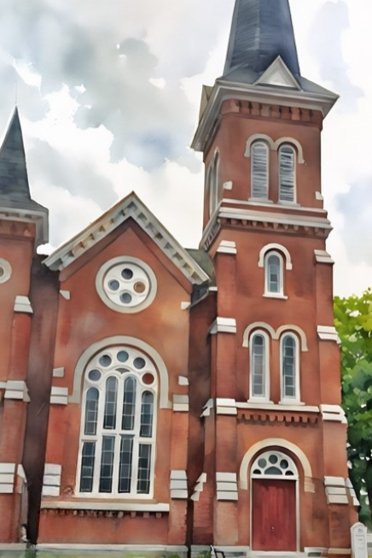
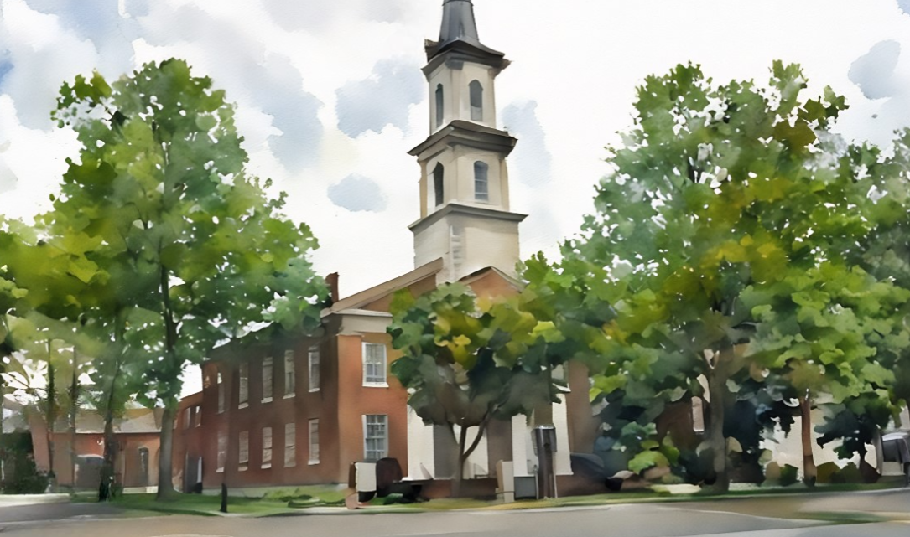
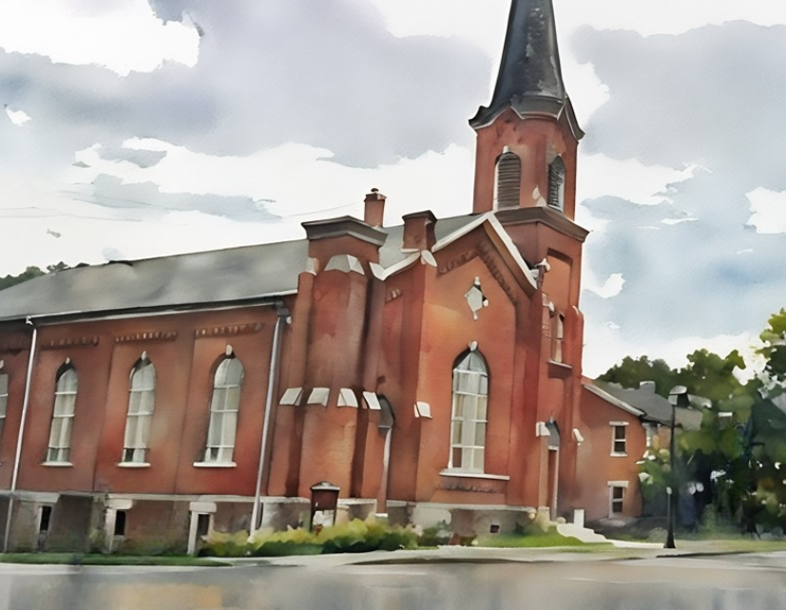
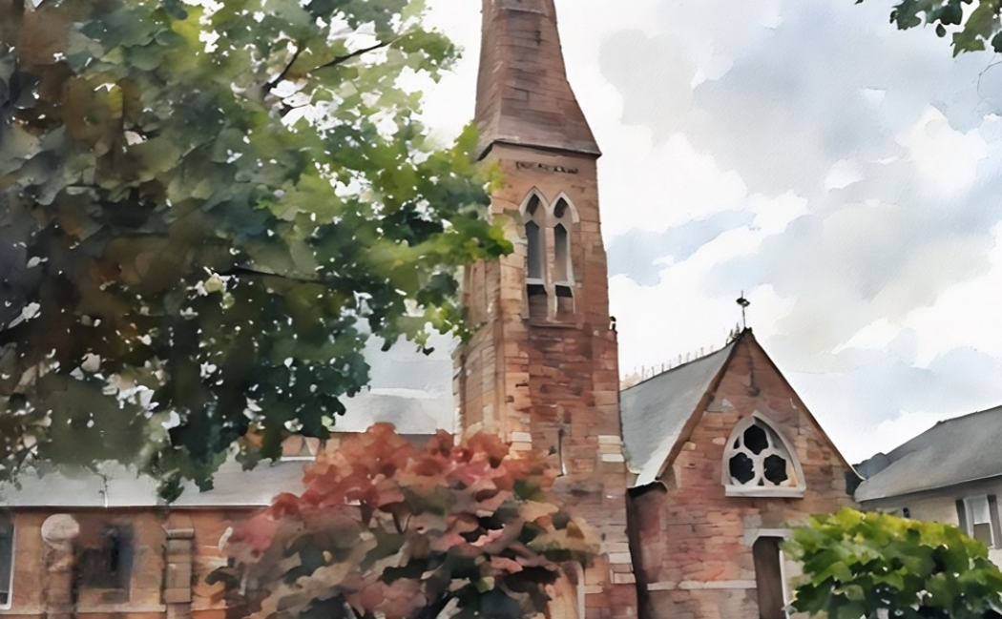
Religious Turmoil
First United Methodist Church
Presbyterian Church
Zion’s Episcopal Church
Baptist Church
Joseph Smith—History 1:5-13
4 Corner Churches today

Slide 11
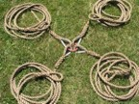
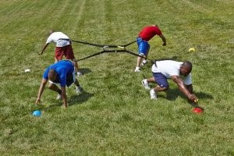
Religious Contention
Everyone had the choice in which church to attend
“in order to have everybody converted”
“it was seen that the seemingly good feelings of both the priests and the converts were more pretended than real;”
“a scene of great confusion and bad feeling ensued—priest contending against priest,
and convert against convert;
so that all their good feelings one for another, if they ever had any, were entirely lost in a strife of words and a contest about opinions.”
Joseph Smith—History 1:6

Slide 12
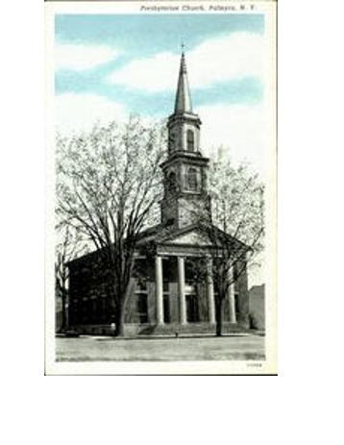
1820
Joseph Smith was 15 years old and 4 members of his family attended the Presbyterian faith:
Lucy—his mother
Hyrum
Samuel Harrison
Sophronia
‘…but though my feelings were deep and often poignant, still I kept myself aloof from all these parties, though I attended their several meetings as often as occasion would permit”
“In process of time my mind became somewhat partial to the Methodist sect”
Joseph Smith—History 1:7-8

Slide 13
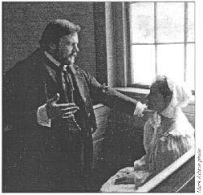
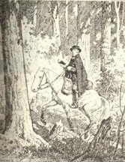
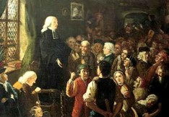
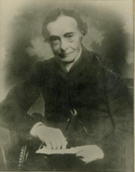
Church Against Church
“The Presbyterians were most decided against the Baptists and Methodists, and used all the powers of both reason and sophistry to prove their errors, or, at least, to make the people think they were in error.
“On the other hand, the Baptists and Methodists in their turn were equally zealous in endeavoring to establish their own tenets and disprove all others.”
Joseph Smith—History 1:9

Slide 14
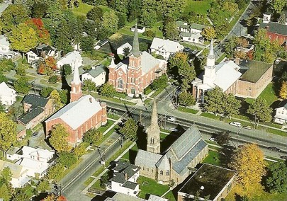
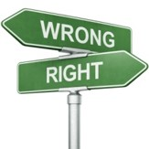
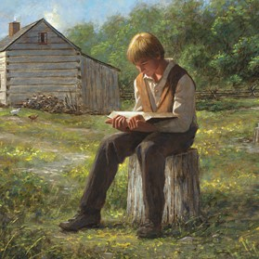
The Power of Scripture
“What is to be done? Who of all these parties are right; or, are they all wrong together? If any one of them be right, which is it, and how shall I know it?”
“Epistle of James, first chapter and fifth verse, which reads: If any of you lack wisdom, let him ask of God, that giveth to all men liberally, and upbraideth not; and it shall be given him.”
Joseph Smith—History 1:10-11

Slide 15
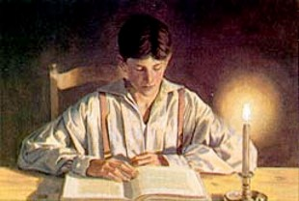
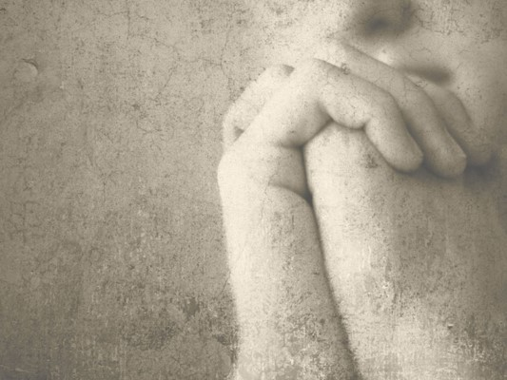
The Passage—The Determination
”for the teachers of religion of the different sects understood the same passages of scripture so differently as to destroy all confidence in settling the question by an appeal to the Bible.”
“At length I came to the conclusion that I must either remain in darkness and confusion, or else I must do as James directs, that is, ask of God.
I at length came to the determination to “ask of God,” concluding that if he gave wisdom to them that lacked wisdom, and would give liberally, and not upbraid, I might venture.
Joseph Smith—History 1:12-13

Slide 16
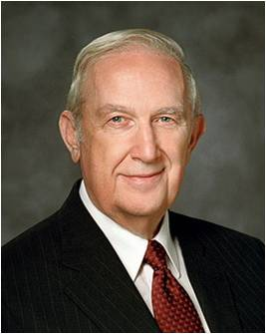
The Passage—The Determination
“Often when we pray for help with a significant matter, Heavenly Father will give us gentle promptings that require us to think, exercise faith, work, at times struggle, then act. It is a step-by-step process that enables us to discern inspired answers.
He will always hear your prayers and will invariably answer them. However, His answers will seldom come while you are on your knees praying, even when you may plead for an immediate response.
Rather, He will prompt you in quiet moments when the Spirit can most effectively touch your mind and heart. Hence, you should find periods of quiet time to recognize when you are being instructed and strengthened. His pattern causes you to grow.
Richard G. Scott
If we ask God in faith, He will answer our prayers
Joseph Smith—History 1:12-13

Slide 17
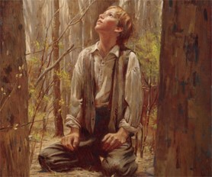
Into The Woods—a Sincere Prayer
1820
It was the first time in my life that I had made such an attempt, for amidst all my anxieties I had never as yet made the attempt to pray vocally.
“Obviously, secret prayer is necessary in many cases where it is awkward or infeasible to pray vocally. So, if we are in a social or a business setting and need comfort or direction, a resort to secret prayer is often our only alternative.”
Frances M. Gibbons
However:
“And again, I command thee that thou shalt pray vocally as well as in thy heart; yea, before the world as well as in secret, in public as well as in private.”
D&C 19:28
Joseph Smith—History 1:15

Slide 18
Doctrinal Mastery
In the First Vision, God called Joseph Smith to be a prophet
Joseph Smith History
1:15-20

Slide 19
After I had retired to the place where I had previously designed to go, having looked around me, and finding myself alone, I kneeled down and began to offer up the desires of my heart to God.
I had scarcely done so...
Joseph Smith—History 1:15

Slide 20
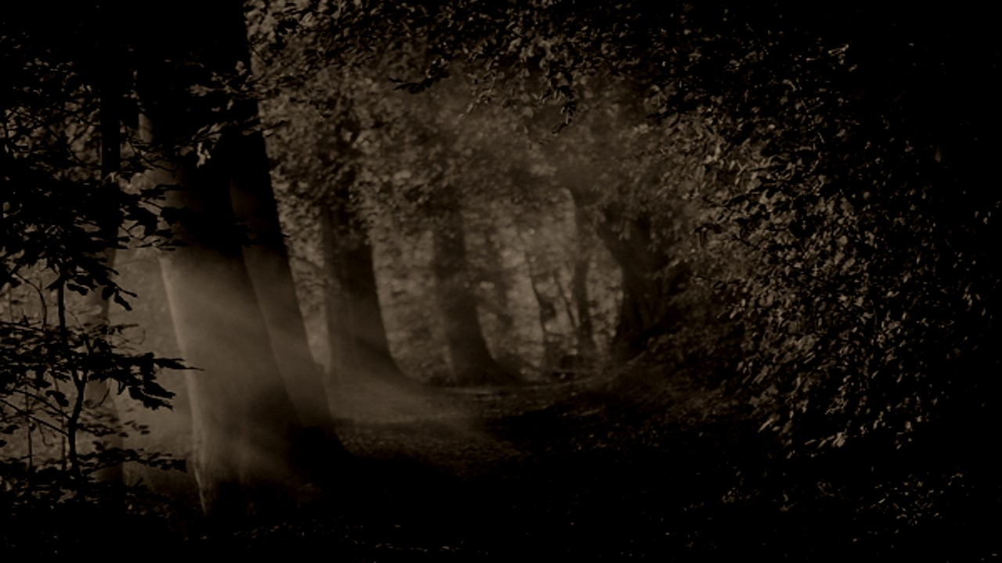
Power of Darkness
“…immediately I was seized upon by some power which entirely overcame me, and had such an astonishing influence over me as to bind my tongue so that I could not speak. Thick darkness gathered around me, and it seemed to me for a time as if I were doomed to sudden destruction.
Why do you think Satan tried to stop Joseph Smith from praying?
Exerting all his powers
Calling upon God to deliver him from his enemy
Just when he was about to sink into despair…
Joseph saw a pillar of light over his head “above the brightness of the sun, which descended gradually until it fell upon me.”
Joseph Smith—History 1:15-16

Slide 21
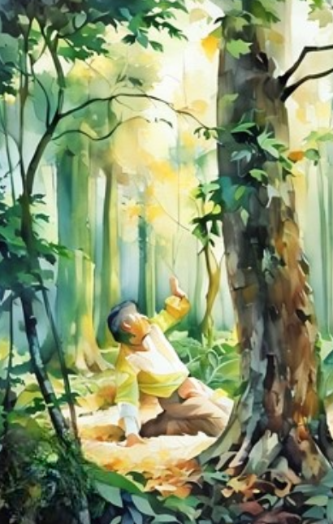
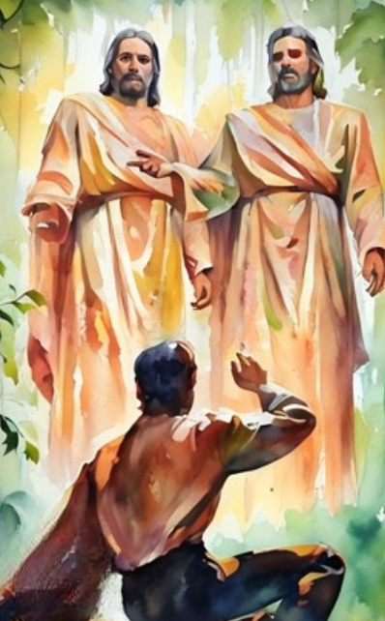
This is My Beloved Son. Hear Him!
7 Words That Changed the World
It no sooner appeared than I found myself delivered from the enemy which held me bound. When the light rested upon me I saw two Personages, whose brightness and glory defy all description, standing above me in the air.
One of them spake unto me, calling me by name and said, pointing to the other—
This is My Beloved Son. Hear Him!”
Joseph Smith—History 1:17

Slide 22
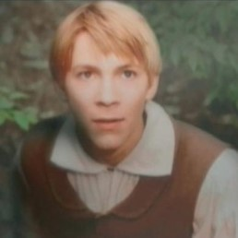
Inquire of the Lord
Which Church to join
Which sect was right
None were right–
“for they were all wrong; and the Personage who addressed me said that all their creeds were an abomination in his sight; that those professors were all corrupt; that: “they draw near to me with their lips, but their hearts are far from me, they teach for doctrines the commandments of men, having a form of godliness, but they deny the power thereof.”
Joseph Smith—History 1:18-20

Slide 23
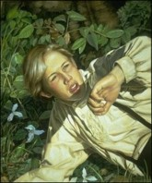
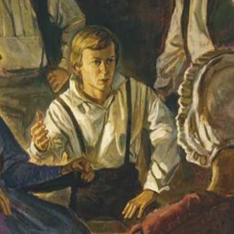
Having No Strength
I found myself lying on my back, looking up into heaven. When the light had departed, I had no strength; but soon recovering in some degree, I went home.
And as I leaned up to the fireplace, mother inquired what the matter was. I replied, “Never mind, all is well—I am well enough off.” I then said to my mother, “I have learned for myself that Presbyterianism is not true.” It seems as though the adversary was aware, at a very early period of my life, that I was destined to prove a disturber and an annoyer of his kingdom; else why should the powers of darkness combine against me?
Why the opposition and persecution that arose against me, almost in my infancy?
Joseph Smith—History 1:20

Slide 24
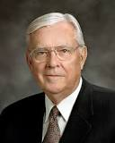
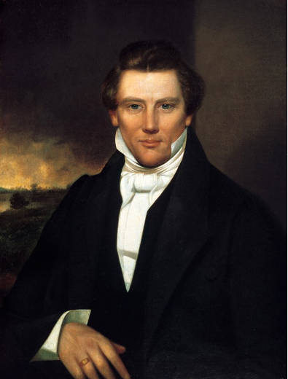
Joseph came to realize that the Bible did not contain all the answers to life’s questions; rather, it taught men and women how they could find answers to their questions by communicating directly with God through prayer.
M. Russell Ballard

Slide 25
Is God aware of us?
Does God speak to people in our day?
Does it matter what church we belong to? Why?
Is it possible to know what is true? How?

Slide 26
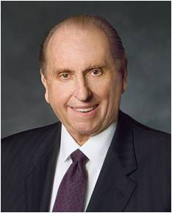
The Rest of the Story
“The two returned to Mr. Pollard’s door. Mr. Pollard answered the knock and angrily said, ‘I thought I told you young men never to return!’
“The junior companion then said, with all the courage he could muster, ‘Mr. Pollard, when we left your door, you said that we didn’t really believe Joseph Smith was a prophet of God.
I want to testify to you, Mr. Pollard, that I know Joseph Smith was a prophet of God, that by inspiration he translated the sacred record known as the Book of Mormon, that he did see God the Father and Jesus the Son.’ The missionaries then departed the doorstep.
“[Mr. Pollard later testified:] ‘That evening, sleep would not come. I tossed and turned. Over and over in my mind I heard the words, “Joseph Smith was a prophet of God. I know it. … I know it. … I know it.” I could scarcely wait for morning to come. I telephoned the missionaries. … They returned, and this time my wife, my family, and I joined in the discussion as earnest seekers of truth. As a result, we have all embraced the gospel of Jesus Christ’”
Thomas S. Monson

Slide 27
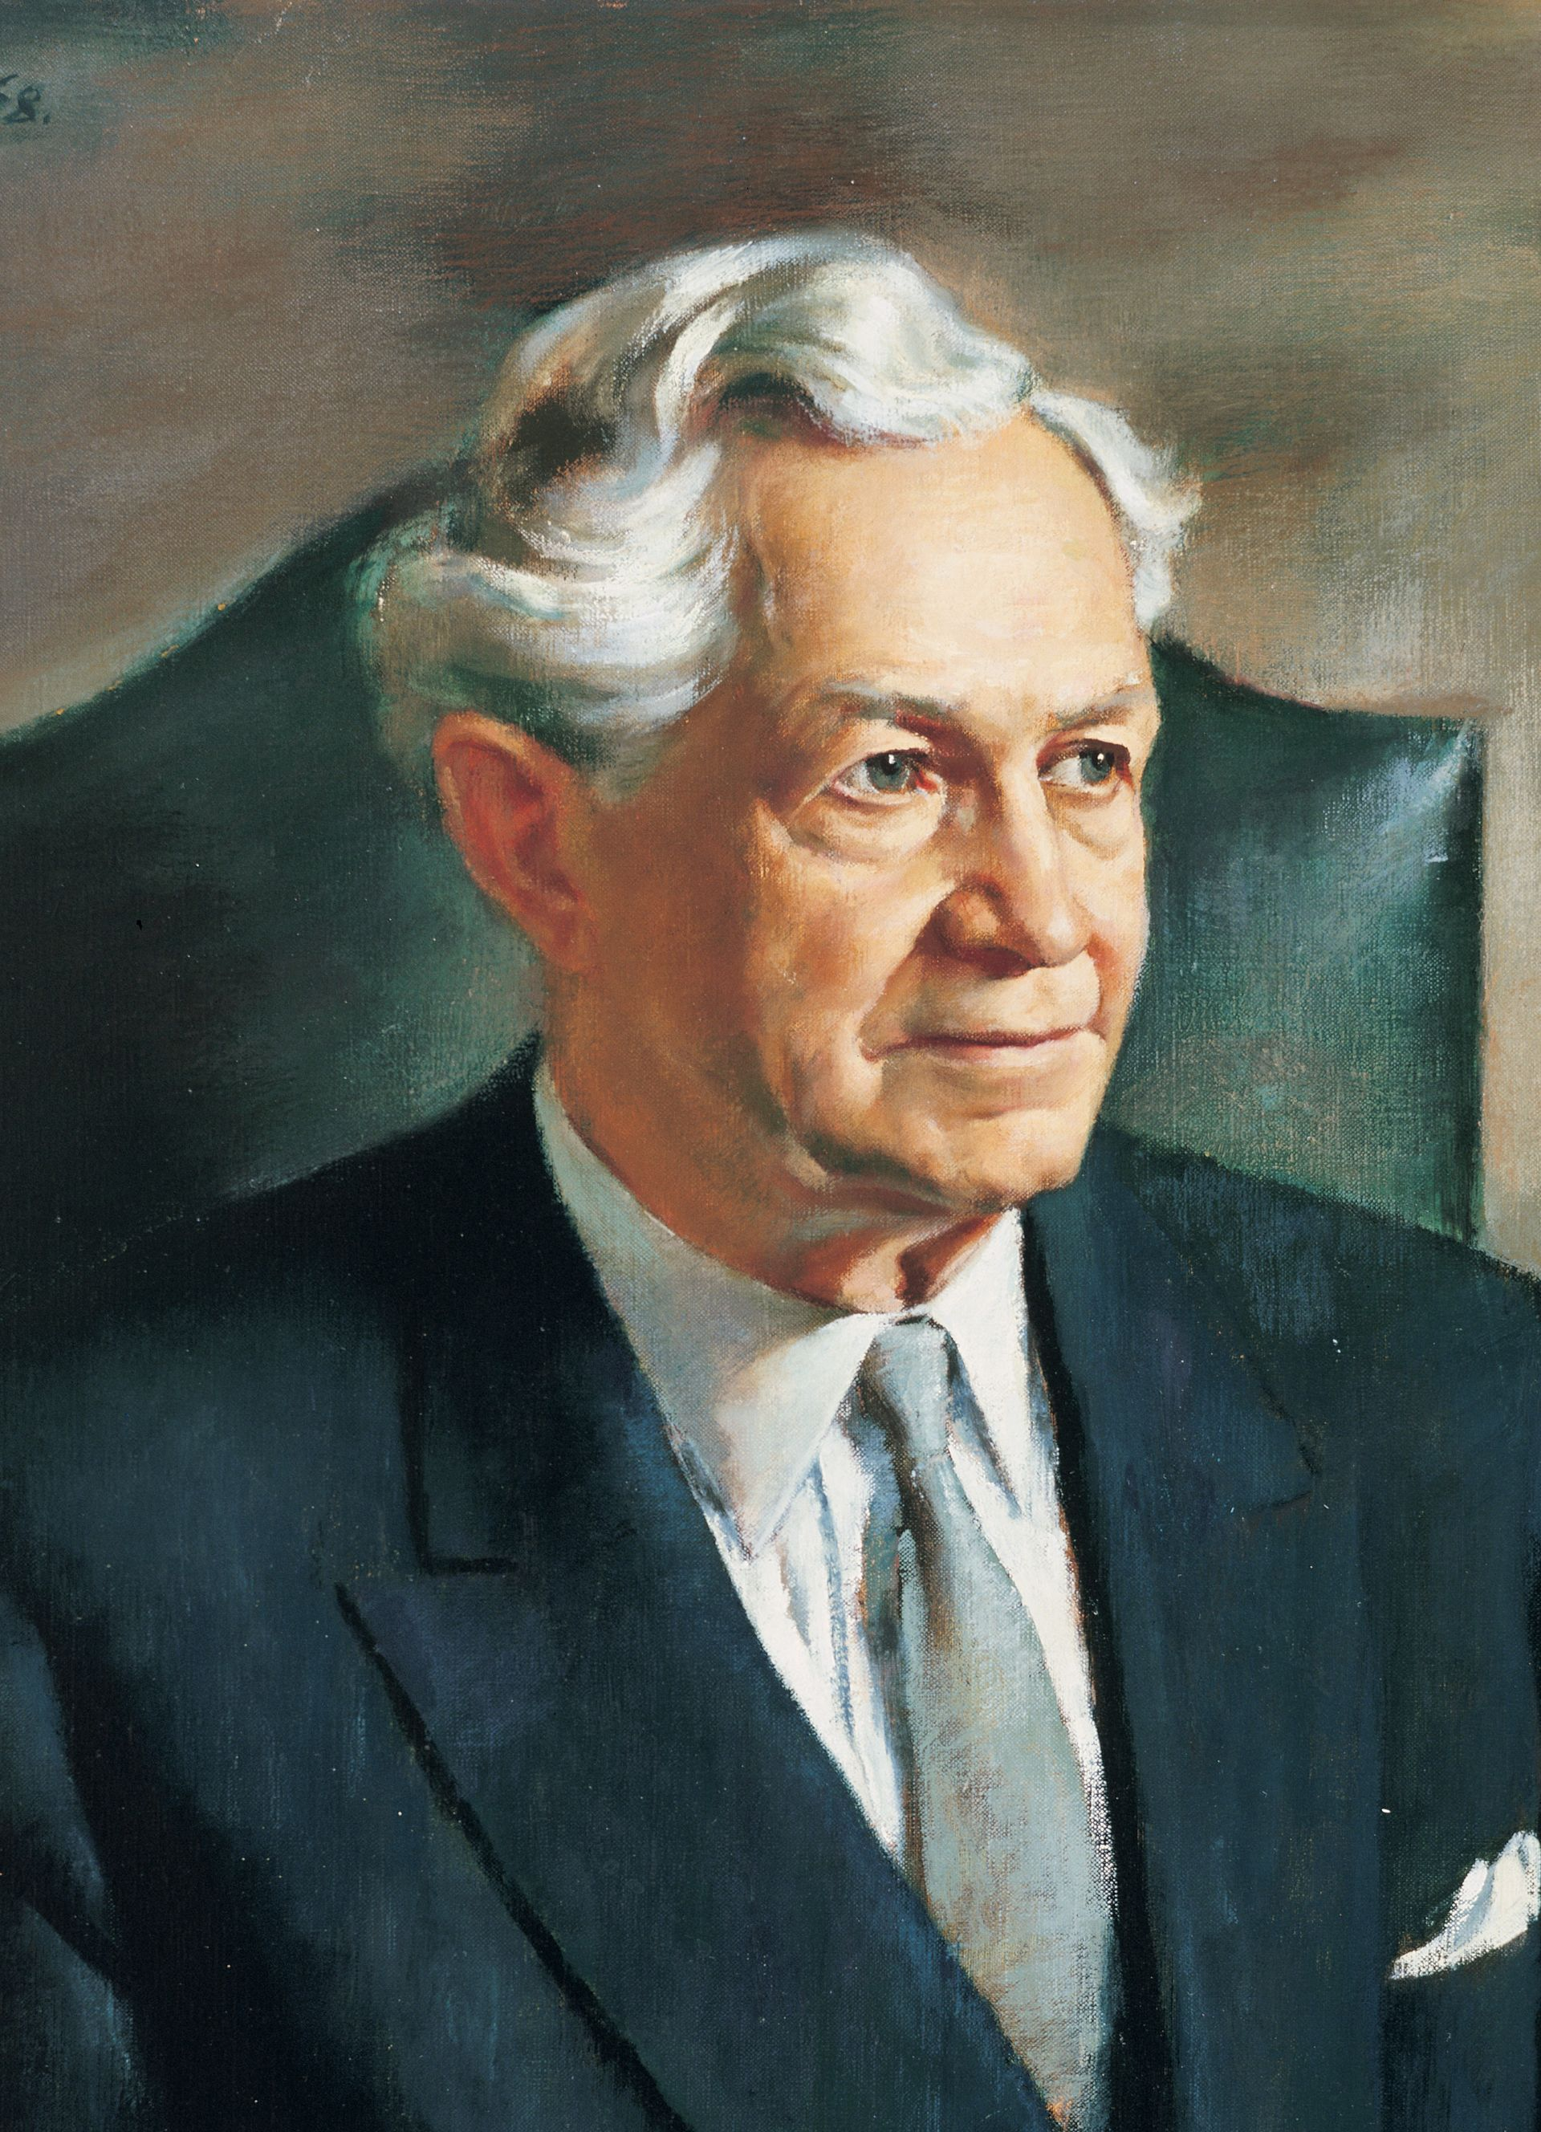
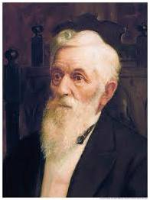
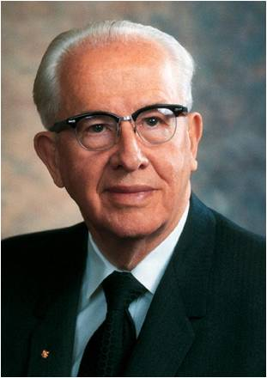
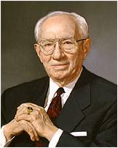
Testimony of Others
I know that Joseph Smith was a true Prophet of the living God. I testify that he saw and spoke with God and with His Son Jesus Christ. The Lord gave me this living testimony and it has been burning within my soul ever since I received it. I now give it unto the whole world. I not only testify to all mankind that Joseph Smith was sent of God and that the work that was established through him is the work of God, but warn all the nations of the earth concerning the predictions made by the Prophet, and testify in the most solemn manner that I know them to be true.
(Teachings of Presidents of the Church: Lorenzo Snow [2012], 274)
The appearing of the Father and the Son to Joseph Smith is the foundation of this Church. Therein lies the secret of its strength and vitality. This is true, and I bear witness to it. That one revelation answers all the queries of science regarding God and his divine personality. Don’t you see what that means? What God is, is answered. His relation to his children is clear. His interest in humanity through authority delegated to man is apparent. The future of the work is assured. These and other glorious truths are clarified by that glorious first vision.
(Teachings of Presidents of the Church: David O. McKay [2003], 93)
I’ve recently been in Palmyra, New York [near where Joseph Smith received the First Vision]. Of the events which occurred in that area, one is led to say: “They either happened or they did not. There can be no gray area, no middle ground.”
And then the voice of faith whispers: “It all happened. It happened just as he said it happened.”
(Teachings of Presidents of the Church: Gordon B. Hinckley: [2016], 148)
The fourteen-year-old boy stood true against the world. God knew his son [Joseph Smith] when he was chosen. He knew he would be loyal and true even to death.
(Teachings of Presidents of the Church: Ezra Taft Benson [2014], 109)

Slide 28
Sources:
Related Videos:
“Ask of God: Joseph Smith’s First Vision” (6:35)
“The Prophet Joseph Smith: Teacher by Example” (16:32; watch from time code 10:39 to 11:59 and from time code 11:59 to 14:09);
“Joseph Smith’s First Prayer” (4:08);
“A Choice Seer Will I Raise Up: The Prophet of the Restoration” (4:42)
Older Videos:
Joseph Smith Was a Prophet Part 1 (1:04)
Origin (4:57)
Preparation of Joseph Smith: The First Vision (2:05)
Joseph Smith Was a Prophet Part 2 (2:03)
The Restoration (19:20)
Doctrine and Covenants Seminary Manual 2025
Presentation by ©http://fashionsbylynda.com/blog/
President Thomas S. Monson (“The Prophet Joseph Smith: Teacher by Example,” Ensign or Liahona, Nov. 2005, 69).
(For more information about Joseph Smith’s four accounts of the First Vision, see Milton V. Backman Jr., “Joseph Smith’s Recitals of the First Vision,” Ensign, Jan. 1985, 8–17.)
Elder Neil L. Andersen (“Trial of Your Faith,” Ensign or Liahona, Nov. 2012, 41).
Elder Dallin H. Oaks (“Reading Church History” [address to CES religious educators, Aug. 16, 1985], 7, LDS.org ).
Milton V. Backman Jr., “Joseph Smith’s Recitals of the First Vision,” Ensign, Jan. 1985, 8–17.)
Richard G. Scott Using the Supernal Gift of Prayer April 2007 Gen. Conf.
Frances M. Gibbons The Dual Aspects of Prayer Oct. 1991 Gen Conf.
M. Russell Ballard, “Shall We Not Go On in So Great a Cause?,” Ensign or Liahona, May 2020, 9.

Slide 29
What was Joseph Smith’s early life like?
“[Joseph Smith’s] parents, Lucy Mack and Joseph Smith Sr., were married on 24 January 1796 and settled on a family farm in Tunbridge, Vermont. Joseph and Lucy rented a farm [in Sharon, Vermont] from Solomon Mack, Lucy’s father, in the summer of 1805 and Joseph also taught school in the winter. It was there that their fifth child, Joseph Smith Jr., was born on 23 December 1805. Lucy and Joseph taught their children religious precepts and Lucy especially encouraged the study of the Bible. Joseph Sr. was suspicious of traditional churches but always retained a strong belief in God” (The Pearl of Great Price Student Manual [Church Educational System manual, 2000], 54).
“Joseph Smith grew up on the family farm and was almost exclusively under his family’s influence. … During his formative years, Joseph Smith began to incorporate and manifest qualities that would help him fulfill his foreordained mission.
“… He developed strong family bonds, learned to work hard, to think for himself, to serve others, and to love liberty” (Church History in the Fulness of Times, 2nd ed. [Church Educational System manual, 2003], 15).
“During Joseph Smith’s earliest years, his family moved frequently, looking for fertile soil or some other way to earn a livelihood. … In 1811 the Smiths moved to the small community of West Lebanon, New Hampshire. … Typhoid fever came into West Lebanon. … One by one the Smith children fell ill. …
“Seven-year-old Joseph, Jr., recovered from [typhoid] fever after two weeks but suffered complications that eventually required four surgeries. The most serious complication involved a swelling and infection in the tibia of his left leg. … Joseph was in agony for over two weeks.” Joseph endured an operation to remove the infection from his leg “without being bound or drinking brandy wine to dull his senses” (Church History in the Fulness of Times, 22–23).
“In 1816, Joseph Sr. went to Palmyra, New York, to investigate the report of good land at low cost. Joseph Jr., at the time a boy of ten, remembered that even though he was not yet fully recovered from his leg operation, the teamster engaged to assist the Smiths in their journey made him walk through snow, forty miles per day for several days, during which time he suffered the most excruciating weariness and pain” (The Pearl of Great Price Student Manual, 54).
“Joseph Smith, Sr., the father of a family of ten—eleven by 1821—worked hard for a living. After two years in Palmyra, he accumulated enough money for a down payment on one hundred acres of wooded land in the nearby township of Farmington. During the first year he and his sons cleared thirty acres of heavy timber, prepared the ground for cultivation, and planted wheat. … Young Joseph later recalled that ‘it required the exertions of all that were able to render any assistance for the support of the Family.’ [“History of Joseph Smith By Himself,” 1832 (written in Kirtland, Ohio, between 20 July and 27 Nov. 1832), LDS Historical Department, Salt Lake City, p. 1.] …
“At this time Joseph’s opportunities for schooling were limited. He attributed this to the ‘indigent circumstances’ he was raised under. ‘We were deprived of the benefit of an education. Suffice it to say, I was merely instructed in reading, writing, and the ground rules of arithmetic which constituted my whole literary acquirements’ [“History of Joseph Smith By Himself,” pp. 1–2]” (Church History in the Fulness of Times, 29–30).

Slide 30
The Accounts of the First Vision:
In conclusion, an examination of the four accounts of the First Vision reveals several important concepts concerning the writing of Church history. Recognizing the importance of preserving that which had transpired, Joseph Smith devoted many hours during the 1830s and early 1840s to recording events which he had witnessed. While describing his sacred experience of 1820, he sometimes emphasized one theme and at other times concentrated on other major concepts. Although the precise wording of what he learned from the Savior is different in all the accounts, the same basic message was included in all except the 1835 recital—that God’s true church was not upon the earth in 1820. Of utmost importance was not the specific language in which the truths were unfolded but the truths themselves.
Since the 1838 recital was included in the Pearl of Great Price, an investigation of the publications of this history helps one better understand principles concerning the formation of scriptures. Joseph Smith was responsible for many changes in punctuation, spelling, and other similar revisions in his manuscript history. After a portion of this history was canonized in the Pearl of Great Price, additional textual refinements were made by editors acting under the authorization of Church leaders. These revisions were apparently made in the interests of grammatical quality, clarification, and consistency. Several short paragraphs were also added that had been included as notes in the manuscript history prior to the Prophet’s martyrdom. All these alterations were in harmony with precedents set by Joseph Smith in his textual revisions of latter-day scriptures. In no instance was there a change in the basic message recorded in the manuscript history concerning the historical setting of the First Vision or the truths unfolded during this remarkable experience. But changes were made in an effort to convey the truths unfolded by God in the latter-days in the best and clearest language that man could fashion.
Milton V. Backman, Jr., father of three, is a professor of Church History at Brigham Young University and serves as a regional welfare agent in the Provo Utah Edgemont Region.—see Milton V. Backman Jr.
Joseph Smith—History. When was Joseph Smith’s official history published?
In 1838 Joseph Smith began work on his official history, which was published in the newspaper Times and Seasons in 1842. This history later became part of the six-volume A Comprehensive History of the Church by B. H. Roberts in 1957. Joseph Smith—History, as it is found in the standard works, was extracted from Joseph Smith’s official history and published as part of a missionary tract called the Pearl of Great Price in 1851. The Pearl of Great Price was canonized as scripture in 1880.

Slide 31
Family of Joseph Smith Sr. and Lucy Mack Smith: The First Family of the Restoration Dec. 2005 Ensign
Joseph SMITH Sr. was born July 12, 1771, in Topsfield, Massachusetts. He married Lucy MACK on January 24, 1796, in Tunbridge, Vermont. Lucy was born July 8, 1775, in Gilsum, New Hampshire. They were the parents of 11 children, listed here in order of birth. Joseph Sr. died September 14, 1840, in Nauvoo, Illinois. Lucy died May 8, 1856, in Nauvoo, Illinois.
* Infant son SMITH was born and died in 1797, Tunbridge, Vermont.
Alvin SMITH was born February 11, 1798, in Tunbridge, Vermont, and died November 19, 1823, in Manchester Township, New York, at the age of 25.
Hyrum SMITH was born February 9, 1800, in Tunbridge, Vermont. He married Jerusha BARDEN on November 2, 1826, in Manchester Township, New York. They had six children. After Jerusha’s death, Hyrum married Mary FIELDING on December 24, 1837, in Kirtland, Ohio. They had two children. Hyrum was martyred June 27, 1844, in Carthage, Illinois. He has 13,583 known descendants. **
Sophronia SMITH was born May 17, 1803, in Tunbridge, Vermont. She married Calvin W. STODDARD on December 2, 1827, in Palmyra, New York. They had two children. After Calvin’s death, Sophronia married William * McCLEARY on February 11, 1838, in Kirtland, Ohio. No children. She died October 28, 1876, in Colchester, Illinois. Sophronia has five known descendants. **
Joseph SMITH Jr. was born December 23, 1805, in Sharon, Vermont. He married Emma HALE on January 18, 1827, in South Bainbridge, New York. They had 11 children. The Prophet Joseph was martyred June 27, 1844, in Carthage, Illinois. He has 1,112 known descendants. **
Samuel Harrison SMITH was born March 13, 1808, in Tunbridge, Vermont. He married Mary BAILEY on August 13, 1834, in Kirtland, Ohio. They had six children. After Mary’s death, Samuel married Levira CLARKon April 29, 1841, in Nauvoo, Illinois. They had three children. Sometimes called the third martyr, Samuel died July 30, 1844, in Nauvoo, Illinois, of injuries sustained while riding from Nauvoo to Carthage to aid his brothers. He has 460 known descendants. **
Ephraim SMITH was born and died March 13, 1810, in Royalton, Vermont.
William B. SMITH was born March 13, 1811, in Royalton, Vermont. He married Caroline A. GRANT on February 14, 1833, in Kirtland, Ohio. They had two children. After Caroline’s death, he married Roxie R. GRANT on May 19, 1847, in Knox, Illinois. They had two children. After they divorced, William married Eliza E. SANBORN on November 12, 1857, in Kirtland, Ohio. They had three children. After Eliza’s death, William married Rosella GOYETTE on December 21, 1889, in Clinton, Iowa. No children. William died on November 13, 1893, in Osterdock, Iowa. He has 234 known descendants. **
* Katharine SMITH was born July 28, 1813, in Lebanon, New Hampshire. She married Wilkins J. SALISBURY on January 8, 1831, in Kirtland, Ohio. They had eight children. After his death, she married Joseph YOUNGERin Illinois. Soon afterward, they divorced. No children. She died February 1, 1900, in Fountain Green, Illinois. Katharine has 92 known descendants. **
Don Carlos SMITH was born March 25, 1816, in Norwich, Vermont. He married Agnes Moultin COOLBRITH on July 30, 1835, in Kirtland, Ohio. They had three children. He died August 7, 1841, in Nauvoo, Illinois. Don Carlos has six known descendants. **
Lucy SMITH was born July 18, 1821, in Manchester Township, New York. She married Arthur MILLIKIN on June 4, 1840, in Nauvoo, Illinois. They had nine children. She died December 9, 1882, in Colchester, Illinois. Lucy has 92 known descendants. **

Slide 32
Doctrine and Covenants 21-26
Sharing the Experience with the World

Slide 33
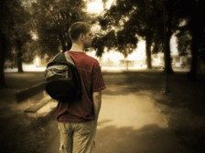
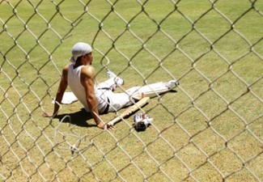
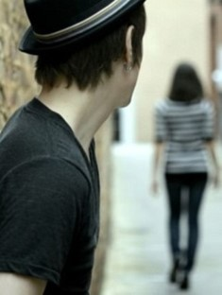
A Conversation with a Young Man in London
President Gordon B. Hinckley
“He said, ‘I’ve got to talk with someone. I’m all alone. …’
“And I said, ‘What’s your problem?’
“And he said, ‘When I joined the Church a little less than a year ago, my father told me to get out of his home and never come back. And I’ve never been back.’
“He continued, ‘A few months later the cricket club of which I was a member read me off its list, barring me from membership with the boys with whom I had grown up and with whom I had been so close and friendly.’
“Then he said, ‘Last month my boss fired me because I was a member of this church, and I have been unable to get another job. …
“‘And last night the girl with whom I have gone for a year and a half said she would never marry me because I’m a Mormon’”

Slide 34
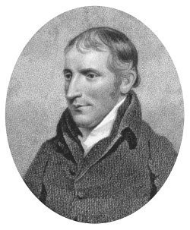
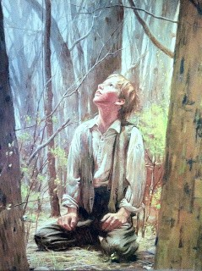
Severely Tested
After Joseph Smith’s Conversation with the Methodist Preacher
“…he treated my communication not only lightly, but with great contempt, saying it was all of the devil, that there were no such things as visions or revelations in these days; that all such things had ceased with the apostles, and that there would never be any more of them.
“…cause of great persecution, which continued to increase; and though I was an obscure boy, only between fourteen and fifteen years of age, and my circumstances in life such as to make a boy of no consequence in the world, yet men of high standing would take notice sufficient to excite the public mind against me, and create a bitter persecution; and this was common among all the sects—all united to persecute me.”
Joseph Smith –History 1:22-23

Slide 35
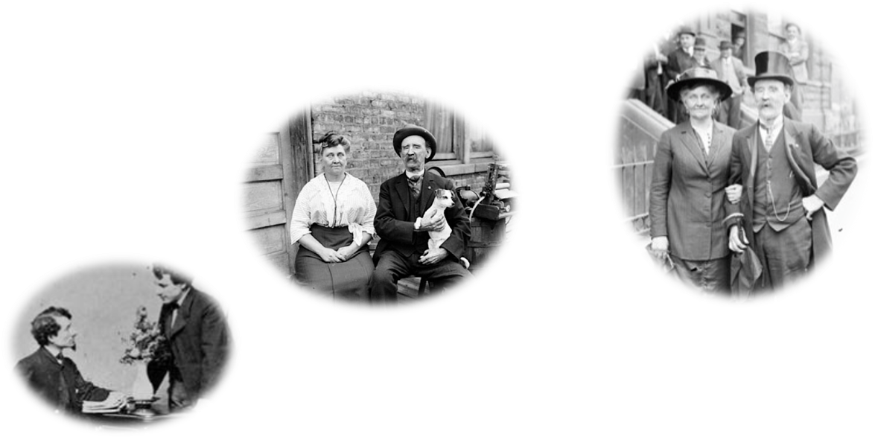
The Persecutors
People of high standing in the community who claimed to be Christians
According to Joseph Smith, why did he experience this persecution at such a young age?
Satan recognized that Joseph Smith would be
“a disturber and an annoyer of his kingdom”
Joseph Smith –History 1:22-23

Slide 36
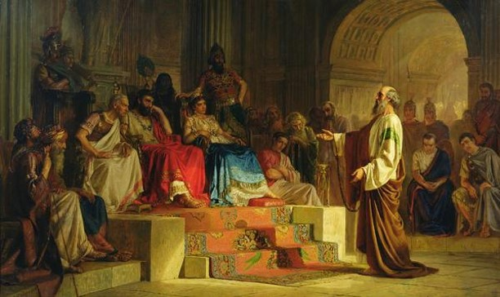
Staying True to Testimony
Joseph Smith felt like Paul in his defense to King Agrippa
Paul had been mocked for his testimony of Jesus Christ and yet remained true to it
Paul had been whipped, in prison many times, beaten with rods, stoned, three times shipwrecked, in perils of robbers, countrymen, heathen, wilderness, sea, and false teachers.
He is weary, and in pan and hungry and thirst with fasting,
naked and cold
But his testimony remains true
2 Corinthians 11:23-27
Joseph Smith –History 1:24

Slide 37
Remaining True in Difficult Times
During difficult times, we can draw strength from the examples of faithful individuals in the scriptures
When have you been strengthened by studying the experience of a faithful individual in the scriptures?
The knowledge we receive from God is true even if the world rejects it.
We should be more concerned about what God thinks of us than what men think.
Even if we are hated and persecuted for our testimonies, we must remain true to them.
Joseph Smith –History 1:25

Slide 38
The Rest of the Story
“I said, ‘If this has cost you so much, why don’t you leave the Church and go back to your father’s home and to your cricket club and to the job that meant so much to you and to the girl you think you love?’
“He said nothing for what seemed to be a long time. Then, putting his head down in his hands, he sobbed and sobbed. Finally, he looked up through his tears and said, ‘I couldn’t do that. I know this is true, and if it were to cost me my life, I could never give it up’”
President Gordon B. Hinckley

Slide 39
Until Further Directed
“I had now got my mind satisfied so far as the sectarian world was concerned—that it was not my duty to join with any of them, but to continue as I was until further directed. I had found the testimony of James to be true—that a man who lacked wisdom might ask of God, and obtain, and not be upbraided.”
Joseph Smith –History 1:26

Slide 40
Sources:
Video:
The Loneliness of Leadership 1:03 and 0:58
Joseph Smith and the Minister (1:57)
President Gordon B. Hinckley (“The Loneliness of Leadership” [Brigham Young University devotional address, Nov. 4, 1969], 3, speeches.byu.edu ).
Picture of Methodist Pastor—not the one Joseph talked to. The Reverend Joseph Sutcliffe, An Early Scriptural Geologist and Methodist Pastor.
Presentation by ©http://fashionsbylynda.com/blog/

