Slide 1

At the Ohio
History in Doctrine and Covenants 41 and 42
Law of Consecration
If we know to do good but choose not to do it, we commit sin
Presentation by ©http://fashionsbylynda.com/blog/

Slide 2
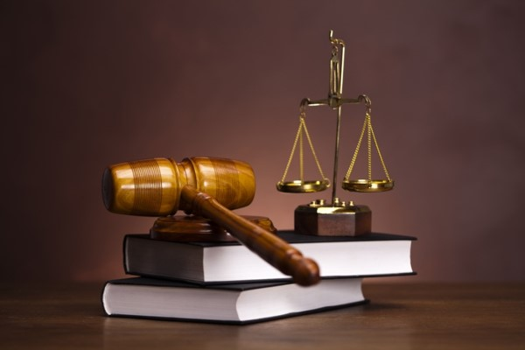

Laws
Why are laws important?
Why might laws be important in the Church?
Once the Saints arrived in Ohio, the Lord fulfilled His promise and gave a revelation referred to as the Law of the Church.
D&C 41:1-3

Slide 3

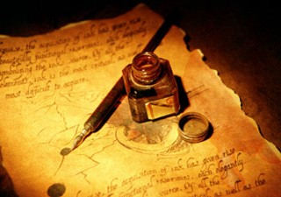

Law of Consecration
A little over a year after the Lord revealed the law of consecration, He commanded the leaders of the Church to establish the United Firm.
One purpose of the United Firm, which was based on principles of the law of consecration, was to establish storehouses to assist with the temporal needs of Church members, especially those who were poor.
This was a blessing to the Saints at this time because many Church members who had relocated from New York to Ohio had to leave behind their homes and property. The United Firm also provided funds to finance various Church undertakings, such as missionary work and publishing efforts.
D&C 42:31-38

Slide 4
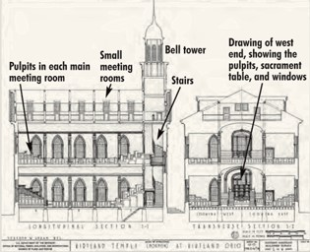
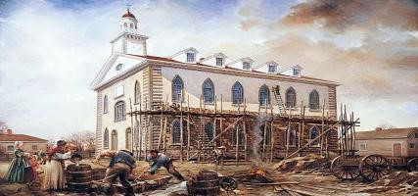
A “House” Built
“Organize yourselves; prepare every needful thing; and establish a house, even a house of prayer, a house of fasting, a house of faith, a house of learning, a house of glory, a house of order, a house of God;”
D&C 88:119
The Kirtland Temple took about three years to build. After the temple was dedicated on March 27, 1836, the Lord began to fulfill His promise to endow the Saints with power and they experienced marvelous spiritual blessings.
D&C 41:7

Slide 5
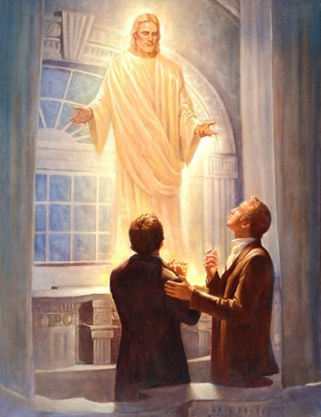
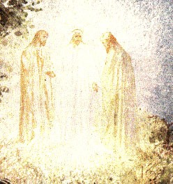
Spiritual Blessings
The Lord personally appeared to Joseph Smith and Oliver Cowdery in the Kirtland Temple and declared that He had “accepted this house”
“For behold, I have accepted this house, and my name shall be here; and I will manifest myself to my people in mercy in this house.”
D&C 110:7
He also sent three heavenly messengers—Moses, Elias, and Elijah—to restore vital priesthood keys to the earth. These keys would give the Saints the authority to perform temple ordinances and to seal families for eternity. In addition, the “keys of the gathering of Israel” were restored at this time (D&C 110:11). As a result, missionaries are called and authorized to teach the gospel throughout the earth.

Slide 6
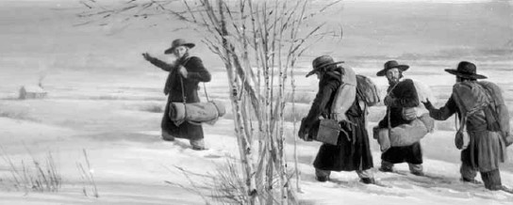
Missionary Work
What commandment did the Lord give the Saints?
How were these missionaries to preach the gospel?
How is this similar to how full-time missionaries preach the gospel today?
Once the Kirtland Temple had been dedicated and the keys for the gathering of Israel had been restored, members of the Church began to preach the gospel of Jesus Christ in more places.
“And from thence, whosoever I will shall go forth among all nations, and it shall be told them what they shall do; for I have a great work laid up in store, for Israel shall be saved, and I will lead them whithersoever I will, and no power shall stay my hand.”
D&C 38:33
D&C 42:6-7

Slide 7
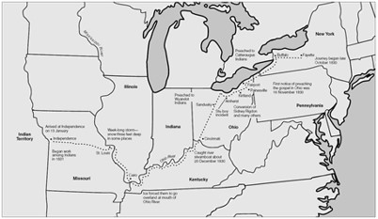
Ideal Location
Kirtland was an ideal location to begin to send missionaries throughout the world.
Kirtland was near several main routes of transportation in the United States.
From Kirtland, missionaries only had to travel short distances to access steamboats on America’s major rivers and Lake Erie.
They also had access to a national road system to the south and a canal system to the north. Because of this, Kirtland was the point of departure for missions to Canada, other parts of the United States, and Great Britain.

Slide 8
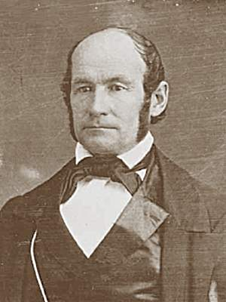
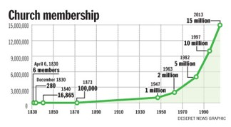
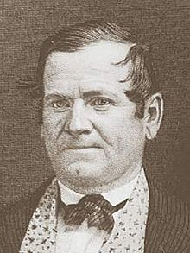
Increased Membership
Because of missionary work during this time, the membership of the Church throughout the world increased by thousands.
In 1837, Elders Heber C. Kimball and Orson Hyde were called along with five others on a mission to Great Britain, where they baptized around 2,000 people.
By 1838, when the Saints left Kirtland because of persecution, there were about 2,000 members of the Church living in Kirtland and nearly 18,000 worldwide.

Slide 9
Other Revelations
After Joseph Smith arrived in Ohio, the Lord told him that he would “receive revelation upon revelation” if he would ask God.
D&C 107
D&C 76:137
Joseph Smith to organize the Church leadership during this time. The First Presidency, the Quorum of the Twelve Apostles, and the Quorum of the Seventy were officially organized while the Saints lived in Ohio.
In addition, Joseph Smith continued his work on the translation of the Bible.
D&C 89
MILK

Slide 10
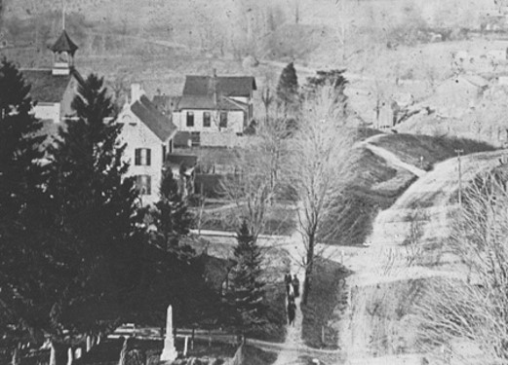
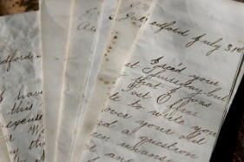
Opposition
As soon as the Saints arrived in Kirtland, anti-Mormon critics began to attack the Church.
“Many false reports, lies, and foolish stories, were published in the newspapers, and circulated in every direction, to prevent people from investigating the work, or embracing the faith.”
Joseph Smith
In September of 1831, a former member of the Church named Ezra Booth tried to dissuade people from joining the Church and published nine letters detailing his criticisms of the Church

Slide 11
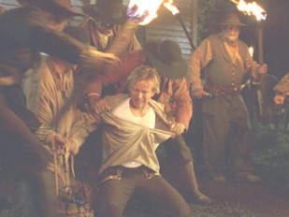
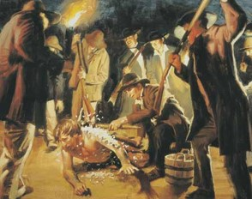
Persecution at its worst
In one severe incident, on the night of March 24, 1832, a mob of 25 to 30 men attacked the John Johnson home in Hiram, Ohio, where Joseph and Emma Smith were staying. The men overpowered Joseph Smith and dragged him out into the night.
They choked him, stripped him, and tried to force a vial of acid into his mouth, which chipped one of his teeth, causing him thereafter to speak with a slight whistle.
Then they left him covered with tar and feathers.
When Joseph regained some strength he made his way back to the house. When he came to the door and Emma saw him covered in tar, which looked to her like blood, she fainted.

Slide 12
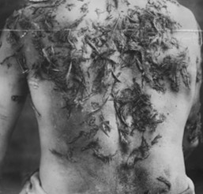
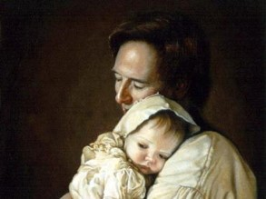
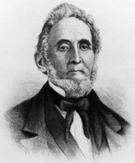
Friends spent the night cleaning off the tar. The next day, which was Sunday, Joseph preached a sermon that was attended by some members of the mob. Following the sermon, Joseph baptized three people.
During the struggle and confusion of this attack, the door to the house was left open. As a result, Joseph’s son, Joseph Murdock Smith, who was already sick with the measles, caught a “severe cold” and died five days later.
That same night Sidney Rigdon was dragged by his heels from his home. His head was severely lacerated by the rough, frozen ground, and he was delirious for several days.
Joseph Smith

Slide 13
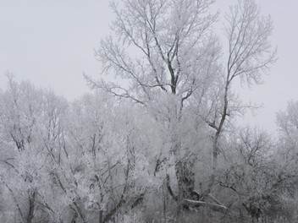

In spite of these and other difficulties, the Saints continued to gather in Kirtland, particularly from 1836 to 1838.
However, persecution became so intense during the winter of 1837 and spring of 1838 that most of the Saints were compelled to leave Ohio.
Some Church leaders, including Joseph Smith, Sidney Rigdon, and Brigham Young, had to flee Kirtland for the safety of their lives.

Slide 14
Sources:
Videos:
The Heart and a Willing Mind (7:56)
Video presentation—Opposition to the Church
To help students visualize the opposition the Saints experienced in Ohio in 1831 and 1832, show segments of the film Joseph Smith: The Prophet of the Restoration. This film is available on mormonchannel.org. A portion of the film contains a depiction of the mob’s attack on Joseph Smith that is referenced in this lesson. The segment most fitting this lesson begins at about 25:30 and runs until approximately 28:00.
Joseph Smith History of the Church, 1:158
History of the Church, 1:261–65
Presentation by ©http://fashionsbylynda.com/blog/

Slide 15
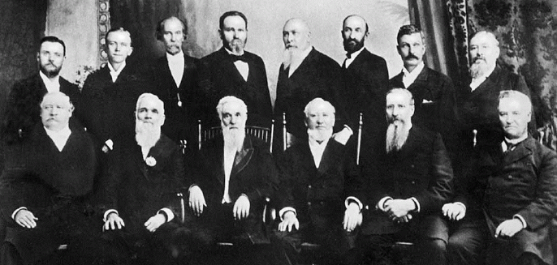
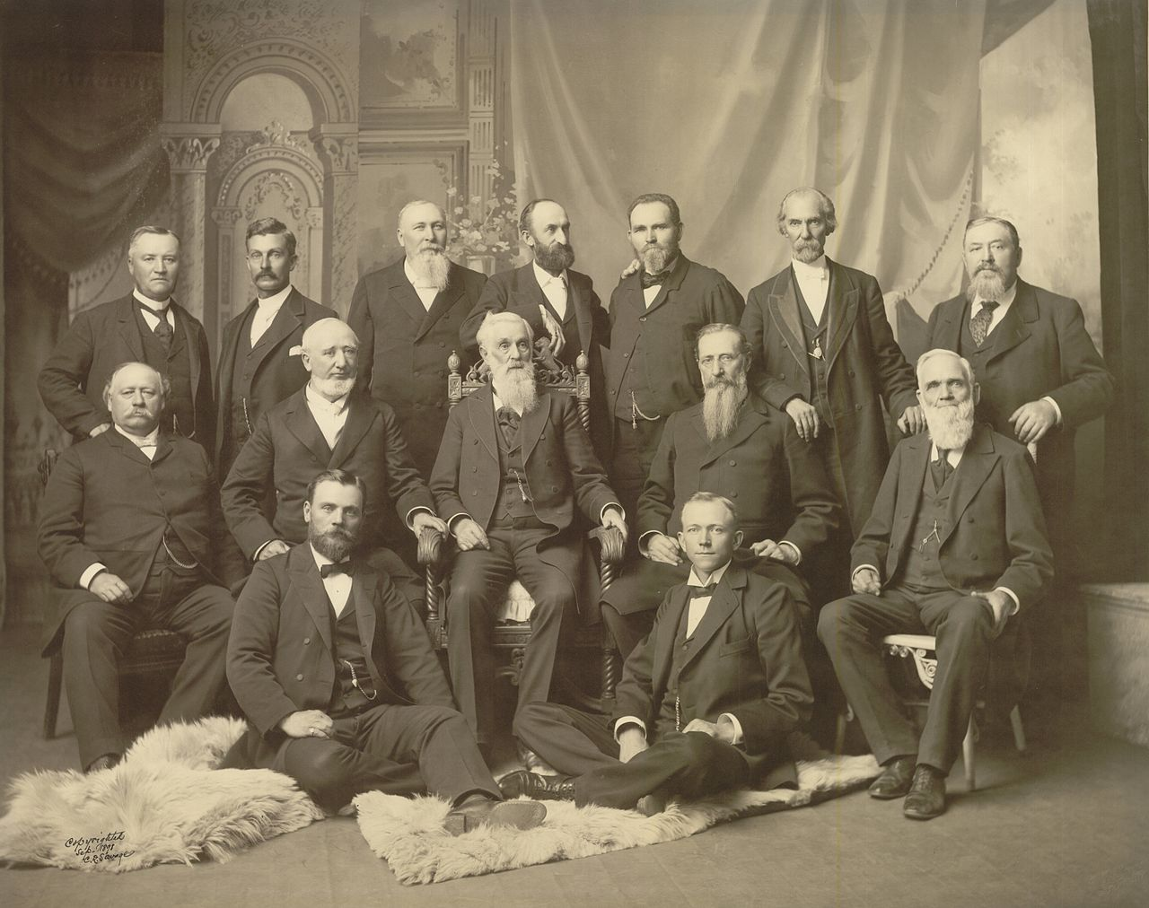
1898 First Presidency of Quorum of the Twelve

Slide 16
LETTER I.
NELSON, Portage Co. Sept. 1831.
Rev. Ira Eddy ---
Dea r Sir: I received yours of the 2d inst. and heartily thank you for
the favor. It revives afresh in my recollection the scenes of past
years, upon the remembrance of which, I dwell with a mixture of
pleasurable and painful sensations. I arrived at my home on the 1sr
of the present month, having finished my tour to the west; since
which time the scenes and events in the history of my life, for the
last few months, have passed in review before my mind.
You are not, it is probable, ignorant of the designs of my most
singular and romantic undertaking: sufficient to say, it was for the
purpose of exploring the promised land -- laying the foundation of
the city of Zion, and placing the corner stone of the temple of
God. A journey of one thousand miles to the west, has taught me
far more abundantly, than I should have probably learned from any
other source. It has taught me quite beyond my knowledge, the
imbecility of human nature, and especially my own weakness. It
has unfolded in its proper character, a delusion to which I had
fallen a victim, and taught me the humiliating truth, that I was
exerting the powers of both my mind and body, and sacrificing my
time and property, to build up a system of delusion, almost
unparalleled in the annals of the world.
If God be a God of consistency and wisdom I now know Mormonism
to be a delusion; and this knowledge is built upon the testimony of
my senses. In proclaiming it, I am aware I proclaim my own
misfortune -- but in doing it, I remove a burden from my mind, and
discharge a duty as humbling to myself, as it may be profitable to
others. You had heard the story of my wanderings, and "was
induced to believe that I had been visited with a species of mental
derangement," and therefore, you "had given me up, as one
among those friends of early association, who in the lapse of time,
would be as though they had not existed." You had concluded that
the magic charm of delusion and falsehood, had so wrapped its
sable mantle around me, as to exclude the light of truth and
secure me a devoted slave. But thanks be to God! the spell is
dissipated, and the "captive exile hasteneth that he may be
loosed, and not die in the pit." When I embraced Mormonism, I
conscientiously believed it to be of God. The impressions of my
mind were deep and powerful, and my feelings were excited to a
degree to which I had been a stranger. Like a ghost, it haunted me
by night and by day, until I was mysteriously hurried, as it were,
by a kind of necessity, into the vortex of delusion. -- At times I
was much elated; but generally, things in prospect were the
greatest stimulants to action. On our arrival in the western part of
the State of Missouri the place of our destination, we discovered that
prophecy and vision had failed, or rather had proved false. --
The fact was so notorious, and the evidence so clear, that no one could mistake it -- so much so, that Mr. Rigdon himself said that "Joseph's vision was a bad thing." This was glossed over, apparently, to the satisfaction of most persons present; but not fully to my own. It excited a suspicion that some things were not right, and prepared my mind for the investigation of a variety of circumstances, which occurred during my residence there, and indeed, to review the whole subject, from its commencement to that time. My opportunities for a thorough investigation, were far greater than they could have been, had I remained at home; and therefore, I do not regret that I made the journey, though I sincerely regret the cause of it. Since my return, I have had several interviews with Messrs. Smith, Rigdon and Cowdery, and the various shifts and turns, to which they resorted in order to obviate objectors and difficulties, produced in my mind additional evidence, that there was nothing else than a deeply laid plan of craft and deception.
The relation in which Smith stands to the church, is that of a
Prophet, Seer, Revealer, and Translator; and when he speaks by
the Spirit, or says he knows a thing by the communication of the
Spirit, it is received as coming directly from the mouth of the Lord.
When he says he knows a thing to be so, thus it must stand
without controversy. A question is agitated between two Elders of
the church -- whether or not a bucket of water will become
heavier by putting a living fish in it. Much is said by each of the
disputants; when at length, Smith decides in the negative, by
saying -- "I know by the spirit, that it will be no heavier." Any
person who chooses, may easily ascertain by actual experiment,
whether the Prophet was influenced in this decision by a true or
false spirit.
It is not my design, at this time, to enter into particulars relative
to the evidence upon which my renunciation of Mormonism is
founded. This evidence is derived from various sources, and is
clear and full, and the conviction which it produces, at least on my
mind, is irresistible. You are not aware of the nature of this
deception, and the spirit that uniformly attends it; nor can you
e ver know it, unless you yield to its influence, and by experience
learn what it is to fall under its power: "from which my earnest
prayer is, that you may ever, ever escape." There probably never
was a plan better suited to lead the sinner and the conscientious,
when in an unguarded hour they listen to its fatal insinuations. The
plan is so ingeniously contrived, having for its aim one principal
point, viz: the establishment of a society in Mis souri, over which
the contrivers of this delusive system, are to possess unlimited and despotic sway.
To accomplish this, the Elders of the church, by commandment given in Missouri, and of which I was both an eye and an ear witness, are to go forth to preach Mormonism to every
creature; and now, said Mr. Rigdon --"The Lord has set us our stint; no matter how soon we perform it -- for when this is done,
he will make his second appearance." I do sincerely, and I trust in deep humility, return unfeigned gratitude to the God of infinite
mercy, who, in condescension to my weakness, by a peculiar train of providences, brought me to the light, enabled me to see the
hidden things of darkness, and delivered me from the snare of the fowler, and from the contagious pestilence which threatened my
entire destruction. The scenes of the past few months, are so different from all others in my life, that they are in truth to me "as a dream when one awaketh." Had my fall affected only myself, my reflections would be far less painful than they now are. But to know -- that whatever influence
I may have possessed, has been exerted to draw others into a
delusion, from which they may not soon be extricated, is to me a
source of sorrow and deep regret. They are at this moment the
object of my greatest anxiety and commiseration. I crave their
forgiveness, and assure them, that they will ever have an interest
in my addresses to the throne of grace. It shall be my endeavor to
undo, as far as possible, what I have done in this case, and also
to prevent the spread of a delusion, pernicious in its influence, and
destructive in its consequences to the body and the soul -- to the
present and eternal interests of all men. I am, through restoring
mercy and grace, as in former years, though unworthily, yet
affectionately yours in Christ, EZRA BOOTH.
To see more letters:
http://www.truthnet.org/Mormon/Mormonismunveiled/15_1831Ezrabooth.htm

Slide 17
Apostasy in Kirtland
In 1833, another former member caused great problems for the Church. Doctor Philastus Hurlbut had been an elder in the Church but was excommunicated for committing adultery while serving a mission. Although the Church leaders showed him mercy and allowed his membership to be restored, he again transgressed and was cut off a second time. Hurlbut then attempted to discredit the Church and Joseph Smith by collecting anti-Mormon affidavits and falsely claiming that the Book of Mormon was based on a manuscript written by Solomon Spaulding rather than translated by the power of God.
Hurlbut claimed that Sidney Rigdon had secretly obtained the Spaulding manuscript and had plagiarized it with Joseph Smith to create the Book of Mormon. However, this attempt to discredit the Book of Mormon was entirely unfounded. When the Spaulding manuscript was found, an examination could not find the alleged parallels to the Book of Mormon or even a resemblance between the two. Further, Sidney Rigdon did not even meet Joseph Smith until well after the publication of the Book of Mormon. Oliver Cowdery testified to the falsehood of Hurlbut’s accusations: “‘I … handled with my hands the gold plates from which [the Book of Mormon] was translated. I also beheld the interpreters. That book is true. Sidney Rigdon did not write it. Mr. Spaulding did not write it. I wrote it myself as it fell from the lips of the prophet.’ [Reuben Miller, journal, 1848–1849, Family and Church History Department Archives, 21 Oct. 1848; punctuation and spelling modernized.]” (as quoted in James E. Faust, “Some Great Thing,” Ensign, Nov. 2001, 47).
Some Ohioans, worried that members of the Church would soon be so numerous that they would form a voting block and have political power, paid Philastus Hurlbut to defame Joseph Smith and the Book of Mormon. Joseph Smith lamented in a letter that the Church members were “suffering great persecution on account of one man by the name of Doctor Hurlbut who has been expelled from the church for lewd and adulterous conduct and to spite us he is lying in a wonderful manner and the people are running after him and giving him money to break down Mormonism which much endangers our lives at present” (“Letter to William W. Phelps and Others, 18 August 1833,” 3; see josephsmithpapers.org ; spelling standardized).

