Slide 1
Doctrine and Covenants 88:1-41
Truth and Light
It was the true Light, which lighteth every man that cometh into the world.
John 1:9
Presentation by http://fashionsbylynda.com/blog/

Slide 2
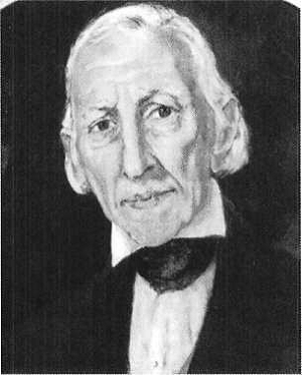
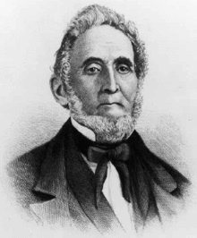
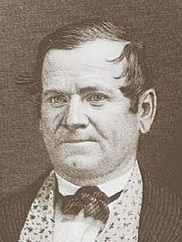
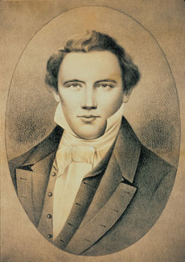
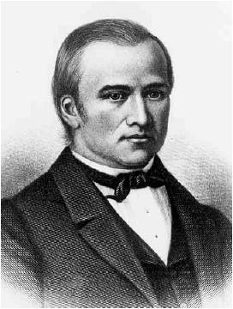
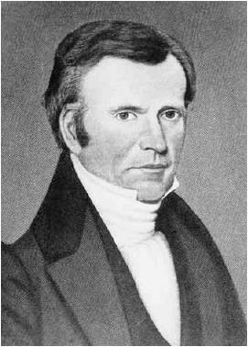
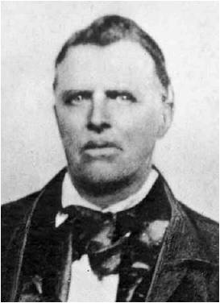
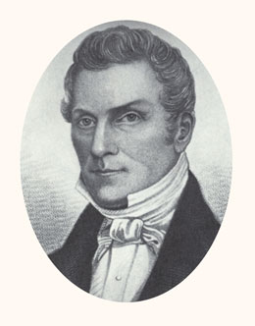
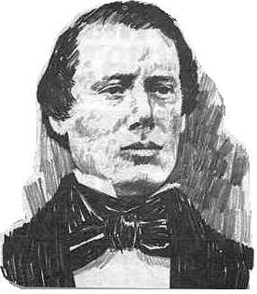
Background
December 27,1832 in Kirtland, Ohio
In a conference, ten high priests, including the Prophet, met in Kirtland to find out the Lord’s will concerning the building of Zion and the duty of the elders of the Church.
The conference lasted two days, during which Joseph instructed the nine other brethren on how to receive the blessings of heaven and the mind of the Lord.
Most of section 88 (vv. 1–126) was given in segments over the two days of the conference.
The 10:
Joseph Smith Sr., Sidney Rigdon, Orson Hyde, Joseph Smith Jr., Hyrum Smith, Samuel H. Smith, Newel K. Whitney, Frederick G. Williams, Ezra Thayer, and John Murdock.

Slide 3
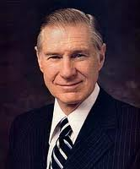
Completely In The Dark
Part of our coming into the light depends upon the focus of our faith. Our faith is not a bundle of beliefs and practices that are too heavy to bear. Those who have come out of the darkness find that their faith carries them.
Coming out of the darkness into the light frees us from the dark side of our souls, which comes from fear, discouragement, and sin. When we come out of the darkness, the bright sunshine of the Savior comes bursting through.
The most sure way to come out of darkness and into the light is through communication with our Heavenly Father by the process known as divine revelation. If we do not follow the living prophet, whoever he may be, we are in danger of dying spiritually.
President James E Faust

Slide 4
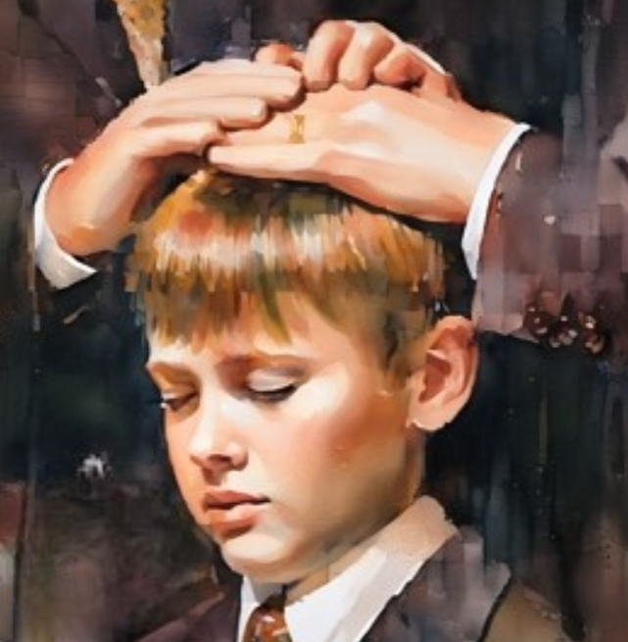
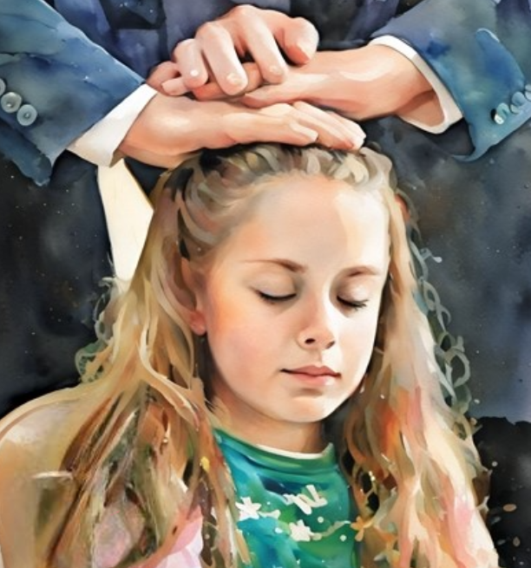
The Comforter
One Comforter is the Holy Ghost, the same as given on the day of Pentecost, and that all Saints receive after faith, repentance, and baptism. This first Comforter or Holy Ghost has no other effect than pure intelligence, … expanding the mind, enlightening the understanding, and storing the intellect with present knowledge.
“After a person has faith in Christ, repents of his sins, and is baptized for the remission of his sins and receives the Holy Ghost, (by the laying on of hands), which is the first Comforter, then let him continue to humble himself before God, hungering and thirsting after righteousness, and living by every word of God, and the Lord will soon say unto him, Son, thou shalt be exalted.
D&C 88:3

Slide 5
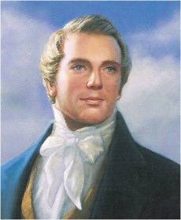
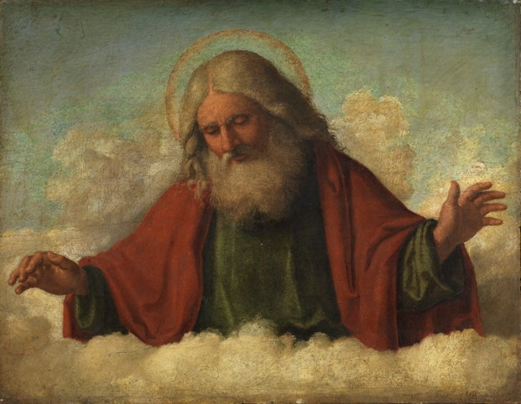
Another Comforter
When the Lord has thoroughly proved him, and finds that the man is determined to serve Him at all hazards, then the man will find his calling and his election made sure, then it will be his privilege to receive the other Comforter, which the Lord hath promised the Saints, as is recorded in the testimony:
But the Comforter, which is the Holy Ghost, whom the Father will send in my name, he shall teach you all things, and bring all things to your remembrance, whatsoever I have said unto you.
John 14:26
D&C 88:3 Joseph Smith

Slide 6
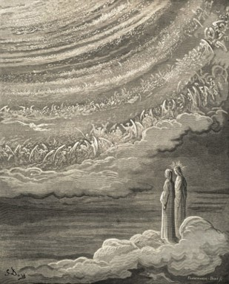
Calling An Election Made Sure
“…It is no more nor less than the Lord Jesus Christ Himself; and this is the sum and substance of the whole matter; that when any man obtains this last Comforter,
…he will have the personage of Jesus Christ to attend him, or appear unto him from time to time, and even He will manifest the Father unto him,
…and they will take up their abode with him, and the visions of the heavens will be opened unto him,
…and the Lord will teach him face to face,
…and he may have a perfect knowledge of the mysteries of the Kingdom of God;
…and this is the state and place the ancient Saints arrived at when they had such glorious visions—Isaiah, Ezekiel, John upon the Isle of Patmos, St. Paul in the three heavens, and all the Saints who held communion with the general assembly and Church of the Firstborn.”
D&C 88:3 Joseph Smith

Slide 7
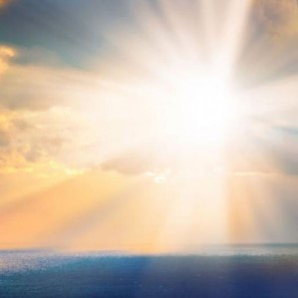
The Truth of Light
The Light of Christ ‘proceedeth forth from the presence of God to fill the immensity of space.’ It is ‘the light which is in all things, which giveth life to all things, which is the law by which all things are governed’
This power is an influence for good in the lives of all people In the scriptures, the Light of Christ is sometimes called the Spirit of the Lord, the Spirit of God, the Spirit of Christ, or the Light of Life.
I am come a light into the world, that whosoever believeth on me should not abide in darkness.
John 12:46
“The Light of Christ should not be confused with the Holy Ghost. It is not a personage, as the Holy Ghost is. Its influence leads people to find the true gospel, be baptized, and receive the gift of the Holy Ghost
D&C 88:6-7

Slide 8
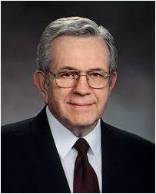
“Just as darkness must vanish when the light of the sun appears, so is evil sent fleeing by the Light of Christ.
“The Light of Christ is like sunlight. It, too, is everywhere present and given to everyone equally.
Light
of
Christ
“There is no darkness in sunlight. Darkness is subject unto it. The sun can be hidden by clouds or by the rotation of the earth, but the clouds will disappear, and the earth will complete its turning. …
“To describe the Light of Christ, I will compare or liken it to the light of the sun. Sunlight is familiar to everyone; it is everywhere present and can be seen and can be felt. Life itself depends upon sunlight.
“The Light of Christ is as universal as sunlight itself. Wherever there is human life, there is the Spirit of Christ. Every living soul is possessed of it. It is the sponsor of everything that is good. It is the inspirer of everything that will bless and benefit mankind. It nourishes goodness itself”
D&C 88:6-13 President Boyd K. Packer

Slide 9
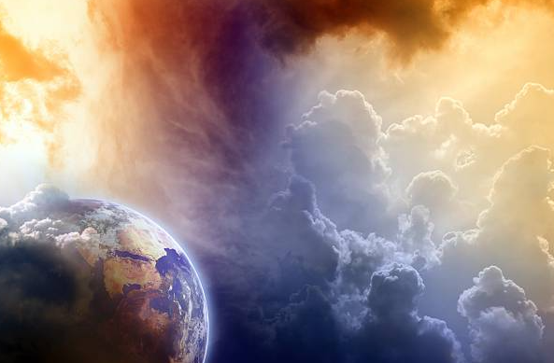
Divine
“[The Light of Christ is] divine energy, power, or influence that proceeds from God through Christ and gives life and light to all things.
It is the law by which all things are governed in heaven and on earth.
It also helps people understand gospel truths and helps to put them on the gospel path that leads to salvation.”
D&C 88:6-13 Guide to the Scriptures, “Light, Light of Christ,” scriptures.ChurchofJesusChrist.org

Slide 10
Our Conscience
“[Conscience is] the inner sense of right and wrong, coming from the Light of Christ in all men.
We are born with a natural capacity to distinguish between right and wrong because of the Light of Christ that is given to every person.
This faculty is called conscience. The possession of it makes us responsible beings.
Like other faculties, our consciences may be deadened through sin or misuse.”
And the Spirit giveth light to every man that cometh into the world; and the Spirit enlighteneth every man through the world, that hearkeneth to the voice of the Spirit. D&C 84:46
For behold, the Spirit of Christ is given to every man, that he may know good from evil; wherefore, I show unto you the way to judge; for every thing which inviteth to do good, and to persuade to believe in Christ, is sent forth by the power and gift of Christ; wherefore ye may know with a perfect knowledge it is of God.\
Moroni 7:16
D&C 88:6-13 Guide to the Scriptures, “Conscience,” scriptures.ChurchofJesusChrist.org)

Slide 11
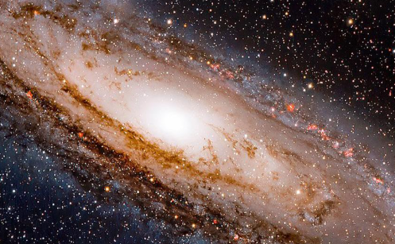
Light Is Universal
It is the essence of light, the power that makes the universe a livable place.
This power “fill[s] the immensity of space” and is that “which is in all things, which giveth life to all things, which is the law by which all things are governed.
Casey Paul Griffiths
D&C 88:7-10; 45-47

Slide 12
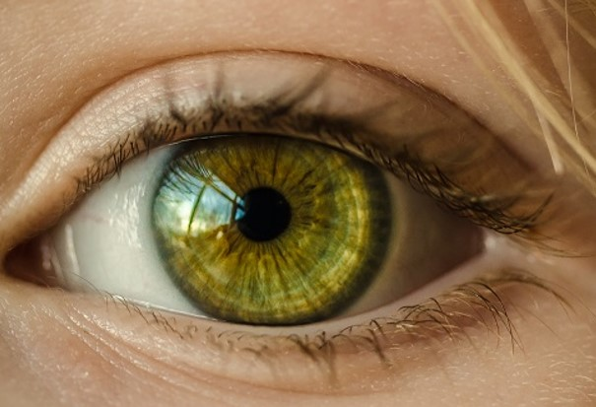
Light and Salvation
Defining light—not only as something that makes vision possible but also as a force that activates and stimulates the intellect
“These scriptures suggest that the term light is used to describe an aspect of God’s power that radiates our from Him, expanding with His work and will, enlightening, organizing, capacitating, and quickening as it does.
He that receiveth light, and continueth in god, receiveth more light; and that light growth brighter and brighter until the perfect day.
D&C 50:24
D&C 88:6-7

Slide 13
The Light of Christ give light and life to all His creations
D&C 88:12-13

Slide 14
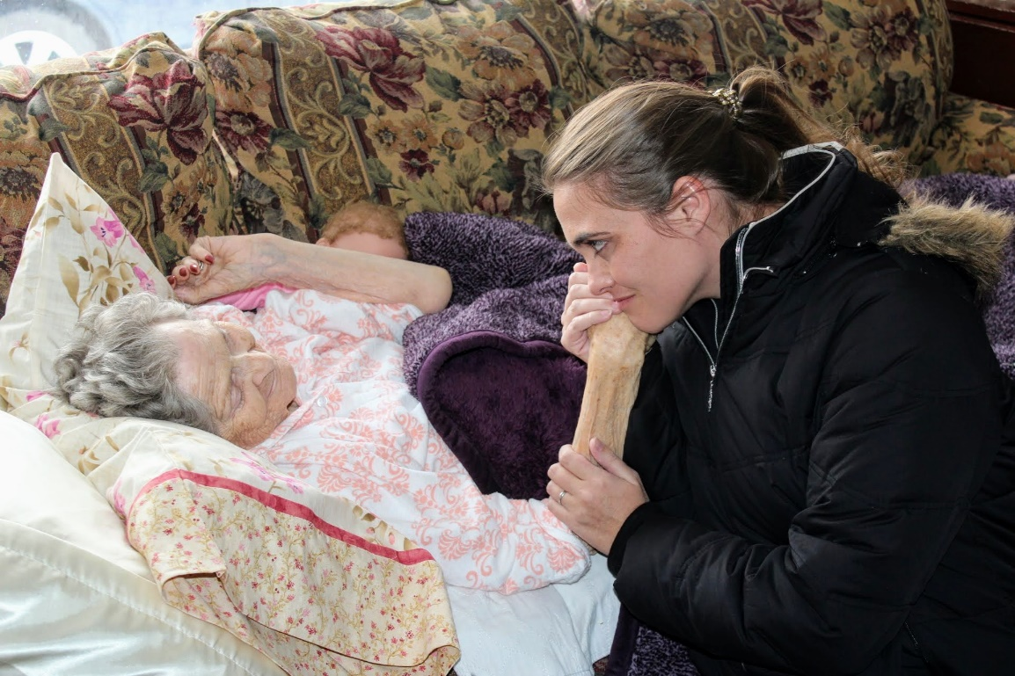
Our Mortal Bodies
An important part of God’s plan is for us to become like Him, both spiritually and physically.
At birth we receive a physical body.
This body will one day die and be resurrected.

Slide 15
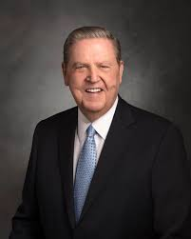
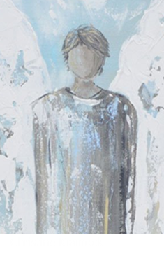
Separation of Spirit and Body
One of the “plain and precious” truths restored to this dispensation is that “the spirit and the body are the soul of man” (D&C 88:15; emphasis added) and that when the spirit and body are separated, men and women “cannot receive a fulness of joy”.
Certainly that suggests something of the reason why obtaining a body is so fundamentally important to the plan of salvation in the first place, why sin of any kind is such a serious matter (namely because its automatic consequence is death, the separation of the spirit from the body and the separation of the spirit and the body from God), and why the resurrection of the body is so central to the great abiding and eternal triumph of Christ’s atonement.
We do not have to be a herd of demonically possessed swine charging down the Gadarene slopes toward the sea to understand that a body is the great prize of mortal life, and that even a pig’s will do for those frenzied spirits that rebelled, and to this day remain dispossessed, in their first, unembodied estate.
Jeffrey R. Holland
D&C 88:15; D&C 93:34

Slide 16
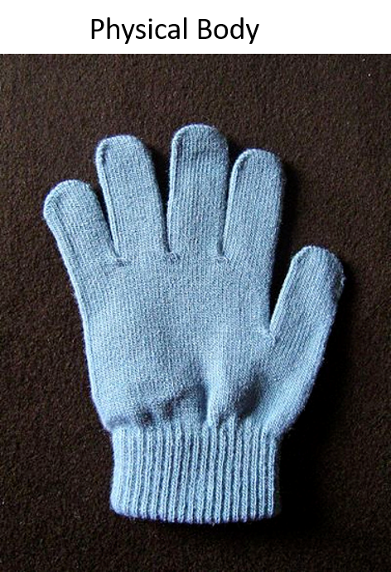
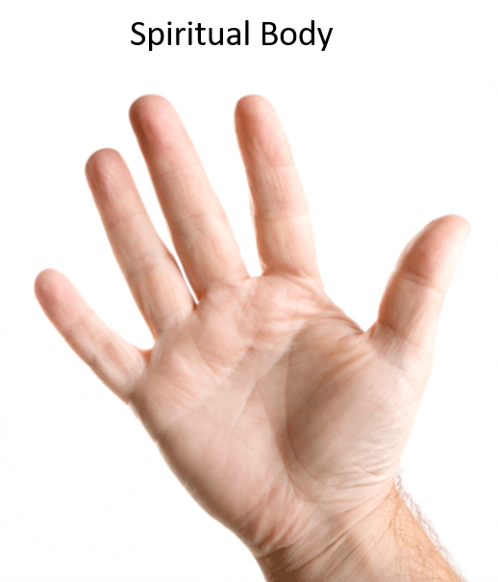
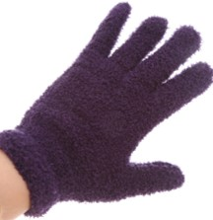
The Spirit and The Body
The Soul of Man
The Hand gives life to the glove—
The Spirit Body gives live to the Physical Body
D&C 88:15

Slide 17
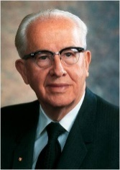
Health of the Body
“There is no question that the health of the body affects the spirit, or the Lord would never have revealed the Word of Wisdom.
God has never given any temporal commandments—that which affects our bodies also affects our [spirits]. …
“… Sin debilitates. It affects not only the [spirit], but the body.
The scriptures are replete with examples of the physical power that can attend the righteous. On the other hand, unrepented sin can diffuse energy and lead to both mental and physical sickness.”
D&C 88:15 President Ezra Taft Benson

Slide 18
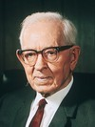
Physical Death of the Body
Putting the glove back on
Taking off the glove
Resurrection
In the resurrection from the dead, the bodies which were laid down natural bodies shall come forth spiritual bodies.
That is to say, in mortality the life of the body is in the blood, but the body when raised to immortality shall be quickened by the spirit and not the blood.
Hence, it becomes spiritual, but it will be composed of flesh and bones, just as the body of Jesus was, who is the prototype.
Joseph Fielding Smith
D&C 88:17-20

Slide 19
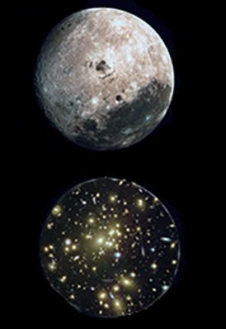
Sanctified Through the Law
And they who are not sanctified through the law which I have given unto you, even the law of Christ, must inherit another kingdom, even that of a terrestrial kingdom, or that of a telestial kingdom. D&C 88:21
Taking off the glove
And again, verily I say unto you, that which is governed by law is also preserved by law and perfected and sanctified by the same. D&C 88:34
D&C 88:17-20

Slide 20
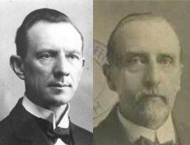
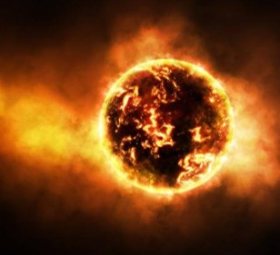
The Earth’s Resurrection
“The entrance to celestial glory is through death and resurrection.
And the Earth itself must pass through the same process, in order to become the dwelling-place of celestial beings”
“The opinion that this globe is to be annihilated finds no support in the Word of God. Here, the important truth is revealed that our globe will be sanctified from all unrighteousness, and prepared for celestial glory, so that it will be fit for the presence of God, the Father. …
It will not remain a dead planet, whirling about aimlessly in space; nor will it be distributed in the form of cosmic dust, throughout the universe. It will be glorified, by celestial glory, and become an abode for resurrected beings.”
D&C 88:18-20 Smith and Sjodahl

Slide 21
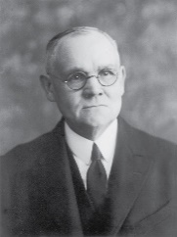
Rewards and Punishments
Will come through the operations of law
“If a man cannot or will not obey celestial laws, that is, live in accordance with the celestial requirements, he must not think that he is discriminated against when he is excluded from the celestial kingdom, because he could not abide it, he could not live there.
If a man cannot or will not obey the terrestrial law he cannot rationally hope for a place in the terrestrial kingdom. If he cannot live the yet lower law—the telestial law—he cannot abide the glory of a telestial kingdom, and he will have to be assigned therefore to a kingdom without glory.”
D&C 88:18-20 Elder James E. Talmage

Slide 22
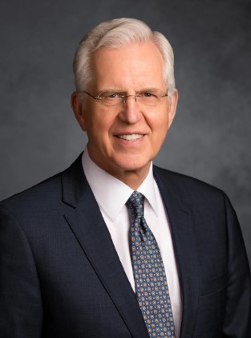
Celestial Law
The law of the celestial kingdom is, of course, the gospel law and covenants, which include our constant remembrance of the Savior and our pledge of obedience, sacrifice, consecration, and fidelity.
D. Todd Christofferson
If we obey celestial laws, we will receive celestial glory or in the Resurrection, we will receive glory according to the law we obey.
D&C 88:18-22

Slide 23
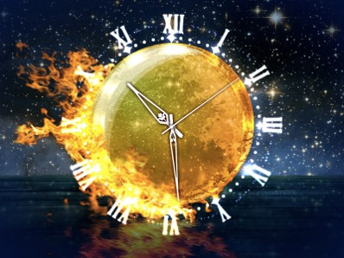
Earth and the Law
There are combustible elements in abundance and heat enough to consume many worlds like ours, whenever the torch is applied. Here we are told, that the Earth will abide ‘the power by which it is quickened’; it will abide the fire and come out of the flames, quickened and purified, like gold out of the refiner’s fire, or a beautiful vessel of potter’s clay out of the fiery furnace.
In this sanctified state it will be the residence of celestial beings, resurrected and inhabiting ‘the same’ bodies that they had here, quickened by celestial glory.
For each individual will receive the glory by which he is quickened.
D&C 88:25-31 Student Manual

Slide 24
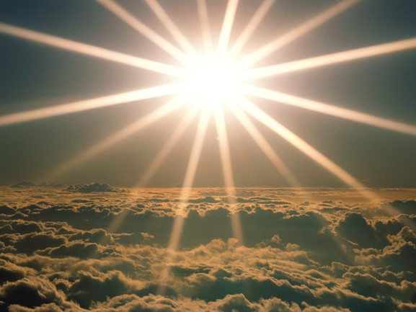
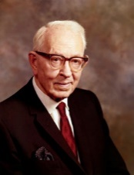
Spirit Body VS Spiritual Body
“After the resurrection from the dead our bodies will be spiritual bodies, but they will be bodies that are tangible, bodies that have been purified, but they will nevertheless be bodies of flesh and bones, but they will not be blood bodies, they will no longer be quickened by blood but quickened by the spirit which is eternal and they shall become immortal and shall never die.”
Joseph Fielding Smith
D&C 88:28

Slide 25
Level of Law
“In the Resurrection each person will receive back the very body he inhabited in mortality, that “there is no fundamental principle belonging to a human system that ever goes into another in this world or in the world to come; I care not what the theories of men are. We have the testimony that God will raise us up, and he has the power to do it. If anyone supposes that any part of our bodies, that is, the fundamental parts thereof, ever goes into another body, he is mistaken.”
The body will be resurrected to a glory equal to the level of law by which one lived. The person who keeps the commandments receives
“truth and light, until he is glorified” HC
If a person obeys only terrestrial or telestial law on earth, what type of body will he or she receive in the Resurrection?
D&C 88:28

Slide 26
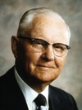
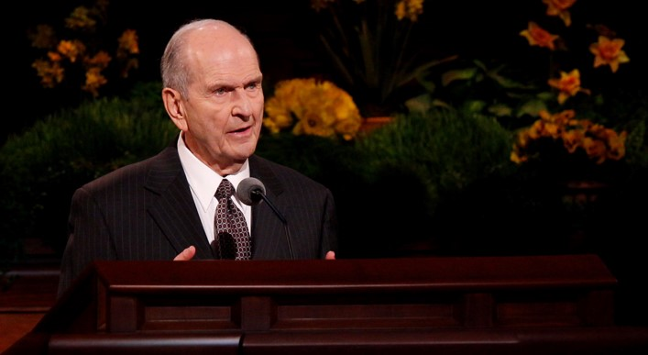
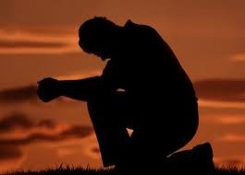
Reassess Ourselves
Am I living the law of obedience to gain entrance into the Celestial Kingdom?
“1. Do I study and ponder the scriptures in an effort to know the will of God and understand His commandments regarding His children?
“2. Do I follow the counsel of God’s living prophet, or do I merely select those things with which I agree, disregarding the others?
“3. Do I seek the advice and counsel of my bishop and stake president on matters of concern to me and my family?
“4. Am I earnestly striving to discipline myself, placing my physical appetites under the subjection of my will?
“5. Am I making every effort to repent of past or present wrongdoings and correct them by doing right?
“6. Do I have an attitude of faith in God even though I experience trials, adversity, and affliction? And do I bear
my burden without a complaining spirit?
D&C 88:28 Elder Delbert L. Stapley

Slide 27
A few years back my husband gave me a pink iPod for Mother’s Day. He and the kids were so excited to give it to me. They had heard me mention that I really wanted something to play music on…
My husband and kids all got on the computer together and found the perfect iPod.
My little daughter picked the pink color.
Parable of the Pink IPod

Slide 28
When Mother’s Day came, I opened my gift and I was completely surprised. I was excited because I really wanted more music in my home.
But I am not really smart enough to figure these gadgets out and I am a little bit lazy.
Weeks passed, months passed, even years passed and there sat the pink iPod.
I never used it.
I didn’t read its manual.
I didn’t experiment or tinker around with it or try to figure the thing out.
I didn’t ask my husband to teach me how to download songs.
I am not even sure I ever took the iPod out of its plastic case that it was boxed in.

Slide 29
The iPod sat in my drawer unused. Which meant I didn’t get to enjoy all the music the iPod could have given me.
A year or two later, my husband found the unused pink iPod. He came to me and pulled the iPod out of the unopened plastic box. He handed it to me and asked me to look on the back.
I peeled off the pink rubber protection and that is when I saw that he and the kids had engraven a little message for me on the back of the iPod. I had no idea the message was even there. Since I had never used it, I had never read the engraving.
We love you mom

Slide 30
I felt terrible. My husband and children had given me this awesome gift and I didn’t use it.
I didn’t get the benefit of the music or games or info that could have been on there.
I didn’t read the message for me on the back.
The iPod couldn't make my life better because I didn’t know how to use it.
I had been given the gift of the pink iPod but I had never received the gift.
Do you see the subtle distinction between being given a gift and actually receiving it?
We love you mom

Slide 31
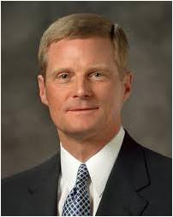
…We have all been given the gift of the Holy Ghost. After we were baptized, we were confirmed. And someone, that held the Priesthood, laid his hands on our head and said, “Receive the Holy Ghost.”
Elder Bednar teaches us that “These four words – “Receive the Holy Ghost” – are a not a passive pronouncement; rather, they constitute a priesthood injunction – an authoritative admonition to act and not simply to be acted upon.”
That is fancy for “the Holy Ghost doesn’t just come to you automatically, you gotta do the work to receive the Holy Ghost”.
We love you mom

Slide 32
The Holy Ghost is just like my iPod. If we want Him with us, we have to take the time to figure Him out.
“For what doth it profit a man if a gift is bestowed upon him, and he receive not the gift? Behold, he rejoices not in that which is given unto him, neither rejoices in him who is the giver of the gift.”
D&C 88:33
It does us no good to be given a gift if we don’t receive it.
We love you mom

Slide 33
1. Sincerely Desire. Receiving the Holy Ghost starts with our sincere and constant desire for His companionship in our lives. Pray for Him to be with you. Ask Him to accompany you wherever you go. Invite Him along.
2. Faithfully Obey. Have you ever thought about why God asks us read the scriptures, say our prayers, pay our tithing, go to church, etc? He doesn’t ask us to do all these Holy Habits just to see if we are going to obey or just to keep us busy or just to help us learn.
He asks us to keep the commandments because He wants to bless us with the Spirit. We obey so we are prepared to RECEIVE the Holy Ghost.
2 Steps
We love you mom

Slide 34
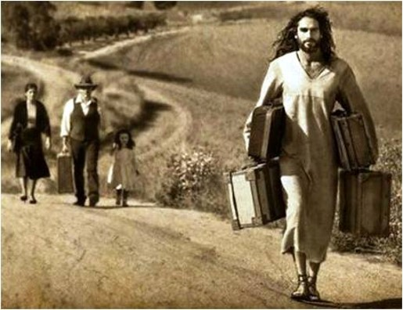
My Burden is Light
“Keeping the commandments of God is not a difficult burden when we do it out of love of Him who has so graciously blessed us.
The Savior has implored us to ‘take my yoke upon you, and learn of me; for I am meek and lowly in heart: and ye shall find rest unto your souls.
For my yoke is easy, and my burden is light.’
Matt. 11:29–30
“Our willingness to comply with the commandments of God is a witness of our faith in Him and our love for Him. A rebellious disposition cannot inherit the celestial kingdom”
D&C 88:34-35 Elder Delbert L. Stapley

Slide 35
Sources:
Videos:
Light and Truth, Part 1 (6:40)
The Spirit and the Body (2:14)
“The Light and Life of the World”
“The Light of Christ”
(History of the Church,1:316) (History of the Church, 5:339)
President James E. Faust Come Listen to a Prophet’s Voice: Coming Out of Darkness March 2006 Friend
Conference Report, Oct. 1929, p. 69.
Joseph Smith (Teachings, pp. 149–51.)
President Boyd K. Packer (“The Light of Christ,” Ensign, Apr. 2005, 13).
Presentation by ©http://fashionsbylynda.com/blog/
President Ezra Taft Benson (“In His Steps,” Ensign, Sep. 1988, 5).
Hyrum M. Smith and Janne M. Sjodahl Doctrine and Covenants Commentary pg. 543
Doctrine and Covenants Student Manual Religion 324-325 Section 88
Joseph Fielding Smith (In Conference Report, Apr. 1917, pp. 62–63.)
Elder Delbert L. Stapley (“The Blessings of Righteous Obedience,” Ensign, Nov. 1977, 20–21).
Casey Paul Griffiths Doctrine and Covenants Central Section 88
Jeffrey R. Holland, “Of Souls, Symbols, and Sacraments,” BYU Devotional, January 12, 1988
D. Todd Christofferson, “Come to Zion,” Ensign or Liahona, Nov. 2008, 38)
Joseph Fielding Smith, Doctrines of Salvation, comp. Bruce R. McConkie [1955], 2:284–85
Parable of the Pink Ipod http://www.raisinglemons.com/thinker/spiritual/parable-of-the-pink-ipod/
“A Secure Anchor” (3:36)
“Why Does God Give Us Commandments?” (0:39)
Presentation by ©http://fashionsbylynda.com/blog/

Slide 36
Another Comforter:
Elder Bruce R. McConkie said of this passage: “In a revelation to certain selected saints in this dispensation, the Lord said that the alms of their prayers were ‘recorded in the book of the names of the sanctified, even them of the celestial world’ (D. & C. 88:2), which is to say that they were among those who had ‘overcome by faith,’ and were ‘sealed by the Holy Spirit of promise, which the Father sheds forth upon all those who are just and true.’ (D. & C. 76:53.) …
“These saints, like their Ephesian Brethren before them, had been called and chosen ‘before the foundation of the world’ that they ‘should be holy and without blame’ before the Lord, through baptism and obedience (Eph. 1:4–7), which is the sole course by which men can sanctify their souls (3 Ne. 27:19–20), thereby qualifying to have their names recorded ‘in the book of the names of the sanctified.’ (D. & C. 88:2.) They had then earned the right by faith and devotion to have the seal of divine acceptance placed on the conditional promises which they had theretofore made. They now had the sure ‘promise … of eternal life’ (D. & C. 88:4), which eternal life is the name of the kind of life which God our Heavenly and Eternal Father lives, and they were prepared to receive the Second Comforter.” (Doctrinal New Testament Commentary, 3:338–39.)
Light of Christ:
“Conscience is a manifestation of the Light of Christ, enabling us to judge good from evil. The prophet Mormon taught: ‘The Spirit of Christ is given to every man, that he may know good from evil; wherefore, I show unto you the way to judge; for every thing which inviteth to do good, and to persuade to believe in Christ, is sent forth by the power and gift of Christ; wherefore ye may know with a perfect knowledge it is of God. … And now, my brethren, seeing that ye know the light by which ye may judge, which light is the light of Christ, see that ye do not judge wrongfully; for with that same judgment which ye judge ye shall also be judged’ (Moroni 7:16, 18)” (True to the Faith: A Gospel Reference [2004], 96).
The Light of Christ should not be confused with the Holy Ghost. The light of Christ is not a person. It is an influence that comes from God and prepares a person to receive the Holy Ghost. It is an influence for good in the lives of all people. Guide to the scriptures John 1:9
Soul:
Most people in the world think of the soul as being synonymous with the spirit of man, but, as Elder James E. Talmage wrote, “it is peculiar to the theology of the Latter-day Saints that we regard the body as an essential part of the soul. Read your dictionaries, the lexicons, and encyclopedias, and you will find that nowhere, outside of the Church of Jesus Christ, is the solemn and eternal truth taught that the soul of man is the body and the spirit combined. It is quite the rule to regard the soul as that incorporeal part of men, that immortal part which existed before the body was framed and which shall continue to exist after that body has gone to decay; nevertheless, that is not the soul; that is only a part of the soul; that is the spirit-man, the form in which every individual of us, and every individual human being, existed before called to take tabernacle in the flesh. It has been declared in the solemn word of revelation, that the spirit and the body constitute the soul of man; and, therefore, we should look upon this body as something that shall endure in the resurrected state, beyond the grave, something to be kept pure and holy.” (In Conference Report, Oct. 1913, p. 117.)
Celestial Spirit:
Elder Bruce R. McConkie defined the relationship between a celestial body and a celestial spirit: “Those who by full obedience to gospel requirements develop celestial bodies, gain at the same time celestial spirits. Then in the resurrection, when ‘the same body which was a natural body,’ (that is, the renewed body, the body sanctified by the Spirit, the celestial body) is received back again, ‘they who are of acelestial spirit’ are quickened by a celestial glory and go on to an inheritance in a celestial kingdom. (D&C 88:28.)” (Mormon Doctrine,p. 118.)

Slide 37
“We do right for various reasons,” said Elder Robert L. Simpson. “Some people do right simply because they don’t want to be punished for doing wrong. When we do right for fear of retribution, I think our foundation is very shaky. Another might say, ‘I want to do right because I have always been taught that this is the thing to do.’ Well, such reasoning is based on hearsay, on the testimony of others, and I think we need to mature beyond that point. I think we need to have our own testimonies instead of the advice of others on a perpetual basis. Others have been heard to say, ‘I want to do right just to please my parents,’ and although we all should have a desire to please our parents, that reason alone is not sufficient to sustain us throughout eternity. Perhaps you have heard people who have indicated that they are doing the right thing simply because they want to be obedient to God’s commands; this, too, is a very high and noble purpose—provided, of course, that obedience is not blind obedience, without personal conviction. But to me the best reason of all is illustrated by the person who feels the desire to do right because he wants to add glory to his Father in heaven. Whatever stage of motivation we find ourselves in, I think we must eventually reinforce this with our own personal testimony that has been built on a foundation of gospel scholarship and understanding—a testimony which leads us to the life of unselfishness and service, one which finds its highest sanctification in the supreme thought that we are living gospel principles because we desire to glorify his great name.” (“Cast Your Burden upon the Lord,” New Era, Jan. 1977, p. 4.)
The Order of the Resurrection:
The righteous who are alive during the Lord’s Second Coming “shall be quickened and be caught up to meet him” (D&C 88:96). Those who will inherit the celestial kingdom will be resurrected first (see D&C 88:96–98). After those who will inherit the celestial kingdom are resurrected, those who will inherit the terrestrial kingdom will be resurrected (see D&C 88:99; see also D&C 76:71–79). These are individuals who did not receive Jesus Christ while they were alive but received Him in the spirit world (see D&C 88:99). After the Millennium, the “last resurrection” (D&C 76:85), or the resurrection of the unjust, will occur. These individuals are those who will inherit the telestial kingdom and, lastly, the sons of perdition “who shall remain filthy still” (see D&C 88:100–102). (Doctrine and Covenants Student Manual [2018], 488)
Divine laws are God’s gifts to His children. … Let me say it as succinctly as I can: As you abide by God’s laws, you are progressing toward exaltation. …
… God’s greatest blessings are reserved for those who obey His laws, as He explained: “For all who will have a blessing at my hands shall abide the law which was appointed for that blessing” [Doctrine and Covenants 132:5]. God’s laws are motivated entirely by His infinite love for us and His desire for us to become all we can become. …
… Exaltation is not easy. Requirements include a focused and persistent effort to keep God’s laws, rigorously repenting when we don’t. But the reward for doing so is far greater than anything we can imagine, because it brings us joy here and “never-ending happiness” [Mosiah 2:41] hereafter. (Russell M. Nelson, “The Love and Laws of God” [Brigham Young University devotional, Sept. 17, 2019], speeches.byu.edu)

