Slide 1
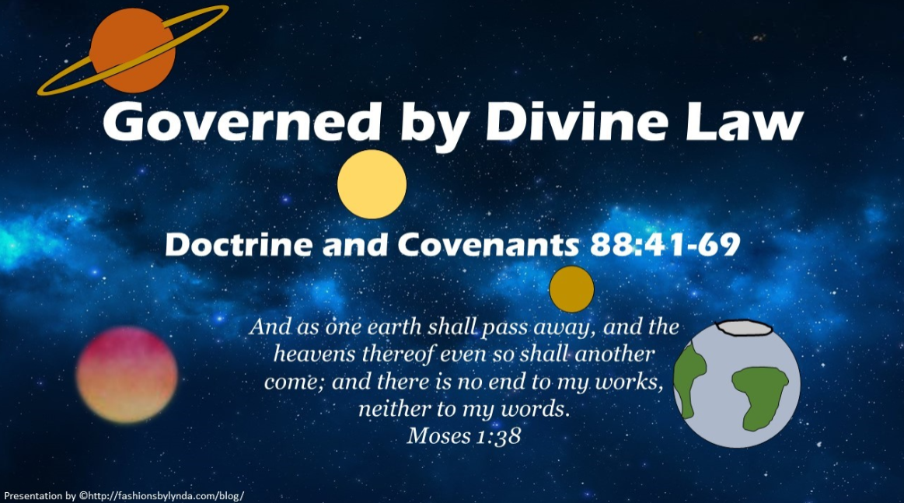

Slide 2
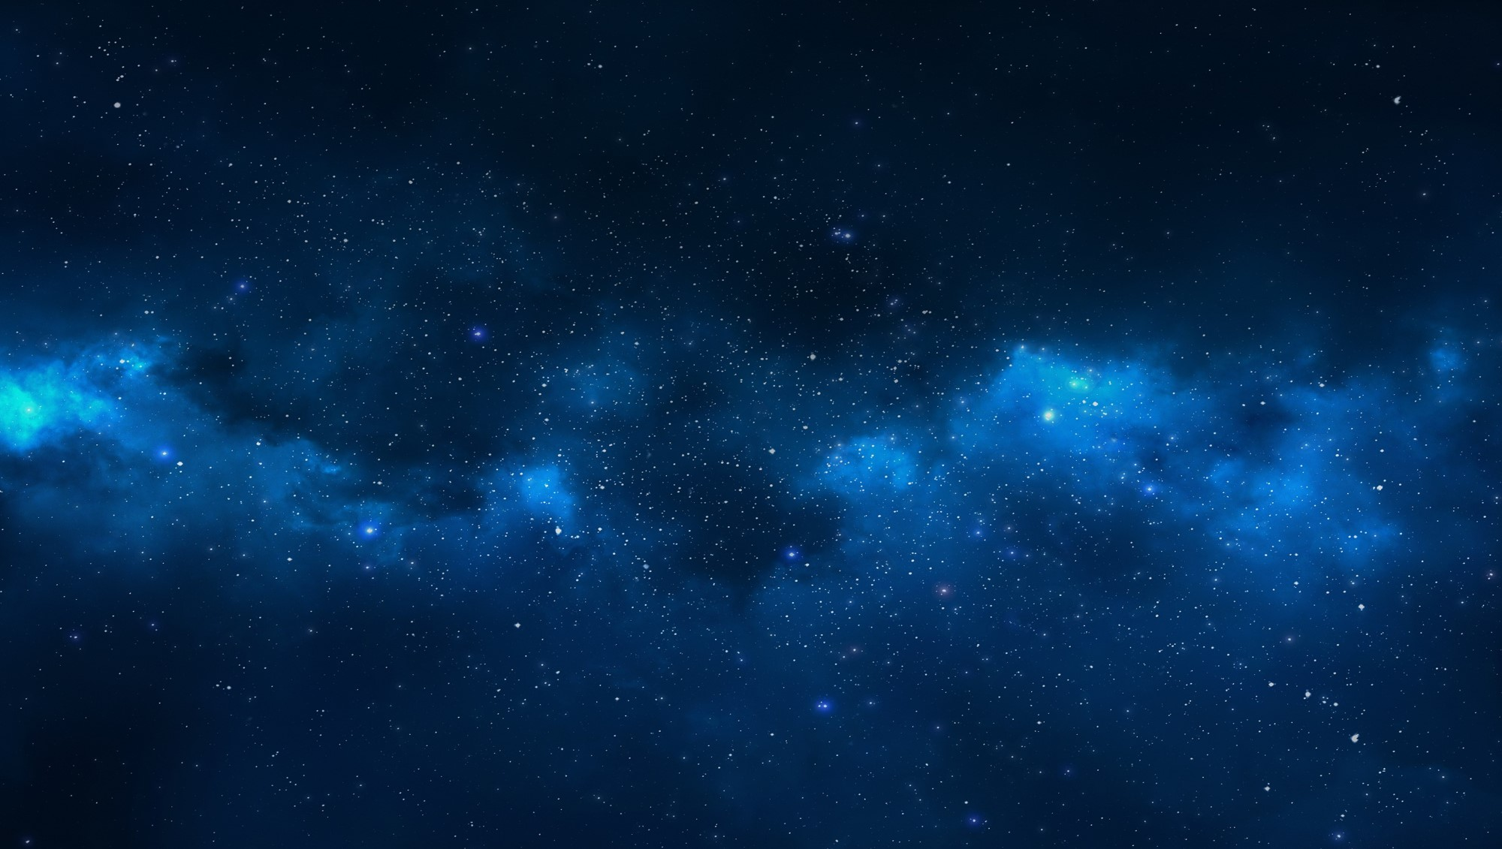

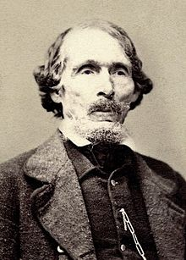

Background-Olive Leaf- A Message of Peace
In a letter written to William W. Phelps, the Prophet Joseph Smith called this revelation “the ‘Olive Leaf’ which we have plucked from the Tree of Paradise, the Lord’s message of peace to us” HC.
The name is appropriate, because the olive tree is a well-known symbol of peace, and the revelation contains numerous keys for achieving spiritual peace.

Slide 3
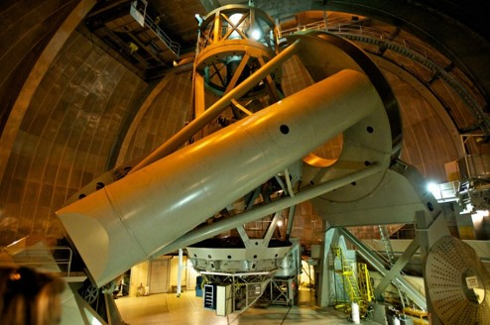
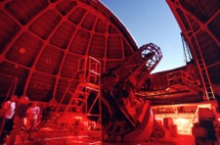
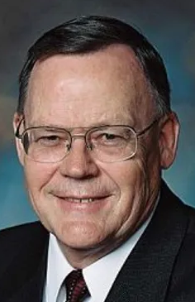
The Universe
We are just a small particle in a vast universe
“In 1920 and the completion of the 100” telescope on Mount Wilson in Southern California, astronomers were absolutely stunned to learn that what they thought were clouds of gas that they had been seeing with the smaller telescope, were actually whole galaxies of stars.”
“Astronomers now say that the known universe is probably ten billion light-years out in every direction that we can see…”
(1 light year is 6 trillion miles)
“Now, with the 200” telescope on Mount Palomar in San Diego County, if you focus on the bowl of the big Dipper just that tiny little portion of the entire sky, you can count over one million galaxies, not stars, but galaxies. Astronomers now estimate there are probably a hundred billion galaxies each containing a hundred billion stars.”
Gerald Lund

Slide 4
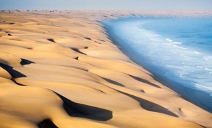
Small and Insignificant
Numberless as the sand upon the seashore
And worlds without number have I created; and I also created them for mine own purpose; and by the Son I created them, which is mine Only Begotten.
Moses 1:33
The only way to come to know the Savior is by realizing our own nothingness in comparison to His majesty and being willing to submit our will to His.
And were it possible that man could number the particles of the earth, yea, millions of earths like this, it would not be a beginning to the number of thy creations; and thy curtains are stretched out still; and yet thou art there, and thy bosom is there; and also thou art just; thou art merciful and kind forever;
Moses 7:30

Slide 5
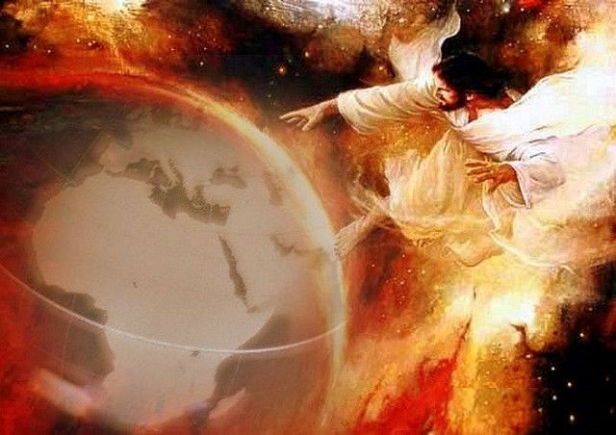
Omnipresence
And God Created All (beyond our comprehension)
He comprehends all things before and round about Him
He is above all things
He is in all things
He is through all things and round about all things
All things are by Him and of Him
Forever and ever
God governs a vast number of creations throughout the heavens, He is aware of each one of us and wants to draw near to us.
D&C 88:41

Slide 6
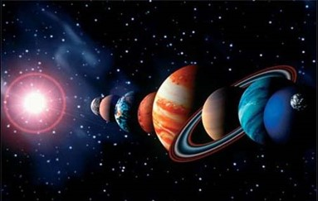
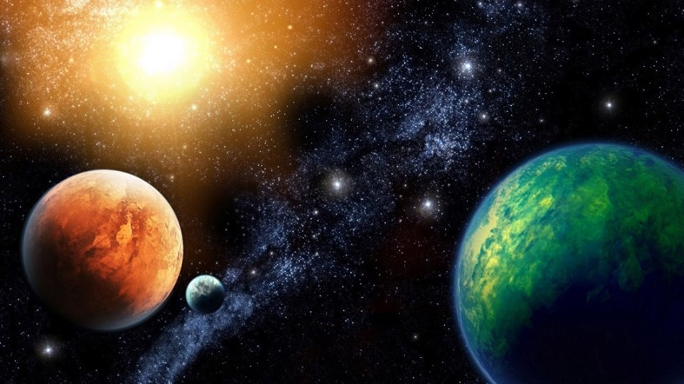
The Law Given and Governed
“Moral laws are just as immutable as those by which the courses of the Earth, the planets, and the stars, are governed.”
Smith and Sjodahl
“He comprehends all things and all things are subject unto Him. Nothing in His universe is left to chance and nothing exists without His knowledge. He organized all things and all thing are governed by Him.”
Otten and Caldwell
D&C 88:42-45

Slide 7
Agency of Man
“Of all of God’s creations, only man has agency to be disobedient to the laws of God. However, because of his agency, man can also choose to come unto God.
If man choses to come unto God in His kingdom, then man must choose to be obedient to the laws of God pertaining to that kingdom.”
Otten and Caldwell
Behold, they do not desire that the Lord their God, who hath created them, should rule and reign over them; notwithstanding his great goodness and his mercy towards them, they do set at naught his counsels, and they will not that he should be their guide.
Helaman 12:6
D&C 88:42-45

Slide 8
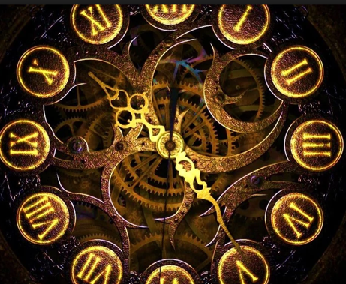
Time of Man
Time, as man knows it, is not the same with God
Now whether there is more than one time appointed for men to rise it mattereth not; for all do not die at once, and this mattereth not; all is as one day with God, and time only is measured unto men.
Alma 40:8
4. In answer to the question—Is not the reckoning of God’s time, angel’s time, prophet’s time, and man’s time, according to the planet on which they reside?
5 I answer, Yes. But there are no angels who minister to this earth but those who do belong or have belonged to it.
6 The angels do not reside on a planet like this earth;
7 But they reside in the presence of God, on a globe like a sea of glass and fire, where all things for their glory are manifest, past, present, and future, and are continually before the Lord.
D&C 130:4-7
D&C 88:44-45

Slide 9
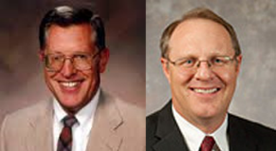
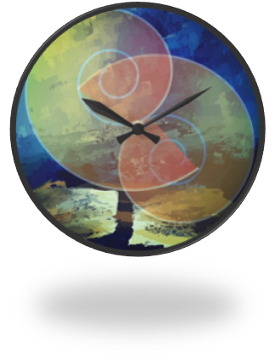
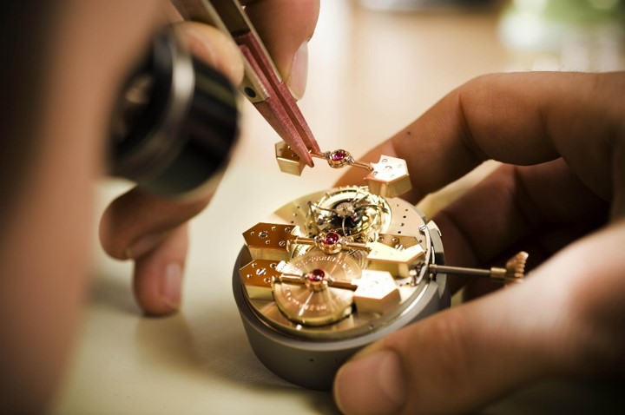
Moving Majestically
When we view God’s creations, we see His majesty and power.
All created things bear witness of a Creator. As the existence of a watch attests to the existence of the watchmaker, so must all life forms trace to a source of life.
D&C 88:47 McConkie and Ostler

Slide 10
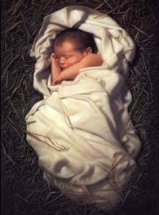
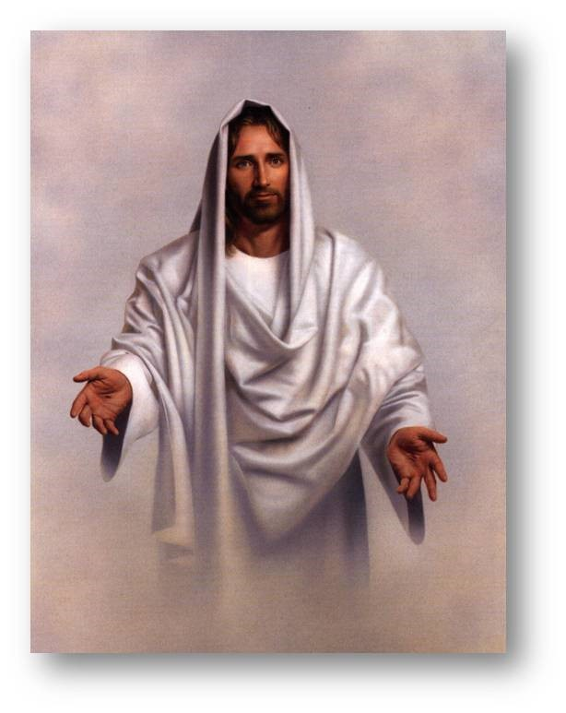
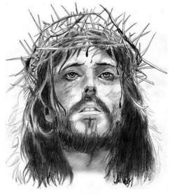
Not Comprehended
“He was in the world, and the world was made by him, and the world knew him not. He came unto his own, and his own received him not.
But as many as received him, to them gave he power to become the sons of God, even to them that believe on his name.”
John 1:10-12
D&C 88:48

Slide 11
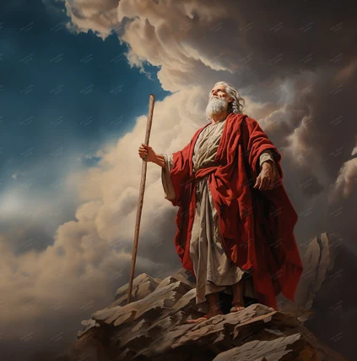
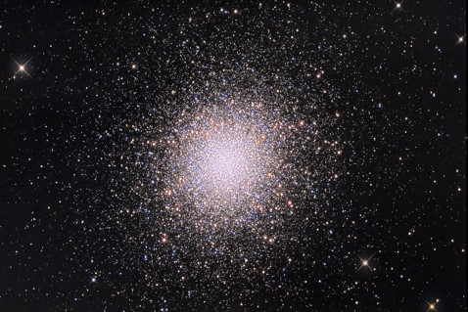
Parable—Servants in the Field
Moses saw in vision that the Savior had created many worlds like this earth that were also inhabited. (Worlds Without Number)
The inhabitants of these worlds are sons and daughters of God and are precious in His sight. The Savior is responsible for these creations and visits them in their times and seasons.
Student Manual
God will visit each of His kingdoms and their inhabitants in His time.
D&C 88:51-61 Moses 1:27-29

Slide 12
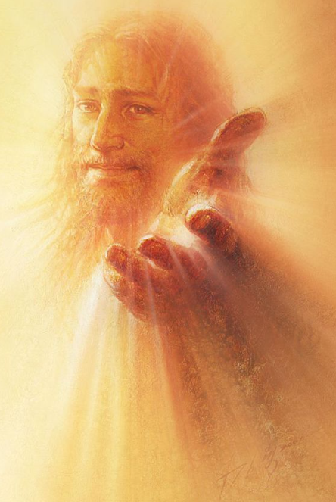
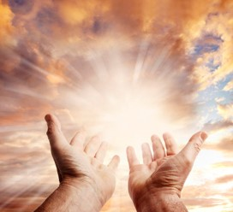
If we draw near to the Lord, then He will draw near to us.
Yongsung Kim
Heavenly Father answers our prayers in the ways that He knows are best for us.
D&C 88:61

Slide 13
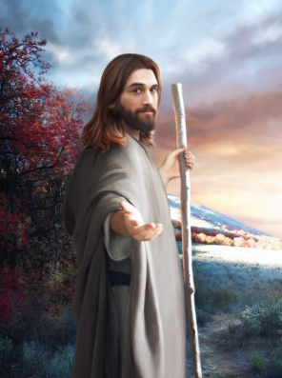

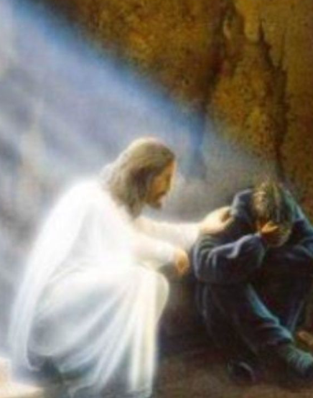
The Invitation
Turn to Me
Joel 2:12
Come unto me
Matthew 11:28
Draw near to me
Doctrine and Covenants 88:63
Therefore also now, saith the Lord, turn ye even to me with all your heart, and with fasting, and with weeping, and with mourning:
Come unto me, all ye that labour and are heavy laden, and I will give you rest.
Draw near unto me and I will draw near unto you; seek me diligently and ye shall find me; ask, and ye shall receive; knock, and it shall be opened unto you.

Slide 14
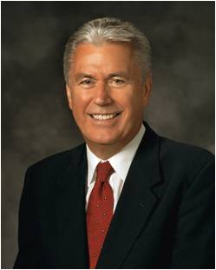
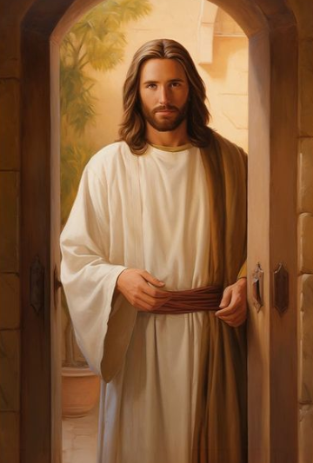
Turn, Come, Draw=To Be Rescued
This is how we show Him that we want to be rescued.
It requires a little faith.
But do not despair. If you cannot muster faith right now, begin with hope.
If you cannot say you know God is there, you can hope that He is. You can desire to believe. That is enough to start.
Then, acting on that hope, reach out to Heavenly Father. God will extend His love toward you, and His work of rescue and transformation will begin.
Over time, you will recognize His hand in your life. You will feel His love. And the desire to walk in His light and follow His way will grow with every step of faith you take.
Dieter F. Uchtdorf

Slide 15
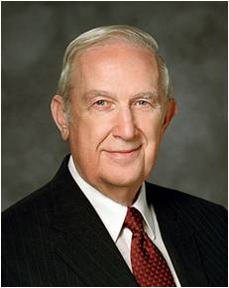
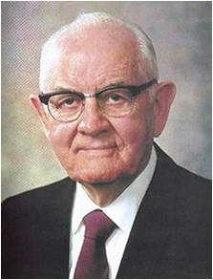
Prayer
“I find that when I get casual in my relationships with divinity and when it seems that no divine ear is listening and no divine voice is speaking, that I am far, far away. If I immerse myself in the scriptures the distance narrows and the spirituality returns”
Spencer W. Kimball
“It is so hard when sincere prayer about something you desire very much is not answered the way you want.
It is difficult to understand why your exercise of deep and sincere faith from an obedient life does not grant the desired result. …
At times it is difficult to recognize what is best or expedient for you over time. Your life will be easier when you accept that what God does in your life is for your eternal good” Elder Richard G. Scott
D&C 88:63-65

Slide 16
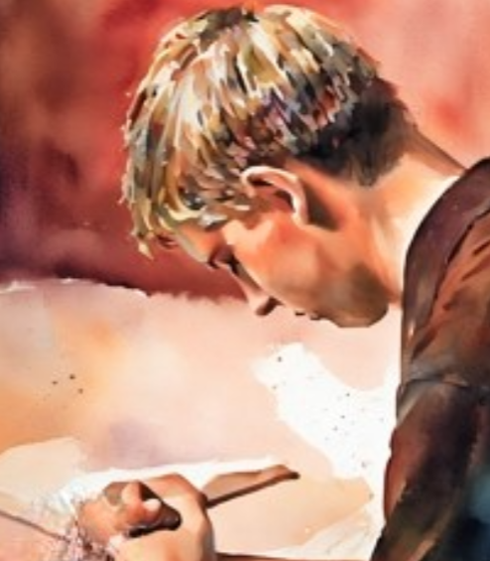
My Spirit is Truth
If my eye is single to God’s glory, then I will be filled with light
To be fully devoted to the work and purposes of God
“As we draw near to Heavenly Father, we become more holy. And as we become more holy, we will overcome disbelief and our souls will be filled with His blessed light.
As we align our lives with this supernal light, it leads us out of darkness and toward greater light.
This greater light leads to the unspeakable ministerings of the Holy Spirit, and the veil between heaven and earth can become thin”
President Dieter F. Uchtdorf
D&C 88:66-69

Slide 17
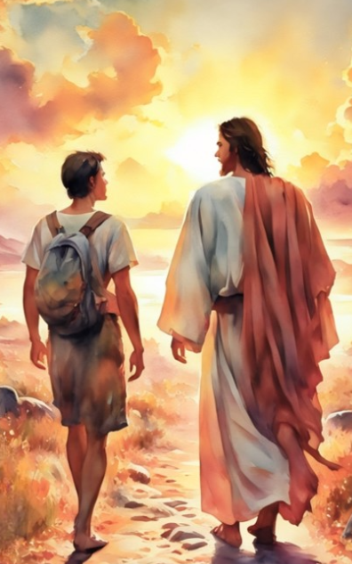
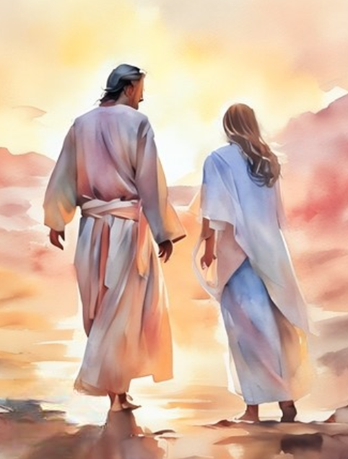
“My dear brothers and sisters, … at times we may … feel insignificant, invisible, alone, or forgotten. But always remember—you matter to Him! …
“God sees you not only as a mortal being on a small planet who lives for a brief season—He sees you as His child.
He sees you as the being you are capable and designed to become. He wants you to know that you matter to Him”
President Dieter F. Uchtdorf

Slide 18
Sources:
Video: Christ the Creator (3:05)
The Hope of God's Light (6:46)
You Matter (0:48)
Gerald Lund Let This Mind Be in You, 1988 DEC Symposium, BYU p. 2
Hyrum M. Smith and Janne M. Sjodahl Doctrine and Covenants Commentary pg. 550
L.G. Otten and C.M. Caldwell Sacred Truths of the Doctrine and Covenants” Volume 2 pg. 109
Joseph Fielding McConkie and Craig J. Ostler Revelations of the Restoration pg. 635
Doctrine and Covenants Student Manual Religion 324-325 Section 88
(Teachings of Presidents of the Church: Spencer W. Kimball [2006], 67).
Presentation by ©http://fashionsbylynda.com/blog/
Elder Richard G. Scott (“Using the Supernal Gift of Prayer,” Ensign or Liahona, May 2007, 9).
President Dieter F. Uchtdorf(“You Matter to Him,” Ensign or Liahona, Nov. 2011, 22).
(“The Love of God,” Ensign or Liahona, Nov. 2009, 23–24).
Dieter F. Uchtdorf, “He Will Place You on His Shoulders and Carry You Home,” Ensign or Liahona, May 2016, 103
Presentation by http://fashionsbylynda.com/blog/

Slide 19
Parable:
Elder Orson Pratt explained: “The Lord wanted to represent these kingdoms so that we could understand what he desired to impart, and he gave it as a parable, in order to assist our weak comprehensions. … Says the interrogator—‘I do not comprehend this idea of the Lord’s withdrawing from one and going to another.’ In order to comprehend this let us come back to our own globe. Do we not expect that the Lord will, by and by, come and visit us and stay a little while, about a thousand years. Yes, and then we shall be made glad with the joy of the countenance of our Lord. He will be among us, and will be our King, and he will reign as a King of kings and Lord of lords. He will have a throne in Zion, and another in the Temple at Jerusalem, and he will have with him the twelve disciples who were with him during his ministry at Jerusalem; and they will eat and drink with him at his table; and all the people of this globe who are counted worthy to be called Zion, the pure in heart, will be made glad by the countenance of their Lord for a thousand years, during which the earth will rest. Then what? He withdraws. What for? To fulfill other purposes; for he has other worlds or creations and other sons and daughters, perhaps just as good as those dwelling on this planet, and they, as well as we, will be visited, and they will be made glad with the countenance of their Lord. Thus he will go, in the time and in the season thereof, from kingdom to kingdom or from world to world, causing the pure in heart, the Zion that is taken from these creations, to rejoice in his presence.
“But there is another thing I want you to understand. This will not be kept up to all eternity, it is merely a preparation for something still greater. And what is that? By and by, when each of these creations has fulfilled the measure and bounds set and the times given for its continuance in a temporal state, it and its inhabitants who are worthy will be made celestial and glorified together. Then, from that time henceforth and for ever, there will be no intervening veil between God and his people who are sanctified and glorified, and he will not be under the necessity of withdrawing from one to go and visit another, because they will all be in his presence.” (In Journal of Discourses, 17:331–32.)
Sanctify ourselves:
Elder J. Thomas Fyans of the Seventy explained what it means to sanctify ourselves:
“From scripture study we receive further direction concerning the way to draw close to the Lord: ‘Sanctify yourselves that your minds become single to God, and the days will come that you shall see him; for he will unveil his face unto you, and it shall be in his own time, and in his own way, and according to his own will.’ (D&C 88:68; italics added.)
Sanctify means to make sacred or holy—to make free from sin, to purify. This we do to be in tune with his Spirit.
“We are given a guide that regularly reminds us of ways we can remain free from sin and have his Spirit with us. We hear it each time we partake of the sacrament. Listen carefully to the words: ‘O God, the Eternal Father, we ask thee in the name of thy Son, Jesus Christ, to bless and sanctify this bread to the souls of all those who partake of it; that they may eat in remembrance of the body of thy Son, and witness unto thee, O God, the Eternal Father, that they are willing to take upon them the name of thy Son, and always remember him, and keep his commandments which he hath given them, that they may always have his Spirit to be with them’ (Moro. 4:3; also D&C 20:77; italics added.)” (“Draw Near unto Me,” Ensign, Nov. 1985, 90).

