Slide 1
Doctrine and Covenants 88:73
Hastening the Work
Behold, I will hasten my work in its time
D&C 88:73
Presentation by http://fashionsbylynda.com/blog/

Slide 2
To Hasten
To accelerate
What are some reasons someone might hasten, or accelerate, a task?
What do you think it means for the Lord to hasten His work?

Slide 3
That Time Of Hastening is Now!
We live in a time when the Lord is hastening His work.
What are some of the ways you have witnessed the Lord hastening His work?

Slide 4
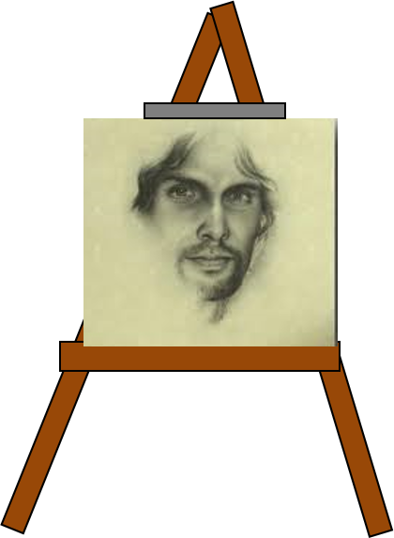
Prepare For The Coming of the Lord
Yea, let the cry go forth among all people: Awake and arise and go forth to meet the Bridegroom; behold and lo, the Bridegroom cometh; go ye out to meet him. Prepare yourselves for the great day of the Lord. D&C 133:10
Who is the Bridegroom?

Slide 5
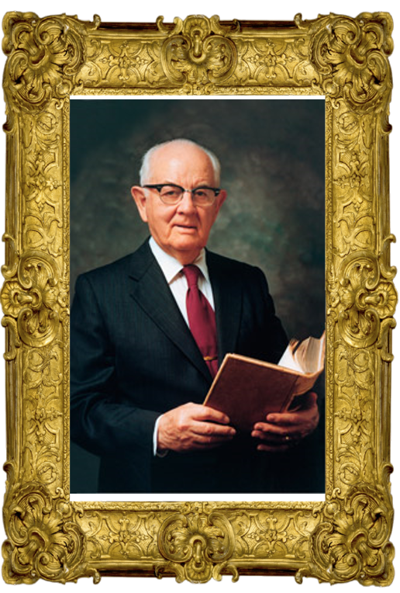
Missionary Work Expands
During President Spencer W. Kimball’s service as President of the Church, the Lord hastened His work.
“We must lengthen our stride and must do it now”
President Spencer W. Kimball

Slide 6
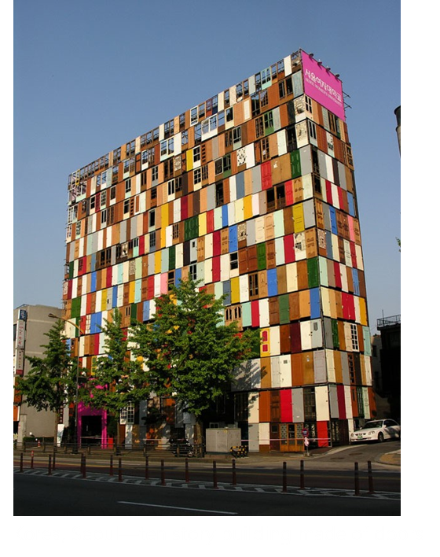
Prepare To Open and Receive
President Spencer W. Kimball told the Saints that the Lord was prepared to open doors for them to share the gospel, including in nations that did not allow missionary work.
However, he also said that the Saints needed to prepare themselves to receive those opportunities.
President Spencer W. Kimball

Slide 7
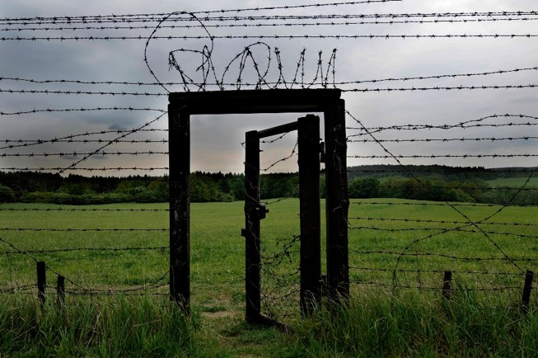
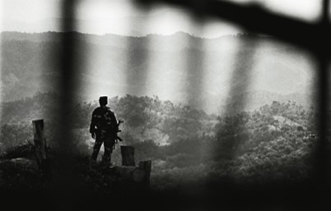
Every Young Man
“I know they have curtains, like iron curtains and bamboo curtains. I know how difficult it is because we have made some efforts. …
But I can see no good reason why the Lord would open doors that we are not prepared to enter.
Why should he break down the Iron Curtain or the Bamboo Curtain or any other curtain if we are still unprepared to enter?”
President Kimball also testified that if every young man prepared to serve a full-time mission, the Lord would open doors and provide a way for missionary work to go forth to the entire world.
President Spencer W. Kimball

Slide 8
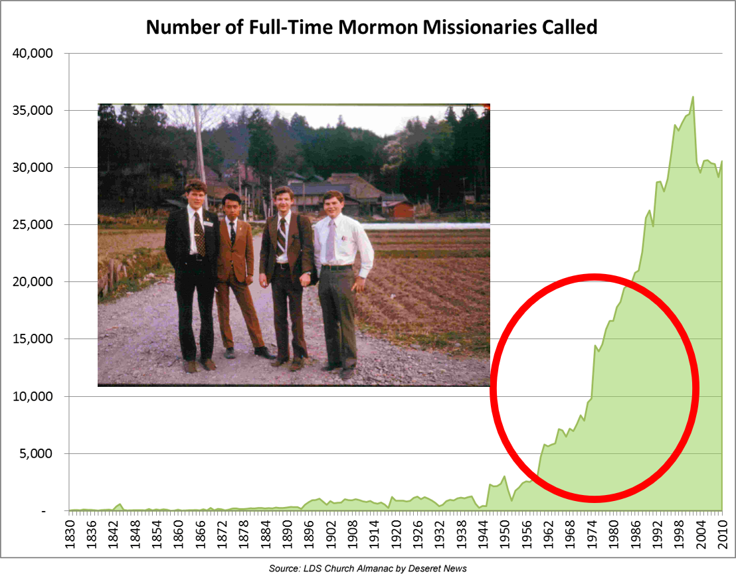
Increase of Missionaries
During President Kimball’s administration the number of full-time missionaries increased by more than 50 percent.
In the late 1980s and early 1990s, the governments of East Germany, nations within the former Soviet Union, and other nations where missionary work had previously been restricted began allowing missionaries to share the gospel in these countries.
President Kimball’s prophecy was fulfilled.
President Kimball served from 1974-1985
Missionaries in 1975 Sakata Missionaries: Elders Jacobsen, Okada, Chapman, and Bugg

Slide 9
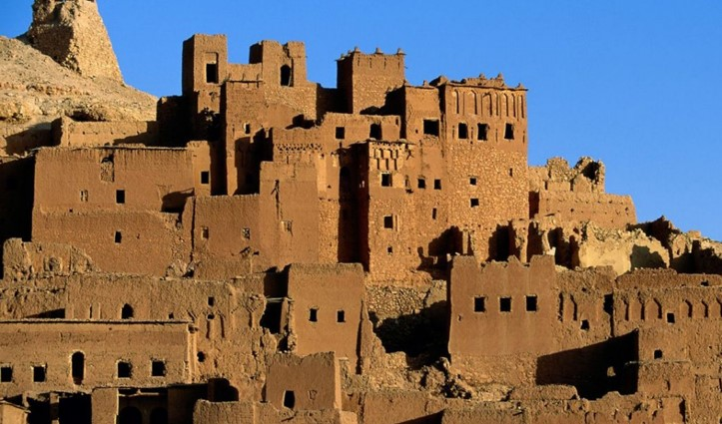
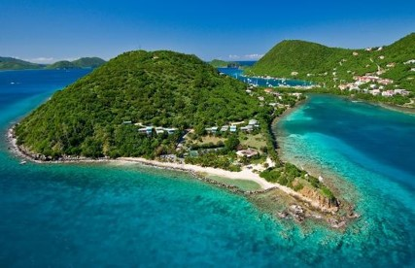
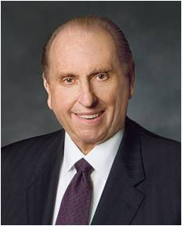
Open Countries To Receive the Gospel
“There remain … areas of the world where our influence is limited and where we are not allowed to share the gospel freely.
As did President Spencer W. Kimball over 32 years ago, I urge you to pray for the opening of those areas, that we might share with them the joy of the gospel.
As we prayed then in response to President Kimball’s pleadings, we saw miracles unfold as country after country, formerly closed to the Church, was opened. Such will transpire again as we pray with faith.”
President Thomas S. Monson

Slide 10
First Missionaries 1974-1985
1974
1975
1976
1977
1978
1979
1980
1983
1984
1985
Portugal
Micronesia
Marshall Island
Poland
Trinidad and Tobago
Réunion
St. Lucia
Martinique
Grenada
Cayman Islands
Slovenia
Vanuatu
Northern Mariana Islands
Iran
Belize
Haiti
Papa New Guinea
St. Vincent and the Grenadines
St. Kitts and Nevis
Antigua and Barbuda
Nauru
Tuvalu
Guadeloupe
Dominican Republic
Ghana
Nigeria
Suriname
Palau
US Virgin Islands
Curaçao
Wikipedia

Slide 11
First Missionaries 1886-1998
1986
1987
1988
1989
1990
1991
1992
1993
1994
1995
1997
1998
Moldova
Democratic Republic of the Congo
Guyana
Cape Verde
Sierra Leone
Ukraine
Kenya
Republic of Congo
Cambodia
Solomon Island
Benin
Lesotho
French Guiana
Mongolia
Malawi
Tanzania
Albania
Lithuania
Swaziland
Liberia
Cyprus
Aruba
Angola
Cameroon
Central African Republic
Ethiopia
Madagascar
Pakistan
Belarus
Botswana
Namibia
Uganda
Estonia
Wikipedia

Slide 12
First Missionaries 1999-2014
1999
2000
2006
2008
2010
2011
2012
2013
2014
Mozambique
Togo
Georgia
Dominica
Laos
Kosovo
Turks and
Caicos Island
Republic of Macedonia
Montenegro
Bosnia and
Herzegovina
Juba Branch,
South Sudan
(see notes*)
Burma (Myanmar)
very brief missionary activity occurred
Gabon
Kazakhstan
Burundi
LDS missionaries are currently not permitted to preach in a number of countries where they have preached previously, including Israel/Palestine, Iran, Laos, Lebanon, Syria, and Vietnam (2012). Wikipedia

Slide 13
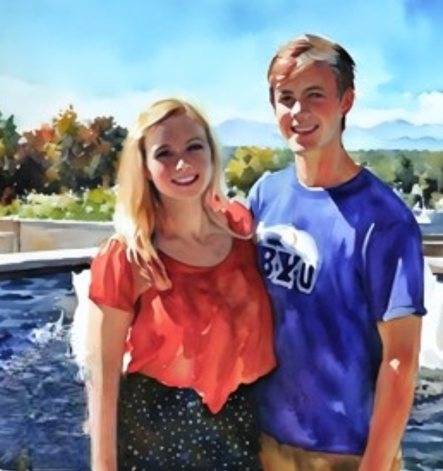
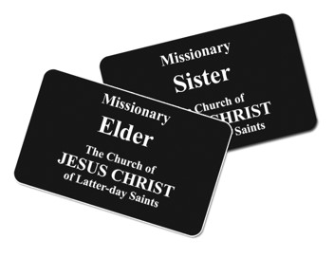
Worthy For a Full-time Mission
Prophets have continued to encourage every worthy, able young man to serve a full-time mission.
Prophets have also welcomed young women to serve full-time missions if they desire to do so.
In October 2012, President Thomas S. Monson announced a change in missionary age requirements, allowing young men to begin service at age 18 and young women at age 19.
Every young man should prepare to serve a full-time mission and keep himself worthy to serve

Slide 14
Becoming Closer to God
“I find that when I get casual in my relationships with divinity and when it seems that no divine ear is listening and no divine voice is speaking, that I am far, far away. If I immerse myself in the scriptures the distance narrows and the spirituality returns”
--President Spencer W. Kimball
Holy Bible
The
Book
of
Mormon
Doctrine
And
Covenants
ANOTHER TESTAMENT
OF JESUS CHRIST
And for this purpose I have commanded you to organize yourselves, even to print my words, the fulness of my scriptures, the revelations which I have given unto you, and which I shall, hereafter, from time to time give unto you—
D&C 104:58
For the purpose of building up my church and kingdom on the earth, and to prepare my people for the time when I shall dwell with them, which is nigh at hand..
D&C 104:59

Slide 15
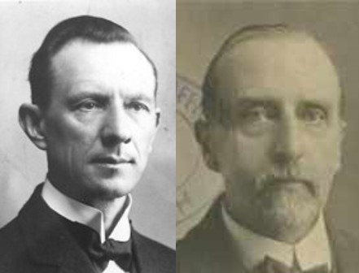
Extensive Study of the Scriptures
Closing words of Hyrum M. Smith and Janne M. Sjodahl:
“These Revelations should be read and studied diligently. They show us the road to life eternal; they tell us of the pitfalls on the way, and how to avoid them; they furnish us with light in the darkness; strength in temptations and trials; comfort when we mourn; and hope in ties of despair.”
“They tell us what is needed for the world’s salvation from error and ignorance, from poverty and disease, from strife and war, from sin, death, and damnation.”
“They proclaim the advent of the Son of God and point to the signs by which we may know that the establishment of His kingdom is near at hand. They tell us how to live so that we may enjoy citizenship in that kingdom, and exaltation in the presence of God.”

Slide 16
Becoming Familiar With the Scriptures
In the early 1970s, Church leaders recognized the need for Church members to become more familiar with the scriptures and to have a standard edition of the Bible for study and teaching.
In 1979, after years of inspired, diligent efforts, the Church printed an official English LDS edition of the King James Bible.
This Bible contained extensive study aids not previously available, including expanded footnotes with cross-references and other aids; improved chapter headings; excerpts from the Joseph Smith Translation; the Topical Guide; and the Bible Dictionary.
In 1981, the Church published a new edition of the English triple combination that included improved footnotes, chapter headings, maps, and an index.
In 2009, the Church published the LDS edition of the Reina-Valera Bible in Spanish.

Slide 17
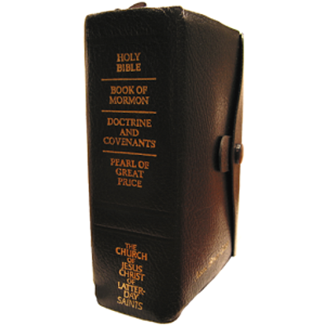
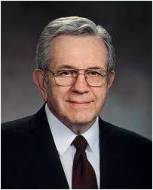
Triple Combination --1981
“With the passing of years, these scriptures will produce successive generations of faithful Christians who know the Lord Jesus Christ and are disposed to obey His will.
“… They will develop a gospel scholarship beyond that which their forebears could achieve. They will have the testimony that Jesus is the Christ and be competent to proclaim Him and to defend Him.”
President Boyd K. Packer
The scriptures testify that Jesus is the Christ.

Slide 18
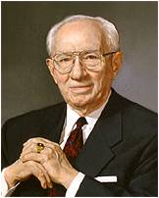
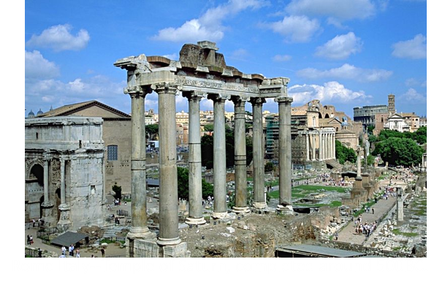
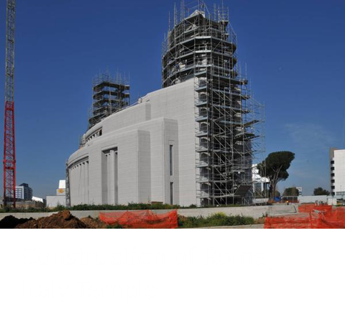
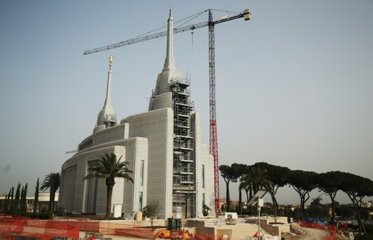
The Growing Number of Temples
“I have a burning desire that a temple be located within reasonable access to Latter-day Saints throughout the world. … The work is moving about as fast as we can go. It is my constant prayer that somehow it might be speeded up so that more of our people might have easier access to a sacred house of the Lord.”
President Gordon B. Hinckley
How many temples were built in the 143 years between the organization of the church in 1830 and the calling of President Spencer W. Kimball in 1973?
17 temples
How many temples were announced or built in the 40 years between 1973 and 2013?
153 temples

Slide 19
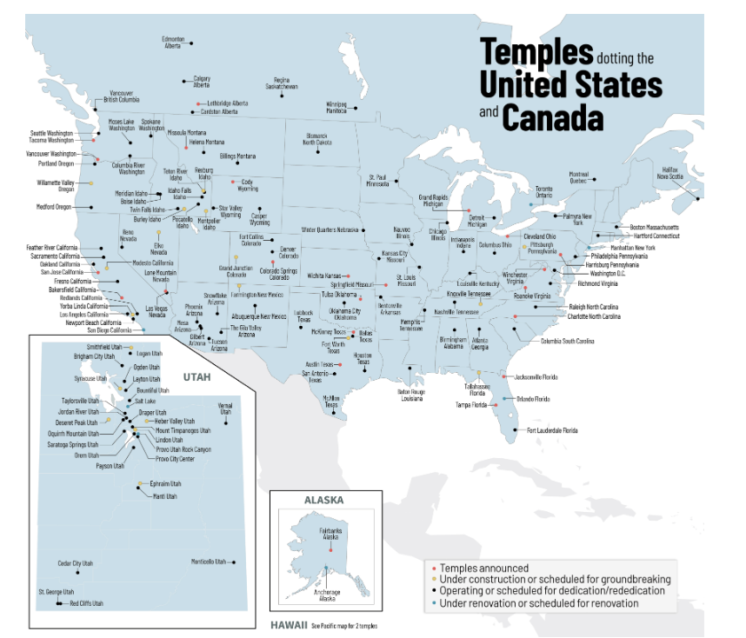
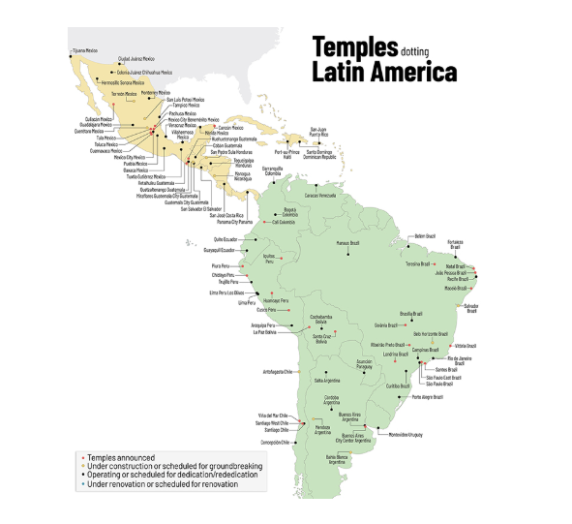
Temples as of 2024
Newsroom

Slide 20
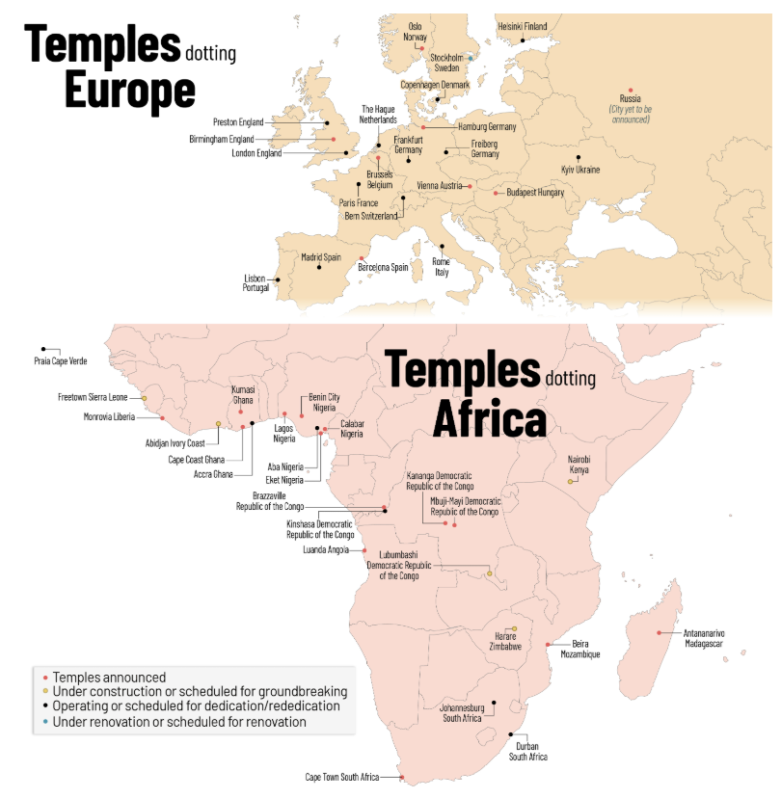
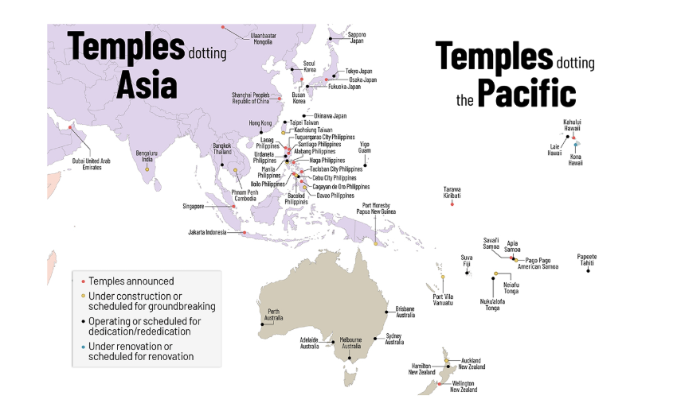
Temples as of 2024
Newsroom

Slide 21
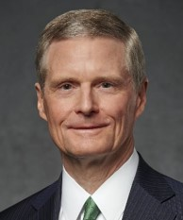
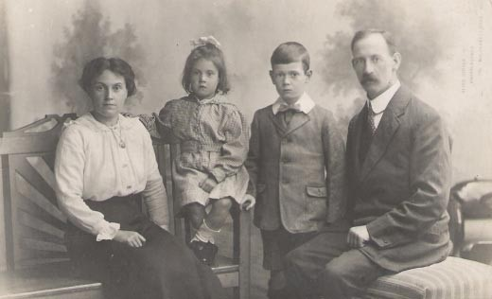
Family Search
“It is no coincidence that FamilySearch and other tools have come forth at a time when young people are so familiar with a wide range of information and communication technologies.
“Your fingers have been trained to text and tweet to accelerate and advance the work of the Lord—not just to communicate quickly with your friends. The skills and aptitude evident among many young people today are a preparation to contribute to the work of salvation.”
Elder David A. Bednar

Slide 22
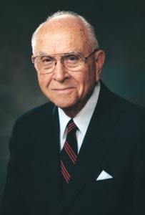
Moving the Work Forward
“Brothers and sisters, the Lord is opening the way and making it possible to expand His work throughout the world, and what a blessing it is for all of us—each in his own way—to take part. …
“Who but the prophets of God could have foreseen the miracle of the rapid expansion of the work of the Lord? Truly, as the Lord foretold in section 88 of the Doctrine and Covenants, He is hastening His work in its time.”
Elder David B. Haight
We can be blessed by taking part in the hastening of the Lord’s work

Slide 23
Sources:
Ministry of Spencer W. Kimball: Expanded Missionary Force (1:19)
President Monson Announces Mission Age Change (1:57)
Family History: An Invitation(2:17)
Ministry of Spencer W. Kimball: Expanded Missionary Force (1:19)
President Spencer W. Kimball (“Always a Convert Church: Some Lessons to Learn and Apply This Year,” Ensign, Sept. 1975, 3).
(“When the World Will Be Converted,” Ensign, Oct. 1974, 5, 7).
” (The Teachings of Spencer W. Kimball, ed. Edward L. Kimball [1982], 135).
Bamboo Curtain Photo A SHAN REBEL on the Burma-Thailand border. (Photo by NIC Dunlop/Panos Pictures)
President Thomas S. Monson (“Welcome to Conference,” Ensign or Liahona, Nov. 2008, 6).
Presentation by ©http://fashionsbylynda.com/blog/
President Boyd K. Packer (“Scriptures,” Ensign, Nov. 1982, 53).
President Gordon B. Hinckley (“Of Missions, Temples, and Stewardship,” Ensign, Nov. 1995, 52, 53).
Elder David B. Haight (“Missionary Work—Our Responsibility,” Ensign, Nov. 1993, 61, 62).
Newsroom https://newsroom.churchofjesuschrist.org/article/see-locations-of-the-churchs-335-temples-across-6-maps-march-2024
Presentation by ©http://fashionsbylynda.com/blog/

Slide 24
Official LDS Church missionaries have never preached in the following countries and territories:
Afghanistan
Algeria
Anguilla
Azerbaijan
Bahrain
Bangladesh
Bhutan
British Virgin Islands
Brunei
Burkina Faso
Chad
China (missionaries have preached in Hong Kong, Macau, and Taiwan)
Comoros
Cuba
Djibouti
East Timor
Egypt
Eritrea
Equatorial Guinea
Falkland Islands
Faroe Islands
Gambia
Greenland
Guinea-Bissau
Iraq
Kuwait
Kyrgyzstan
Libya
Liechtenstein
Maldives
Mali
Mauritania
Monaco
Morocco
Nepal
Niger
Norfolk Island
North Korea
2015
Oman
Pitcairn Islands
Qatar
Rwanda
San Marino
Saudi Arabia
Senegal
Seychelles
Somalia
Sudan
Tunisia
Turkmenistan
United Arab Emirates
Uzbekistan
Vatican City
Wallis and Futuna
Yemen
Additionally, LDS missionaries are currently not permitted to preach in a number of countries where they have preached previously, including Israel/Palestine, Iran, Laos, Lebanon, Syria, and Vietnam. Wikipedia

Slide 25
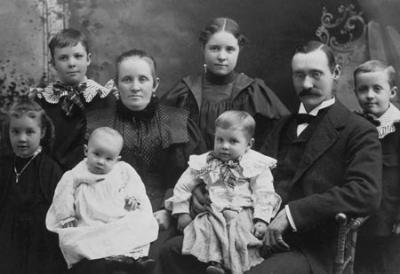
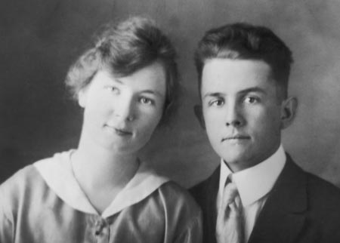
Spencer Woolley Kimball was born on March 28, 1895, the sixth of Andrew and Olive Kimball’s eleven children.
They lived on a small farm on the south edge of Thatcher, Arizona.
When Spencer was 11, his mother died.
During his youth he learned to sing and lead music and was appointed stake chorister at age 15. He also learned to play the piano. Years later, he alternated with Elder Harold B. Lee as accompanist for the weekly meetings of the Quorum of the Twelve Apostles.
In addition to his home, school, and Church responsibilities, Spencer worked as a secretary for his father. Andrew wrote many letters, averaging six a day. Spencer took dictation from him and then typed the letters.
In 1914, Spencer graduated from Gila Academy, expecting to enter the University of Arizona in the fall. During the graduation exercises, however, Andrew Kimball announced that Spencer was to be called on a mission.
In preparation for his mission, Spencer went to work in Globe, Arizona, as a dairy hand.
From October 1914 to December 1916, Spencer served as a full-time missionary in the Central States Mission, headquartered in Independence, Missouri. This was the same area where his father, his stepmother, and one of his older brothers had served.
In the summer of 1917, about seven months after Spencer Kimball returned home from his mission, he noticed an announcement in the local newspaper. Camilla Eyring, who had moved to the Gila Valley in 1912 with her family, would be teaching home economics at the Gila Academy.
After 31 days, Spencer had become a fixture at the Eyring household. The couple decided to marry, but their plans were affected by the ongoing World War I. Spencer was obligated to stay in Thatcher, Arizona, to await possible draft into the army, so they would not be able to make the long trip to a temple in Utah. They were married civilly on November 16, 1917, but looked forward to a temple sealing as soon as possible. That goal was realized the following June in the Salt Lake Temple.
Spencer and Camilla eventually had four children: three sons and a daughter (Spencer LeVan, Andrew Eyring, Edward Lawrence, and Olive Beth)
Spencer began his professional life as a bank clerk. As the years passed, he moved from banking to life insurance and real estate development. The economic upheaval of the Great Depression (1929–39) hit Spencer’s business interests hard, but the family was able to weather the adversity.
Spencer’s father passed away in 1924, after having served as stake president for nearly three decades. When President Heber J. Grant, seventh President of the Church, subsequently reorganized the stake presidency, 29-year-old Spencer was called to serve as second counselor.
On July 8, 1943, President J. Reuben Clark Jr. of the First Presidency called Spencer at home. He said that Spencer had been called to fill one of the two vacant seats in the Quorum of the Twelve Apostles.
Late in 1956, he felt a hoarseness in his voice. The diagnosis was cancer of the throat. An operation in July 1957 resulted in the removal of one vocal cord and part of another.
The night of December 26, 1973, President Harold B. Lee, the 11th President of the Church, died suddenly. Consistent with the order of apostolic succession in the Church, on December 30, 1973, Spencer W. Kimball, as the senior member of the Quorum of the Twelve, became President of The Church of Jesus Christ of Latter-day Saints.
Andrew and Olive Kimball in 1897 with their children ( from left to right): Ruth, Gordon, Alice, Clare, Spencer (on Andrew’s lap), and Delbert.
Camilla Eyring and Spencer W. Kimball
Excerpts from: Teachings of Presidents of The Church 2006

Slide 26
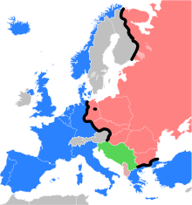
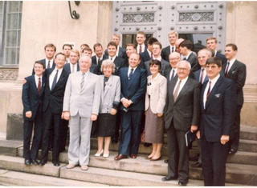
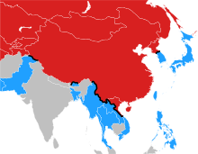
The Iron Curtain symbolized the ideological conflict and physical boundary dividing Europe into two separate areas from the end of World War II in 1945 until the end of the Cold War in 1991. The term symbolized efforts by the Soviet Union to block itself and its satellite states from open contact with the west and non-Soviet-controlled areas. On the east side of the Iron Curtain were the countries that were connected to or influenced by the Soviet Union. On either side of the Iron Curtain, states developed their own international economic and military alliances: Wikipedia
At the end of World War II, in 1945, missionaries once again were sent to areas in the western “zones of occupation” in Germany—what would become the Federal Republic of Germany. But they were not permitted to enter the Russian zone of occupation, the eastern area of Germany that would become the German Democratic Republic (GDR). Members in the eastern branches of the Church would have to provide their own missionary force. So, for the next twenty years, single women and single and married men accepted the call to serve as full-time missionaries within the German Democratic Republic’s borders.
In the mid-1960s, even this internal missionary service was banned by the government. For the next twenty-five years there were no full-time missionaries in eastern Germany. One can easily imagine, then, the joy and excitement that swept through the thirty wards and branches in the German Democratic Republic when the government announced, in late October 1988, that foreign missionaries would once again be allowed to enter areas where they had not served for fifty years.
By the first of June 1989, the full-time missionary force had increased to twenty-two.
Missionaries arrived in the German Democratic Republic on the last day of March 1989, and their first baptisms were held within a few days. For more information:
https://www.lds.org/ensign/1991/06/the-wall-comes-down-the-church-in-eastern-germany-part-2-19891990?lang=eng
The Bamboo Curtain was a Cold War euphemism for the political demarcation between the Communist states and the capitalist and non-communist states of East Asia, particularly the People's Republic of China. The term was less often applied to the Korean Demilitarize Zone dividing North and South Korea and the flexible Southeast Asia border between Communism and the West (here referring to the forces aligned against Communism during the Cold War).
During the Cultural Revolution in China, the Chinese authorities put its sections of the Curtain under a lock-down of sorts, forbidding entry into or passage out of the country without explicit permission from the Chinese government. Many would-be refugees attempting to flee to capitalist countries were prevented from escaping in this manner. Occasional relaxations had led to several waves of influx of refugees into the then-British crown colony of Hong Kong.
Today, the demilitarized zone separating North and South Korea is typically described as the DMZ. "Bamboo Curtain" is used most often to refer to the enclosed borders and economy of Burma (though this began to open in 2010). The Bamboo Curtain has since given way to the business model called the bamboo network.
The Bamboo Curtain in 1959. The Curtain itself is in black. Note that at the time, Laos was allied with the United States, as the Communist Pathet Lao did not take over the country until later. Also, North and South Vietnam had not yet been united. The boundaries of the now-independent former Soviet republics are anachronistically shown. Wikipedia
Missionaries in East Germany pose with the state secretary of religious affairs for the German Democratic Republic, Kurt Lffler, in August 1989
Deseret News

Slide 27
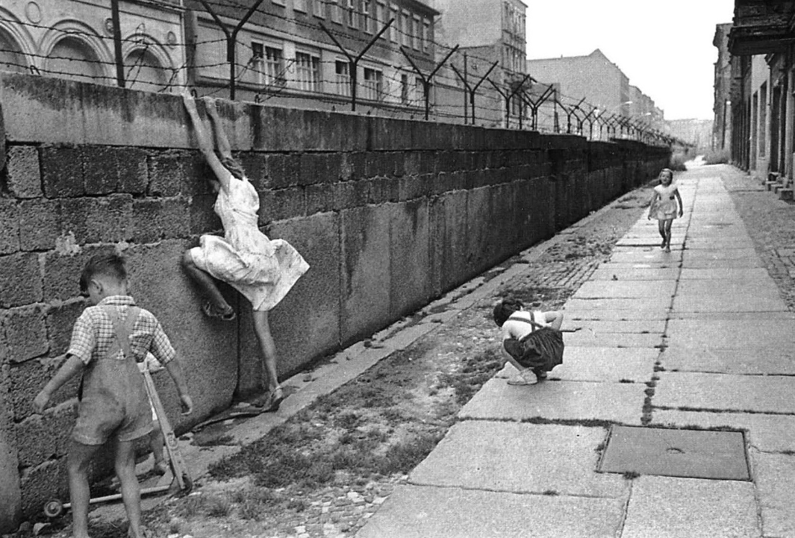
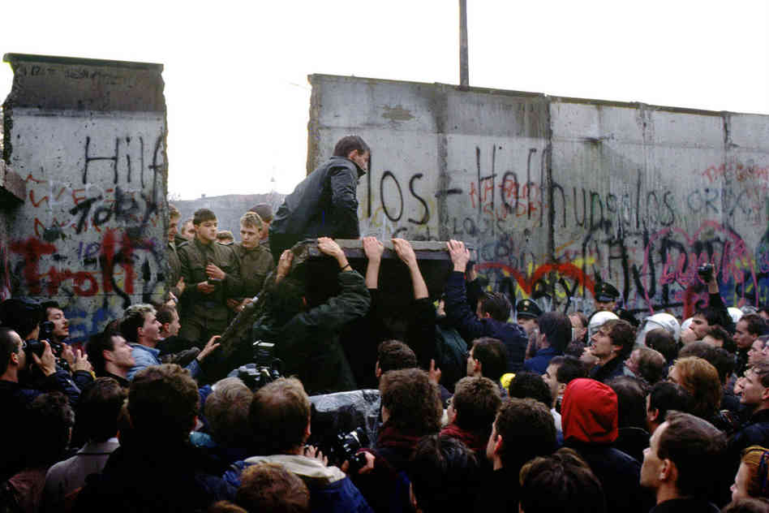
The Berlin Wall:
In 1989, a series of radical political changes occurred in the Eastern Bloc, associated with the liberalization of the Eastern Bloc's authoritarian systems and the erosion of political power in the pro-Soviet governments in nearby Poland and Hungary. After several weeks of civil unrest, the East German government announced on 9 November 1989 that all GDR citizens could visit West Germany and West Berlin. Crowds of East Germans crossed and climbed onto the wall, joined by West Germans on the other side in a celebratory atmosphere. Over the next few weeks, euphoric people and souvenir hunters chipped away parts of the wall; the governments later used industrial equipment to remove most of what was left. Contrary to popular belief the wall's actual demolition did not begin until the summer of 1990 and was not completed until 1992. The fall of the Berlin Wall paved the way for German reunification, which was formally concluded on 3 October 1990.
Hungary effectively disabled its physical border defenses with Austria on 19 August 1989 and, in September, more than 13,000 East German tourists escaped through Hungary to Austria. This set up a chain of events. The Hungarians prevented many more East Germans from crossing the border and returned them to Budapest. These East Germans flooded the West German embassy and refused to return to East Germany.
(President Deiter F. Uchtdorf) The fall of the Berlin Wall came as a complete shock 25 years ago today. There were signs of a real thaw in the Cold War, but the wall fell suddenly on Nov. 9, 1989, due to a miscommunication and momentum, not any grand vision.
President Uchtdorf recalled that day during an hour long interview Wednesday with the Deseret News. The story that emerged was one of a boy and man swept up by the Cold War — a young boy who escaped East Germany and became a West German fighter pilot and church leader with a front-row seat to history.
"I always knew that Germany one day would be united again," President Uchtdorf said, "but in my heart and mind I always thought, 'Well, it won't be in my lifetime, and it won't be in the lifetime of my children, but perhaps during the lifetime of my grandchildren or great-grandchildren.' But I knew it would happen, someday.
"And then it was there. And then it was there, just like that."
The LDS Church and the Berlin Wall: President Uchtdorf recalls escape from East Germany, life with the wall—Deseret News
http://www.deseretnews.com/article/865615100/The-LDS-Church-and-the-Berlin-Wall-President-Uchtdorf-recalls-escape-from-East-Germany-life-with.html?pg=all

Slide 28
Mormon Temples: A Conversation with a Church Leader (15:46)
“We must lengthen our stride”
President Spencer W. Kimball taught:
“Do we, too, have something we need to share? Yes! We have the gospel of Jesus Christ, the gospel of peace, the gospel of joy. We have truths that can make any person better and more fulfilled, any marriage happier and sweeter, any home more heavenly. We have the priesthood power of God to bless our homes and lives and the lives of others. Yes, it is to ourselves, our homes, our quorums, our classes, our Church assignments that we must carry more energetically those things that we have received. And it is to our nonmember neighbors and associates that we are now asked to also ‘give such as we have.’ The Lord has commanded us to do so. We must lengthen our stride and must do it now” (“Always a Convert Church: Some Lessons to Learn and Apply This Year,” Ensign, Sept. 1975, 3).
https://www.youtube.com/watch?v=vGN9Mg-KnMY
Rome Italy Temple 2:47
https://www.youtube.com/watch?v=1MgUCQ2pXnE
LDS Temples built chronologically
http://www.ldschurchtemples.com/chronological/
Temple handout (Map)
http://www.ldschurchtemples.com/~ldschu5/maps/downloads/TemplesWorldMap.pdf
https://mormontempletrek.com/world-temple-map/
The Quorums of the Seventy
The expansion of the Quorums of the Seventy is evidence that the Lord is hastening His work.
In 1976, President Spencer W. Kimball organized the First Quorum of the Seventy, and additional Quorums of the Seventy have been added as the Church has grown. The number of quorums can continue to expand as needed.
“[As of 2014] there are … eight Quorums of the Seventy. Each quorum may have up to 70 members. Members of Quorums of the Seventy are often referred to simply as ‘Seventies.’ Seventies are called to proclaim the gospel and build up the Church. They work under the direction of the Quorum of the Twelve Apostles and the Presidency of the Seventy. …
“… Members of the First and Second Quorums of the Seventy are considered General Authorities, meaning that they have authority to serve anywhere in the world. Members of the remaining quorums are called Area Seventies, and their authority is limited to the area where they serve” (“Quorums of the Seventy,” LDS.org).
Note * https://africasouth.churchofjesuschrist.org/the-first-missionaries-to-serve-missions-from-the-southern-sudan
Other interesting sites

