Slide 1

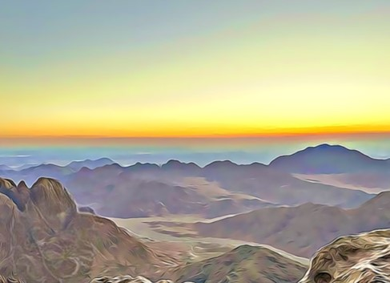
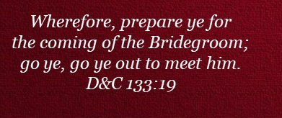
Doctrine and Covenants 88:70-117
Preparing for the Last Days
Presentation by ©http://fashionsbylynda.com/blog/

Slide 2
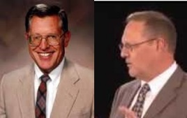
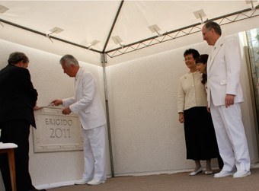
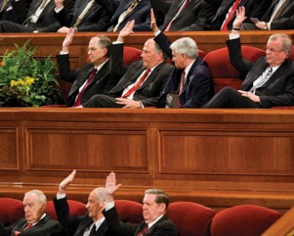
Call A Solemn Assembly
“Solemn assemblies are meeting of particularly solemn or sacred nature.”
It is limited by both worthiness and by invitation.
3 Kinds:
A temple dedication
The sustaining of a new presidency of the Church
Special priesthood leadership meetings held in temples
D&C 88:70 McConkie and Ostler

Slide 3
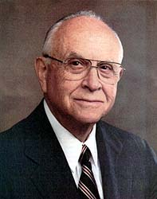
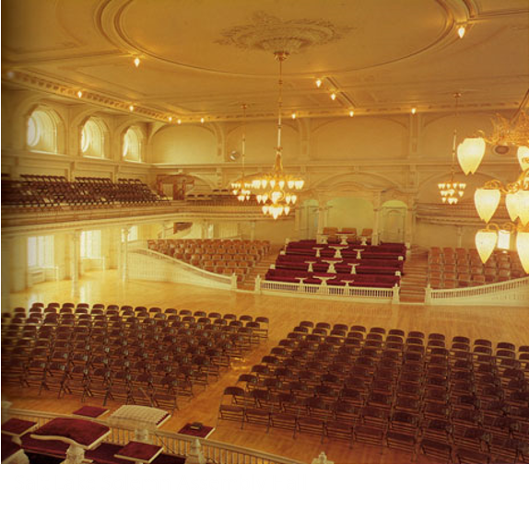
Meetings for the Church
“A solemn assembly, as the name implies, denotes a sacred, sober, and reverent occasion when the Saints assemble under the direction of the First Presidency. Solemn assemblies are used for three purposes: the dedication of temples, special instruction to priesthood leaders, and sustaining a new President of the Church” Elder David B. Haight
Between January and May 1836, a number of meetings were held in Kirtland. Some of these meetings were solemn assemblies. Solemn assemblies are special meetings distinguished from other Church meetings.
During the week of March 27, 1836, solemn assemblies were held as part of the dedication of the Kirtland Temple, and another solemn assembly was held three days later on March 30, 1836.
Another solemn assembly was held about a year later on April 6, 1837.
D&C 88:70

Slide 4
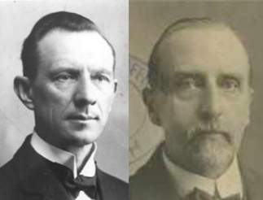
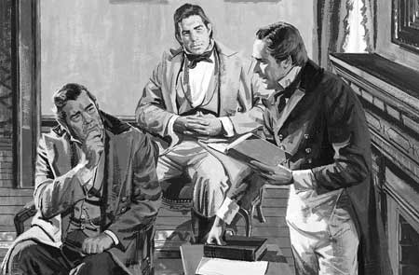
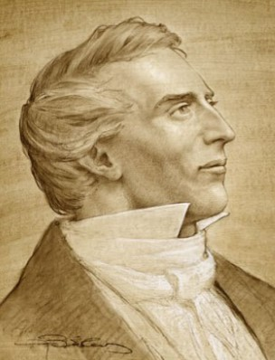
First Labors in this Last Kingdom
The first laborers included:
Joseph and Hyrum Smith, Oliver Cowdery, the Whitmers, Samuel Smith, Orson Hyde, the Pratts, Sidney Rigdon, the Johnsons, and many others, mentioned in the revelations in Section 75—they were to meet in solemn assembly in Kirtland, Ohio
Smith and Sjodahl
“We must have all things prepared, and call our solemn assembly as the Lord has commanded us, that we may be able to accomplish His great work, and it must be done in God’s own way. The house of the Lord must be prepared, and the solemn assembly called and organized in it, according to the order of the house of God.”
Prophet Joseph Smith
D&C 88:70

Slide 5

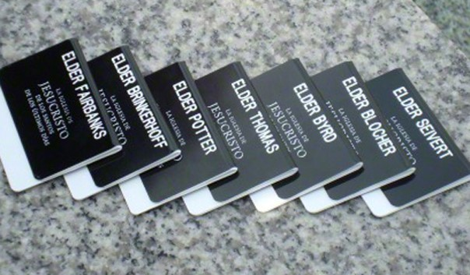
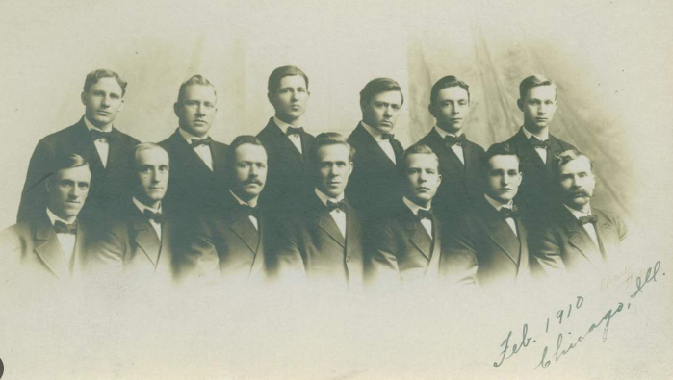
Prepare and Teach
What were these “first laborers” commanded to do to prepare to teach others as missionaries?
Purify yourselves from the sins of the world, in order that you may be clean
“One who accepts the call to the ministry in the Church of Christ must first be saved from all selfishness, so that he desires only the glory of God”
Smith and Sjodahl
D&C 88:74

Slide 6
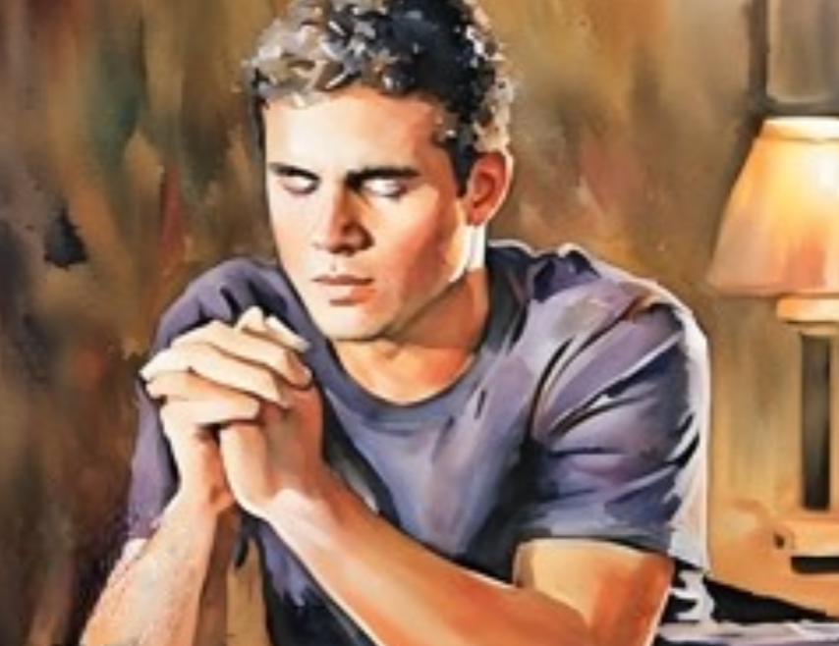

Organize, Prepare, and Sanctify
What could we do to “organize,” “prepare,” and “sanctify” ourselves to become more effective at sharing the gospel?
Fast and Pray
“Our Lord teaches us that there are evil spirits that cannot be overcome except by those who spiritual life and faith are made strong by self-denial and communion with God.”
Smith and Sjodahl
How does being cleansed from sin influence our ability to share the gospel?
And it came to pass after they had fasted and prayed for the space of two days and two nights, the limbs of Alma received their strength, and he stood up and began to speak unto them, bidding them to be of good comfort:
For, said he, I have repented of my sins, and have been redeemed of the Lord; behold I am born of the Spirit.
Mosiah 27:23-24
D&C 88:76

Slide 7
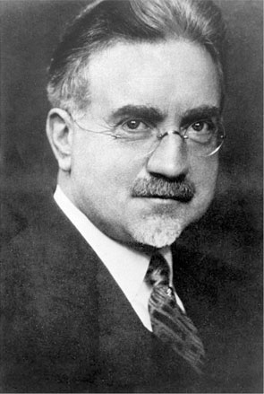
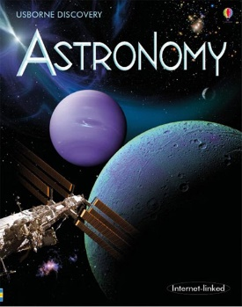

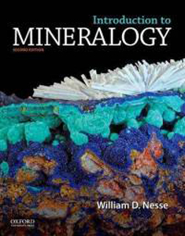
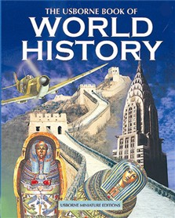

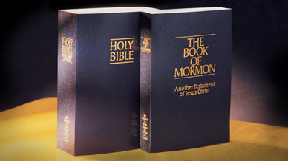
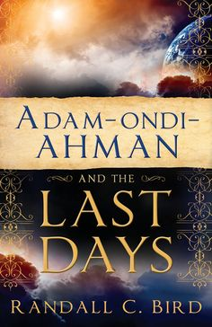

Teach One Another
“Theology is not the only subject in which the Elders should be interested. They should study:
Form a school and teach each other all useful knowledge
Things both in heaven—Astronomy.
And in the earth—Everything pertaining to the cultivation of the soil.
And under the earth—Mineralogy, geology, etc.
Things which have been—History, in all its branches.
Things which are at home and abroad—Domestic and foreign politics.
Things which must shortly come to pass—Prophecies.
Wars—perplexities—judgment—The signs of the times, by which the observer may know that the day of the Lord is at hand.
A knowledge of countries and kingdoms—physical and political geography, languages, etc.
D&C 88:77-80 Elder John A. Widtsoe
NOTE: I am not prompting these books, they are there for visual effects

Slide 8

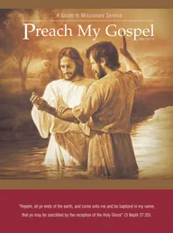
To Be His Ambassadors
“God does not require all His servants to become doctors, or professors, or even profound students of these subjects, but He expects them to know enough of these things to be able to magnify their callings as His ambassadors to the world.”
D&C 88:77-80 Elder John A. Widtsoe

Slide 9
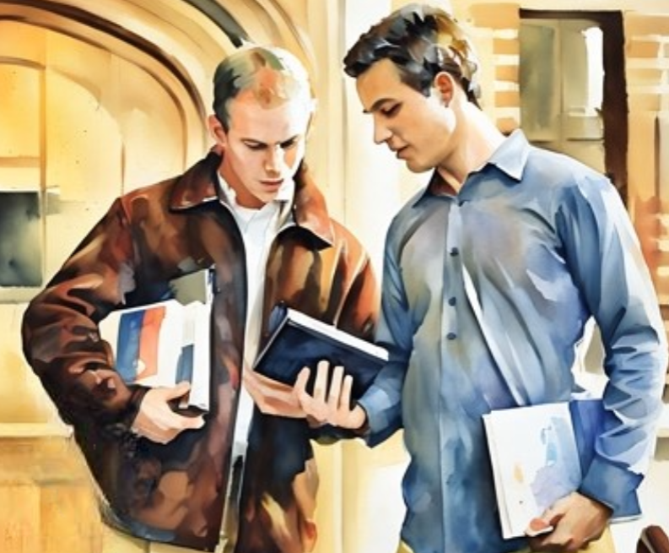

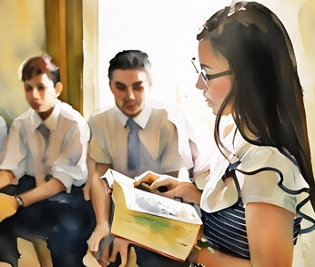
As we teach one another diligently, the Lord will help us understand His truths more perfectly. By teaching one another, we can prepare to share the gospel with others.

Slide 10



When have you been thankful because someone warned you about something?
What does it mean that we have been warned?
Because we have been warned through the message of the gospel, the Lord expects us to warn our neighbors.
D&C 88:81-86 See Mini Lesson 1

Slide 11
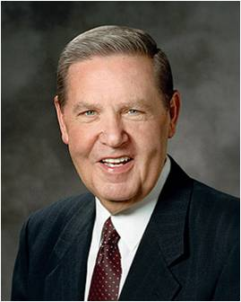
“No missionary can be unrepentant of sexual transgression or profane language or pornographic indulgence and then expect to challenge others to repent of those very things!
You can’t do that. The Spirit will not be with you, and the words will choke in your throat as you speak them.
You cannot travel down what Lehi called ‘forbidden paths’ and expect to guide others to the ‘strait and narrow’ one—it can’t be done.”
Elder Jeffrey R. Holland
1 Nephi 8:28; 2 Nephi 31:18

Slide 12

Before the Lord’s Second Coming, what kind of testimonies will follow the testimonies of missionaries?
Why is it critical that we be prepared for the Lord’s Second Coming?
The righteous will rise to meet Christ when He comes
D&C 88:87-98 See Mini Lesson 2

Slide 13
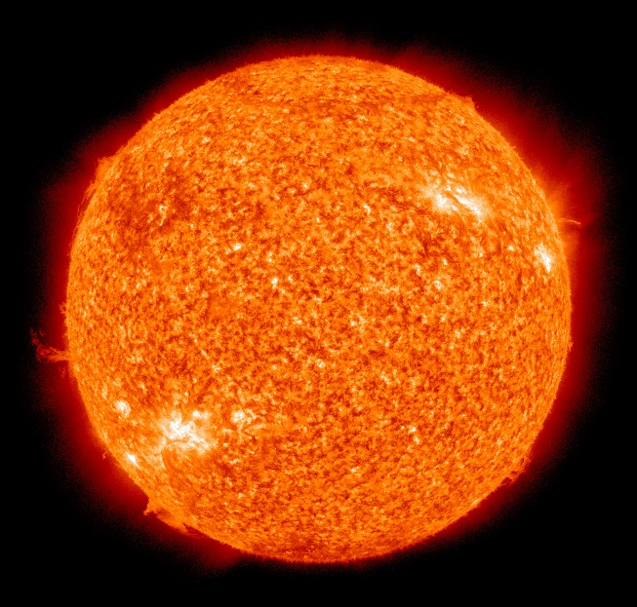
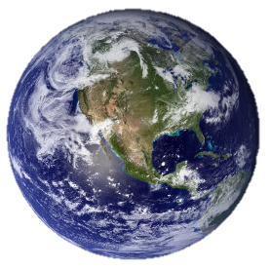
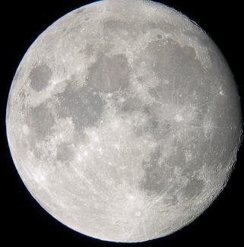
Events of the Last Days
The Earth will tremble and reel to and fro
Stars become angry
The sun shall hide his face
The moon will turn to blood
This Revelation lifts a part of the veil for the future and permits the Lord’s servants to view the events surrounding the time before the Millennium and during
D&C 88:87-116

Slide 14
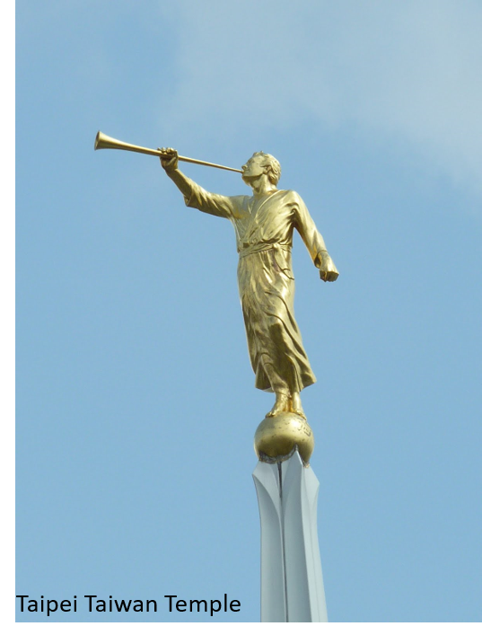
Angels
After the testimony of the messengers a great sign will appear in heaven, which, like the sun, will be seen all round the world.
Messengers of God—warning of the coming of the Bridegroom
“The Lord will not come to reign over the righteous, in this world, in 1843, nor until everything for the Bridegroom is ready.”
HC
Invites all to worship God=
Moroni and the coming forth of the Book of Mormon
Missionaries who take the message to the world (D&C 133:36-39 and 90:9-11 and 88:103-4)
D&C 88:87-116

Slide 15

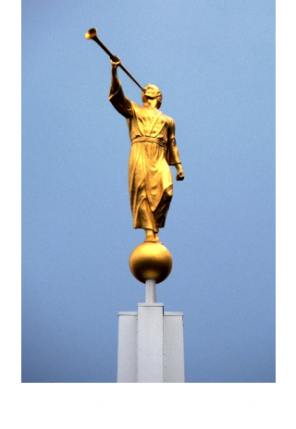

1st Angel
World Events
Ready to be burned
Silence for half an hour
“Whether the half hour here spoken of is according to our reckoning—thirty minutes, or whether it be according to the reckoning of the Lord, we do not know.
“During the period of silence all things are perfectly still; no angel flying during that half hour; no trumpets sounding; no noise in the heaven above…but immediately after this silence the scroll is unfolded.
The face of the Lord shall be revealed.
D&C 88:94-96 Smith and Sjodahl

Slide 16
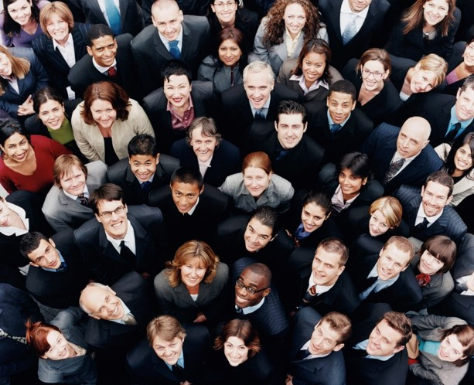
Resurrection of the Dead
The First Fruits
Everyone who has ever lived on earth will be resurrected, but those who are “reconciled unto [God] through the atonement of Christ” are the “first-fruits of Christ.” They are those who come forth in the first resurrection and inherit the celestial kingdom.
Bible Dictionary
D&C 88:96-98

Slide 17
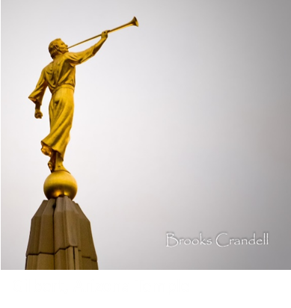
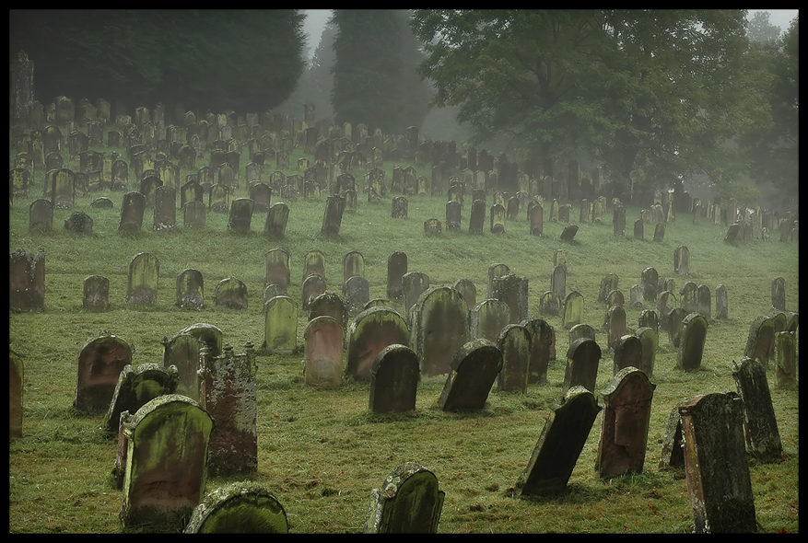
2nd Angel
The time has come for the redemption of the spirits who have accepted Christ in the spirit world up to the time of His second coming.
They will be resurrected the, and enter terrestrial glory.
Smith and Sjodahl
D&C 88:99

Slide 18
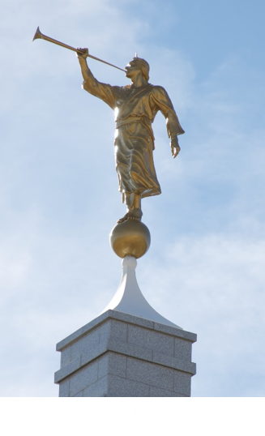
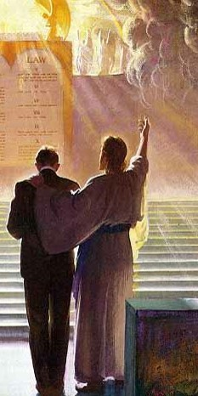
3rd Angel
When the 3rd angel sounds his trump, those who are worthy of telestial glory will be judged and receive the reward for which they have prepared themselves by their works in the flesh
Until the thousand years are ended
D&C 88:100-101
Smith and Sjodahl

Slide 19
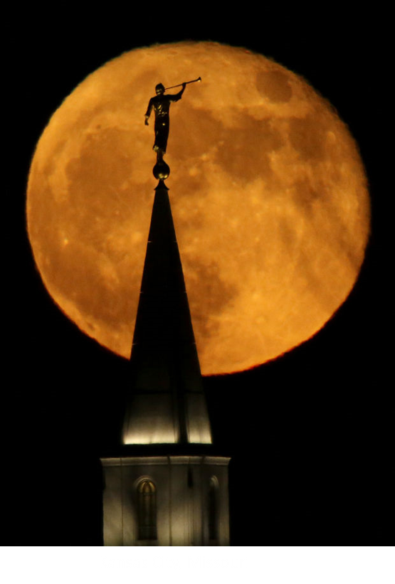

4th Angel
Those who remain shall come forth and be returned to their place
D&C 88:102
Smith and Sjodahl

Slide 20
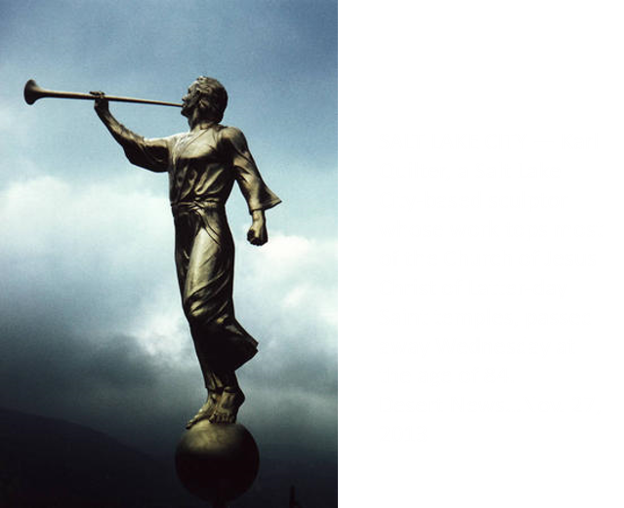
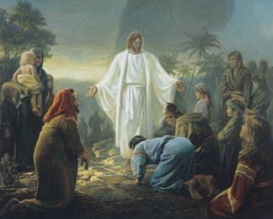
5th Angel
Those who are in heaven as well as on Earth will be summoned to fall down and worship, and give glory to God, who reigns supreme for ever and ever.
This call will come to all,
Those in heaven or earth, and those who are righteous or wicked, even the sons of perdition
D&C 88:103

Slide 21
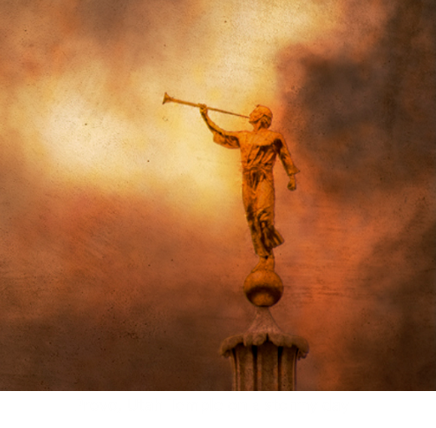
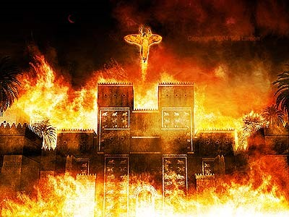
6th Angel
Judgment on the apostate church
A form of Apostasy
Babylon is a result of wickedness for Satan and his followers –it is a state of mind—everything that uses deceit, blasphemy and lying.
Revelation 14:8
“She is fallen! Is fallen!”
D&C 88:104
Smith and Sjodahl

Slide 22
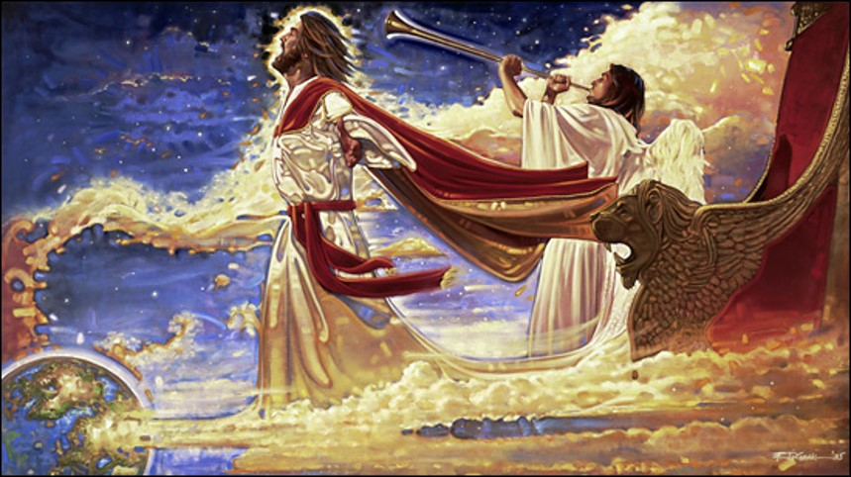
7th Angel
When the 7th angel sounds his trump, the triumphant cry will ascend to heave and reverberate through the universe, “It is finished!”
The plan of redemption as proposed, has been carried out in its every detail.
“The Lamb of God hath overcome.”
D&C 88:106
Smith and Sjodahl

Slide 23
In the Order of Righteousness
The Lord revealed that the dead will be resurrected in order of their righteousness.
Those who are resurrected first will inherit the celestial kingdom
D&C 88:97–98
Those who are resurrected second will inherit the terrestrial kingdom
D&C 88:99
Those who will inherit the telestial kingdom will be resurrected after the Millennium
D&C 88:100-101
At the end of the thousand years of peace known as the Millennium, Satan and his followers will come to battle against the people of God led by Michael (or Adam).
Satan and his followers will be defeated and cast into outer darkness.
Finally, those who “remain filthy”—those who have lived on the earth and have become sons of perdition—will be resurrected and cast into outer darkness
D&C 88:102
D&C 88:107 Seminary Lesson Manual

Slide 24
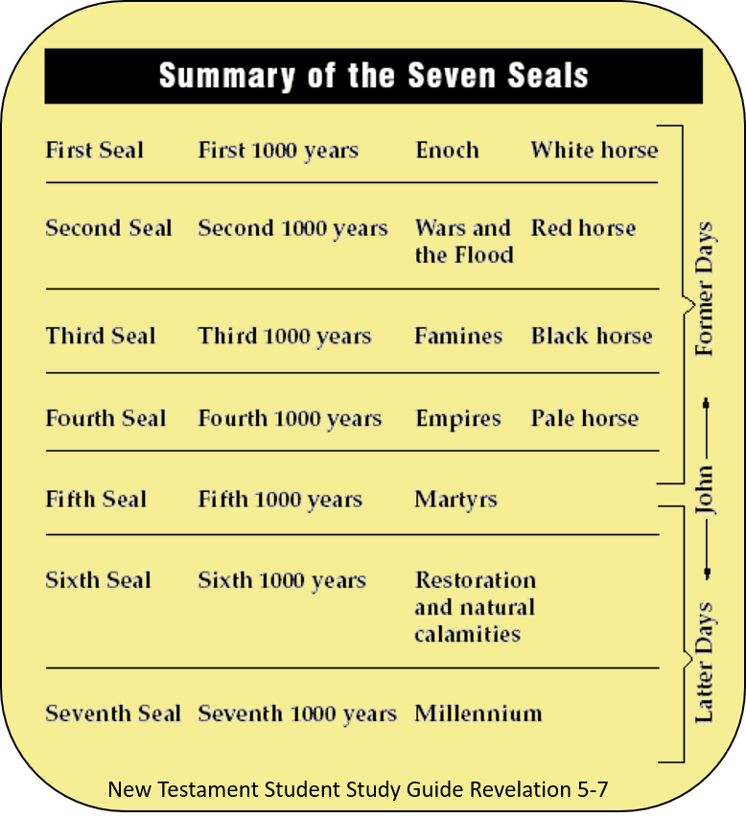
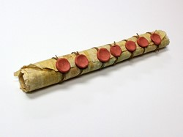
The Work of God is Finished
When the trumps of God are sounded, all things will be made known—
D&C 88:108-110

Slide 25
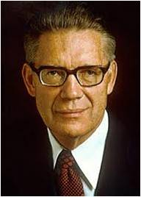
Satan Shall Be Bound
1000 Years
How is Satan Bound?
Satan was not bound in heaven—he also had free agency
“Our revelation says: ‘And in that day Satan shall not have power to tempt any man’ (D&C 101:28).
Men no longer will succumb to his enticements because their hearts are so set on righteousness that they refuse to forsake that which is good to follow him who is evil.”
So how is he bound?
Bound by us
Wherefore, all things which have been revealed unto the children of men shall at that day be revealed; and Satan shall have power over the hearts of the children of men no more, for a long time…
2 Nephi 30:18
D&C 88:108-110 Bruce R. McConkie

Slide 26
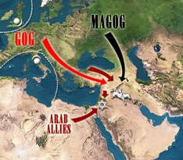
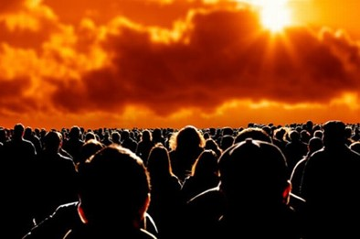
A Little Season
“After the Millennium plus a little season—during which men turn again to wickedness, then cometh the end, not of the world, which occurred at the Second Coming, but the end of earth.”
The Final Battle
Gog and Magog—the battle of the Great God…Michael (Adam) will lead the armies of heaven and Lucifer the legions of hell.”
D&C 88:111 Bruce R. McConkie

Slide 27

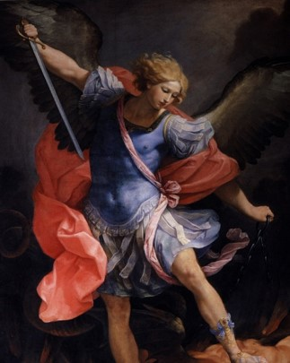
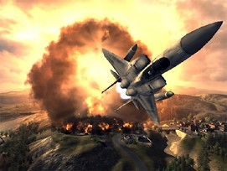

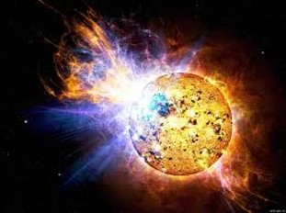
Michael—The Archangel
He will lead the battle for the Lord against Satan and his followers
Michael is Adam—holds the “keys of salvation” or “keys of the universe”
D&C 78:16
“This final great battle, in which spirits mortal men, and resurrected personages all participate, will be the end of war as far as this earth is concerned. Then the earth shall be celestialized and become the abode of the righteous forever”
Bruce R. McConkie
D&C 88:112-116 McConkie and Ostler

Slide 28
Sources:
Video: We Teach (2:24)
Those Warned Must Warn Others (1:14)
Elder David B. Haight (“Solemn Assemblies,” Ensign, Nov. 1994, 14).
Prophet Joseph Smith (Teachings of the Prophet Joseph Smith, sel. Joseph Fielding Smith, Salt Lake City: Deseret Book Co., 1938, p. 91.)
History of the Church Vol. V., p. 291
Presentation by ©http://fashionsbylynda.com/blog/
Elder Jeffrey R. Holland (“We Are All Enlisted,” Ensign or Liahona, Nov. 2011, 45).
Hyrum M. Smith and Janne M. Sjodahl Doctrine and Covenants Commentary pg. 554-555
Joseph Fielding McConkie and Craig J. Ostler Revelations of the Restoration pg. 639, 648
Elder John A Widtsoe (Priesthood and Church Government, pp. 55–56.)
Bible Dictionary, "resurrection,“ p. 761
Bruce R. McConkie Millennial Messiah, 22, 668-9
Mormon Doctrine, 75
Provo Temple-- Moroni http://www.mbborupphotography.com/provo-moroni/
Presentation by ©http://fashionsbylynda.com/blog/

Slide 29
“Heber C. Kimball recorded the Prophet’s instructions to the elders before that solemn assembly: ‘We had been commanded to prepare ourselves for a solemn assembly. At length the time arrived for this assembly to meet; previous to which the Prophet Joseph exhorted the elders to solemnize their minds, by casting away every evil from them, in thought, word and deed, and to let their hearts become sanctified, because they need not expect a blessing from God without being duly prepared for it, for the Holy Ghost would not dwell in unholy temples.’ (Orson F. Whitney, Life of Heber C. Kimball, 3d ed., Salt Lake City: Bookcraft, 1967, p. 91.)
“This long-awaited solemn assembly was held in the Kirtland Temple on 30 March 1836, three days after its dedication. In the assembly, three hundred brethren met and received some of the ordinances of the gospel, and the Prophet Joseph Smith set in order the Church’s different quorums. (See History of the Church, 2:430–33; D&C 88:139–141; 109:35.) A year later, on 6 April 1837, another solemn assembly was called to celebrate the anniversary of the Church and to further organize the priesthood quorums” (Robert J. Norman, “I Have a Question,” Ensign, Dec. 1988, 53).
President Brigham Young said: “Theology is the most important of all sciences. There are a great many branches of education. Some go to college to learn languages, some to study law, some to study physics, and some to study astronomy and various other branches of science. We want every branch of science taught in this place that is taught in the world. Bur our favorite study is that branch which particularly belongs to the elders of Israel, namely, theology. Every Elder should become a profound theologian—should understand this branch better than all the world.” Journal of Discourse Vol. VI, p. 317
Elder Orson Pratt said that “there will be a great division of the people” at the end of the Millennium, when the battle against Gog and Magog commences. “The Saints then, will have become very numerous, probably more numerous than ever before; and they will be obliged to gather together in one place, as we now do from the four quarters of the earth. … Satan will gather his army. … He with his army will come against the Saints, and the beloved city, and encompass them round about. His army will be so great that it will be able to come upon the Saints on all sides: he is to encompass their camp. Because of the favorable position he is to hold, in that great last battle, and because of the vast number of his army, he doubtless believes that he will get the mastery and subdue the earth and possess it. I do not think he fully understands all about the designs of God.” (In Journal of Discourses, 18:346.)
Those who join Satan and his host will “not rebel in ignorance or dwindle in unbelief, as the Lamanites did; but they will sin wilfully against the law of heaven, and so great will the power of Satan be over them, that he will gather them together against the Saints and against the beloved city, and fire will come down out of heaven and consume them.” (Orson Pratt, in Journal of Discourses, 16:322.)
Solemn Assembly:
“Heber C. Kimball recorded the Prophet’s instructions to the elders before that solemn assembly: ‘We had been commanded to prepare ourselves for a solemn assembly. At length the time arrived for this assembly to meet; previous to which the Prophet Joseph exhorted the elders to solemnize their minds, by casting away every evil from them, in thought, word and deed, and to let their hearts become sanctified, because they need not expect a blessing from God without being duly prepared for it, for the Holy Ghost would not dwell in unholy temples.’ (Orson F. Whitney, Life of Heber C. Kimball, 3d ed., Salt Lake City: Bookcraft, 1967, p. 91.)
“This long-awaited solemn assembly was held in the Kirtland Temple on 30 March 1836, three days after its dedication. In the assembly, three hundred brethren met and received some of the ordinances of the gospel, and the Prophet Joseph Smith set in order the Church’s different quorums. (See History of the Church, 2:430–33; D&C 88:139–141; 109:35.) A year later, on 6 April 1837, another solemn assembly was called to celebrate the anniversary of the Church and to further organize the priesthood quorums” (Robert J. Norman, “I Have a Question,” Ensign, Dec. 1988, 53).

Slide 30
Mini-lesson 1: Doctrine and Covenants 88:81–86
Begin your lesson with the following question:
• When have you been thankful because someone warned you about something? (You might also want to share an experience.)
Invite someone to read Doctrine and Covenants 88:81–83 aloud.
Ask others to look for what the Lord taught about warnings. Invite them to report what they found. Then ask the following questions:
• What does it mean that we have been warned? (We have been taught the truths of the restored gospel of Jesus Christ.)
• What truth can we learn from these verses? Because we have been warned through the message of the gospel, the Lord expects us to warn our neighbors.
Summarize Doctrine and Covenants 88:84–85 by explaining that the Lord instructed the priesthood holders who were present when Joseph Smith received this revelation to labor diligently to prepare themselves and the Saints to escape the future judgments that await the wicked.
Invite someone to read Doctrine and Covenants 88:86 aloud. Ask your group to look for how we should live as we prepare to share the gospel. Ask them to report what they found.
• What does it mean to “entangle not yourselves in sin”? How can this instruction apply in your life as you prepare to receive temple ordinances, serve a full-time mission, or get married and have a family?
Read Statement “No missionary can be unrepentant of sexual transgression or profane language or pornographic indulgence and then expect to challenge others to repent of those very things! You can’t do that. The Spirit will not be with you, and the words will choke in your throat as you speak them. You cannot travel down what Lehi called ‘forbidden paths’ [1 Nephi 8:28] and expect to guide others to the ‘strait and narrow’ [2 Nephi 31:18] one—it can’t be done”
Elder Jeffrey R. Holland (“We Are All Enlisted,” Ensign or Liahona, Nov. 2011, 45).
Conclusion:
You may want to share your testimony of the importance of staying clean in order to be effective in sharing the gospel. Encourage those you are teaching to seek to be clean from the entanglement of sin.

Slide 31
Mini-lesson 2: Doctrine and Covenants 88:87–98
Invite someone to read Doctrine and Covenants 88:87–91 aloud. Ask them to look for examples of powerful testimonies.
After they read, ask the following question:
• Before the Lord’s Second Coming, what kind of testimonies will follow the testimonies of missionaries?
Read Doctrine and Covenants 88:92 silently and look for what the angels of heaven will say during this time before the Second Coming. The term Bridegroom refers to Jesus Christ.
• Why is it critical that we be prepared for the Lord’s Second Coming?
Read Doctrine and Covenants 88:95–98 aloud.
Look for two different groups of people who will be lifted up to meet the Savior when He comes. Then ask the following question:
• Who will be lifted up to meet Jesus Christ when He comes? (His Saints who are alive and His Saints who have died. The righteous will rise to meet Christ when He comes.
Review Doctrine and Covenants 88:98 and look for words or phrases that describe the groups of Saints who get to participate in the Lord’s coming.
Ask:
• What words or phrases did you find? (the phrase “first fruits” refers to the righteous Saints who will come forth in the First Resurrection.)

