Slide 2
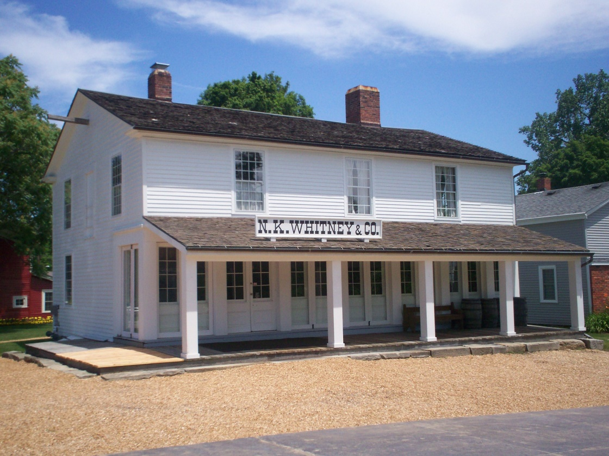
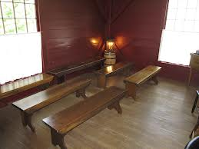
Background
January 1833 Kirtland, Ohio
A group of priesthood holders followed the Lord’s command to meet together in what was called the School of the Prophets to prepare themselves to preach the gospel throughout earth.
As they met, the Lord taught these brethren how to be edified, or uplifted, through the Spirit as they learned together.

Slide 3
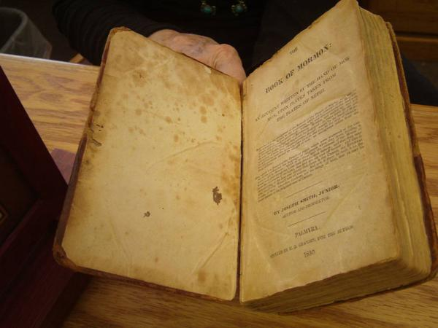
Seek Learning
The School of the Prophets founded by the Lord was organized in February 1833.
“Those who attended ‘had many manifestations of the presence of the Spirit of the Lord,’ including speaking in foreign tongues.”
Teach one another—words of wisdom
Teach out of the best books
D&C 88:118, 127 Smith and Sjodahl

Slide 4
Doctrinal Mastery
And as all have not faith, seek ye diligently and teach one another words of wisdom; yea, seek ye out of the best books words of wisdom; seek learning, even by study and also by faith.
D&C 88:118

Slide 5
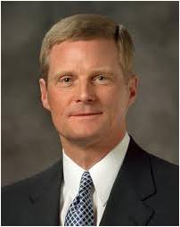
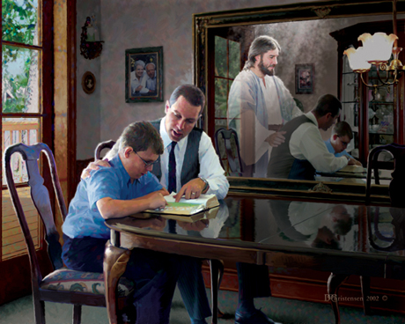
Study By Faith
“Learning by faith requires spiritual, mental, and physical exertion and not just passive reception. …
“… Learning by faith cannot be transferred from an instructor to a student through a lecture, a demonstration, or an experiential exercise; rather, a student must exercise faith and act in order to obtain the knowledge for himself or herself” Elder David A. Bednar
Doc Christensen
We learn as we exercise our faith through obedience
D&C 88:118

Slide 6
How Can I Increase My Faith?
A young woman regularly reads the scriptures, but she rarely pauses to think about what she is reading. She does not feel that reading the scriptures benefits her very much.
A young man attends his Church meetings and enjoys participating in class discussions. Sometimes he feels prompted to make changes in his life based on what he learns, but he usually does not act on those promptings.
If we diligently seek to learn through study and faith, our faith in Jesus Christ will increase.
In order to increase our faith in Jesus Christ, we must be willing to sacrifice our time and talents to learn of Him
D&C 88:118

Slide 7
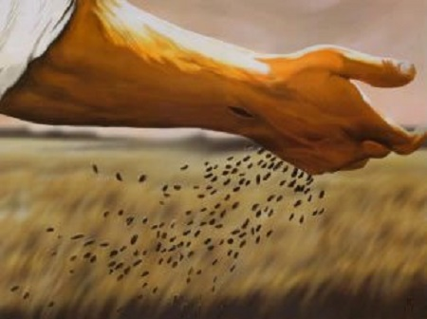
Planting the Seed
1. Compare the word of God unto a seed (vs. 28)
2. Plant the seed in your heart, not just in your head (vs. 28)
3. Neither cast it out by unbelief nor resist the Spirit of the Lord which accompanies it (vs. 38)
4. If it begins to swell within you and enlarges your soul and enlightens your understanding, it is good: if it does not, it is bad and should be cast away.
Alma 32:28-43 Student Manual

Slide 8
Seeing It Grow
Your faith is now dormant and your knowledge is perfect in one
thing: the fact that the seed was good or bad (vss. 33-35)
2. If the seed is good and begins to grow, additional nourishment and care will cause the seed to become a tree which brings forth fruit (added knowledge of the truth of other things). (vss. 36-37)
3. If the seed or the tree is neglected, it will wither; but this does not mean that the seed was not good. It means that one’s spiritual ground is barren and unproductive. In other words, the experiment did not fail; you failed the experiment! (vss. 38-40)
On the other hand, diligence, patience, and a continuance of faith will cause the tree to spring up “unto everlasting life” (vs. 41) and enable you to “pluck the fruit thereof, which is most precious,…sweet above all that is sweet,…white above all that is white,…pure above all that is pure” (vs. 42)
Alma 32:28-43 Student Manual

Slide 9
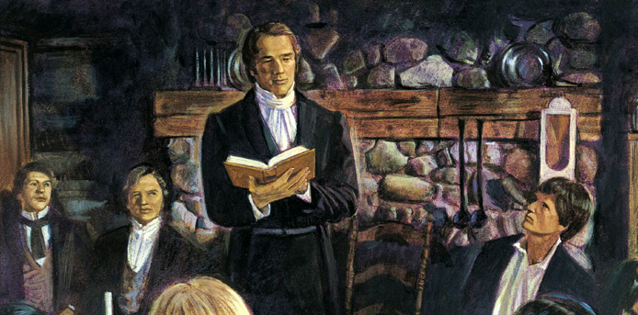
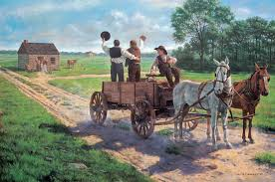
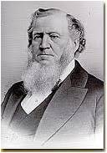
To Prepare To Go Out Into The World
“The members of that school were but few at first, and the Prophet commenced to teach them in doctrine to prepare them to go out into the world to preach the gospel unto all people, and gather the select from the four quarters of the Earth, as the prophets anciently have spoken.
“While this instruction prepared the Elders to administer in word and doctrine, it did not supply the teachings necessary to govern their private, or temporal, lives; it did not say whether they should be merchants, farmers, mechanics, or money-changers. The Prophet began to instruct them how to live, that they might be better prepared to perform the great work they were called to accomplish.”
D&C 88: 119 Brigham Young

Slide 10
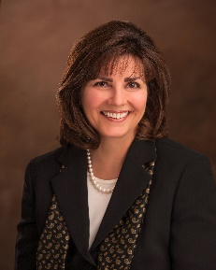
Organize Yourself-Places of Learning
The School of the Prophets was patterned after the principles taught in this verse.
Our homes can be places of prayer, fasting, faith, learning, and order.
Brigham Young
Teaching and learning are eternal principles.
&
We are all learners and all teachers
“In the Bible Dictionary we learn, “A temple is literally a house of the Lord. … A place where the Lord may come, it is the most holy of any place of worship on the earth.
Only the home can compare with the temple in sacredness.” Our homes can become holy places where seeds of testimony are first planted in the heart of the “temple of God” (1 Corinthians 3:16).
Our homes can be a safe place of learning and can become more holy throughout our lives as we continue to create opportunities to feel and be taught by the Spirit.
Carole M. Stephens
D&C 88: 119

Slide 11
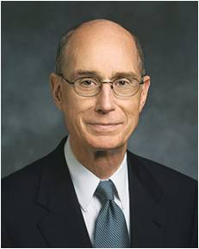
The Knowledge You Already Have
“You were tutored by Him before you came into this life. You learned that our Father had a plan of happiness. … This plan is marked by covenants with [Him]. You learned that the way back home to Him would not be easy”
Henry B. Eyring
D&C 88: 119

Slide 12
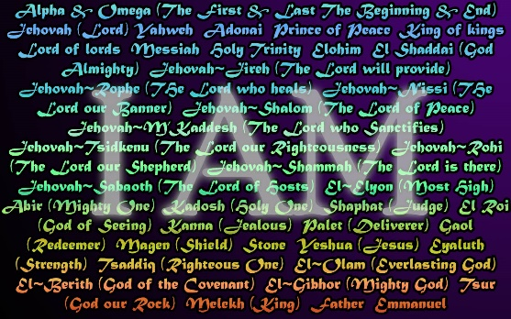
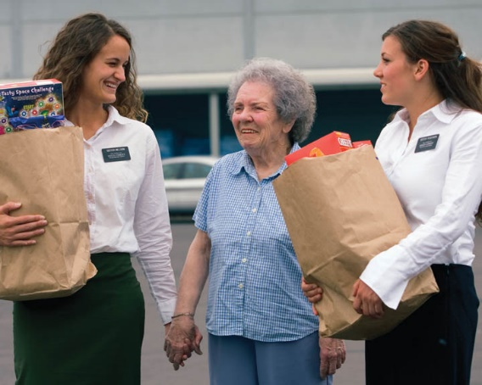
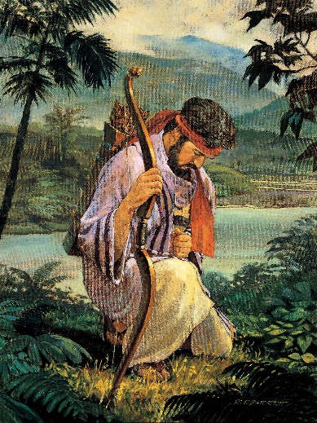
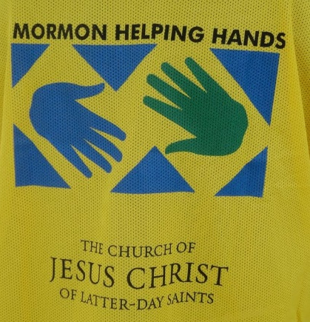
What Are We To Do?
Avoid Light speeches, loud laughter, and cease lustful thoughts
Listening is just as important as teaching
Organize
Do all things in the name of the Lord
Love one another and help sustain one another
Get the rest you need, physically
Have Charity
Pray Always
D&C 88: 119-126

Slide 13
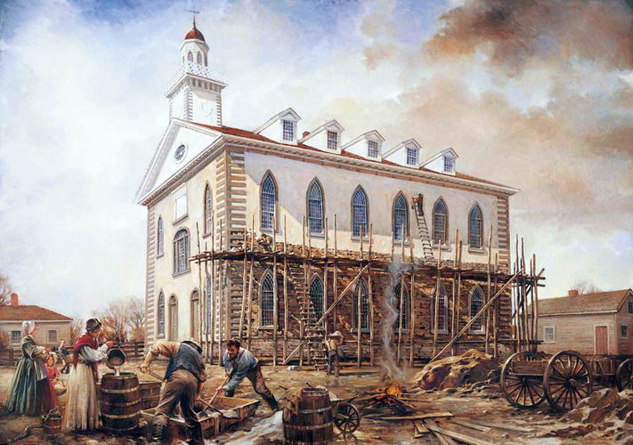
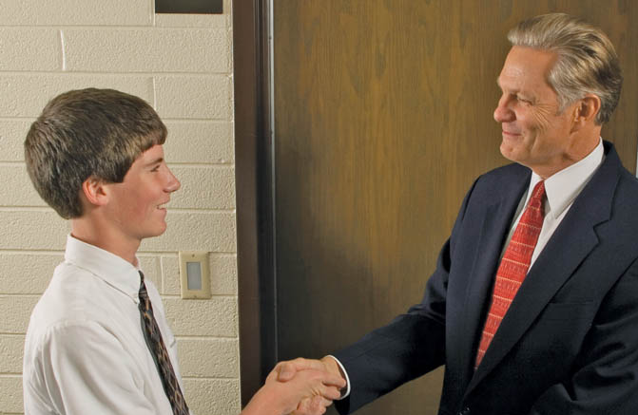
Order of the School of Prophets
While the temple was under construction, the School of the Prophets met in the upper room of Newel K. Whitney’s store in Kirtland.
Edify one another--The Lord expected the members of the School of the Prophets to establish good relationships with each other as they learned together.
Salutation of a teacher—greet as they enter
A promise--The school would become a sanctuary where the Spirit could edify them.
Fellowship: If we show friendship and love to each other, then we can invite the Spirit as we study the gospel together.
D&C 88: 127-136

Slide 14
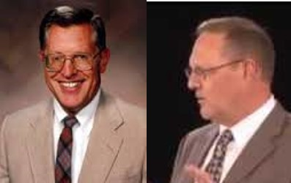
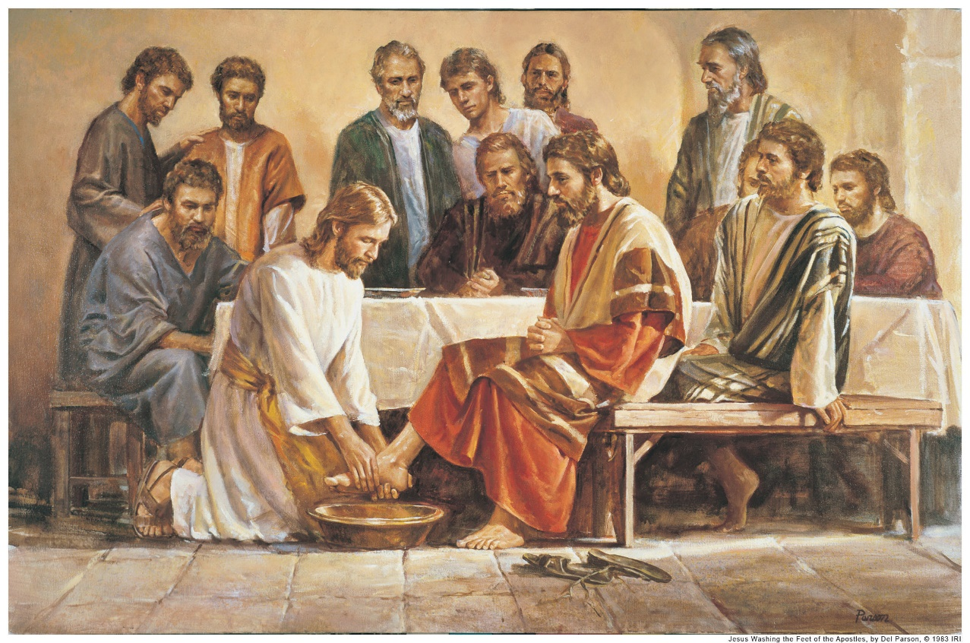
Washing and Anointing was Instituted by the Savior with the Twelve at the Last Supper is identified as an ordinance.
All ordinances are done under the direction of those who have been given the keys or presidency over them.
D&C 88: 139-141 McConkie and Ostler

Slide 15
Sources:
Videos:
School of the Prophets (1:21)
We Come Together & Unite As One (6:19)
Brigham Young (In Hyrum M. Smith and Janne M. Sjodahl, Doctrine and Covenants Commentary, p. 567.)
Elder David A. Bednar(“Seek Learning by Faith,” Ensign, Sept. 2007, 64).
Book of Mormon Student Manual Religion 121-122 pg. 300
Homes Can Be Holy Places of Gospel Learning
Contributed By Carole M. Stephens, Relief Society general presidency
Presentation by ©http://fashionsbylynda.com/blog/
18 NOVEMBER 2014 Mormon Newsroom
Henry B. Eyring, “Daughters in the Covenant,” Ensign, May 2014
Joseph Fielding McConkie and Craig J. Ostler Revelations of the Restoration pg. 650
Presentation by ©http://fashionsbylynda.com/blog/

Slide 16
Laughter:
“Joyful laughter meets with divine approval, and when properly engaged in, it is wholesome and edifying. Incident to the normal experiences of mortality, there is ‘A time to weep, and a time to laugh.’ (Eccles. 3:4.)
Though laughter at the appropriate time is not sin, it must be governed. President Brigham Young said: “I like to be pleased myself; I like to be filled with joy, but if I cannot be filled with joy and gladness that is full of meat and marrow, or, in other words, full of meaning and sense, I would rather retain my gravity.
“There is but one step between life and death, between faithfulness and apostasy, between the sublime and the ridiculous. …
“Never give way to vain laughter.” (In Journal of Discourses, 9:290.)
President Joseph F. Smith taught: “The Lord has called upon us to be a sober-minded people, not given to much laughter, frivolity and light-mindedness, but to consider thoughtfully and thoroughly the things of his kingdom that we may be prepared in all things to understand the glorious truths of the gospel, and be prepared for blessings to come. …
“… I believe that it is necessary for the Saints to have amusement, but it must be of the proper kind. I do not believe the Lord intends and desires that we should pull a long face and look sanctimonious and hypocritical. I think he expects us to be happy and of a cheerful countenance, but he does not expect of us the indulgence in boisterous and unseemly conduct and the seeking after the vain and foolish things which amuse and entertain the world. He has commanded us to the contrary for our own good and eternal welfare.” (In Conference Report, Oct. 1916, p. 70.)
The Prophet Joseph Smith said: “The things of God are of deep import; and time, and experience, and careful and ponderous and solemn thoughts can only find them out. Thy mind, O man! if thou wilt lead a soul unto salvation, must stretch as high as the utmost heavens, and search unto and contemplate the darkest abyss, and the broad expanse of eternity—thou must commune with God. How much more dignified and noble are the thoughts of God, than the vain imaginations of the human heart! None but fools will trifle with the souls of men.
“How vain and trifling have been our spirits, our conferences, our councils, our meetings, our private as well as public conversations—too low, too mean, too vulgar, too condescending for the dignified characters of the called and chosen of God, according to the purposes of his will, from before the foundation of the world!” (Teachings, p. 137.)
With regard to laughter, President Gordon B. Hinckley taught:
“You can have a good time. Of course you can! We want you to have fun. We want you to enjoy life. … We want you to be robust and cheerful, to sing and dance, to laugh and be happy.
“But in so doing, be humble and be prayerful, and the smiles of heaven will fall upon you” (“A Prophet’s Counsel and Prayer for Youth,” Ensign, Jan. 2001, 11).
Washing and Anointing:
As brethren who held the priesthood joined the School of the Prophets, they were received by the ordinance of washing of feet, which was to be done by the Prophet, following the example of Jesus Christ described in John 13. Regarding this ordinance, Elder Bruce R. McConkie of the Quorum of the Twelve Apostles taught:
“Washing of feet is a gospel ordinance; it is a holy and sacred rite, one performed by the saints in the seclusion of their temple sanctuaries. It is not done before the world or for worldly people. For his day and dispensation Jesus instituted it in the upper room at the time of the Last Supper.
“‘Our Lord did two things in the performance of this ordinance: 1. He fulfilled the old law given to Moses; and 2. He instituted a sacred ordinance which should be performed by legal administrators among his true disciples from that day forward.
“‘As part of the restoration of all things, the ordinance of washing of feet has been restored in the dispensation of the fulness of times. …
“‘The knowledge relative to the washing of feet has been revealed step by step in this day until a full knowledge is now incorporated in the revealed ordinances of the Lord’s house’ (Mormon Doctrine,[2nd ed. (1966), 829, 831])” (Doctrinal New Testament Commentary, 3 vols. [1966–73], 1:708, 710).

