Slide 2
Friends
Can you be tempted to listen to a friend rather than follow the commandments or the counsel of their parents or leaders?
Why is it sometimes difficult to resist our friends when they try to influence us to do something wrong?
Are there moments when we should be faithful to God and not give in to the pressure of others?

Slide 3
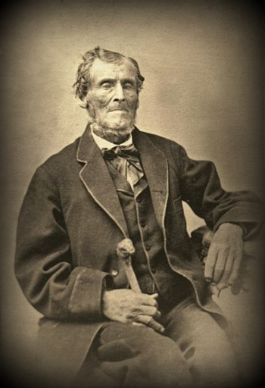
Martin Harris
April 1828-June 1828
He was born in 1783 at Eastown, New York
He was a respected citizen of Palmyra, a prosperous farmer and businessman.
He was acting as scribe to Joseph while he translated.
He was 22 years older than Joseph.
He had given Joseph and Emma $50 (which was a substantial amount of money at that time) to help them move to Harmony, Pennsylvania (where Emma’s family lived), thus helping to support Joseph while he translated the plates.
In February 1828, Joseph encouraged Martin to take copies of characters from the plates to professors in New York.

Slide 4
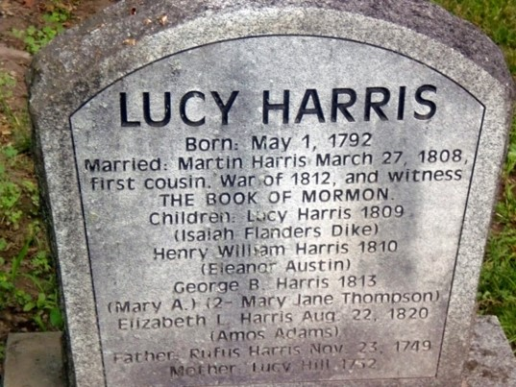
Lucy Harris
She was born on May 1, 1792, at Swift’s Landing (later Palmyra), Ontario Co., New York.
She is the daughter of Rufus Harris and Lucy Hill, who were affiliated with the Religious Society of Friends (Quakers).
Lucy married her first cousin Martin Harris on March 27, 1808, in Palmyra, New York.
She had become partially deaf by the year 1827.
She separated from her husband in June 1830 and died in Palmyra in 1836.
She became increasingly concerned about Martin’s interest and financial involvement in the translation of the plates.
She and others began to press Martin for evidence of the plates’ existence.
To appease their concerns, in mid-June Martin requested that Joseph allow him to take the 116 pages of manuscript they had completed to show as evidence.

Slide 5
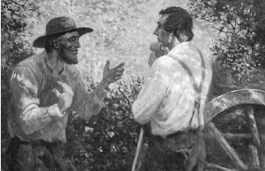
Pressure
“[Martin] desired of me that I would inquire of the Lord, through the Urim and Thummim, if he might not [take the manuscript home and show it].
I did inquire, and the answer was that he must not. However, he was not satisfied with this answer, and desired that I should inquire again. I did so, and the answer was as before.
Still he could not be contented, but insisted that I should inquire once more”
Joseph Smith

Slide 6
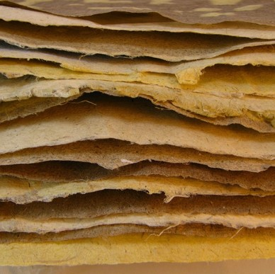
The Third Time
After much pleading Joseph asked the Lord a third time, and the Lord gave permission for Martin to take the manuscript “on certain conditions”
Martin promised that he would show the manuscript only to his wife and a few other family members.
Martin returned to New York with the manuscript.
Shortly after Martin’s departure, Emma Smith gave birth to a son, Alvin, who died shortly after birth.
Emma nearly died herself, and for two weeks Joseph stayed at her bedside.
History of the Church 1:21

Slide 7
Three Weeks
By this time, Martin had been gone for three weeks and they had heard nothing from him.
Emma, who was slowly recovering, persuaded Joseph to go to New York and find out why Martin had not sent any word.
Joseph traveled to his parents’ home, and once he arrived there, he sent for Martin.
Martin took all morning to arrive.
When he did, he sat down to eat with the Smith family but immediately dropped his utensils.
When asked if he was all right, he cried out and eventually admitted that he had lost the 116 pages of manuscript.
History of Joseph Smith

Slide 8
The Work of Men
“Remember, remember that it is not the work of God that is frustrated, but the work of men;”
The purposes of God cannot be frustrated.
God is Merciful
Although God said that His work could not be frustrated, He also wanted the Prophet to understand the mistakes he had made and the consequences of those mistakes.
D&C 3:1-3,10

Slide 9
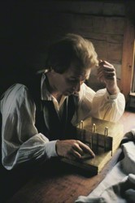
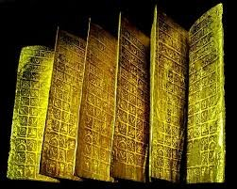
116 Pages
These pages were from the Book of Lehi—the first part of the Book of Mormon
“Moroni had given strict instructions that Joseph not to show the plates to anyone, except those to whom he should be commanded to exhibit them”
“Joseph Smith had transgressed by listening to the continued pleading of his friend. It should be realized that Joseph Smith at this time was but a youth with confidence in the promise of his friends. His faith in God was absolutely firm, but he lacked experience in trusting his untried friend in his constant pleadings. He learned his less. From this time on he made no other such mistake. A great man does not repeat his mistakes.”
Doctrine and Covenants Commentary
D&C 3:6

Slide 10
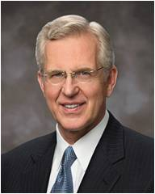
Persuasions of Men
“…how oft you have transgressed the commandments and the laws of God, and have gone on in the persuasions of men.”
Man--mankind
“There are many places in the scriptures that counsel mankind to fear God. In our day we generally interpret the word fear as “respect” or “reverence” or “love”; that is, the fear of God means the love of God or respect for Him and His law.
That may often be a correct reading, but I wonder if sometimes fear doesn’t really mean fear, as when the prophets speak of fearing to offend God by breaking His commandments. …
“… We should so love and reverence Him that we fear doing anything wrong in His sight, whatever may be the opinions of or pressure from others”
Elder D. Todd Christofferson
We should fear God more than man
D&C 3:6-7

Slide 11
The Fiery Darts
“…and he would have been with you in every time of trouble.”
If we are faithful to the Lord’s commandments, He will support us during times of trouble.
What would God have done if Joseph Smith had listened to the initial answer to Martin’s request?
What would God do for us if we listen to His requests?
D&C 3:8

Slide 12
Lesson Learned
Joseph learned that God would support him as he chose to be faithful. Joseph moved forward in life, trusting in God’s commandments and guidance, even though he experienced pain, persecution, imprisonment, and even death. (D&C 122;135)

Slide 13
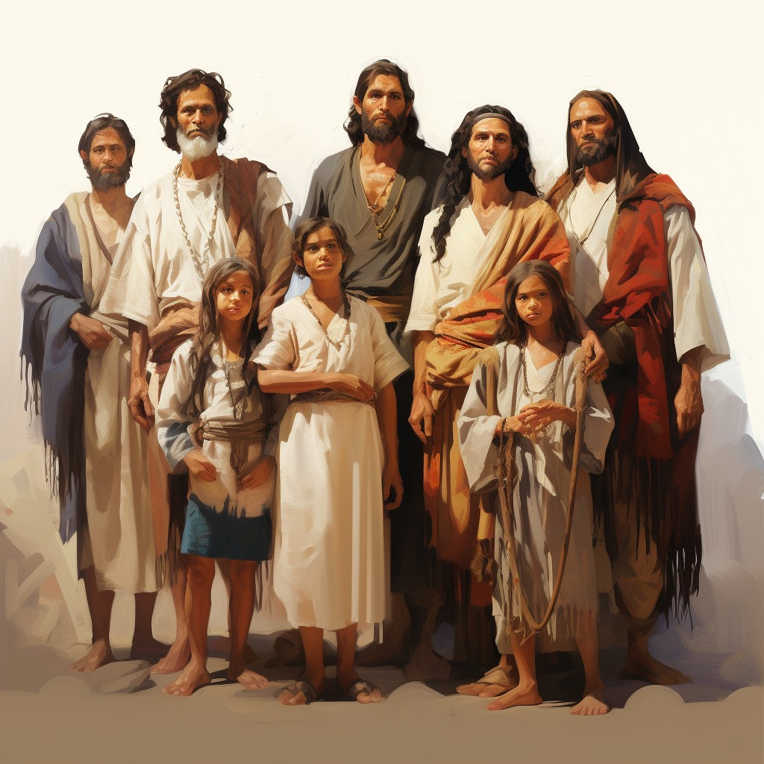
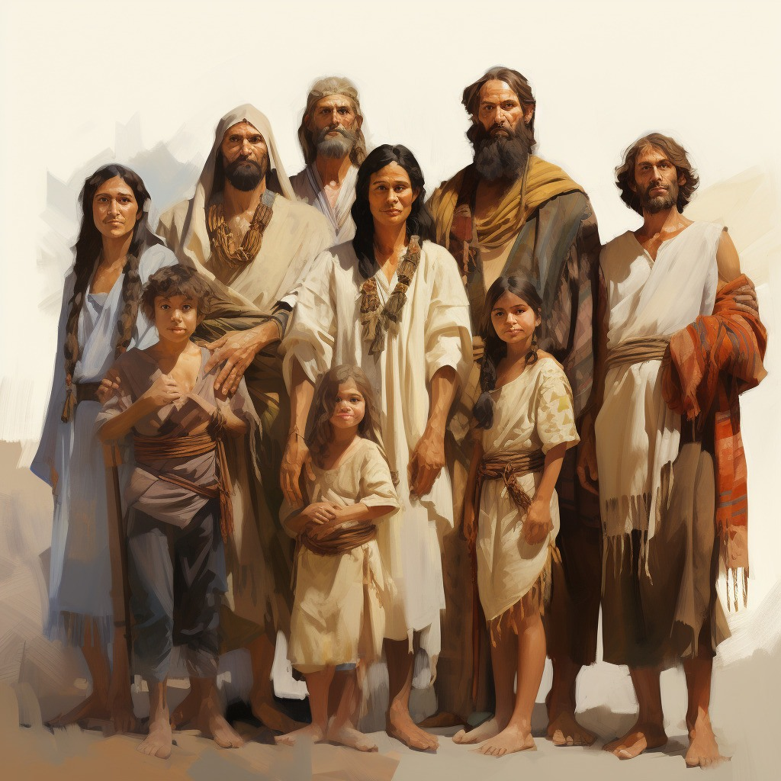
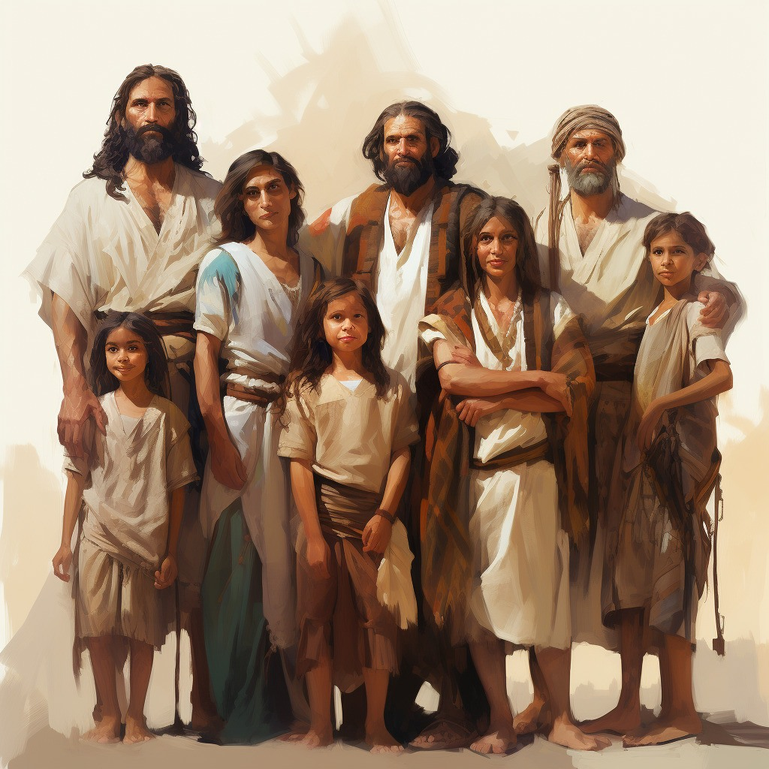
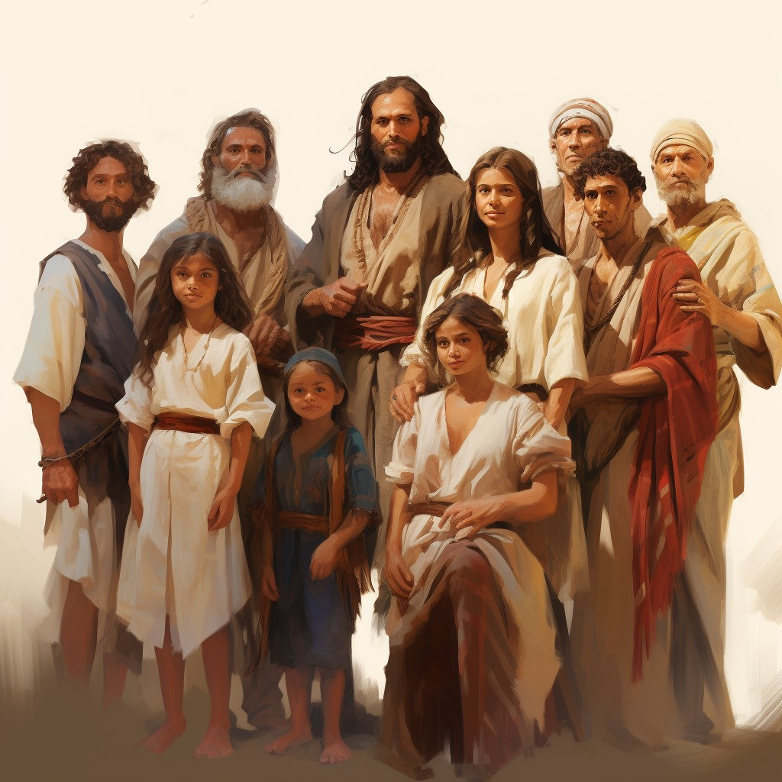
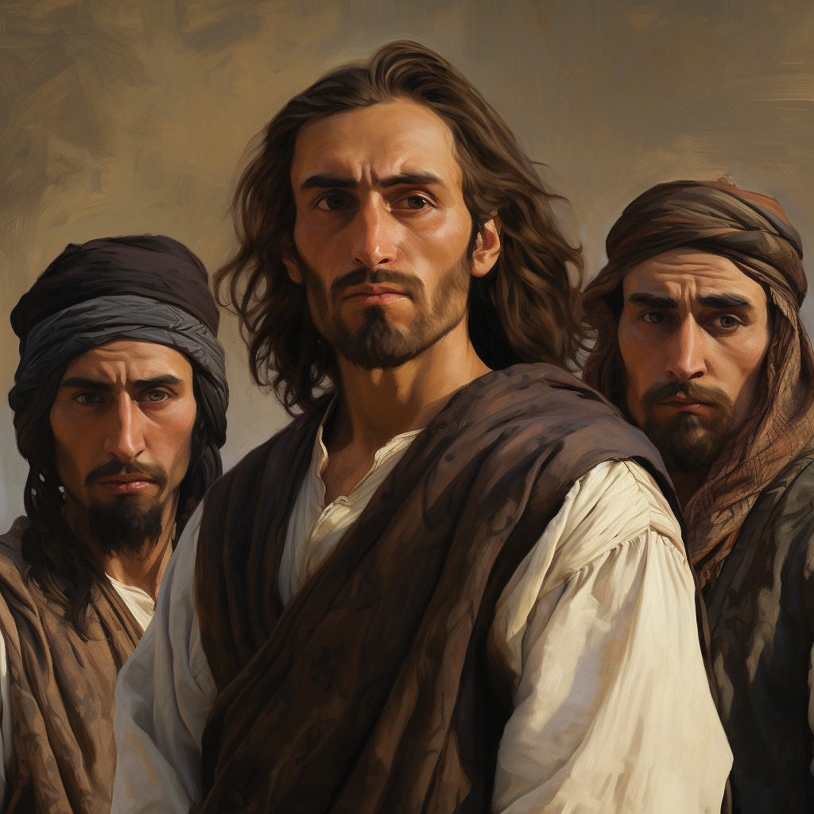
Nevertheless
“…through the testimony of the Jews, even so shall the knowledge of a Savior come unto my people—”
“…my work shall go forth”
Testimonies through their fathers of the:
Nephites
Jacobites
Josephites
Zoramites
The knowledge of the:
Lamanites
Lemuelites
Ishmaelites
Because of their iniquity to their fathers
D&C 3:16-20

Slide 14
“We got back more than we lost. And it was known from the beginning that it would be so. We do not know exactly what we missed in the 116 pages, but we do know that what we received on the small plates was the personal declarations of three great witnesses, [Nephi, Jacob, and Isaiah],...testifying that Jesus is the Christ....I think you could make a pretty obvious case that the sole purpose of the small plates was to give a platform for these three witnesses."
Jeffrey R. Holland

Slide 15
Sources:
Video:
“The Work of God” (ChurchofJesusChrist.org) from time code 2:25 to 8:45.
http://en.wikipedia.org/wiki/Lucy_Harris
Joseph Smith (in History of the Church, 1:21).
History of Joseph Smith by His Mother, ed. Preston Nibley [1958], 124–29 for more details of this account.)
Elder D. Todd Christofferson (“A Sense of the Sacred” [CES fireside for young adults, Nov. 7, 2004], 6–7, LDS.org ; see also speeches.byu.edu ).
Doctrine and Covenants Commentary by Hyrum M. Smith pg 19
Presentation by http://fashionsbylynda.com/blog/
Jeffrey R. Holland (CES Symposium, BYU, Aug. 9, 1994 as taken from Latter-day Commentary on the Book of Mormon compiled by K. Douglas Bassett, p. 198)
Presentation by http://fashionsbylynda.com/blog/

Slide 16
Lucy Mack Smith recorded that Martin Harris’s wife, Lucy, “was a very peculiar woman, one that was naturally of a very jealous disposition … and when anything was said that she did not hear distinctly she suspected that it was some secret which was designedly kept from her.” Lucy Harris was suspicious of Joseph Smith and was intent on seeing the plates. When Martin went to see Joseph about the work of the translation, Lucy Harris went along and questioned Joseph about the plates, demanding to see them. He told her she could not, “for he was not permitted to exhibit them to any one except those whom the Lord should appoint to testify of them.”
The night after Joseph told Lucy Harris this, she had a dream, which she reported to the Smiths in the morning: “A personage appeared to her who told her that as she had disputed the servant of the Lord, … she had done that which was not right in the sight of God. After which he said to her, ‘Behold, here are the plates, look upon them and believe.’” Lucy then told Joseph that she wanted to help support the translation.
Unfortunately, Lucy Harris’s change of heart did not last long, and she soon demanded physical evidence of the plates again. Shortly after Joseph and Emma moved to Harmony, Pennsylvania, Martin followed without telling his wife that he was leaving. When she found out, she was angry that her husband was spending so much time away from her and was even more concerned that the Smiths were trying to defraud him.
Martin returned to New York shortly, but when he prepared to go to Harmony again, Lucy Harris insisted on going with him. When they arrived at Joseph and Emma’s home, she announced that she was not going to leave until she saw the plates. She ransacked the entire house, but did not find them. From then on, she claimed that her husband had been duped by “a grand imposter.” After two weeks, Martin took her home. Despite her attempts to dissuade him, he returned to Harmony to help Joseph. In Martin’s absence, Lucy continued going about “from house to house, telling her grievances, and declaring that Joseph Smith was practicing a deception upon the people.” (See History of Joseph Smith by His Mother, ed. Preston Nibley [1958], 114–22.)
Martin Harris’ confession:
Mr. Harris pressed his hands upon his temples, and cried out in a tone of deep anguish, ‘Oh, I have lost my soul! I have lost my soul!’
“Joseph who had not expressed his fears till now, sprang from the table, exclaiming, ‘Martin, have you lost that manuscript? Have you broken your oath, and brought down condemnation upon my head as well as your own?’
“‘Yes; it is gone,’ replied Martin, ‘and I know not where.’ …
“Said Joseph, … ‘All is lost! all is lost! What shall I do? I have sinned—it is I who tempted the wrath of God. I should have been satisfied with the first answer which I received from the Lord; for he told me that it was not safe to let the writing go out of my possession.’ He wept and groaned, and walked the floor continually.
“At length he told Martin to go back and search again.
“‘No’; said Martin, ‘it is all in vain; for I have ripped open beds and pillows [looking for the manuscript]; and I know it is not there.’
“‘Then must I,’ said Joseph, ‘return with such a tale as this? I dare not do it. And how shall I appear before the Lord? Of what rebuke am I not worthy from the angel of the Most High?’ …
“The next morning, he set out for home. We parted with heavy hearts, for it now appeared that all which we had so fondly anticipated, and which had been the source of so much secret gratification, had in a moment fled, and fled forever” (Lucy Mack Smith, History of Joseph Smith by His Mother, ed. Preston Nibley [1958], 125–29).
Why Would The Lord Allow Joseph to Give Martin the Pages After His Third request?
Martin begged Joseph to ask a third time, and Joseph did so. This time God did not say no. Instead, it was as though God said, “Joseph, you know how I feel about this, but you have your agency to choose.” Feeling himself relieved of the constraint, Joseph decided to allow Martin to take 116 manuscript pages and show them to a few family members. The translated pages were lost and never recovered. The Lord severely rebuked Joseph.
Joseph learned, as the Book of Mormon prophet Jacob taught: “Seek not to counsel the Lord, but to take counsel from his hand. For … he counseleth in wisdom” [Jacob 4:10]. Jacob cautioned that unfortunate things happen when we ask for things we should not. …
If we have received personal revelation for our situation and the circumstances have not changed, God has already answered our question. (Dale G. Renlund, “A Framework for Personal Revelation,” Liahona, Nov. 2022, 18)

