Slide 1
Doctrine and Covenants 4
Called to Serve
“No Man can serve two masters; for either he will hate the one, and love the other; or else he will hold to the one and despise the other. Ye cannot serve god and mammon.”
Matthew 6:24
Presentation by http://fashionsbylynda.com/blog/

Slide 2
How would the Savior service you?
How might it affect you if they served in the following ways?
Wholeheartedly or half-heartedly
Patiently or impatiently
Motivated by love for you or by something else

Slide 3
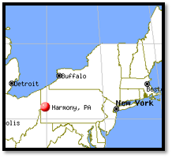
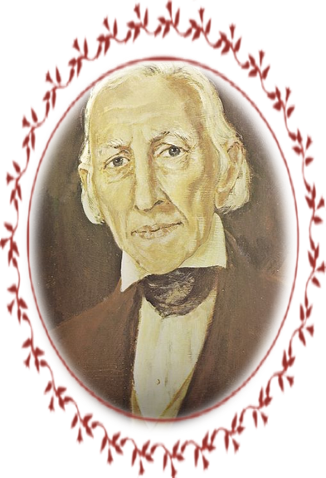
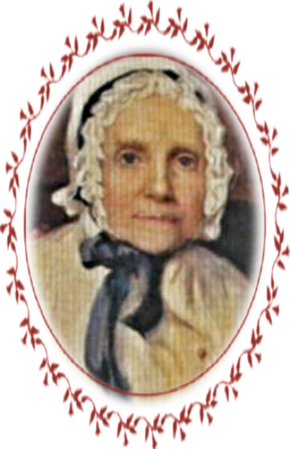
Joseph Smith Sr.
February 1829
Joseph Smith’s father had a desire to serve, but he didn’t know what the Lord wanted him to do.
Joseph Smith Sr. and his wife, Lucy, visited their son in Harmony, Pennsylvania.
During that visit, Joseph Smith Jr.
received a revelation in answer to
his father’s question.
D&C 4:1-7

Slide 4
Accepting a Calling
Joseph Smith was laboring in Harmony, Pa., taking refuge from the persecution he received from the people in New York.
Joseph Smith Sr. was one of the first to accept a calling from God
Joseph Smith Sr. was one of the Eight Witnesses of the Book of Mormon and one of the first to be baptized when the Church was officially organized on April 6, 1830.
He also served as the first Patriarch to the Church and as Assistant Counselor to the First Presidency.
D&C 4:2

Slide 5
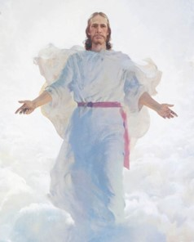
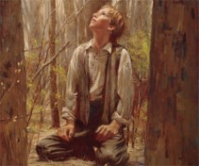
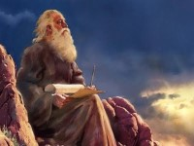
A Marvelous Work
The Book of Mormon is marvelous
It was brought to light by immortal hands
It was brought by a young man, of little education and humble circumstances to be translated from a different language and published
It teaches of prophecies and the story of a different society unknown to man
It has encountered bitter opposition, yet brings joy to those who embrace it
Isaiah’s prophecy has been fulfilled
Isaiah 29:8,9
Not only the coming of the Book of Mormon but it has reference to the restoration in the Dispensation of the Fulness of Times
D&C 4:1---Commentary

Slide 6
Serve Him
With All your heart, might, mind, and strength
All devotion, will-power, reasoning, and physical strength…all dedicated to the Lord
This is a way of saying that a person must be totally committed to the work and have no reservation.
Manual
D&C 4:2

Slide 7
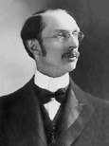
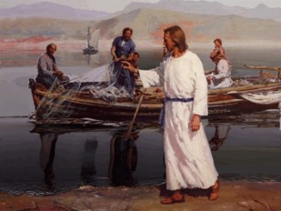
A Desire To Serve
If you have a desire to serve you will be called
“My understanding is that the most important mission that I have in this life is: first, to keep the commandments of God, as they have been taught to me; and next, to teach them to my Father’s children who do not understand them…
“It is not necessary for you to be called to go into the mission field in order to proclaim the truth. Begin on the man who lives next door by inspiriting confidence in him, by inspiriting love in him for
you because of your righteousness,
and your missionary work has
already begun.”
Elder George Albert Smith
D&C 4:3

Slide 8
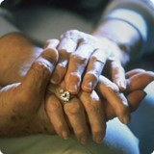
“Some of the most important service you can give will be within your own home.
You can also serve in your Church assignments, school, and community.
You can serve by doing temple and family history work.
You can serve by sharing the gospel with others now and as a full-time missionary in the future.
Often the most meaningful service is expressed through simple, everyday acts of kindness.
Seek the guidance of the Holy Ghost each day to know whom to serve and how to help meet their needs. Follow the example of the Savior as you serve others”
For the Strength of Youth

Slide 9
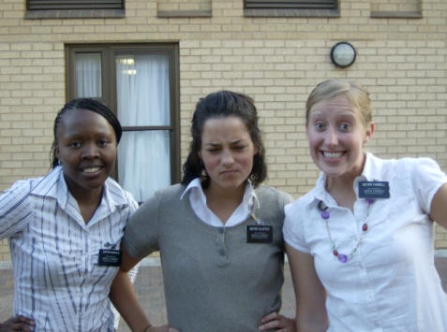
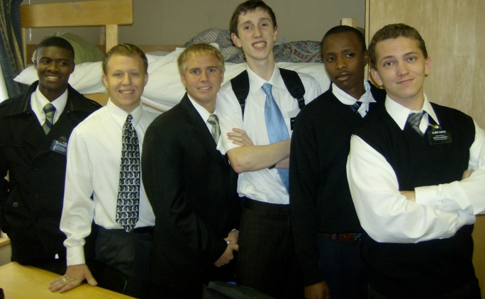
The Field is White
“The field was ripe for harvest at the time the Lord established the Church. The world had been prepared during many centuries, by religious movements. To thrust in the sickle and reap is to lay up a store for the future…
…Sowing and reaping follow each other. The early period of the Church was a time of reaping. Later, missionary labor became more like gleaning, and then sowing.”
Commentary
D&C 4:4

Slide 10
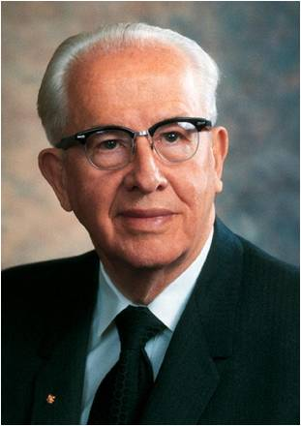
“Men and women who turn their lives over to God will discover that He can make a lot more out of their lives than they can.
He will deepen their joys, expand their vision, quicken their minds, strengthen their muscles, lift their spirits, multiply their blessings, increase their opportunities, comfort their souls, raise up friends, and pour out peace.
Whoever will lose his life in the service of God will find eternal life.”
President Ezra Taft Benson
As we labor diligently to bring others unto Jesus Christ, we can also receive salvation for ourselves.

Slide 11
Faith, Hope, and Charity
“Whereby are given unto us exceeding great and precious promises: that by these ye might be partakers of the divine nature, having escaped the corruption that is in the world through lust.
And beside this, giving all diligence, add to your faith virtue; and to virtue knowledge;
And to knowledge temperance; and to temperance patience; and to patience godliness;
And to godliness brotherly kindness; and to brotherly kindness charity.
For if these things be in you, and abound, they make you that ye shall neither be barren nor unfruitful in the knowledge of our Lord Jesus Christ.
2 Peter 1:4-8
D&C 4:5-7

Slide 12
Sources:
Video:
Christlike Attributes” (2:53)
Unselfish Service (2:25)
The Vineyard (3:48)
Missionaries to Match Our Message (2:25)
Excerpts from Doctrine and Covenant Commentary by Hyrum M. Smith pg. 23-24
Presentation by http://fashionsbylynda.com/blog/
Doctrine and Covenants Student Manual Religion 324-325, pg. 12
” (For the Strength of Youth [booklet, 2011], 32).
The Teachings of Ezra Taft Benson pg. 361
Presentation by http://fashionsbylynda.com/blog/

Slide 13
Serving Him requires all of our heart, might, mind, and strength. Consequently, selflessly serving others counteracts the self-centered and selfish tendencies of the natural man. We grow to love those whom we serve. And because serving others is serving God, we grow to love Him and our brothers and sisters more deeply. Such love is a manifestation of the spiritual gift of charity, even the pure love of Christ. (David A. Bednar, “If Ye Had Known Me,” Ensign or Liahona, Nov. 2016, 104)
Why Study Doctrine and Covenants 4?
Doctrine and Covenants 4] is very short, only seven verses, but it contains sufficient counsel and instruction for a lifetime of study. No one has yet mastered it. It was not intended as a personal revelation to Joseph Smith [Sr.], but to be of benefit to all who desire to embark in the service of God. It is a revelation to each member of the Church. … Perhaps there is no other revelation in all our scriptures that embodies greater instruction pertaining to the manner of qualification of members of the Church for the service of God, and in such condensed form than this revelation. It is as broad, as high and as deep as eternity. No elder [or sister] of the Church is qualified to teach in the Church, or carry the message of Salvation to the world, until he [or she] has absorbed, in part at least, this heaven-sent instruction. (Joseph Fielding Smith, Church History and Modern Revelation [1953], 1:35)

