Slide 1
Assess Your Learning

Slide 2
Progress you have already made
What you still need to learn and do
Your Goal
Why is it helpful to pause and evaluate what we have learned and how we have progressed?

Slide 3
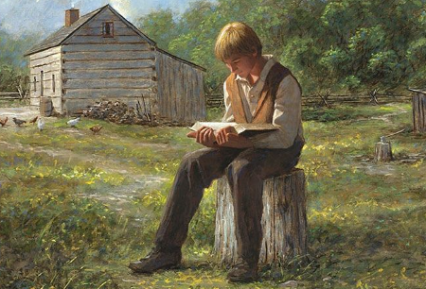
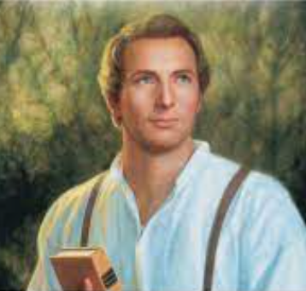
How did scripture study help Joseph Smith?
How is your effort affecting you?

Slide 4
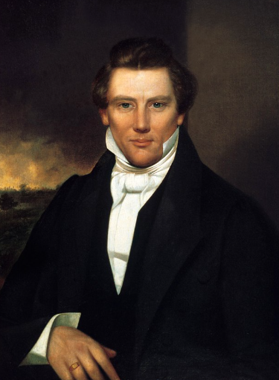
What have you learned about Joseph Smith?

