Slide 1
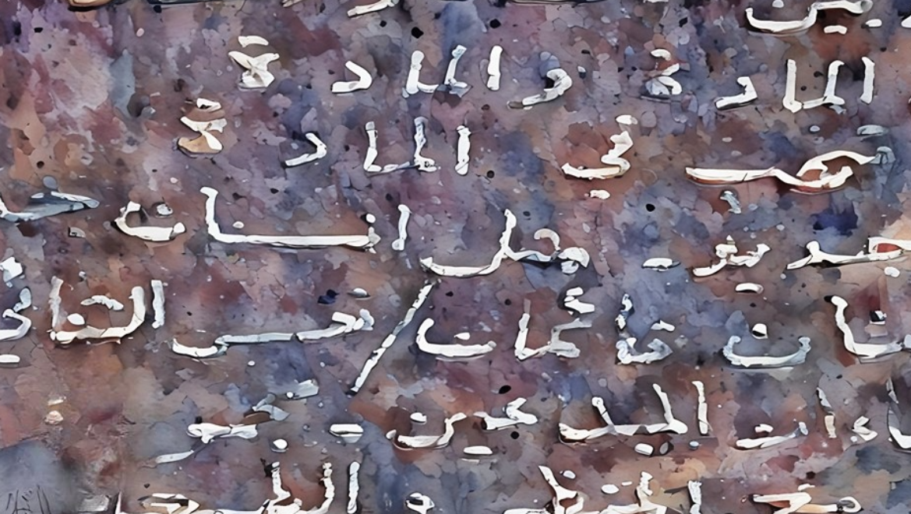
Translation of the Book of Mormon
Presentation by http://fashionsbylynda.com/blog/

Slide 2
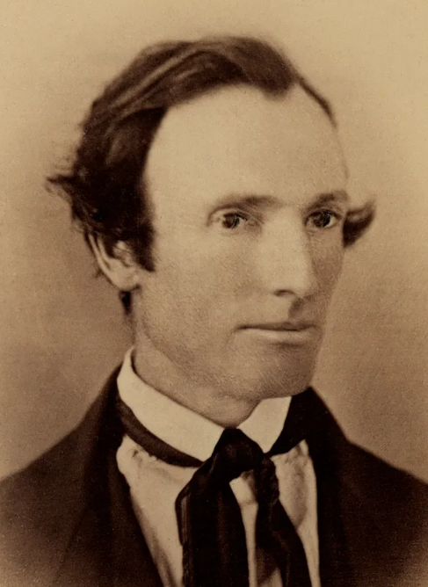
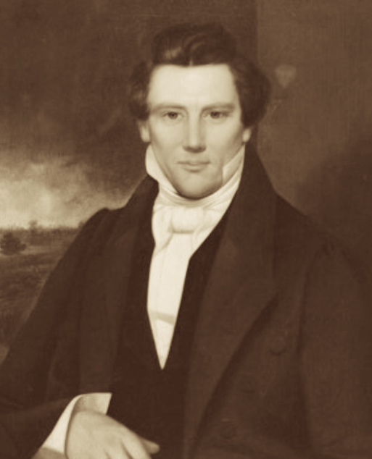
Scribe
A person who made written copies of documents, before the invention of printing
With Oliver Cowdery serving as his scribe, Joseph Smith made miraculous progress on the translation of the Book of Mormon during the spring of 1829 in Harmony, Pennsylvania.
While we don’t know specific details about how Joseph Smith translated the Book of Mormon, we do know he did it by the gift and power of God.
It is estimated that, with Oliver as his scribe, Joseph Smith completed the translation of the Book of Mormon in approximately 65 working days.

Slide 3
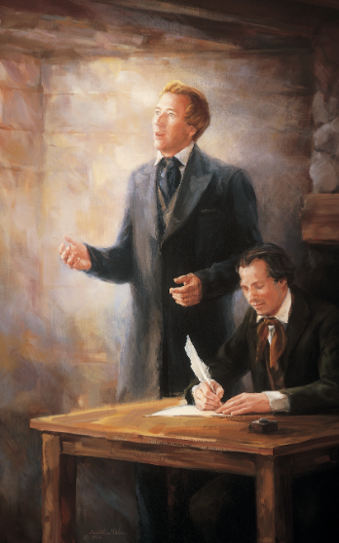
By the Gift of the Holy Spirit
“I would inform you that I translated [the book], by the gift and power of God.” When pressed for specifics about the process of translation, Joseph repeated on several occasions that it had been done “by the gift and power of God” and once added, “It was not intended to tell the world all the particulars of the coming forth of the book of Mormon.”
Why is it important to know the Book of Mormon was translated by the power of God rather than by Joseph Smith?
Gospel Topics Essays

Slide 4
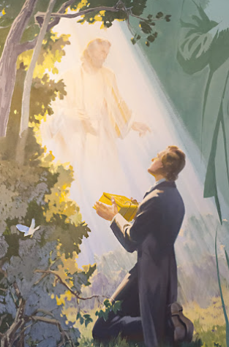
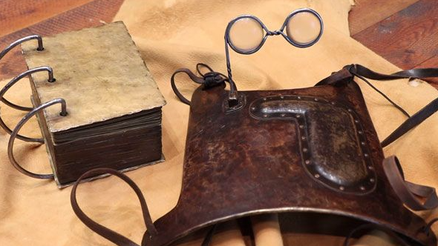
Preparing
When the angel Moroni appeared to Joseph Smith in 1823, he gave instructions to the Prophet about how the Book of Mormon would come forth.
He said there was a book deposited, written upon gold plates, giving an account of the former inhabitants of this continent, and the source from whence they sprang. He also said that the fulness of the everlasting Gospel was contained in it, as delivered by the Savior to the ancient inhabitants;
Also, that there were two stones in silver bows—and these stones, fastened to a breastplate, constituted what is called the Urim and Thummim—deposited with the plates; and the possession and use of these stones were what constituted “seers” in ancient or former times; and that God had prepared them for the purpose of translating the book.
Joseph Smith History 1:34-35

Slide 5
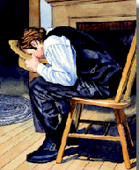
Urim and Thummin
Book of Mormon = Interpreters or specticles
Joseph Smith used another instrument called a seer stone.
The Prophet had discovered this instrument several years before he obtained the gold plates.
Witnesses said Joseph would sometimes place either the Urim and Thummim or the seer stone into a hat to block out light, which allowed him to better see the words that appeared on the physical instruments.
Gospel Topics Essays

Slide 6
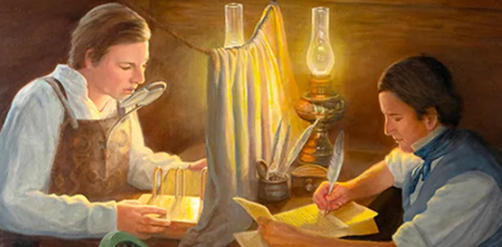
Oliver cowdery’s Description
“These were days never to be forgotten—to sit under the sound of a voice dictated by the inspiration of heaven, awakened the utmost gratitude of this bosom! Day after day I continued, uninterrupted, to write from his mouth, as he translated with the Urim and Thummim, or, as the Nephites would have said, ‘Interpreters,’ the history or record called ‘The Book of Mormon.’” (see full article)

Slide 7
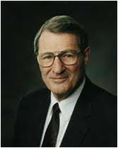
The Realm of faith
Why do we not have more disclosure concerning the process of translation of the Book of Mormon? Perhaps the full process was not disclosed because we would not be ready to understand it, even if given.
Perhaps, too, the Lord wanted to leave the Book of Mormon in the realm of faith, though it is drenched with intrinsic evidence. After all, Christ instructed Mormon, who was reviewing the Savior’s own teachings among the Nephites, not to record all of them on the plates because “I will try the faith of my people” (3 Ne. 26:11).
Perhaps the details of translation are withheld also because we are intended to immerse ourselves in the substance of the book rather than becoming unduly concerned with the process by which we received it.
Neal A. Maxwell

Slide 8
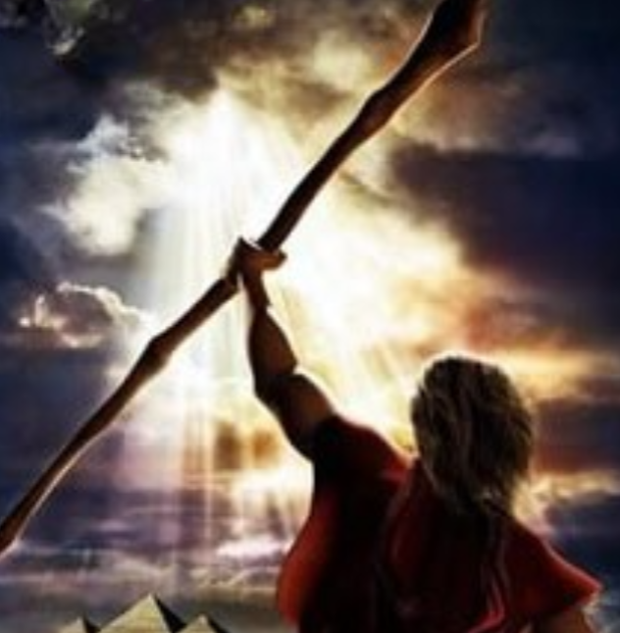
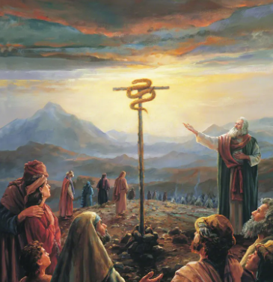
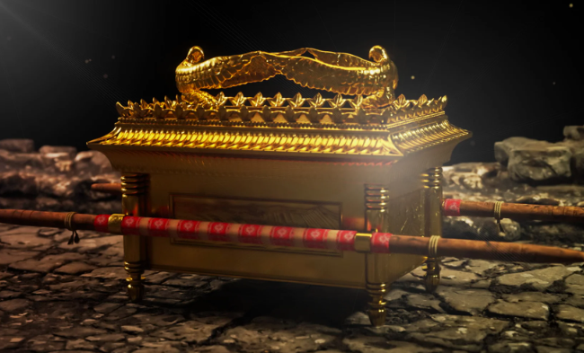
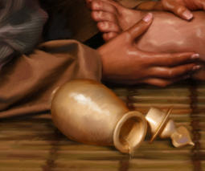
The Realm of faith
“In addition to the Urim and Thummim, the Bible mentions other physical instruments used to access God’s power: the rod of Aaron, a brass serpent, holy anointing oils, the Ark of the Covenant, and even dirt from the ground mixed with saliva to heal the eyes of a blind man”
Gospel Topics Essays

Slide 9
Sources:
Videos:
Seer Stone (3:47)
“Days of Harmony” from time code 7:18 to 11:33
Gospel Topics Essays, “Book of Mormon Translation,” ChurchofJesusChrist.org
Presentation by http://fashionsbylynda.com/blog/
Messenger and Advocate, vol. 1 (October 1834), pp. 14–16
Neal A. Maxwell, “By the Gift and Power of God,” Ensign, Jan. 1997, 41).

Slide 10
A Miracle:
Think of the short time Joseph took to translate the Book of Mormon. Working from April to June of 1828, Joseph translated the 116 pages that Martin Harris later lost. Joseph began translating again on Tuesday, April 7, 1829, with Oliver Cowdery as scribe. The manuscript was completed eighty-five days later, on June 30 of that year. Of course, not all of that time was spent working on the translation. … Conservatively estimated, this left sixty-five or fewer working days on which the prophet and his scribes translated this book, which contains 531 pages in its current edition. (See John W. Welch, Ensign, Jan. 1988, pp. 46–47.) That calculates to an average of eight pages per day. Consider this when you translate a book, or as you schedule your own reading of the Book of Mormon. (Russell M. Nelson, “A Treasured Testament,” Ensign, July 1993, 61–62)
The Book of Mormon can be a revelatory experience for you, just like it was for Joseph.
The prophets who wrote the Book of Mormon saw our day. They wrote to us. Their words speak to our times, our needs, and our purposes. If your heart is open as you read and pray about the Book of Mormon, the Holy Ghost will “manifest the truth of it unto you” [Moroni 10:4]. (Kim B. Clark, “Thou Art Joseph” [worldwide devotional for young adults, May 7, 2017], ChurchofJesusChrist.org)

Slide 11
Oliver Cowdery describes these events thus: “These were days never to be forgotten—to sit under the sound of a voice dictated by the inspiration of heaven, awakened the utmost gratitude of this bosom! Day after day I continued, uninterrupted, to write from his mouth, as he translated with the Urim and Thummim, or, as the Nephites would have said, ‘Interpreters,’ the history or record called ‘The Book of Mormon.’
“To notice, in even few words, the interesting account given by Mormon and his faithful son, Moroni, of a people once beloved and favored of heaven, would supersede my present design; I shall therefore defer this to a future period, and, as I said in the introduction, pass more directly to some few incidents immediately connected with the rise of this Church, which may be entertaining to some thousands who have stepped forward, amid the frowns of bigots and the calumny of hypocrites, and embraced the Gospel of Christ.
“No men, in their sober senses, could translate and write the directions given to the Nephites from the mouth of the Savior, of the precise manner in which men should build up His Church, and especially when corruption had spread an uncertainty over all forms and systems practiced among men, without desiring a privilege of showing the willingness of the heart by being buried in the liquid grave, to answer a ‘good conscience by the resurrection of Jesus Christ.’
“After writing the account given of the Savior’s ministry to the remnant of the seed of Jacob, upon this continent, it was easy to be seen, as the prophet said it would be, that darkness covered the earth and gross darkness the minds of the people. On reflecting further it was as easy to be seen that amid the great strife and noise concerning religion, none had authority from God to administer the ordinances of the Gospel. For the question might be asked, have men authority to administer in the name of Christ, who deny revelations, when His testimony is no less than the spirit of prophecy, and His religion based, built, and sustained by immediate revelations, in all ages of the world when He has had a people on earth? If these facts were buried, and carefully concealed by men whose craft would have been in danger if once permitted to shine in the faces of men, they were no longer to us; and we only waited for the commandment to be given ‘Arise and be baptized.’
“This was not long desired before it was realized. The Lord, who is rich in mercy, and ever willing to answer the consistent prayer of the humble, after we had called upon Him in a fervent manner, aside from the abodes of men, condescended to manifest to us His will. On a sudden, as from the midst of eternity, the voice of the Redeemer spake peace to us, while the veil was parted and the angel of God came down clothed with glory, and delivered the anxiously looked for message, and the keys of the Gospel of repentance. What joy! what wonder! what amazement! While the world was racked and distracted—while millions were groping as the blind for the wall, and while all men were resting upon uncertainty, as a general mass, our eyes beheld, our ears heard, as in the ‘blaze of day’; yes, more—above the glitter of the May sunbeam, which then shed its brilliancy over the face of nature! Then his voice, though mild, pierced to the center, and his words, ‘I am thy fellow-servant,’ dispelled every fear. We listened, we gazed, we admired! ’Twas the voice of an angel from glory, ’twas a message from the Most High! And as we heard we rejoiced, while His love enkindled upon our souls, and we were wrapped in the vision of the Almighty! Where was room for doubt? Nowhere; uncertainty had fled, doubt had sunk no more to rise, while fiction and deception had fled forever!
“But, dear brother, think, further think for a moment, what joy filled our hearts, and with what surprise we must have bowed, (for who would not have bowed the knee for such a blessing?) when we received under his hand the Holy Priesthood as he said, ‘Upon you my fellow-servants, in the name of Messiah, I confer this Priesthood and this authority, which shall remain upon earth, that the Sons of Levi may yet offer an offering unto the Lord in righteousness!’

Slide 12
“I shall not attempt to paint to you the feelings of this heart, nor the majestic beauty and glory which surrounded us on this occasion; but you will believe me when I say, that earth, nor men, with the eloquence of time, cannot begin to clothe language in as interesting and sublime a manner as this holy personage. No; nor has this earth power to give the joy, to bestow the peace, or comprehend the wisdom which was contained in each sentence as they were delivered by the power of the Holy Spirit! Man may deceive his fellow-men, deception may follow deception, and the children of the wicked one may have power to seduce the foolish and untaught, till naught but fiction feeds the many, and the fruit of falsehood carries in its current the giddy to the grave; but one touch with the finger of his love, yes, one ray of glory from the upper world, or one word from the mouth of the Savior, from the bosom of eternity, strikes it all into insignificance, and blots it forever from the mind. The assurance that we were in the presence of an angel, the certainty that we heard the voice of Jesus, and the truth unsullied as it flowed from a pure personage, dictated by the will of God, is to me past description, and I shall ever look upon this expression of the Savior’s goodness with wonder and thanksgiving while I am permitted to tarry; and in those mansions where perfection dwells and sin never comes, I hope to adore in that day which shall never cease.”—Messenger and Advocate, vol. 1 (October 1834), pp. 14–16.

