Slide 1
Doctrine and Covenants 6
Willing to Serve
Therefore, O ye that embark in the service of God, see that ye serve him with all your heart, might, mind and strength, that ye may stand blameless before God at the last day
D&C 4:2
Presentation by http://fashionsbylynda.com/blog/

Slide 2
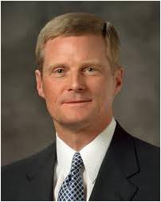
How is turning on a light bulb different from watching a sunrise?
“…sometimes revelation happens “quickly, completely, and all at once [like turning on a light in a dark room]. … [But] most frequently, revelation comes in small increments over time”
Elder David A. Bednar

Slide 3
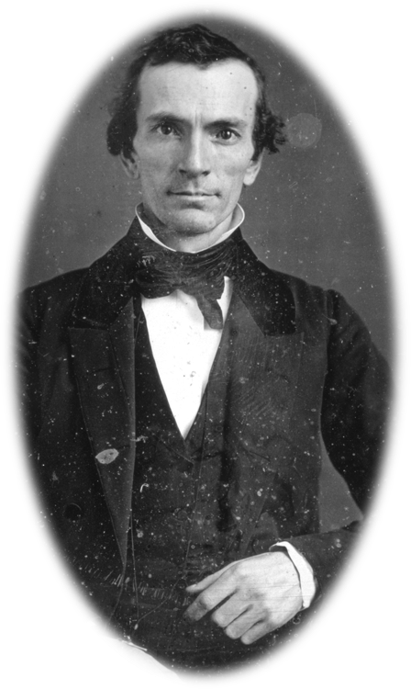
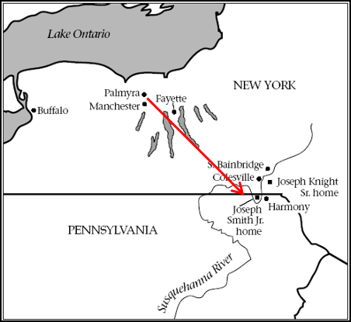
Information-Word of Mouth
Oliver Cowdery had been teaching in a neighborhood of Manchester, New York and boarded in the home of the Smith family.
While there he heard of the wonderful story of the Book of Mormon and was impressed to go to Harmony, Pennsylvania to learn more about the Book; about 140 miles away.
Oliver was also an intimate friend of the Whitmer’s. He later wrote his testimony of the truthfulness to David Whitmer.
Joseph Smith History 1:66

Slide 4
Oliver Cowdery
He was born October 3, 1806, in Wells, Rutland County, Vermont
He was a schoolteacher and boarded with the Joseph Smith’s parents
Having heard of the work of the prophet Joseph Smith, he went to meet him at Harmony, Pennsylvania on April 5, 1829
Two days after, he started to be the scribe in the translation of the Book of Mormon
He received the Aaronic Priesthood along with Joseph Smith under the hands of John the Baptist on May 15, 1929, and the Melchizedek Priesthood shortly thereafter from Peter, James, and John
He was the second elder of the Church
With Joseph, he beheld the Lord, Jesus Christ in the Kirtland temple on April 3, 1836, and there received the priesthood keys from Elijah, Elias, and Moses.
Three revelations were given to him in sections 8, 9,and 28.
He played a leading role in Church History
Who’s Who

Slide 5
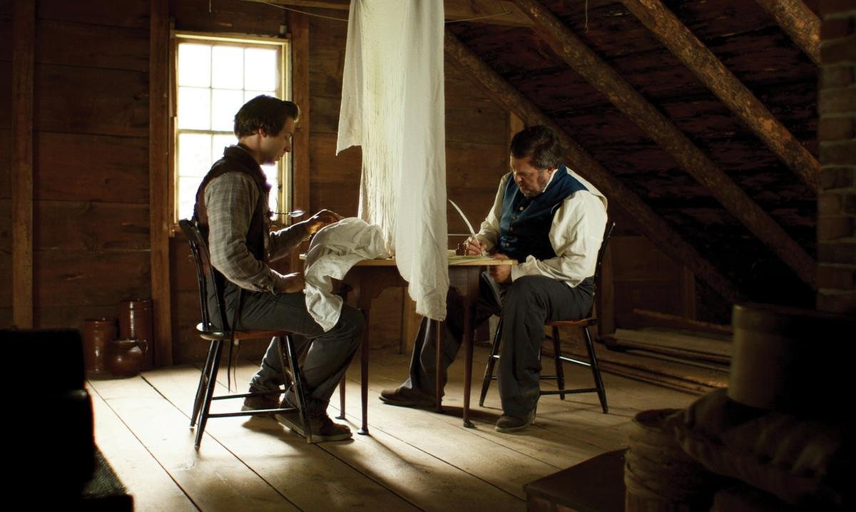
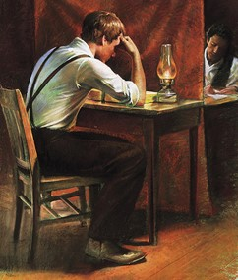
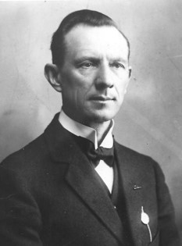
Resuming the Work
Joseph Smith was now asked to resume the work of translating the Book of Mormon as Oliver was his scribe—amanuensis—acting as
“According to Oliver Cowdery he wrote the entire Book (save a few pages) as the words fell from the lips of the Prophet.”
Hyrum M. Smith
Joseph Smith History 1:67

Slide 6
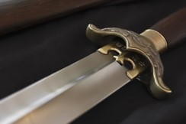
Two-Edged Sword
The word quick in the King James Version of the Bible does not mean swift but rather “living, alive”. To be quickened by the Spirit means to be given spiritual life. The word of the Lord is quick and powerful because it is a source of life, energy, and power.
Bible Dictionary
Many swords of ancient times had only one cutting edge.
When someone decided to make a two-edged sword, the effectiveness of the weapon was increased tremendously.
Now it could cut in any direction, no matter how the blow was struck.
Thus, the likening of the word of God to the two-edged sword is a vivid simile. Just as a sharp sword can cut deep enough to sever limbs and destroy life, so the word of the Lord is powerful enough that it can bring destruction of the soul (spiritual death) to those who do not give heed to it.
The word of God also has power to pierce the soul as a sword and penetrate to the inmost parts of man. It can cut through error and falsehood with double-edged efficiency.-- Manual
D&C 6:2

Slide 7
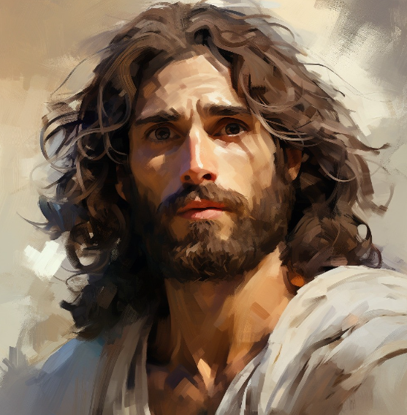
John the Beloved
John the Beloved is promised that he will live and bring souls to Christ until the Second Coming
Note: Nothing has been revealed about the specifics of John’s ministry as a translated being.
Sometime during April 1829, while Oliver was helping Joseph with the translation, he and Joseph had “a difference of opinion … about the account of John the Apostle, mentioned in the New Testament, whether he died, or whether he continued [to live]”
The Joseph Smith Papers
“Then went this saying abroad among the brethren, that that disciple should not die: yet Jesus said not unto him, He shall not die; but, If I will that he tarry till I come, what is that to thee?
This is the disciple which testifieth of these things, and wrote these things: and we know that his testimony is true.”
John 21:23-24

Slide 8
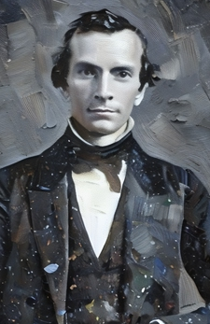
Words to Oliver
Verse 3-4 Serve
Verse 5 Pray
Verse 6 Keep the Commandments
Verse 7 Search for wisdom, not riches
Verse 8 Your righteous desires will be an influence to others
Verse 9 Repent and you will be blessed
D&C 6:3-9

Slide 9
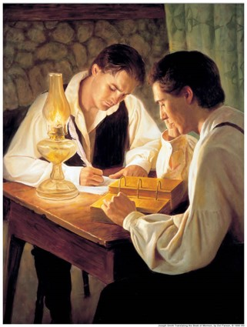
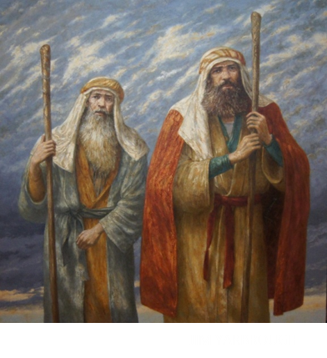
The Gift
“Oliver Cowdery’s gift was the spirit of revelation by which he could obtain the knowledge of things divine.
He also had the gift of Aaron. Aaron was the spokesman of Moses, and Oliver Cowdery became the first spokeman of the Prophet, or of the church, when, on April 30, 1830, he preached the first public discourse in this dispensation.”
Hyrum M. Smith
The gifts of the spirit are not for public display
Salvation is the greatest gift…deliverance from outward dangers, victory over enemies, remission of sins through acceptance of Christ and obedience to His laws, and eternal exaltation
D&C 6:10-13

Slide 10
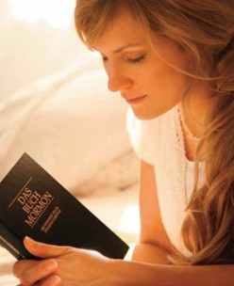
Receiving and Recognizing Revelation
As we seek answers from Heavenly Father, He will give us instruction.
The Lord will enlighten our minds through the Holy Ghost.
God knows our thoughts and the intents of our hearts.
When we have received revelation, we should treasure it up in our hearts.
D&C 6:14-17, 20

Slide 11
Communication From God
“Sometimes the sun rises on a morning that is cloudy or foggy. Because of the overcast conditions, perceiving the light is more difficult, and identifying the precise moment when the sun rises over the horizon is not possible. …
“In a similar way, we many times receive revelation without recognizing precisely how or when we are receiving revelation”
David A. Bednar
How might we sometimes overlook or dismiss the Lord’s answers to our prayers?
D&C 6:21-24

Slide 12
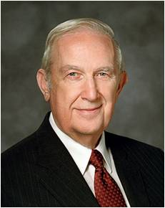
“Recognizing answers to prayer can sometimes be very difficult. Sometimes we unwisely try to face life by depending on our own experience and capacity. It is much wiser for us to seek through prayer and divine inspiration to know what to do. Our obedience assures that when required, we can qualify for divine power to accomplish an inspired objective.
“Like many of us, Oliver Cowdery did not recognize the evidence of answers to prayers already given by the Lord. …
“If you feel that God has not answered your prayers, ponder these scriptures [D&C 6:14–15]—then carefully look for evidence in your own life that He may have already answered you” (“How to Obtain Revelation and Inspiration for Your Personal Life,”
Richard G. Scott
“We may not see angels, hear heavenly voices, or receive overwhelming spiritual impressions. … But as we honor our covenants and keep the commandments, as we strive ever more consistently to do good and to become better, we can walk with the confidence that God will guide our steps. …
“… Sometimes the spirit of revelation will operate immediately and intensely, other times subtly and gradually, and often so delicately you may not even consciously recognize it. But regardless of the pattern whereby this blessing is received, the light it provides will illuminate and enlarge your soul, enlighten your understanding (see Alma 5:7; 32:28), and direct and protect you and your family.”
David A. Bednar

Slide 13
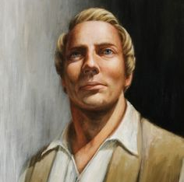
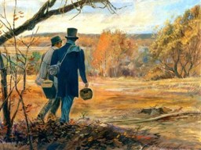
A Secret Prayer Leads to a Revelation
“After we had received this revelation, Oliver Cowdery stated to me that after he had gone to my father’s to board, and after the family had communicated to him concerning my having obtained the plates, that one night after he had retired to bed he called upon the Lord to know if these things were so, and the Lord manifested to him that they were true, but he had kept the circumstance entirely secret, and had mentioned it to no one; so that after this revelation was given, he knew that the work was true, because no being living knew of the thing alluded to in the revelation, but God and himself.”
Joseph Smith
D&C 6:22

Slide 14
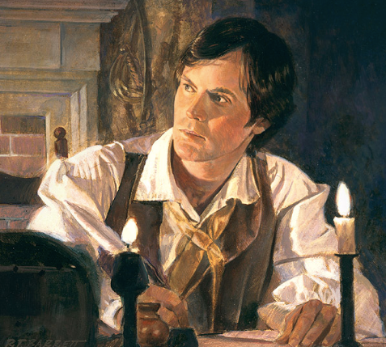
Fear Not
Fear Not
The Lord told Oliver that if he desired, he could have the gift of translation and stand with Joseph as a second witness of the Book of Mormon.
The Lord told Oliver that if he desired, he could have the gift of translation and stand with Joseph as a second witness of the Book of Mormon.
“Fear not to do good, my sons, for whatsoever ye sow, that shall ye also reap; therefore, if ye sow good ye shall also reap good for your reward.”
“Fear not to do good, my sons, for whatsoever ye sow, that shall ye also reap; therefore, if ye sow good ye shall also reap good for your reward.”
As we look unto Jesus Christ, we can overcome doubt and fear
D&C 6:25-37

Slide 15
Doctrinal Mastery
“Look unto me in every thought;
doubt not, fear not.”
D&C 6:36

Slide 16
Every Thought
The way to optimism as we go forward was given by the Lord: “Look unto me in every thought; doubt not, fear not”.
President Monson told us how to do that. We are to ponder and apply the Book of Mormon and the words of prophets. Pray always.
Be believing.
Serve the Lord with all our heart, might, mind, and strength. We are to pray with all the energy of our hearts for the gift of charity, the pure love of Christ.
And above all, we are to be consistent and persistent in following prophetic counsel.
Henry B. Eyring
D&C 6:36; Moroni 7:47-48

Slide 17
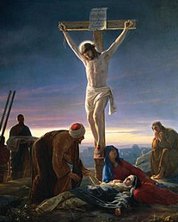
Behold His Wounds
The five wounds comprised 1) the nail hole in his right hand, 2) the nail hole in his left hand, 3) the nail hole in his right foot, 4) the nail hole in his left foot, 5) the wound to his torso from the piercing of the spear.
“Fear not”
[Luke 5:10; 8:50; 12:7; Doctrine and Covenants 38:15; 50:41; 98:1].
“Doubt not”
[Doctrine and Covenants 6:36].
“Be of good cheer”
[Matthew 14:27; John 16:33; Doctrine and Covenants 61:36; 68:6; 78:18].
“Let not your heart be troubled”
[John 14:1, 27].
Behold the wounds in Jesus’ Hands,
The marks upon His side.
Then ponder whom He meant to save
When on the cross He died.
We cannot see the love of God
Which saves us from the Fall,
Yet know that Christ from wood and nails
Built mansions for us all.
Behold the Wounds in Jesus’ Hands
Words by John V. Pearson
Music by David R. Naylor
D&C 6:37
Dieter F. Uchtdorf

Slide 18
Sources:
Video:
Patterns of Light: Spirit of Revelation (3:03)
Receiving Revelation (4:17)
This is the Spirit of Revelation (9:41)
Elder David A. Bednar (“The Spirit of Revelation,” Ensign or Liahona, May 2011, 88-90).
Presentation by ©http://fashionsbylynda.com/blog/
Who’s Who in the Doctrine and Covenants by Ed J. Pinegar and Richard J. Allen pgs. 17-18
(Bible Dictionary, “quick,” p. 756).
Doctrine and Covenants Student Manual Religion 324-235 pg. 15
Aaron and Moses Art by JIM YARBROUGH
Joseph Smith (History of the Church, 1:35).
Richard G. Scott Ensign or Liahona, “How to Obtain Revelation and Inspiration for Your Personal Life,” May 2012, 47.
(Histories, Volume 1: 1832–1844, vol. 1 of the Histories series of The Joseph Smith Papers [2012], 284).
Dieter F. Uchtdorf, “Jesus Christ Is the Strength of Youth,” Liahona, Nov. 2022,9
Henry B. Eyring, “Fear Not to Do Good,” Ensign or Liahona, Nov. 2017, 103
Presentation by ©http://fashionsbylynda.com/blog/

Slide 19
Historical Background-- Oliver Cowdery
In the winter of 1829 Oliver Cowdery taught school near the home of Joseph Smith Sr. It was the custom of the day for teachers to board in the homes of their pupils, and since the Smiths had children in Oliver’s school, he came to stay with them. While there he heard stories about the Book of Mormon plates and asked Father Smith to tell him the details. Father Smith finally consented, and Oliver Cowdery became one of the few in whom the family confided the story. Lucy Mack Smith recorded the events that followed:
“Shortly after receiving this information, he [Oliver] told Mr. Smith that he was highly delighted with what he had heard, that he had been in a deep study upon the subject all day, and that it was impressed upon his mind, that he should yet have the privilege of writing for Joseph. Furthermore, that he had determined to pay him a visit at the close of the school. …
“On coming in on the following day, he said, ‘The subject upon which we were yesterday conversing seems working in my very bones, and I cannot, for a moment, get it out of my mind; finally, I have resolved on what I will do. Samuel [Smith], I understand, is going down to Pennsylvania to spend the spring with Joseph; I shall make my arrangements to be ready to accompany him thither, … for I have made it a subject of prayer, and I firmly believe that it is the will of the Lord that I should go. If there is a work for me to do in this thing, I am determined to attend to it.’” (History of Joseph Smith, p. 139.)
In April Samuel and Oliver went to Harmony, Pennsylvania, to visit Joseph. Lucy Mack Smith recorded the following: “Joseph had been so hurried with his secular affairs that he could not proceed with his spiritual concerns so fast as was necessary for the speedy completion of the work; there was also another disadvantage under which he labored, his wife had so much of her time taken up with the care of her house, that she could write for him but a small portion of the time. On account of these embarrassments, Joseph called upon the Lord, three days prior to the arrival of Samuel and Oliver, to send him a scribe, according to the promise of the angel; and he was informed that the same should be forthcoming in a few days. Accordingly, when Mr. Cowdery told him the business that he had come upon, Joseph was not at all surprised.” (History of Joseph Smith, p. 141.)
The narrative is picked up at this point in the history of the Prophet: “Two days after the arrival of Mr. Cowdery (being the 7th of April) I commenced to translate the Book of Mormon, and he began to write for me, which having continued for some time, I inquired of the Lord through the Urim and Thummim, and obtained the following: [D&C 6]” (History of the Church, 1:32–33).

Slide 20
THE Prophet Joseph Smith said very little about the actual process of translating the Book of Mormon. However, a thorough study of the original text of the Book of Mormon (including a detailed examination of both the original and printer's manuscripts) and a careful review of statements made by those who witnessed Joseph Smith translating combine to provide valuable information about the translation process. Even details such as spelling corrections and textual insertions provide definite clues about how Joseph translated. This evidence does not support theories that Joseph Smith composed the text himself or that he took the text from some other source. Instead, it indicates that the Lord exercised what I refer to as "tight control" over the word-by-word translation of the Book of Mormon. In particular, the evidence suggests that Joseph Smith saw specific words written out in English and read them off to the scribe, and that the accuracy of the resulting text depended on the carefulness of Joseph and his scribe. Indeed, this evidence is most compatible with the account that Joseph himself gave, that he translated the Book of Mormon "by the gift and power of God’:
During the translation process, the witnesses were able to observe, in an open setting, the following:
Joseph Smith placing the interpreters (either the Urim and Thummim or the seer stone) in a hat and placing his face into the hat; Joseph dictating for long periods of time without reference to any books, papers, manuscripts, or even the plates themselves;
Joseph spelling out unfamiliar Book of Mormon names;
after each dictated sequence, the scribe reading back to Joseph what was written so that Joseph could check the correctness of the manuscript;
Joseph starting a dictation session without prompting from the scribe about where the previous session had ended.
SEE MORE:
Neal A Maxwell Institute:
https://publications.mi.byu.edu/publications/jbms/7/1/S00005-50be28d378b0e4Skousen.pdf

