Slide 1
Spirit of Revelation
Doctrine and Covenants 8
“If any of you lack wisdom, let him ask of God, that giveth to all men liberally, and upbraideth not; and it shall be given him.”
James 1:5
Presentation by ©http://fashionsbylynda.com/blog/

Slide 2
Promise of a Gift
What can you do to make your prayers more meaningful?
How can you know when God is speaking to you?
“And whatsoever ye shall ask the Father in my name, which is right, believing that ye shall receive, behold it shall be given unto you.”
3 Nephi 18:20

Slide 3
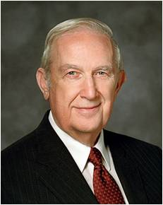
Instructions to Oliver
Ask in Faith
Have an Honest Heart
Believe you will receive
If we pray with faith and an honest heart, we can receive knowledge from God
“Prayer is most effective when we strive to be clean and obedient, with worthy motives, and are willing to do what He asks. Humble, trusting prayer brings direction and peace.”
Elder Richard G. Scott
D&C 8:1

Slide 4
By the Holy Ghost
In Your Heart
In Your Mind
It is by the spirit that Moses was able to lead the children of Israel out of bondage
It is by the spirit that will lead us on the right path out of our own bondage

Slide 5
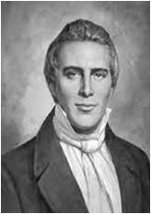
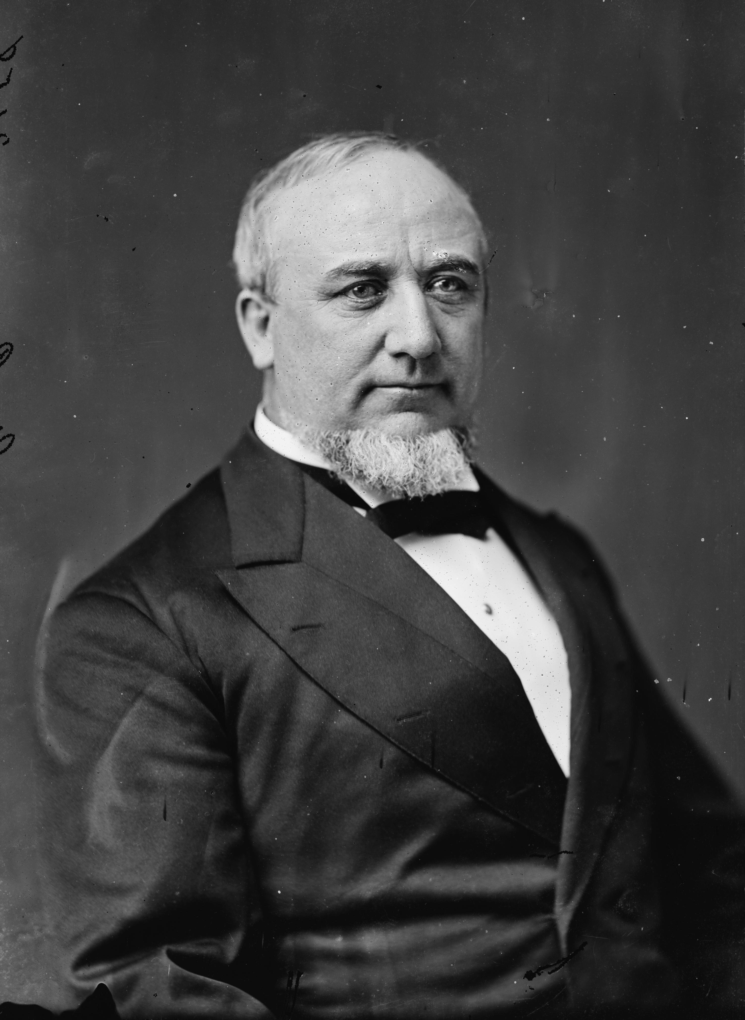
Sudden Stroke of Ideas
“A person may profit by noticing the first intimation of the spirit of revelation; for instance, when you feel pure intelligence flowing into you, it may give you sudden strokes of ideas … ; and thus by learning the Spirit of God and understanding it, you may grow into the principle of revelation, until you become perfect in Christ Jesus.”
Joseph Smith
“The apostles of this Church have all the authority, they have all the keys, … all the spirit of revelation necessary to lead this people into the presence of the Lamb in the celestial kingdom of our God.”
Elder George Q. Cannon
D&C 8:2

Slide 6
Doctrinal Mastery
2 Yea, behold, I will tell you in your mind and in your heart, by the Holy Ghost, which shall come upon you and which shall dwell in your heart.
3 Now, behold, this is the spirit of revelation; behold, this is the spirit by which Moses brought the children of Israel through the Red Sea on dry ground.
D&C 8:2-3

Slide 7
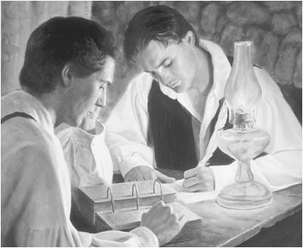
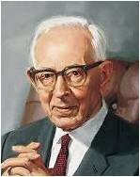
Voice of the Spirit
Oliver Cowdery was given the gift of understanding the voice of the Spirit. If he hearkened to the inspiration of the Holy Ghost, he could protect himself from those who would seek to bring about his physical death and also from those who would tempt him to sin and thus bring his soul “to destruction”.
Manual
“A soul cannot be destroyed.
“Every soul born into this world shall receive the resurrection and immortality and shall endure forever. Destruction does not mean, then, annihilation. When the Lord says they shall be destroyed, he means that they shall be banished from his presence, that they shall be cut off from the presence of light and truth, and shall not have the privilege of gaining this exaltation; and that is destruction.”
Joseph Fielding Smith
D&C 8:4

Slide 8
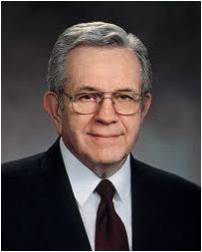
By the Mind, By the Heart
“You can learn now, in your youth, to be led by the Holy Ghost.
“As an Apostle I listen now to the same inspiration, coming from the same source, in the same way, that I listened to as a boy. The signal is much clearer now.”
President Boyd K. Packer
Mind
Heart
The Lord communicates to our minds and our hearts through the Holy Ghost
I bear witness that the Lord, through the Holy Ghost, can speak to your mind and heart. Sometimes the impressions are just general feelings. Sometimes the direction comes so clearly and so unmistakably that it can be written down like spiritual dictation.
Richard G. Scott

Slide 9
If You Apply This Gift…
You will be blessed
You will have the knowledge to do this work
You will be delivered out of the hands of your enemies
Remember,
this is your gift
D&C 8:4-5

Slide 10
Communication With God
John 14:26
Galatians 5:22-23
Helaman 5:30
D&C 11:12-13
But the Comforter, which is the Holy Ghost, whom the Father will send in my name, he shall teach you all things, and bring all things to your remembrance, whatsoever I have said unto you.
But the fruit of the Spirit is love, joy, peace,longsuffering, gentleness, goodness, faith,
Meekness, temperance: against such there is no law.
And it came to pass when they heard this voice, and beheld that it was not a voice of thunder, neither was it a voice of a great tumultuous noise, but behold, it was a still voice of perfect mildness, as if it had been a whisper, and it did pierce even to the very soul—
And now, verily, verily, I say unto thee, put your trust in that Spirit which leadeth to do good—yea, to do justly, to walk humbly, to judge righteously; and this is my Spirit.
Verily, verily, I say unto you, I will impart unto you of my Spirit, which shall enlighten your mind, which shall fill your soul with joy;

Slide 11
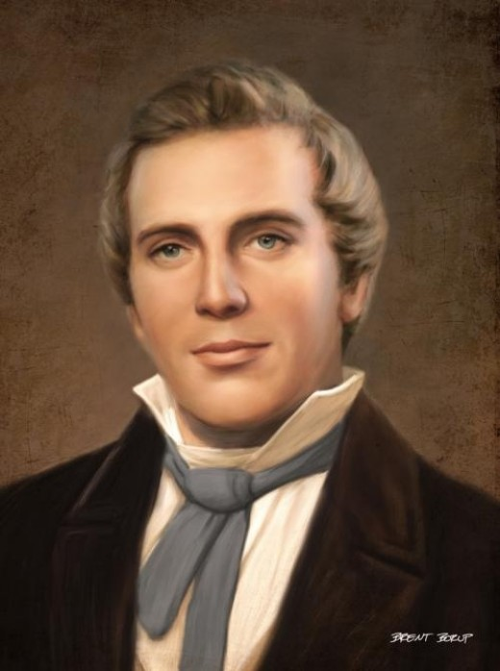
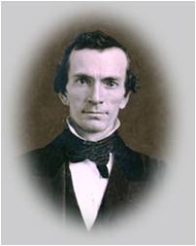
The Gift of Aaron
“There was another gift bestowed upon Oliver Cowdery, and that was the gift of Aaron. Like Aaron with his rod in his hand going before Moses as a spokesman, so Oliver Cowdery was to go before Joseph Smith.
Oliver was blessed with the great honor of holding the keys of this dispensation with Joseph Smith, and, like Aaron, did become a spokesman on numerous occasions. It was Oliver who delivered the first public discourse in this dispensation.”
(Smith)
Ask in Faith and in Wisdom
Aaron was the elder brother of Moses. Being prompted by the Spirit of the Lord, he met his younger brother in the wilderness and accompanied him to Egypt. He introduced him to the children of Israel in the land of Goshen. He was his spokesman before Pharaoh, and he assisted him in opening up the dispensation which Moses was commissioned to proclaim.
(See: Exodus 4:27–31)
Manual
D&C 8:6-9

Slide 12
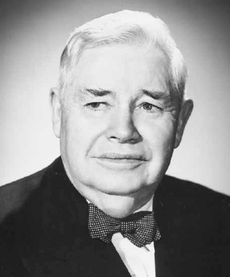
The Power of Faith
“As I think about faith, this principle of power, I am obliged to believe that it is an intelligent force. Of what kind, I do not know. But it is superior to and overrules all other forces of which we know. …
“[We] have had this great power given unto us, this power of faith. What are we doing about it? Can you, can we, do the mighty things that the Savior did? Yes.
They have been done by the members of the Church who had the faith and the righteousness so to do.
Think of what is within your power if you but live the Gospel, if you but live so that you may invoke the power which is within you.”
President J. Reuben Clark Jr.
How do you exercise your faith?
D&C 8:11-12

Slide 13
Sources:
Videos:
Voice of the Spirit (3:54)
“Patterns of Light: Spirit of Revelation” (3:04)
Richard G. Scott, “To Acquire Spiritual Guidance,” Ensign or Liahona, Nov. 2009, 9
Joseph Smith (Teachings of Presidents of the Church: Joseph Smith [2007], 132).
Hyrum M. Smith Doctrine and Covenants Commentary pg. 43
Presentation by ©http://fashionsbylynda.com/blog/
Elder George Q. Cannon Journal of Discourses, 21:270–71
Doctrine and Covenants Student Manual Religion 324-325 pg. 19
Joseph Fielding Smith (Doctrines of Salvation, 2:227–28
President Boyd K. Packer (“Prayers and Answers,” Ensign, Nov. 1979, 21).
Elder Richard G. Scott (“Helping Others to Be Spiritually Led” [address to CES religious educators, Aug. 11, 1998], 3–4, LDS.org ).
(Smith, Church History and Modern Revelation, 1:52.)
President J. Reuben Clark Jr. (In Conference Report, Apr. 1960, p. 21.)
Presentation by ©http://fashionsbylynda.com/blog/

Slide 14
Applying the Spirit D&C 8:4 “The spirit of revelation … is not restricted to the presiding authorities of the Church; rather, it belongs to and should be operative in the life of every man, woman, and child who reaches the age of accountability and enters into sacred covenants. Sincere desire and worthiness invite the spirit of revelation into our lives. …
“… Because the Spirit whispers to us gently and delicately, it is easy to understand why we should shun inappropriate media, pornography, and harmful, addictive substances and behaviors. These tools of the adversary can impair and eventually destroy our capacity to recognize and respond to the subtle messages from God delivered by the power of His Spirit. Each of us should consider seriously and ponder prayerfully how we can reject the devil’s enticements and righteously ‘apply unto it,’ even the spirit of revelation, in our personal lives and families” David A. Bednar (“The Spirit of Revelation,” Ensign or Liahona, May 2011, 87–88).
Joseph Smith Received Revelations through the Power of God
Those who believed that Joseph Smith’s revelations contained the voice of the Lord speaking to them also accepted the miraculous ways in which the revelations were received. Some of the Prophet Joseph’s earliest revelations came through the same means by which he translated the Book of Mormon from the gold plates. In the stone box containing the gold plates, Joseph found what Book of Mormon prophets referred to as “interpreters,” or a “stone, which shall shine forth in darkness unto light” (Alma 37:23–24). He described the instrument as “spectacles” and referred to it using an Old Testament term, Urim and Thummim (see Exodus 28:30).
He also sometimes applied the term to other stones he possessed, called “seer stones” because they aided him in receiving revelations as a seer. The Prophet received some early revelations through the use of these seer stones. For example, shortly after Oliver Cowdery came to serve as a scribe for Joseph Smith as he translated the plates, Oliver and Joseph debated the meaning of a biblical passage and sought an answer through revelation. Joseph explained: “A difference of opinion arising between us about the account of John the Apostle … whether he died, or whether he continued; we mutually agreed to settle it by the Urim and Thummim.” In response, Joseph Smith received the revelation now known as section 7 of the Doctrine and Covenants, which informed them that Jesus had told the Apostle John, “Thou shalt tarry until I come in my glory” (D&C 7:3).
Records indicate that soon after the founding of the Church in 1830, the Prophet stopped using the seer stones as a regular means of receiving revelations. Instead, he dictated the revelations after inquiring of the Lord without employing an external instrument. One of his scribes explained that process: “The scribe seats himself at a desk or table, with pen, ink, and paper. The subject of inquiry being understood, the Prophet and Revelator inquires of God. He spiritually sees, hears, and feels, and then speaks as he is moved upon by the Holy Ghost.”
Great and Marvelous Are the Revelations of God
BY GERRIT DIRKMAATChurch History Department Jan. Ensign 2013
The English word revelation is translated from a Greek word apocalypse, meaning to make known or uncover. This is in contrast to apocrypha, which connotes covered or concealed. Divine revelation is one of the grandest concepts and principles of the gospel of Jesus Christ, for without it, man could not know of the things of God and could not be saved with any degree of salvation in the eternities.
Continuous revelation from God to His Saints, through the Holy Ghost or by other means, such as visions, dreams, or visitations, makes possible daily guidance along true paths and leads the faithful soul to complete and eternal salvation in the celestial kingdom. The principle of gaining knowledge by revelation is the principle of salvation. It is the making known of divine truth by communication with the heavens and consists not only of revelation of the plan of salvation to the Lord’s prophets but also a confirmation in the hearts of the believers that the revelation to the prophets is true. It also consists of individual guidance for every person who seeks for it and follows the prescribed course of faith, repentance, and obedience to the gospel of Jesus Christ. “The Holy Ghost is a revelator,” said Joseph Smith, and “no man can receive the Holy Ghost without receiving revelations” (HC 6:58). Without revelation, all would be guesswork, darkness, and confusion.
In the Lord’s Church the First Presidency and the Council of the Twelve are prophets, seers, and revelators to the Church and to the world. In addition, every person may receive personal revelation for his own benefit. It is contrary to the laws of God for any person to receive revelation for those higher in authority (see D&C 28:2–8; 100:11;107:91–92).
Bible Dictionary
The Transforming Power of Faith and Character--RICHARD G. SCOTT
As you walk to the boundary of your understanding into the twilight of uncertainty, exercising faith, you will be led to find solutions you would not obtain otherwise. With even your strongest faith, God will not always reward you immediately according to your desires. Rather, God will respond with what in His eternal plan is best for you, when it will yield the greatest advantage. Be thankful that sometimes God lets you struggle for a long time before that answer comes. That causes your faith to increase and your character to grow.
I have personally verified that concepts like faith, prayer, love, and humility hold no great significance and produce no miracles until they become a living part of us through our own experience, aided by the sweet prompting of the Holy Spirit.
To summarize:
• God uses your faith to mold your character.
• Character is the manifestation of what you are becoming.
• Strong character results from consistent correct choices.
• The bedrock of character is integrity.
• The more your character is fortified, the more enabled you are to exercise the power of faith. Oct. 2010 Gen. Conf.

