Slide 1
Doctrine and Covenants 9
The Lord’s Way
“For God hath not given us the spirit of fear; but of power, and of love, and of a sound mind.”
2 Timothy 1:17
Presentation by ©http://fashionsbylynda.com/blog/

Slide 2
Making Decisions
What kinds of decisions will you be making in the next year?
What kinds of decisions will you be making in the next 5 to 10 years?

Slide 3
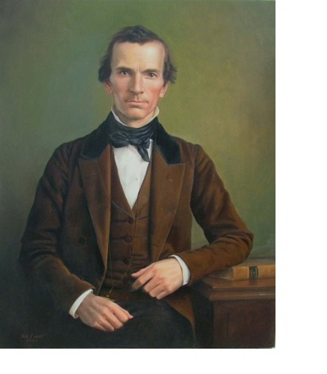
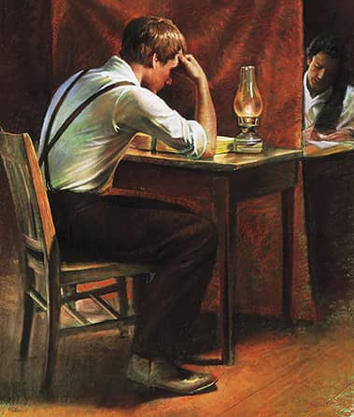
Oliver Wants to Translate
April 1829
Although Oliver Cowdery was eager to translate, he was not content merely to assist in the work of translating by serving as Joseph’s scribe.
He wanted to translate as Joseph did. The Lord’s desire, on the other hand, was for Oliver to continue to serve as scribe and then seek for greater gifts.
Oliver, however, became impatient and was given permission to translate on his own.

Slide 4
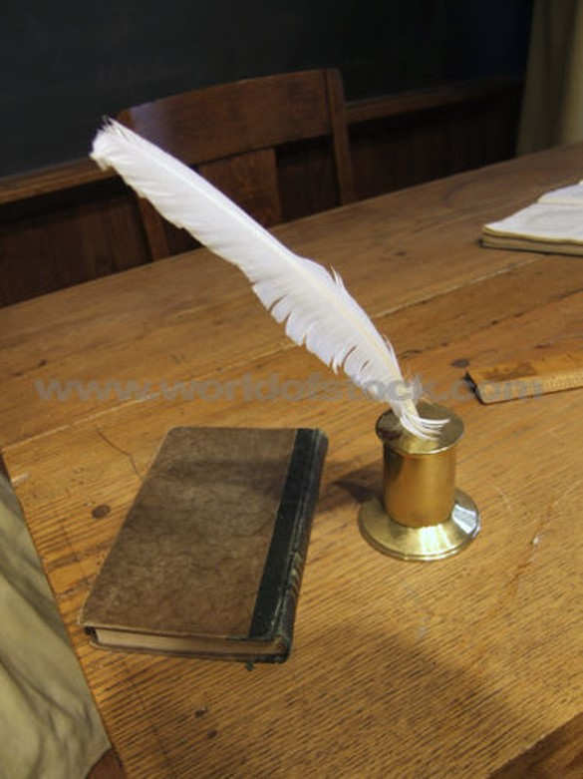
His Own Way—Not the Lord’s
The Lord assigned Oliver’s failure to translate to the fact that he did not translate according to that which he desired of the Lord.
Oliver had to learn that translating as Joseph Smith was doing was by the gift and power of God. Evidently, Oliver had received sufficient instruction, but instead went his own way, using his own wisdom. He was therefore stopped from translating.
D&C 9:1

Slide 5
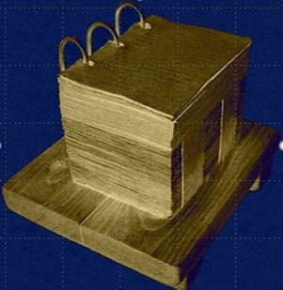
Sealed Portion
“Several years after this revelation was given, the records from which the book of Abraham was translated fell into Joseph Smith’s hands. Perhaps this was one of those other records which the Lord had in mind. It should also be remembered that a portion of the gold plates was sealed. These too shall come forth some time in the future and may have been among those referred to in this statement by the Lord.”
Manual
This sealed portion contains the complete record of the vision of the brother of Jared (see Ether 4:4–5)
“And behold the book shall be sealed; and in the book shall be a revelation from God, from the beginning of the world to the ending thereof.
Wherefore, because of the things which are sealed up, the things which are sealed shall not be delivered in the day of the wickedness and abominations of the people. Wherefore the book shall be kept from them.”
2 Nephi 27:7-8
D&C 9:2

Slide 6
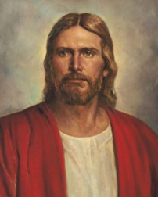
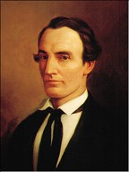
Patience
The Lord is asking Oliver to be patient
He calls him “my son”
“He speaks for the Father, and represents the Father, and is, therefore, in that sense both the Father and the Son.”
“And because he dwelleth in flesh he shall be called the Son of God, and having subjected the flesh to the will of the Father, being the Father and the Son—”
Mosiah 15:2
D&C 9:3

Slide 7
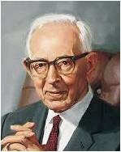
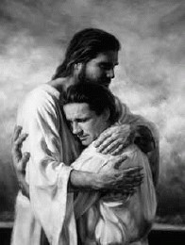
Privilege Taken Away
The privilege of writing for Joseph had been taken away from Oliver because he failed to “commence” in what he had been requested to do in D&C 6:25
“Oliver’s failure came because he did not continue as he commenced, and the task being a difficult one, his faith deserted him.”
Joseph Fielding Smith
“It is wisdom in me that I have dealt with you after this manner.”
The Lord, however, does not punish a person for sins he has not yet committed, even though He knows that he will commit them sometime in the future.
Oliver had demonstrated by his present insufficient faith that it was better for him to wait for a season before he translated.
Also, Joseph needed a scribe, and Oliver’s impatience at being only a scribe had been satisfied since he had learned that translation was not nearly as simple a task as it first appeared. It was therefore wisdom in God to have Oliver wait.--Manual
D&C 9:5-6

Slide 8
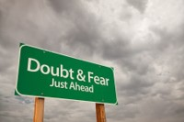
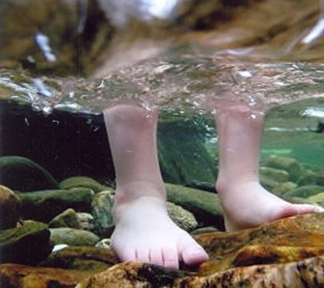
Decisions
“In the process of revelation and making important decisions, fear plays a destructive, sometimes paralyzing role.
To Oliver Cowdery, who missed the opportunity of a lifetime because he didn’t seize it in the lifetime of the opportunity, the Lord said, ‘You did not continue as you commenced.’
Does that sound familiar to those who have been illuminated and then knuckled under to second thoughts and returning doubts? …
“… After you have gotten the message, after you have paid the price to feel His love and hear the word of the Lord, go forward. Don’t fear, don’t vacillate, don’t quibble, don’t whine. … Dismiss your fears and wade in with both feet”
Elder Jeffrey R. Holland

Slide 9
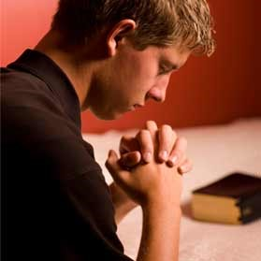
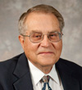
Principles For Receiving Revelation
“But, behold, I say unto you, that you must study it out in your mind; then you must ask me if it be right, and if it is right I will cause that your bosom shall burn within you; therefore, you shall feel that it is right.”
“Spiritual effort, as well as mental and physical effort, was required in order to translate the sacred records of the Book of Mormon.
Oliver Cowdery thought that all he needed to do in order to translate was to ask the Lord, but here he is told that he must also ‘study it out’ in his mind as well as to ask the Lord whether or not it is right.
The Lord also gives Oliver a key so that he will know when the translation is right: his bosom shall burn within him.”
Ludlow--Manual
D&C 9:7-9

Slide 10
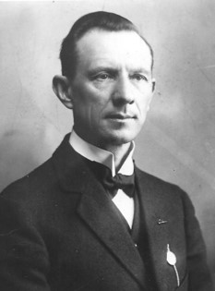
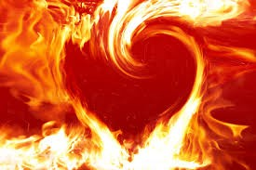
“Study Out in Your Mind”
“After study and prayer the Lord will make it manifest whether the result obtained is right or wrong;
If right:
Burning in your bosom
If wrong:
There will be no manifestation—no feeling
D&C 9:8---Hyrum M. Smith

Slide 11
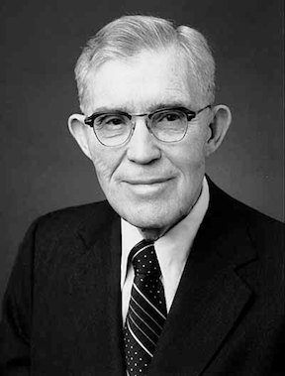
“Burning in Your Bosom”
“If I am to receive revelation from the Lord, I must be in harmony with him by keeping his commandments.
Then as needed, according to his wisdom, his word will come into my mind through my thoughts, accompanied by a feeling in the region of my bosom. It is a feeling which cannot be described, but the nearest word we have is ‘burn’ or ‘burning.’
Accompanying this always is a feeling of peace, a further witness that what one heard is right. Once one recognizes this burning, this feeling, this peace, one need never be drawn astray in his daily life or in the guidance he may receive.”
Elder S. Dilworth Young
D&C 9:8

Slide 12
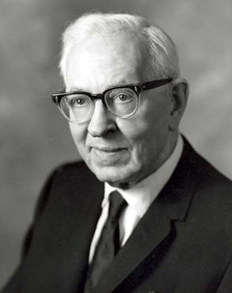
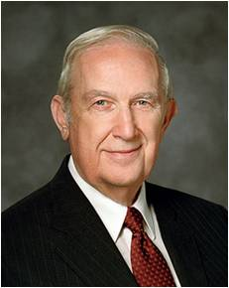
When you have been listening to some inspired speaker who has presented a new thought to you, have you not felt that burning within and the satisfaction in your heart that this new thought is true?
On the other hand, have you experienced the feeling of stupor, gloom, or uneasiness when some thought has been presented which was in conflict with the revealed word of the Lord, and you have felt by this manifestation of the Spirit that what was said is not true? It is a great gift, which all may receive, to have this spirit of discernment, or revelation, for it is the spirit of revelation.”
Joseph Fielding Smith
“The feeling of peace is the most common confirming witness that I personally experience. When I have been very concerned about an important matter, struggling to resolve it without success, I continued those efforts in faith. Later, an all-pervading peace has come, settling my concerns, as He has promised”
Elder Richard G. Scott

Slide 13
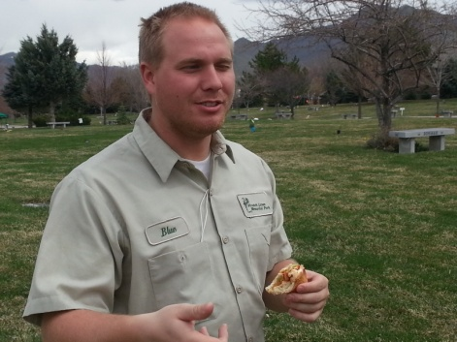
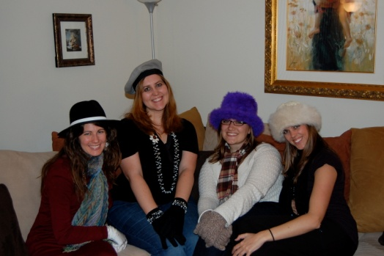
In making these life changing decisions, what could these people do in order to receive their own revelation?
1. A young man receives an offer for a good job, but it requires him to work on Sunday. He is trying to decide whether to accept the job.
2. A young woman has been thinking about the friends she is associating with and the negative influence they have on her. She wants to stop hanging out with them, but she does not know the most tactful way to withdraw from them.
3. A young woman is considering what she should do after she completes high school. She knows she wants to continue her education but is unsure of which educational institution she should attend.
Revelation can come through our feelings as we ask the Lord for guidance.

Slide 14
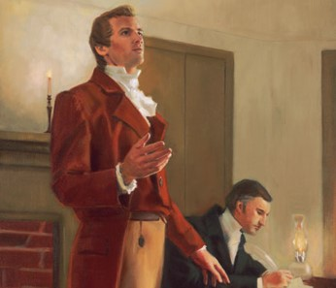
Encouragement
“I have given unto my servant Joseph sufficient strength,..”
Be patient with your calling
Be faithful and yield to temptation
Stand fast in the work
You will be “lifted up at the last day”
D&C 9:12-14

Slide 15
Sources:
Videos:
This Is the Spirit of Revelation(9:40)
Proceed with Trust (1:20)
This is the Spirit of Revelation (3:40)
Doctrine and Covenants Student Manual Religion 324-325 pg. 20
Presentation by ©http://fashionsbylynda.com/blog/
Joseph Fielding Smith (Church History and Modern Revelation [1953], 1:51).
Elder Jeffrey R. Holland (“Cast Not Away Therefore Your Confidence,” Ensign, Mar. 2000, 10).
(Ludlow, Companion, 1:94.) Student Manual Religion 324-324 pg. 21
Elder S. Dilworth Young (“The Still Small Voice,” Ensign, May 1976, p. 23.)
Hyrum M. Smith Doctrine and Covenants Commentary pg. 46
Elder Richard G. Scott (“Using the Supernal Gift of Prayer,” Ensign or Liahona, May 2007, 10).
Oliver Cowdery art by Ken Corbett
Presentation by ©http://fashionsbylynda.com/blog/

Slide 16
President Joseph Fielding Smith pointed out that “it seems probable that Oliver Cowdery desired to translate out of curiosity, and the Lord taught him his place by showing him that translating was not the easy thing he had thought it to be. In a subsequent revelation (Sec. 9), the explanation was made that Oliver’s failure came because he did not continue as he commenced, and the task being a difficult one, his faith deserted him. The lesson he learned was very necessary, for he was shown that his place was to act as scribe for Joseph Smith and that it was the latter who was called and appointed by command of the Lord to do the translating. There must have been some desire on the part of Oliver Cowdery to be equal with the Prophet and some impatience in having to sit and act as scribe, but when he failed to master the gift of translating, he was then willing to accept the will of the Lord.” (Church History and Modern Revelation, 1:50–51.)
President Joseph Fielding Smith indicated how both Oliver Cowdery and the general Church membership contributed to the failure of the Saints to have these records today: “It is possible that some of them might have been translated had the people received the Book of Mormon with full purpose of heart and had been faithful to its teachings. This was the promise the Lord made through Mormon. He said he would try the faith of the people and if they were willing to accept the lesser things (i.e., the Book of Mormon) then he would make known to them the greater things. That we have failed in this is very apparent, we have not accepted the revelations in the Book of Mormon, neither in the Doctrine and Covenants, with that faith and willingness to know the will of the Lord which would entitle us to receive this greater information. Oliver Cowdery was a party to this failure by turning away from the Church for a number of years when it needed his service. He therefore lost his privilege to translate through his own disobedience, and the people have lost the privilege of receiving the ‘greater things’ spoken of by the Lord to Mormon (III Nephi 26:8–11) until the day shall come when they are willing to be obedient in all things and will exercise faith such as was had by the brother of Jared. It should be remembered that such faith has rarely been seen on the earth. It appears, therefore, that we must wait until the reign of unrighteousness is at an end before the Lord will give to the people these writings, containing ‘a revelation from God, from the beginning of the world to the ending thereof.’ (II Nephi 27:7.)” (Church History and Modern Revelation, 1:52–53.)
Sealed Portion: When Moroni was finishing the Book of Mormon record, he was commanded to seal up some of the plates, and Joseph Smith was later commanded not to translate them. This sealed portion contains the complete record of the vision of the brother of Jared (see Ether 4:4–5). This vision included “all things from the foundation of the world unto the end thereof” (2 Nephi 27:10–11; see also Ether 3:25). So basically the Lord revealed to the brother of Jared the history of mankind, and the sealed portion of the plates was Moroni’s translated copy of it.
Few people have seen the sealed record—for instance, the Nephites in the land Bountiful at the Savior’s coming (see Ether 4:1–2) and Moroni (see Ether 12:24). The Lord said the sealed portion would be revealed to the world “in mine own due time” (Ether 3:27). He also said it would “not go forth unto the Gentiles until the day that they shall repent of their iniquity, and become clean before the Lord” (Ether 4:6; see also 2 Nephi 27:8). Oct. 2011 Ensign “What is the Sealed Portion of the Book of Mormon and Will We Ever What It Is?”
According to Joseph Smith’s associates who saw the golden plates, anywhere from half to two-thirds of all the plates were in the sealed portion (see Kirk B. Henrichsen, “What Did the Golden Plates Look Like?”New Era, July 2007, 31).
Burning in Bosom--Elder Dallin H. Oaks explained:
“I have met persons who told me they have never had a witness from the Holy Ghost because they have never felt their bosom ‘burn within’ them.
“What does a ‘burning in the bosom’ mean? Does it need to be a feeling of caloric heat, like the burning produced by combustion? If that is the meaning, I have never had a burning in the bosom. Surely, the word ‘burning’ in this scripture signifies a feeling of comfort and serenity. That is the witness many receive. That is the way revelation works.
“Truly, the still, small voice is just that, ‘still’ and ‘small’” (“Teaching and Learning by the Spirit,” Ensign, Mar. 1997, 13).

