Slide 1
Doctrine and Covenants 11
A Desire to Serve the Lord
“…blessed is my servant Hyrum Smith; for I, the Lord, love him because of the integrity of his heart, and because he loveth that whish is right before me, saith the Lord.”
D&C 124:15
Presentation by ©http://fashionsbylynda.com/blog/

Slide 2
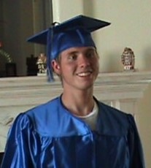
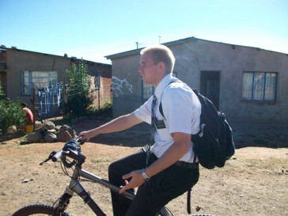
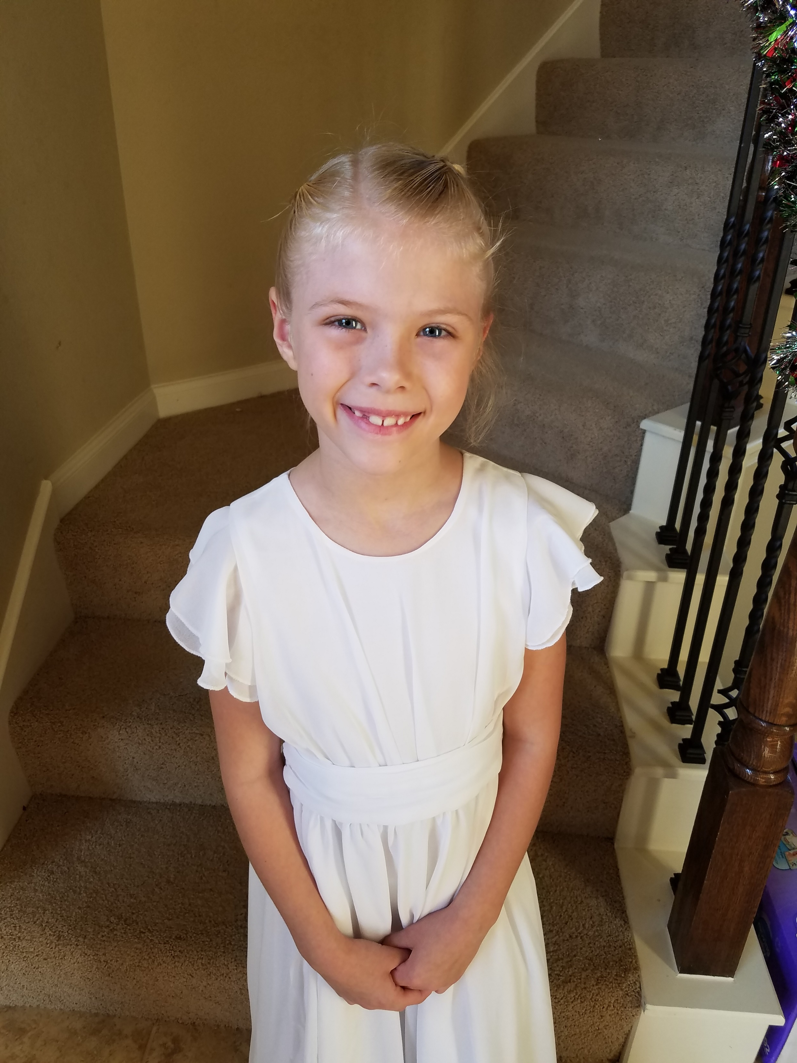
Whom We Choose to Follow
The things we seek after, and how we spend our time can greatly influence who we will eventually become.
As part of the Restoration, our loving Savior provided generous counsel on where the focus of our lives should be.

Slide 3
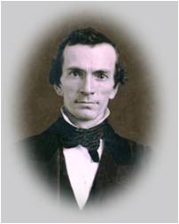
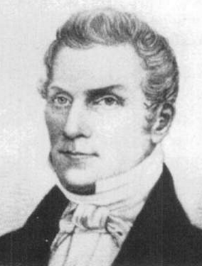
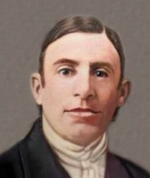
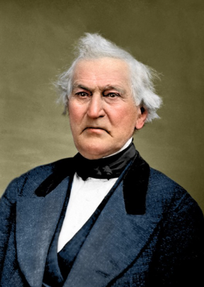
Repeated Truths
In 1829, many people—like Oliver Cowdery, Hyrum Smith, Joseph Knight Sr., and David Whitmer—wanted to learn what Jesus Christ would have them know and do.
Several of the Savior’s loving responses include repeated truths He wants us all to understand and live by.
D&C 6:1-16
D&C 11:1-6
D&C 12:1-6
D&C 14:1-6

Slide 4
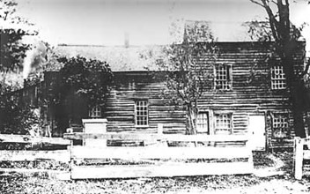
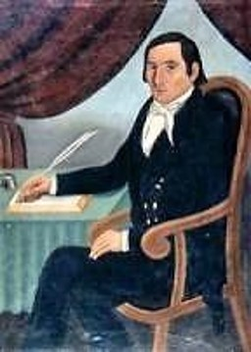
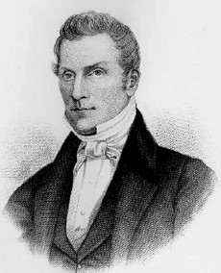
A Desire to Serve
May 1829
Joseph Knight and Hyrum Smith visited the Prophet Joseph Smith in Harmony, Pennsylvania.
Both men expressed their desire to serve God and assist in the Restoration of the gospel.

Slide 5
Hyrum Smith--Recap
He was born on February 9, 1800, at Tunbridge, Orange County, Vermont
He was the older brother of Joseph Smith Jr.
He married Jerusha Barden, in 1826
He was baptized by Joseph in June 1829
On April 6, 1830, he became one of the six original members of the church
He moved to Kirtland Ohio where he became an elder and later a high priest
He served an extended mission in 1831 to Ohio and Missouri
In 1836-37 he was given higher priesthood duties, serving on the high council and as Second Counselor in the First Presidency (D&C 112:17)
In November 1838 until April 1839, he was imprisoned along with Joseph and others in the Liberty Jail
He later settled in Nauvoo and was called a patriarch to the Church by a revelation on January 19, 1841 (D&C 124:91)
He, along with Joseph Smith Jr., were martyred on June 27, 1844, at Carthage, Hancock County, Illinois
His son, Joseph F. Smith received the revelation concerning the glorious ongoing work of salvation in the spirit realm. (D&C 138:53)
Who’s Who

Slide 6
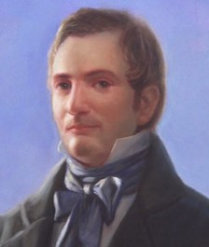
Lord’s Counsel to Hyrum
Hyrum Smith wanted to know how he could help Joseph in the Lord’s work. Joseph inquired of the Lord and received this revelation.
This counsel can be applied to all
Pray for guidance
Keep the Commandments
Establish Zion—spread the word of the gospel
Seek for wisdom, not riches
Call those to repentance
D&C 11:5-9

Slide 7
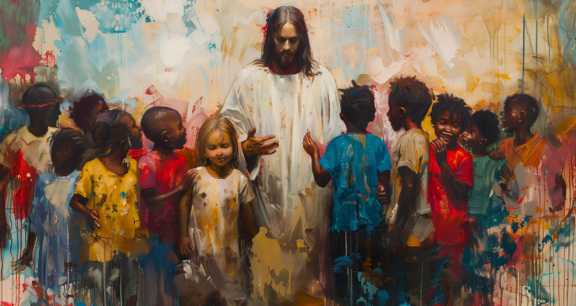
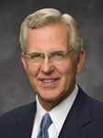
Seek Not For Riches
We are God’s children, set apart for immortality and eternal life. …
Jesus Christ desires to give us eternal life, which is the most valuable of all gifts.
In the end, it is the blessing of a close and abiding relationship with the Father and the Son that we seek.
It makes all the difference and is everlastingly worth the cost.
D. Todd Christofferson
D&C 11:7; 6:7

Slide 8
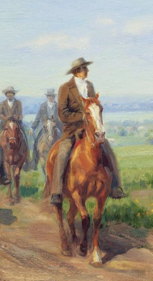
Revealing Chapter 11
In May 1829, Hyrum Smith’s great desire was to participate in the Restoration of the Savior’s Church.
He traveled over 250 miles from Palmyra, New York, to Harmony, Pennsylvania, to visit his younger brother Joseph and learn what he could do to help.
D&C 11:8

Slide 9
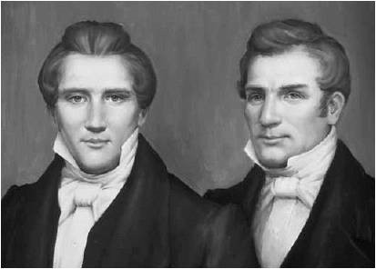
Joseph’s Words to Hyrum
“Brother Hyrum, what a faithful heart you have got! Oh, may the Eternal Jehovah crown eternal blessings upon your head, as a reward for the care you have had for my soul! O how many are the sorrows we have shared together and again we find ourselves shackled with the unrelenting band of oppression. Hyrum, thy name shall be written in the Book of the Law of the Lord.: for those who come after thee to look upon, that they may pattern after thy works.”
History of the Church

Slide 10
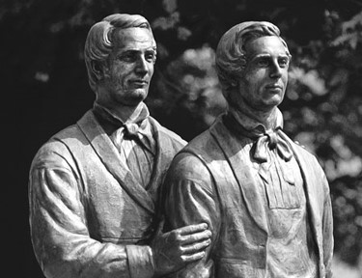
Hyrum’s Gift
“The Lord declared that Hyrum Smith had a gift. The great gift which he possessed was that of a tender, sympathetic heart; a merciful spirit.
The Lord on a later occasion said: ‘Blessed is my servant Hyrum Smith; for I, the Lord, love him because of the integrity of his heart, and because he loveth that which is right before me, saith the Lord.’ (D. & C., 124:15.)
This great gift was manifest in his jealous watch care over the Prophet lest some harm come to him.”
President Joseph Fielding Smith

Slide 11
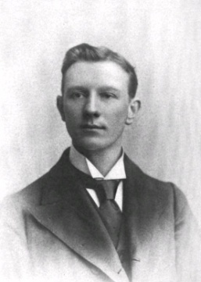
Hyrum’s Patriarchal Blessing
Given to him by his father Joseph Smith Sr. on December 18, 1833 in Kirtland, Ohio
“I now ask my heavenly Father in the name of Jesus Christ, to bless thee with the same blessing with which Jacob blessed his son Joseph, for thou art his true descendant, and thy posterity shall be numbered with house of Ephraim, and with them thou shalt stand up to crown the tribes of Israel, when they come shouting to Zion, …The Lord will multiply His choice blessings upon thee and thy seed after thee, and thou with them shalt have an inheritance in Zion, and they shall possess it from generation to generation, and thy name shall never be blotted out from among the just, for the righteous shall rise up, and also thy children after thee, and say thy memory is just, that thou wert a just man and perfect in thy day.”
Hyrum M. Smith

Slide 12
Desire, Desires, and Desireth
desireth to reap –Hyrum had a desire to engage in public speaking.
if you desire—You will do much good for this work
desire of me in faith—One must have faith in Christ to serve
shall you know, all things whatsoever you desire of me—The Holy Spirit will make it known to you
according to your desires—You will receive that which you desire in your heart
if you desire, you shall have my Spirit and my word—You will have the Holy Spirit to help in converting many unto the true gospel
All who have good desires, and have thrust in their sickle to reap.
D&C 11:3, 8, 10, 14, 17, 21

Slide 13
The Truth Is:
We can receive blessings from God according to our righteous desires.
If we desire to do God’s work, we will be the means of doing much good.

Slide 14
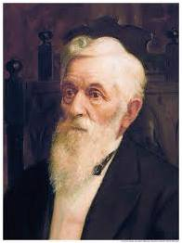
“My Spirit…Shall Enlighten Your Mind”
“There is a way by which persons can keep their consciences clear before God and man, and that is to preserve within them the spirit of God, which is the spirit of revelation to every man and woman. It will reveal to them, even in the simplest of matters, what they shall do, by making suggestions to them.
We should try to learn the nature of this spirit, that we may understand its suggestions, and then we will always be able to do right. This is the grand privilege of every Latter-day Saint. We know that it is our right to have the manifestations of the spirit every day of our lives. …
From the time we receive the Gospel, go down into the waters of baptism and have hands laid upon us afterwards for the gift of the Holy Ghost, we have a friend, if we do not drive it from us by doing wrong. That friend is the Holy Spirit, the Holy Ghost, which partakes of the things of God and shows them unto us.
This is a grand means that the Lord has provided for us, that we may know the light, and not be groveling continually in the dark.”
President Lorenzo Snow

Slide 15
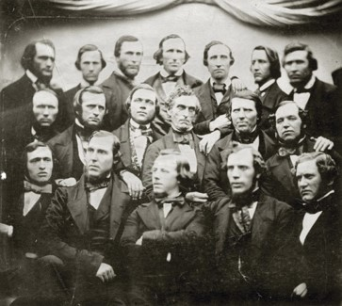
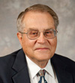
Preparing to Serve
“The Lord … teaches Hyrum Smith several steps to be followed in preparing for a mission:
Desire to serve the Lord
Live worthily to receive the Spirit of the Lord so it can ‘enlighten your mind, which shall fill your soul with joy.’
Keep the commandments of the Lord, assisting in the work of the Lord in any way that you might be asked
Seek to obtain the word of the Lord through (a) studying the word of the Lord that had already gone forth—the Bible—and (b) studying the word of the Lord that was then being translated—the Book of Mormon
Build upon the gospel, denying not either the spirit of revelation nor the spirit of prophecy
“The Lord indicates further that these suggestions are for ‘all who have good desires’ to serve.” (Ludlow, Companion, 1:108–9.)
D&C 11: 10, 13, 17-27

Slide 16
Hyrum Receives the Call
Hyrum eventually received the call to preach, exhort, and strengthen the Church
This indicates that his desires to assist in the Lord’s work were sincere and that he followed the Lord’s instructions to prepare himself.
Those who study the Lord’s word will receive His Spirit and the power to convince others of the truth of the gospel
“Behold, I speak unto you, Hyrum, a few words; for thou also art under no condemnation, and thy heart is opened, and thy tongue loosed; and thy calling is to exhortation, and to strengthen the church continually. Wherefore thy duty is unto the church forever, and this because of thy family. Amen.”
D&C 23:3

Slide 17
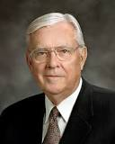
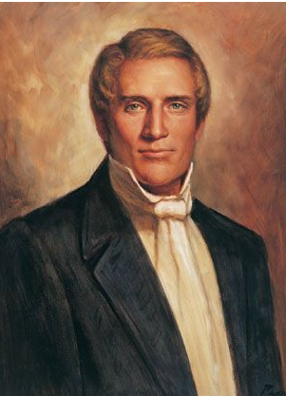
Unfailing Service
Hyrum gave unfailing service to the Church. In 1829 he was among a handful of individuals who were allowed to view the gold plates from which the Book of Mormon was translated, and for the rest of his life he testified to the divine nature of the Book of Mormon. …
Hyrum served in the Ohio bishopric, on the first high council, as Patriarch, counselor in the First Presidency, and finally as one of only two men ever to hold the office of Assistant President of the Church.
Hyrum served many missions for the Church. …
Clearly, Hyrum Smith was one of the firm pillars of the Restoration. But sadly, many Church members know little about him except that he was martyred with his brother in Carthage Jail.
M. Russell Ballard
He was among the first to be baptized in this gospel dispensation. At age thirty, he was the oldest of the six men chosen in 1830 to formally organize The Church of Jesus Christ of Latter-day Saints. …

Slide 18
Sources:
Video: “The Soul’s Sincere Desire”
Who’s Who in the Doctrine and Covenants by Ed J. Pinegar and Richard J. Allen pgs. 84-85, 135-137 and Ensign Oct 1978
History of the Church Vol. V pp. 107-8
President Joseph Fielding Smith (Church History and Modern Revelation, 1:57.)
Journal of Discourses, Vol. XI p. 8 D.H.C. 1:354
Presentation by ©http://fashionsbylynda.com/blog/
President Lorenzo Snow (In Conference Report, Apr. 1899, p. 52.)
(Ludlow, Companion, 1:108–9.) Doctrine and Covenants Student Manual Religion 324-325 pg. 25
Doctrine and Covenants Commentary Hyrum M. Smith pgs. 23, 67
D. Todd Christofferson, “Our Relationship with God,” Liahona, May 2022, 79–80)
(History of the Church, 5:124–25.) M. Russell Ballard, “Hyrum Smith: ‘Firm as the Pillars of Heaven,’” Ensign, Nov. 1995, 7
Presentation by ©http://fashionsbylynda.com/blog/

