Slide 1
Doctrine and Covenants 12
Joseph Smith 1:66-75
Doctrine and Covenants 13
“And it shall be upon Aaron to minister; and his sound shall be heard when he goeth in unto the holy place before the LORD, and when he cometh out, that he die not.”
Exodus 28:25
Presentation by ©http://fashionsbylynda.com/blog/

Slide 2
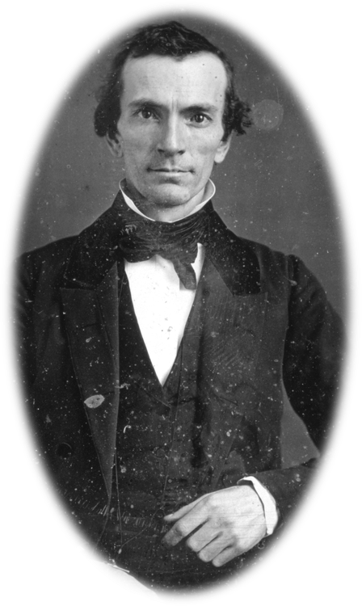
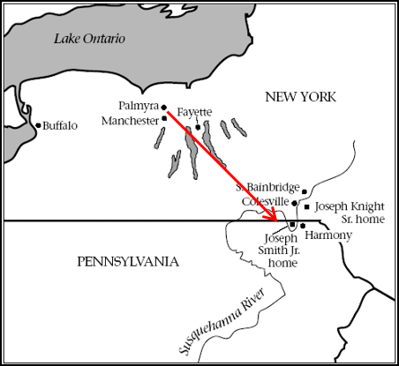
Previously…Word of Mouth
Oliver Cowdery had been teaching in a neighborhood of Manchester, New York and boarded in the home of the Smith family.
While there he heard of the wonderful story of the Book of Mormon and was impressed to go to Harmony, Pennsylvania to learn more about the Book. About 140 miles away
Oliver was also an intimate friend of the Whitmers. He later wrote his testimony of the truthfulness to David Whitmer.
Joseph Smith History 1:66

Slide 3
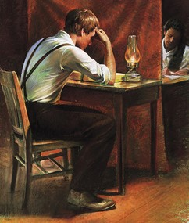
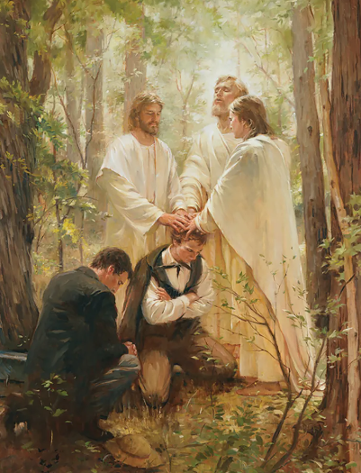
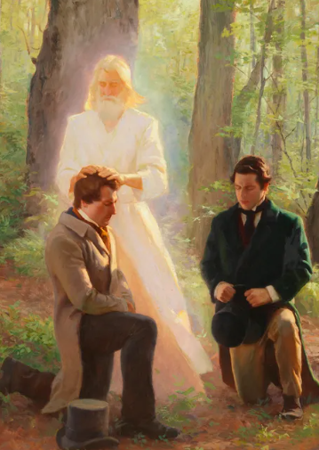
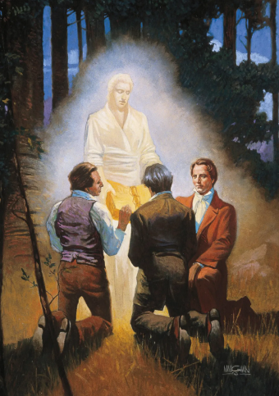
Overview
While translating the Book of Mormon, Joseph Smith and Oliver Cowdery had a question about baptism for the remission of sins.
They inquired of the Lord. In response to their question, John the Baptist appeared and restored the Aaronic Priesthood.
The restoration of the priesthood continued weeks later when Peter, James, and John restored the Melchizedek Priesthood. As the Book of Mormon translation came to an end, three individuals were selected to see the gold plates.
Oliver Cowdery, David Whitmer, and Martin Harris saw the angel Moroni and gold plates in a vision.
They also heard the voice of the Lord declaring the Book of Mormon is true.
Manual
Joseph Smith History 1:68-75

Slide 4
Joseph Knight Sr.
He was born November 3, 1772, at Oakham, Worcester County, Massachusetts
He operated a farm and gristmill at Colesville, New York and hired Joseph Smith to work for him
He married Polly Peck and had 7 children
He learned from Joseph Smith about the Restoration of the gospel and allowed Joseph to use his horse and carriage to transport the plates when they were turned over to him by Moroni
Section 12 in the Doctrine and Covenants is a revelation given to Joseph Smith counseling him
He gave encouragement and financial support to the prophet, Joseph Smith
His second son, Newel, was baptized in May 1830 and later Joseph Knight was baptized on June 28, 1830, by Oliver Cowdery in Colesville, New York
He and his family moved to Ohio and then to Jackson County, Missouri, then finally relocating to Nauvoo in 1839
He became ill and died on February 2, 1847, at Mount Pisgah, Harrison County, Iowa
He remained strong and faithful in the gospel
Who’s Who

Slide 5
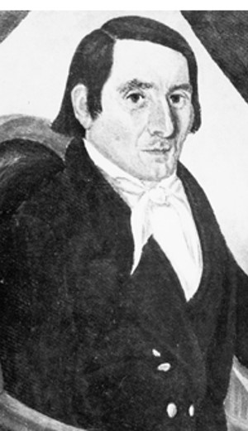
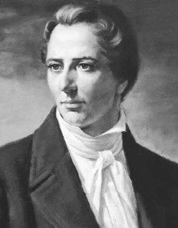
Joseph’s Words of Joseph Knight Sr.
22 August 1842
“For fifteen years he has been faithful and true, and even-handed and exemplary, and virtuous and kind, never deviating to the right hand or to the left. Behold he is a righteous man … and it shall be said of him, by the sons of Zion, while there is one of them remaining, that this man was a faithful man in Israel; therefore his name shall never be forgotten.”
History of the Church

Slide 6
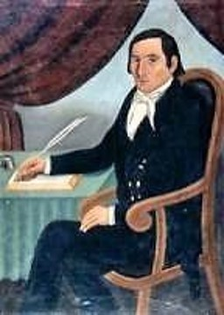
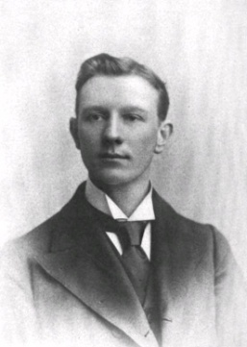
The Call for Joseph Knight Sr.
“And no one can assist in this work except he shall be humble and full of love, having faith, hope, and charity, being temperate in all things, whatsoever shall be entrusted to his care.”
“Joseph Knight Sr. had shown a generous willingness to sacrifice both his means and his time, and his assistance was gratefully accepted. But he needed instruction. The Lord, therefore, told him that those who would assist in the furtherance of His work must be humble, full of love, faith, hope, and charity, and be temperate in all things—in eating and drinking, and all the enjoyments of life. All temporal blessings are to be
enjoyed in moderation, for
indulgence may become a
hindrance to effectual work
in the service of God.”
Hyrum M. Smith
D&C 12:8

Slide 7
I Am The Light
“Behold, I am the light and the life of the world, that speak these words, therefore give heed with your might, and then you are called. Amen.”
“It is our Lord who is speaking. He calls Himself the Light and the Life of the World.”
Hyrum M. Smith
“In him was life; and the life was the light of men.”
John 1:4
“Jesus saith unto him, I am the way, the truth, and the life: no man cometh unto the Father, but by me.”
John 14:6
D&C 12:9

Slide 8
Review… Universal Apostasy
Following the death of the Savior and His Apostles, over the centuries, man was no longer authorized to act for God.
Prophecy :
“The earth also is defiled under the inhabitants thereof; because they have transgressed the laws, changed the ordinance, broken the everlasting covenant” (Isaiah 24:5).

Slide 9
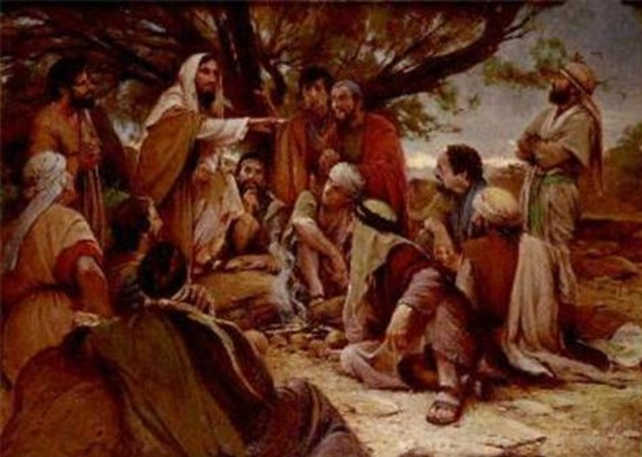
As Promised by the Savior
“And Jesus answered and said unto them, Elias truly shall first come, and restore all things.
But I say unto you, That Elias is come already, and they knew him not, but have done unto him whatsoever they listed. Likewise shall also the Son of man suffer of them.
Then the disciples understood that he spake unto them of John the Baptist.”
Matthew 17:11-13

Slide 10
Prequiz
1. Where in the scriptures can we learn about the restoration of the Aaronic Priesthood?
2. On what date was the Aaronic Priesthood restored?
3. What was the name of the angel who restored the Aaronic Priesthood to the earth by conferring it upon Joseph Smith and Oliver Cowdery?
4. How was the Aaronic Priesthood conferred upon them?
5. What else did the angel promise Joseph and Oliver they would receive? From whom would they receive it?
a. May 15, 1829
b. By the Laying of Hands
c. Joseph Smith History or Doctrine and Covenants 13
d. John the Baptist
e. John the Baptist told them they would later receive the Melchizedek priesthood from the Apostles Peter, James, and John.

Slide 11
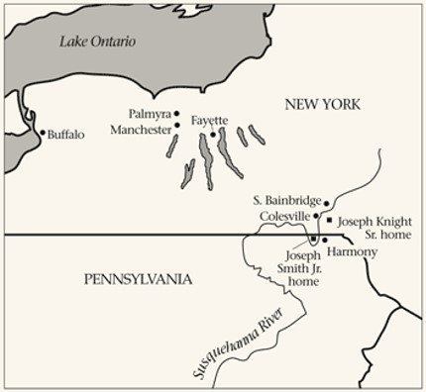
Into the Woods
May 15, 1829
“Upon you my fellow servants, in the name of Messiah, I confer the Priesthood of Aaron, which holds the keys of the ministering of angels, and of the gospel of repentance, and of baptism by immersion for the remission of sins; and this shall never be taken again from the earth until the sons of Levi do offer again an offering unto the Lord in righteousness.”
Joseph Smith History 1:69

Slide 12
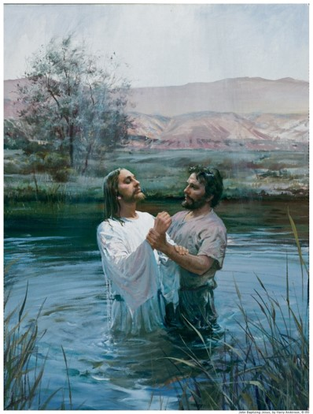
Aaron Priesthood— the Lesser Priesthood
See D&C 107:13-14 and D&C 84:26-27
John, the Baptist held these key in the dispensation for the Meridian of Time, and because of this authority he was sent in the dispensation of the Fulness of Times to confer these keys in the day of restoration of all things.
This Priesthood…holds the keys of the preparatory Gospel, which is the Gospel of faith, repentance, and the remission of sins by baptism by immersion, but does not hold the authority of laying on of hands for the gift of the Holy Ghost.
Joseph Smith History 1:70—Hyrum M. Smith

Slide 13
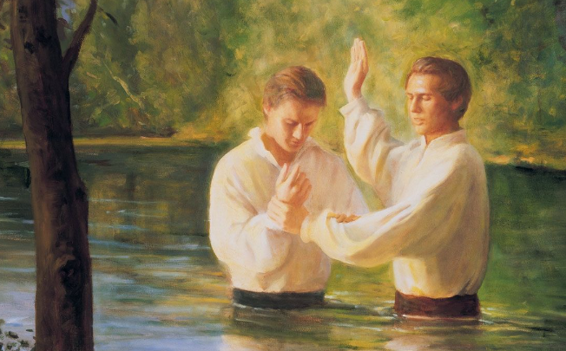
Preforming Baptisms
Once Joseph and Oliver had the keys of authority from John the Baptist (Aaronic Priesthood authority), they were authorized by heaven to perform Aaronic priesthood ordinances.
Joseph and Oliver had the authority to baptize, so the direction from heaven was that they baptize each other.

Slide 14
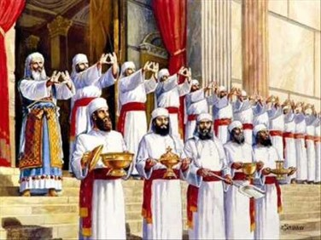
Levitical Duties of the Aaronic Priesthood
Confers authority to receive the ministration of angels
To preach the gospel of repentance
To baptize for the remission of sins
To administer “The law of carnal commandment
This Priesthood attended to the Tabernacle and the Temple service including sacrifices
They took care of everything belonging to the Sanctuary
They kept the fire upon the altar burning continually
They dressed the burnt offerings and killed the Pascal lamb
They received the blood of the sacrifices in basins and sprinkled it round the altar
They disposed of the meat offerings and other offerings
They performed the ceremonies of purification and judged cases of leprosy
Joseph Smith History 1:70—Hyrum M. Smith

Slide 15
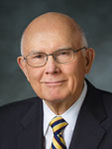
What does it mean that the Aaronic Priesthood holds [the key of] the ‘gospel of repentance and of baptism, and the remission of sins’?
The meaning is found in the ordinance of baptism and in the sacrament. Baptism is for the remission of sins, and the sacrament is a renewal of the covenants and blessings of baptism. Both should be preceded by repentance. …
“Not one of [us] has lived without sin since [our] baptism. Without some provision for further cleansing after our baptism, each of us is lost to things spiritual. …
“We are commanded to repent of our sins and to come to the Lord with a broken heart and a contrite spirit and partake of the sacrament in compliance with its covenants. When we renew our baptismal covenants in this way, the Lord renews the cleansing effect of our baptism. …
“We cannot overstate the importance of the Aaronic Priesthood in this. All of these vital steps pertaining to the remission of sins are performed through the saving ordinance of baptism and the renewing ordinance of the sacrament.
Both of these ordinances are officiated by holders of the Aaronic Priesthood under the direction of the bishopric, who exercise the keys of the gospel of repentance and of baptism and the remission of sins”
Elder Dallin H. Oaks

Slide 16
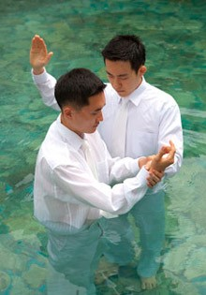
Angelic Messages
“As a young holder of the Aaronic Priesthood, I did not think I would see an angel, and I wondered what such appearances had to do with the Aaronic Priesthood.
“But the ministering of angels can also be unseen. Angelic messages can be delivered by a voice or merely by thoughts or feelings communicated to the mind”
Elder Dallin H. Oaks

Slide 17
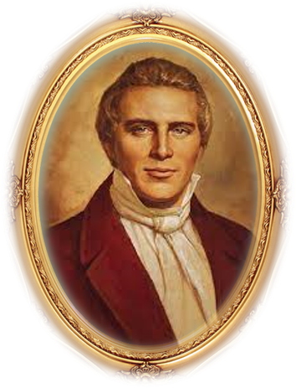
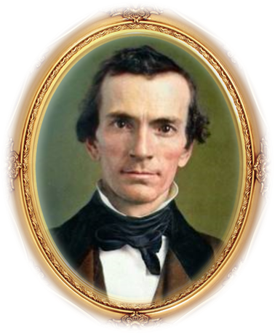
Promises
Since Joseph and Oliver had not yet received the gift of the Holy Ghost, what they experienced on this occasion was the power of the Holy Ghost.
Joseph and Oliver would receive the Melchizedek Priesthood for conferring the gift of the Holy Ghost at a later date.
The power of the Holy Ghost can come upon a person before baptism and witness that the gospel is true. But the right to have the constant companionship of the Holy Ghost, whenever one is worthy, is a gift that can be received only by the laying on of hands by a Melchizedek Priesthood holder after authorized baptism into the true Church of Jesus Christ.
Guide to the Scriptures
Joseph Smith History 1:73-75

Slide 18
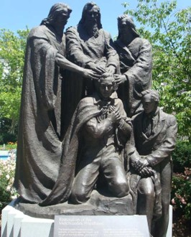
Peter, James, and John
John acted by the authority of Peter, James and John who held the key of the Melchizedek Priesthood
Somewhere between May 15 and June of 1892
Peter, James, and John (the Beloved) held the keys of the Priesthood of Melchizedek
These Priesthood keys of the higher ordinances, including the laying on of hands for the gift of the Holy Ghost
“…The voice of Peter, James, and John in the wilderness between Harmony, Susquehanna county, and Colesville, Broome county, on the Susquehanna river, declaring themselves as possessing the keys of the kingdom, and of the dispensation of the fulness of times!”
D&C 128:20
Joseph Smith History 1:72—Hyrum M. Smith

Slide 19
Doctrinal Mastery
“Upon you my fellow servants, in the name of Messiah I confer the Priesthood of Aaron, which holds the keys of the ministering of angels, and of the gospel of repentance, and of baptism by immersion for the remission of sins; and this shall never be taken again from the earth, until the sons of Levi do offer again an offering unto the Lord in righteousness.”
D&C 13:1

Slide 20
Sources:
Videos:
Spiritual Treasures” (18:07; watch from time code 3:00 to 3:51)
Days of Harmony (25:00)
Special Witness—Elder Bednar(3:46)
Keys of the Aaronic Priesthood(1:46)
Angelic Messages (0:53)
Restoration of the Aaronic Priesthood (1:02)
Hyrum M. Smith Doctrine and Covenants Commentary pg. 68-69
Elder Dallin H. Oaks (“The Aaronic Priesthood and the Sacrament,” Ensign, Nov. 1998, 37–38).
Doctrine and Covenants Commentary Hyrum M. Smith pgs. 23, 67
(History of the Church, 5:124–25.)
Presentation by ©http://fashionsbylynda.com/blog/
https://www.lds.org/ensign/1978/10/the-joseph-knight-family?lang=eng
Seminary Teacher Manual 2025
Presentation by ©http://fashionsbylynda.com/blog/

Slide 21
Before Joseph Knight Sr.’s Baptism:
In December 1827, however, Joseph and Emma relocated to Harmony. As the work of translation progressed, Joseph Knight occasionally visited them and gave them supplies. In late March 1830, Knight took Smith to Manchester and witnessed the organization of the church (IV.A. I. JOSEPH KNIGHT, SR., REMINISCENCE, CIRCA 1835-1847, 6-7). Knight’s son Newel was the first in the family to receive baptism during a visit to Fayette in May 1830. Other family members, including Joseph Knight, Sr., were baptized at a special meeting held in Colesville on 28 June (I.A. 15, JOSEPH SMITH HISTORY, 1839, 43; IV.A.3, NEWEL KNIGHT AUTOBIOGRAPHY, CIRCA 1846, 55). The Knight family, together with brother-in-law Hezekiah Peck’s family, formed the nucleus of a small branch of the church in Colesville. Regarding this event, Richard L. Bushman has noted: “Altogether twenty-eight people came into the church through the Knight-Peck connection in the first few months. … The Knights and the other families [in Colesville] accounted for sixty baptisms in the first nine months” (Bushman 1984, 151).
Resistance to the emergence of Mormonism in the Colesville area was headed by the Presbyterians. On the day before the June 1830 baptismal meeting, the Reverend John Sherer attempted to abduct young Emily Colburn in order to prevent her baptism but was intercepted by her sister Sally (Colburn) Knight, wife of Newell Knight, and others. The following morning, Emily’s brother-in-law arrived with a power of attorney ordering her immediate return to Sandford, Broome County, New York (IV.D.7, EMILY [COLBURN] AUSTIN AUTOBIOGRAPHY, 1882, 38-48; I.A.I 5, JOSEPH SMITH HISTORY, 1839,42-43; IV.C. I.JOHN SHERER TO ABSALOM PETERS, 18 NOV 1830). Presbyterians Abram W. Benton, Nathan Boynton, and Cyrus McMaster were responsible for Joseph Smith’s further legal difficulties in Colesville. On 30 June 1830, Smith was arrested there for being a “disorderly person” and taken before Justice Joseph Chamberlin of South Bainbridge the following day (I.A. 15, JOSEPH SMITH HISTORY, 1839, 44-45; IV.F.5, EBENEZER HATCH BILL OF COSTS, 4 JUL 1830; IV.F.4, JOSEPH CHAMBERLIN BILL OF COSTS, 1 JUL 1830; I.B.5, LUCY SMITH HISTORY, 1845, MS:114, 1853:157; IV.A.l, JOSEPH KNIGHT, SR., REMINISCENCE, CIRCA 1835-1847, 8; IV.A.5, JOSEPH KNIGHT, JR., HISTORY, 1862, 215; IV.A.3, NEWEL KNIGHT AUTOBIOGRAPHY, CIRCA 1846, 55-56; IV.B.2, MARTHA CAMPBELL TO JOSEPH SMITH, 19 DEC 1843; IV.C.2, ABRAM W. BENTON REMINISCENCE, MAR 1831). Smith was acquitted but was immediately served with another warrant for trial in Colesville. The following day, 2 July, Smith appeared before Justice Joel K. Noble on the same charge but was eventually acquitted (I.A.15, JOSEPH SMITH HISTORY, 1839, 44-45; I.B.5, LUCY SMITH HISTORY, 1845, MS: Frag. 6, 1853:157; IV.A.3, NEWEL KNIGHT AUTOBIOGRAPHY, CIRCA 1846, 55-56; IV.C.6, JOHN S. REED REMINISCENCE, 1844; IV.D.l, JOHN S. REED TO BRIGHAM YOUNG, 6 DEC 1861; IV.F.5, EBENEZER HATCH BILL OF COSTS, 4 JUL 1830). Legally frustrated, Smith’s enemies came to mob him, but he escaped and fled back to Harmony.
http://signaturebooks.com/2010/12/excerpt-early-mormon-documents-vol-4/
Minister, the Desire of Hyrum Smith:
“It was necessary to correct certain prevalent errors concerning preaching, for the benefit of the little circle of friends who, under divine guidance, now were laying the foundations of the Church.
One of these errors was the assumption that a minister can prove that he has divine authority, by quoting the commission of our Lord to His first Apostles. The Lord therefore instructs His servant not to suppose that he is sent to preach until he is actually called, as were the Twelve. On the other hand, one who is so called must not refuse to obey. This was illustrated in the case of Leman Copley, who was tried before the High Council in Kirtland in 1833, for having neglected to go on a mission when called.”
Journal of Discourses Vol. XI p. 8 D.H.C. 1:354

Slide 22
What does it mean that the Aaronic Priesthood holds “the key of the ministering of angels” and of the “gospel of repentance and of baptism, and the remission of sins”? The meaning is found in the ordinance of baptism and in the sacrament. Baptism is for the remission of sins, and the sacrament is a renewal of the covenants and blessings of baptism. Both should be preceded by repentance. When we keep the covenants made in these ordinances, we are promised that we will always have His Spirit to be with us. The ministering of angels is one of the manifestations of that Spirit. (Dallin H. Oaks, “The Aaronic Priesthood and the Sacrament,” Ensign, Nov. 1998, 37–38)
Sons of Levi’s Offering:
It is generally supposed that sacrifice was entirely done away when the Great Sacrifice [i.e.,] the sacrifice of the Lord Jesus was offered up, and that there will be no necessity for the ordinance of sacrifice in the future; but those who assert this are certainly not acquainted with the duties, privileges and authority of the Priesthood, or with the Prophets.
“The offering of sacrifice has ever been connected and forms a part of the duties of the Priesthood. It began with the Priesthood, and will be continued until after the coming of Christ, from generation to generation. …
“These sacrifices, as well as every ordinance belonging to the Priesthood, will, when the Temple of the Lord shall be built, and the sons of Levi be purified, be fully restored and attended to in all their powers, ramifications, and blessings. This ever did and ever will exist when the powers of the Melchizedek Priesthood are sufficiently manifest; else how can the restitution of all things spoken of by the Holy Prophets be brought to pass. It is not to be understood that the law of Moses will be established again with all its rites and variety of ceremonies; this has never been spoken of by the prophets; but those things which existed prior to Moses’ day, namely, sacrifice, will be continued.” (Teachings, pp. 172–73.)
President Joseph Fielding Smith further explained that “we are living in the dispensation of the fulness of times into which all things are to be gathered, and all things are to be restored since the beginning. Even this earth is to be restored to the condition which prevailed before Adam’s transgression. Now in the nature of things, the law of sacrifice will have to be restored, or all things which were decreed by the Lord would not be restored. It will be necessary, therefore, for the sons of Levi, who offered the blood sacrifices anciently in Israel, to offer such a sacrifice again to round out and complete this ordinance in this dispensation. Sacrifice by the shedding of blood was instituted in the days of Adam and of necessity will have to be restored.
Sacrifice: “The sacrifice of animals will be done to complete the restoration when the temple spoken of is built; at the beginning of the millennium, or in the restoration, blood sacrifices will be performed long enough to complete the fulness of the restoration in this dispensation. Afterwards sacrifice will be of some other character.” (Doctrines of Salvation, 3:94.)
D&C 13:1 Ministering of angels:
“I had the administration of angels while holding the office of a priest. I had visions and revelations. I traveled thousands of miles. I baptized men, though I could not confirm them because I had not the authority to do it.
“I speak of these things to show that a man should not be ashamed of any portion of the priesthood.” President Wilford Woodruff (Discourses of Wilford Woodruff, p. 298.)
“This Shall Never Be Taken Again from the Earth”
“We may be sure that the Aaronic Priesthood will never be taken from the earth while mortality endures, for there will always be need for temporal direction and the performance of ordinances pertaining to ‘the preparatory Gospel.’” (Smith, Church History and Modern Revelation, 1:62.)
Who Are the “Sons of Levi”?
President Joseph Fielding Smith explained that “after the children of Israel came out of Egypt and while they were sojourning in the wilderness, Moses received a commandment from the Lord to take Aaron and his sons and ordain them and consecrate them as priests for the people. (Ex. 28.) At that time the males of the entire tribe of Levi were chosen to be the priests instead of the firstborn of all the tribes, and Aaron and his sons were given the presidency over the Priesthood thus conferred. Since that time it has been known as the Priesthood of Aaron, including the Levitical Priesthood.” (Church History and Modern Revelation, 1:63.)
For Further Study of the Priesthood: The Restoration of the Aaronic and Melchizedek Priesthoods
BY LARRY C. PORTER Ensign 1996 Dec.

Slide 23
Keys
Elder Bruce R. McConkie explained that the revelations of God refer to keys in two ways:
“Two different usages of the term keys are found in the revelations. One has reference to the directive powers whereby the Church or kingdom and all its organizations are governed, the keys of the kingdom being the powers of presidency. The other usage refers to the means provided whereby something is revealed, discovered, or made manifest” (Mormon Doctrine, 2nd ed. [1966], 409–10).
The ministering of angels
President Gordon B. Hinckley explained the ministering of angels this way:
“When Wilford Woodruff, a man who had lived many years and had many experiences, was the President of the Church, he said to the boys of the Aaronic Priesthood: ‘I desire to impress upon you the fact that it does not make any difference whether a man is a Priest or an Apostle, if he magnifies his calling. A Priest holds the keys of the ministering of angels,’ said he. ‘Never in my life, as an Apostle, as a Seventy, or as an Elder, have I ever had more of the protection of the Lord than while holding the office of a Priest.’ (Millennial Star,53:629.)
“Think of it, my dear young brethren. This priesthood which you hold carries with it the keys of the ministering of angels. That means, as I interpret it, that if you live worthy of the priesthood, you have the right to receive and enjoy the very power of heavenly beings to guide you, to protect you, to bless you. What boy, if he is thoughtful, would not welcome this remarkable blessing?” (“The Priesthood of Aaron,” Ensign, Nov. 1982, 45).
Elder Dallin H. Oaks of the Quorum of the Twelve Apostles offered the following insight into the key of the ministering of angels:
“In a closely related way, these ordinances of the Aaronic Priesthood are also vital to the ministering of angels.
“‘The word “angel” is used in the scriptures for any heavenly being bearing God’s message’ (George Q. Cannon, Gospel Truth, sel. Jerreld L. Newquist [1987], 54). The scriptures recite numerous instances where an angel appeared personally. …
“But the ministering of angels can also be unseen. Angelic messages can be delivered by a voice or merely by thoughts or feelings communicated to the mind. …
“… Most angelic communications are felt or heard rather than seen.
“How does the Aaronic Priesthood hold the key to the ministering of angels? The answer is the same as for the Spirit of the Lord.
“In general, the blessings of spiritual companionship and communication are only available to those who are clean. As explained earlier, through the Aaronic Priesthood ordinances of baptism and the sacrament, we are cleansed of our sins and promised that if we keep our covenants we will always have His Spirit to be with us. I believe that promise not only refers to the Holy Ghost but also to the ministering of angels, for ‘angels speak by the power of the Holy Ghost; wherefore, they speak the words of Christ’ (2 Nephi 32:3). So it is that those who hold the Aaronic Priesthood open the door for all Church members who worthily partake of the sacrament to enjoy the companionship of the Spirit of the Lord and the ministering of angels. …
“The Aaronic Priesthood holds the keys of the ‘gospel of repentance and of baptism, and the remission of sins’ (D&C 84:27). The cleansing power of our Savior’s Atonement is renewed for us as we partake of the sacrament. The promise that we ‘may always have his Spirit to be with [us]’ (D&C 20:77) is essential to our spirituality. The ordinances of the Aaronic Priesthood are vital to all of this” (“The Aaronic Priesthood and the Sacrament,” Ensign, Nov. 1998, 38–40).

