Slide 1
Doctrine and Covenants 14-16
The Whitmer’s
“And ye shall be hated of all men for my name’s sake: but he that endureth to the end shall be saved.” Matthew 10:22
Presentation by ©http://fashionsbylynda.com/blog/

Slide 2
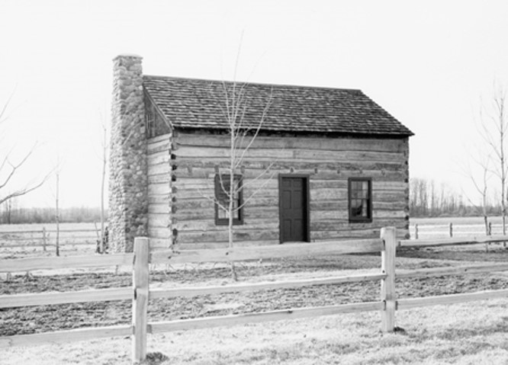
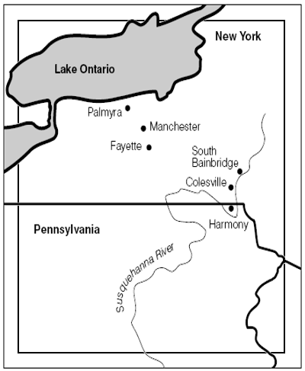
Zealous Friends and Neighbors
Late May 1829
The threats caused Joseph Smith and Oliver Cowdery to move from Harmony, Pennsylvania, to Fayette, New York
David Whitmer helped them move to his home
The Whitmer family took great interest in the unfolding events of the Restoration.
They were “anxious to know their respective duties”
Their roles were received in a revelation to Joseph Smith in D&C 14-16
History of the Church 1:48-49

Slide 3
David Whitmer
He was born on January 7, 1805, near Harrisburg, Pennsylvania
He was the son of Peter Whitmer Sr. and brought up as a Presbyterian
He learned in 1828 of the mission of Joseph Smith
He became one of the three witnesses of the Book of Mormon
He was one of the original 6 members of the Church when it was organized on April 6, 1830 and ordain an elder that day
While the translation of the Book of Mormon went on in the Whitmer home he and his brothers, John and Peter, were anxious to know the will of God concerning them
He was president of the Clay County high council in 1834, and President of the Church in Missouri
He fell prey to pride and apostasy and on April 13, 1838 he was excommunicated and moved to Richmond, Missouri where he set up a business and community service. He was known as honest and was respected
He died January 25, 1888 and consistently confirmed his witness of the Book of Mormon
Who’s Who and Hyrum M. Smith

Slide 4
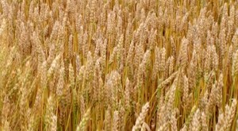
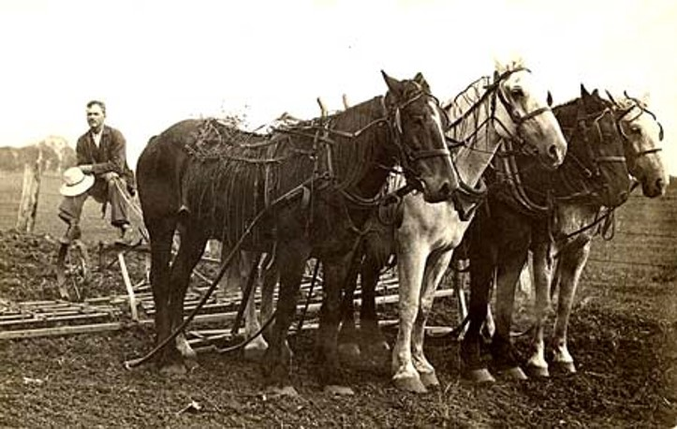
2 Days of Heavy Work
“David Whitmer needed to plant wheat seed on the family farm and spread plaster of paris, which was used as a fertilizer. He felt inspired that he should help Joseph and Oliver after he had completed those tasks.
“David went to the field, and found that he had two heavy days’ work before him. … He then fastened his horses to the harrow, and instead of dividing the field into what is, by farmers, usually termed lands, drove around the whole of it, continuing thus till noon, when, on stopping for dinner, he looked around, and discovered to his surprise, that he had harrowed in full half the wheat. After dinner he went on as before, and by evening he finished the whole two days’ work.

Slide 5
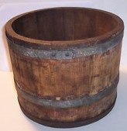
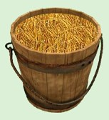
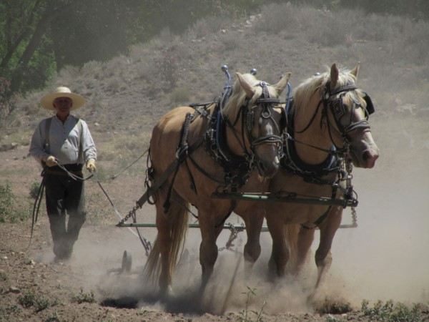
The Sowing Is Done
“His father, on going into the field the same evening, saw what had been done, and he exclaimed, ‘There must be an overruling hand in this, and I think you would better go down to Pennsylvania as soon as your plaster of paris is sown.’
“The next morning, David took a wooden measure under his arm and went out to sow the plaster, which he had left, two days previous, in heaps near his sister’s house, but, on coming to the place, he discovered that it was gone! He then ran to his sister, and inquired of her if she knew what had become of it. Being surprised she said, ‘Why do you ask me? was it not all sown yesterday?’

Slide 6
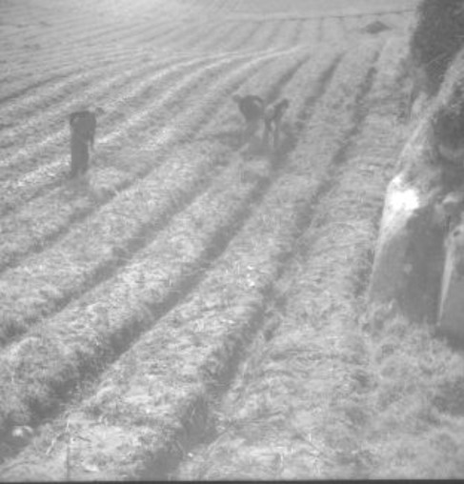
Three Men
“‘Not to my knowledge,’ answered David.
“‘I am astonished at that,’ replied his sister, ‘for the children came to me in the forenoon, and begged of me to go out and see the men sow plaster in the field, saying, that they never saw anybody sow plaster so fast in their lives.
I accordingly went, and saw three men at work in the field, as the children said, but, supposing that you had hired some help, on account of your hurry, I went immediately into the house, and gave the subject no further attention.’
“David made considerable inquiry in regard to the matter, both among his relatives and neighbors, but was not able to learn who had done it”
Lucy Mack Smith, History of Joseph Smith by His Mother,

Slide 7
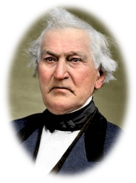
Promises and Blessings to David Whitmer
In order for David Whitmer or any of God’s children to have eternal life they must endure to the end, that is, remain faithful throughout their mortal probation.
If we keep God’s commandments and endure to the end, we will receive eternal life
“But he that shall endure unto the end, the same shall be saved.”
Matthew 24:13
“Beareth all things, believeth all things, hopeth all things, endureth all things.”
1 Corinthians 13:7
D&C 14:7

Slide 8
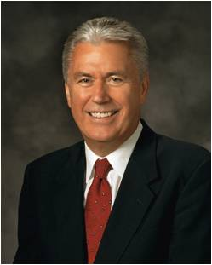
Enduring to the end, or remaining faithful to the laws and ordinances of the gospel of Jesus Christ throughout our life, is a fundamental requirement for salvation in the kingdom of God. …
… Enduring to the end is not just a matter of passively tolerating life’s difficult circumstances or “hanging in there.”
Ours is an active religion, helping God’s children along the strait and narrow path to develop their full potential during this life and return to Him one day.
Dieter F. Uchtdorf

Slide 9
Why do you think keeping the commandments and enduring to the end are required to obtain eternal life?
How is Jesus Christ an example of keeping the commandments and faithfully enduring to the end?
How can this knowledge help us keep an eternal perspective when dealing with life’s challenges?

Slide 10
What Blessings Can We Receive?
Stand as a Witness:
The Lord counseled David Whitmer to ask in faith and to be believing so that he would receive the Holy Ghost and also that he might see, hear, and know the truthfulness of the Book of Mormon.
Student Manual
If we faithfully assist the Lord in His work, the Lord will bless us spiritually and temporally.
In what ways has the Lord asked you to assist in His work?
What blessings have come into your life as you have assisted in the Lord’s work?
D&C 14:8

Slide 11
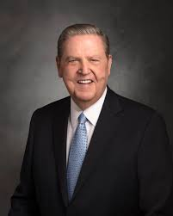
If we give our heart to God, if we love the Lord Jesus Christ, if we do the best we can to live the gospel, then tomorrow—and every other day—is ultimately going to be magnificent, even if we don’t always recognize it as such.
Why? Because our Heavenly Father wants it to be! He wants to bless us.
A rewarding, abundant, and eternal life is the very object of His merciful plan for His children!
It is a plan predicated on the truth “that all things work together for good to them that love God”,
So, keep loving. Keep trying. Keep trusting. Keep believing. Keep growing. Heaven is cheering you on today, tomorrow, and forever.
Jeffrey R. Holland
Romans 8:28; D&C 14:8-11

Slide 12
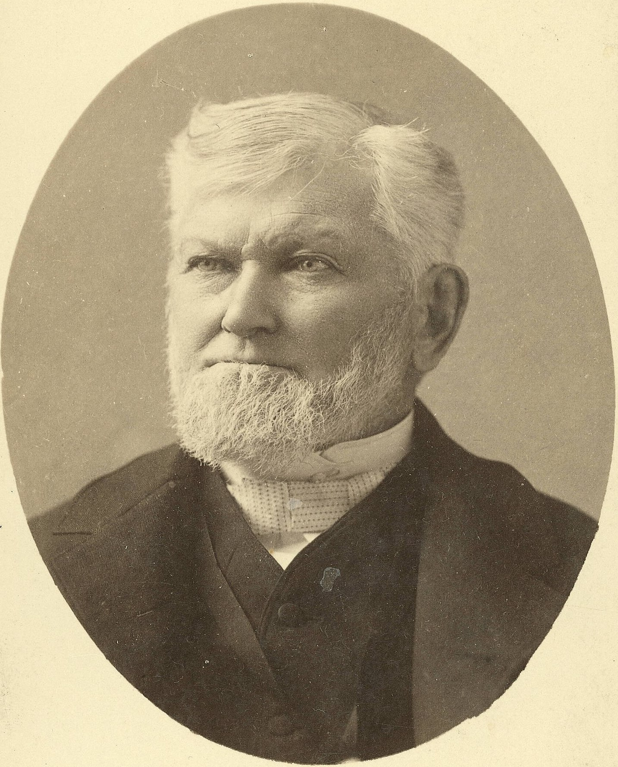
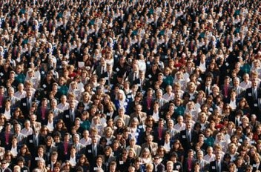
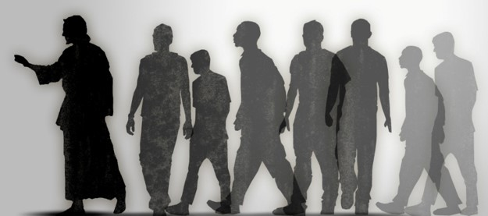
Who Are The Gentiles?
“We are all Gentiles. The Latter-day Saints are all Gentiles in a national capacity. The Gospel came to us among the Gentiles.
We are not Jews, and the Gentile nations have got to hear the Gospel first.
The whole Christian world have got to hear the Gospel, and when they reject it, the law will be bound and the testimony sealed, and it will turn to the house of Israel.
Up to the present day we have been called to preach the Gospel to the Gentiles, and we have had to do it.
For the last time we have been warning the world, and we have been engaged in that work for forty-five years.”
President Wilford Woodruff
D&C 14:10-11

Slide 13
John Whitmer
He was born on August 27, 1802, at Fayette Township, New York, third son of Peter Whitmer Sr.
He learned in 1828 of the mission of Joseph Smith and assisted as scribe in the translation of the Book of Mormon
He was baptized by Oliver Cowdery
He was one of the 8 witnesses of the Book of Mormon
Tirelessly he engaged in missionary work for the restored gospel
He wrote segments of the history of the Church and assisted in the care for and published the revelation of the Lord as part of the covenant obligation of the Church leadership
He became a member of the presidency of the Church in Missouri. Later, in Kirtland, he became editor of the Messenger and Advocate publication
He helped in the financial transactions for purchasing tracts of lands…because of allegations concerning irregularities in these transactions…he was excommunicated on March 10, 1838
He died on July 11, 1878..he was bitter against Joseph Smith but never recanted his testimony of the Book of Mormon
Who’s Who and Hyrum M. Smith

Slide 14
Peter Whitmer
He was born on September 27, 1809 at Fayette Township, New York. He was the 5th son of Peter Whitmer Sr.
He learned in 1828 of the mission of Joseph Smith and baptized in June 1829 by Oliver Cowdery and ordained an elder
He served as a scribe and became one of the 8 witnesses of the Book of Mormon
He was sent with Parley P. Pratt , Oliver Cowdery, and Zeba Peterson on a mission to the Lamanites
He established a trade as a tailor
He was ordained a high priest on October 25, 1831
Because of mob persecution he relocated to Clay County, Missouri
He took an active part in the Saints and had a charitable nature
He remained faithful to the end and because of his health he died on September 22, 1836 at Liberty, Clay County, Missouri
His revelation is revealed in D&C 16 and identical to John Whitmer’s in D&C 15
Who’s Who and Hyrum M. Smith

Slide 15
Same Message
The Lord reveals the same message to different individuals because they may have similar needs, circumstances, or desires.
However
We can be sure that He knows us individually. In this example, He called John Whitmer and Peter Whitmer Jr. by name and revealed His will to them one at a time.
Hearken—Listen to the words you have asked for
Sharpness—two edge sword—the word of the Lord
My arm—God’s power, all over the earth, and He has made known
Declare repentance—to engage in the ministry…which eventually John forgot
D&C 15-16

Slide 16
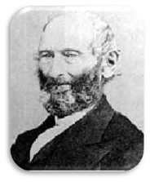
Testimonies of David and John Whitmer
“I will say once more to all mankind, that I have
never at any time denied that testimony or any part thereof. I also testify to the world, that neither
Oliver Cowdery nor Martin Harris ever at any
time denied their testimony. They both died
affirming the truth of the divine authenticity of the
Book of Mormon.”
David Whitmer in a proclamation to the American Cyclopedia and the
Encyclopedia Britannica
Even though there was a falling out with John and Joseph he still had a testimony of the Book of Mormon
Statement made to Heber C. Kmball and Theodore Turley in Far West…
“I now say, I handled those plates; there were fine engraving on both sides, I handled them, they were shown to me by supernatural power.”
John Whitmer
D&C 15-16

Slide 17
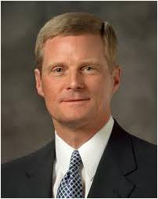
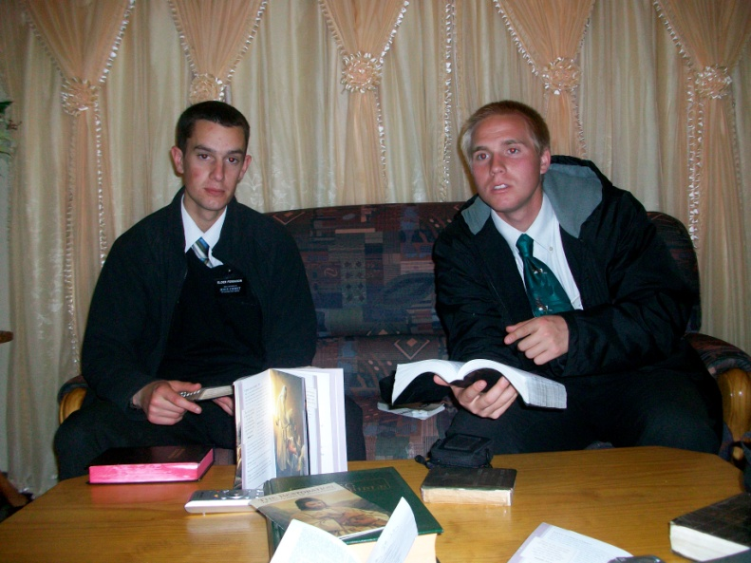
“God Knows Who I Am”
“Some time ago I spoke with a priesthood leader who was prompted to memorize the names of all of the youth ages 13 to 21 in his stake. Using snapshots of the young men and women, he created flash cards that he reviewed while traveling on business and at other times. This priesthood leader quickly learned all of the names of the youth.
“One night the priesthood leader had a dream about one of the young men whom he knew only from a picture. In the dream he saw the young man dressed in a white shirt and wearing a missionary name tag. With a companion seated at his side, the young man was teaching a family. The young man held the Book of Mormon in his hand, and he looked as if he were testifying of the truthfulness of the book. The priesthood leader then awoke from his dream.

Slide 18
“God Knows Who I Am”
“At an ensuing priesthood gathering, the leader approached the young man he had seen in his dream and asked to talk with him for a few minutes. After a brief introduction, the leader called the young man by name and said: ‘I am not a dreamer. I have never had a dream about a single member of this stake, except for you. I am going to tell you about my dream, and then I would like you to help me understand what it means.’
“The priesthood leader recounted the dream and asked the young man about its meaning. Choking with emotion, the young man simply replied, ‘It means God knows who I am.’ The remainder of the conversation between this young man and his priesthood leader was most meaningful, and they agreed to meet and counsel together from time to time during the following months”
David A. Bednar

Slide 19
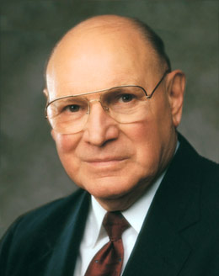
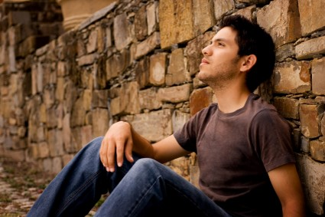
Enduring to the End
“Enduring to the end is the doctrine of continuing on the path leading to eternal life after one has entered into the path through faith, repentance, baptism, and receiving the Holy Ghost. Enduring to the end requires our whole heart. …
“Enduring to the end means that we have planted our lives firmly on gospel soil, staying in the mainstream of the Church, humbly serving our fellow men, living Christlike lives, and keeping our covenants.
Those who endure are balanced, consistent, humble, constantly improving, and without guile. Their testimony is not based on worldly reasons—it is based on truth, knowledge, experience, and the Spirit”
Elder Joseph B. Wirthlin

Slide 20
Sources:
Videos:
Inviting All to Come unto Christ: Sharing the Gospel (4:29)
God Knows Who I Am (1:55)
God Will Lift Us Up (4:58)
Am I Good Enough (3:28)
Days of Harmony” (25:01) from time code 21:55 to 23:53
“A Day for the Eternities” (23:09) from time code 1:35 to 8:20
“Whitmer Farm: A Place of Miracles” (15:42) from time code 0:00 to 4:23
Who’s Who in the Doctrine and Covenants by Ed J. Pinegar and Richard J. Allen pg. 165, 166-167, 168-169
Hyrum M. Smith Doctrine and Covenants Commentary pg. 71,74
(Lucy Mack Smith, History of Joseph Smith by His Mother, ed. Preston Nibley [1958], 148–49).
Doctrine and Covenants Student Manual Religion 324-325 pg. 30
Presentation by ©http://fashionsbylynda.com/blog/
President Wilford Woodruff (In Journal of Discourses, 18:112.)
John Whitmer Historical Record p. 485 also found in Hyrum M. Smith Doctrine and Covenants Commentary pg. 75
David Whitmer’s proclamation to the American Cyclopedia and the Encyclopedia Britannica
http://www.fairmormon.org/wp-content/uploads/2012/02/Book_of_Mormon_Witnesses_4.pdf
David A. Bednar (“The Tender Mercies of the Lord,” Ensign or Liahona, May 2005, 100).
Elder Joseph B. Wirthlin (“Press On,” Ensign or Liahona, Nov. 2004, 101).
Dieter F. Uchtdorf, “Have We Not Reason to Rejoice?,” Ensign or Liahona, Nov. 2007, 20
Jeffrey R. Holland, “Tomorrow the Lord Will Do Wonders among You,” Ensign or Liahona, May 2016, 127
Presentation by ©http://fashionsbylynda.com/blog/

Slide 21
In 1833 when Missouri vigilantes were harassing the
Mormons, a mob of about five hundred men put David’s
testimony to the test. The mob drove David and several
others to the public square, stripped, tarred, and feathered
them, aimed their guns then threatened these men to deny the
Book of Mormon and confess it to be a fraud, or die instantly.
David Whitmer raised his hands and bore witness to these
angry men that the Book of Mormon was the Word of God.
The mob trembled with fear and let them go. Afterwards, an
unbelieving doctor told David that his fearless testimony and
the fear that gripped the mob had made him a believer in the
Book of Mormon…
Shortly after David and other notable Mormons had been
excommunicated Sidney Rigdon preached his “Salt Sermon”
(which was later criticized by the Brethren) warning dissenters
to leave town. Other radical Mormons, such as Sampson
Avard, enforced expulsion of those who did not leave on their
own. Joseph Smith and the Twelve criticized Rigdon’s
aggressive speeches as well as the secret and unsanctioned
actions of Avard. As Anderson noted, “David Whitmer could
have received true spiritual comfort because of the unjust
methods that his former associates were using against
him….”
Whitmer claims that God told him to separate
himself from the Latter-day Saints. This could easily have
been inspired direction. Confrontation with some of the more
radical characters within the Church (such as Sampson) might have caused Whitmer serious harm (physical, emotional, or
spiritual). However Whitmer understood this direction from
God, it did not conflict with his testimony of the truthfulness
of the Book of Mormon.
David Whitmer left the Church in 1838 but continued to
proclaim and assert his testimony and the truthfulness of what
he had seen and heard. Although Whitmer never returned to
Mormonism, in the fifty years he lived outside of the Church
he insisted that he knew the Book of Mormon was divinely
revealed. Anyone seriously interested in Whitmer’s testimony
should read Lyndon W. Cook’s, David Whitmer Interviews: A
Restoration Witness.
Cook documents seventy-two interviews
with Whitmer concerning his experience with the angel and
plates – the experience upon which his Book of Mormon
testimony is based. All seventy-two interviews took place after
David had left the Church. If he had lost his testimony
following his excommunication, he would have had ample
opportunity to deny his earlier proclamation. Instead,
however, we find that Whitmer continued to assert its
truthfulness.
Like Oliver Cowdery, and Martin Harris, David Whitmer
bore the testimony to the truthfulness of reality of his
encounter with the angel and the authenticity of the Book of
Mormon until the day he died. Book of Mormon critics have
not been able to impugn their testimonies but have instead resorted to character assassination. As history demonstrates,
however, the honesty, integrity and reliability of these
witnesses confound the critics every bit as much as the
testimony of the three witnesses confounds those who refuse
to accept the revealed word of God.
Excerpts from fairmormon.org on David Whitmer
http://www.fairmormon.org/wp-content/uploads/2012/02/Book_of_Mormon_Witnesses_4.pdf

