Slide 1

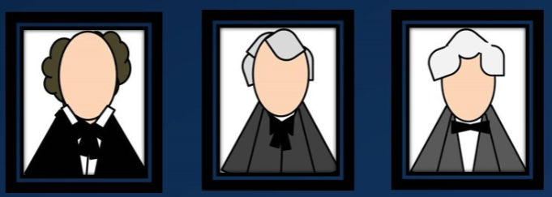
Doctrine and Covenants 17
Three Special Witnesses
“And unto three shall they be shown by the power of God; wherefore they shall know of the surety that these things are true.”
Ether 5:3
Presentation by ©http://fashionsbylynda.com/blog/

Slide 2
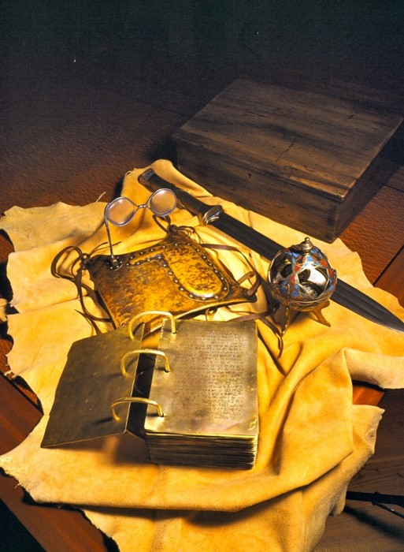
Finished with the Plates
Joseph Smith delivered up the plates, the breastplate, and the Urim and Thummim to the angel Moroni when he was finished and had accomplished the work God had required of him.
Rely upon my Word—Only by Faith
Faith is the force by which everything in the Kingdom of God takes place.
D&C 17:1

Slide 3
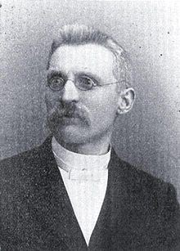
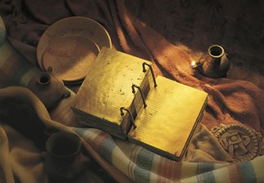
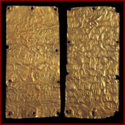
View of the Plates
“The records were engraved on plates which had the appearance of gold.
Each plate was neatly seven by eight inches in width and length, being not quite as thick as common tin.
They had engraving on both sides and were bound together in a volume as the leaves of a book and fastened at one edge with three rings running through the whole.
The volume was about six inches in thickness, and part of it was sealed.”
Andrew Jenson
D&C 17:1

Slide 4
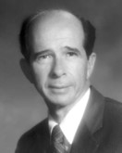
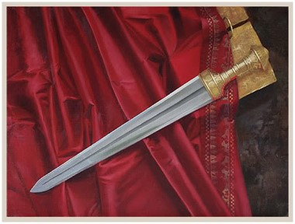
The Sword of Laban
“The people having loved Nephi exceedingly, he having been a great protector for them, having wielded the sword of Laban in their defense, and having labored in all his days for their welfare.”
Jacob 1:10
Laban, a Book of Mormon contemporary of Nephi in Jerusalem (600 BC) possessed a unique sword. "The hilt thereof was of pure gold, and the workmanship thereof was exceedingly fine, and the blade thereof was of the most precious steel" (1 Nephi 4:9)
Nephi made many swords “after the manner of the sword of Laban (2 Nephi 5:14).
The sword of Laban seems to have been preserved as a sacred object among the Nephites.
Author: Benson, Reed A.
D&C 17:1

Slide 5
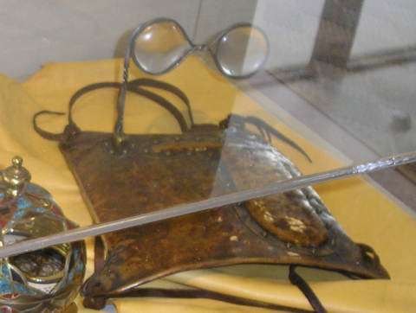
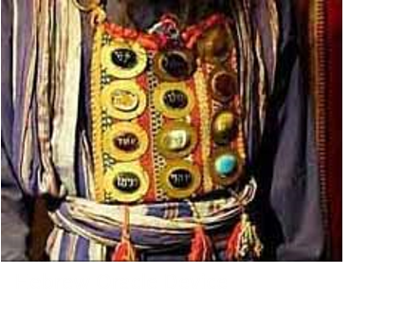
Urim and Thummim
The place where God resides is a Urim and Thummim, and this Earth is to become one, in its sanctified state (D&C 130:8,9).
John describes the earth, in its sanctified state, as a “sea of glass” (Rev 4:6, 15:2, and D&C 130:7).
The Urim and Thummim acted as a director from God. The Doctrine and Covenants are revelations from God through the Urim and Thummim.
D&C 17:1

Slide 6
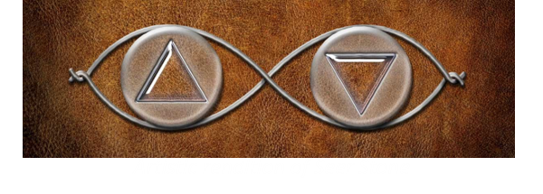
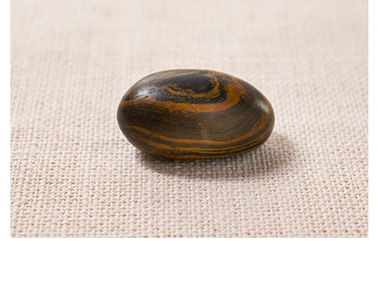
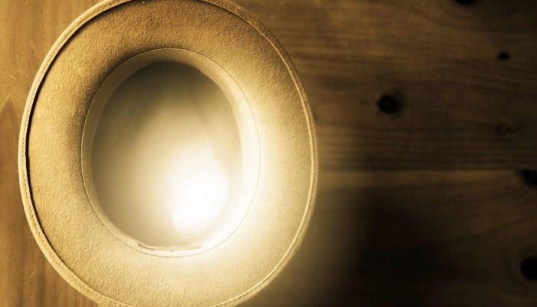
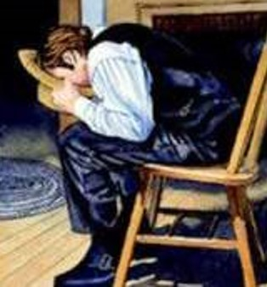
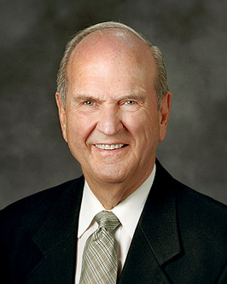
The Brother of Jared
The instrument which Joseph had was that which was given to the brother of Jared, and deposited with the Jaredite Record, also know as the Book of Ether. It was entrusted to the care of Alma, the son of Alma, and finally hidden in the hill Cumorah.
“Joseph Smith would put the seer stone into a hat, and put his face in the hat, drawing it closely around his face to exclude the light; and in the darkness the spiritual light would shine. A piece of something resembling parchment would appear, and on that appeared the writing. One character at a time would appear, and under it was the interpretation in English.”
Elder Russell M. Nelson
“And behold, these two stones will I give unto thee, and ye shall seal them up also with the things which ye shall write.”
Ether 3:23
D&C 17:1

Slide 7
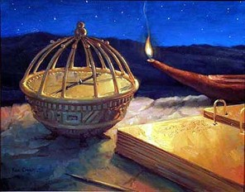
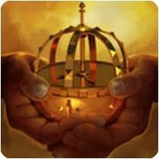
Miraculous Directors--Compass
“And it came to pass that the voice of the Lord said unto him: Look upon the ball, and behold the things which are written.
And it came to pass that when my father beheld the things which were written upon the ball, he did fear and tremble exceedingly, and also my brethren and the sons of Ishmael and our wives.
And it came to pass that I, Nephi, beheld the pointers which were in the ball, that they did work according to the faith and diligence and heed which we did give unto them.
1 Nephi 16:26-28
D&C 17:1

Slide 8
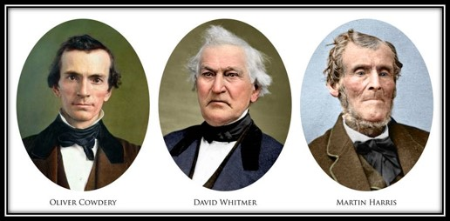
Permitted to See the Plates
Joseph Smith knew through the Book of Mormon and revelations that the Lord would allow other individuals to see the gold plates. He knew that three of the witnesses would see them through the power of God.
If we obey and exercise faith in God, we can receive a witness of the truths of the gospel.
Although we may not have the opportunity to see the same physical objects the Three Witnesses saw, we can receive a witness of truths of the gospel.
D&C 17:2-3

Slide 9
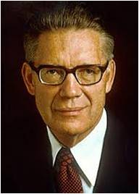
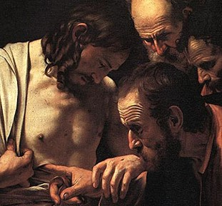
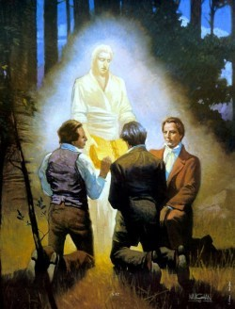
Law of Witnesses
The Three Witnesses fulfilled an important law established by the Lord.
“whenever the Lord has established a dispensation by revealing his gospel and by conferring priesthood and keys upon men, he has acted in accordance with the law of witnesses which he himself ordained. This law is: ‘In the mouth of two or three witnesses shall every word be established.’
“Never does one man stand alone in establishing a new dispensation of revealed truth, or in carrying the burden of such a message and warning to the world. In every dispensation, from Adam to the present, two or more witnesses have always joined their testimonies, thus leaving their hearers without excuse in the day of judgment should the testimony be rejected.”
Elder Bruce R. McConkie
D&C 17:3-4

Slide 10
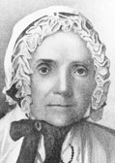
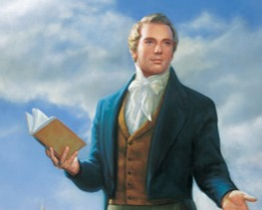
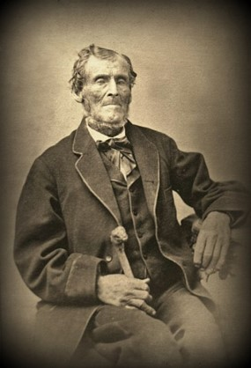
Be Humble and Repent
“The next morning, after attending to the usual services, namely, reading, singing and praying, Joseph arose from his knees, and approaching Martin Harris with a solemnity that thrills through my veins to this day, when it occurs to my recollection, said,
‘Martin Harris, you have got to humble yourself before God this day, that you may obtain a forgiveness of your sins.
If you do, it is the will of God that you should look upon the plates, in company with Oliver Cowdery and David Whitmer’”
Lucy Mack Smith

Slide 11

Retired to the Woods
“Martin Harris, David Whitmer, Oliver Cowdery and [I] … retired [to the woods near the Whitmer home], and having knelt down, we began to pray in much faith to Almighty God. …
“According to previous arrangement, I commenced by vocal prayer to our Heavenly Father, and was followed by each of the others in succession.
We did not at the first trial, however, obtain any answer or manifestation of divine favor in our behalf.
We again observed the same order of prayer … but with the same result as before.
“Upon this, our second failure, Martin Harris proposed that he should withdraw himself from us, believing, as he expressed himself, that his presence was the cause of our not obtaining what we wished for. He accordingly withdrew from us,…

Slide 12
The Angel Held the Plates
…and we knelt down again, and had not been many minutes engaged in prayer, when presently we beheld a light above us in the air, of exceeding brightness; and behold, an angel stood before us. In his hands he held the plates which we had been praying for these to have a view of. He turned over the leaves one by one, so that we could see them, and discern the engravings theron distinctly. …
We heard a voice from out of the bright light above us, saying, ‘These plates have been revealed by the power of God, and they have been translated by the power of God. The translation of them which you have seen is correct, and I command you to bear record of what you now see and hear.’

Slide 13
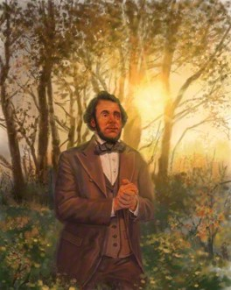
“Tis Enough”
“I now left David and Oliver, and went in pursuit of Martin Harris, whom I found at a considerable distance, fervently engaged in prayer. He soon told me, however, that he had not yet prevailed with the Lord, and earnestly requested me to join him in prayer, that he also might realize the same blessings which we had just received.
We accordingly joined in prayer, and ultimately obtained our desires, for before we had yet finished, the same vision was opened to our view, at least it was again opened to me, and I once more beheld and heard the same things; whilst at the same moment, Martin Harris cried out, apparently in an ecstasy of joy, ‘’Tis enough; ’tis enough; mine eyes have beheld; mine eyes have beheld’”
History of the Church

Slide 14
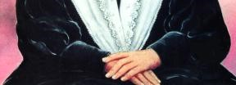
Returning Home
“When they returned to the house it was between three and four o’clock p. m. Mrs. Whitmer, Mr. Smith and myself, were sitting in a bedroom at the time.
On coming in, Joseph threw himself down beside me, and exclaimed, ‘Father, mother, you do not know how happy I am: the Lord has now caused the plates to be shown to three more besides myself.
They have seen an angel, who has testified to them, and they will have to bear witness to the truth of what I have said, for now they know for themselves, that I do not go about to deceive the people, and I feel as if I was relieved of a burden which was almost too heavy for me to bear, and it rejoices my soul, that I am not any longer to be entirely alone in the world.’
Upon this, Martin Harris came in: he seemed almost overcome with joy, and testified boldly to what he had both seen and heard. And so did David and Oliver, adding that no tongue could express the joy of their hearts, and the greatness of the things which they had both seen and heard”
Lucy Mack Smith

Slide 15
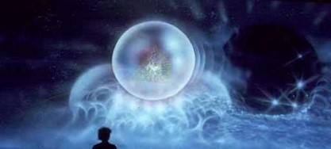
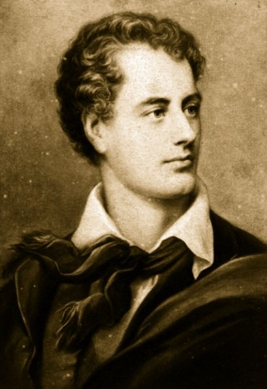
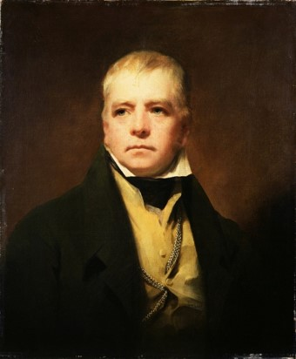
Spirit Testifies of the Truth
“And he has translated the book, even that part which I have commanded him, and as your Lord and your God liveth it is true.”
“Within this awful volume lies
The mystery of mysteries.
Happiest he of human race
To whom our God has given grace
To read, to fear, to hope, to pray,
To lift the latch, and force the way;
And better had he ne’er been born
Who reads to doubt, or reads to scorn.”
Sir Walter Scott
This is poem is copied in Lord Byron’s own Bible
D&C 17:6

Slide 16
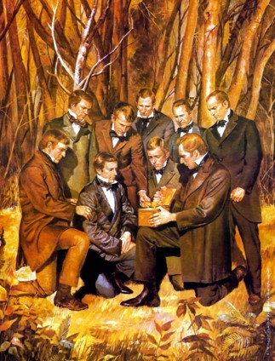
Eight Witnesses
The Testimony of the Eight Witnesses
A few days after the Three Witnesses saw the gold plates, “eight additional witnesses—faithful men who were close to the Prophet during the translation—were also chosen to see the plates. …
Joseph was permitted to show them the plates near the Smith residence in Manchester when he was making arrangements for the printing of the book. [See History of the Church, 1:58.]
The Eight Witnesses testified that they handled and lifted the plates and saw the engravings on the individual leaves. Their testimony is also contained in all published editions of the Book of Mormon”
(Church History in the Fulness of Times Student Manual, 2nd ed. [Church Educational System manual, 2003], 60–61).
D&C 17:6

Slide 17
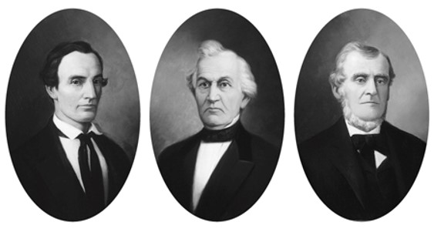
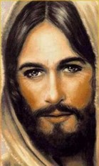
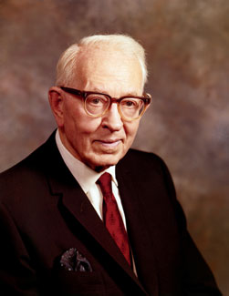
Grace of the Lord
After a man has done all that he can for himself, it is only by the grace of the Lord (that is, by his love, mercy, and condescension) that he can gain salvation
(see 2 Nephi 11:24; 25:23)
These three men were promised that if they would do all that they were instructed in this revelation, the Lord’s grace is sufficient to ensure their salvation.
“We are all transgressors of the law to some extent, no matter how good we have tried to be—we are therefore unable in and of ourselves to receive redemption from our sins by any act of our own.
“… it is by the grace of Jesus Christ that we are saved.”
President Joseph Fielding Smith
D&C 17:8

Slide 18
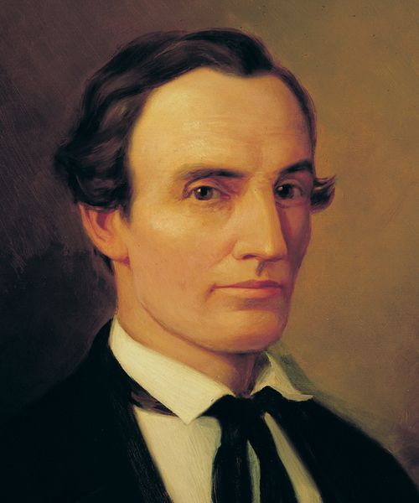
Witness
Served as Joseph’s principal scribe for most of the Book of Mormon translation
“I wrote, with my own pen, the entire Book of Mormon (save a few pages) as it fell from the lips of the Prophet Joseph Smith, as he translated it by the gift and power of God. … That book is true. Sidney Rigdon did not write it; Mr. Spaulding did not write it; I wrote it myself as it fell from the lips of the Prophet.” Oliver Cowdery
Oliver Cowdery

Slide 19
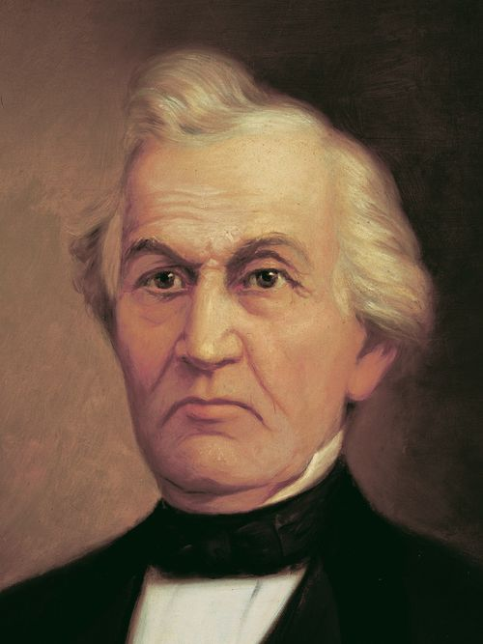
Witness
Invited Joseph Smith to complete the translation of the Book of Mormon in his family’s home
On Sunday evening, at 5:30 (Jan. 22, 1888), Mr. Whitmer called his family and some friends to his bedside. … He then addressed himself to all around his bedside in these words: ‘Now you must all be faithful in Christ. I want to say to you all, the Bible and the record of the Nephites (Book of Mormon) is true, so you can say that you have heard me bear my testimony on my death-bed. All be faithful in Christ, and your reward will be according to your works. God bless you all. My trust is in Christ forever, worlds without end. Amen.’
David Whitmer

Slide 20
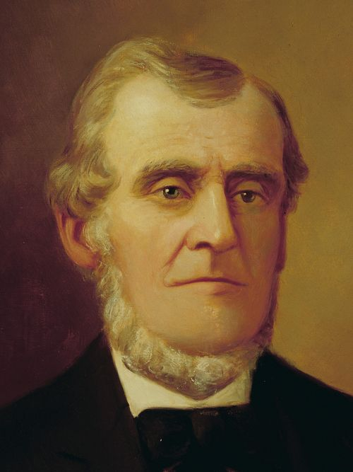
Witness
Provided financing for the printing of the Book of Mormon
Shortly before he died
“Yes, I did see the plates on which the Book of Mormon was written; I did see the angel; I did hear the voice of God; and I do know that Joseph Smith is a Prophet of God, holding the keys of the Holy Priesthood.
Martin Harris

Slide 21
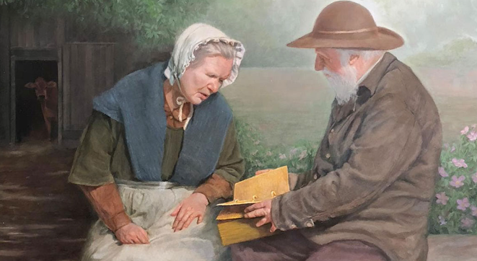
Mary Whitmer– A Witness
When Joseph, Emma, and Oliver moved into the Whitmer home, it increased the burden of Mary Whitmer. She already tended to the needs of her husband and eight children who lived at the home or nearby. Although Mary did not complain about the additional work, she was becoming weary.
“One day, while she was out by the barn where the cows were milked, she saw a gray-haired man with a knapsack slung across his shoulder. His sudden appearance frightened her, but as he approached, he spoke to her in a kind voice that set her at ease.
“‘My name is Moroni,’ he said. ‘You have become pretty tired with all the extra work you have to do.’ He swung the knapsack off his shoulder, and Mary watched as he started to untie it.
“‘You have been very faithful and diligent in your labors,’ he continued. ‘It is proper, therefore, that you should receive a witness that your faith may be strengthened.’
“Moroni opened his knapsack and removed the gold plates. He held them in front of her and turned their pages so she could see the writings on them. After he turned the last page, he urged her to be patient and faithful as she carried the extra burden a little longer. He promised she would be blessed for it.
“The old man vanished a moment later, leaving Mary alone. She still had work to do, but that no longer troubled her”
Saints

Slide 22
After the Lord blesses us with a witness of the truth, we have a responsibility to testify of it.

Slide 23
Sources:
Video:
Testimony of the Witnesses(3:02)
“A Day for the Eternities” (23:09; watch from time code 15:01 to 17:55)
“An Enduring Testimony of the Mission of the Prophet Joseph” (17:32; watch from time code 4:18 to 5:43).
Joseph Smith –History 1:52, 59-60
Andrew Jenson Historical Record, p. 363 from Hyrum M. Smith Doctrine and Covenants Commentary p. 77
Sword of Laban-- Author: Benson, Reed A. BYU Education 1992 Publication Harold B. Lee Library
Elder Russell M. Nelson A Treasured Testament July 1993 Ensign
Elder Bruce R. McConkie (Mormon Doctrine, p. 436.)
Lucy Mack Smith (History of Joseph Smith by His Mother, ed. Preston Nibley [1958], 151–52).
History of the Church, 1:54–55).
Presentation by ©http://fashionsbylynda.com/blog/
Lucy Mack Smith (History of Joseph Smith by His Mother, 152).
President Joseph Fielding Smith (Doctrines of Salvation, 2:309.)
See Also October 2015 Ensign “Joseph the Seer”
(“The Three Witnesses,” The Historical Record, ed. Andrew Jenson, vol. 6, nos. 3–5 [May 1887], 201; see also George Reynolds, “History of the Book of Mormon,” The Contributor, vol. 5, no. 12 [Sept. 1884], 446).
[Richmond Democrat, Feb. 2, 1888, quoted in Andrew Jenson, Latter-day Saint Biographical Encyclopedia, 4 vols. (1901), 1:270]” (in Doctrine and Covenants Student Manual [Church Educational System manual, 2001], 33).
. [“The Last Testimony of Martin Harris,” recorded by William H. Homer in a statement sworn before J. W. Robinson, Apr. 9, 1927, quoted in Francis W. Kirkham, A New Witness for Christ in America, 2 vols. (1960), 1:254.]” (In Doctrine and Covenants Student Manual, 33.)
Saints: The Story of the Church of Jesus Christ in the Latter Days, vol. 1, The Standard of Truth, 1815–1846 [2018], 70–71
Presentation by ©http://fashionsbylynda.com/blog/

Slide 24
Significance of Testimonies:
Each of the three had ample reason and opportunity to renounce his testimony if it had been false, or to equivocate on details if any had been inaccurate. As is well known, because of disagreements or jealousies involving other leaders of the Church, each one of these Three Witnesses was excommunicated from The Church of Jesus Christ of Latter-day Saints by about eight years after the publication of their testimony. All three went their separate ways, with no common interest to support a collusive effort. Yet to the end of their lives—periods ranging from 12 to 50 years after their excommunications—not one of these witnesses deviated from his published testimony or said anything that cast any shadow on its truthfulness.
Furthermore, their testimony stands uncontradicted by any other witnesses. Reject it one may, but how does one explain three men of good character uniting and persisting in this published testimony to the end of their lives in the face of great ridicule and other personal disadvantage? Like the Book of Mormon itself, there is no better explanation than is given in the testimony itself, the solemn statement of good and honest men who told what they saw. (Dallin H. Oaks, “The Witness: Martin Harris,” Ensign, May 1999, 36)
Oliver Cowdery testimony:
I am a dying man, and what would it profit me to tell you a lie? I know … that this Book of Mormon was translated by the gift and power of God. My eyes saw, my ears heard, and my understanding was touched, and I know that whereof I testified is true. It was no dream, no vain imagination of the mind—it was real. (Jacob F. Gates, “Testimony of Jacob Gates,” Improvement Era, Mar. 1912, 418–19)

Slide 25
The Urim and Thummim
There is difference of opinion among Bible students concerning the use of this sacred instrument; but it is generally admitted that through it the divine will on important questions was ascertained in some manner not described. In the original Hebrew text of I Samuel 14:41, ( “Therefore Saul said unto the Lord God of Israel, Give a perfect lot…” presupposed by the translators of the Septuagint, we read, “And Saul said, O Jehovah, the God of Israel, why hast thou not answered thy servant this day? If the iniquity be in me, or in Jonathan my son, give Urim; and if it be in thy people Israel, give Thummim.:
The Hebrew words rendered * * * Give perfect (lot) are a mutilated fragment of the longer text preserved in the Septuagint * * *). The priest who cast the lots on this occasion was evidently Ahijah” This shows that the people of God anciently enquired of the Lord through Urim and Thummim. When, however, the Spirit of prophecy was poured out in great abundance, the sacred instrument was not necessarily needed.
After the organization of the Church the Prophet Joseph could ascertain the mind and will of the Lord without any outward aid. The office of the Sprit is to lead into all truth.—Hyrum M. Smith pg. 20
Septuagint---from the Latin word Septuagint (meaning seventy), is a translation of the Hebrew Bible and some related texts into Koine Greek.
Wikipedia
Jewish Urim and Thummim: Objects connected with the breastplate of the high priest, and used as a kind of divine oracle.
"revelation and truth" or “lights and perfections”
It is called a "breastplate of judgment" ("ḥoshen ha-mishpaṭ"); it is four-square and double; and the twelve stones were not put inside the ḥoshen, but on the outside.
Jewish Encyclopedia.com
George Gordon Byron, 6th Baron Byron, later George Gordon Noel, 6th Baron Byron, FRS (22 January 1788 – 19 April 1824) : commonly known simply as Lord Byron, was an English poet and a leading figure in the Romantic movement. Among Byron's best-known works are the lengthy narrative poems Don Juan and Childe Harold's Pilgrimage and the short lyric She Walks in Beauty. He is regarded as one of the greatest British poets and remains widely read and influential.
Sir Walter Scott, 1st Baronet, FRSE (15 August 1771 – 21 September 1832) was a Scottish historical novelist, playwright, and poet.
Scott was the first English-language author to have a truly international career in his lifetime, with many contemporary readers in Europe, Australia, and North America. His novels and poetry are still read, and many of his works remain classics of both English-language literature and of Scottish literature. Famous titles include Ivanhoe, Rob Roy, The Lady of the Lake, Waverley, The Heart of Midlothian and The Bride of Lammermoor.
Wikipedia
Elder Bruce R. McConkie of the Quorum of the Twelve Apostles taught:
“One of the most solemn oaths ever given to man is found in these words of the Lord relative to Joseph Smith and the Book of Mormon. ‘He [meaning Joseph Smith] has translated the book, even that part which I have commanded him,’ saith the Lord, ‘and as your Lord and your God liveth it is true.’ (D&C 17:6.)
“This is God’s testimony of the Book of Mormon. In it Deity himself has laid his godhood on the line. Either the book is true or God ceases to be God. There neither is nor can be any more formal or powerful language known to men or gods” (“The Doctrine of the Priesthood,” Ensign, May 1982, 33).

Slide 26
Be it known unto all nations, kindreds, tongues, and people, unto whom this work shall come: That we, through the grace of God the Father, and our Lord Jesus Christ, have seen the plates which contain this record, which is a record of the people of Nephi, and also of the Lamanites, their brethren, and also of the people of Jared, who came from the tower of which hath been spoken. And we also know that they have been translated by the gift and power of God, for his voice hath declared it unto us; wherefore we know of a surety that the work is true. And we also testify that we have seen the engravings which are upon the plates; and they have been shown unto us by the power of God, and not of man. And we declare with words of soberness, that an angel of God came down from heaven, and he brought and laid before our eyes, that we beheld and saw the plates, and the engravings thereon; and we know that it is by the grace of God the Father, and our Lord Jesus Christ, that we beheld and bear record that these things are true. And it is marvelous in our eyes. Nevertheless, the voice of the Lord commanded us that we should bear record of it; wherefore, to be obedient unto the commandments of God, we bear testimony of these things. And we know that if we are faithful in Christ, we shall rid our garments of the blood of all men, and be found spotless before the judgment-seat of Christ, and shall dwell with him eternally in the heavens. And the honor be to the Father, and to the Son, and to the Holy Ghost, which is one God. Amen.
Oliver Cowdery
David Whitmer
Martin Harris
Testimony of the Three Witnesses
https://www.lds.org/scriptures/bofm/three?lang=eng

Slide 27
Oliver Cowdery, David Whitmer, and Martin Harris never faltered in bearing testimony of the truthfulness of the Book of Mormon.
As history attests, however, they did falter in other Church-related areas. David Whitmer left the Church and never came back. Oliver Cowdery and Martin Harris both left the Church but were eventually rebaptized and died in full fellowship. But even while they were out of the Church, all three continued to bear solemn witness of the reality of their experience on that day. They undoubtedly felt the weight of the Lord’s warning to them to keep his commandments or the gates of hell would prevail against them.
Francis W. Kirkham wrote about Oliver Cowdery’s death that “in the year 1878, David Whitmer said to Elders Orson Pratt and Joseph F. Smith concerning his departure: ‘Oliver died the happiest man I ever saw. After shaking hands with the family and kissing his wife and daughter, he said, “Now I lay me down for the last time; I am going to my Savior”; and he died immediately, with a smile on his face.’” (New Witness for Christ, 1:248.)
The Richmond Democrat carried the following account of David Whitmer: “On Sunday evening, at 5:30 (Jan. 22, 1888), Mr. Whitmer called his family and some friends to his bedside, and addressing himself to the attending physician, said: ‘Dr. Buchanan, I want you to say whether or not I am in my right mind, before I give my dying testimony.’ The doctor answered: ‘Yes, you are in your right mind, for I have just had a conversation with you.’ He then addressed himself to all around his bedside in these words: ‘Now you must all be faithful in Christ. I want to say to you all, the Bible and the record of the Nephites (Book of Mormon) is true, so you can say that you have heard me bear my testimony on my death-bed. All be faithful in Christ, and your reward will be according to your works. God bless you all. My trust is in Christ forever, worlds without end. Amen.’” (In Jenson, Biographical Encyclopedia, 1:270.)
The last testimony of Martin Harris was given to Elder William Harrison Homer, who was with him at the time of his death. Elder Homer recorded:
“The next day, July 10, 1875, marked the end. It was in the evening. It was milking time, and Martin Harris, Jr., and his wife, Nancy Homer Harris, had gone out to milk and to do the evening’s chores. In the house with the stricken man were left my mother, Eliza Williamson Homer, and myself, who had had so interesting a day with Martin Harris at Kirtland. I stood by the bedside holding the patient’s right hand and my mother at the foot of the bed, Martin Harris had been unconscious for a number of days. When we first entered the room the old gentleman appeared to be sleeping. He soon woke up and asked for a drink of water. I put my arm under the old gentleman, raised him, and my mother held the glass to his lips. He drank freely, then he looked up at me and recognized me. He said, ‘I know you. You are my friend.’ He said, ‘Yes, I did see the plates on which the Book of Mormon was written; I did see the angel; I did hear the voice of God; and I do know that Joseph Smith is a Prophet of God, holding the keys of the Holy Priesthood.’ This was the end. Martin Harris, divinely-chosen witness of the work of God, relaxed, gave up my hand. He lay back on his pillow and just as the sun went down behind the Clarkston mountains, the soul of Martin Harris passed on. …
(Signed) William Harrison Homer.
“Signed in the presence of Mrs. W. H. Homer, Joseph Homer, Leah Widtsoe, John A. Widtsoe.” (In New Witness for Christ, 1:253–54.)

