Slide 1
Doctrine and Covenants 18: 1-13
The Worth of Souls
“For behold, this is my work and my glory—to bring to pass the immortality and eternal life of man.”
Moses 1:39
Presentation by ©http://fashionsbylynda.com/blog/

Slide 2
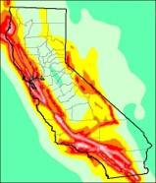
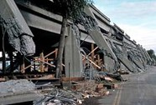
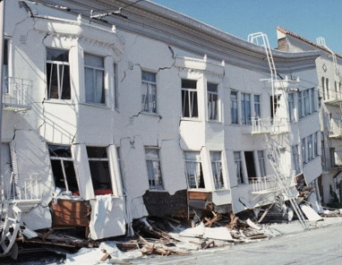
The Earthquake
On October 17, 1989, at 5:04 p.m., an earthquake measuring 6.9 on the Richter scale hit the San Francisco, California, area of the United States. Thousands of buildings were damaged or destroyed. The foundations of many buildings cracked, which caused the buildings to be declared unsafe.
What concerns would you have about living in a house with a weak foundation?

Slide 3
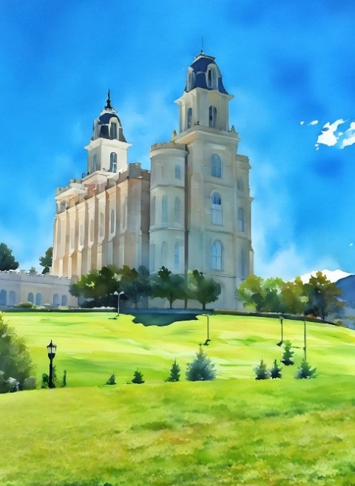
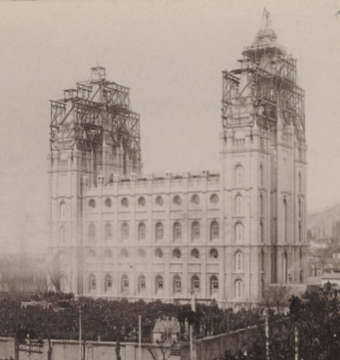
Revelation
In June 1829, Joseph Smith, Oliver Cowdery, and David Whitmer received a revelation known as Doctrine and Covenants 18.
The revelation was about calling twelve Apostles in the last days and building up the Church.

Slide 4
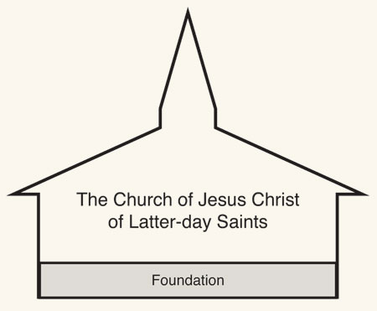
Building Up The Church
The true Church is built upon Jesus Christ and His gospel
These things you have written, translated by Joseph, are true
Rely on the things written
Build up the Church upon the foundation of my gospel and my rock
The Guide to the Scriptures defines rock as “figuratively, Jesus Christ and his gospel, which are a strong foundation and support (D&C 11:24;33:12–13).
Rock can also refer to revelation, by which God makes his gospel known to man (Matt. 16:15–18)”
Guide to the Scriptures
D&C 18:1-5

Slide 5
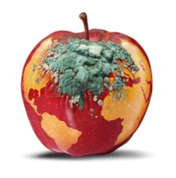
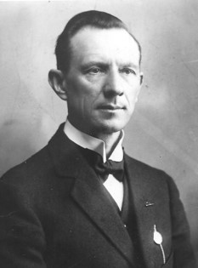
The World We Live In
“As fruit, when ripe, falls, so the world, when ripened in iniquity, is destroyed. The Lord, therefore, commanded His servants to preach repentance, to avert destruction.
Ripening in iniquity
…The most conspicuous sin of the world in this age, as when Paul wrote his letter to the Romans is unchastity. Consequently, the voice of the Church has been raised against that sin with more emphasis than against any other evil.”
Hyrum M. Smith
“For this cause God gave them up unto vile affections: for even their women did change the natural use into that which is against nature:”
Romans 1:26
D&C 18:6

Slide 6
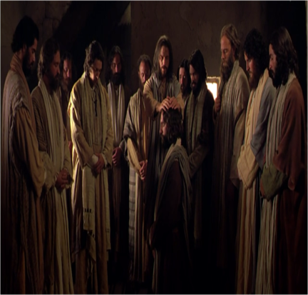
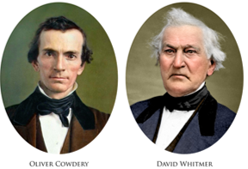
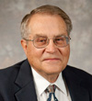
The Calling
The Lord called Oliver Cowdery and David Whitmer to preach repentance, as He had called the ancient Apostle Paul to do.
While Oliver and David were not called to be members of the Quorum of the Twelve Apostles, they would have roles in establishing this quorum in the latter days.
“In New Testament times, the Savior called and ordained twelve men whom he called both disciples and apostles to be special witnesses for him. Later other men, including Paul, were called and ordained as apostles. In this revelation, the Lord announces that he is going to give some men in this dispensation the same powers and authority he gave anciently to Paul.”
Victor L. Ludlow
D&C 18:9

Slide 7
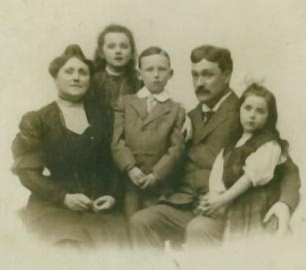
Special Instructions
“Remember the worth of souls is great in the sight of God;”
“And how are we to determine the value of souls? This matter has been determined for us also by revelation. The souls of men are so precious in the sight of God that He gave to the world His Only Begotten Son, that by the shedding of His blood He might draw all men unto Him. That is why the great Prophet of this dispensation, Joseph Smith, and these others, John Whitmer, Oliver Cowdery, David Whitmer, and the rest, were called to bring souls unto Christ.
And if one of these men should labor all his days,
and bring save it be but one soul unto Christ,
and that one should be his wife, what great joy
he would have with his wife in heaven.
Then if he should labor all his days and bring
unto Christ the souls of his wife and his children,
and none else perchance, how great would be
his joy in heaven with his wife and children.”
Elder Rudger Clawson
D&C 18:10

Slide 8
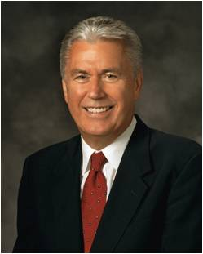
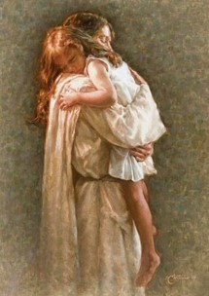
The Worth of Souls
“God sees you not only as a mortal being on a small planet who lives for a brief season—He sees you as His child. He sees you as the being you are capable and designed to become. He wants you to know that you matter to Him”
President Dieter F. Uchtdorf
What price did the Savior pay for our souls?
The phrase “all men” refers to all people
How can we show gratitude for the sacrifice the Savior has made for us?
One of the best ways we can show our gratitude is by repenting
My worth is so great that Jesus Christ suffered and died so I can repent.
D&C 18:10-11

Slide 9
Doctrinal Mastery
Remember the worth of souls is great in the sight of God;
For, behold, the Lord your Redeemer suffered death in the flesh; wherefore he suffered the pain of all men, that all men might repent and come unto him.
D&C 18:10-11
D&C 18:10-11

Slide 10
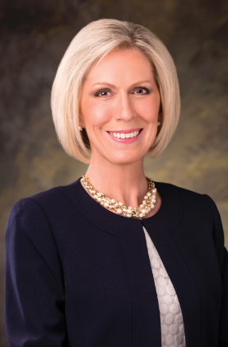
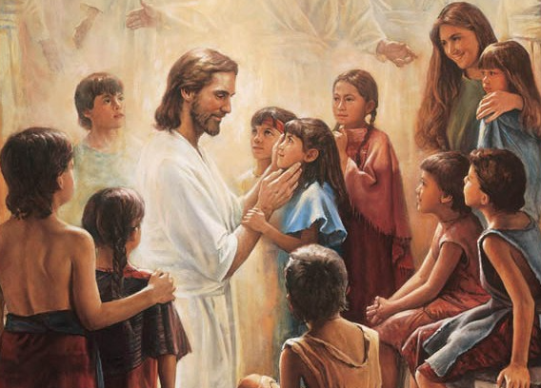
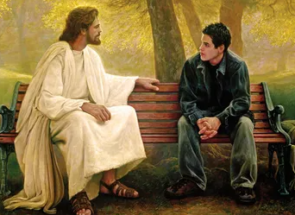
Let me point out the need to differentiate between two critical words: worth and worthiness. They are not the same.
Spiritual worth means to value ourselves the way Heavenly Father values us, not as the world values us. Our worth was determined before we ever came to this earth. “God’s love is infinite and it will endure forever.”
On the other hand, worthiness is achieved through obedience. If we sin, we are less worthy, but we are never worth less!
We continue to repent and strive to be like Jesus with our worth intact.
As President Brigham Young taught: “The least, the most inferior spirit now upon the earth … is worth worlds.” No matter what, we always have worth in the eyes of our Heavenly Father.
Joy D. Jones

Slide 11
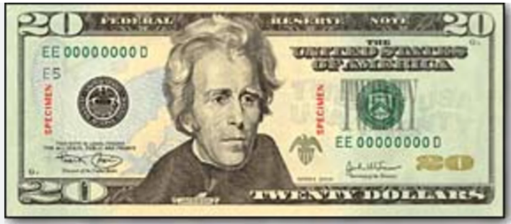
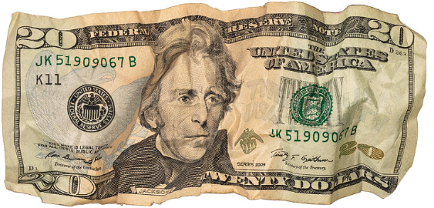
What About My Soul?
We know from modern revelation that “the worth of souls is great in the sight of God”
We cannot gauge the worth of another soul any more than we can measure the span of the universe. Every person we meet is a VIP [Very Important Person] to our Heavenly Father. …
One woman who had been through years of trial and sorrow said through her tears,
“I have come to realize that I am like an old 20-dollar bill—crumpled, torn, dirty, abused, and scarred. But I am still a 20-dollar bill. I am worth something. Even though I may not look like much and even though I have been battered and used, I am still worth the full 20 dollars.”
Dieter F. Uchtdorf

Slide 12
Ponder Your Worth
Pray each morning and night to understand more clearly how your Father in Heaven sees you.
Plan a regular time to reflect in your journal about your worth.
Spend time on multiple occasions reading and studying more deeply your patriarchal blessing.
Think about how you could approach it differently to really understand what your Father in Heaven wants you to know and feel about yourself.

Slide 13
Sources:
Videos:
“The Hope of God’s Light” (6:46)
My Brother’s Keeper” from time code 1:54 to 4:24
video “Am I Good Enough?” (3:28),
You Matter to Him (0:26)
Our True Identity (3:38)
The Worth of Souls (2:38)
(Guide to the Scriptures, “Rock,” scriptures.lds.org).
Presentation by ©http://fashionsbylynda.com/blog/
(Ludlow, Companion, 1:133–34.) D&C Manual Religion 324-325 pg. 35
Elder Rudger Clawson(In Conference Report, Apr. 1901, pp. 7–8.)
President Dieter F. Uchtdorf (“You Matter to Him,” Ensign or Liahona, Nov. 2011, 22).
Dieter F. Uchtdorf, “You Are My Hands” Ensign or Liahona, May 2010, 69
Joy D. Jones, “Value beyond Measure,” Ensign or Liahona, Nov. 2017, 14

Slide 14
D&C 18 “In this revelation, Oliver Cowdery was informed that he had received a witness by the Spirit of Truth of the work, especially of the Book of Mormon. Many times during the translating of the record, manifestations of this kind had come to him. Not only had the Spirit made this truth manifest, but he had previous to this revelation stood in the presence of a heavenly messenger and under his hands received the Holy Aaronic Priesthood. Therefore, the Lord could say to him: ‘I have manifested unto you by my Spirit in many instances, that the things which you have written (i.e., as scribe) are true; wherefore you know that they are true.’” (Smith, Church History and Modern Revelation, 1:81.)
“My Church, My Gospel, and My Rock”?
When the Lord refers to His Church, He is referring to the assembled believers and disciples who have taken upon themselves His name and covenanted to be obedient to His gospel (see D&C 10:67). The Lord defined His gospel in Doctrine and Covenants 39:6. The rock spoken of here and elsewhere is explained in Notes and Commentary on Doctrine and Covenants 11:24.
How Much We Are Worth:
What our Heavenly Father offers us is Himself and His Son, a close and enduring relationship with Them through the grace and mediation of Jesus Christ, our Redeemer. We are God’s children, set apart for immortality and eternal life. Our destiny is to be His heirs, “joint-heirs with Christ” [Romans 8:17]. (D. Todd Christofferson, “Our Relationship with God,” Liahona, May 2022, 79)
“The expression “the rock” is used in the scriptures with different meanings that must be interpreted according to the context. There are times when it refers to Christ and times when it refers to the gospel and other times when the reference is to revelation and again to the Church.
Joseph Fielding Smith Answers to Gospel Questions Vol. 1 pg. 95
The worth of a soul:
The impact of this statement that Christ suffered “the pain of all men,” here given by the Lord to emphasize his high appraisal of the worth of human souls, is sharpened by the realization of the intensity of that suffering.
Such is the worth of a soul. Surely it “is great in the sight of God” (D&C 18:10). They should be of like value in the sight of men. As God’s work and glory is to bring to pass the eternal life of man, so the desire, hope, and work of every man should be to obtain eternal life for himself. And not for himself only but also for his fellowmen; and it will be when he fully appreciates who and what he is—his nature, origin, destiny, and potentiality.
Man is a dual being—a living soul—composed of a body of spirit and a physical body. His spirit existed as an individual personal entity in a premortal life long before the earth was created. As a matter of fact, this earth was expressly created as a place for the spirits of men to take on mortality.
“What shall it profit a man, if he shall gain the whole world, and lose his own soul?
“Or what shall a man give in exchange for his soul?” (Mark 8:36–37.)
Immortality connotes life without end.
Eternal life, on the other hand, connotes quality of life—exaltation, the highest type of immortality, the kind of life enjoyed by God himself.
The Worth of Souls MARION G. ROMNEY
Oct 1978 Gen. Conf
Reaching Our Potential as His Sons and Daughters:
While we may look at the vast expanse of the universe and say, “What is man in comparison to the glory of creation?” God Himself said we are the reason He created the universe! His work and glory—the purpose for this magnificent universe—is to save and exalt mankind [see Moses 1:38–39]. In other words, the vast expanse of eternity, the glories and mysteries of infinite space and time are all built for the benefit of ordinary mortals like you and me. Our Heavenly Father created the universe that we might reach our potential as His sons and daughters.
This is a paradox of man: compared to God, man is nothing; yet we are everything to God. While against the backdrop of infinite creation we may appear to be nothing, we have a spark of eternal fire burning within our breast. We have the incomprehensible promise of exaltation—worlds without end—within our grasp. And it is God’s great desire to help us reach it. (Dieter F. Uchtdorf, “You Matter to Him,” Ensign or Liahona, Nov. 2011, 20)

