Slide 1
Doctrine and Covenants 18:11-16
Great is His Joy
Presentation by ©http://fashionsbylynda.com/blog/

Slide 2
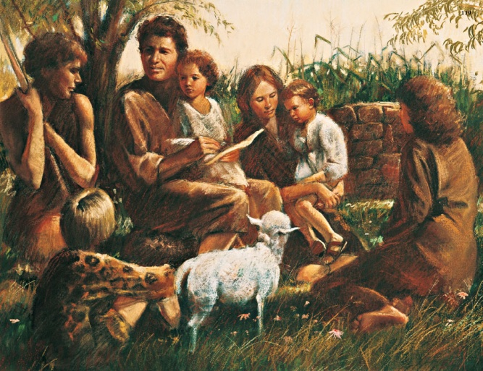
Men Might Have Joy
Adam fell that men might be; and men are, that they might have joy.
2 Nephi 2:25
BECAUSE OF THE FALL
Adam and Eve were driven out of the garden to till the earth
Adam and Eve brought forth children—the family of all the earth
Adam and Eve and their descendants would experience mortal life, including misery, joy, and the ability to do good and to sin
We are subject to physical and spiritual death
WITHOUT THE FALL
All things would have remained as they were when they were created
Adam and Eve would have had no children
Adam and Eve would have remained in a state of innocence, unable to know joy or misery, good or sin

Slide 3
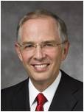
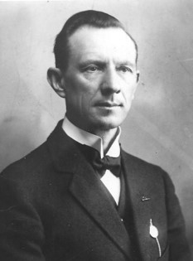
Great Is His Joy
“Crying repentance simply means helping people return to God”
Elder Neil L. Andersen
What are some ways we can help others repent?
If we help others to repent and come unto the Lord, we will feel joy with them in the kingdom of God.
“They were to remember that even if they should labor a life-time and bring only one soul to Christ, their joy would be great, and that they would have correspondingly greater joy, if they should win many souls.”
Hyrum M. Smith
D&C 18:14-15

Slide 4
Doctrinal Mastery
“And if it so be that you should labor all your days in crying repentance unto this people, and bring, save it be one soul unto me, how great shall be your joy with him in the kingdom of my Father!
And now, if your joy will be great with one soul that you have brought unto me into the kingdom of my Father, how great will be your joy if you should bring many souls unto me!”
D&C 18:15-16
D&C 18:15-16

Slide 5
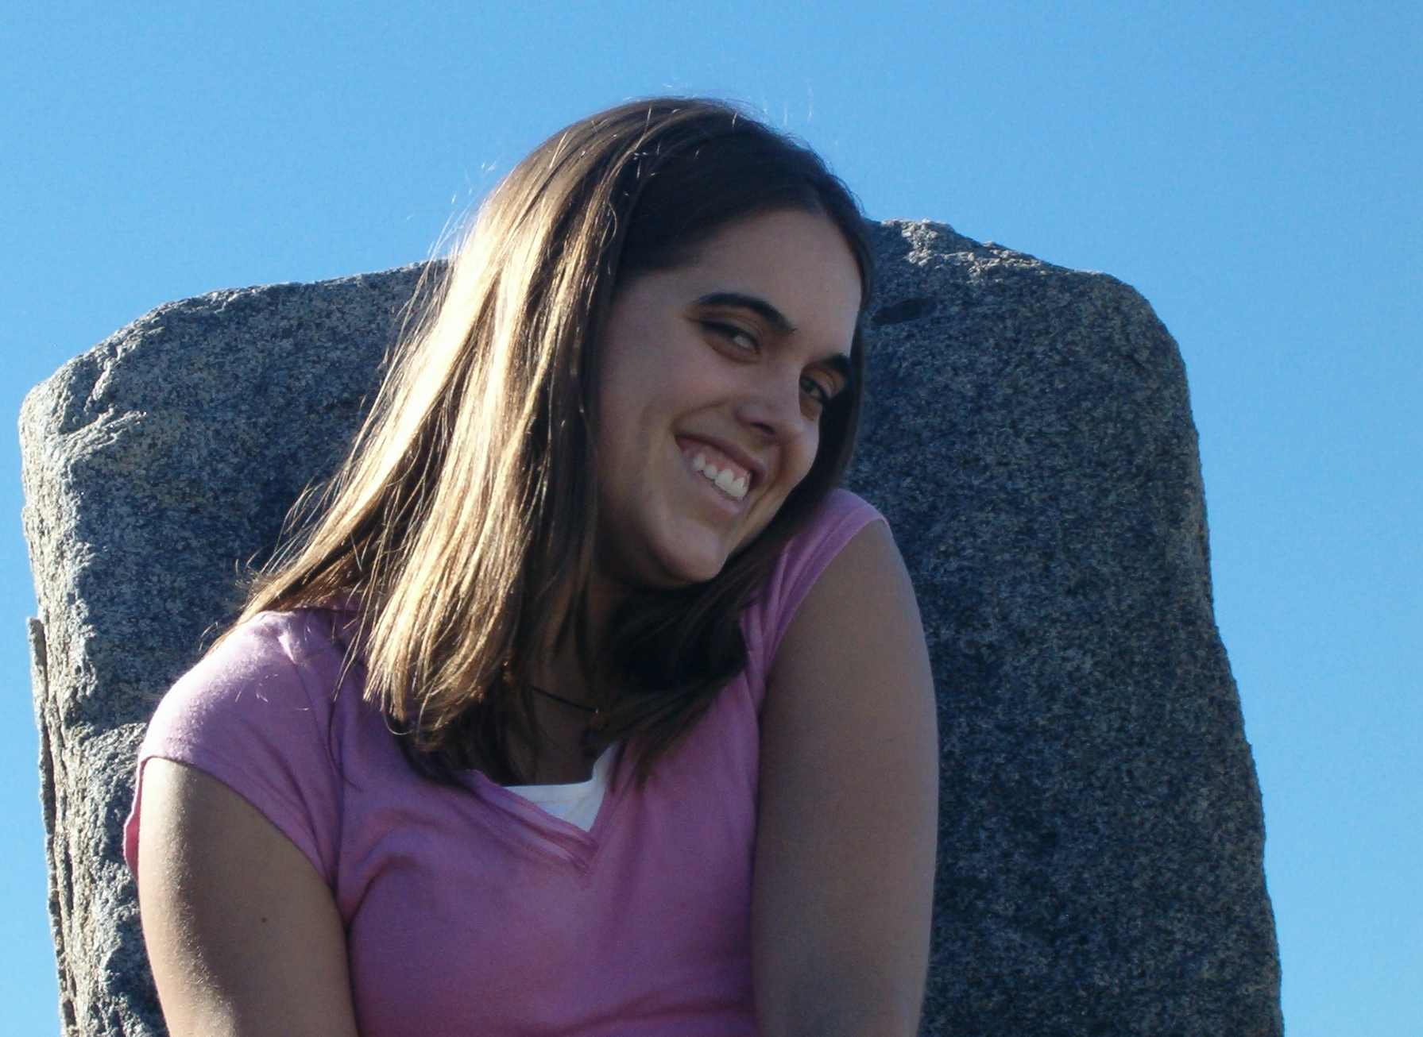
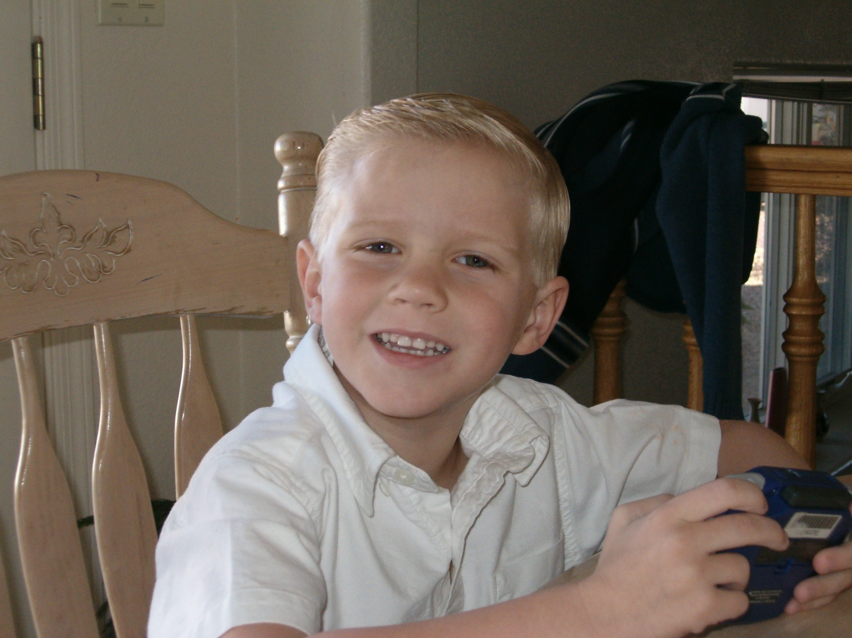
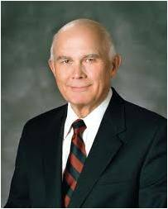
What is Joy?
Joy is more than happiness. Joy is the ultimate sensation of well-being. It comes from being complete and in harmony with our Creator and his eternal laws. …
… God’s mercy is the only source of the ultimate and eternal joy, which restores every loss, dries every tear, and erases every pain. Eternal joy transcends all suffering.
In this life and in the life to come, that joy comes about through the Resurrection and the remission of sins.
Dallin H. Oaks

Slide 6
Sources:
Video:
“I’ll Go Where You Want Me to Go” (5:45)
“Good Things to Share” (2:21)
Hyrum M. Smith Doctrine and Covenants Commentary pg. 65
Presentation by ©http://fashionsbylynda.com/blog/
Elder Neil L. Andersen “Crying repentance simply means helping people return to God” (“Preparing for Your Spiritual Destiny” [CES fireside address, Jan. 10, 2010], 7
Dallin H. Oaks, “Joy and Mercy,” Ensign, Nov. 1991, 73–74
Presentation by ©http://fashionsbylynda.com/blog/

Slide 7
When a person learns the glorious purpose of life, comes to understand that Christ forgives and succors those who follow Him, and then chooses to follow Christ into the waters of baptism, life changes for the better—even when the external circumstances of life do not.
A radiantly happy sister I met in Onitsha, Nigeria, told me that from the time she learned the gospel and was baptized (and now I use her words), “everything is good for me. I am happy. I am in heaven.” Sharing the gospel kindles joy and hope in the souls of both giver and receiver. Truly, “how great shall be your joy” as you share the gospel! Sharing the gospel is joy upon joy, hope upon hope. (Marcus B. Nash, “Hold Up Your Light,” Liahona, Nov. 2021, 71)
The blessings of sharing the gospel include increasing our conversion to the will of God and letting God prevail in our lives. We bless others to experience a “mighty change” of heart [Alma 5:14]. There is truly eternal joy in helping to bring souls unto Christ. (Quentin L. Cook, “Conversion to the Will of God,” Liahona, May 2022, 57)

