Slide 1
Doctrine and Covenants 19:1-24
He Suffered For Us All
“One of the great revelations given in this dispensation; there are few of greater import than this”
Joseph Fielding Smith
Presentation by ©http://fashionsbylynda.com/blog/

Slide 2
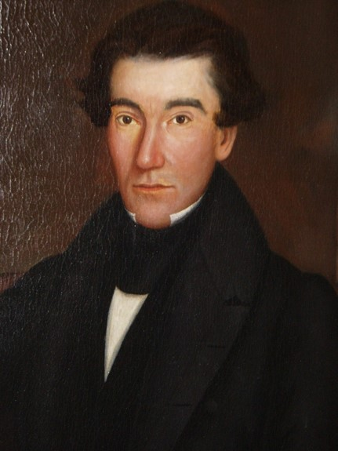
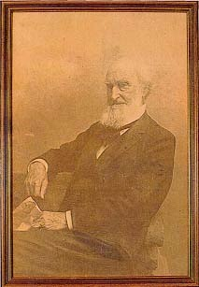
Printing
In June 1829, Joseph Smith hired the printer Egbert B. Grandin to print 5,000 copies of the Book of Mormon at a cost of $3,000. Using his farm as collateral, Martin Harris personally guaranteed to pay the cost of printing if sales of the book did not cover the cost.
An 1843 portrait of Egbert B. Grandin. He was twenty-two when he published the Book of Mormon.
Grandin bought a new typeface, Duodecimo, for the book. The specific book it was used in was the first printed edition of the Book of Mormon.
Egbert B. Grandin was the printer/publisher and John H. Gilbert was the typesetter. It was printed in 1830 in Palmyra, NY.

Slide 3
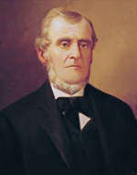
Martin Asks For Revelation
In a plea for comfort and guidance, Martin Harris asked the Prophet Joseph Smith for a revelation from the Lord.
In Doctrine and Covenants 19, the Savior recounted how He chose to submit to Heavenly Father’s will and gained the power to overcome all things.
Desiring to support the Prophet Joseph Smith and the publication of the Book of Mormon, Martin Harris promised to help pay for the printing.
When he later realized that this may require him to sell his farm, he asked Joseph for a revelation of guidance from the Lord.
Martin was promised peace if he would repent and submit to what the Lord had asked him to do.

Slide 4
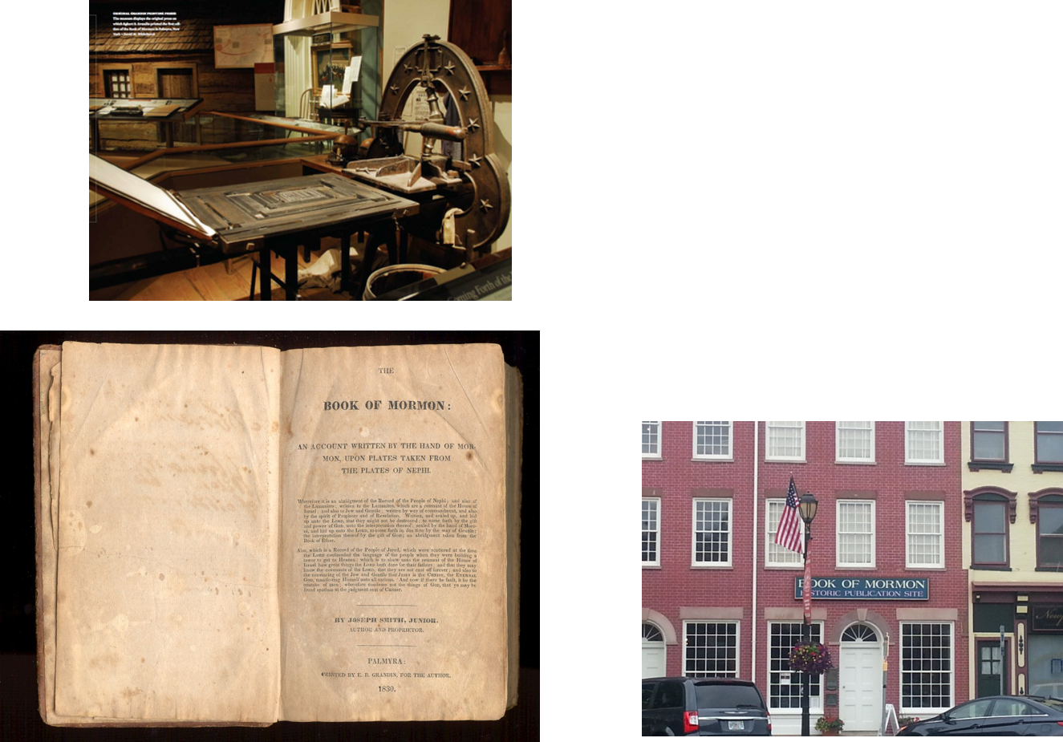
Boycott Sales
. Before the publication was complete, some townspeople held a meeting and passed a resolution not to purchase the Book of Mormon. Concerned about these threats, Grandin stopped printing to avoid not being paid for the work.

Slide 5
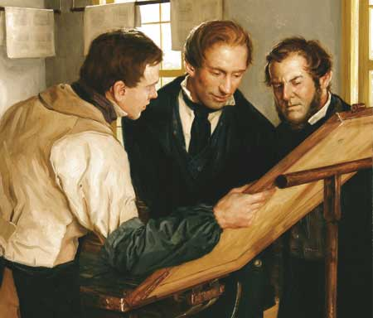
Martin’s Concern
Martin was concerned that the books would not sell, and he requested that Joseph inquire of the Lord about how they should proceed. The revelation found in Doctrine and Covenants 19 was given the next day.

Slide 6
Submitting to Heavenly Father’s Will
What are we asked to do as members of the Church?
Jesus Christ humbly submitted His will to Heavenly Father

Slide 7
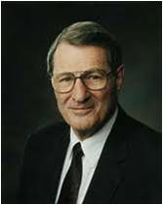
The submission of one’s will is really the only uniquely personal thing we have to place on God’s altar.
The many other things we “give” … are actually the things He has already given or loaned to us.
However, when you and I finally submit ourselves, by letting our individual wills be swallowed up in God’s will, then we are really giving something to Him!
It is the only possession which is truly ours to give!
Neal A. Maxwell

Slide 8
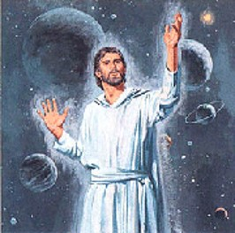
Alpha and Omega
“The first and the last letter of the Greek alphabet, used as symbols of the beginning and the ending. Christ is so called, because He is the Author and the Preserver of all things.”
Smith and Sjodahl
“Hath in these last days spoken unto us by his Son, whom he hath appointed heir of all things, by whom also he made the worlds;”
Hebrews 1:2
“And, Thou, Lord, in the beginning hast laid the foundation of the earth; and the heavens are the works of thine hands:”
Hebrews 1:10
D&C 19:1

Slide 9
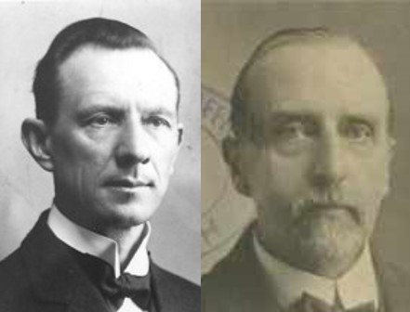
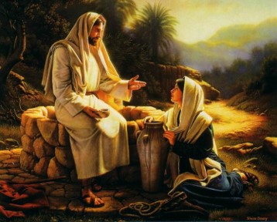
Christ the Lord
“ ‘Christ’ means ‘anointed.’ Prophets, Priests, and Kings were anointed, and our Lord unites all these offices in Him. He is the anointed Lord. The Greek word Christ is the same as the Hebrew Messiah (Mashiac), the title used in:
Smith and Sjodahl
“He first findeth his own brother Simon, and saith unto him, We have found the Messias, which is, being interpreted, the Christ.”
John 1:41
“The woman saith unto him, I know that Messias cometh, which is called Christ: when he is come, he will tell us all things.”
John 4:25
Simon Dewey
D&C 19:1

Slide 10
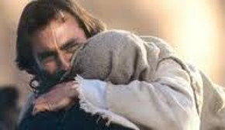
I Am He
“ This is equivalent to Jehovah. …
“Ehyeh ‘asher ‘Ehyeh (Ex. 3:14), which implies that, while He is, or exists, and is therefore different from all non-existing deities of merely human imagination. He is not an abstract existence without form or substance, but He is a real Being, manifesting Himself in history. He is always with His people, active for their welfare.”
“And God said unto Moses, I AM THAT I AM: and he said, Thus shalt thou say unto the children of Israel, I AM hath sent me unto you.”
Exodus 3:14
D&C 19:1

Slide 11
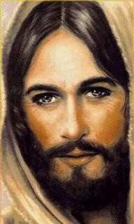
The Beginning and the End
“He was in the beginning and will remain throughout all eternities. He is endless.”
Smith and Sjodahl
“And surely every man must repent or suffer, for I, God, am endless.”
D&C 19:4
D&C 19:1

Slide 12
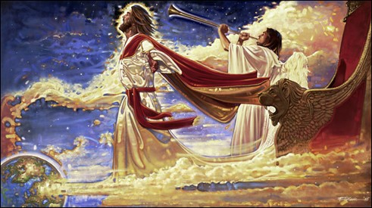
Redeemer of the World
“Christ is our Redeemer. He delivers those who turn to Him from the bondage of sin and guilt. He has ‘bought’ us. And the world will in due time be delivered from the power of Satan, from sin and all its consequences, such as war, poverty, ignorance, sickness, and even death.”
Smith and Sjodahl
“For ye are bought with a price: therefore glorify God in your body, and in your spirit, which are God’s.”
1 Corinthians 6:20
”Ye are bought with a price; be not ye the servants of men.”
1 Corinthians 7:23
D&C 19:1

Slide 13
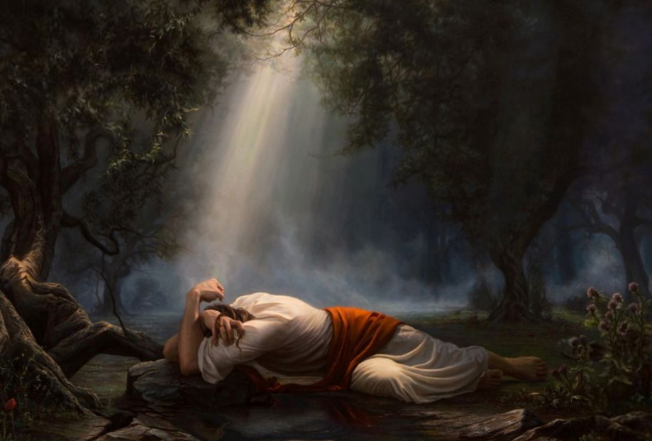
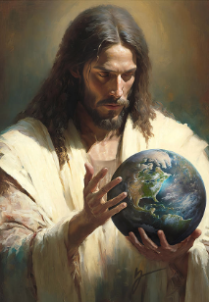
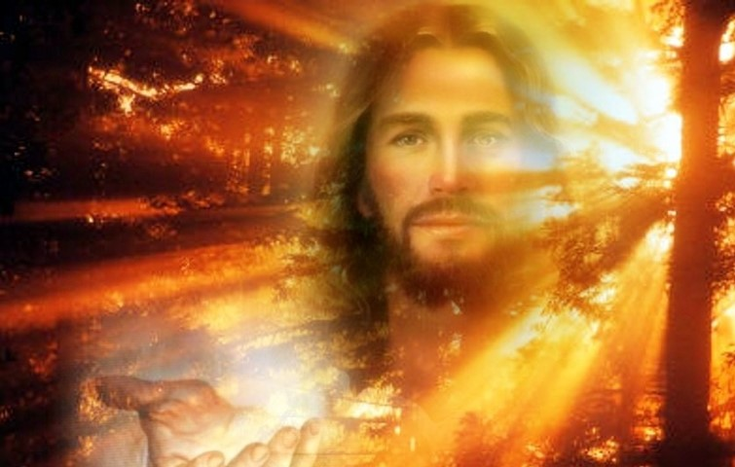
Jesus Christ’s Relationship with His Father
Mortal Ministry
John 6:38; 8:28-29
Mosiah 15:7-8
Premortal Life
Moses 4:1-2
3 Nephi 1:13-14
Postmortal Life
3 Nephi 11:10-11
Adam Abram
Greg Collins

Slide 14
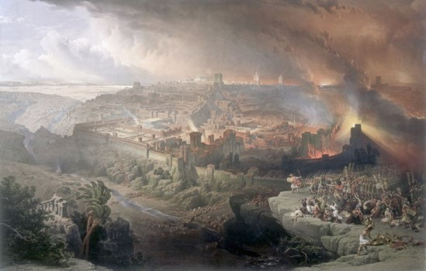
The Kingdom Is His
“Retaining all power, even to the destroying of Satan and his works at the end of the world, and the last great day of judgment, which I shall pass upon the inhabitants thereof, judging every man according to his works and the deeds which he hath done.”
End of the World—this is not a total destruction of the World
The flood was the end of the antediluvian world.
The destruction of Jerusalem by Titus was the end of the world to which the first Christians were looking forward.
The next end of the world will be the overthrow of the kingdoms of the world and the establishment of the Millennium.
D&C 19:3

Slide 15
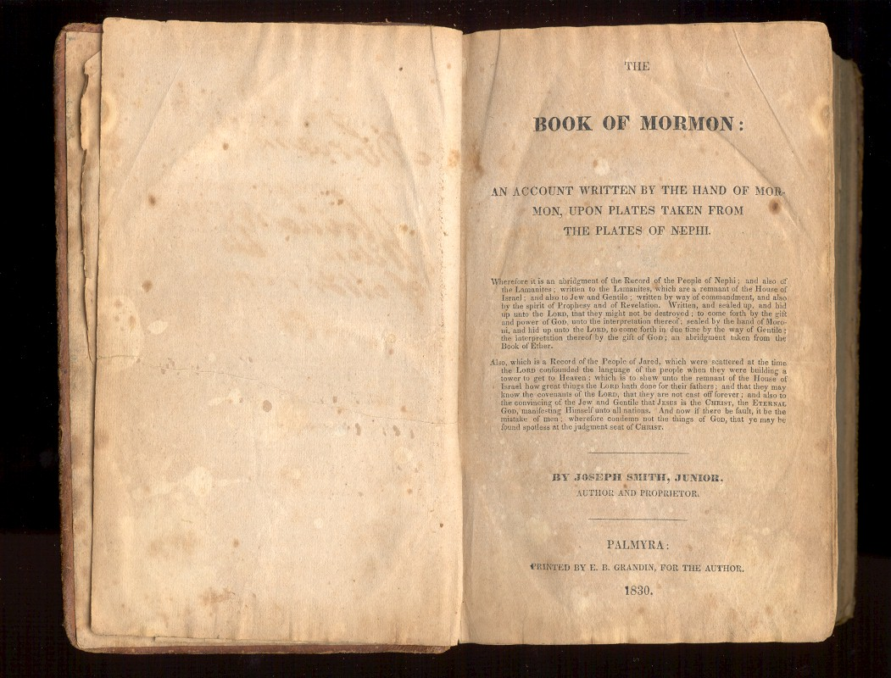
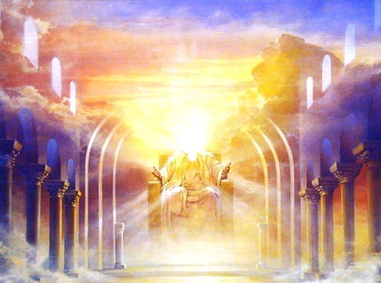
The Savior suffered for our sins so we could repent and not have to suffer as He did.
Jesus Christ’s suffering and His atoning blood satisfied the demands of justice.
Therefore, mercy is extended to those who repent.
Jesus Christ fulfilled the will of His Father.
Jesus Christ will judge us according to our works
D&C 19:16-19

Slide 16
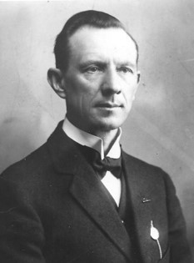
All Must Repent
Those who do not repent will have to suffer a penalty for their sins.
“His judgments are irrevocable. From them there is no appeal. They are final. In that sense they are everlasting.”
Hyrum M. Smith
Endless punishment and eternal punishment do not refer to the length of time people will suffer for their sins.
The Savior said, “I am endless, and the punishment which is given from my hand is endless punishment, for Endless is my name”
Therefore, when He refers to endless punishment or eternal punishment, He is speaking of the punishment
He will administer according to divine law and the requirements of justice.
D&C 19:5-6, 10

Slide 17
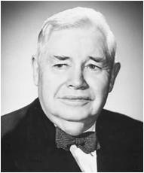
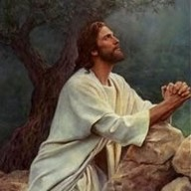
“god’s Punishment”
“When the Lord comes to give us our reward … and our punishment, I feel that [the Savior] will give that punishment which is the very least that our transgression will justify.
I believe that he will bring into his justice all of the infinite love and blessing and mercy and kindness and understanding which he has. …
“And on the other hand, I believe that when it comes to making the rewards for our good conduct, he will give us the maximum that it is possible to give, having in mind the offense which we have committed”
President J. Reuben Clark
D&C 19:4-12

Slide 18
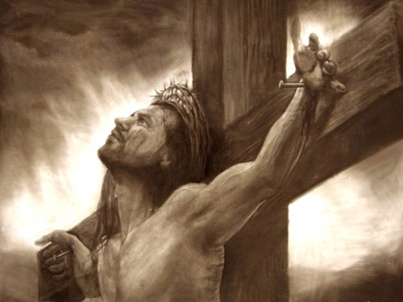
The Reality of Christ’s Suffering
“We cannot comprehend the great suffering that the Lord had to take upon himself to bring to pass this redemption from death and from sin. …
“We get into the habit of thinking, I suppose, that his great suffering was when he was nailed to the cross by his hands and his feet and was left there to suffer until he died.
As excruciating as that pain was, that was not the greatest suffering that he had to undergo, for in some way which I cannot understand, but which I accept on faith, and which you must accept on faith, he carried on his back the burden of the sins of the whole world. It is hard enough for me to carry my own sins. How is it with you? And yet he had to carry the sins of the whole world, as our Savior and the Redeemer of a fallen world, and so great was his suffering before he ever went to the cross, we are informed, that blood oozed from the pores of his body.”
President Joseph Fielding Smith
D&C 19:13-15

Slide 19
The Savior suffered for our sins so we could repent and not have to suffer as He did.
Jesus Christ’s suffering and His atoning blood satisfied the demands of justice.
Therefore, mercy is extended to those who repent.
D&C 19:16-19

Slide 20
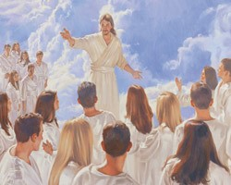
The Choice Is Ours
“We will end up either choosing Christ’s manner of living or His manner of suffering! It is either ‘suffer even as I’ (D&C 19:16–17), or overcome ‘even as [He] … overcame…”
Elder Neal A. Maxwell
“To him that overcometh will I grant to sit with me in my throne, even as I also overcame, and am set down with my Father in his throne.”
Revelation 3:21
“When the doctrine of repentance is fully understood, then it is seen that repentance is all that ever needs to be taught, for repentance means not only to stop doing those things which are wrong but also to start doing those things which are right.” (Ludlow Companion, 1:143)
D&C 19:16-17

Slide 21
Doctrinal Mastery
“For behold, I, God, have suffered these things for all, that they might not suffer if they would repent;
But if they would not repent they must suffer even as I;
Which suffering caused myself, even God, the greatest of all, to tremble because of pain, and to bleed at every pore, and to suffer both body and spirit—and would that I might not drink the bitter cup, and shrink—
Nevertheless, glory be to the Father, and I partook and finished my preparations unto the children of men.
D&C 19:16-19

Slide 22
Truth or Myth
M
The main purpose of repentance is to punish sinners.
Those who don’t repent will be unworthy to return to live with God.
Even though it can be hard, repentance is worth it.
Repentance is a gift from God.
Heavenly Father cannot really love me until I repent.
Repentance is a painless process.
T
T
T
M
M

Slide 23
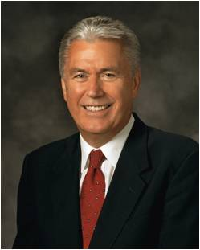
MythS About Repentance
Myth #1:
I still remember my sin, so I must not have been forgiven.
“Satan will try to make us believe that our sins are not forgiven because we can remember them. Satan is a liar; he tries to blur our vision and lead us away from the path of repentance and forgiveness. God did not promise that we would not remember our sins. Remembering will help us avoid making the same mistakes again. But if we stay true and faithful, the memory of our sins will be softened over time.”
—President Dieter F. Uchtdorf

Slide 24
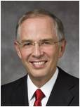
Myth #2:
I still feel guilty, so I must not have been forgiven.
“For those who are truly repentant but seem unable to feel relief: continue keeping the commandments.
I promise you, relief will come in the timetable of the Lord. Healing also requires time.”
—Elder Neil L. Andersen

Slide 25
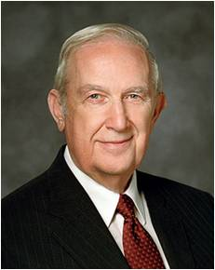
Myth #3:
Bad thoughts just come into my mind, so there’s nothing I can do about it.
“Some bad thoughts come by themselves. Others come because we invite them by what we look at and listen to. Talking about or looking at immodest pictures … can stimulate powerful emotions. It will tempt you to watch improper [videos] or movies. These things surround you, but you must not participate in them. Work at keeping your thoughts clean by thinking of something good. The mind can think of only one thing at a time. Use that fact to crowd out ugly thoughts. Above all, don’t feed thoughts by reading or watching things that are wrong. If you don’t control your thoughts, Satan will keep tempting you until you eventually act them out.”
—Elder Richard G. Scott (1928–2015)

Slide 26
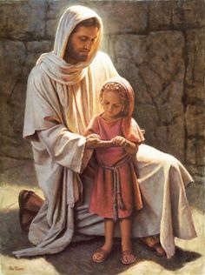
Myth #4:
God can’t love me anymore because of my mistakes.
“God loves all of His children, and He will never cease to love and to hope for us. The plan of our Heavenly Father is clear, and His promises are great: ‘For God sent not his Son into the world to condemn the world; but that the world … might be saved’ (John 3:17).”
—President Dieter F. Uchtdorf
Del Parson

Slide 27
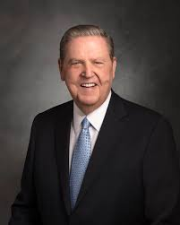
Myth #5:
My sins are so bad that I can’t be forgiven.
“However many chances you think you have missed, however many mistakes you feel you have made or talents you think you don’t have, or however far from home and family and God you feel you have traveled, I testify that you have not traveled beyond the reach of divine love. It is not possible for you to sink lower than the infinite light of Christ’s Atonement shines.”
—Elder Jeffrey R. Holland

Slide 28
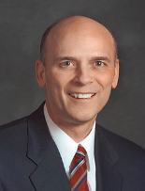
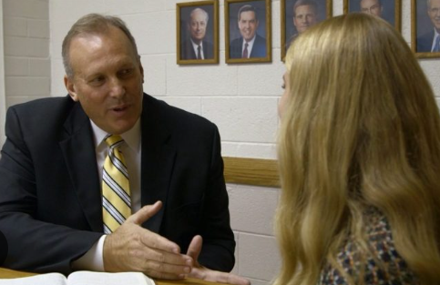
Myth #6:
I’ve stopped committing a serious sin, so I don’t need to see the bishop. I can just pray and be fine, or just tell my parents.
“The Lord has declared that the bishop is a common judge in Israel (see D&C 107:72, 74). He has the responsibility to determine the worthiness of the members of his ward. By ordination and righteous living, the bishop is entitled to revelation from the Holy Ghost regarding the members of his ward, including you.
“The bishop can help you through the repentance process in ways your parents or other leaders are unable to provide. If the sin is serious enough, he may determine that your privileges in the Church should be restricted. For example, as part of your repentance process, he may ask you to refrain from partaking of the sacrament or exercising the priesthood for a period of time. He will work with you and determine when you are worthy again to resume those sacred activities.”
—Elder C. Scott Grow

Slide 29
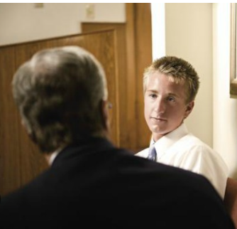
Myth #7:
I can’t talk to the bishop because he’ll look down on me.
“I promise you he will not condemn you. As a servant of the Lord, he will be kind and understanding as he listens to you. He will then help you through the repentance process. He is the Lord’s messenger of mercy to help you become clean through the Atonement of Jesus Christ.”
—Elder C. Scott Grow

Slide 30
Myth #8:
I did it again, so I don’t deserve to be forgiven. Maybe I can’t change.
“Sometimes in our repentance, in our daily efforts to become more Christlike, we find ourselves repeatedly struggling with the same difficulties. As if we were climbing a tree-covered mountain, at times we don’t see our progress until we get closer to the top and look back from the high ridges. Don’t be discouraged. If you are striving and working to repent, you are in the process of repenting.”
“At this very moment, someone is saying, ‘Brother Andersen, you don’t understand. You can’t feel what I have felt. It is too difficult to change.’
“You are correct; I don’t fully understand. But there is One who does. He knows. He has felt your pain. He has declared, ‘I have graven thee upon the palms of my hands’ [Isaiah 49:16]. The Savior is there, reaching out to each of us, bidding us: ‘Come unto me’ [3 Nephi 9:14]. We can repent. We can!”
—Elder Neil L. Andersen

Slide 31
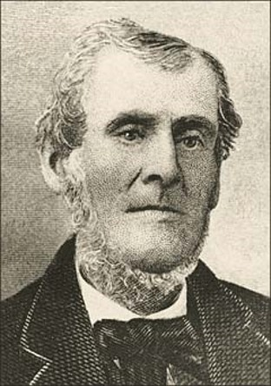
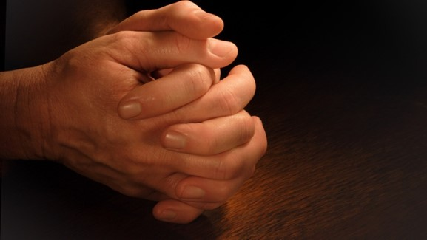
Withdrawal of Spirit
The phrase “at the time I withdrew my Spirit” may have had reference to the experience Martin Harris went through after he lost the 116 manuscript pages of the Book of Mormon.
Lucy Mack Smith, Joseph’s mother, recalled that when Martin Harris told Joseph Smith about the lost manuscript, he “cried out in a tone of deep anguish, ‘Oh, I have lost my soul! I have lost my soul!’”
Suffering for sin can happen in mortality as well as after we die. When we sin, the Holy Ghost withdraws, leaving us without the comfort and sanctifying power of His presence. In His absence, we get a “taste” of the suffering the Savior experienced as He suffered for our sins.
The process of repentance makes it possible for us to reconcile ourselves with our Father in Heaven and again enjoy the companionship of the Holy Ghost, with all its attendant blessings.
D&C 19:20

Slide 32
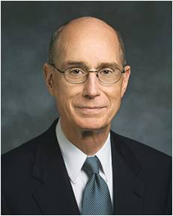
“If you have difficulty in feeling the Holy Ghost, you might wisely ponder whether there is anything for which you need to repent and receive forgiveness”
Henry B. Eyring

Slide 33
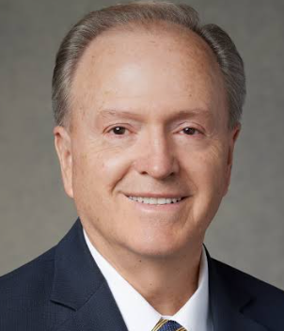
No one is more on our side than the Savior. …
… Repentance isn’t His backup plan in the event we might fail. Repentance is His plan, knowing that we will.
Lynn G. Robbins

Slide 34
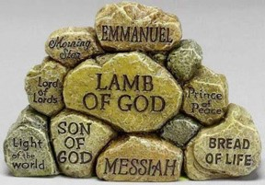
Sources:
“For God So Loved the World” (4:48), beginning at time code 1:56.
Sin Results in Suffering (0:36)
“Christ Suffered for All” (2:20)
“Where Justice, Love, and Mercy Meet” (5:36)
Atonement—Not a One-Time Thing (3:00)
Where the Book of Mormon Went to Press Feb. 1998 Ensign
Neal A. Maxwell, “Swallowed Up in the Will of the Father,” Ensign, Nov. 1995, 24)
Hyrum M. Smith and Janne M. Sjodahl Commentary pg. 91, 93
” President J. Reuben Clark (“As Ye Sow … ,” Brigham Young University Speeches of the Year [May 3, 1955], 7).
President Joseph Fielding Smith (In Conference Report, Oct. 1947, pp. 147–48.)
Elder Neal A. Maxwell (“Overcome … Even As I Also Overcame,” Ensign, May 1987, 72).
Lucy Mack Smith (History of Joseph Smith by His Mother, ed. Preston Nibley [1958], 128).
Presentation by ©http://fashionsbylynda.com/blog/
“Eight Myths about Repentance,” Liahona, Mar. 2016, 52–55.
Henry B. Eyring(“Gifts of the Spirit for Hard Times,” Ensign or Liahona, June 2007, 23).
Lynn G. Robbins, “Until Seventy Times Seven,” Ensign or Liahona, May 2018, 22
Presentation by ©http://fashionsbylynda.com/blog/

Slide 35
Submission to His Will:
Men and women who turn their lives over to God will discover that He can make a lot more out of their lives than they can. He will deepen their joys, expand their vision, quicken their minds, … lift their spirits, multiply their blessings, increase their opportunities, comfort their souls, raise up friends, and pour out peace. Whoever will lose his life in the service of God will find eternal life. (Teachings of Presidents of the Church: Ezra Taft Benson [2014], 42–43)
D&C 19:6, 11-12 Endless Punishment and Torment
“We learn from the Doctrine and Covenants that eternal punishment, or everlasting punishment, does not mean that a man condemned will endure this punishment forever. … When a man pays the penalty of his misdeeds and humbly repents, receiving the gospel, he comes out of the prison house and is assigned to some degree of glory according to his worth and merit” (Doctrines of Salvation, comp. Bruce R. McConkie, 3 vols. [1954–1956], 2:160). President Joseph Fielding Smith
D&C 19:6, 11-12 Endless Punishment and Torment
“‘Eternal punishment’ … does not mean that the individual sufferer or sinner is to be eternally and everlastingly made to endure and suffer. No man will be kept in hell longer than is necessary to bring him to a fitness for something better. When he reaches that stage the prison doors will open and there will be rejoicing among the hosts who welcome him into a better state” (in Conference Report, Apr. 1930, 97; see also Doctrine and Covenants Student Manual, 2nd ed. [Church Educational System manual, 2001], 37). James E. Talmage
D&C 19:2,19: His will
The thing Christ seems most anxious to stress about His mission—beyond the personal virtues and beyond the magnificent sermons and even beyond the healing, is that He submitted His will to the will of the Father” (“Therefore, What?” [address to CES religious educators, Aug. 8, 2000], 8, LDS.org). Elder Jeffrey R. Holland
D&C 19:6, 11-12 Justice
“When the Lord comes to give us our reward … and our punishment, I feel that [the Savior] will give that punishment which is the very least that our transgression will justify. I believe that he will bring into his justice all of the infinite love and blessing and mercy and kindness and understanding which he has. … President J. Rueben Clark
D&C 19:6, 11-12 Endless Punishment and Torment
“When the Lord comes to give us our reward … and our punishment, I feel that [the Savior] will give that punishment which is the very least that our transgression will justify. I believe that he will bring into his justice all of the infinite love and blessing and mercy and kindness and understanding which he has. …
“And on the other hand, I believe that when it comes to making the rewards for our good conduct, he will give us the maximum that it is possible to give, having in mind the offense which we have committed” (“As Ye Sow … ,” Brigham Young University Speeches of the Year [May 3, 1955], 7). President J. Reuben Clark

Slide 36
JESUS CHRIST FULFILLED THE WILL OF HIS FATHER. | JESUS CHRIST WILL JUDGE US ACCORDING TO OUR WORKS.
D&C 19:15, 18–19 The Savior’s suffering was sore, exquisite, and hard to bear. The Savior’s suffering caused Him to tremble because of pain and to bleed from every pore. Jesus Christ suffered both physically and spiritually. The Savior prayed that He might be spared from partaking of the bitter cup. The Savior fulfilled the Father’s will and “finished [His] preparations unto the children of men” (D&C 19:19). | D&C 19:4–12 All men must repent or suffer. God’s punishment D&C 19:13–17 Those who choose not to repent will suffer the penalty for their sins. D&C 19:16–19 Jesus Christ’s suffering and His atoning blood satisfied the demands of justice. Therefore, mercy is extended to those who repent.

Slide 37
Eternal Punishment VS Eternal Damnation:
Elder Bruce R. McConkie explained the difference between these two terms:
“Eternal damnation is the opposite of eternal life, and all those who do not gain eternal life, or exaltation in the highest heaven within the celestial kingdom, are partakers of eternal damnation. Their eternal condemnationis to have limitations imposed upon them so that they cannot progress to the state of godhood and gain a fulness of all things.
“They ‘remain separately and singly, without exaltation, … to all eternity; and from henceforth are not gods, but are angels of God forever and ever.’ (D. & C. 132:17.) Their kingdom or progress has an ‘end,’ and they ‘cannot have an increase.’ (D. & C. 131:4) Spirit children are denied to them to all eternity, and they inherit ‘the deaths,’ meaning an absence of posterity in the resurrection. (D. & C. 132:16–25)
“They are never redeemed from their spiritual fall and taken back into the full presence and glory of God. Only the obedient are ‘raised in immortality unto eternal life.’ The disobedient, ‘they that believe not,’ are raised in immortality ‘unto eternal damnation; for they cannot be redeemed from their spiritual fall, because they repent not.’ (D. & C. 29:42–44)” (Mormon Doctrine, p. 234.)
End of the World:
Elder Bruce R. McConkie explained that this expression does not mean the end of the earth: “The end of the world is the end of unrighteousness or of worldliness as we know it, and this will be brought about by ‘the destruction of the wicked’ [JS—M 1:4]. When our world ends and the millennial era begins, there will be a new heaven and a new earth. (Isa. 65:17–25; D. & C. 101:23–24) Lust, carnality, and sensuousness of every sort will cease, for it will be the end of the world.” (Mormon Doctrine, p. 848.)
God’s Punishments:
Elder James E. Talmage stated: “During this hundred years [of Church history] many other great truths not known before, have been declared to the people, and one of the greatest is that to hell there is an exit as well as an entrance. Hell is no place to which a vindictive judge sends prisoners to suffer and to be punished principally for his glory; but it is a place prepared for the teaching, the disciplining of those who failed to learn here upon the earth what they should have learned. True, we read of everlasting punishment, unending suffering, eternal damnation. That is a direful expression; but in his mercy the Lord has made plain what those words mean. ‘Eternal punishment,’ he says, is God’s punishment, for he is eternal; and that condition or state or possibility will ever exist for the sinner who deserves and really needs such condemnation; but this does not mean that the individual sufferer or sinner is to be eternally and everlastingly made to endure and suffer. No man will be kept in hell longer than is necessary to bring him to a fitness for something better. When he reaches that stage the prison doors will open and there will be rejoicing among the hosts who welcome him into a better state. The Lord has not abated in the least what he has said in earlier dispensations concerning the operation of his law and his gospel, but he has made clear unto us his goodness and mercy through it all, for it is his glory and his work to bring about the immortality and eternal life of man.” (In Conference Report, Apr. 1930, p. 97.)
Eternal punishment Elder James E. Talmage of the Quorum of the Twelve Apostles gave additional insights concerning the meaning of eternal punishment:
“‘Eternal punishment’ … does not mean that the individual sufferer or sinner is to be eternally and everlastingly made to endure and suffer. No man will be kept in hell longer than is necessary to bring him to a fitness for something better. When he reaches that stage the prison doors will open and there will be rejoicing among the hosts who welcome him into a better state” (in Conference Report, Apr. 1930, 97; see also Doctrine and Covenants Student Manual,2nd ed. [Church Educational System manual, 2001], 37).

Slide 38
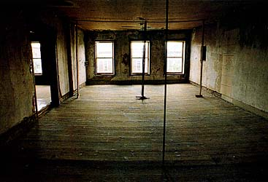
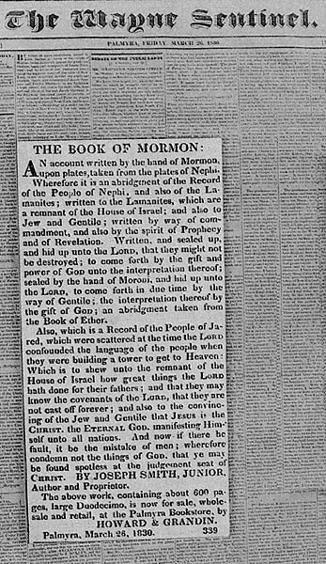
Where the Book of Mormon Went to Press
The second floor of the Grandin building, where E. B. Grandin and a partner, Luther Howard, operated a bindery. Here each sixteen-page sheet of the Book of Mormon was folded, stitched, and cut into a booklet, called a signature. There were thirty-seven signatures in the book. These were assembled and bound in sheepskin covers.
A page from the Wayne Sentinel with the first advertisement for the Book of Mormon. E. B. Grandin printed this weekly newspaper. The book did not sell well because local residents boycotted sales.

Slide 39
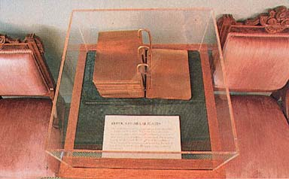
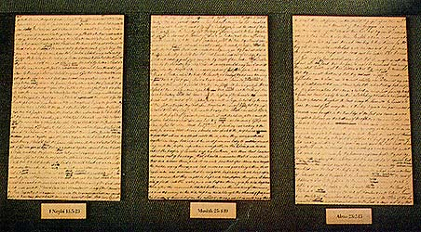
Model of the gold plates, based on eyewitness descriptions of their appearance. By the inspiration of God, Joseph Smith translated the Book of Mormon from an ancient American record made of thin gold plates.
Three sheets from the printer’s manuscript of the Book of Mormon. The original manuscript that Oliver Cowdery made under Joseph Smith’s dictation was written so quickly that it contained no punctuation, little capitalization, and many spelling errors. At Joseph Smith’s request, Oliver Cowdery made another handwritten copy for the printer to use. This extra copy helped protect the translation from possible loss.

Slide 40
Duodecimo
Typeface
End of the World:
Elder Bruce R. McConkie explained that this expression does not mean the end of the earth: “The end of the world is the end of unrighteousness or of worldliness as we know it, and this will be brought about by ‘the destruction of the wicked’ [JS—M 1:4]. When our world ends and the millennial era begins, there will be a new heaven and a new earth. (Isa. 65:17–25; D. & C. 101:23–24) Lust, carnality, and sensuousness of every sort will cease, for it will be the end of the world.” (Mormon Doctrine, p. 848.)

