Slide 1
Doctrine and Covenants 19:25-41
Sacrifices with Eternal Perspective
“And these all, having obtained a good report through faith, received not the promise:
God having provided some better thing for us, that they without us should not be made perfect.”
Hebrews 11:39-40
Presentation by ©http://fashionsbylynda.com/blog/

Slide 2
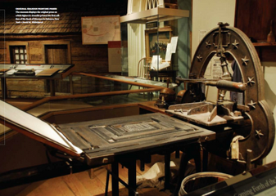
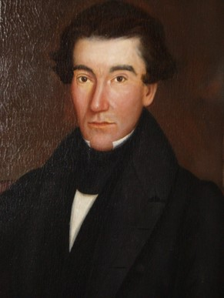
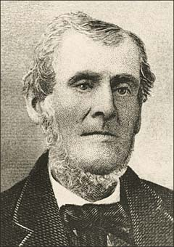
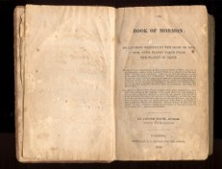
Recap--Martin’s Farm
In order to guarantee E. B. Grandin payment for printing the Book of Mormon, Martin Harris signed a mortgage agreement on his farm in August 1829.
During the printing, some local citizens held a meeting and passed resolutions not to purchase the Book of Mormon. guidance.
Martin Harris, fearing that he might lose his farm if the Book of Mormon did not sell, approached the Prophet and requested guidance.

Slide 3
Martin’s Situation
Sacrifices
Sacrifices for You
Counsel from God
Money for Printing Book of Mormon
Money
A portion of property and land
Giving up two years away from home
Leave your home to preach the gospel
Job/Education
Family or Friends
Pray always

Slide 4
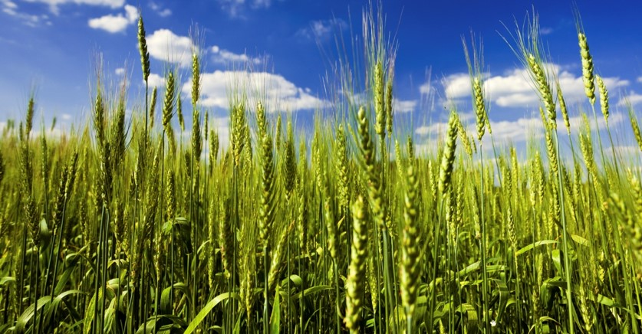
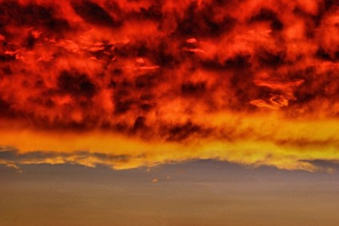
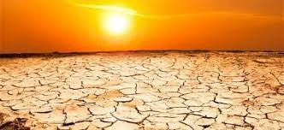
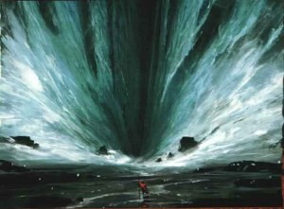
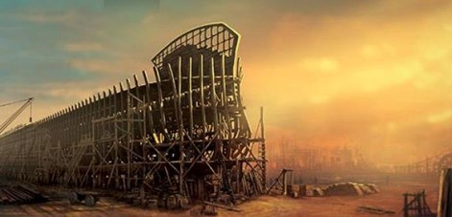
Having Faith To Follow Through
If you were faced with having to do something that was right, but you were unsure how it would turn out, what would help you have the faith to follow through even though it was hard?
Hebrews 11
By faith Noah built an ark and saved his family from the flood
Moses parted the waters of the Red Sea
Elijah called down fire from heaven (see 1 Kings 18:17–40).
Nephi called for a famine
He also asked the Lord to end the famine
Seas have been calmed, visions opened, and prayers answered, all through the power of faith.
Gospel Principles
D&C 19:23-24

Slide 5
Learn of Me
“The truth is, those who diligently seek to learn of Christ eventually will come to know Him.
They will personally receive a divine portrait of the Master, although it most often comes in the form of a puzzle—one piece at a time.
Each individual piece may not be easily recognizable by itself; it may not be clear how it relates to the whole.
Each piece helps us to see the big picture a little more clearly.
Eventually, after enough pieces have been put together, we recognize the grand beauty of it all.
Then, looking back on our experience, we see that the Savior had indeed come to be with us—not all at once but quietly, gently, almost unnoticed.”
If we learn of Christ, listen to His words, and walk in the meekness of His Spirit, then we will have peace.
D&C 19:23-24 President Dieter F. Uchtdorf

Slide 6
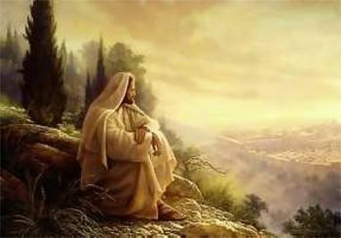
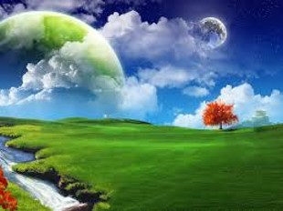
Inner Peace
“Peace can mean either freedom from conflict and turmoil or the inner calm and comfort born of the Spirit that God gives to his faithful Saints”
Guide to the Scriptures
“And the peace of God, which passeth all understanding, shall keep your hearts and minds through Christ Jesus.”
Philippians 4:7
“But learn that he who doeth the works of righteousness shall receive his reward, even peace in this world, and eternal life in the world to come.”
D&C 59:23
D&C 19:23

Slide 7
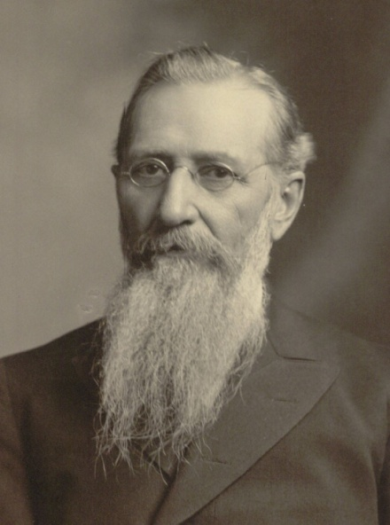
Shalt Not Covet
“And again, I command thee that thou shalt not covet thine own property, but impart it freely to the printing of the Book of Mormon, which contains the truth and the word of God—”
“We are here on His (Christ’s Earth, we breath His air, we behold His sunlight. We eat His food, we wear His clothing. “Our “Own” property belongs to Him.”
Joseph F. Smith
D&C 19:26

Slide 8
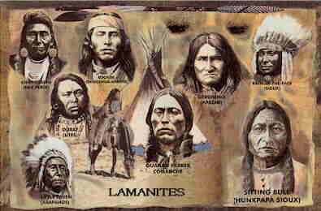
Lamanites
“Not only in the Book of Mormon are the descendants of Lehi called Jews, but also in the Doctrine and Covenants... Again, in giving instruction to the elders who had journeyed from Kirtland to Missouri, the Lord revealed the place for the building of the temple and gave instruction for the purchase of land ‘lying westward, even unto the line running directly between Jew and Gentile.’ (Section 57:4.) This line westward was the dividing line between the whites and Indians.”
“Lehi was a citizen of Jerusalem, in the kingdom of Judah. Presumably his family had lived there for several generations, and all of the inhabitants of the kingdom of Judah, no matter which tribe they had descended through, were known as Jews. …
The Mulekites in the Book of Mormon were of, and present-day Lamanites share this heritage. Also, in the Book of Mormon Jew is sometimes used to mean the whole house of Israel
Manual
D&C 19:27 President Joseph Fielding Smith

Slide 9
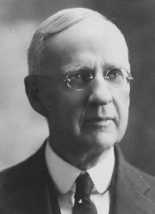
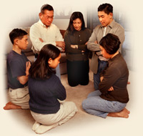
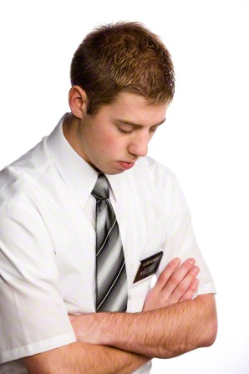
Pray Vocally
“Prayer is not reserved for the Sabbath day or for any particular occasion. It is not only to be used at the general conferences of the Church, but the spirit of prayer must be in our hearts unceasingly.
We must pray in our families; we must pray in secret; we must pray in our hearts. The spirit of prayer must be with us when we retire at night and when we arise in the morning.
It must be upon us when we leave our homes for our daily employment; in the office; in the shop; in the field; in the mountains or in the valleys, or wherever we are.
We are told … that if that spirit is upon us the Lord will bless us, and the blessings which will come in answer to prayer will be of more importance to us than treasures of earth.”
Elder Rudger Clawson
D&C 19:28

Slide 10
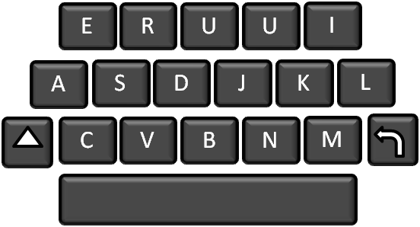
Share the Gospel
“…and to stand as witnesses of God at all times and in all things, and in all places that ye may be in,…”
Mosiah 18:9
“There are new ways to invite others to ‘come and see.’ Let’s make sharing our faith online more a part of our daily life. LDS.org, Mormon.org, Facebook, Twitter—all provide opportunities.” — Elder Neil L. Andersen
“After all that has been said, the greatest and most important duty is to preach the Gospel”
Prophet Joseph Smith
There's no shortage of ways to spread the word. Blogs, social networks, instant messenger, and mobile phones can help you share the gospel on the web.
Publishing your life through a blog can be an excellent way to share with the world what being a member of the Church means to you.
D&C 19:29

Slide 11
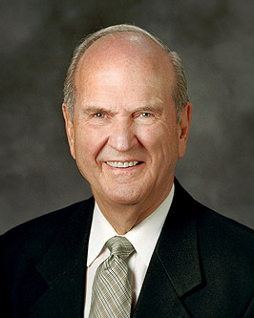
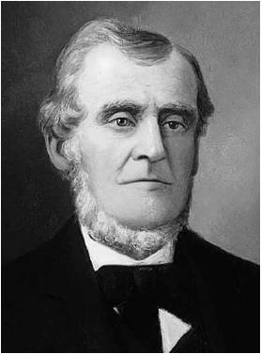
Ignoring Lord’s Counsel
Disregarding God’s Commandment:
“[You] will encounter people who pick which commandments they will keep and ignore others that they choose to break. I call this the cafeteria approach to obedience. This practice of picking and choosing will not work. It will lead to misery. To prepare to meet God, one keeps all of His commandments”
Elder Russell M. Nelson
Just as the Lord knew Martin Harris, He knows each of us. And just as He gave Martin commandments and counsel to help him, the Lord gives commandments and counsel to help us.
Are there any commandments that you might disregard of have a tendency to not fully keep them?
D&C 19:33

Slide 12
A Sacrifice
“Born in poverty but nurtured in faith, Jose [Garcia] prepared for a mission call. I was present the day his recommendation was received.
There appeared the statement: ‘Brother Garcia will serve at great sacrifice to his family, for he is the means of much of the family support.
He has but one possession—a treasured stamp collection—which he is willing to sell, if necessary, to help finance his mission.’
“President [Spencer W.] Kimball listened attentively as this statement was read to him, and then he responded: ‘Have him sell his stamp collection. Such sacrifice will be to him a blessing’”
D&C 19:36-41

Slide 13
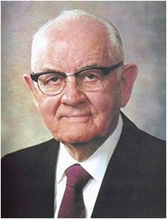
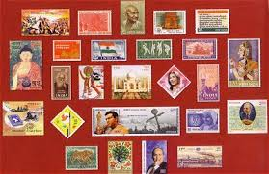
If we do the will of the Lord, He will give us blessings that are of greater value than the treasures of the earth.
“Then, with a twinkle in his eye and a smile on his face, this loving prophet said, ‘Each month at Church headquarters we receive thousands of letters from all parts of the world.
See that we save these stamps and provide them to Jose at the conclusion of his mission. He will have, without cost, the finest stamp collection of any young man in Mexico’”
President Thomas S. Monson
D&C 19:36-41

Slide 14
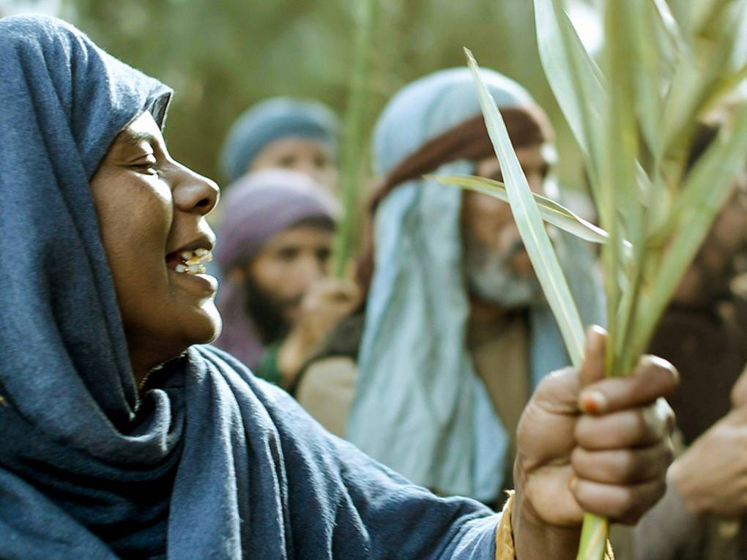
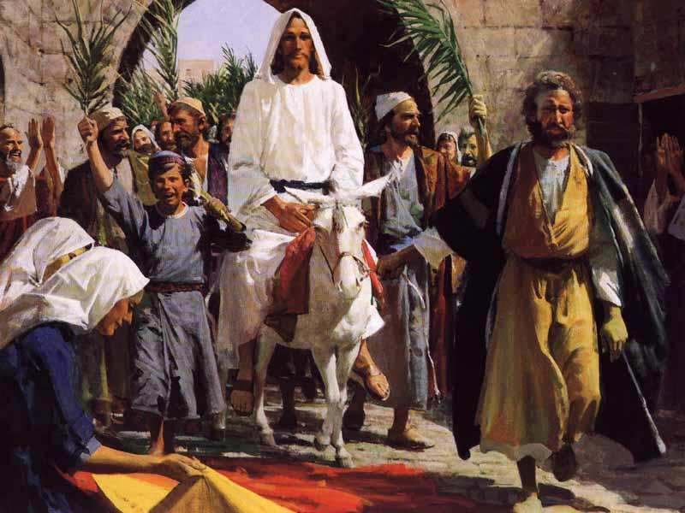
Hosanna
“Hosanna is a transliteration of a Hebrew (or Semitic) word that literally means ‘save now’ and that could be translated ‘grant us salvation.’
Most of the prayers said by the Jews at the Feast of Tabernacles begin with this word, and it was also used by the multitude as they greeted Jesus Christ when he came into Jerusalem during the last week of His life upon the earth. …”
(Ludlow, Companion, 2:136.)
“And the multitudes that went before, and that followed, cried, saying, Hosanna to the Son of David: Blessed is he that cometh in the name of the Lord; Hosanna in the highest.”
Matthew 21:9
D&C 19:37

Slide 15
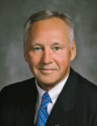
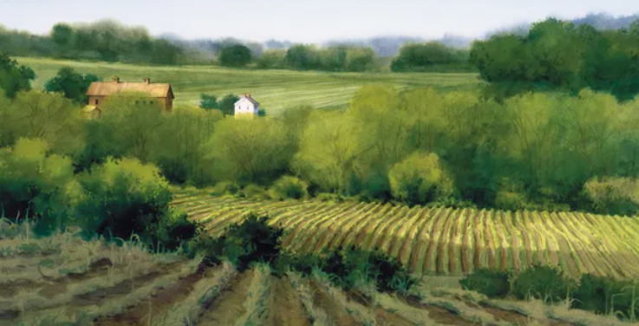
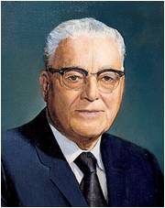
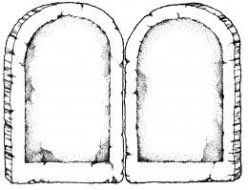
Obedience
“When we choose to disobey a commandment, it is usually because (1) we have convinced ourselves that the commandment does not apply to us; (2) we do not believe that it is important; or (3) we are certain that it is too difficult to obey”
Elder Bruce A. Carlson
“The safety of the church lies in the members keeping the commandments. … As they keep the commandments, blessings will come” President Harold B. Lee
Martin Harris obeyed the command to impart of his property to finance the printing of the Book of Mormon by selling 151 acres of his farm.
Because of Martin’s choice, millions of lives have been blessed and will continue to be blessed.

Slide 16
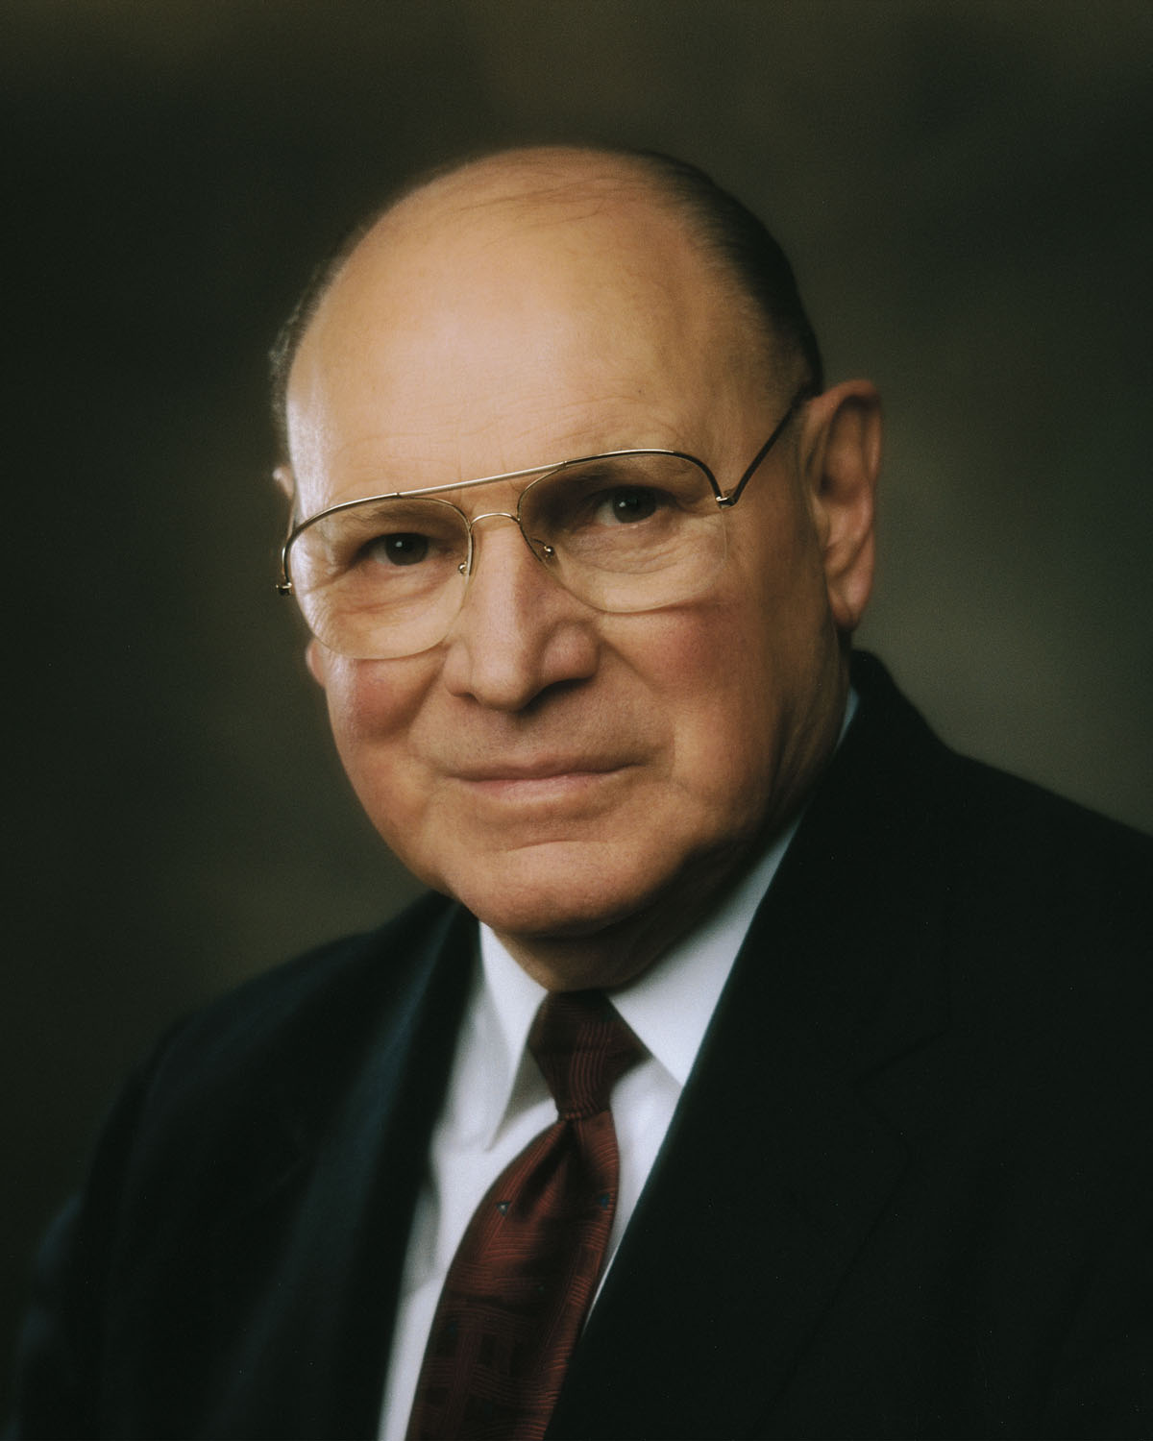
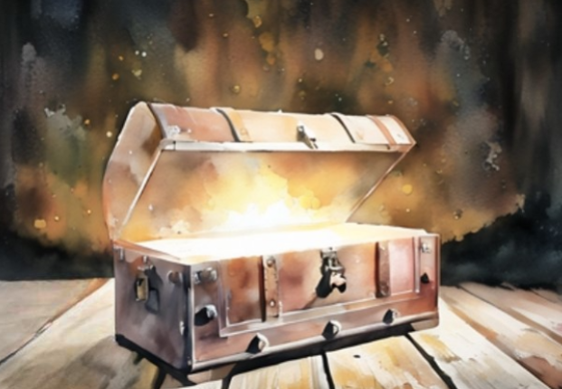
Blessings Greater Than Treasures
The scriptures tell us, “Lay not up for yourselves treasures upon earth, where moth and rust doth corrupt, and where thieves break through and steal: But lay up for yourselves treasures in heaven” [Matthew 6:19–20].
The riches of this world are as dust compared to the riches that await the faithful in the mansions of our Heavenly Father.
How foolish is he who spends his days in the pursuit of things that rust and fade away. How wise is he who spends his days in the pursuit of eternal life.
Joseph B. Wirthlin
D&C 19:38

Slide 17
Sources:
Videos:
A Blessing from Sacrifice, Part 1(0:58) and A Blessing from Sacrifice, Part 2(0:35)
Sharing Your Beliefs (2:02)
Quote by Joseph F. Smith--Hyrum M. Smith and Janne M. Sjodahl Commentary pg. 96
Chapter 18: Faith in Jesus Christ Gospel Principles, (2011), 101–6
President Dieter F. Uchtodorf Waiting on the Road to Damascus May 2011 Gen. Conf
(Guide to the Scriptures, “Peace,” scriptures.lds.org).
President Joseph Fielding Smith (“How Was Lehi a Descendant of the Jews?” Improvement Era, Oct. 1955, p. 702.)
Student Manual Doctrine and Covenants Religion 324-325 pg. 38
Elder Rudger Clawson(In Conference Report, Apr. 1904, pp. 42–43
Prophet Joseph Smith (Teachings, p. 113).
Presentation by ©http://fashionsbylynda.com/blog/
Elder Neil L. Andersen Sharing the Gospel on Line
Elder Russell M. Nelson(“Face the Future with Faith,” Ensign or Liahona, May 2011, 34).
President Thomas S. Monson(“Profiles of Faith,” Ensign, Nov. 1978, 56).
Elder Bruce A. Carlson (“When the Lord Commands,” Ensign or Liahona, May 2010, 38).
President Harold B. Lee (Stephen W. Gibson, “Presidency Meets the Press,” Church News, July 15, 1972, 3).
Joseph B. Wirthlin, “Earthly Debts, Heavenly Debts,” Ensign or Liahona, May 2004, 43
Presentation by ©http://fashionsbylynda.com/blog/

Slide 18
Martin Harris’s Key Contribution:
Elder Dallin H. Oaks of the Quorum of the Twelve Apostles highlighted Martin Harris’s key contribution to the Restoration of the gospel:
“Having a special interest in Martin Harris, I have been saddened at how he is remembered by most Church members. He deserves better than to be remembered solely as the man who unrighteously obtained and then lost the initial manuscript pages of the Book of Mormon…
“One of Martin Harris’s greatest contributions to the Church, for which he should be honored for all time, was his financing the publication of the Book of Mormon. In August 1829 he mortgaged his home and farm to Egbert B. Grandin to secure payment on the printer’s contract. Seven months later, the 5,000 copies of the first printing of the Book of Mormon were completed. Later, when the mortgage note fell due, the home and a portion of the farm were sold for $3,000. In this way, Martin Harris was obedient to the Lord’s revelation:
“‘Thou shalt not covet thine own property, but impart it freely to the printing of the Book of Mormon…
“‘Pay the debt thou hast contracted with the printer. Release thyself from bondage’ (D&C 19:26, 35)” (“The Witness: Martin Harris,” Ensign, May 1999, 36).
Journal Notes:
None of the early residents of Palmyra, with the exception of the Smith family, ‘received so many rebuffs’ and endured ‘so many unfeeling comments’ from near neighbors as Martin did. Let it be remembered that no other early believer in the Restoration contributed more financial support to the coming forth of the Book of Mormon than Martin. Without his willingness to meet the publisher’s financial requirements, the printing of the Book of Mormon would have been delayed if not postponed for an indeterminate season. … The financial support of Martin Harris, too often forgotten in the abyss of history and the personal struggles of the man, was very significant. Martin was raised up to help a prophet of God secure the first publication of the Restoration, and he fulfilled that important role at great personal cost” (Susan Easton Black and Larry C. Porter, “For the Sum of Three Thousand Dollars, ”Journal of Book of Mormon Studies, vol. 14, no. 2 [2005], 11).
Martin Harris was faithful to the Lord’s instructions in Doctrine and Covenants 19 and did impart freely of his property to finance the printing of the Book of Mormon. Martin Harris owned approximately 231 acres of quality farmland. He had previously deeded 80 acres to his wife Lucy Harris, leaving about 151 acres under his control. In August 1829 Martin mortgaged those 151 acres to the printer Egbert B. Grandin as payment for the $3,000 cost of printing the Book of Mormon. When the mortgage was signed, E. B. Grandin considered himself paid in full and immediately began work on printing the book.
According to the terms of the 18-month mortgage, Martin Harris was not required to make regular payments and he was entitled to remain on the land. He also retained the option to sell the property at any time and use the proceeds to pay E. B. Grandin the $3,000 owed him. E. B. Grandin had the right to sell the property or assign the mortgage note to someone else at any time during the term of the mortgage. In October 1830, E. B. Grandin sold the mortgage note to Thomas Rogers, who later sold the property to Thomas Lakey. Since E. B. Grandin had the ability to sell the mortgage at any time, his investment was secure from the moment the note was signed. Thus, Martin Harris’s mortgage essentially paid for the costs of printing the Book of Mormon from the beginning of the publication process. (See Documents, Volume 1: July 1828–June 1831, vol. 1 of the Documents series of The Joseph Smith Papers [2012], 86–89.)
In 1813, at the age of 30, Martin Harris acquired 320 acres of his father's farm just north of Palmyra, where he prospered and was active in community affairs. When Joseph Smith, Jr. translated the record that became the Book of Mormon, Harris was one of his first scribes and helped pay expenses. He also mortgaged part of his farm to pay for the book's publication, and he was one of the witnesses who bore testimony of the divinity of the book. HillCumorah.org

