Slide 1
Lesson 26
Articles and Covenants
Doctrine and Covenants 20:1-36
The
Book
of
Mormon
ANOTHER TESTAMENT
OF JESUS CHRIST
“And we know that these things are true and according to the revelations of John, neither adding to, nor diminishing from the prophecy of his book, the holy scriptures, or the revelations of God which shall come hereafter by the gift and power of the Holy Ghost, the voice of God, or the ministering of angels.”
D&C 20:35
Presentation by ©http://fashionsbylynda.com/blog/

Slide 2
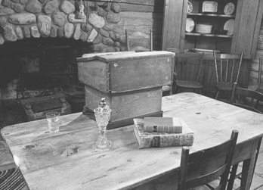
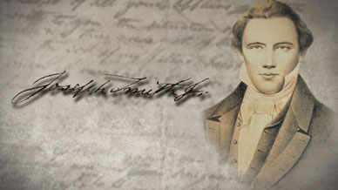
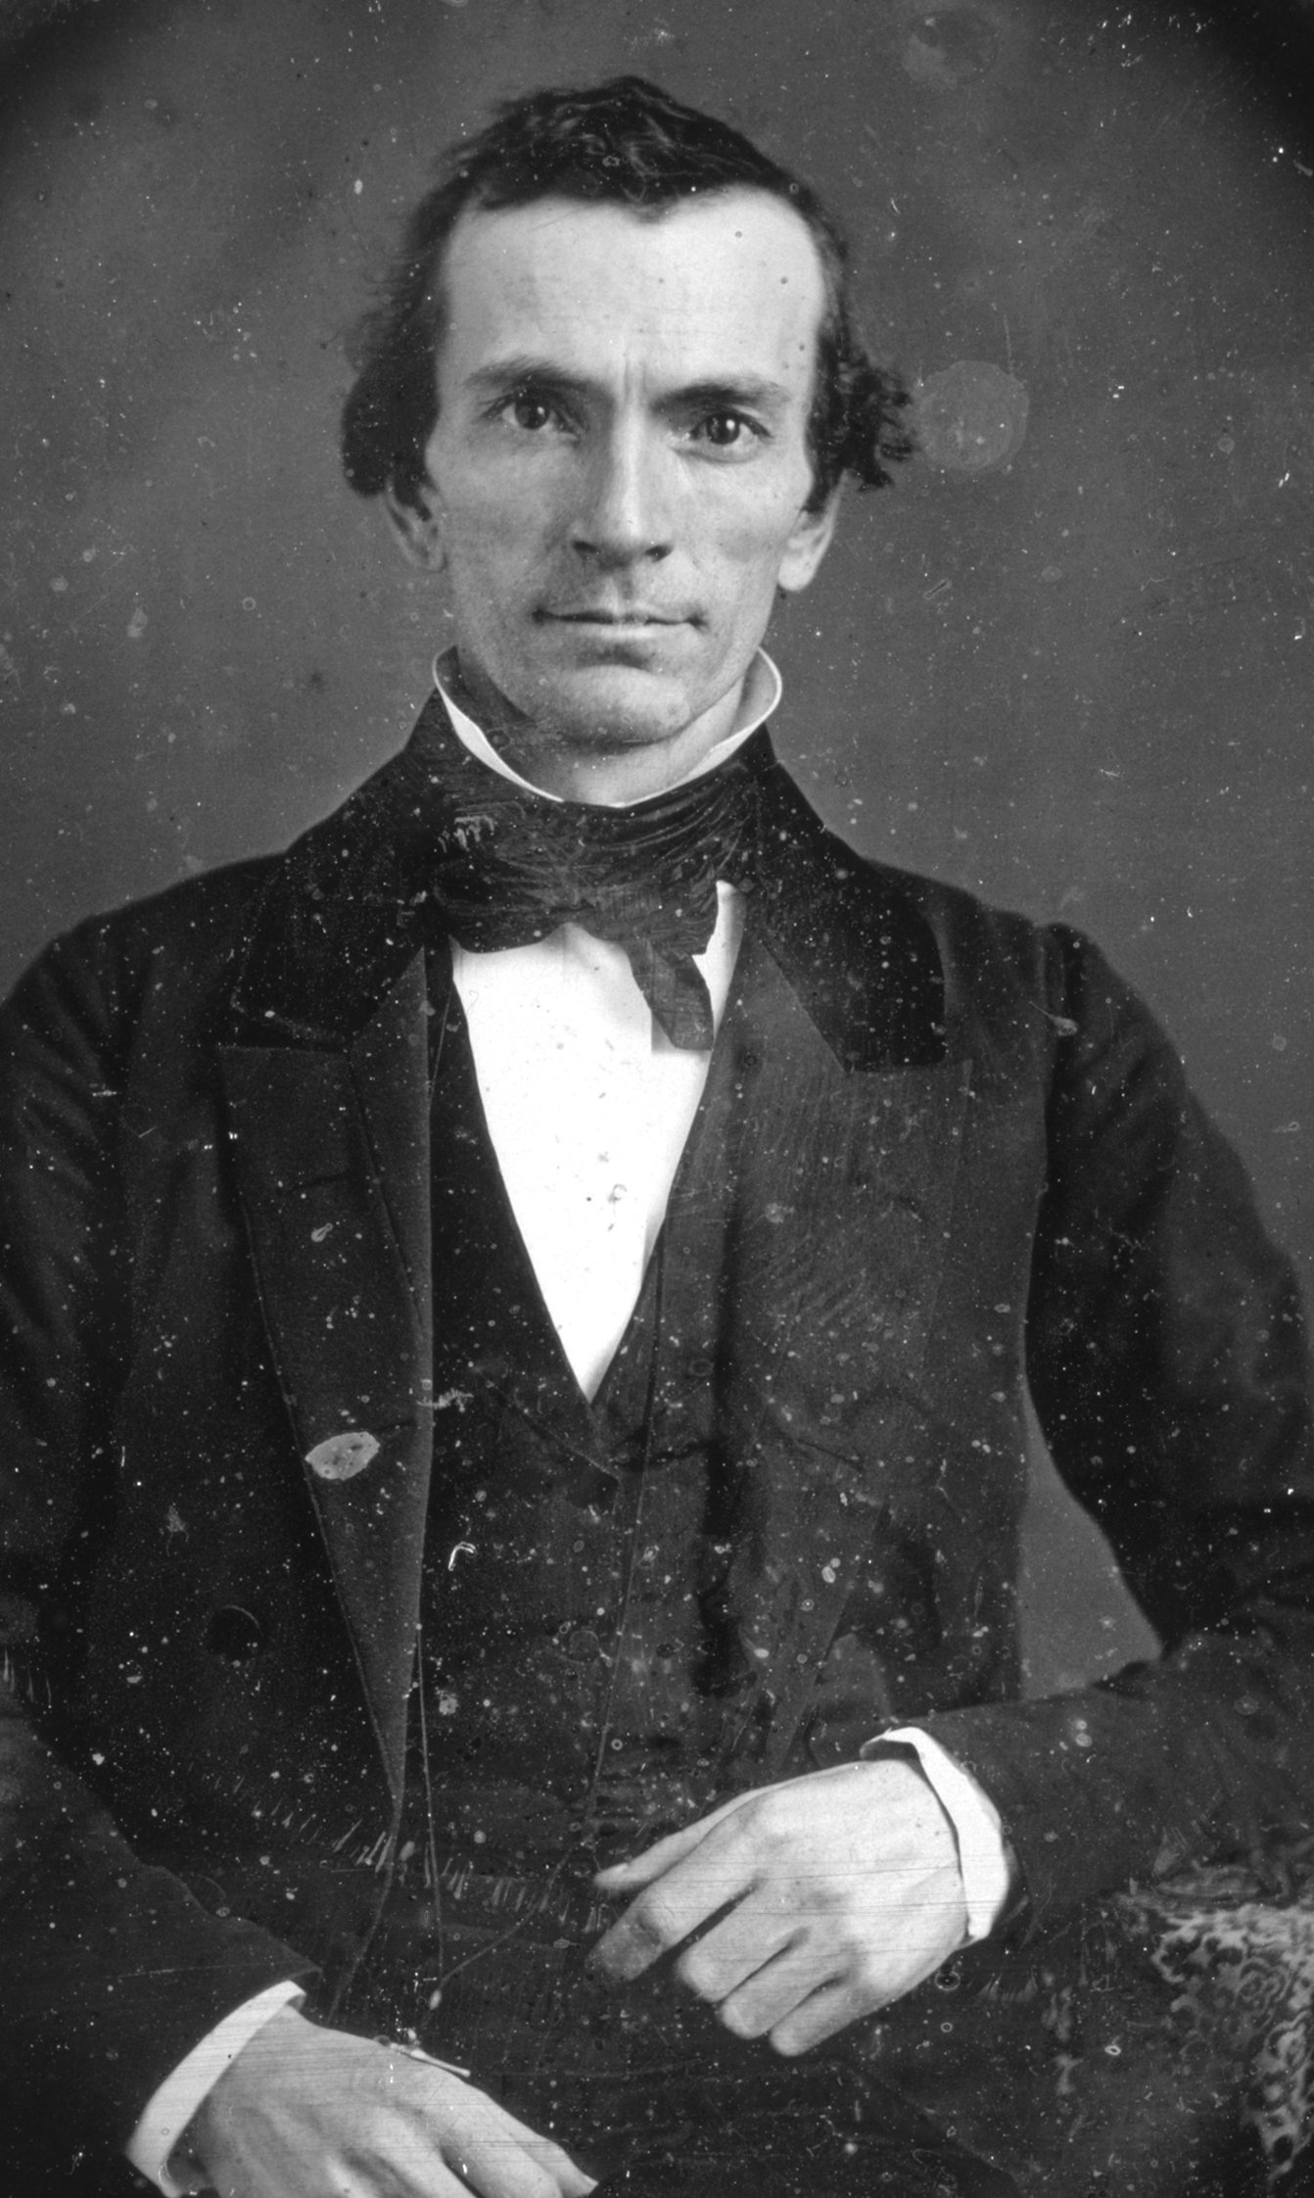
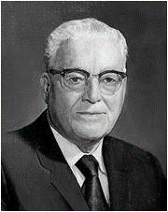
Evening and Morning Star
Page 1
1832
First Given Revelation
Joseph Smith is Called
Joseph Smith, Jun., was called of God, and ordained an apostle of Jesus Christ, to be the first elder of the Church. Oliver Cowdery was also called to be the second elder of the Church (D&C 20:2-3)
The Church is Organized
On April 6, 1830, at Peter Whitmer’s home,
“April 6, is a significant date because it commemorates not only the anniversary of the organization of The Church of Jesus Christ of Latter-day Saints in this dispensation, but also the anniversary of the birth of the Savior, our Lord and Master, Jesus Christ”. Harold B. Lee Apr. 1973 Ensign
Articles and Covenants of the Church
This Revelation revealed on June 9, 1832, was unanimously accepted by those present at the Conference held in Fayette, New York and presiding over by Joseph Smith.
Thus, this became the first revelation given through Joseph Smith to be formally sustained by the Church membership
This revelation includes a concise treatment of the basic doctrine, ordinances, and requirements for membership in The Church of Jesus Christ of Latter-day Saints. It is now known as Doctrine and Covenants Section 20.

Slide 3
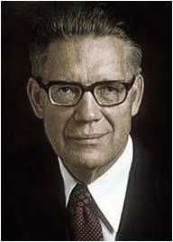
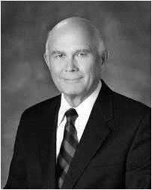
Page 2
Fullness of the Gospel
Vanities of the World by Joseph Smith
I Have A Question
“Our revelations say that the Book of Mormon contains the fulness of the gospel. This is true in the sense that the Book of Mormon is a record of God’s dealings with a people who had the fulness of the gospel, and therefore the laws and principles leading to the highest salvation are found recorded in that book.” Bruce R. McConkie, Mormon Doctrine, p. 333
“During the space of time which intervened between the time I had the vision and the year eighteen hundred and twenty-three—having been forbidden to join any of the religious sects of the day, and being of very tender years, and persecuted by those who ought to have been my friends, and to have treated me kindly, and if they supposed me to be deluded to have endeavored in a proper and affectionate manner to have reclaimed me,—I was left to all kinds of temptations; and mingling with all kinds of society, I frequently fell into many foolish errors, and displayed the weakness of youth, and the foibles of human nature; which, I am sorry to say, led me into divers temptations, offensive in the sight of God. In making this confession, no one need suppose me guilty of any great or malignant sins. A disposition to commit such was never in my nature. But I was guilty of levity, and sometimes associated with jovial company, etc., not consistent with that character which ought to be maintained by one who was called of God as I had been. But this will not seem very strange to anyone who recollects my youth and is acquainted with my native cheery temperament.” --History of the Church 1:9-10
What blessings does the Lord promise to those who receive the Book of Mormon in faith?
What will happen to those who harden their hearts in unbelief and reject the Book of Mormon?
What are some ways we can receive the Book of Mormon in faith?
How can the Book of Mormon lead a person to “work righteousness”?
Answers: D&C 20:14-15
Dallin H. Oaks on Testimony
“A testimony of the gospel is a personal witness borne to our souls by the Holy Ghost that certain facts of eternal significance are true and that we know them to be true” “Testimony,” Ensign or Liahona, May 2008, 26.
Witnesses of Christ Come Forth
We know that there is a God in heaven, who is infinite and eternal, from everlasting to everlasting the same unchangeable God, the framer of heaven and earth, and all things which are in them;
And that he created man, male and female, after his own image and in his own likeness, created he them;
And gave unto them commandments that they should love and serve him, the only living and true God, and that he should be the only being whom they should worship. Oliver Cowdery, Martin Harris, and David Whitmer—D&C 20:17-19

Slide 4
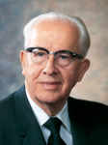
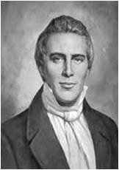
Page 3
Doctrines of the Church of Jesus Christ of Latter-day Saints
Key Doctrines of the Gospel
The Natural Man
“In the twentieth section of the Doctrine and Covenants, the Lord devotes several verses to summarizing the vital truths which the Book of Mormon teaches. It speaks of God, the
creation of man, the Fall, the Atonement, the
ascension of Christ into heaven, prophets, faith, repentance, baptism, the Holy Ghost, endurance,
prayer, justification and sanctification through grace,
and loving and serving God” D&C 17-36
Ezra Taft Benson (“A New Witness for Christ,” Ensign, Nov. 1984, 7).
One issue that has troubled many is the inherent goodness or evil of mankind. Do people by virtue of their birth inherit some kind of original sin, or are they instinctively good?
Those who argue that people are inherently wicked and their very nature sinful cite the abundant wickedness in the world.
People have demonstrated a widespread tendency to be selfish, immoral, cruel, and greedy. Those who think people are basically good point out that if we are inherently evil, then we would have had to inherit that evil from God, since we are His children. That, of course, contradicts all we know of God’s nature.
The scriptural definition of “natural man” is fallen, disobedient man, and this “nature” can be overcome when a person “yields to the enticings of the Holy Spirit, and putteth off the natural man and becometh a saint through the atonement of Christ the Lord”
D&C 18-20 Student Manual Religion 324-325 pg. 40-41
D&C 20:18-20
1. God lives and is infinite, eternal, and unchanging.
2. We are created in the image and likeness of God.
3. God gave His Only Begotten Son to be crucified and rise again so that all who believe, are baptized, and endure in faith may be saved.
4. The Holy Ghost testifies of the Father and the Son.
The Father, the Son, and the Holy Ghost work together to prepare us for eternal life.
The History of The Coming of the Book of Mormon as
Spring 1820: Joseph Smith receives the First Vision (JS—H 1:15–20)
1820–1823: “During the space of time which intervened between the time I had the vision and the year eighteen hundred and twenty-three … I was left to all kinds of temptations; and … I frequently fell into many foolish errors, and displayed the weakness of youth, and the foibles of human nature” (JS—H 1:28).
September 1823: The angel Moroni ministers to Joseph Smith (JSH 1:30-33)
September 1823: The angel Moroni gives instructions to Joseph Smith (JSH 1:34-42
September 22, 1827- Summer 1829: Joseph Smith obtains gold plates and the Urim and Thummim and translates the Book of Mormon (JSH 1:59-75
Paul’s Offer to Israel is Refused
Paul and his companion Barnabas preach to the Gentiles who embrace the gospel, but the Jews persecute them and send them out of the land.
Acts 13:46-32

Slide 5
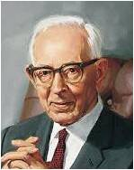
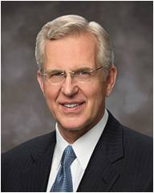
Page 4
Justification and Sanctification Explained
The Father, the Son and the Holy Ghost Are One
“Because of ‘the infinite virtue of His great atoning sacrifice,’ Jesus Christ can satisfy or ‘answer the ends of the law’ on our behalf. Pardon comes by the grace of Him who has satisfied the demands of justice by His own suffering, ‘the just for the unjust, that he might bring us to God’ (1 Pet. 3:18). He removes our condemnation without removing the law.
We are pardoned and placed in a condition of righteousness with Him. We become, like Him, without sin. We are sustained and protected by the law, by justice. We are, in a word, justified. “Thus, we may appropriately speak of one who is justified as pardoned, without sin, or guiltless. For example, ‘Whoso repenteth and is baptized in my name shall be filled; and if he endureth to the end, behold, him will I hold guiltless before my Father at that day when I shall stand to judge the world’ (3 Ne. 27:16; emphasis added). Yet glorious as the remission of sins is, the Atonement accomplishes even more. That ‘more’ is expressed by Moroni:
“‘And again, if ye by the grace of God are perfect in Christ, and deny not his power, then are ye sanctified in Christ by the grace of God, through the shedding of the blood of Christ, which is in the covenant of the Father unto the remission of your sins, that ye become holy, without spot’ (Moro. 10:33; emphasis added).
“To be sanctified through the blood of Christ is to become clean, pure, and holy. If justification removes the punishment for past sin, then sanctification removes the stain or effects of sin. The Prophet Joseph Smith testified:
“‘And this is the gospel, the glad tidings, which the voice out of the heavens bore record unto us—
“‘That he came into the world, even Jesus, to be crucified for
the world, and to bear [justify] the sins of the world, and to
sanctify the world, and to cleanse it from all unrighteousness’
(D&C 76:40–41)”
Elder D. Todd Christofferson of the Quorum of the Twelve
Apostles(“Justification and Sanctification,”
Ensign, June 2001, 20–22).
D&C 20:30-31
“It is perfectly true, as recorded in the Pearl of Great Price and in the Bible, that to us there is but one God [see Moses 1:6; Mark 12:32]. Correctly interpreted God in this sense means Godhead, for it is composed of Father, Son, and Holy Spirit. This Godhead presides over us, and to us, the inhabitants of this world, they constitute the only God, or Godhead. There is none other besides them. [See 1 Corinthians 8:5–6.]
To them we are amenable, and
subject to their authority, and there
is no other Godhead unto whom we
are subject. However, as the Prophet
has shown, there can be, and are,
other Gods.” Joseph Fielding Smith
(Answers to Gospel Questions, 2:142.)
D&C 20:28
Fall From Grace
Elder Theodore M. Burton says: “…it means that Jesus Christ is kind and merciful to us when we serve him with our whole hearts, but not any of us can take refuge in past righteousness or service. It also means that there is a possibility that any one of us can fall out of good standing, even those who have already achieved a certain degree of righteousness. Therefore, we need to be on our constant guard, each of us, that we not allow ourselves to fall into habits of carelessness in our faith, in our prayers, or in our various Church activities or responsibilities. It is for this reason that I am resolving again to live closer to God each day and to follow his chosen prophets and apostles more diligently than I have ever done in the past.” (In Conference Report, Oct. 1973, p. 153; or Ensign, Jan. 1974, p. 116.)
D&C 20:32

