Slide 1
Doctrine and Covenants 20:37-84
Requirement for Baptism
and
The Priesthood of the Church
Presentation by ©http://fashionsbylynda.com/blog/

Slide 2
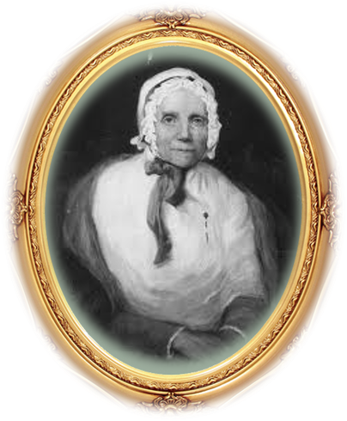
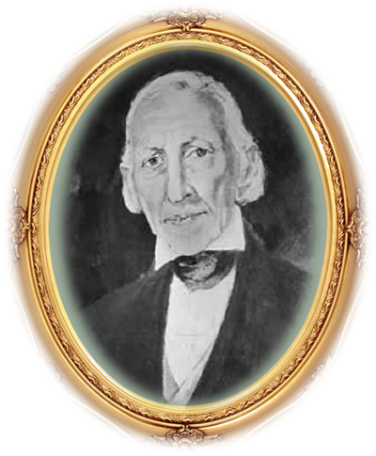
Background
On April 6, 1830, as part of the meeting to organize the restored Church of Jesus Christ, Joseph Smith and Oliver Cowdery confirmed those who had previously been baptized and bestowed upon them the gift of the Holy Ghost
History of the Church
Joseph Smith’s parents were baptized and confirmed that day. This was a joyful time for the Prophet, who exclaimed, “Praise to my God! that I lived to see my own father baptized into the true Church of Jesus Christ!”
Lucy Mack Smith
D&C 20:37

Slide 3
Requirements of Baptism
Manifest by their works that they have received the Spirit of Christ
Shall be received by baptism into his church
Willing to take upon them the name of Jesus Christ
Determined to serve Jesus to the end
Humble themselves before God
Witness before church that they have repented
Come forth with broken hearts and contrite spirits
Have a desire to be baptized
D&C 20:37

Slide 4
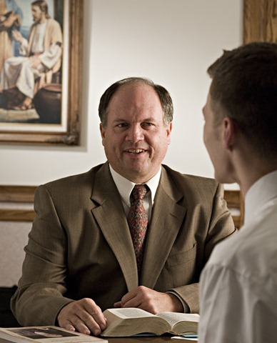
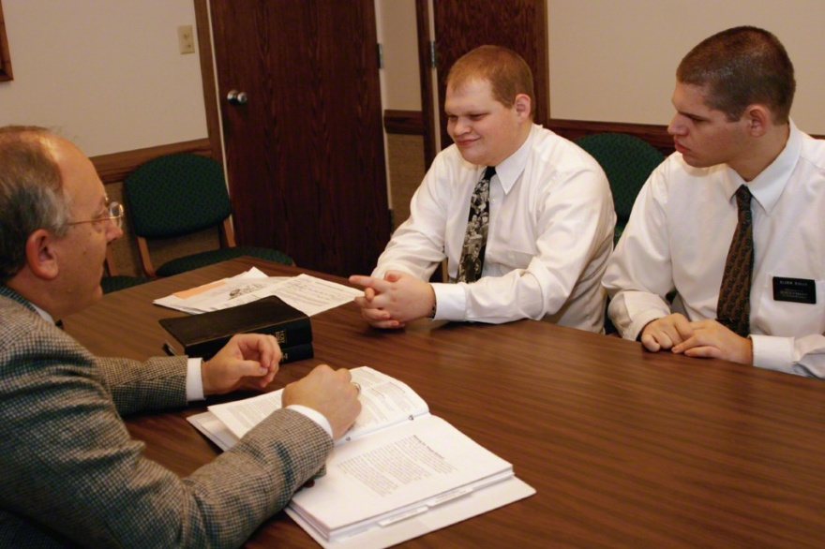
Before Baptism
The bishop or an assigned counselor conducts interviews for the baptism and confirmation of 8-year-old children who are members of record and 8-year-old children who are not members of record but have at least one parent or guardian who is a member.
Full-time missionaries interview converts for baptism and confirmation.

Slide 5
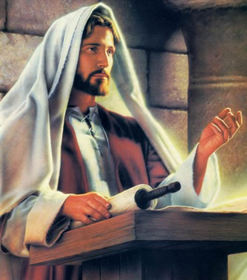
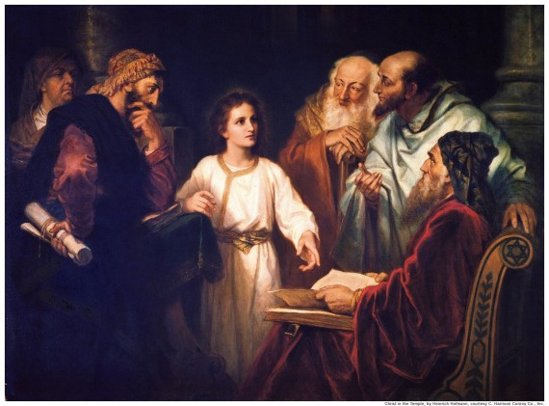
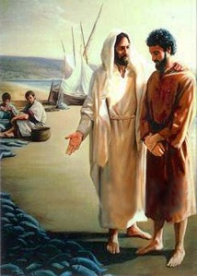
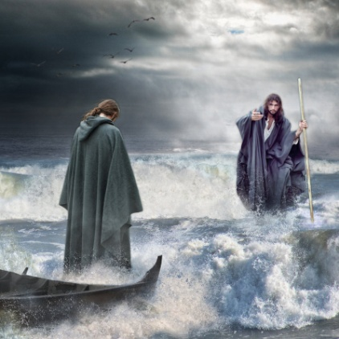
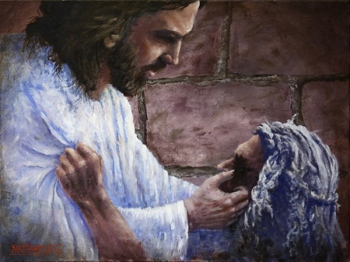
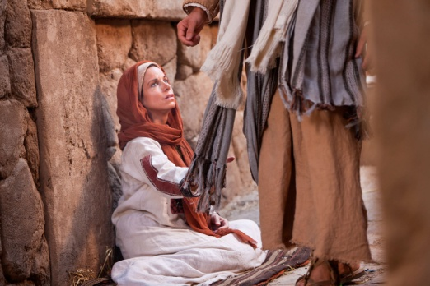
Duties of the Priesthood
April 6, 1830
Preach
To deliver a sermon or religious address to an assembled group of people, typically in church.
Teach
To cause or help (someone) to learn about a subject by giving lessons
Expound
To teach something in greater detail
Exhort
Warn
Invite
To strongly encourage someone to do something
to urge or advise to be careful
To ask (someone) to Come Unto Christ
D&C 20:38

Slide 6
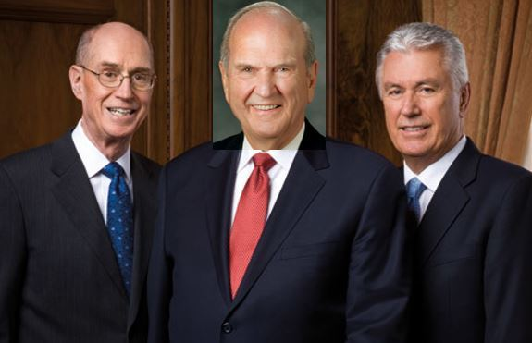
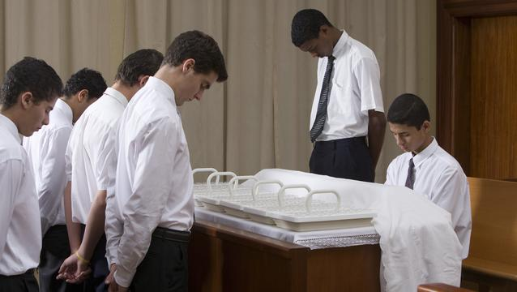
Aaronic Priesthood
Prophets, apostles, other Church leaders, and full-time missionaries have these responsibilities.
However,
These are duties that all priesthood holders, including Aaronic Priesthood holders, can carry out.
The Aaronic Priesthood holders in your class have been trusted with significant opportunities to serve.

Slide 7
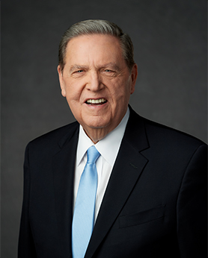
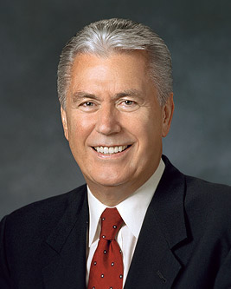
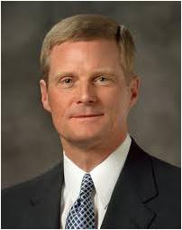
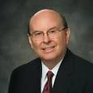
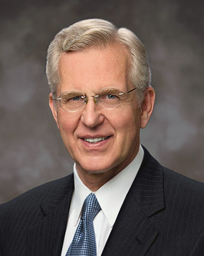
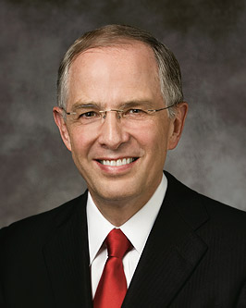
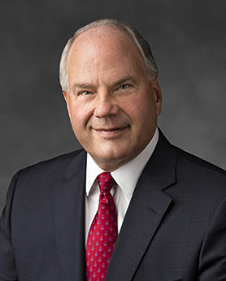
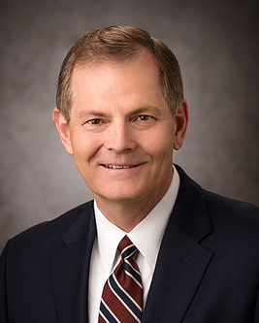
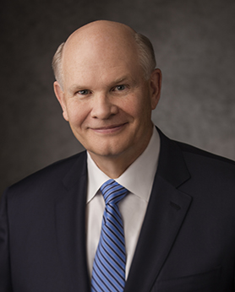
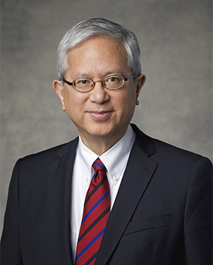
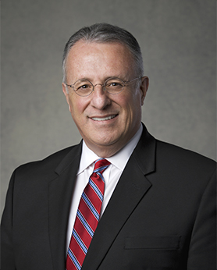
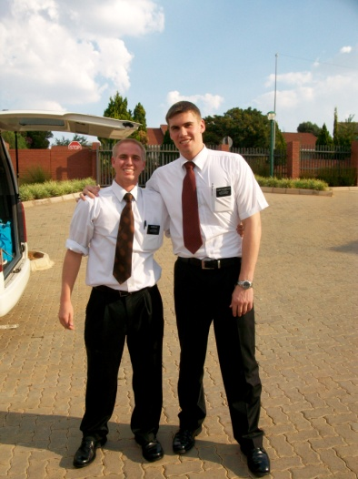
Duties of an Elder
Elders
D&C 20:38-45
An Apostle is an Elder
Baptize and Confirm the Gift of the Holy Ghost by laying on of hands
Ordain other Elders, Priest, Teachers and Deacons
Administer the Sacrament
Teach, Expound, Exhort, and watch of the church
Take lead in all meetings and conduct with the Holy Spirit
M. Russell Ballard
Jeffrey R. Holland
Dieter F. Uchtdorf
David A. Bednar
Quentin L. Cook
D. Todd Christofferson
Neil L. Anderson
Ronald A. Rasband
Gary E. Stevenson
Dale G. Renlund

Slide 8
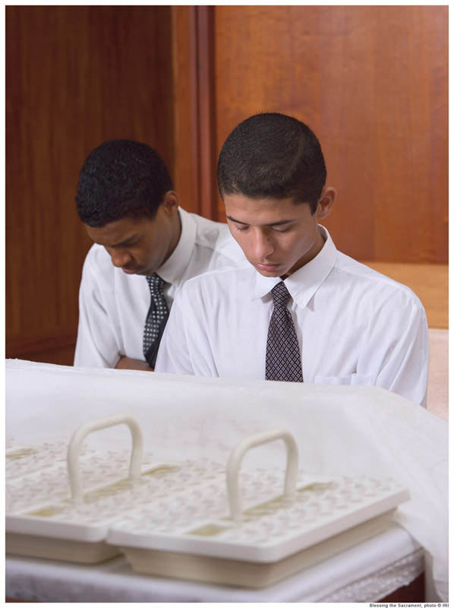
Duties of a Priest
Priests
D&C 20:46-52
Teach, Expound, Exhort, Baptize
Administer the Sacrament
Visit the house of each member, and exhort them to pray vocally and in secret and attend to all family duties.
Ordain other Elders, Priest, Teachers and Deacons
Confirm the Gift of the Holy Ghost
Take lead in all meetings when there is no Elder present
Assist an Elder if occasion arises

Slide 9
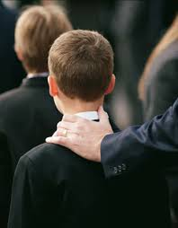
Duties of a Teacher
Teachers and Deacons
D&C 20:53-59
Watch over the church continually and strengthen them
To see that there is no iniquity in the church, neither hardness with each other, neither lying, backbiting, nor evil speaking
See that the church meet together often, and also see that all the members do their duty.
To take the lead of meetings in the absence of the elder or priest—
They are to assisted always, in all their duties in the church, by the deacons, if occasion requires.
But neither teachers nor deacons have authority to baptize, administer the sacrament, or lay on hands;
To warn, expound, exhort, and teach, and invite all to come unto Christ.

Slide 10
As a priesthood holder is ordained to additional offices of the priesthood, he retains the lesser offices and their associated responsibilities.
As Heavenly Father’s sons receive higher offices of the priesthood, they receive more responsibilities and opportunities to serve others.
All priesthood holders have the responsibility to perform ordinances and to watch over members of the Church and minister to them.

Slide 11
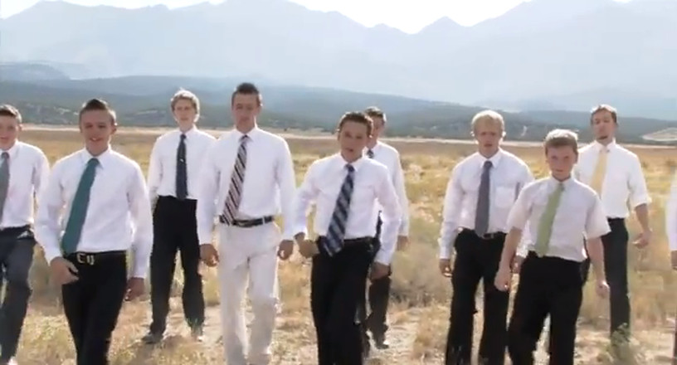
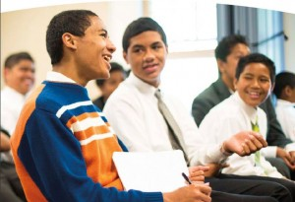
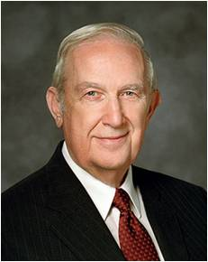
At All Times
“If you are a priesthood holder, remember that the priesthood should be a part of you at all times and in all circumstances. It is not like a cloak that you can put on and take off at will. Any ordination to a priesthood office is a call to lifelong service, with the promise that the Lord will qualify you to do His work according to your faithfulness.
“You must be worthy in order to receive and exercise priesthood power. The words you speak and your everyday behavior affect your ability to serve. Your behavior in public must be above reproach. Your behavior in private is even more important”
True to the Faith
“The purpose of priesthood authority is to give, to serve, to lift, to inspire”
Elder Richard G. Scott

Slide 12
Young Women
Young women have many opportunities to serve.
Some may choose to serve missions, and they will someday have the privilege of being members of Relief Society, “work[ing] alongside men who hold the priesthood to increase faith and personal righteousness, strengthen families and homes, and seek out and help those in need” Daughters in My Kingdom

Slide 13
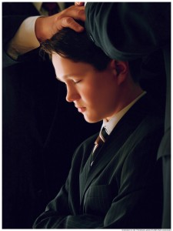
To Be Ordained
“Every elder, priest, teacher, or deacon is to be ordained according to the gifts and callings of God unto him; and he is to be ordained by the power of the Holy Ghost, which is in the one who ordains him.”
D&C 20:60

Slide 14
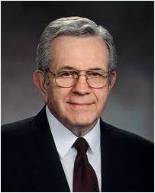
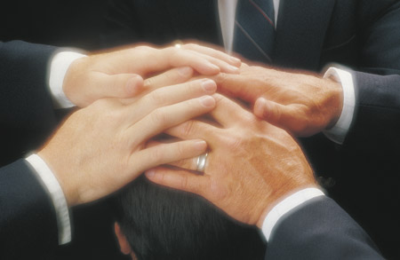
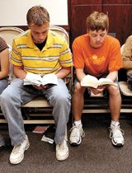
Authority
“Your authority comes through your ordination; your power comes through obedience and worthiness. …
“Power in the priesthood comes from doing your duty in ordinary things:
attending meetings, accepting assignments, reading the scriptures, keeping the Word of Wisdom.”
Elder Boyd K. Packer

Slide 15
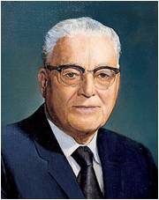
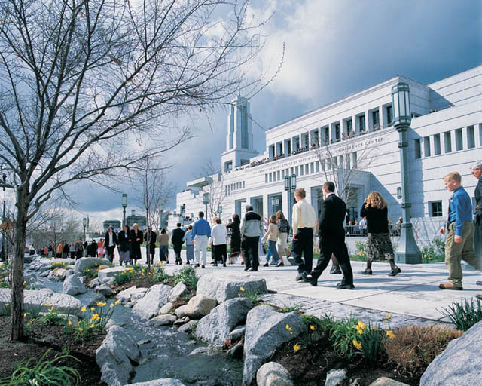
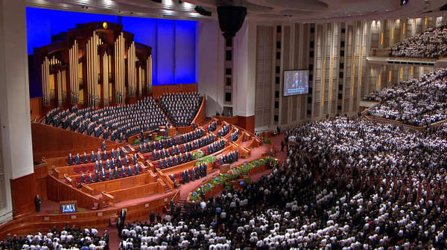
Purposes
“Now, you Latter-day Saints, I think you have never attended a conference where in these three days you have heard more inspired declarations on most every subject and problem about which you have been worrying.
If you want to know what the Lord would have the Saints know and to have his guidance and direction for the next six months, get a copy of the proceedings of this conference, and you will have the latest word of the Lord as far as the Saints are concerned.”
President Harold B. Lee
D&C 20:61-63

Slide 16
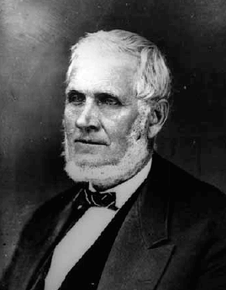
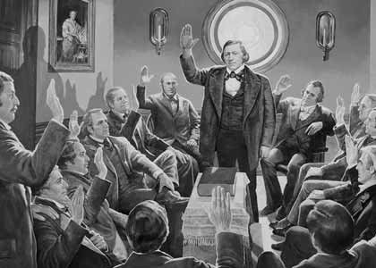
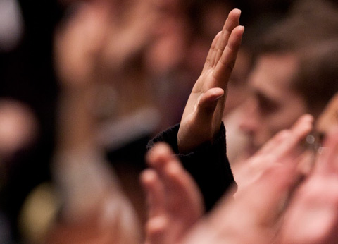
The Vote
“What is meant by sustaining a person? …
…if a man be a teacher, and I vote that I will sustain him in his position, when he visits me in an official capacity I will welcome him and treat him with consideration, kindness and respect and if I need counsel I will ask it at his hand, and I will do everything I can to sustain him.
That would be proper and a principle of righteousness, and I would not say anything derogatory to his character. If that is not correct I have it yet to learn.
And then if anybody in my presence were to whisper something about him disparaging to his reputation, I would say, Look here! are you a Saint? Yes. Did you not hold up your hand to sustain him? Yes. Then why do you not do it? Now, I would call an action of that kind sustaining him.
If any man make an attack upon his reputation—for all men’s reputations are of importance to them—I would defend him in some such way.”
President John Taylor
D&C 20:65

Slide 17
Sources:
Video:
Becoming a Priesthood Man: Priesthood Duty (4:53)
Power in the Priesthood (0:55)
Video: Priesthood Responsibilities (2:50)
(True to the Faith: A Gospel Reference[2004], 127).
Elder Richard G. Scott “Honor the Priesthood and Use It Well,” Ensign or Liahona, Nov. 2008, 46.)
Presentation by ©http://fashionsbylynda.com/blog/
(Daughters in My Kingdom: The History and Work of Relief Society [2011], 7).
Elder Boyd K. Packer (“The Aaronic Priesthood,” Ensign, Nov. 1981, 32–33).
President Harold B. Lee (In Conference Report, Oct. 1973, p. 168; or Ensign, Jan. 1974, p. 128.)
President John Taylor (In Journal of Discourses, 21:207–8.)
Presentation by ©http://fashionsbylynda.com/blog/

Slide 18
What Is Meant by “an Apostle Is an Elder”?
“We learn at this time the Lord revealed that the designation ‘Elder’ is one applicable to the apostles and likewise to all others who hold the Melchizedek Priesthood. The use of this designation makes it needless to use unnecessarily sacred terms as ‘Apostle,’ ‘Patriarch,’ ‘High Priest,’ etc. It is proper in general usage to speak of the apostles, the seventies and all others holding the Melchizedek Priesthood as ‘elders.’ Of course, the term President, in speaking of the First Presidency, is the proper designation.” (Smith, Church History and Modern Revelation, 1:95.)
What Is the Major Function of the Office of Deacon?
With no specific responsibilities assigned to the office of deacon, “the duty of Deacons is to assist the Teachers. A Deacon holds the power and authority first bestowed in the Aaronic Priesthood. One who performs those duties well, thereby qualifies himself for the more advanced positions.” (Smith and Sjodahl, Commentary, p. 108; see also Enrichments M and N in the Appendix.)
The Duties :
President Wilford Woodruff said: “I traveled thousands of miles and preached the Gospel as a Priest, and, as I have said to congregations before, the Lord sustained me and made manifest His power in the defense of my life as much while I held that office as He has done while I have held the office of an Apostle. The Lord sustains any man that holds a portion of the Priesthood, whether he is a Priest, an Elder, a Seventy, or an Apostle, if he magnifies his calling and does his duty” (Deseret Weekly, Nov. 7, 1896, 641). (See also Boyd K. Packer, “The Aaronic Priesthood,” Ensign, Nov. 1981, 33.)
President Boyd K. Packer of the Quorum of the Twelve Apostles emphasized that proper priesthood ordination is of great importance to the Lord:
“You can receive the priesthood only from one who has the authority and ‘it is known to the church that he has authority.’ (D&C 42:11.)
“The priesthood cannot be conferred like a diploma. It cannot be handed to you as a certificate. It cannot be delivered to you as a message or sent to you in a letter. It comes only by proper ordination. An authorized holder of the priesthood has to be there. He must place his hands upon your head and ordain you.
“That is one reason why the General Authorities travel so much—to convey the keys of priesthood authority. Every stake president everywhere in the world has received his authority under the hands of one of the presiding brethren of the Church. There has never been one exception.
“Remember these things. The priesthood is very, very precious to the Lord. He is very careful about how it is conferred, and by whom. It is never done in secret” (“The Aaronic Priesthood,” Ensign, Nov. 1981, 32).
Purpose of Priesthood:
James E. Faust of the First Presidency said:
“Caring for others is the very essence of priesthood responsibility. It is the power to bless, to heal, and to administer the saving ordinances of the gospel” (“Power of the Priesthood,” Ensign, May 1997, 41).

Slide 19
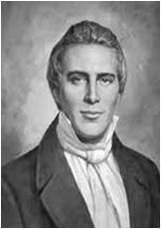
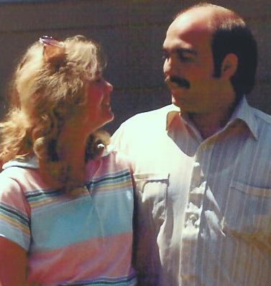
After Baptism
Duties of the members:
By baptism we enter into a solemn covenant with God. We must, therefore, learn to know our duties as baptized members of the church
“Be kindly affectionate, one towards another;
that the fathers should be kind to their children,
husbands to their wives,
masters to their slave, or servants,
children obedient to their parents,
wives to their husbands,
and slaves or servants to their masters:”
Joseph Smith
D&C 20:68-71

Slide 20
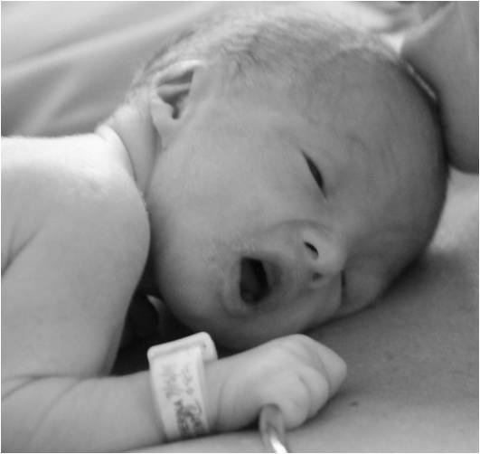
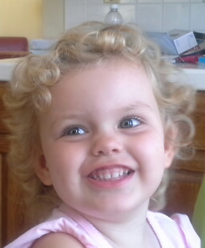
A Name and a Blessing
“Every member of the church of Christ having children is to bring them unto the elders before the church, who are to lay their hands upon them in the name of Jesus Christ, and bless them in his name.”
“Baptism is for the remission of sins, and no man can repent of a sin until he is accountable before God.”
Joseph Fielding Smith
“…wherefore, little children are whole, for they are not capable of committing sin;”
Moroni 8:8
“And their little children need no repentance, neither baptism. Behold, baptism is unto repentance to the fulfilling the commandments unto the remission of sins.
Moroni 8:11
D&C 20:70-71
See Moroni 8:5-26

Slide 21
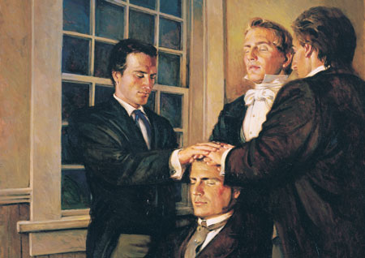
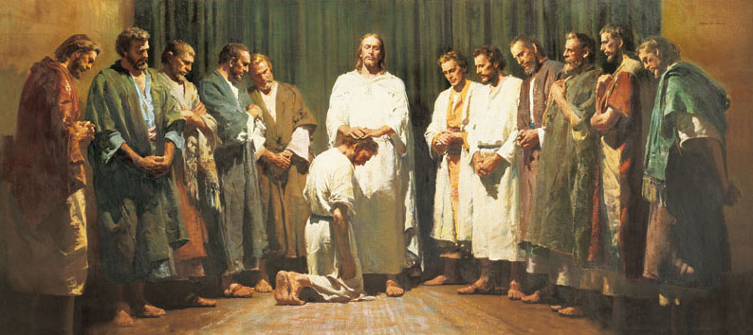
Authority
The person who is called of God has the authority of Jesus Christ to baptize
In mortality, the priesthood is the power and authority that God gives to man to act in all things necessary for the salvation of God’s children. The blessings of the priesthood are available to all who receive the gospel.
Handbook 2:1
The priesthood is the power and authority of God. It has always existed and will continue to exist without end.
“This high priesthood being after the order of his Son, which order was from the foundation of the world; or in other words, being without beginning of days or end of years, being prepared from eternity to all eternity, according to his foreknowledge of all things—
“Now they were ordained after this manner—being called with a holy calling, and ordained with a holy ordinance, and taking upon them the high priesthood of the holy order, which calling, and ordinance, and high priesthood, is without beginning or end—”
Alma 13:7-8
D&C 20:73

Slide 22
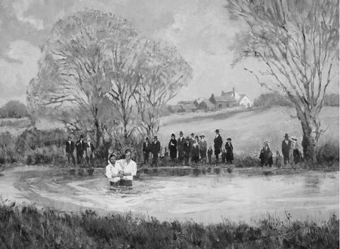
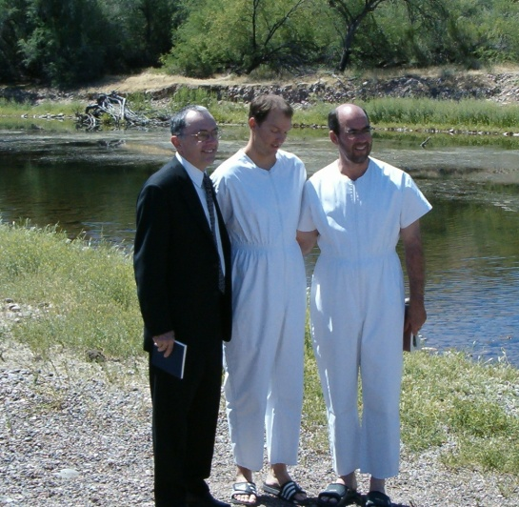
The Witnesses of Baptism
Two priests or Melchizedek Priesthood holders witness each baptism to make sure it is performed properly.
The baptism must be repeated if the words are not spoken exactly as given in Doctrine and Covenants 20:73 or if part of the person’s body or clothing is not immersed completely.
Under the direction of the presiding authority, a priest or Melchizedek Priesthood holder may perform the ordinance of baptism…
D&C 20:73

Slide 23
By Immersion
The Person being baptized:
1. Stands in the water with the person to be baptized.
2. Holds the person’s right wrist with his left hand (for convenience and safety); the person who is being baptized holds the priesthood holder’s left wrist with his or her left hand.
3. Raises his right arm to the square.
4. States the person’s full name and says, “Having been commissioned of Jesus Christ, I baptize you in the name of the Father, and of the Son, and of the Holy Ghost. Amen” (D&C 20:73).
5. Has the person hold his or her nose with the right hand (for convenience); then the priesthood holder places his right hand high on the person’s back and immerses the person completely, including the person’s clothing.
6. Helps the person come up out of the water.
Convert baptisms are usually performed by a priesthood holder in the ward or by one of the missionaries who taught the person. A convert may also request that another qualified member perform the baptism.
Handbook 20.3.8
D&C 20:73

Slide 24
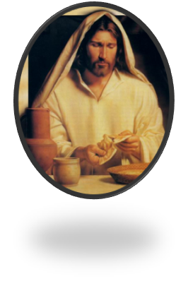
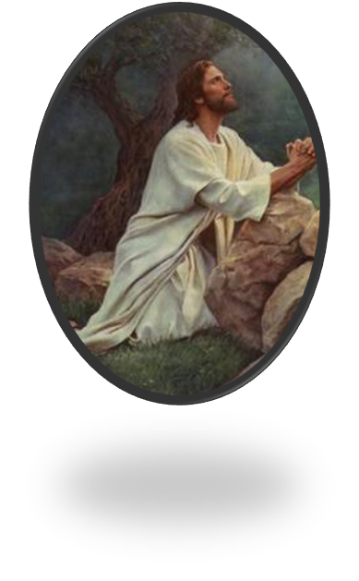
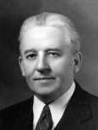
The Sacrament
Bread and Wine—the emblems:
Bread is the proper emblem of the spiritual food we receive in the Sacrament.
“Wine” is here, used as a synonym for the Cup.
(see Matthew 26:27)
The essential part of the Sacrament is that those who partake of it receive broken bread and drink of the cup, in remembrance of the broken body and spilt blood of the Redeemer.
Both must be blessed, and both must be received by the communicants.
Smith and Sjodahl
“The one thing that would make for the safety of every man and woman would be to appear at the sacrament table every Sabbath day. We would not get very far away in one week—not so far away that, by the process of self-investigation, we could not rectify the wrongs we may have done. … The road to the sacrament table is the path of safety for Latter-day Saints”
Elder Melvin J. Ballard
D&C 20:75-79

Slide 25
Partaking
When we partake of the sacrament, we witness that we are willing to take upon ourselves the name of Jesus Christ, that we will always remember Him, and that we will keep His commandments.
D&C 20:77-79

Slide 26
Always Remember Him
“We should first put in place the things that make it possible to always remember Him—frequent prayer and scripture study, thoughtful study of apostolic teachings, weekly preparation to partake of the sacrament worthily, Sunday worship, and recording and remembering what the Spirit and experience teach us about discipleship.
“Other things may come to your mind particularly suited to you at this point in your life. …
“… I can attest that over time our desire and capacity to always remember and follow the Savior will grow. We should patiently work toward that end and pray always for the discernment and divine help we need”
Elder D. Todd Christofferson
D&C 20:77-79

Slide 27
Remission of Sins
“The renewal of our covenants by partaking of the sacrament should also be preceded by repentance, so we come to that sacred ordinance with a broken heart and a contrite spirit…Then, as we renew our baptismal covenants and affirm that we will “always remember him’ the Lord will renew the promised remission of our sins, under the conditions and at the time he chooses…”
Dallin H. Oaks
“You receive great blessings when you keep the baptismal covenant. As you renew it, the Lord renews the promised remission of your sins. Cleansed from sin, you are able to ‘always have his Spirit to be with [you]’ (D&C 20:77). The Spirit’s constant companionship is one of the greatest gifts you can receive in mortality. The Spirit will guide you in the paths of righteousness and peace, leading you to eternal life with your Father in Heaven and Jesus Christ.”
True to the Faith
D&C 20:77-79

Slide 28
Keeping Records of Members
The priesthood holders in the early Church were instructed to record the names of people who had joined the Church.
They kept these names in a book.
The names of those who fell away from the Church were removed from the book.
In addition, Church members who moved from one location to another were to take a certificate of their membership with them to give to their new priesthood leaders.
In our day, Church leaders continue to keep accurate membership records, but the methods of doing so are more efficient.
D&C 20:80-84

Slide 29
Sources:
Videos:
Same Jersey (5:01)
Partake of the Sacrament (1:48)
Always Remember Him (5:27)
Sacrament Worship (1:31)
History of the Church, 1:61
Lucy Mack Smith, History of Joseph Smith by His Mother, ed. Preston Nibley [1958], 168; see also History of the Church, 1:79.
Joseph Smith History of the Church, Vol. II, p. 263
Joseph Fielding Smith Doctrines of Salvation, 2:50; see also Moroni 8:5–26).
Elder Melvin J. Ballard (in Bryant S. Hinckley, Sermons and Missionary Services of Melvin Joseph Ballard [1949], 151).
Presentation by ©http://fashionsbylynda.com/blog/
Hyrum M. Smith and Janne M. Sjodahl Commentary pg. 111
Elder D. Todd Christofferson (“To Always Remember Him,” Ensign, Apr. 2011, 51).
(True to the Faith: A Gospel Reference [2004], 148).
Dallin H. Oaks Ensign Nov 1996
Presentation by ©http://fashionsbylynda.com/blog/

Slide 30
Priesthood Keys
Priesthood keys are the authority God has given to priesthood leaders to direct, control, and govern the use of His priesthood on earth. The exercise of priesthood authority is governed by those who hold its keys (see D&C 65:2; 81:2; 124:123). Those who hold priesthood keys have the right to preside over and direct the Church within a jurisdiction.
Jesus Christ holds all the keys of the priesthood pertaining to His Church. He has conferred upon each of His Apostles all the keys that pertain to the kingdom of God on earth. The senior living Apostle, the President of the Church, is the only person on earth authorized to exercise all priesthood keys (see D&C 43:1–4; 81:2; 107:64–67, 91–92; 132:7). Handbook 2.1.1
History of administration of the sacrament:
Weekly administration of the sacrament did not begin until sometime in the 1850s. There is no known revelation commanding the weekly practice to have been adopted, but rather the custom developed and spread throughout the church over time.
Until the late 1890s or early 20th century, the entire congregation generally knelt during the sacramental prayers, consistent with D&C 20:76 and Moroni 4:2. More recent direction from church leaders only requires that the individual giving the prayer kneel.
Deacons and teachers didn't originally take part in the preparing or passing of the sacrament, which seems to have been first encouraged in 1898 and was widely implemented between the 1920s or 1930s. Previous reluctance to involve them was probably due to the following verse from the LDS Doctrine and Covenants:
But neither teachers nor deacons have authority to baptize, administer the sacrament, or lay on hands. (Doctrine and Covenants 20:58, LDS edition) The term administer has since been interpreted as reading the sacrament prayer, which deacons and teachers still do not have the authority to do. Individual water cups, instead of drinking from a common cup, were introduced in 1911.
Passing the sacrament first to the presiding church authority was emphasized in 1946. Wikipedia
Granite Vault Records for the Church:
The world’s largest collection of genealogical records is housed in a secure vault located in the mountains near Salt Lake City, Utah. The Church of Jesus Christ of Latter-day Saints built the Granite Mountain Records Vault in 1965 to preserve and protect records of importance to the Church, including its vast collection of family history microfilms.
For security reasons, there is no public access to the Granite Mountain Records Vault.
The vault safeguards more than 3.5 billion images on microfilm, microfiche, and digital media. Currently, the Church is in the process of digitizing the microfilms and making those digital records available through the FamilySearch.org website
http://www.mormonnewsroom.org/article/granite-mountain-records-vault
Water or Wine: “For, behold, I say unto you, that it mattereth not what ye shall eat or what ye shall drink when ye partake of the sacrament, if it so be that ye do it with an eye single to my glory—remembering unto the Father my body which was laid down for you, and my blood which was shed for the remission of your sins.”
D&C 27:2
In 1833 Joseph Smith received the revelation known as the Word of Wisdom, part of which states that alcohol consumption is harmful to a person's health and well-being. Initially the Word of Wisdom was treated simply as counsel, and the early saints would still drink alcohol on occasion. During the late 19th century, church leaders slowly started to take the Word of Wisdom as a commandment. This increased respect for the Word of Wisdom, combined with the scripture in Doctrine and Covenants 27:2. The practice was officially adopted church-wide in 1912.
Occasionally circumstances permit various other food substitutes as well. Crackers and tortillas are sometimes used in outdoor, rugged settings, such as church sponsored Boy Scout camping trips. The Church's official policy, however, is that Boy Scout troops not camp or hike on Sundays. Stories abound of WWII impoverished European congregations using potato slices. In such situations, the word "bread" (in English) is typically used in the prayers.
Wikipedia

