Slide 1

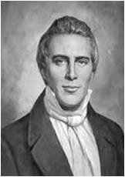
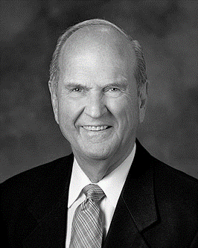
Doctrine and Covenants 21
Yesterday and Today
Presentation by ©http://fashionsbylynda.com/blog/

Slide 2
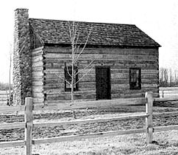

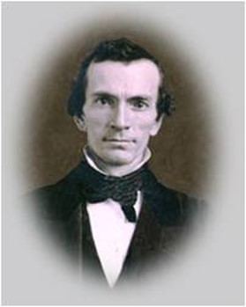
Background
The Church of Jesus Christ of Latter-day Saints was officially organized on April 6, 1830, at the home of Peter Whitmer Sr. in Fayette, New York. Nearly 60 people attended the meeting, which consisted of prayer, sustainings, ordinations, the administration of the sacrament, and confirmations.
“I then laid my hands upon Oliver Cowdery, and ordained him an Elder of the ‘Church of Jesus Christ of Latter-day Saints;’ after which, he ordained me also to the office of an Elder of said Church.” Joseph Smith
Although they had been ordained to the Melchizedek Priesthood earlier, they were told to defer ordaining each other to the office of elder until the Church was organized .”
History of the Church

Slide 3
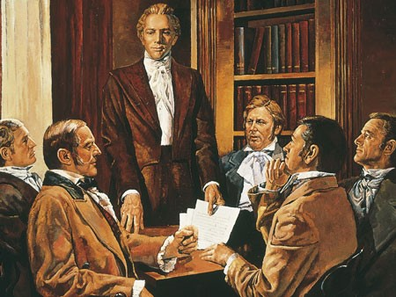
Six Members
Names of 6 members of the church as they were organized April 6, 1830
Oliver Cowdery
Joseph Smith, Jun
Hyrum Smith
Peter Whitmer, Jun
Samuel H. Smith
David Whitmer
HC Vol. 1. p. 76 footnote

Slide 4

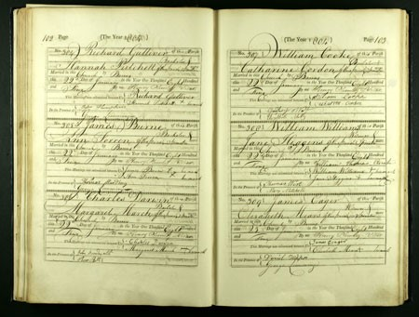
Record Keeping
The Spirit directed the Saints to keep a record of the things that took place. Such as the duties and responsibilities of the prophet.
The titles given him were not for honor or payment of services but a duty of service.
Today:
Storing records in the Granite Vault preserves the church records.
D&C 21:1

Slide 5
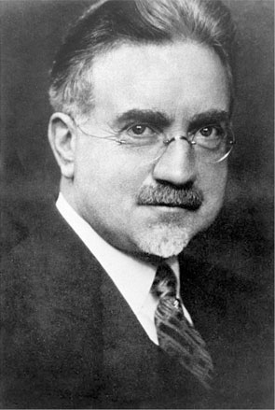
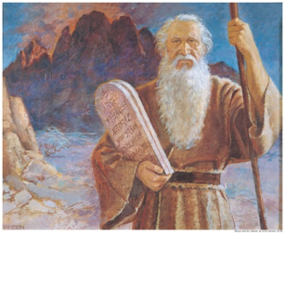
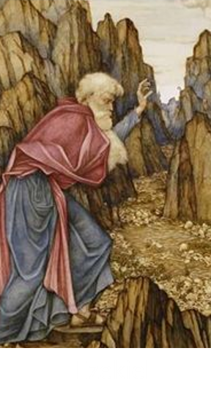
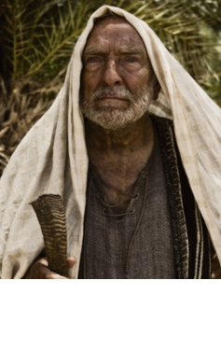
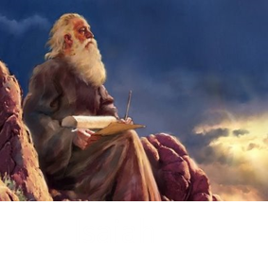
A Seer
What does it mean that the Lord called Joseph Smith to be a seer?
“A seer is one who sees with spiritual eyes. He perceives the meaning of that which seems obscure to [unclear to or hidden from] others; therefore he is an interpreter and clarifier of eternal truth. He foresees the future from the past and the present. This he does by the power of the Lord operating through him directly, or indirectly with the aid of divine instruments such as the Urim and Thummim. In short, he is one who sees, who walks in the Lord’s light with open eyes”
John A. Widtsoe
D&C 21:1

Slide 6
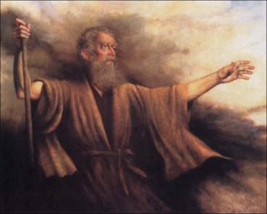
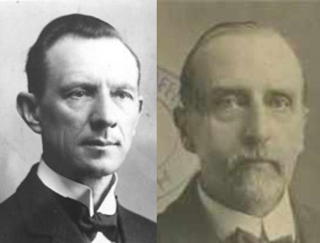
A Prophet
What does it mean that the Lord called Joseph Smith to be a prophet?
A prophet is “a person who has been called by and speaks for God. As a messenger of God, a prophet receives commandments, prophecies, and revelations from God. His responsibility is to make known God’s will and true character to mankind and to show the meaning of his dealings with them. A prophet denounces sin and foretells its consequences. He is a preacher of righteousness. On occasion, prophets may be inspired to foretell the future for the benefit of mankind. His primary responsibility, however, is to bear witness of Christ”
Guide to the Scriptures
“Originally the Hebrews called the prophets, Seers (1 Samuel 9:9), and that designation is used by Lehi, when he blesses his sons and quotes to them the prophecies of his ancestor, Joseph (2 Nephi 3:5-22).”
Smith and Sjodahl
D&C 21:1

Slide 7
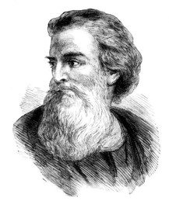
Other Titles
Translator: someone who (1) converts written or spoken words to another language or (2) gives clearer meaning to an existing translation by improving or correcting it or by restoring lost material.
Apostle: a special witness of Jesus Christ to the world.
Elder: “the proper title given to all holders of the Melchizedek Priesthood” and to someone who has been called to be a full-time minister for Jesus Christ.
Joseph was called, as was Paul, through the divine will, not human agency.
“Paul, a servant of Jesus Christ, called to be an apostle, separated unto the gospel of God,”
Romans 1:1
D&C 21: 1 Guide to the Scriptures and Bible Dictionary

Slide 8
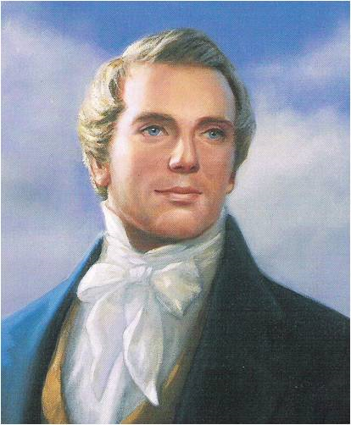
Why is it important for us to know that Joseph Smith was called by God to restore and lead the Church of Jesus Christ?
God directed Joseph Smith to restore the Church of Jesus Christ.
D&C 21: 2-3

Slide 9
Doctrinal Mastery
Wherefore, meaning the church, thou shalt give heed unto all his words and commandments which he shall give unto you as he receiveth them, walking in all holiness before me;
For his word ye shall receive, as if from mine own mouth, in all patience and faith.
For by doing these things the gates of hell shall not prevail against you; yea, and the Lord God will disperse the powers of darkness from before you, and cause the heavens to shake for your good, and his name’s glory.
D&C 21:4-6

Slide 10
Receive From Mine Own Mouth
the church
his
words and commandments
In all patience and faith
members of The Church of Jesus Christ of Latter-day Saints in Joseph Smith’s day as well as our own
specifically Joseph Smith, but can also refer to the current Church President
could refer to all of a prophet’s teachings and counsel, including specific instructions given by the Lord through the prophet
could mean that we can trust completely in the prophet’s teachings, that we should not be critical of him, that we should follow his counsel in spite of any personal shortcomings he may have, and that we should await promised blessings patiently
As we receive the Lord’s words through His prophets in patience and faith, He will disperse the powers of darkness, He will give us blessings from heaven, and we will be protected against the adversary.
D&C 21: 4-5

Slide 11
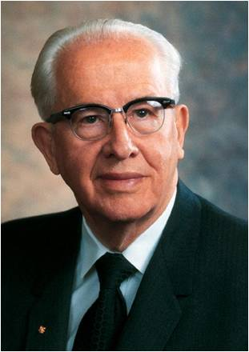
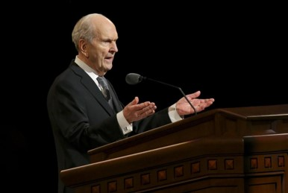
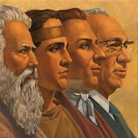

Following the Prophet
“First: The prophet is the only man who speaks for the Lord in everything.
“Second: The living prophet is more vital to us than the standard works.
“Third: The living prophet is more important to us than a dead prophet.
“Fifth: The prophet is not required to have any particular earthly training or credentials to speak on any subject or act on any matter at any time.
“Sixth: The prophet does not have to say ‘Thus saith the Lord’ to give us scripture.
Ezra Taft Benson

Slide 12
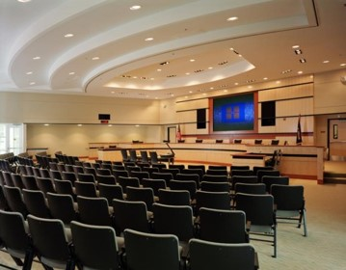

“Seventh: The prophet tells us what we need to know, not always what we want to know.
“Eighth: The prophet is not limited by men’s reasoning.
“Ninth: The prophet can receive revelation on any matter, temporal or spiritual.
“Tenth: The prophet may be involved in civic matters.
“Eleventh: The two groups who have the greatest difficulty in following the prophet are the proud who are learned and the proud who are rich.
Ezra Taft Benson

Slide 13
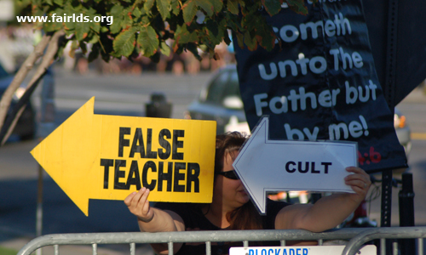
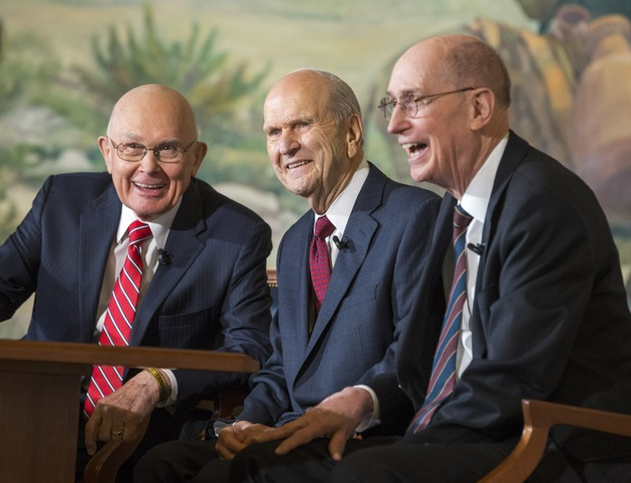
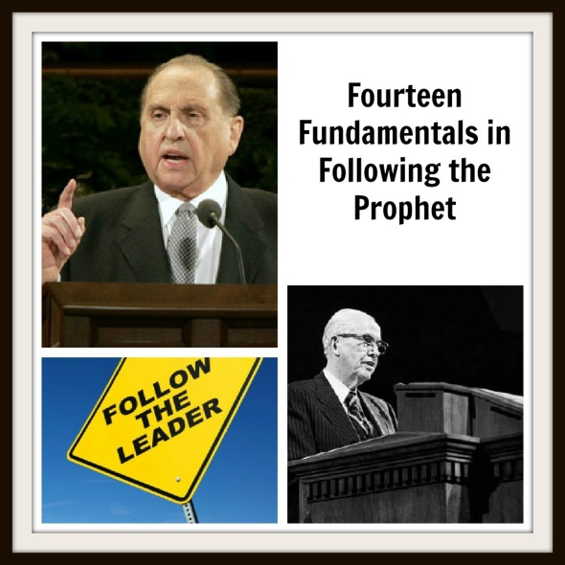
“Twelfth: The prophet will not necessarily be popular with the world or the worldly.
“Thirteenth: The prophet and his counselors make up the First Presidency—the highest quorum in the Church.
“Fourteenth: The prophet and the presidency—the living prophet and the First Presidency—follow them and be blessed; reject them and suffer”
Ezra Taft Benson

Slide 14
Heed to “All Words”
Which of the prophet’s teachings are we to heed?
(We are to heed “all his words and commandments.”)
Why might it sometimes require patience and faith to heed the words of a prophet?
How does knowing that the prophet receives counsel and commandments from the Lord help you to receive his words “in all patience and faith”?
If we heed the words of the prophet, we will be protected against the adversary
D&C 4-5

Slide 15


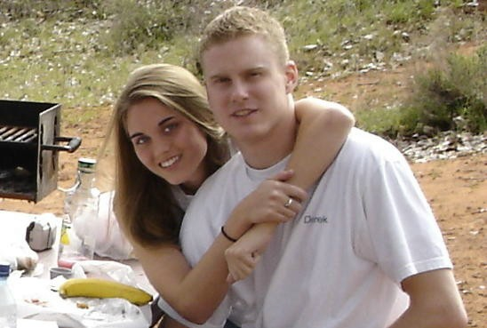
Example of Heeding
“A date is a planned activity that allows a young man and a young woman to get to know each other better. In cultures where dating is acceptable, it can help you learn and practice social skills, develop friendships, have wholesome fun, and eventually find an eternal companion.
“You should not date until you are at least 16 years old. When you begin dating, go with one or more additional couples. Avoid going on frequent dates with the same person. Developing serious relationships too early in life can limit the number of other people you meet and can perhaps lead to immorality. Invite your parents to become acquainted with those you date.
“Choose to date only those who have high moral standards and in whose company you can maintain your standards. Remember that a young man and a young woman on a date are responsible to protect each other’s honor and virtue.”
For the Strength of the Youth

Slide 16

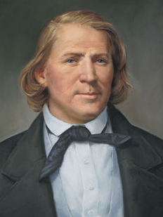
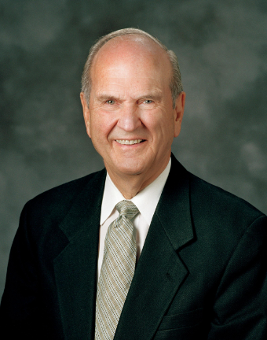
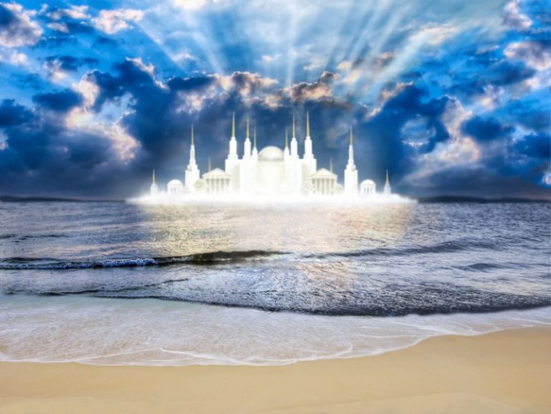
Zion
For the Saints in 1830 Joseph Smith was the prophet whom God inspired to move the cause of Zion.
For the Saints in 1860, the one called “to move the cause of Zion” was Brigham Young.
For the Saints in the year 2018, the one who had this calling was Russell M. Nelson.
Though the sorrow Joseph Smith would experience in “moving the cause of Zion” was not yet over—indeed, had hardly begun—the Lord had heard his pleadings for help in establishing the work. His sins were remitted, the Lord manifested his blessings on Joseph’s work, and Joseph needed no longer to stand alone in carrying forth the kingdom.
With the organization of the Church, the kingdom was set up. The stone cut out of the mountain without hands would now roll forth until Zion was fully established and filled the whole earth (see Daniel 2). Student Manual
D&C 21:6-9

Slide 17
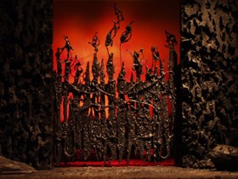

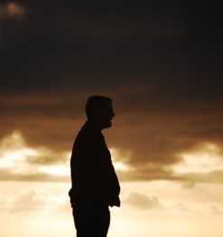

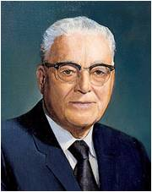
Always a Promise
There is always a blessing for those who are obedient to God’s laws and commandments.
If you will “do these things”:
The gates of hell shall not prevail against you.
The Lord God will disperse the powers of darkness from before you.
The Lord God will cause the heavens to shake for your good, and his name’s glory
The Lord will give a special witness that the prophet’s words are given to him by Jesus Christ
Otten and Caldwell
To you Latter-day Saints everywhere, that promise will be yours if you will follow the leadership the Lord has place within the church…”
President Harold B. Lee (Ensign Nov. 1971)
D&C 21:6-9

Slide 18
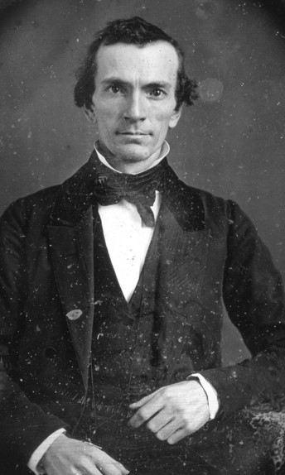
“Mine Apostle”
At the first meeting of the Church, Oliver Cowdery was ordained an elder by the Prophet Joseph Smith, and the Prophet was ordained an elder by Oliver Cowdery.
Greek, apostle means
“one sent forth”
Oliver Cowdery was sent forth by Jesus Christ and commanded to testify of the Savior.
Although Oliver was given apostolic responsibilities, he was not a member of the Quorum of the Twelve Apostles.
However, he did assist in seeking out the men who were called as members of that quorum when it was organized in 1835.
D&C 21:10-12—Guide to the Scriptures

Slide 19
Sources:
Videos:
Organization of the Church (1:47)
Following Prophetic Counsel (0:41)
History of the Church, 1:61
John A. Widtsoe, Evidences and Reconciliations, arr. G. Homer Durham, 3 vols. in 1 [1960], 258.
Presentation by ©http://fashionsbylynda.com/blog/
Guide to the Scriptures, “Prophet, Translate, Apostles” scriptures.lds.org
Bible Dictionary, “Apostle, Elders”.
Hyrum M. Smith and Janne M. Syodahl Commentary pg. 116
President Harold B. Lee (In Conference Report, Oct. 1970, pp. 152–53.)
Ezra Taft Benson (“Fourteen Fundamentals in Following the Prophet” [Brigham Young University fireside address, Feb. 26, 1980], 1, 6,speeches.byu.edu ).
For the Strength of Youth [booklet, 2011], 4; see alsoLDS.org .
Oliver Cowdery picture found on http://mormonmatters.org/2009/02/05/oliver-cowdery-was-punkd/
Student Manual Doctrine and Covenants Religion 324-325 Section 21, pg 45-46
Otten and Caldwell Sacred Truths of the Doctrine and Covenants pg. 93-94
Presentation by ©http://fashionsbylynda.com/blog/

Slide 20
Receive from mine own mouth:
President Joseph Fielding Smith answered that question in this manner: “There has been much speculation in relation to the statement of the Lord to the Prophet Joseph Smith: ‘For his word ye shall receive, as if from mine own mouth, in all patience and faith.’ This is the word which the Lord gave to Israel in relation to Moses. It is just as true in the case of any other person who is sustained as the mouthpiece of the Almighty. Later, in speaking of his inspired servants, the Lord said: ‘And whatsoever they shall speak when moved upon by the Holy Ghost shall be scripture, shall be the will of the Lord, shall be the mind of the Lord, shall be the word of the Lord, shall be the voice of the Lord, and the power of God unto salvation.’ (D. & C. 68:4.) In this dispensation the same characteristics are shown by the people as were in ancient times. We are more inclined to accept as the word of the Lord something which was uttered in some former dispensation, but look with critical eye and unbelief upon that which the Lord delivers today through his chosen servants. Yet the word of the Lord is very clear on this matter. Let us not lose sight of the word of the Lord, that by hearkening to his chosen servant—and this is true whether it is Joseph Smith or some other President of the Church—‘the gates of hell shall not prevail against us.’” (Church History and Modern Revelation, 1:107–8.)
Patience and Faith:
Elder M. Russell Ballard of the Quorum of the Twelve Apostles taught:
“It is no small thing, my brothers and sisters, to have a prophet of God in our midst. Great and wonderful are the blessings that come into our lives as we listen to the word of the Lord given to us through him. At the same time, knowing that [the current Church President] is God’s prophet also endows us with responsibility. When we hear the counsel of the Lord expressed through the words of the President of the Church, our response should be positive and prompt. History has shown that there is safety, peace, prosperity, and happiness in responding to prophetic counsel as did Nephi of old: ‘I will go and do the things which the Lord hath commanded’” (“His Word Ye Shall Receive,” Ensign, May 2001, 65).
D&C 4-5
“The only safety we have as members of this church is to do exactly what the Lord said to the Church in that day when the Church was organized. We must learn to give heed to the words and commandments that the Lord shall give through his prophet, ‘as he receiveth them, walking in all holiness before me; … as if from mine own mouth, in all patience and faith.’
There will be some things that take patience and faith. You may not like what comes from the authority of the Church. It may contradict your political views. It may contradict your social views. It may interfere with some of your social life.
“… Your safety and ours depends upon whether or not we follow the ones whom the Lord has placed to preside over his church. He knows whom he wants to preside over this church, and he will make no mistake. The Lord doesn’t do things by accident. …
“Let’s keep our eye on the President of the Church.”
President Harold B. Lee
“I bear witness to you, my brothers and sisters, that God sustains [the living prophet], and no one else in the world today but him, because he has the holy calling of prophet, seer, and revelator, representing the Lord upon the earth in our time. He only has the right to revelation for the people of the Church, and if all people would understand that, they would not be tossed about by those who would seek to divert their minds from the Church and its glorious principles. …
“… They will be fortified against false teachers and anti-Christs, and we do have them among us.” (In Conference Report, Oct. 1953, p. 70.)
Elder Harold B. Lee testified: “We are not dependent only upon the revelations given in the past as contained in our standard works—as wonderful as they are. … We have a mouthpiece to whom God does and is revealing his mind and will. God will never permit him to lead us astray. As has been said, God would remove us out of our place if we should attempt to do it. You have no concern. Let the management and government of God, then, be with the Lord. Do not try to find fault with the management and affairs that pertain to him alone and by revelation through his prophet—his living prophet, his seer, and his revelator.” Elder Delbert L. Stapley declared:
(The Place of the Living Prophet [ address delivered to seminary and institute of religion personnel], 8 July 1964, p. 16.)
Unpopular Teachings:
Our Heavenly Father desires that His children knowingly and willingly choose to become like Him and qualify for the kind of life He enjoys. In doing so, His children fulfill their divine destiny and become heirs to all that He has. For this reason, Church leaders cannot alter God’s commandments or doctrine contrary to His will, to be convenient or popular. (Dale G. Renlund, “Our Good Shepherd,” Ensign or Liahona, May 2017, 30–31)

