Slide 1
Doctrine and Covenants
22-24
True Authority
Presentation by ©http://fashionsbylynda.com/blog/

Slide 2
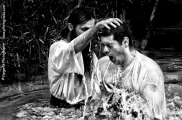
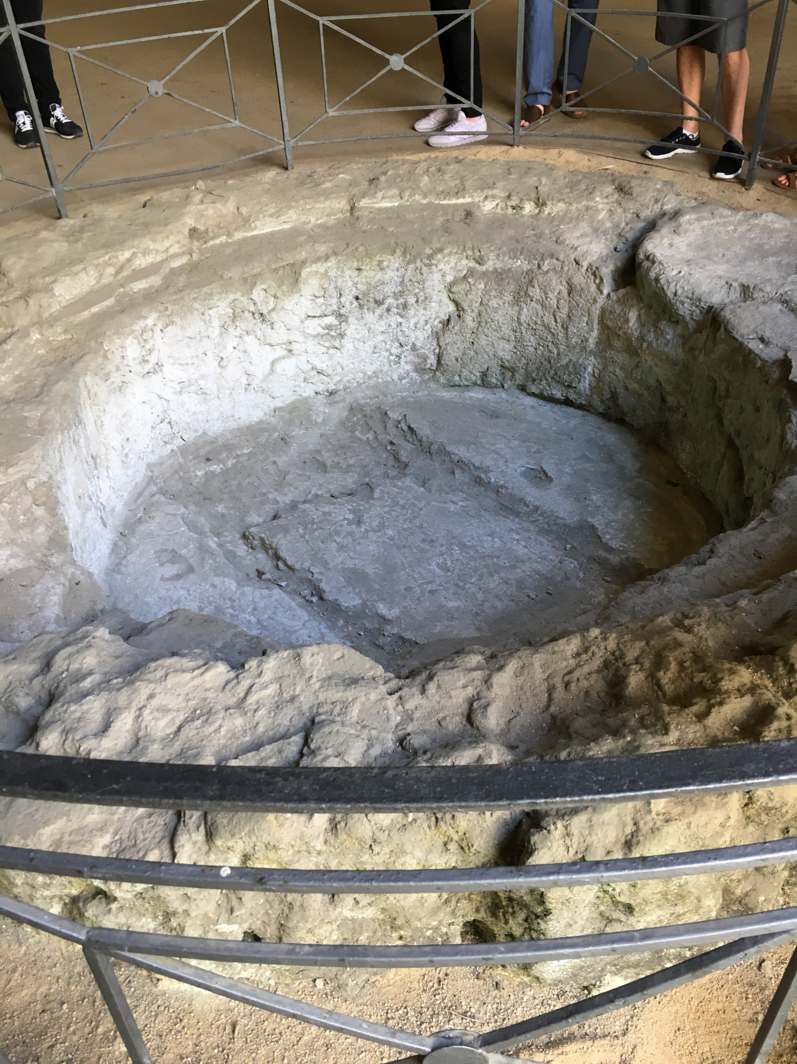
Dead Works
Unauthorized Authority:
During the Great Apostasy, the ordinances of Jesus Christ’s Church were changed, eliminated, or performed without proper authority.
Romanists hold that, in the case of an emergency, anybody—man or woman, Jew, pagan, or atheist, may administer baptism, and that it is valid, provided the administrator really intended to baptize.
Smith and Syodahl
Baptismal font in catacombs in Napoli, Italy
D&C 22:1

Slide 3
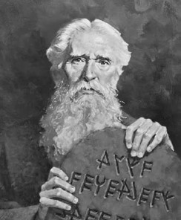
Law of Moses
The law of Moses, with its system of carnal commandments, ceremonies, rituals, and symbols, was given to help the Israelites remember God and look forward to the Atonement of Jesus Christ.
The Savior fulfilled this law through the Atonement (see Alma 34:13–14). During His mortal ministry, Jesus Christ and His Apostles labored to teach the Jews that salvation could not come by obedience to the law alone, but through the saving power of the Atonement.
The Lord compared an individual who had undergone unauthorized baptisms to those who relied on the law of Moses without having faith in Jesus Christ. This comparison emphasizes the need to let go of “dead” religious practices that cannot save us and embrace the new and everlasting covenant of the gospel, just as early Jewish converts to Christianity had to do.
D&C 22:2

Slide 4
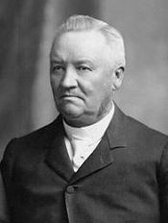
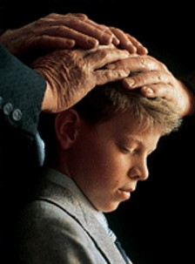
Life of the Holy Spirit
“The true Church must be established by authority of God, and there must be the life of the Holy Spirit in it. The Holy Ghost must be conferred upon the members by the ordinances ordained for its bestowal, and when the Spirit is received it will testify unto the recipients that they have obeyed the demands of the true Gospel.
Anthon H. Lund

Slide 5
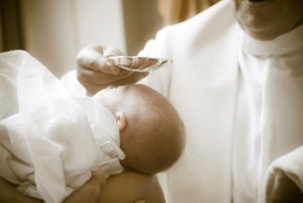
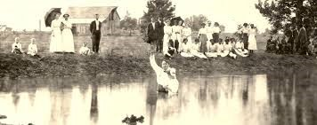
Old Covenants--Rebaptism
Many of those seeking membership in the Church had been baptized in their former faiths. They wondered why they had to be baptized again.
Baptism must be performed by one having authority from God.
Revelation in D&C 22:
The ordinance of baptism must be performed by those with the authority to grant individuals Church membership and entrance into the kingdom of God.
D&C 22:1-4

Slide 6
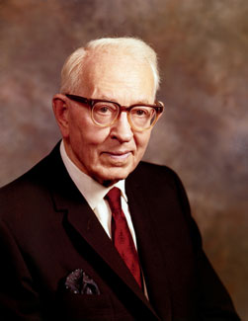
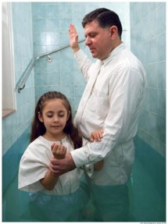
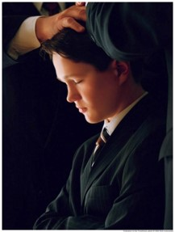
New and Everlasting Covenant
“The new and everlasting covenant is the fulness of the gospel.
It is composed of ‘All covenants, contracts, bonds, obligations, oaths, vows, performances, connections, associations, or expectations’ that are sealed upon members of the Church by the Holy Spirit of promise, or the Holy Ghost, by the authority of the President of the Church who holds the keys.
The President of the Church holds the keys of the Melchizedek Priesthood. He delegates authority to others and authorizes them to perform the sacred ordinances of the priesthood.
Joseph Fielding Smith
D&C 22:1-4

Slide 7
Who knows you best?
What do they know about you?
What do they not know about you?

Slide 8
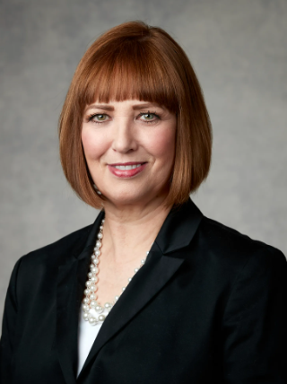
Heavenly Father also knows you. He knows where you are, and who you are, and what you need.
He hears and answers your prayers.
No matter how lonely you feel, He’s always there.
You are never alone. You can always turn to Him.
Cristina B. Franco
Heavenly Father and Jesus Christ know each of us and will give us counsel according to our desires and circumstances.

Slide 9
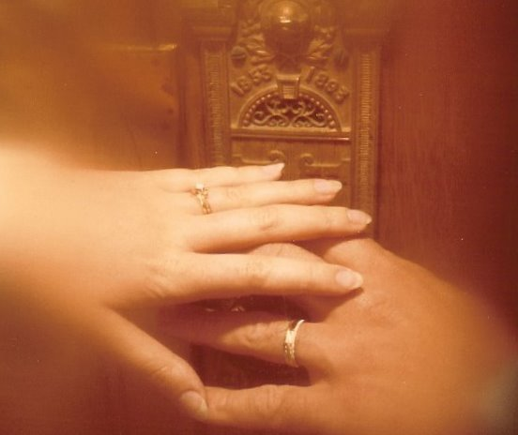
Marriage for Eternity
“Marriage for eternity is a new and everlasting covenant. Baptism is also a new and everlasting covenant [see D&C 132:22], and likewise ordination to the priesthood, and every other covenant is everlasting and a part of the new and everlasting covenant which embraces all things.”
Joseph Fielding Smith
D&C 22:1-4

Slide 10
Take Council From God Only
For my thoughts are not your thoughts, neither are your ways my ways, saith the Lord.
For as the heavens are higher than the earth, so are my ways higher than your ways, and my thoughts than your thoughts.”
Isaiah 55:8-9
“Wherefore, brethren, seek not to counsel the Lord, but to take counsel from his hand. For behold, ye yourselves know that he counseleth in wisdom, and in justice, and in great mercy, over all his works.”
Jacob 4:10
D&C 22:4

Slide 11
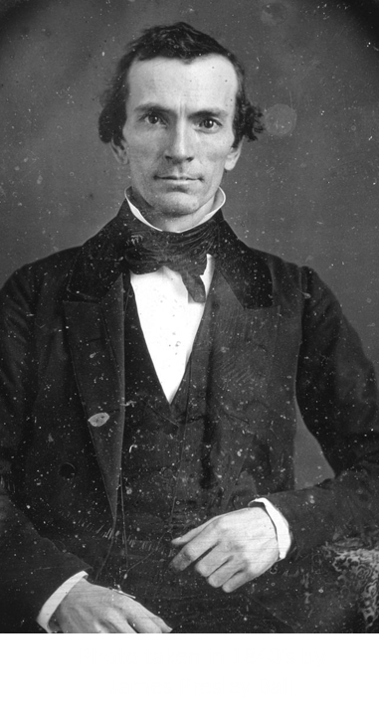
5 Men—Called of God
Oliver was a schoolteacher. He served as a scribe for Joseph Smith Jr. when translating the Book of Mormon.
He was one of the Three Witnesses of the Book of Mormon and was the second elder of the restored Church.
He shared the gospel with the Whitmer family and his other friends in Fayette, New York.
On several occasions his pride was manifested, including once when he wrote to Joseph Smith Jr. concerning part of a revelation with which he did not agree.
His pride caused him to leave the Church for a time between 1838 and 1847.
D&C 23:1-2

Slide 12
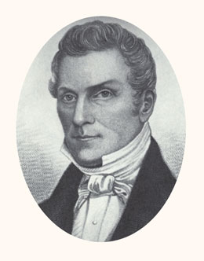
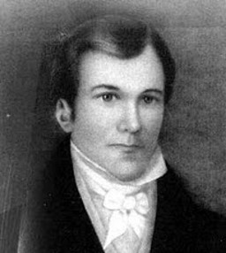
5 Men—Called of God
Hyrum Smith, an older brother of the Prophet, assisted in the publication of the Book of Mormon by working directly with the printer.
He served as president of the first branch of the Church in Colesville, New York. Hyrum was faithful to the Lord and the Church throughout his life.
Samuel Smith, a younger brother of the Prophet, was baptized in May 1829.
In June 1830, he departed on a mission and placed a Book of Mormon that would eventually lead to the conversion of Brigham Young and many of his family members.
Samuel was loyal to his family and to the Church throughout his life. Samuel was not ready to preach when this revelation was given, but two months later he would begin his missionary service.
D&C 23:3-4

Slide 13
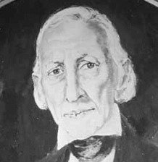
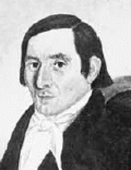
5 Men—Called of God
Joseph Smith Sr., the Prophet’s father, joined the Church the day it was organized.
The following summer, he and his son Don Carlos embarked on a mission to extended family in New York.
He became a high priest and the first patriarch of the Church. Joseph Smith Jr. described his father as “a man faithful to his God and to the Church in every situation and under all circumstances through which he was called to pass.”
History of the Church
Joseph Knight Sr. was a close friend of Joseph Smith Jr. and had shown him great kindness. He provided the Prophet with supplies while he worked on the translation of the Book of Mormon.
He had felt a desire to be baptized with others on the day the Church was organized, but he refrained because he wanted to study the Book of Mormon further. He later wrote, “I should [have] felt better if I had … gone forward” to be baptized (as quoted in Larry Porter,
The Joseph Knight Family Article
D&C 23:5-6

Slide 14
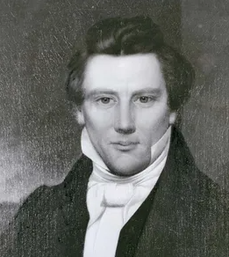
5 Men—Called of God
Joseph Smith Jr.
Joseph Smith Sr., the Prophet’s father, joined the Church the day it was organized.
The following summer, he and his son Don Carlos embarked on a mission to extended family in New York.
He became a high priest and the first patriarch of the Church. Joseph Smith Jr. described his father as “a man faithful to his God and to the Church in every situation and under all circumstances through which he was called to pass.”
History of the Church
Joseph Smith Jr. was the Lord’s Prophet. In April 1830, Joseph organized the restored Church. Immediately, the new Church faced persecution.
Joseph was arrested on false charges and released.
He had the responsibility to provide for his family and lead the Church at the same time.
“As busy as he was with the new church, he had to plant his fields soon if he wanted a successful fall harvest.
His payments to Emma’s father on the farm were already late, and if his crops failed, he would have to find another way to pay off his debt.”
(Saints, 1:90)
Joseph Knight Sr. was a close friend of Joseph Smith Jr. and had shown him great kindness. He provided the Prophet with supplies while he worked on the translation of the Book of Mormon.
He had felt a desire to be baptized with others on the day the Church was organized, but he refrained because he wanted to study the Book of Mormon further. He later wrote, “I should [have] felt better if I had … gone forward” to be baptized (as quoted in Larry Porter,
The Joseph Knight Family Article
D&C 23
D&C 24:1-6

Slide 15
Divine Truth Bestowed
“When a person is a recipient of divine truth, he is obligated to conform his life to that truth. By so doing, that individual is approved of the Lord. When a person knowingly lives contrary to the Lord’s will he is under condemnation in the sight of the Lord.”
Otten and Caldwell

Slide 16
Sources:
Video:
“Heavenly Father Knows Me” (3:18)
Hyrum M. Smith and Janne M. Sjodahl Commentary pg. 119
Anthon H. Lund CR, October 1915 p. 10 (Otten and Caldwell Sacred Truths of the Doctrine and Covenants pg. 97)
Presentation by ©http://fashionsbylynda.com/blog/
Cristina B. Franco, “Heavenly Father Knows You,” Friend, June 2018, 16
Joseph Fielding Smith (Answers to Gospel Questions, comp. Joseph Fielding Smith Jr., 5 vols. [1957–66], 1:65).
Joseph Smith Sr. History of the Church, 4:192
“The Joseph Knight Family,” Ensign, Oct. 1978, 40; spelling and capitalization standardized).
Otten and Caldwell Sacred Truths of the Doctrine and Covenants pg. 104
Stuart Miles digital free photography Your way My way
Presentation by ©http://fashionsbylynda.com/blog/

Slide 17
Heavenly Father is Aware of Me:
I assure you that our Heavenly Father and His Beloved Son, Jesus Christ, love you. They are intimately aware of your circumstances, your goodness, your needs, and your prayers for help. Again and again, I pray for you to feel Their love for you. (Russell M. Nelson, “Overcome the World and Find Rest,” Liahona, Nov. 2022, 95)
Importance of Restoration:
Elder James E. Talmage of the Quorum of the Twelve Apostles explained:
“When the Lord established his Church amongst the Nephites upon this continent, he told those who were chosen and ordained, unto whom authority was given, just how to administer the ordinance of baptism. They were to say: ‘Having authority given me of Jesus Christ, I baptize you in the name of the Father and of the Son, and of the Holy Ghost.’ That does not give us in this age any such authority. The words that Christ spoke unto his apostles of old would be no authority unto the apostles today, nor unto any of the elders of the Church. I repeat, the words that he, the Lord, spoke unto the disciples who were chosen from among the Nephites would be no authority unto us; but in this day and age he has spoken again, and has given that same power and authority to speak in his name, and to administer the ordinances of the gospel, after the pattern that he has set; and therefore the elders and priests who take candidates, who have professed their faith, and who have repented of their sins, into the waters of baptism today, declare that they have authority given them; and, being commissioned of Jesus Christ, they baptize in the name of the Father and of the Son and of the Holy Ghost” (in Conference Report, Apr. 1924, 68; see also Doctrine and Covenants Student Manual, 2nd ed. [Church Educational System manual, 2001] , 46).
Some early Church converts did not understand that the Lord does not accept a baptism unless it is performed by someone holding priesthood authority. President Joseph Fielding Smith explained:
“Immediately after the Church was organized, converts were made. Some of these had belonged to churches which believed in baptism by immersion. In fact, many of the early converts of the Church had previously accepted this mode, believing that it was right. The question of divine authority, however, was not firmly fixed in their minds. When they desired to come into the Church, having received the testimony that Joseph Smith [was a true prophet], they wondered why it was necessary for them to be baptized again when they had complied with an ordinance of baptism by immersion” (Church History and Modern Revelation [1953], 1:109).
“Enter ye in at the gate”
Baptism is the gate, or requirement, for entry into the celestial kingdom for anyone who has reached the age of accountability (see2 Nephi 31:15–21). The ordinance of baptism, while absolutely essential, becomes valid only when it is accompanied by a corresponding change of heart that leads to a new life.
Elder John A. Widtsoe of the Quorum of the Twelve Apostles described such a changed life:
“I remember the man who baptized me into the Church, a very common, ordinary man … with a jug of beer two or three times a day, a glass of whiskey a little later, … tobacco mostly all day long, living a useless, purposeless life, except for three meals a day, and the satisfaction of some of the carnal appetites. He heard the Gospel and accepted it. It was good. It was something he had been longing for. The man grew in power and stature in the Church. As I recall it, he filled five or six missions and presided over one of the missions of the Church. He was the same man, with the same arms, same feet, same body, same mind, but changed because of the Spirit that comes with the acceptance of eternal truth” (in Conference Report, Apr. 1952, 34; see also Doctrine and Covenants Student Manual, 2nd ed. [Church Educational System manual, 2001]
Message for Me Today:
I believe He would start by expressing His deep love for you. He might say it with words, but it would also flow so strongly—just from His presence—that it would be unmistakable, reaching deep into your heart, filling your whole soul! … I believe He would assure you with words He has spoken in the scriptures. (Dieter F. Uchtdorf, “Jesus Christ Is the Strength of Youth,” Liahona, Nov. 2022, 9)

Slide 18
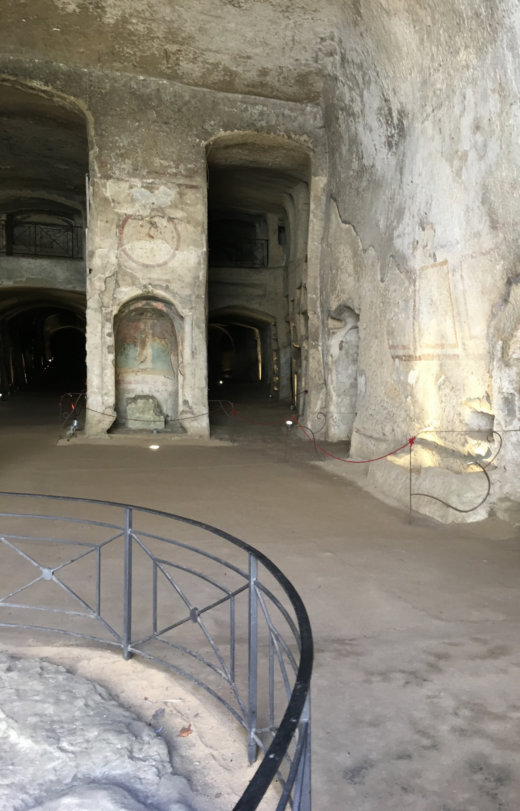
In the History of Mormonism, Samuel Smith, born March 1808, was Joseph's younger brother. He was baptized into the Church of Jesus Christ of Latter-day Saints on May 25, 1829, at the age of 22. He was the third person to be baptized in the church and receiving the priesthood. Joseph then asked Samuel to be the first missionary. His first day of being on a mission, Samuel walked 25 miles, carrying only a knapsack full of Book of Mormons. Samuel visited four houses along the way, but none of them wanted to buy a copy. Tired, hungry, and discouraged, Samuel stopped by an inn to rest. He asked the innkeeper if he wanted to buy a Book of Mormon. He told the innkeeper about his brother receiving revelation from an angel where the plates were buried. Angry, the innkeeper called Samuel a liar and threw him out of his inn. So Samuel had to sleep under an apple tree on the ground. The next morning Samuel stopped by a widow's house. In return, the widow gave Samuel some breakfast. He gave her a Book of Mormon in return. Then he walked eight miles and shared the Book of Mormon with John Greene, a Methodist minister.
He only took it see if others he knew might be interested in buying a copy. Mr. Greene’s wife, Rhoda, was Brigham Young’s sister, but Brigham did not know about the church yet. Two months later, Samuel returned to the Greene's home. When he arrived, Mr. Greene wasn't home, but Mrs. Greene told Samuel that she had read the book. The Spirit prompted Samuel to leave the book with her, and he did. Later, Mrs. Greene convinced her husband to read the book, and the couple was later baptized. Samuel also sold a copy of the Book of Mormon to Brigham Young’s brother: Phineas Young, a Methodist preacher. Samuel told Phineas about the book, including how he is one of the witnesses of the Golden Plates. Phineas thanked Samuel for his time and had it in his mind to find errors in the book and expose it to the world. A week later, and after reading the book twice, Phineas told his congregation that he believed the Book of Mormon. Later in the summer, the Young family read the Book of Mormon, including Brigham Young. Even though Samuel baptized no one and would feel like he didn't succeed in his calling, his efforts would later convert many church members, including Brigham Young who would be the next prophet of the church, and Heber C. Kimball, an Apostle to the church. Samuel died a month after Joseph did in 1844, from gunshot wounds received from the mob while he was fleeing on horseback.
Posted by Ben Sokaol Dec. 2012
The Catacombs of San Gennaro are underground paleo-Christian burial and worship sites in Naples, Italy, carved out of tuff, a porous stone. They are situated in the northern part of the city, on the slope leading up to Capodimonte (it), consisting of two levels, San Gennaro Superiore, and San Gennaro Inferiore. The catacombs lie under the Rione Sanità neigborhood of Naples, sometimes called the "Valley of the Dead".[ The site is now easily identified by the large church of Madre del Buon Consiglio.
Other ritual spaces included a confessional, baptismal font, a carved tuff table used as a seat for a consignatorium (area for confirmation), or “oleorum” table for holy oils, and possibly, monastic and hermit cells.
^{Wikipedia}
^{Photo by Lynda Blau}

Slide 19
Doctrine and Covenants 24
Magnify Your Calling
Presentation by ©http://fashionsbylynda.com/blog/

Slide 20
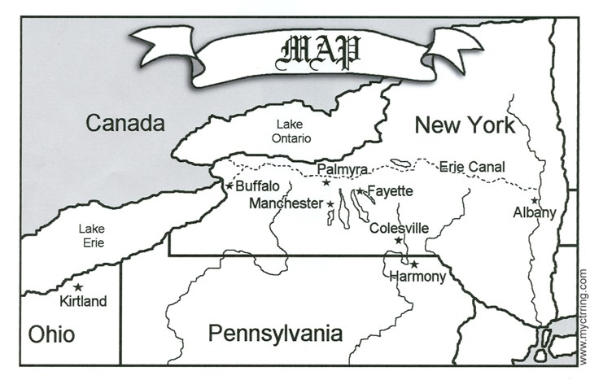
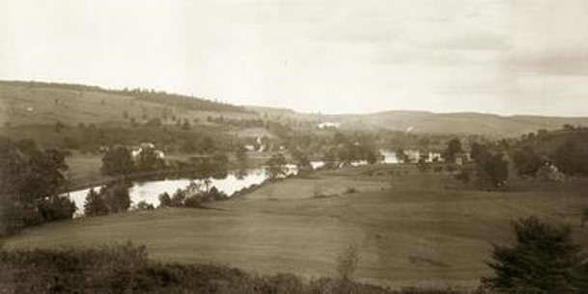
Historical Setting
June 1830
After the Church was organized, the Prophet Joseph Smith visited groups of friends in Manchester, Fayette and Colesville, New York.
In Colesville Joseph was teaching the gospel to a number of people who were anxious to be baptized.
Their interest in the church created feelings of opposition among the sectarian priests who feared the loss of their followers.
HC

Slide 21
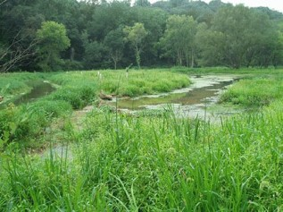
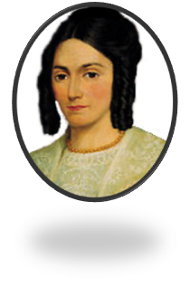
Mob Action
A stream was dammed to prepare for baptisms the next day (Sunday), but a hostile mob destroyed the dam during the night.
Early Monday morning, the dam was rebuilt and 13 people were baptized, including Emma Smith. By the time the baptisms were completed, however, a mob of nearly 50 men had gathered, insulting and threatening to harm the Saints.
HC

Slide 22
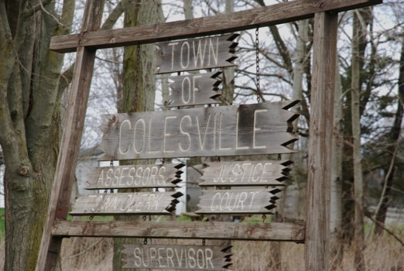
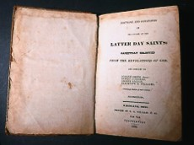
Joseph Arrested
That evening, the Saints met to confirm those who had been baptized earlier that day, but before the confirmations could be performed, Joseph was arrested on charges of “being a disorderly person, of setting the country in an uproar by preaching the Book of Mormon.
This resulted in a trial and eventually acquittal, with harassments throughout the proceedings.
After the trial, Joseph and Oliver Cowdery returned to the Prophet’s home in Harmony, Pennsylvania.
The Prophet received three revelations known as sections 24, 25, and 26.
HC

Slide 23
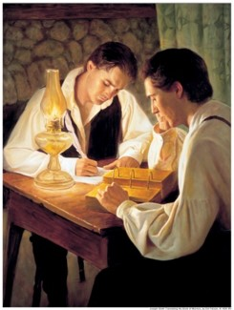
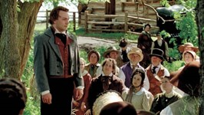
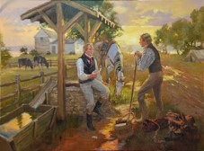
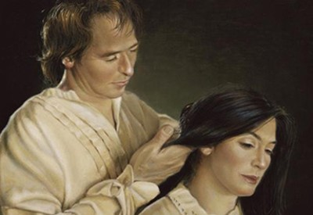
How Rough Did It Get?
Joseph’s Schedule:
Committed to translate and publish the Book of Mormon
Organizing the Lord’s Church
Sending missionaries to the Saints and others
To provide temporally for his family (which he missed the planting season)

Slide 24
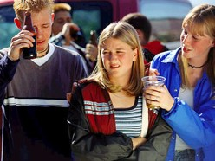
How Rough Can It Get?
Your Schedule:
Finishing High School
Deciding on college or a mission
Peer pressure
Family situations
Funding for College/and or mission

Slide 25
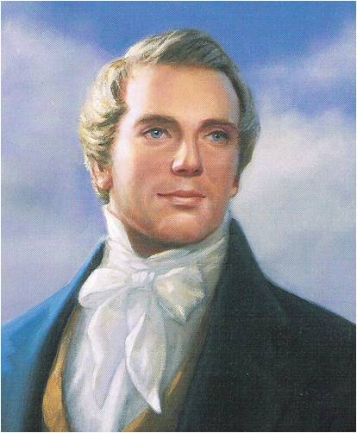
The Lord’s Answer
To Joseph:
Magnify Your Calling
Secure your temporal needs
Then speedily go to Colesville, Fayette, and Manchester and the Lord will bless them spiritually and temporally
Continue to pray
Continue to translate the Book of Mormon
Be Patient
To You:
Magnify Your Calling
Save your earnings for your needs, not your wants
Continue to serve others and look for missionary opportunities among your friends
Continue to pray
Continue to read
and study the
scriptures
Be Patient
D&C 24:3-8

Slide 26
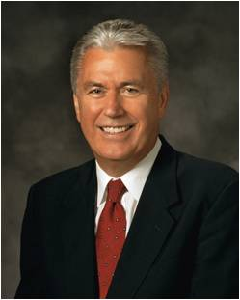
“Patience—the ability to put our desires on hold for a time—is a precious and rare virtue. We want what we want, and we want it now. Therefore, the very idea of patience may seem unpleasant and, at times, bitter.
Nevertheless, without patience, we cannot please God; we cannot become perfect. Indeed, patience is a purifying process that refines understanding, deepens happiness, focuses action, and offers hope for peace.”
“There is an important concept here: patience is not passive resignation, nor is it failing to act because of our fears.
Patience means active waiting and enduring. It means staying with something and doing all that we can—working, hoping, and exercising faith; bearing hardship with fortitude, even when the desires of our hearts are delayed. Patience is not simply enduring; it is enduring well!”
President Dieter F. Uchtdorf
If we are patient and endure our afflictions, the Lord will be with us
D&C 24:8

Slide 27
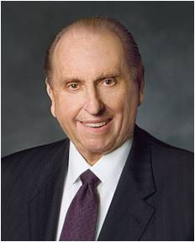
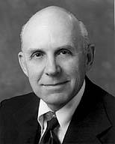
Supporting a Mission
The Lord promised Joseph that his temporal needs would be taken care of if he would “magnify” his calling.
The members were encouraged to support and sustain the Prophet in every possible way.
With the great increase in the number of new missionaries - many coming from modest means - President Thomas S. Monson invited members to donate generously to the missionary fund.—May 18, 2013
“Do not squander your missionary funds for a bike, then a scooter, then a car or stereo, and records, etc. Do not rationalize that this is an “investment” which can be transferred into ready cash just before you go. Self-denial and purposeful saving may well be the greatest blessing to come from your missionary service.”
A. Theodore Tuttle
D&C 24:3-9

Slide 28
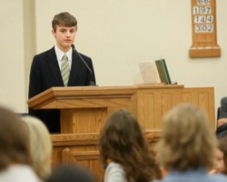
“Continue In Bearing My Name”
All persons who are baptized as members of the Church covenant to take upon them the name of Christ and be known as Christians.
They thus bear witness to all others by their words and deeds concerning the Savior and His mission.
“And the members shall manifest before the church, and also before the elders, by a godly walk and conversation, that they are worthy of it, that there may be works and faith agreeable to the holy scriptures—walking in holiness before the Lord.”
D&C 20:69
D&C 24:10

Slide 29
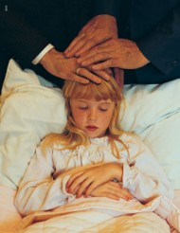
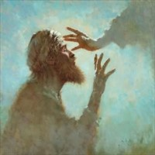
Miracles
“Oliver Cowdery was commanded to avoid requiring miracles outside of those associated with the preaching of the gospel unless commanded of the Lord
It is expected that priesthood holders acting properly will do works of the priesthood.
The miracles … are gifts of the Spirit (Holy Ghost) bestowed upon those who believe and obey the gospel of Christ and are intended not to convert people to the truth but to bless those who are already converted.
By requiring the person who is in need of a miracle to request it, the scriptures are fulfilled, that is, the miracle is performed in behalf of one who believes and is, therefore, a sign of his faith.”
Student Manual
D&C 24:13-14

Slide 30
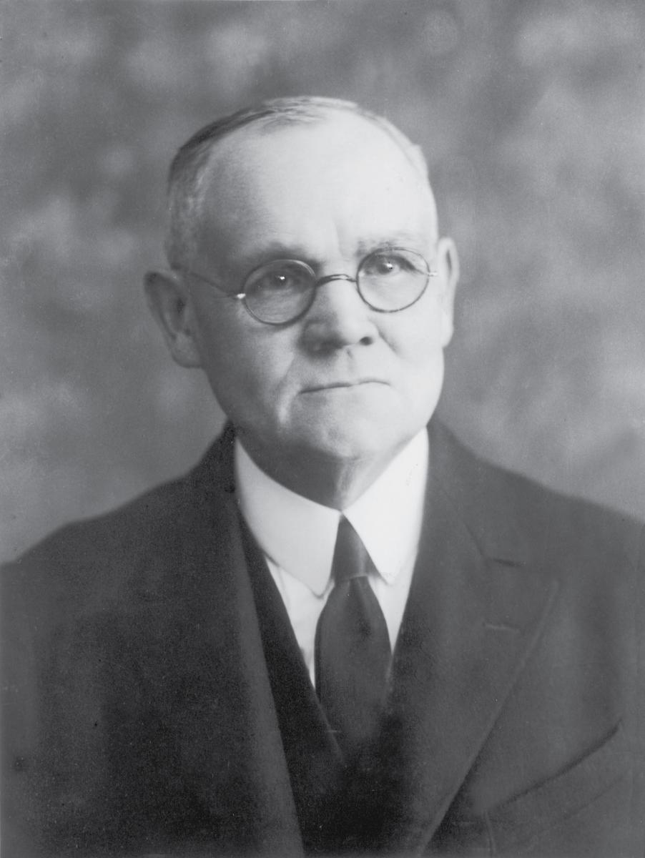
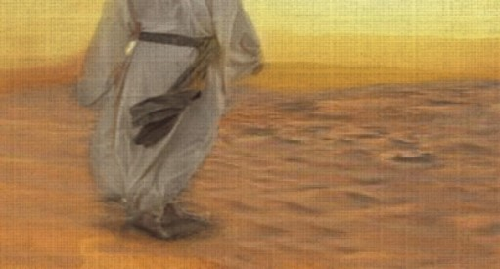
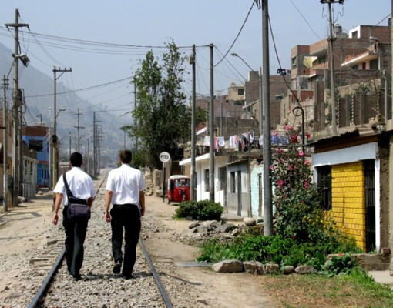
Shake the Dust
“To ceremonially shake the dust from one’s feet as a testimony against another was understood by the Jews to symbolize a cessation of fellowship and a renunciation of all responsibility for consequences that might follow. It became an ordinance of accusation and testimony by the Lord’s instructions to His apostles. …
In the current dispensation, the Lord has similarly directed His authorized servants to so testify against those who wilfully and maliciously oppose the truth when authoritatively presented.
The responsibility of testifying before the Lord by this accusing symbol is so great that the means may be employed only under unusual and extreme conditions, as the Spirit of the Lord may direct”
Elder James E. Talmage
D&C 24:15

Slide 31
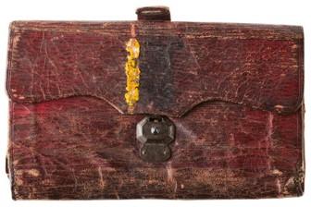
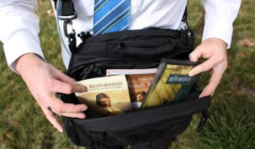
No Purse, No Scrip
Joseph and Oliver were to traveled without money, relying on the goodness of Church members and others to provide food and shelter.
Today, full-time missionaries are not commanded to go without purse or scrip.
D&C 24:18

Slide 32
“Prune My Vineyard”
See Allegory of the Olive Tree
Jacob 5
“In this dispensation the Lord’s vineyard covers the whole earth, and the laborers are going forth to gather scattered Israel before the appointed day of burning when the vineyard will be purified of corruption.”
Elder Bruce R. McConkie
D&C 24:19

Slide 33
Sources:
Video:
Mountains to Climb (5:04)
History of the Church Vol. 1, pp. 86-144 and CHMR Vol. 1, pp. 114, History of the Church, 1:86–88
Presentation by ©http://fashionsbylynda.com/blog/
President Dieter F. Uchtdorf Continue in Patience April 2010 General Conf.
Bruce R. McConkie (In Conference Report, Apr. 1975, p. 77; or Ensign, May 1975, p. 52.)
Presentation by ©http://fashionsbylynda.com/blog/

Slide 34
Magnifying our Callings:
The word magnify is commonly interpreted to mean “enlarge.” In order for an enlargement to take place, one needs to gather the powers of the existing resources and focus them on a given point. This is illustrated in the process by which a magnifying lens enlarges by focusing the powers of the available light.
Joseph Smith was to concentrate and focus all his energies and talents to the calling given him by the Lord at that time. He was to pray, write, expound the scriptures, exercise patience and administer the affairs of the Church. As he utilized all of his available resources in the magnifying of his calling , the Lord would then give the increase and enlarge his abilities and the fruits of his labors.” Otten and Caldwell Sacred Truths of the Doctrine and Covenants pp. 107
The Law of Common Consent
Elder Bruce R. McConkie explained that “administrative affairs of the Church are handled in accordance with the law of common consent. This law is that in God’s earthly kingdom, the King counsels what should be done, but then he allows his subjects to accept or reject his proposals. Unless the principle of free agency is operated in righteousness men do not progress to ultimate salvation in the heavenly kingdom hereafter. Accordingly, church officers are selected by the spirit of revelation in those appointed to choose them, but before the officers may serve in their positions, they must receive a formal sustaining vote of the people over whom they are to preside. (D. & C. 20:60–67; 26:2; 28; 38:34–35; 41:9–11; 42:11; 102:9; 124:124–145.)” (Mormon Doctrine, pp. 149–50.)
Miracles:
President Spencer W. Kimball taught that “where [the Lord’s] priesthood was and where faith was found, there would be the signs of power, not for show but for a blessing to the people” (“President Kimball Speaks Out on Administration to the Sick,” New Era, Oct. 1981, 45). In our day, believers receive healings and miracles just as they always have. However, we do not hear about all healings and miracles that occur. Such experiences are sacred. Many times, people who receive such miracles feel prompted to keep them quiet and private.
President Joseph Fielding Smith taught of the circumstances in which a non-consenting vote would be given:
“I have no right to raise my hand in opposition to a man who is appointed to any position in this Church, simply because I may not like him, or because of some personal disagreement or feeling I may have, but only on the grounds that he is guilty of wrong doing, of transgression of the laws of the Church which would disqualify him for the position which he is called to hold” (Doctrines of Salvation, comp. Bruce R. McConkie, 3 vols. [1954–56], 3:124; see also Doctrine and Covenants Student Manual, 2nd ed. [Church Educational System manual, 2001], 52).
“The Lord, Jesus Christ, is our perfect example of patience. Though absolutely unyielding in adherence to the truth, he exemplified patience repeatedly during his mortal ministry. He was patient with his disciples, including the Twelve, despite their lack of faith and their slowness to recognize and understand his divine mission. He was patient with the multitudes as they pressed about him, with the woman taken in sin, with those who sought his healing power, and with little children. Finally, he remained patient through the sufferings of his mock trials and his crucifixion.
The Prophet Joseph Smith’s afflictions and sufferings… Beyond imprisonments, mobbings, and beatings, he suffered the anguish of betrayal by disloyal, unfaithful associates. But he offered the hand of friendship and fellowship to them even after they had opposed and betrayed him.
We should learn to be patient with ourselves. Recognizing our strengths and our weaknesses, we should strive to use good judgment in all of our choices and decisions, make good use of every opportunity, and do our best in every task we undertake. We should not be unduly discouraged nor in despair at any time when we are doing the best we can. Rather, we should be satisfied with our progress even though it may come slowly at times.”
Patience, a Key to Happiness
By Elder Joseph B. Wirthlin

