Slide 1
Doctrine and Covenants 27
Sacrament and Armor of God
“And Jesus said unto them, I am the bread of life: he that cometh to me shall never thirst.: John 6:35
Presentation by ©http://fashionsbylynda.com/blog/

Slide 2
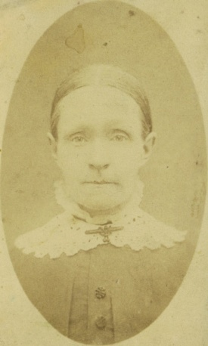
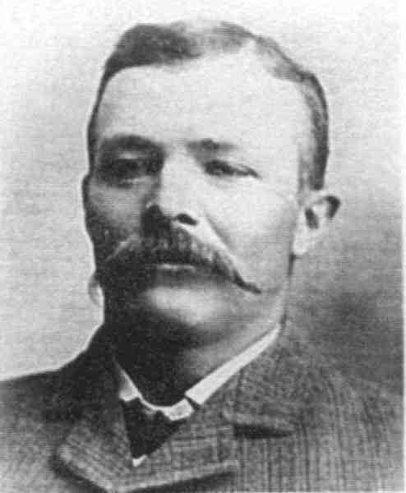
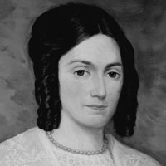
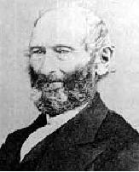
Historical Background
August 1830
Newel Knight and his wife, Sally, traveled to Harmony, Pennsylvania, to visit the Prophet Joseph Smith.
Sally Knight and Emma Smith had been baptized earlier in the summer but had not yet been confirmed because of persecution by a mob.
During the Knights’ visit to Harmony, it was determined that Sally and Emma should be confirmed and that the group, along with John Whitmer, would partake of the sacrament together.
When Joseph went out to obtain wine for the sacrament, he was met by a heavenly messenger who communicated the revelation now recorded in Doctrine and Covenants 27.

Slide 3
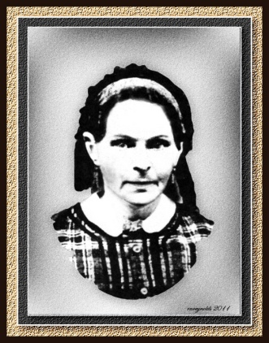
Newel Knight
He was born on September 13, 1800, in Vermont to Joseph Knight Sr. and Polly Peck
While boarding in Colesville, N.Y. with the Knight family in 1826, he became acquainted with Joseph Smith
In April 1830 Joseph miraculously rescued Newel from the effects of an evil influence
He was baptized in May of 1830
He remained faithful to the Church during persecution and hardship during his sojourn in Missouri and later in Nauvoo
He was called as a Branch President in Thompson, Ohio in 1831 and led faithful Saints to Missouri, and was on the High Council in Nauvoo
His first wife, Sally Coburn, died because of suffering in Missouri in 1834. They had one son, Samuel Knight
With his second wife, Lydia Goldthwaite, they had 7 children (married 23 Nov 1835)
He died with a lung disorder on January 11, 1847
Who’s Who

Slide 4
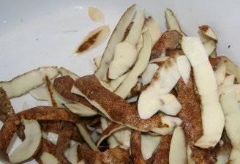
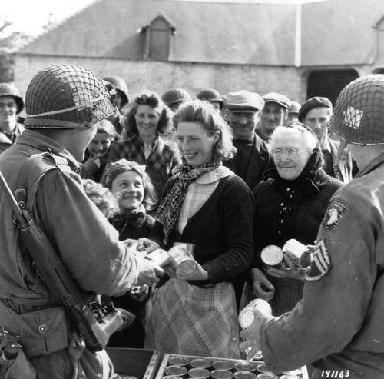
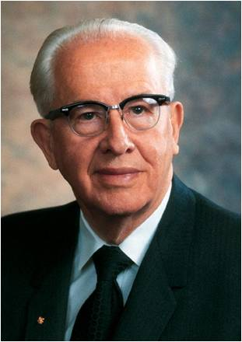
Spiritual Emblems
What spiritual purpose might these be used for?
“I cannot forget the French Saints who, unable to obtain bread, used potato peelings for the emblems of the sacrament”
President Ezra Taft Benson
D&C 27:2

Slide 5
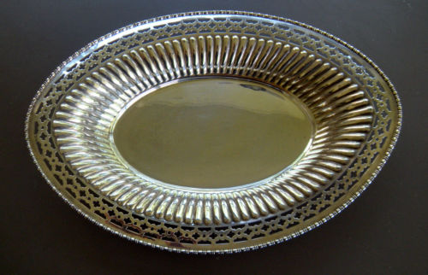
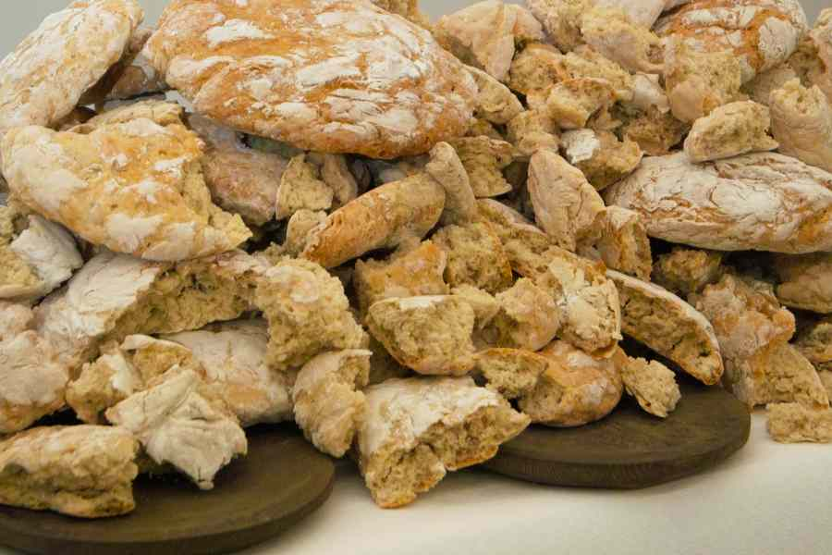
Emblems to Remember
What we use as emblems of the sacrament is not as important as what those emblems help us remember.
As we partake of the sacrament, we are to remember the atoning sacrifice of Jesus Christ.
D&C 27:2

Slide 6
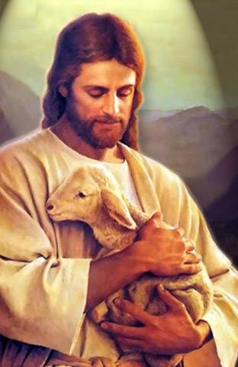
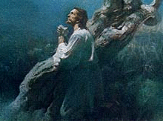

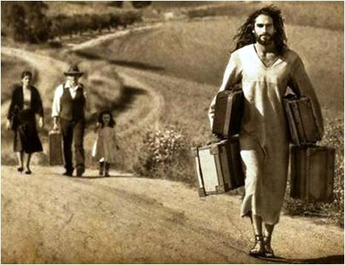
Remembering Him
We remember the life of the Jesus and the model He set for us by His own life.
We remember His atoning sacrifice made in our behalf through which He endured shame and incomprehensible pain in order to pay for our sins and bring about the Resurrection.
We remember the covenants we have made with Him and examine how well we are keeping those covenants.
We remember him in our everyday life by asking ourselves:
“What would Jesus do in this situation?” or
“How would He respond to this challenge” or
“What would He say if He were here now?”
We use Him as the constant standard by which we measure all of our own thoughts, words, and actions.
Student Manual

Slide 7
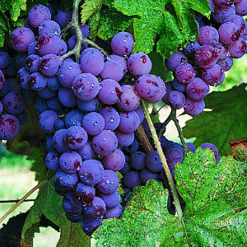
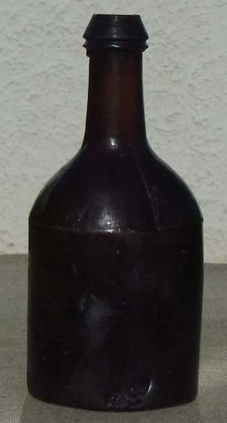
Warned Against Wine
One day, as Joseph Smith was traveling to obtain wine to use for the sacrament, he was stopped by a heavenly messenger who shared truths intended to help the Saints.
The Lord warned Joseph Smith not to purchase wine or strong drink (any drink with intoxicating qualities) from the enemies of the Church for use in the sacrament.
They were to use only wine that was “made new” by the Saints.
The Word of Wisdom would not be revealed for another two and a half years
in D&C 89 and that in the Church today we use water for the sacrament.
D&C 27:4-5

Slide 8
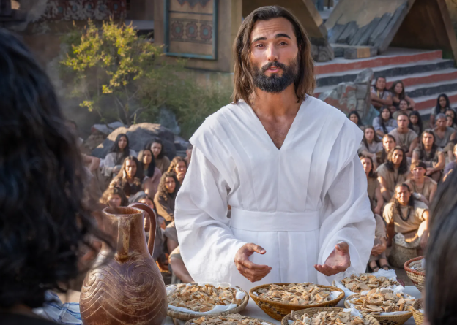
Book of Mormon Wine
Wine was one of the two Sacramental emblems of the ancient Church in Book-of-Mormon lands.
“The manner of administering the wine—Behold, they took the cup, and said:
O God, the Eternal Father, we ask thee, in the name of thy Son, Jesus Christ, to bless and sanctify this wine to the souls of all those who drink of it, that they may do it in remembrance of the blood of thy Son, which was shed for them; that they may witness unto thee, O God, the Eternal Father, that they do always remember him, that they may have his Spirit to be with them. Amen.”
Moroni 5:1,2
D&C 27:4-5

Slide 9
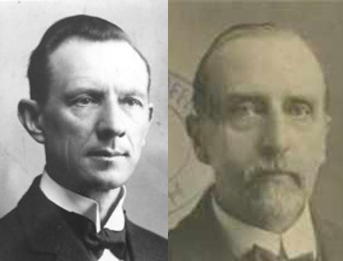
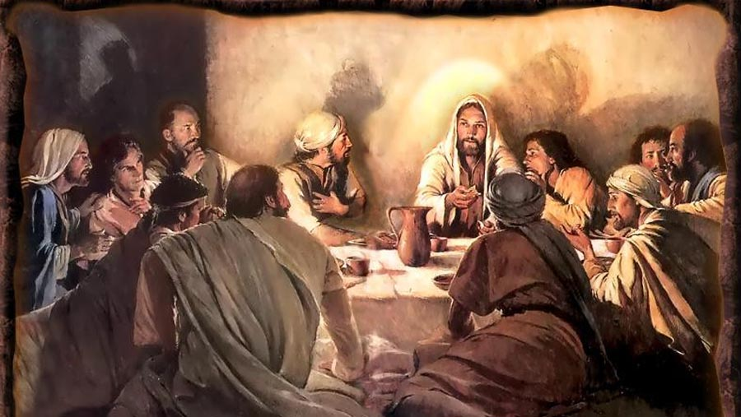
New Testament Wine
The New Testament Churches used wine diluted with water
Smith and Syodahl
“After the same manner also he took the cup, when he had supped, saying, This cup is the new testament in my blood: this do ye, as oft as ye drink it, in remembrance of me.”
1 Corinthians 11:25
Nothing is mentioned as to what was in the cup….it was to represent Jesus’ blood.
D&C 27:4

Slide 10
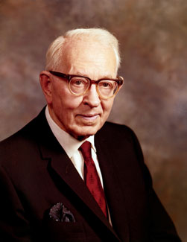
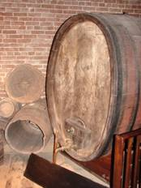
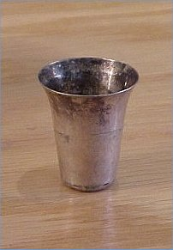
Joseph’s Warning on Wine
“[A] heavenly messenger told Joseph Smith that it mattered not what should be used for the Sacrament, and he was not to purchase wine or strong drink from his enemies.
The reason for this is obvious, for the Prophet had many enemies. However, this reason went further than merely protection against his enemies, for it was a caution against evil and designing persons who would adulterate these things.
Joseph Smith was also told that wine should not be used for the Sacrament unless it was made by the Saints, and should be had new among them.”
Joseph Fielding Smith

Slide 11
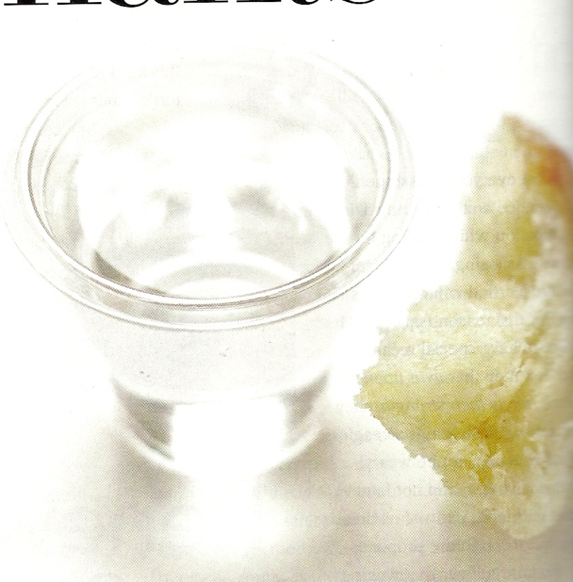
Today’s Water
“While the Church did not adopt the custom of using water exclusively in the Sacrament at that early time, yet it was from this time that water was used as a substitute for wine, which had been used principally because of its resemblance to blood.
Today throughout the Church water is used in the Sacrament in remembrance of the blood of Jesus Christ which was shed for the remission of sins in behalf of all who repent and accept the Gospel”
President Joseph Fielding Smith

Slide 12
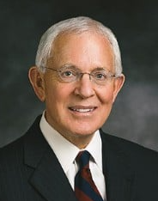
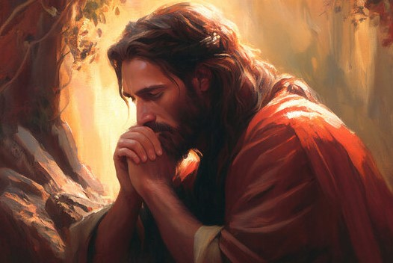
Eye Single to My Glory
Having an eye single to the glory of God means to be spiritually focused on the Savior and His redeeming work and not on ourselves.
Marlin K. Jensen
We should partake of the sacrament with an eye single to the glory of God, remembering Jesus Christ and His Atonement for us.
The angel revealed the Savior’s message to remember that the Savior’s body “was laid down for you” and his blood “was shed for the remission of your sins”
D&C 27:2

Slide 13

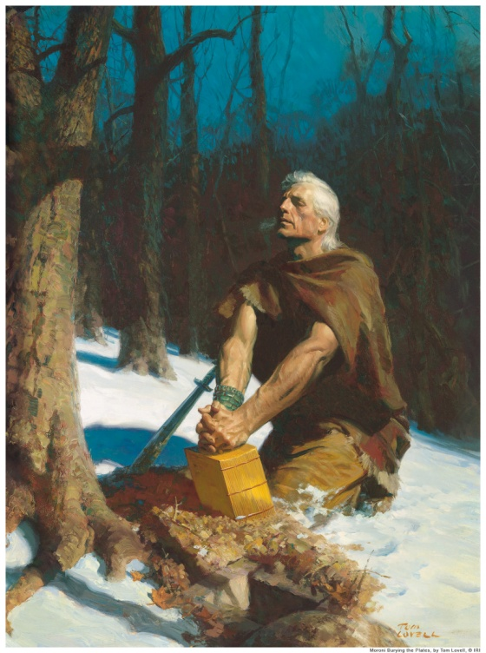
Those in Attendance at The Great Sacrament
Moroni
Reveal the Book of Mormon
Keys of the record of the Stick of Ephraim
D&C 27:5

Slide 14
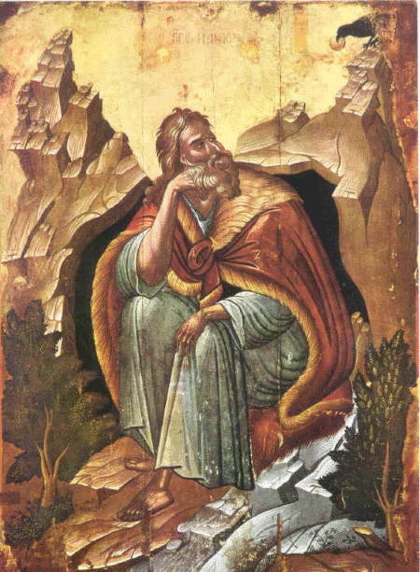
Elias
Committed the keys of bringing to pass the restoration of all things
D&C 27:6

Slide 15
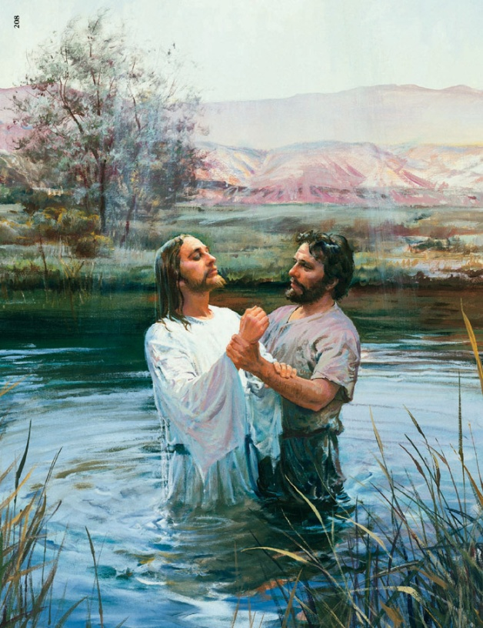
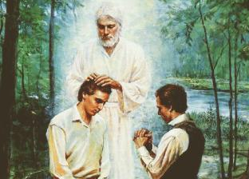
John, Son of Zacharias
To ordain Joseph and Oliver Cowdery with the Aaronic Priesthood
D&C 27:7-8

Slide 16
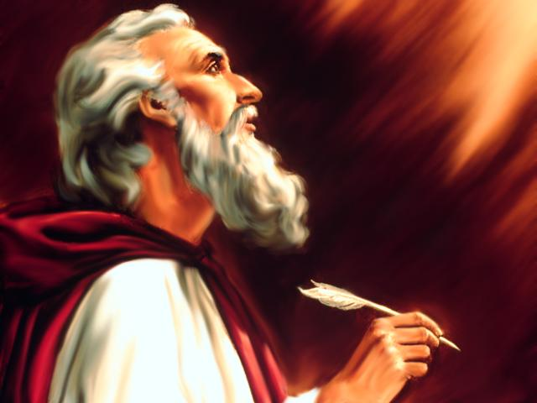

Elijah
Committed the keys of the power of turning the hearts of the fathers to the children, and the hearts of the children to the fathers
D&C 27:9

Slide 17
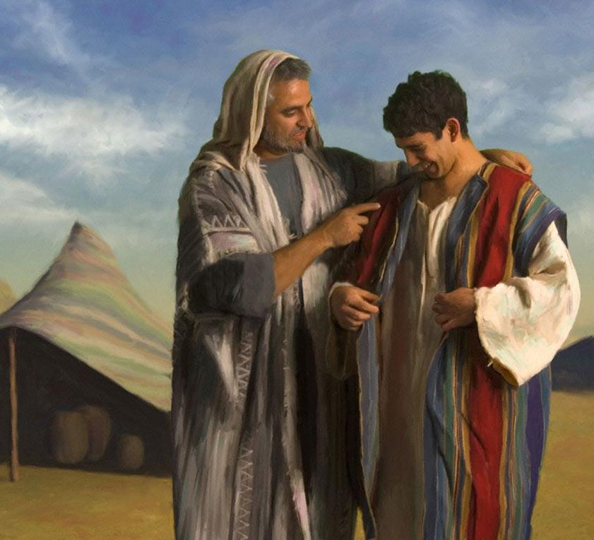
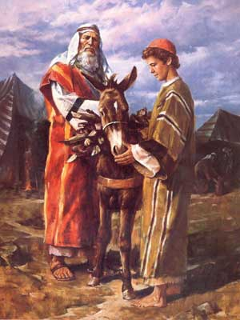
Joseph and Jacob, and Isaac, and Abraham,
Promises Remain
D&C 27:10

Slide 18
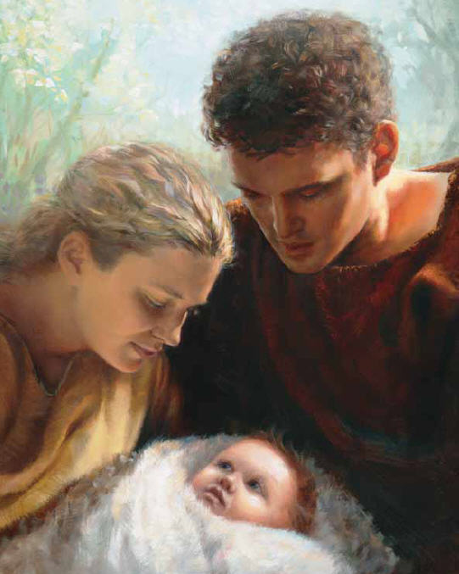
Michael---Adam
The Father of All
D&C 27:11

Slide 19
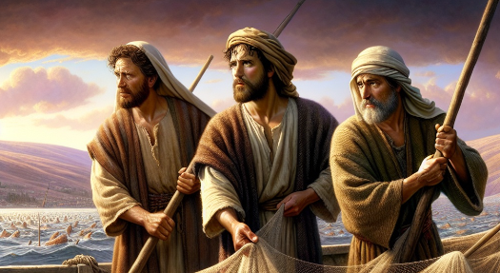
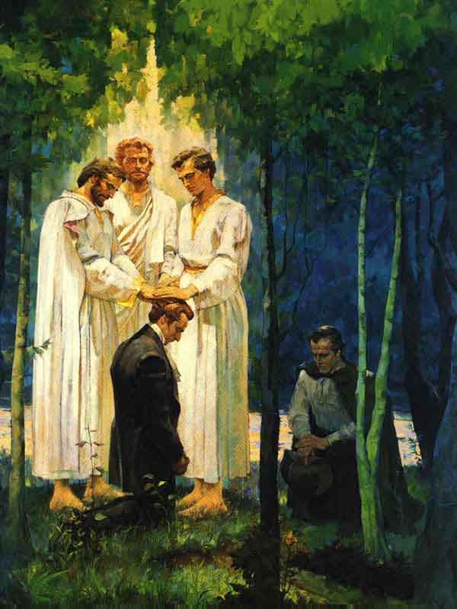
Peter, James, and John
“…by whom I have ordained you and confirmed you to be apostles, and especial witnesses of my name, and bear the keys of your ministry and of the same things which I revealed unto them;”
D&C 27:12

Slide 20
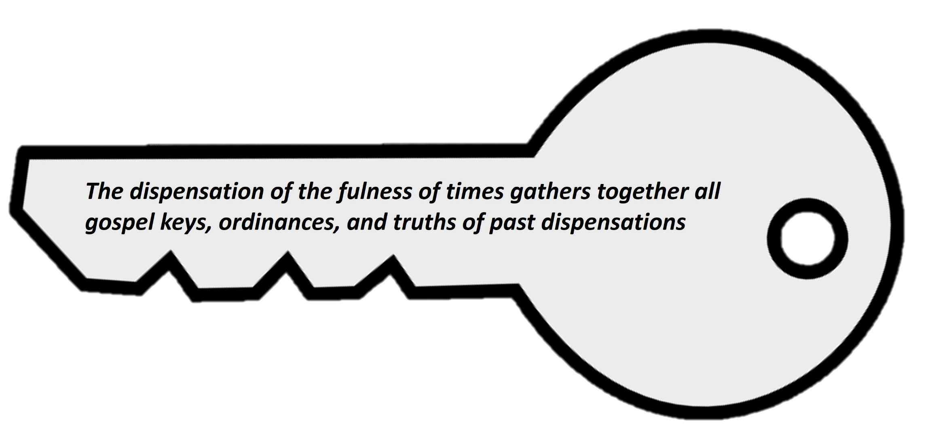
Gather Together Again
Unto whom I have committed the keys of my kingdom, and a dispensation of the gospel for the last times; and for the fulness of times, in the which I will gather together in one all things, both which are in heaven, and which are on earth;
And also with all those whom my Father hath given me out of the world.
The Lord will partake of the sacrament again on the earth
D&C 27:13-14

Slide 21
Dispensations
Noah
3100 BC
Moses
1400 BC
Joseph Smith
AD 1830
Adam
4000 BC
Apostasy
Enoch
3300 BC
Flood
Jesus
AD 1
Abraham
2000 BC
D&C 27:14

Slide 22
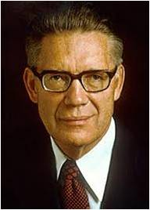
Every Faithful Person
“Every faithful person in the whole history of the world, every person who has so lived as to merit eternal life in the kingdom of the Father will be in attendance and will partake, with the Lord, of the sacrament”
Bruce R. McConkie
D&C 27:14

Slide 23
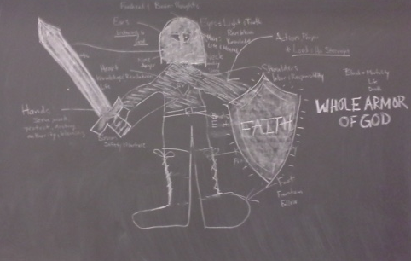
Doctrine and Covenants 27:15-18
As part of the message Joseph received from an angel of God, Joseph was taught about how the Saints could invite greater protection from Jesus Christ.

Slide 24
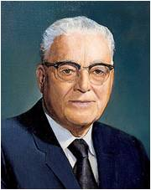
The Whole Armor of God
“We have the four parts of the body that the Apostle Paul said [are] the most vulnerable to the powers of darkness.
The loins, typifying virtue, chastity. (The loins is that part of the body between the lower rib and the hip into which you will recognize are the vital organs which have to do with reproduction.)
The heart, typifying our conduct.
Our feet, our goals or objectives in life
and finally our head, our thoughts.” ”
Harold B. Lee
Helmet of Salvation
Breastplate of Righteousness
Sword of Spirit
Shield of Faith
Grit about with truth
Preparation of Gospel of peace
If we take upon ourselves the whole armor of God, we will be able to withstand evil.
D&C 27:15-18

Slide 25
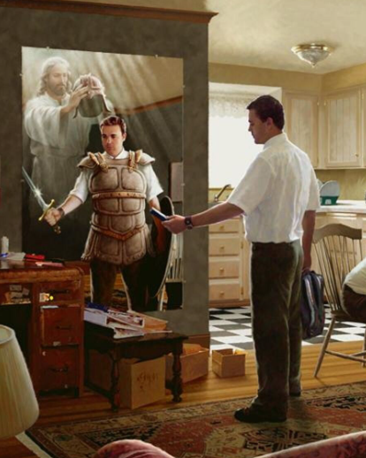
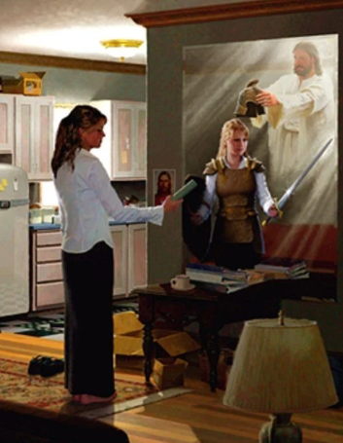
Pieces of Armor
How can the sacrament be a powerful way to invite the Savior’s help and protection (His whole armor) in our lives?
Sword of Spirit
Loins girt about the truth
1 Nephi 15:24;
Helaman 3:29-30
John 14:6; D&C 88:6; Moses 1:6
The Word of God
Virtue
Helmet of salvation
Breastplate of righteousness
Mosiah 3:17; Hebrews 5:9
Isaiah 59:16-17; 2 Nephi 4:33; Philippians 3:9
Our thoughts
Feet shod with the preparation of the gospel of peace
Shield of faith
Intercessor=someone who does what others cannot do for themselves
Moroni 7:33; Psalm 28:7
Our Hearts
Isaiah 9:6; Mosiah 15:18
Faith in Jesus Christ
D&C 27:15-18
Goals/Direction in life

Slide 26
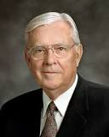

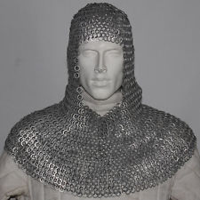
“I like to think of this spiritual armor not as a solid piece of metal molded to fit the body but more like chain mail. Chain mail consists of dozens of tiny pieces of steel fastened together to allow the user greater flexibility without losing protection.
I say that because it has been my experience that there is not one great and grand thing we can do to arm ourselves spiritually. True spiritual power lies in numerous smaller acts woven together in a fabric of spiritual fortification that protects and shields from all evil”
Elder M. Russell Ballard
“Put ye on the Lord Jesus Christ” (Romans 13:14).

Slide 27
Sources:
Video: Watch “An Eye Single to the Glory of God” (1:36)
Put on the Whole Armor of God(3:10)
Who’s Who in the Doctrine and Covenants by Ed J. Pinegar and Richard J. Allen pg. 85 also rootsweb.ancestry.com
Marlin K. Jensen, “An Eye Single to the Glory of God,” Ensign, Nov. 1989, 27–28
President Ezra Taft Benson (“Prepare for the Days of Tribulation,” Ensign, Nov. 1980, 33–34).
Book of Mormon Student Manual Religion 121-122 pg. 419
Hyrum M. Smith and Janne M. Sjodahl Doctrine and Covenants Commentary pg. 134
President Joseph Fielding Smith (Church History and Modern Revelation, 2 vols. [1953], 1:132; see also Doctrine and Covenants Student Manual, 2nd ed. [Church Educational System manual, 2001], 55).
Presentation by ©http://fashionsbylynda.com/blog/
Bruce R. McConkie (The Promised Messiah: The First Coming of Christ [1978], 595).
Harold B. Lee, Feet Shod with the Preparation of the Gospel of Peace, Brigham Young University Speeches of the Year [Nov. 9, 1954], 2).
Elder M. Russell Ballard (“Be Strong in the Lord,” Ensign, July 2004, 8).
Presentation by ©http://fashionsbylynda.com/blog/

Slide 28
D&C 25:5
D&C 25:6
D&C 25:7-8
D&C 25:9
D&C 25:10
D&C 25:11
D&C 25:12
Each scripture reference names one or more of the individuals the Savior said would be present at the great sacrament meeting

Slide 29
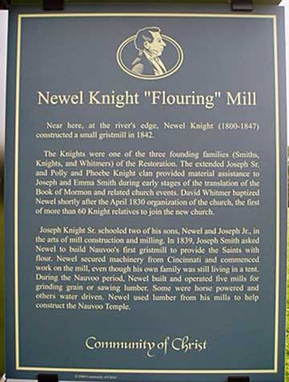
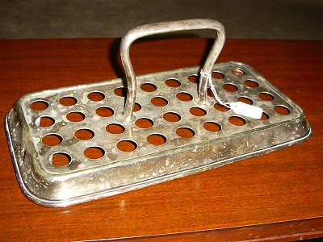
BIOGRAPHY: Came west with the Abraham O. Smoot - George B. Wallace Company (1847)
History:
Samuel Knight was born in a log cabin in Independence, Jackson County, Missouri on October 14, 1832. His father, Newel Knight, had been born in 1800 in Vermont, but had spent most of his life in upstate New York until his move to western Missouri in 1831. His mother, Sally Coburn Knight, born in 1804, was likewise a native New Englander. Soon after his parents joined the "Mormon" church, they moved to Kirtland, Ohio, then to Independence, Missouri. In Missouri, Sally had their child, which she named "Samuel", because she had "asked him of the Lord." During the persecutions they camped on the banks of the Missouri River, in shanties. Most were soaked by the rain that poured down and Sally became sick. Samuel was 13 months old. His mother was expecting their second child. Both Newel and Sally came down with malaria. In the midst of these awful circumstances, on Sep. 15, 1834, Sally gave birth to a son who they named Eli. He did not survive the day. Tragically, Sally also died. His father Newel had received a mission call, so his Aunt Esther (his mother's sister) cared for Samuel. Samuel did not see his father for another year. While Newel was in Kirtland on his mission, he met Lydia Goldthwaite, and they were married in November, 1835 by Joseph Smith. They arrived back in Missouri in May 1836. Lydia was the only mother Samuel ever knew, and many years later, he said that Lydia treated him "better than her own children." After Joseph Smith was killed, 11 year old Samuel was in the conference when he "was surprised to hear the voice of Joseph Smith. He arose in astonishment and beheld the transfiguration of Brigham Young...." The family departed Nauvoo, Illinois for the trek west. At the age of 13 Samuel would be considered a man and would be expected to perform a man's duties on the trail. For more information on Samuel Knight and Lydia see http://freepages.genealogy.rootsweb.ancestry.com/~knight57/direct/knight/aqwg579.htm#11101
Sacrament Tray and Cup used in LDS Sacrament meetings (Silver)

Slide 30
Since Elias refers to more than one person, references to him are sometimes confusing. Elder Bruce R. McConkie explained:
“Correcting the Bible by the spirit of revelation, the Prophet restored a statement of John the Baptist which says that Christ is the Elias who was to restore all things. ([JST], John 1:21–28.) By revelation we are also informed that the Elias who was to restore all things is the angel Gabriel who was known in mortality as Noah. (D. & C. 27:6–7; Luke 1:5–25;Teachings, p. 157.) From the same authentic source we also learn that the promised Elias is John the Revelator. (D. & C. 77:9, 14.) Thus there are three different revelations which name Elias as being three different persons. What are we to conclude?
“By finding answer to the question, by whom has the restoration been effected, we shall find who Elias is and find there is no problem in harmonizing these apparently contradictory revelations. Who has restored all things? Was it one man? Certainly not. Many angelic ministrants have been sent from the courts of glory to confer keys and powers, to commit their dispensations and glories again to men on earth. At least the following have come: Moroni, John the Baptist, Peter, James, and John, Moses, Elijah, Elias, Gabriel, Raphael, and Michael. (D. & C. 13; 110;128:19–21.) Since it is apparent that no one messenger has carried the whole burden of the restoration, but rather that each has come with a specific endowment from on high, it becomes clear that Elias is a composite personage. The expression must be understood to be a name and a title for those whose mission it was to commit keys and powers to men in this final dispensation.” (Mormon Doctrine, p. 221; see also D&C 110:12–16.)
The Dispensation of the Fulness of Times
Elder David W. Patten, one of the first Apostles and martyrs in this dispensation, said: “Now the thing to be known is, what the fullness of times means, or the extent or authority thereof. It means this, that the dispensation of the fullness of times is made up of all the dispensations that ever have been given since the world began, until this time. Unto Adam first was given a dispensation. It is well known that God spake to him with His own voice in the garden, and gave him the promise of the Messiah. And unto Noah also was a dispensation given; for Jesus said, ‘As it was in the days of Noah, so shall it be also in the days of the Son of Man;’ and as the righteous were saved then, and the wicked destroyed, so it will be now. And from Noah to Abraham, and from Abraham to Moses, and from Moses to Elias, and from Elias to John the Baptist, and from then to Jesus Christ, and from Jesus Christ to Peter, James, and John, the Apostles—all received in their time a dispensation by revelation from God, to accomplish the great scheme of restitution, spoken of by all the holy prophets since the world began; the end of which is the dispensation of the fullness of times, in the which all things shall be fulfilled that have been spoken of since the earth was made.” (In History of the Church,3:51.)

Slide 31
The Sacrament:
I … worry that some of you check your email, Facebook, Twitter, or Instagram accounts or send text messages during the most important gathering in the restored Church of Jesus Christ of Latter-day Saints—our sacred sacrament meeting. In this important meeting we should be focusing on the Lord through praying, singing hymns, and partaking the emblems of His body and blood instead of hooking up to our multimedia devices. You cannot connect to the Spirit during the presentation of the sacrament while looking at or sending a message on your smartphone or your tablet. This connection requires the Light of Christ, settling from your minds into your hearts with burning love and devotion. (M. Russell Ballard, “Be Still and Know That I Am God” [Church Educational System devotional for young adults, May 4, 2014], broadcasts.ChurchofJesusChrist.org)
Putting on the whole armor:
In our prayers we may begin the protective process of putting on the whole armor of God (see Ephesians 6:11; D&C 27:15) by looking forward to the day ahead and asking for help with the sometimes-frightening things we may face. Please, my friends, do not forget to ask the Lord to protect and be with you. (J. Devn Cornish, “The Privilege of Prayer,” Ensign or Liahona, Nov. 2011, 102)
Developing faith in the Lord Jesus Christ is a step-by-step, line-upon-line, and precept-upon-precept process. We promote the process of strengthening our faith when we do what is right—increased faith always follows as a consequence. If we exercise our faith daily with prayer, study, and obedience, the Savior helps our unbelief, and our faith becomes a shield to “quench all the fiery darts of the wicked” [Doctrine and Covenants 27:17]. Alma taught that we may “withstand every temptation of the devil, with [our] faith on the Lord Jesus Christ” [Alma 37:33]. However, we can neither ignore nor reject the essential ingredients of faith and then expect to reap a rich harvest. (L. Whitney Clayton, “Help Thou Mine Unbelief,” Ensign, Nov. 2001, 29)

Slide 32
Wine ---One Source of interest---not gospel doctrine. This might be too much information.
1. What do the words mean?
A. “Yayin/Oinos” - can mean “fermented/unfermented” wine; can mean “intoxicating/non-
intoxicating” wine
1) Prov. 23:29ff – must be “fermented” – cannot be grape juice
2) Isaiah 16:10 – cannot be “fermented” – must mean grape juice
3) Pliny the Elder says, “good wine” was one destitute of spirits – (Lib. IV CB)
4) Horace wrote of wine that was non-intoxicating in his Odes (I. 18)
5) Plutarch, in Moralia, wrote of wine that neither affected the brain nor passions and
remarked that he liked wine that was non-intoxicating.
6) Barnes, in his commentary on the Gospel of John, states, “the common wine of Judea was
the pure juice of the grape without any mixture of alcohol and was harmless.”
7) Aristotle wrote of wine as both fermented and unfermented (Meteorological 384a 4-5 /
388 b 9-13).
8) Athenaeas wrote of unfermented wine taken from the fields (Banquet 1, 54 / 2, 24 / 6, 89).
9) The Septuagint (an intertestamental Greek translation of the Old Testament) translates the
Hebrew word “tirosh” (new wine) as “oinos” 33 times. Obviously, they believed oinos
could be unfermented.
10) The word “yayin” (O.T. wine) can refer to newly pressed (unfermented) wine
(Encyclopaedia Judiaca, 1971, vol. 16, p. 538).
11) Josephus wrote that the “fruit of the vine” was unfermented juice.
12) The Jewish Encyclopedia, 1901 (vol. 5, p. 165) states that Jesus would have used the
unfermented wine of the Seder Service to institute the Lord’s Supper.
B. “Tirosh/Gleukos” – means “new wine” – Acts 2:13 (not fully aged)
C. “Shakar” – means “strong drink” – same word as “drunk” – I Sam. 1:14-15
1) 1901 Jewish Encyclopedia – shakar means “unmixed wines”
2) T.W.O.T. – “Wine was the most intoxicating drink known in ancient times. All the wine was
light wine, i.e. not fortified with extra alcohol. Concentrated alcohol was only known in
the Middle Ages when the Arabs invented distillation (“alcohol” is an Arabic word) so
what is now called liquor or strong drink (i.e. whiskey, gin, etc.) and the 20% fortified
wines were unknown in Bible times.” (vol. 1, p. 865)
3) Dr. Ed Dobson states unequivocally, “drinking beverages with strong alcoholic content was
prohibited. In fact, even the Greeks thought people who did that were barbaric . . . the
Bible and culture condemn unmixed drinks and strong drink.” (sermon 4/22/88)
4) McNeil – everything we have today is strong drink by these standards.
Something of Interest

Slide 33
2. How was wine stored?
A. Boiled until thickened – non-intoxicating – “The wine Jesus and most other Jews drank was
‘oinos’, a drink made by boiling or evaporating fresh grape juice down to a heavy syrup
or paste in order to prevent spoilage and simplify storage. To make a beverage, water
would be added as needed to a small quantity of the syrup. That mixture was
nonalcoholic, and even when allowed to ferment, it was not intoxicating because it was
mostly water.” (The MacArthur New Testament Commentary, Matthew 8-15, p. 261-
262)
1) The Talmud, a codification of Jewish law, states that the Jews regularly used boiled wine
(Erubin 29a).
2) Pliny the Elder, in his Natural Histories, wrote of wine that had the consistency of honey and
could last ten years.
3) Dr. Caspar Neumann (a chemistry professor) said, “It is observable that when sweet juices
are boiled down to a thick consistency, they not only do not ferment in that state, but
are not easily brought into fermentation when diluted with water... “ (Nott, London ed.,
p. 81).
B. Liquid stored in jars/skins – fermented (mixed with water) – Professor Robert Stein explains
that wine was stored in large jars called “amphorae”. The wine was taken from these
jars and poured into large bowls called “kraters”, where it was mixed with water. Wine
was never served directly from the “amphorae” without first being mixed with water.
The ratio could be as high as 20 parts water to one part wine. (Christianity Today, June,
1975, pp. 9-11)
“To begin with, the wine was mixed with water and indeed . . . the benediction (blessing)
should not be pronounced ‘til the water had been added to the wine.” (The Life & Times of
Jesus Christ the Messiah, II, p. 208, Alfred Edersheim)
Jews (Jesus) always diluted their wine with water, usually to the proportion of three parts
water to one part wine.” (The Bible Expository Commentary, vol. 1, p. 292, Warren Wiersbe)
In the 1901 Jewish Encyclopedia, vol. 12, p. 533 it states that “yayin” (wine” was always
diluted with water.
B.C. Homer, in his Odyssey, advocates a 20-parts water to one-part wine ratio.
Pliny, in his Natural Histories, advocates an 8:1 ratio.
The Jewish Talmud states that if wine is not mixed in at least a 3:1 ratio it is no longer wine.
Something of Interest

Slide 34
Conclusion
“The wine that was consumed in biblical times was not what we know as wine today. It was more of
a concentrated grape juice with its intoxicating properties basically removed. You cannot defend
wine-drinking today on the basis of wine-drinking in Bible times because the two are totally different.”
(Living in the Spirit, p. 31, John MacArthur)
A brochure from the American Educational Materials, Anaheim, California, gives a running history of
alcohol up until 1985. It comments on the alcohol at the time of Jesus Christ as being “ancient
fermenting of fruit juice, man’s oldest tranquilizer, very low alcohol content”.
“It (wine) was invariably fermented (no refrigeration), it was not always inebriating and in most
instances was but slightly alcoholic.” (Unger Bible Dictionary, p. 1168)
“The strength of natural wines is limited by two factors. The percentage of alcohol will be half of the
percentage of the sugar in the juice. And if the alcoholic content is much above 10-11%, the yeast
cells are killed and fermentation ceases. Probably ancient wines were 7-10%.” (T.W.O.T., p. 376)
Therefore, much of the wine was boiled, removing its alcoholic content. Jewish people mixed their
fermented wines at least 3:1 with water. If the wine had a 7-10% alcoholic content, mixing it would
reduce the alcoholic content to between 1.75% and 2.50%. In our culture, a drink has to exceed
3.2% to even be considered “alcoholic”. In Jesus’ day, one would have to drink all day in order to
become drunk. This explains the comment of Paul to churches that their pastors “not be given to
much wine”. (I Timothy 3:3)
The process of distillation was not invented until after 1000 AD, so ancient wines could not have a
high alcoholic content (Encyclopedia Britannica).
You simply cannot defend social drinking on the idea that Jesus drank fermented wine because much
of the wine of the day was unfermented and the fermented wine of the day would have been mixed
with water and thus sub-alcoholic.
http://www.fbcgrovecity.org/pdf/Wine%20in%20Bible%20Times.pdf
Something of Interest

