Slide 1
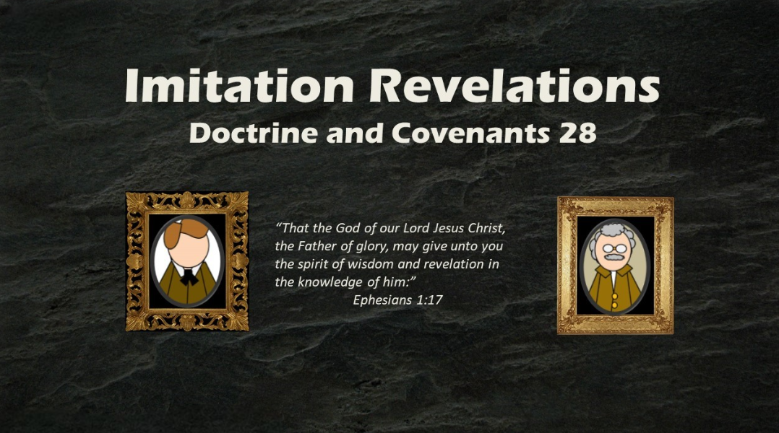
Presentation by ©http://fashionsbylynda.com/blog/

Slide 2

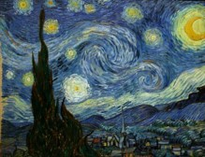
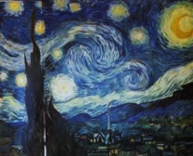




Imitations
Which one is the Real One?

Slide 3


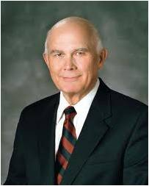
Mistaking Imitations
Why might it be harmful to mistake an imitation for something that is real?
“The devil is the father of lies, and he is ever anxious to frustrate the work of God by his clever imitations”
Elder Dallin H. Oaks

Slide 4
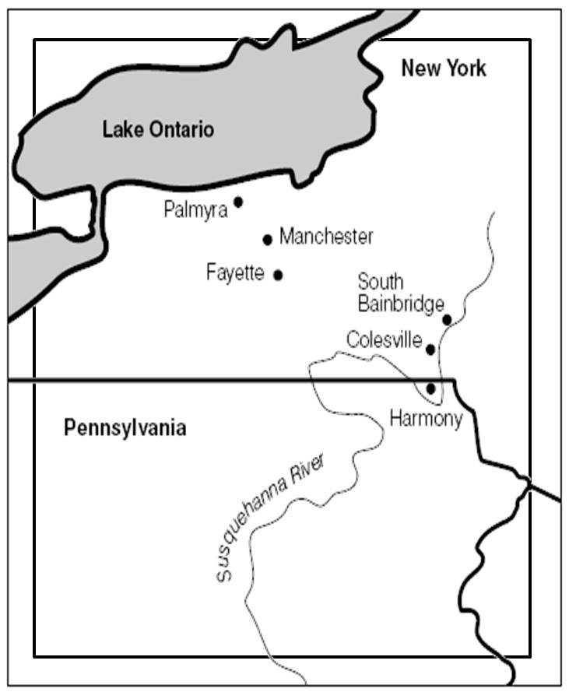
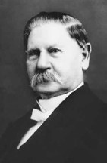


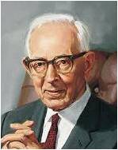
Imitation Revelation
August 1830--Just before the conference in Fayette, New York
Hiram Page, one of the 8 witnesses of the Book of Mormon, claimed to receive revelations from a stone
“He also claimed that he received the revelation of the place where the City of Zion should be built”
“Hiram claimed to receive certain spurious revelations, at the variance with the principles of the Gospel ad the revelations received by Joseph Smith”
“Oliver Cowdery and the Whitmer’s were deceived by these false declarations…This caused serious trouble, and Oliver Cowdery took the Prophet to task for not accepting what Hiram Page had given.”
Joseph Fielding Smith

Slide 5
Hiram Page
He was born in 1800 Vermont
He was a medical practitioner and became acquainted with Peter Whitmer’s family in New York and married Peter’s oldest daughter Catherine in 1825
Learning of the mission of Joseph Smith he eventually became one of the 8 witnesses of the Book of Mormon
He was baptized on April 11, 1830
Prior to the church conference in September of 1830, he came into possession of a small stone and claimed to receive revelations for the church through it
He recanted his claim on September 26, 1830, the day of the conference
After receiving beatings from mobs, and his family suffering abuse, they were expelled along with other Saints and moved to Clay County
He lost faith in Joseph Smith’s leadership and was excommunicated, but retained his testimony of the Book of Mormon
He died on his farm near Excelsior Spring, Missouri on August 12, 1852
Who’s Who

Slide 6
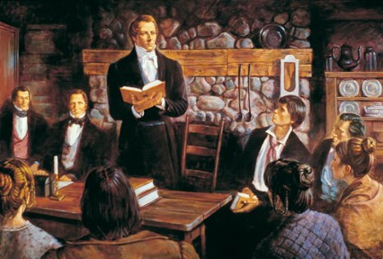
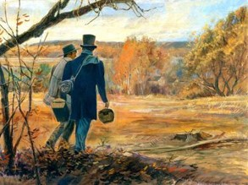
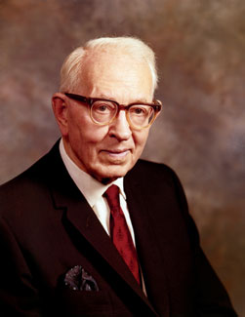
Who is Entitled to Receive Revelation for the Church?
The Church, having been organized only a few short months, faced one of its first major problems at the time this revelation was given in September 1830:
“Finally the prophet persuaded Oliver Cowdery that these things were wrong, and later the whole membership renounced the revelation given through this stone, but this did not come until the Lord had given the Church the revelation known as Section 28.”
Joseph Fielding Smith

Slide 7
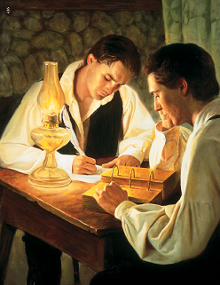
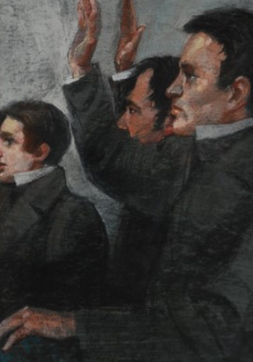
Joseph Receives/Oliver Teaches
“The Lord taught Oliver Cowdery and the entire church membership that revelation for the Lord’s church will be given to and through only one man, the Lord’s prophet.”
Joseph was responsible to receive commandments and revelations for the Church. Oliver was responsible to teach by the Comforter concerning the commandments and revelations that Joseph received.
The Lord reveals His mind and will to His appointed mouthpiece, the prophet.
All revelations that are binding upon the church membership will be presented to the Church for their sustaining vote. This is done in compliance with the Law of Common Consent.
Officers and members of the Church, who are authorized to teach, are charged with the responsibility to stay within the guidelines the Lord gave to Oliver Cowdery in D&C 28:1-6
D&C 28:1-2 and Otten & Caldwell

Slide 8
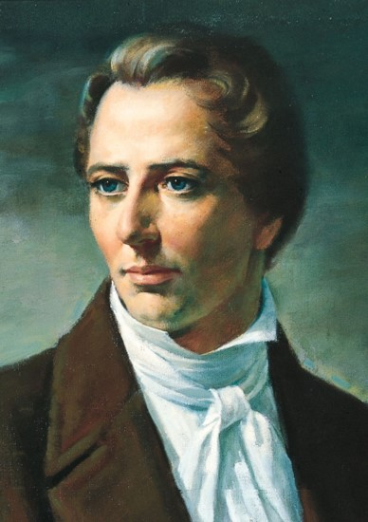
True Divine Intervention
The Prophet taught in 1833 that “it is contrary to the economy of God for any member of the Church, or anyone, to receive instructions for those in authority, higher than themselves;
Therefore, you will see the impropriety of giving heed to them;
but if any person have a vision or a visitation from a heavenly messenger, it must be for his own benefit and instruction; for the fundamental principles, government, and doctrine of the Church are vested in the keys of the kingdom.”
Joseph Smith
D&C 28:3

Slide 9
Gift of Prophecy
The Gift of Prophecy (D&C 46:22)
Those who receive true revelations about the past, present, or future have the gift of prophecy.
Prophets have this gift, but we too can have it to help us govern our own lives (see 1 Corinthians 14:39).
We may receive revelations from God for ourselves and our own callings, but never for the Church or its leaders.
It is contrary to the order of heaven for a person to receive revelation for someone over whom he or she does not preside.
If we truly have the gift of prophecy, we will not receive any revelation that does not agree with what the Lord has said in the scriptures.
Gospel Principles
The Lord will give revelation for the whole Church only through the President of the Church.
D&C 28:3

Slide 10
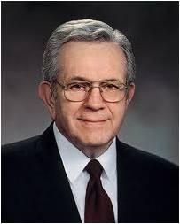
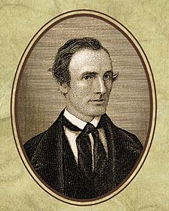
By Wisdom
The Lord was telling Oliver that while he might give counsel and advice to the Saints, he was not to establish Church doctrine or revelation. That was the office of the prophet only.
“We are entitled to personal revelation. However, unless we are set apart to some presiding office, we will not receive revelations concerning what others should do. …
“An unusual spiritual experience should not be regarded as a personal call to direct others. It is my conviction that experiences of a special, sacred nature are individual and should be kept to oneself”
President Boyd K. Packer
The Lord does not give individuals revelation to direct someone who presides over them.
The Lord may give us revelation for our own benefit and to help us in our callings and assignments.
D&C 28:6-7

Slide 11
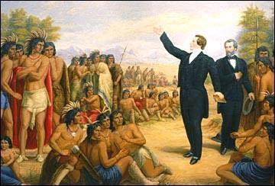
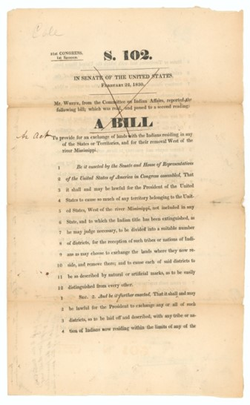
Go to the Lamanites
The term Lamanites refers to a group of people in the Book of Mormon, many of whom were descendants of Laman, the eldest son of Lehi. The Lord’s use of the term Lamanites in Doctrine and Covenants 28:9 indicates that some of Lehi’s descendants were among the American Indians who, at the time, were living on what was considered the western border of the United States.
In May 1830, the United States Congress passed the Indian Removal Bill, which required all American Indians to relocate to the federal Indian Territory west of the state of Missouri. Thus, Oliver Cowdery and his companions traveled to western Missouri, “on the borders by the Lamanites” (D&C 28:9), to teach the gospel to American Indians.
No one knows where the City of Zion shall be, but it will be on the borders of the Lamanites
D&C 28:8-9

Slide 12
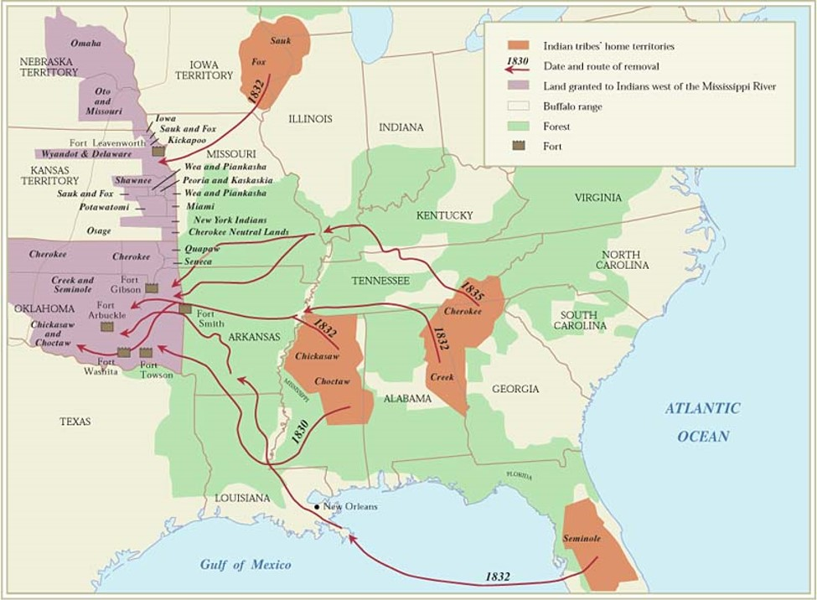
Indian Territory
In 1823 the Supreme Court handed down a decision (Johnson v. M’Intosh) which stated that Indians could occupy lands within the United States but could not hold title to those lands. The Indian Removal Act, part of a United

Slide 13

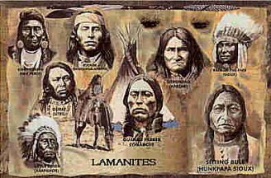
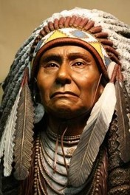
Understanding the term “American Indians”
The Book of Mormon does not claim that American Indians descended exclusively from the family of Lehi.
“We must be careful in the conclusions that we reach.
The Book of Mormon teaches the history of three distinct peoples … who came from the old world to this continent. It does not tell us that there was no one here before them.
It does not tell us that people did not come after. And so if discoveries are made which suggest differences in race origins, it can very easily be accounted for, and reasonably, for we do believe that other people came to this continent”
President Anthony W. Ivins
D&C 28:8

Slide 14
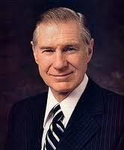

The Influence of Satan’s Activities
“Satan is not an enlightening subject. I consider him to be the great imitator. …
“It is not good practice to become intrigued by Satan and his mysteries.
No good can come from getting close to evil. Like playing with fire, it is too easy to get burned. …
The only safe course is to keep well distanced from him and any of his wicked activities or nefarious practices.
The mischief of devil worship, sorcery, witchcraft, voodooism, casting spells, black magic, and all other forms of demonism should always be avoided”
President James E. Faust
Satan may try to deceive us through false revelation
D&C 28:11

Slide 15


What Should You Do?
1. You receive an electronic communication claiming to be new revelation. It contains teachings that are not in harmony with the scriptures or the words of the living prophets.
2. You notice that a member of your ward
makes a statement that is doctrinally incorrect as she bears her testimony during sacrament meeting. You are concerned that if the message is mistaken for truth, it might have a hurtful impact on others.
Who should correct the member who spoke incorrectly?
The Lord invites His leaders to help correct us when we have been deceived.

Slide 16

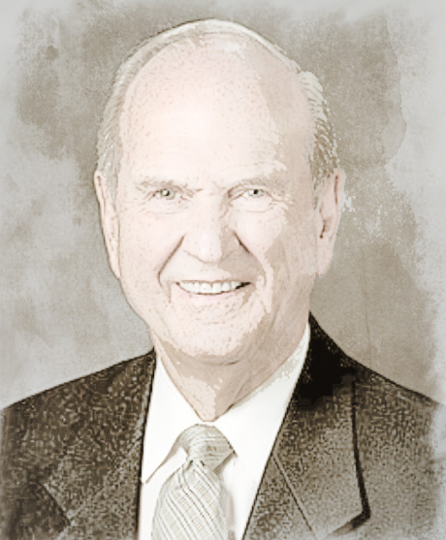

Personal Framework of Revelation
“Doctrine, commandments, and revelations for the Church are the prerogative of the living prophet, who receives them from the Lord Jesus Christ [see Doctrine and Covenants 21:4–5]. …”
“We receive personal revelation only within our purview [or range of influence] and not within the prerogative [right or privilege] of others. …”
“Personal revelation will be in harmony with the commandments of God and the covenants we have made with Him. …”
“When we ask for revelation about something for which God has already given clear direction, we open ourselves up to misinterpreting our feelings and hearing what we want to hear”
Liahona, Nov. 2022, 16–17

Slide 17
What is a True Revelation?
The prophet encourages the entire Church to attend the temple.
A concerned group of members boldly teaches that God wants the Church to make changes to doctrine or to alter a policy about a difficult issue.
A member believes the Lord has revealed to him what the bishop should do in their ward.
A young woman’s mother tells her she doesn’t feel good about a certain choice the young woman is making.
While dating in college, a young adult says he has received revelation that a specific young woman should marry him.
example, a young man can feel inspired that the Lord approves of him asking a young woman to marry him, but she is entitled to her own revelation about what is best for her.

Slide 18
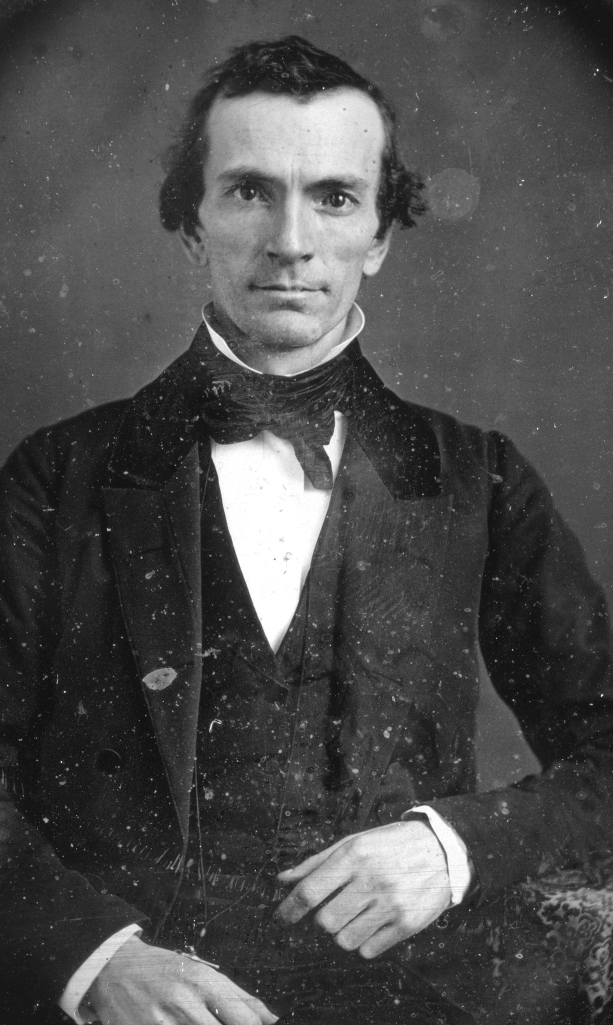
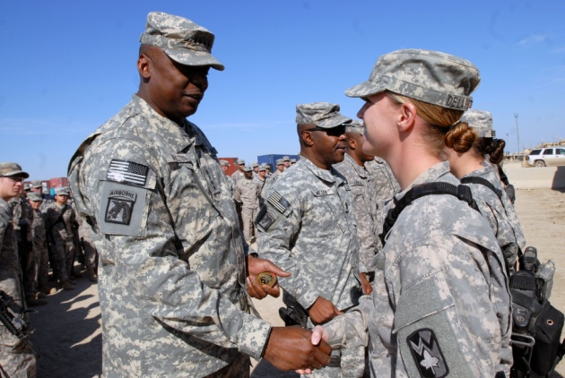
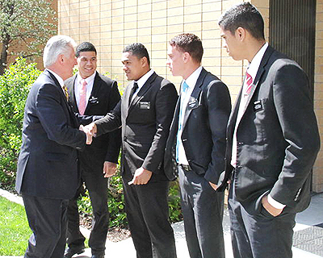
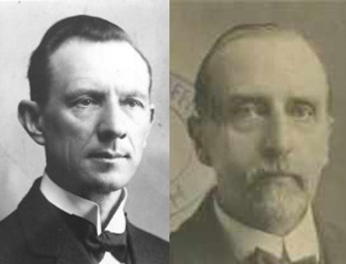
Oliver’s Calling
The Lord denounced Hiram Page’s false revelations
“The Lord, having reveled the error of Hiram Page in the matter of the “seer-stone,” directed Oliver Cowdery to labor with him and show him, in all kindness, that he was being deceived by the Evil One.
Oliver Cowdery could not go on his important mission to the Lamanite, until he had settled this difficulty.
When the Church is weakened by schisms, missionary effort cannot have the same success as when unity and harmony prevail.
The strength of an army in the field depends largely on the conditions at the bases of supply.
It is so with the missionary forces of the Church.”
Smith and Syodahl
D&C 28:11-14

Slide 19
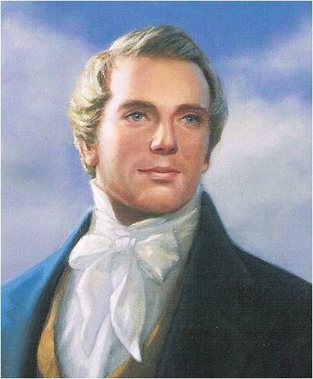
To our great grief, … we soon found that Satan had been lying in wait to deceive, and seeking whom he might devour.
Brother Hiram Page had in his possession a certain stone, by which he had obtained certain “revelations” concerning the upbuilding of Zion, the order of the Church, etc., all of which were entirely at variance with the order of God’s house, as laid down in the New Testament, as well as in our late revelations.
Teachings of Presidents of the Church: Joseph Smith

Slide 20
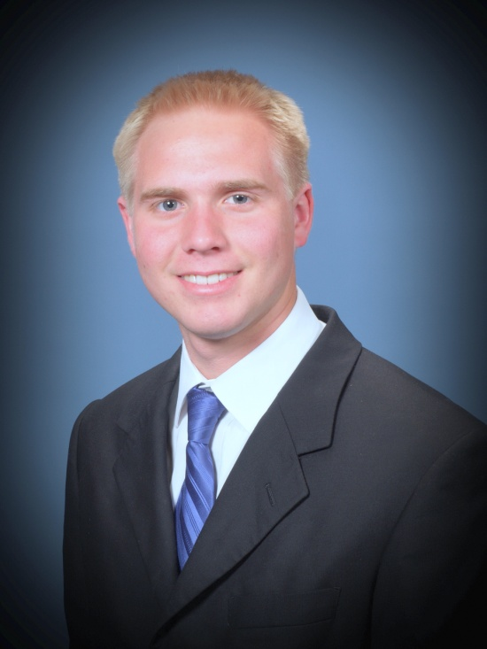
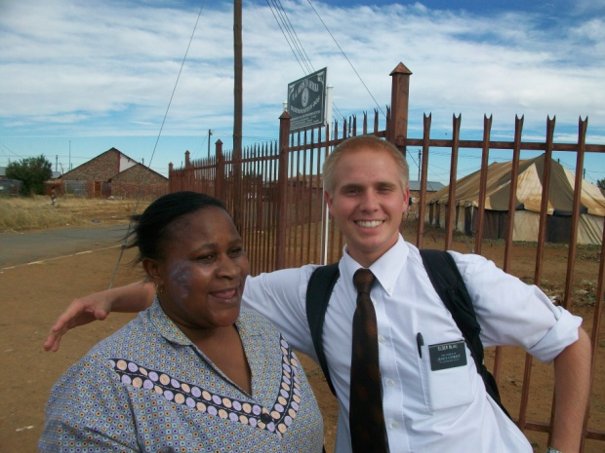
Missionary’s Calling
“When a missionary goes out into the world, in obedience to a divine call, being in full fellowship with the Church, and leaving no unsettled incidents behind, he may rely on the Lord for protection and guidance.”
The Gospel should be preached with joy, and not as a message of sorrow and gloom. The labors of a missionary should not be a hard but a pleasant duty (service).”
Smith and Syodahl
D&C 28:15

Slide 21
Sources:
Video:
Revelation Follows Lines of Authority (0:57)
Revelation Comes in an Orderly Way (1:00)
Elder Dallin H. Oaks (“Two Lines of Communication,” Ensign or Liahona, Nov. 2010, 84).
Presentation by ©http://fashionsbylynda.com/blog/
Who’s Who in the Doctrine and Covenants by Ed J. Pinegar and Richard J. Allen pgs. 109-110
Joseph Fielding Smith (CHMR, Vol. 1, p 125)
Otten & Caldwell Sacred Truths of the Doctrine and Covenants pgs. 135-136
Joseph Smith (History of the Church, 1:338.)
Gospel Principles : Chapter 22: The Gifts of the Spirit (2011), 125–32
President Boyd K. Packer (“Revelation in a Changing World,” Ensign, Nov. 1989, 14–15).
President Anthony W. Ivins (in Conference Report, Apr. 1929, 15).
Hyrum M. Smith and Janne M. Syodahl Doctrine and Covenants Commentary pg. 142
President James E. Faust (“The Forces That Will Save Us,” Ensign, Jan. 2007, 5).
Teachings of Presidents of the Church: Joseph Smith [2007], 196
Presentation by http://fashionsbylynda.com/blog/

Slide 22
Newel Knight:
“After arranging my affairs at home, I again set out for Fayette, to attend our second conference, which had been appointed to be held at Father Whitmer’s where Joseph then resided. On my arrival I found Brother Joseph in great distress of mind on account of Hyrum Page, who had managed to get up some dissension of feeling among the brethren by giving revelations concerning the government of the Church and other matters, which he claimed to have received through the medium of a stone he possessed. He had quite a roll of papers full of these revelations, and many in the Church were led astray by them. Even Oliver Cowdery and the Whitmer family had given heed to them, although they were in contradiction to the New Testament and the revelations of these last days. Here was a chance for Satan to work among the little flock, and he sought by this means to accomplish what persecution failed to do. Joseph was perplexed and scarcely knew how to meet this new exigency. That night I occupied the same room that he did and the greater part of the night was spent in prayer and supplication. After much labor with these brethren they were convinced of their error, and confessed the same, renouncing the revelations as not being of God, but acknowledged that Satan had conspired to overthrow their belief in the true plan of salvation. In consequence of these things Joseph enquired of the Lord before conference commenced and received the revelation published on page 140 of the Doctrine and Covenants [section 28], wherein God explicitly states His mind and will concerning the receiving of revelations.
“Conference having assembled, the first thing done was to consider the subject of the stone in connection with Hyrum Page, and after considerable investigation and discussion, Brother Page and all the members of the Church present renounced the stone, and the revelations connected with it, much to our joy and satisfaction.” (Journal History, 26 Sept. 1830.)
An official statement by the First Presidency of the Church in 1913 gave additional illumination to this principle: “From the days of Hiram Page (Doc. and Cov., Sec. 28), at different periods there have been manifestations from delusive spirits to members of the Church. Sometimes these have come to the men and women who because of transgression became easy prey to the Arch-Deceiver. At other times people who pride themselves on their strict observance of the rules and ordinances and ceremonies of the Church are led astray by false spirits, who exercise an influence so imitative of that which proceeds from a Divine source that even these persons, who think they are ‘the very elect,’ find it difficult to discern the essential difference. Satan himself has transformed himself to be apparently ‘an angel of light.’
“When visions, dreams, tongues, prophecy, impressions or any extraordinary gift or inspiration, convey something out of harmony with the accepted revelations of the Church or contrary to the decisions of its constituted authorities, Latter-day Saints may know that it is not of God, no matter how plausible it may appear. Also, they should understand that directions for the guidance of the Church will come, by revelation, through the head. All faithful members are entitled to the inspiration of the Holy Spirit for themselves, their families, and for those over whom they are appointed and ordained to preside. But anything at discord with that which comes from God through the head of the Church is not to be received as authoritative or reliable. In secular as well as spiritual affairs, Saints may receive Divine guidance and revelation affecting themselves, but this does not convey authority to direct others, and is not to be accepted when contrary to Church covenants, doctrine or discipline, or to known facts, demonstrated truths, or good common sense. …
“Be not led by any spirit or influence that discredits established authority and contradicts true scientific principles and discoveries, or leads away from the direct revelations of God for the government of the Church. The Holy Ghost does not contradict its own revealings. Truth is always harmonious with itself. Piety is often the cloak of error. The counsels of the Lord through the channel he has appointed will be followed with safety, therefore, O! ye Latter-day Saints, profit by these words of warning.” (Joseph F. Smith, Anthon H. Lund, and Charles W. Penrose, “A Warning Voice,” Improvement Era, Sept. 1913, pp. 1148–49.)
Oliver’s responsibilities:
Not long before the Lord revealed the truths that are now recorded in Doctrine and Covenants 28, Oliver Cowdery did something that showed that he did not yet fully understand the differences between his responsibilities in the Church and Joseph Smith’s responsibilities as the President of the Church. Invite a student to read the following account:
Joseph Smith was living in Harmony, Pennsylvania, when he received a letter from Oliver Cowdery, who was in Fayette, New York, about 100 miles (160 kilometers) away. Oliver said he had discovered an error in the revelation we now call Doctrine and Covenants 20. Oliver wrote: “I command you in the name of God to erase those words.” Joseph traveled to Fayette and learned that the Whitmer family agreed with Oliver about the supposed error in the revelation. Joseph wrote, “It was not without both labor and perseverance that I could prevail with any of them to reason calmly on the subject.” Eventually, the Prophet “succeeded in bringing not only the Whitmer family, but … Oliver Cowdery also to acknowledge that they had been in error” (Histories, Volume 1: 1832–1844, vol. 1 of the Histories series of The Joseph Smith Papers [2012], 426; see also pages 424–25).

Slide 23
The Lamanite mission was a very important movement of the young but vigorous Church. Oliver Cowdery was the first-appointed member of the party. Peter Whitmer, Jr., was added by Revelation (Sec. 30); and then Parley P. Pratt and Ziba Peterson (Sec. 32). Soon after the Conference the little party set out on the perilous journey of about 1,500 miles. They started on foot, trusting in the Lord to open the way. Near Buffalo they visited the Catteraugus Indians and left the Book of Mormon with them. Then they proceeded to Kirtland, Ohio. Here they visited Sidney Rigdon, then a popular Campbellite minister. He and some of his friends joined the Church. Night and day, for some time, the missionaries were teaching the people in Kirtland and vicinity. After having ordained Rigdon, Isaac Morley, John Murdock, Lyman Wight and others, to the ministry, the missionaries left for the West. Near Sandusky they visited the Wyandot tribe and preached the gospel. In Cincinnati and St. Louis they met with very little success. At the latter place their progress was impeded by heavy snowstorms. With the opening of the New Year, 1831, they continued their journey, traveling on foot 300 miles over prairies, without shelter and fire, living on frozen corn, bread and raw pork. At length they reached Independence, Mo., on the extreme western frontier of the State. They had traveled four months and suffered untold hardships; they had preached to two Indian nations and to thousands of white people, and organized several strong branches of the Church.
“After having rested a little at Independence, three of the brethren crossed the frontier and visited the Shawnee Indians. Then they went among the Delawares. These manifested a great deal of interest in the Book of Mormon. Therefore the jealousy of ministers was aroused and these prevailed upon the Indian agents to expel the missionaries from the Indian country. They, accordingly, returned to Jackson county, where they labored for some time with encouraging success.” (Smith and Sjodahl, Commentary, p. 144.)

Slide 24
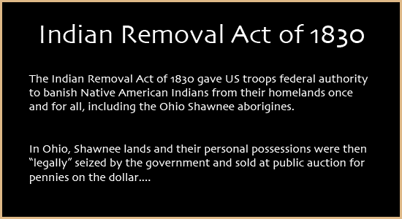
Just for more Information on the Indian Removal Act of 1830
Videos on Indian Removal Act
http://www.kumeyaay.info/whoswho/bios/gb/3indianremovalact.html
Also: http://storiesofusa.com/american-expansion-marbury-madison-thomas-jefferson-louisiana-purchase-lewis-clark-journey-war-1812-missouri-compromise-monroe-doctrine-indian-removal-act-battle-alamo-mexican-american-war-1803-1853/#indian-removal-act-1830
The Indian Removal Act was a law passed by Congress on May 28, 1830, during the presidency of Andrew Jackson. It authorized the president to negotiate with Indian tribes in the Southern United States for their removal to federal territory west of the Mississippi River in exchange for their homelands.
The act was strongly supported by non-native people of the South, who were eager to gain access to lands inhabited by the Five Civilized Tribes. Christian missionaries, most notably Jeremiah Evarts, protested against its passage.
The "Five Civilized Tribes," made up of the Chickasaw, Choctaw, Muscogee-Creek, Seminole, and original Cherokee Nations, had been established as autonomous nations in the southeastern United States. The acculturation proposed by George Washington was well under way among the Cherokee and Choctaw. Thomas Jefferson's policy had been to respect the Native Americans' rights to their homelands, allowing all Native Americans who had adopted Anglo-European behavior to remain east of the Mississippi. He planned to guide them towards practicing an agriculture-based society. However, Andrew Jackson sought to renew a policy of political and military action for the removal of the Native Americans from these lands and worked toward enacting a law for Indian removal.
In the 1823 case of Johnson v. M'Intosh, the United States Supreme Court handed down a decision which stated that Indians could occupy lands within the United States, but could not hold title to those lands. Jackson, as was common before the American Civil War, viewed the union as a federation of sovereign states. He opposed Washington’s policy of establishing treaties with Indian tribes as if they were foreign nations. Thus, the creation of Indian jurisdictions was a violation of state sovereignty under Article IV, Section 3 of the Constitution. As Jackson saw it, either Indians comprised sovereign states (which violated the Constitution) or they are subject to the laws of existing states of the Union. Jackson urged Indians to assimilate and obey state laws. Further, he believed he could only accommodate the desire for Indian self-rule in federal territories. That required resettlement west of the Mississippi River on federal lands.
^{Wikipedia}

