Slide 1
Doctrine and Covenants 29:1-29
Gathering of the Savior’s Elect
When the Son of man shall come in his glory, and all the holy angels with him, then shall he sit upon the throne of his glory:
Matthew 25:31
Presentation by ©http://fashionsbylynda.com/blog/

Slide 2
Trust
Who would you trust with…
Your house keys
Your password to a personal device or account
Your most personal dream or goal
1
2
3
4
5
6
7
8
9
*
0
#
What do you know about that person or people that influences your willingness to trust them?

Slide 3
Trust Words
Integrity
Commitment
Privacy
Reliability
Caring
Honesty
Consistency
Generosity
Non-Judgmental
Confidentiality
Availability

Slide 4
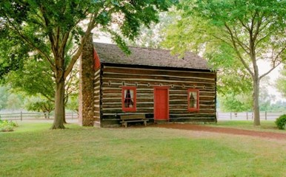
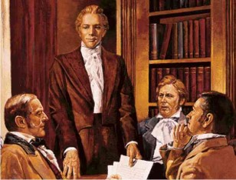
Before the Second Conference
The Church was less than six months old—September 1830.
Newel Knight helped move the Prophet’s family to Fayette, New York, where the Smiths had been invited to live with David Whitmer’s family.
Before the conference that was held on September 26, 1830 the Prophet Joseph Smith received a revelation in the presence of 6 Elders.

Slide 5
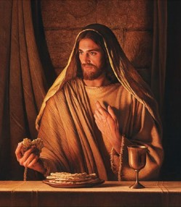
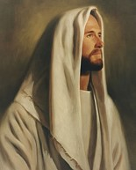
I Am
“Jesus saith unto him, I am the way, the truth, and the life: no man cometh unto the Father, but by me.”
John 14:6
“I am the true vine, and my Father is the husbandman.”
John 15:1
“And Jesus said unto them, I am the bread of life: he that cometh to me shall never hunger; and he that believeth on me shall never thirst.”
John 6:35
“I am the living bread which came down from heaven: if any man eat of this bread, he shall live for ever: and the bread that I will give is my flesh, which I will give for the life of the world.”
John 6:51
D&C 29:1

Slide 6
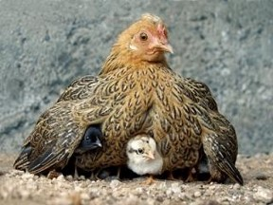
Under His Wings
What must the chicks do in order to be safely gathered under the protection of their mother’s wings?
Chicks have to make the effort to go to their mother.
Jesus Christ will gather us as we hearken to His voice, humble ourselves, and call upon Him in prayer.
D&C 29:2

Slide 7
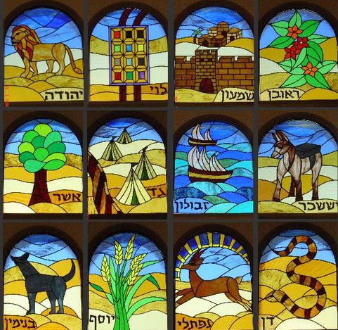
Gathering Of Israel
From the beginning, prophets have prophesied concerning the gathering of Israel. The house of Israel—the Lord’s covenant people—will be gathered in the last days before the coming of Christ.
The Lord gathers His people as they exercise faith in Him and keep His commandments.
“We believe in the literal gathering of Israel and in the restoration of the Ten Tribes; that Zion (the New Jerusalem) will be built upon the American continent; that Christ will reign personally upon the earth; and, that the earth will be renewed and receive its paradisiacal glory:”
Article of Faith 10
One way the Savior gathers people is through our efforts to share the gospel
D&C 29:2

Slide 8
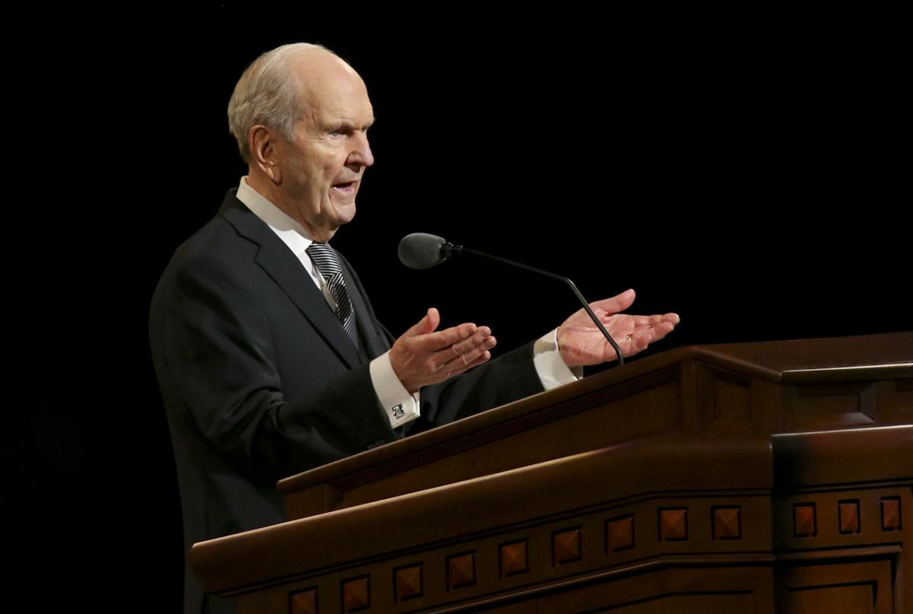
Ways to Hear the Voice of the Savior
The Holy Bible
How is hearkening to the Savior’s voice different from just hearing His voice?
The
Book
of
Mormon
Doctrine
And
Covenants
ANOTHER TESTAMENT
OF JESUS CHRIST
Why do you think we need to be humble in order to be gathered by the Savior?
D&C 29:2

Slide 9
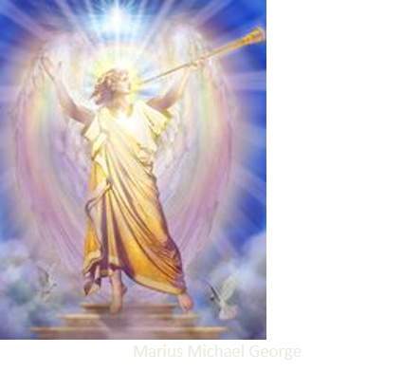
Voice of a Trump
Chosen out of the world
Those who will share the gospel
Jesus is our advocate
He will be our defender at the day of judgment
It is through Him we will enter into eternal life with our Heavenly Father
Heavenly Father and Jesus Christ desire to give us Their kingdom.
Has your testimony of the Atonement of Jesus Christ brought happiness to your life?
D&C 29:4-5

Slide 10
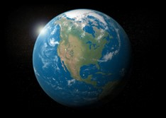
Mine Elect
Hear My Voice
Gather
Prepare others for the message of the Savior
“In the councils of heaven it had been decreed that the Saints should gather to one place on the American continent, in order to be prepared against the last great tribulations of the world.”
D&C 29:7

Slide 11
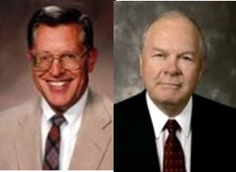
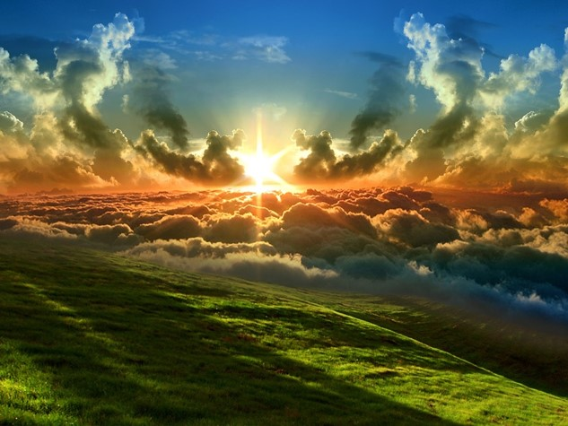
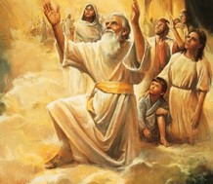
A Holy Sanctuary
“And that it was the place of the New Jerusalem, which should come down out of heaven, and the holy sanctuary of the Lord.”
Symbolic—the New Jerusalem will be built upon heavenly principles and under the influence of revelation to the Lord’s chosen officers.
Those who are cleansed and purified through the atonement of Jesus Christ will build up a new City of Holiness
JFM and RLM
Literal—Enoch’s city—the City of Holiness that was taken up into heaven will come down from heaven and be united with the earthly New Jerusalem (see Moses 7:13-21)
Bruce R. McConkie
Ether 13:3

Slide 12
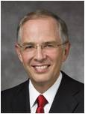
Gathering the Elect of God
“Your mission will be a sacred opportunity to bring others to Christ and help prepare for the Second Coming of the Savior.
“The Lord has long spoken of the necessary preparations for His Second Coming.
To Enoch, He declared, ‘Righteousness will I send down out of heaven; and truth will I send forth out of the earth, … and righteousness and truth will I cause to sweep the earth as with a flood, to gather out mine elect from the four quarters of the earth.’ [Moses 7:62.]
D&C 29:7 Elder Neil L. Andersen

Slide 13
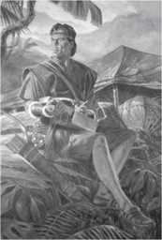
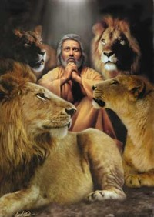
Mission of the Elect
The prophet Daniel prophesied that in the latter days the gospel would roll forth unto the ends of the earth as a ‘stone [that is] cut out of [a] mountain without hands.’
[Daniel 2:45.]
Nephi spoke of the latter-day Church as being few in number but spread upon all the face of the earth. [See 1 Nephi 14:12–14.] The Lord declared in this dispensation, ‘Ye are called to bring to pass the gathering of mine elect.’
“Your mission is a great opportunity and
responsibility, important to this promised
gathering and linked to your eternal destiny”
D&C 29:7 Elder Neil L. Andersen

Slide 14
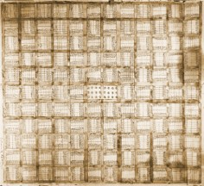
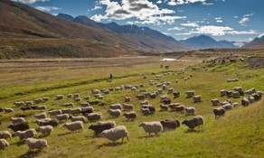
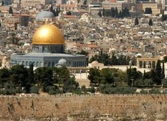
Gathering Place
“Stakes of Zion are … being organized at the ends of the earth. In this connection, let us ponder these truths:
A stake of Zion is a part of Zion. You cannot create a stake of Zion without creating a part of Zion.
Zion is the pure in heart; we gain purity of heart by baptism and by obedience. A stake has geographical boundaries. To create a stake is like founding a City of Holiness. Every stake on earth is the gathering place for the lost sheep of Israel who live in its area.
The gathering place for Peruvians is in the stakes of Zion in Peru, or in the places which soon will become stakes. The gathering place for Chileans is in Chile; for Bolivians it is in Bolivia; for Koreans it is in Korea; and so it goes through all the length and breadth of the earth.
Scattered Israel in every nation is called to gather to the fold of Christ, to the stakes of Zion, as such are established in their nations”
Elder Bruce R. McConkie
D&C 29:7-8

Slide 15
Other Places To Gather
In the early days,Jackson County, Missouri was the central gathering place of the Saints
True, in the early days of the Church, conversion often meant emigration as well. But now the gathering takes place in each nation.
The choice to come unto Christ is not a matter of physical location; it is a matter of individual commitment. People can be “brought to the knowledge of the Lord” [3 Nephi 20:13] without leaving their homelands.
The Lord has decreed the establishment of Zion [see Doctrine and Covenants 6:6] in each realm where He has given His Saints their birth and nationality.
Scripture foretells that the people “shall be gathered home to the lands of their inheritance, and shall be established in all their lands of promise” [2 Nephi 9:2].

Slide 16
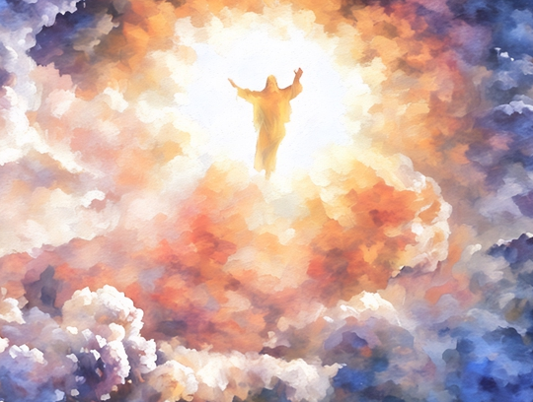
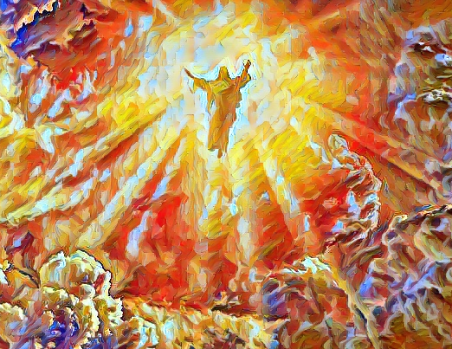
A Thousand Years
The Second Coming of Jesus Christ will be a great and dreadful day.
Those who reject Jesus Christ’s messengers and teachings will suffer the consequences of their choices.
Those who are striving to follow Him will have the joy of seeing their Redeemer return to earth.
He will save them from wickedness and sorrow and dwell with them for a thousand years.
Manual
D&C 29:9

Slide 17
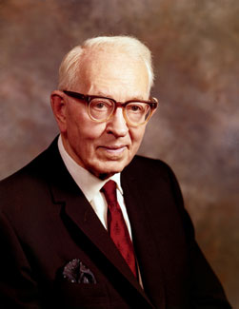
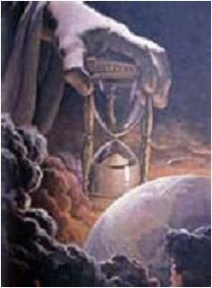
“The Hour is Nigh”
“The world is rapidly coming to its end, that is, the end of the days of wickedness. When it is fully ripe in iniquity the Lord will come in the clouds of heaven to take vengeance on the ungodly, for his wrath is kindled against them.
Do not think that he delayeth his coming. Many of the signs of his coming have been given, so we may, if we will, know that the day is even now at our doors.
… The day of the coming of the Lord is near. I do not know when. …
That day is close at hand. It behooves us as Latter-day Saints to set our houses in order, to keep the commandments of God, to turn from evil to righteousness, if it is necessary, and serve the Lord in humility and faith and prayer.”
President Joseph Fielding Smith
D&C 29:9

Slide 18
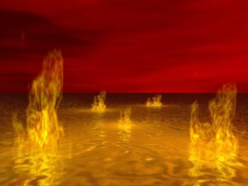
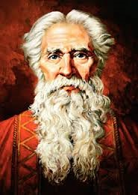
“Shall be as Stubble”
All through the scriptures we have the word of the Lord that at his coming the wicked and the rebellious will be as stubble and will be consumed. Isaiah has so prophesied. …
Surely the words of the Lord are not to be received lightly or considered meaningless.”
President Joseph Fielding Smith
“Is this passage figurative, or will the wicked really burn?
It is not a figure of speech that is meaningless, or one not to be taken literally when the Lord speaks of the burning.
D&C 29:9

Slide 19
Doctrinal Mastery
For the hour is nigh, and that which was spoken by mine apostles must be fulfilled; for as they spoke so shall it come to pass;
For I will reveal myself from heaven with power and great glory, with all the hosts thereof, and dwell in righteousness with men on earth a thousand years, and the wicked shall not stand.
D&C 29:10-11

Slide 20
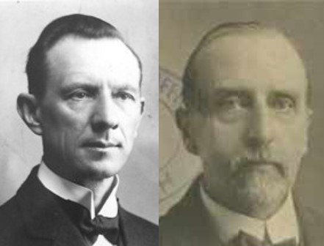
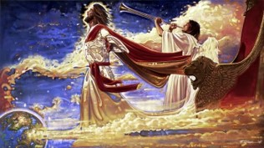
The Lord Will Reveal Himself
“Before this “stormy” day is ended, the Lord will reveal himself in power and glory.
A thousand years—the millennium will then begin.
Our Lord will dwell with men on Earth for a thousand years, as he blessed His disciple with His visible presence after His resurrection, for forty days, His kingdom is then on Earth.
Smith and Sjodahl
Christ is a glorified, celestial being, and the glory of such beings is comparable to that of the sun.
The presence of Christ when He comes in His glory will be as a consuming fire. The mountains will flow down at His presence, the elements will melt with fervent heat, and the waters will boil. Even the sun will hide its face in shame.
The scriptures also talk about the time when “devouring fire” will be poured out upon the wicked.”
Student Manual
D&C 29:11, D&C 76-70, Hebrew 12:29, D&C 133:40-44, 49; D&C 35:14; 1 Nephi 22:17, 23; Ezekiel 38:22; 39:6

Slide 21
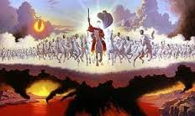
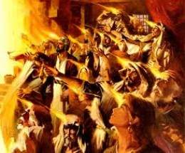
Those Who Come With Christ
The Savior declared that He will come again to the earth with power and glory.
The hosts who will come with the Savior in glory at His Second Coming will be faithful Saints who have lived in all periods of time in the earth’s history.
The righteous who have died will be resurrected, and the wicked will be destroyed. Jesus Christ will “dwell in righteousness with men on earth a thousand years.
D&C 29:11

Slide 22
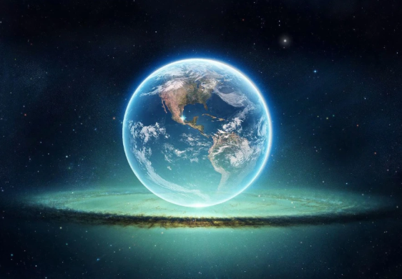
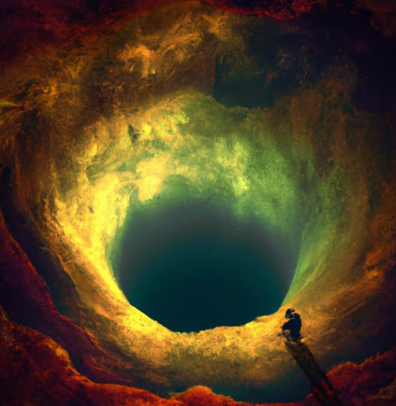
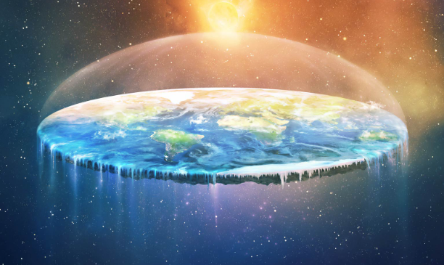
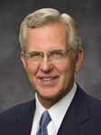
When He Comes Again
Doctrine and Covenants 29:23–27
Revelation 20:1–3
When He comes, oppression and injustice will not only diminish; they will cease. …
Poverty and suffering will not only decline; they will vanish. …
Even the pain and sorrow of death will be done away. …
… Let us devote ourselves more diligently to the preparations needed for the day when pain and evil are ended altogether. D. Todd Christofferson
Isaiah 65:19–25
1 Nephi 22:24–28

Slide 23
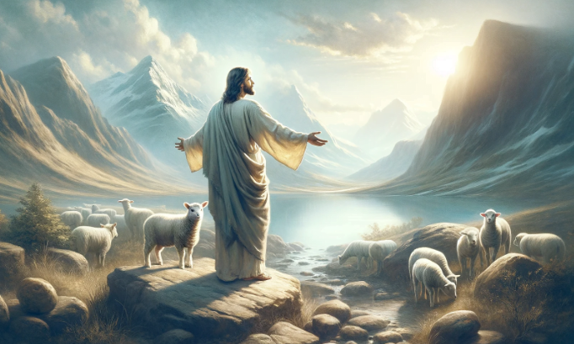
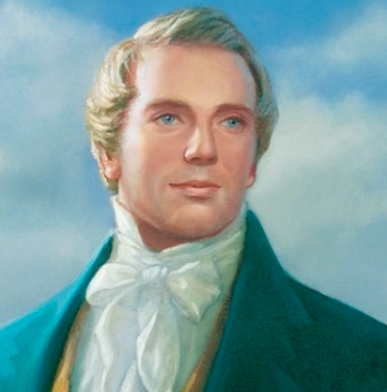
Resident on the Earth
… Jesus will be a resident on the earth a thousand [years] with the Saints is not the case, but will reign over the Saints and come down and instruct.
Teachings of Presidents of the Church: Joseph Smith [2007], 258

Slide 24
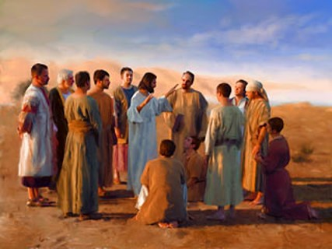
Promise to the 12
“Our Lord prepared a special reward for his first Apostles. He promised them, while yet with them I the flesh, that, seated on thrones of glory, they should judge the twelve tribes of Israel.
When our Lord comes to judgment, His Apostles will take the places promised to them, arrayed in the robes of their office.”
Smith and Sjodahl
D&C 29:12

Slide 25
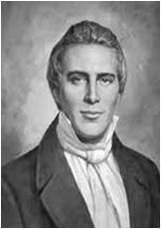
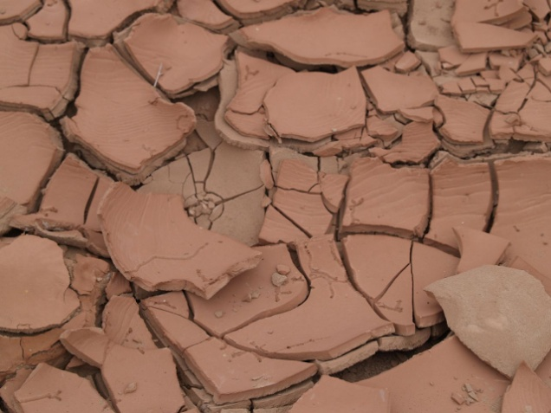
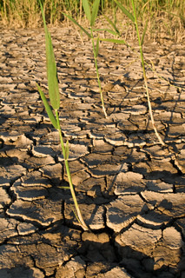
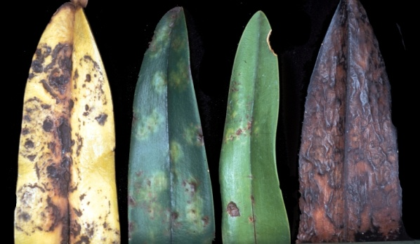
Escape
“Concerning the coming of the Son of Man … it is a false idea that the Saints will escape all the judgments, whilst the wicked suffer; for all flesh is subject to suffer, and ‘the righteous shall hardly escape’ [see D&C 63:34];
still many of the Saints will escape, for the just shall live by faith [see Habakkuk 2:4];
yet many of the righteous shall fall a prey to disease, to pestilence, etc., by reason of the weakness of the flesh, and yet be saved in the Kingdom of God.”
Joseph Smith
D&C 29:14-21

Slide 26
Signs of the Second Coming
The sun shall be darkened
The moon shall be turned into blood
The stars shall fall from heaven
Signs will be in heaven above and in the earth beneath
Weeping and wailing among the hosts of men
Hailstorm to destroy the crops
Wickedness
Flies and maggots and flesh fall and eyes from sockets while fowls and beasts devour them up
The abominable church will be devoured by fire
D&C 29:14-21

Slide 27
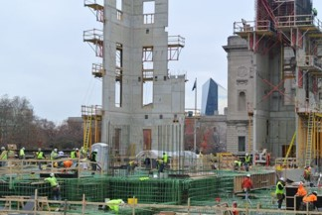
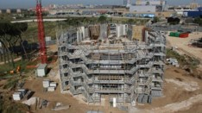
Satan Bound a Thousand Years
The condition of the world during the Millennium
“During the thousand years Satan will be bound so that he cannot tempt any man.
During this time temples will be erected in all parts of the land and the work of salvation for the dead will be continued until it is accomplished and the Lord will reveal all things pertaining to His kingdom.
The Lord and other resurrected beings will visit the earth from time to time and give instruction to those still in mortality so that eventually the knowledge of the Lord will cover the earth as the waters do the sea.”
“They shall not hurt nor destroy in all my holy mountain: for the earth shall be full of the knowledge of the Lord, as the waters cover the sea.”
Isaiah 11:9
D&C 29:22-29 Smith and Sjodahl

Slide 28
The Final Judgment
The condition of the world after the Millennium
D&C 29:22 Men shall again deny God
D&C 29:25
“for a little season” ---
The Earth will be spared, but the end is inevitable
D&C 29:26-29
Before the end—Michael will summon the dead; all shall rise—the righteous to eternal life, and the wicked to eternal fire
“And when the thousand years are expired, Satan shall be loosed out of his prison,” Revelation 20:17
D&C 29:22-29 Smith and Sjodahl

Slide 29
Separation of Individuals
“And the righteous shall be gathered on my right hand unto eternal life; and the wicked on my left hand will I be ashamed to own before the Father;”
D&C 29:27
When the Son of man shall come in his glory, and all the holy angels with him, then shall he sit upon the throne of his glory:
And before him shall be gathered all nations: and he shall separate them one from another, as a shepherd divideth his sheep from the goats:
And he shall set the sheep on his right hand, but the goats on the left.”
Matthew 25:31-33

Slide 30
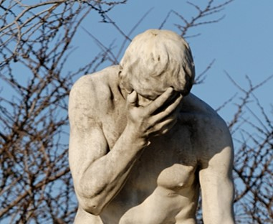
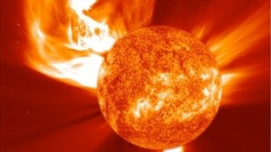
Ye Cursed
The final fate of the sons of perdition
The curse they bring upon themselves by their disobedience.
These will have the loss of Heavenly Father’s presence.
These will have lost the Spirit
“For behold, justice exerciseth all his demands, and also mercy claimeth all which is her own; and thus, none but the truly penitent are saved.”
Alma 42:24

Slide 31
Sources:
Videos:
“Migration: A Yearning for Home” (4:15),
The Scattering and Gathering of Israel Is First Spiritual (1:07)
Men’s Hearts Shall Fail Them(3:23)
A Witness of God (2:41)
Elder Neil L. Andersen (“Preparing the World for the Second Coming,” Ensign or Liahona, May 2011, 50–51).
Elder Bruce R. McConkie (“Come: Let Israel Build Zion,” Ensign, May 1977, 118).
Millennial Messiah pg. 302-309
Joseph Fielding McConkie and Robert L. Millet Doctrinal Commentary on the Book of Mormon Vol. 4 pg. 307, 316-317
Presentation by ©http://fashionsbylynda.com/blog/
President Joseph Fielding Smith (Doctrines of Salvation, 3:2–3.) and (Church History and Modern Revelation, 1:238.
Hyrum M. Smith and Janne M. Sjodahl Doctrine and Covenants Commentary pg. 147, 149
Joseph Smith (Teachings of Presidents of the Church: Joseph Smith [2007], 253).
D. Todd Christofferson, “Preparing for the Lord’s Return,” Ensign or Liahona, May 2019, 81
Teachings of Presidents of the Church: Joseph Smith [2007], 258.
Presentation by ©http://fashionsbylynda.com/blog/

Slide 32
Vengeance Upon the Wicked: D&C 29:17-21
Elder Bruce R. McConkie said: “Those with refined senses find it difficult to conceive of the desolation, destruction, and death that will prevail during the final great battles ushering in Christ’s reign of peace. So great shall be the slaughter and mass murder, the carnage and gore, the butchery and violent death of warring men, that their decaying bodies ‘shall stop the noses of the passengers,’ and it shall be a task of mammoth proportions merely to dispose of them. Then shall Ezekiel’s prophecy be fulfilled that every feathered fowl and every beast of the field shall assemble to ‘eat the flesh of the mighty, and drink the blood of the princes of the earth.’ (Ezek. 39.) And then shall the cry go forth of which John wrote: ‘Come and gather yourselves together unto the supper of the great God; That ye may eat the flesh of kings, and the flesh of captains, and the flesh of mighty men, and the flesh of horses, and of them that sit on them, and the flesh of all men, both free and bond, both small and great.’ (Rev. 19:17–18.) That all this is an actual, literal supper, an horrible but real event yet to be, has been specifically confirmed in latter-day revelation. (D. & C. 29:18–21.)” (Mormon Doctrine, p. 772.)
The figure of a cup full of indignation (see D&C 29:17) suggests that the Lord will no longer forbear taking vengeance on the wicked who will not repent. Just as there is a limit to the amount a cup can hold, so there is a limit to the amount of patience the Lord will show towards those who perform wicked acts. To restrain Himself longer would be a disservice to mankind for whom He has offered Himself as Savior. Since the blood of His Atonement will not cleanse those who do not repent, pestilence, famine, plague, and destruction are the tools He uses to reclaim those who are past feeling and will not hearken to the still, small voice (see1 Nephi 17:45; D&C 43:20–27). These terrible judgments are the natural result of man’s wickedness. God’s plea is for people to turn from such wickedness and be spared these awful consequences of sin.
Unpleasant Things:
President Joseph Fielding Smith said: “I know these are unpleasant things. It is not a pleasant thing even for me to stand here and tell you that this is written in the Scriptures. If the Lord has a controversy with the nations, He will put them to the sword. Their bodies shall lie unburied like dung upon the earth. That is not nice, is it, but should we not know it? Is it not our duty to read these things and understand them? Don’t you think the Lord has given us these things that we might know and we might prepare ourselves through humility, through repentance, through faith, that we might escape from these dreadful conditions that are portrayed by these ancient prophets? That is why I am reading them. I feel just as keenly as you do about the condition, and I pray for it to come to an end, but I want it to come to an end right.” (Signs of the Times, pp. 154–55.)
Earth Destroyed—New One take place: D&C 22-25
President Joseph Fielding Smith explained that this passage “does not mean that this earth shall pass away and another take its place, and the heaven thereof shall pass away, and another heaven take its place, but that the earth and its heaven shall, after passing away through death, be renewed again in immortality. This earth is living and must die, but since it keeps the law it shall be restored through the resurrection by which it shall become celestialized and the abode of celestial beings. The next verse of this revelation explains this as follows: [D&C 29:24–25].
“So we see that the Lord intends to save, not only the earth and the heavens, not only man who dwells upon the earth, but all things which he has created. The animals, the fishes of the sea, the fowls of the air, as well as man, are to be re-created, or renewed, through the resurrection, for they too are living souls.” (In Conference Report, Oct. 1928, pp. 99–100; see also D&C 88:17–19, 25–26.)
Preceding the Coming:
Concerning the coming of the Son of Man … ; it is a false idea that the Saints will escape all the judgments, whilst the wicked suffer; for all flesh is subject to suffer, and “the righteous shall hardly escape” [see Doctrine and Covenants 63:34]; still many of the Saints will escape, for the just shall live by faith [see Habakkuk 2:4]; yet many of the righteous shall fall a prey to disease, to pestilence, etc., by reason of the weakness of the flesh, and yet be saved in the Kingdom of God. (Teachings of Presidents of the Church: Joseph Smith [2007], 253)
All the hosts:
The hosts who will come with the Savior in glory at His Second Coming will include faithful Saints who have lived in all periods of time in the earth’s history. The righteous who have died will be resurrected, and they, along with the righteous who are still living on earth, will be “caught up to meet him” and “shall descend with him” (see Doctrine and Covenants 88:95–98).

