Slide 1
Doctrine and Covenants 29:30-50
Spiritual Death
He that hath an ear, let him hear what the Spirit saith unto the churches; He that overcometh shall not be hurt of the second death.
Revelation 2:11
Presentation by ©http://fashionsbylynda.com/blog/

Slide 2
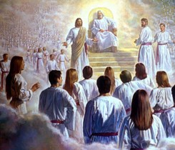
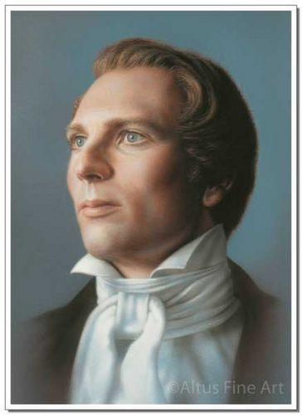
Judgments of God
Man in his mortal condition, with very limited understanding and imperfect character, is in no position to fully understand the judgments of God, who is perfect and omniscient (see D&C 38:2). God does not reveal all of His judgments and the reasons for His actions. It is certain, however, that all God’s judgments are just and right.
“He [God] holds the reins of judgment in His hands; He is a wise Lawgiver, and will judge all men, not according to the narrow, contracted notions of men, but, ‘according to the deeds done in the body whether they be good or evil.’…”
Joseph Smith
Simon Dewey
D&C 29:30

Slide 3
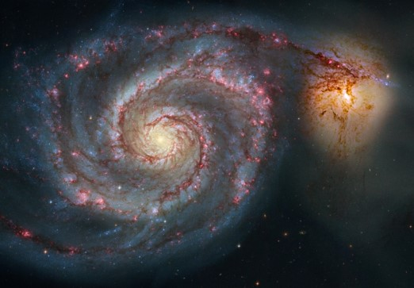
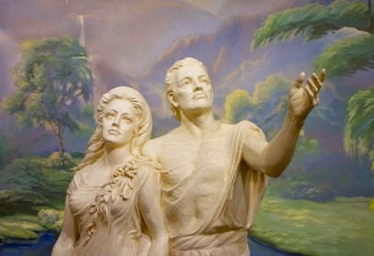
Spiritual State
At the Creation, Adam, Eve, the earth, and all things on the earth were in a spiritual state.
Even though Adam and Eve had physical bodies, they were not subject to death and could dwell in God’s presence forever.
However, as part of Heavenly Father’s plan, all His creations would become temporal.
In other words, they would become temporary and subject to death.
Following the resurrection, they will return to a spiritual state—physical but also immortal.
D&C 29:31-35

Slide 4
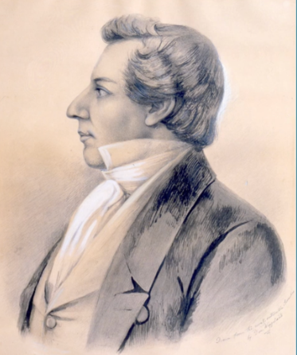
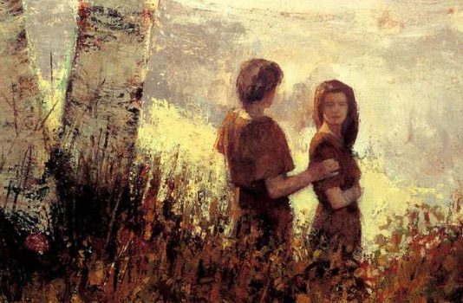
Background
The Lord had been teaching Joseph Smith about the Fall of Adam and Eve and agency during his work on the inspired translation of the Bible.
The Lord teaches about redemption from the Fall of Adam and Eve through the Atonement of Jesus Christ.

Slide 5
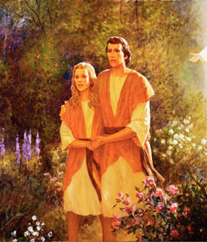
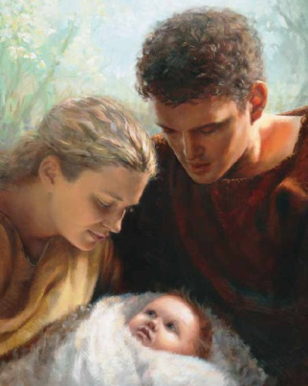
Before and After the Fall
Before the Fall—2 Nephi 22-23
No physical death, Adam and Eve would have lived forever if they had not transgressed
No Spiritual death, they lived in God’s presence
No progression toward exaltation possible
They could not have children
They were innocent, knowing neither good nor evil, joy nor misery
After the Fall
All things became mortal and could die physically (2 Nephi 9:6)
Adam and Eve were cast out of God’s presence and became spiritually dead (D&C 29:40-42)
Eternal progression according to Heavenly Father’s plan became possible (Moses 5:11)
They could have children (Moses 4:22; 5:11)
They knew good and evil and could experience joy and misery (Moses 5:11)
D&C 29:30-50

Slide 6
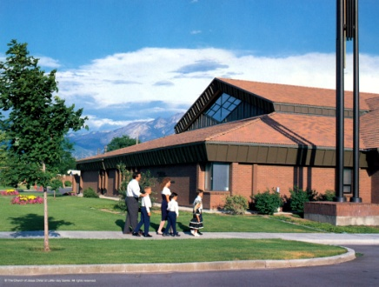
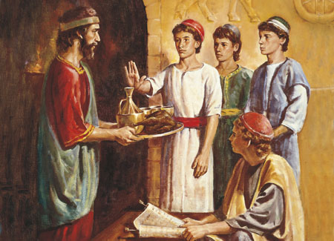
Examples of Spiritual Laws
All things unto Him are spiritual…even commandments and laws
Sabbath Day—Provides a way to worship and give reverence to God
Our observance brings us closer to our spiritual relationship with the Lord
Word of Wisdom—not only a health law but a principle of obedience
Morality—spiritual sensitivity
Tithing—spiritual satisfaction
Pray always—spiritual experiences
Sacrament—touches the spiritual fibers of our souls (renews our spiritual covenants)
D&C 29:34-35 Otten and Caldwell excerpts

Slide 7
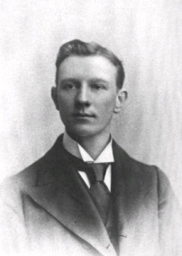
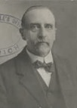
“Man makes a distinction between temporal and spiritual laws, and some are very much concerned about keeping the two separate.
To the Lord everything is both spiritual and temporal, and the laws He gives are consequently spiritual, because they concern spiritual beings.
When He commanded Adam to eat bread in the sweat of his brow, or Moses to strike the rock that the people might drink, or the Prophet Joseph to erect the Nauvoo House, or the Saints in Utah to build fences and roads, such laws were for their spiritual welfare, as well as physical.
To obey such laws, when given, is a spiritual duty. One who performs his daily labor ‘as to the Lord, and not to men’ (Eph. 6:7) derives spiritual benefit from whatever his duties are.”
Smith and Sjodahl

Slide 8
Give Me Power and Glory
The devil rebelled against God in the premortal spirit world and turned away “a third part of the hosts of heaven.” Because the devil and his followers rebelled, they were cast out.
“Because of free agency Satan had the ability to tempt Adam.
There can be no free agency where there is no possibility to choose between right and wrong.
If only one course of action is open to us, we are not free agents.”
Why does the Lord allow the devil to tempt us?
D&C 29:36-39

Slide 9
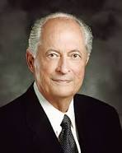
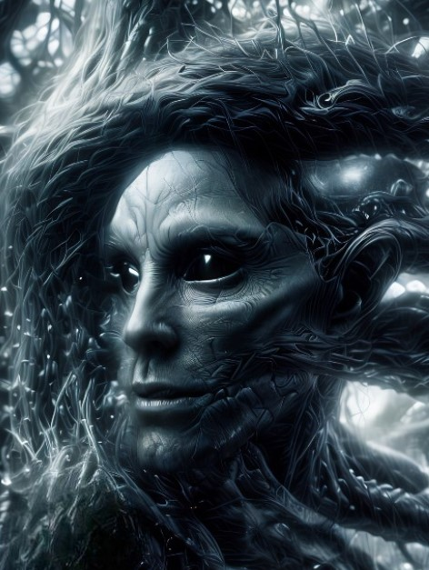
Because of Lucifer’s rebellion, a great spiritual conflict ensued. Each of Heavenly Father’s children had the opportunity to exercise the agency Heavenly Father had given him or her. We chose to have faith in the Savior Jesus Christ—to come unto Him, follow Him, and accept the plan Heavenly Father presented for our sakes.
But a third of Heavenly Father’s children did not have faith to follow the Savior and chose to follow Lucifer, or Satan, instead.
And God said, “Wherefore, because that Satan rebelled against me, and sought to destroy the agency of man, which I, the Lord God, had given him, … I caused that he should be cast down.
Robert D. Hales
Wherefore, because that Satan rebelled against me, and sought to destroy the agency of man, which I, the Lord God, had given him, and also, that I should give unto him mine own power; by the power of mine Only Begotten, I caused that he should be cast down;
Moses 4:3
D&C 29:36-39

Slide 10
Temptations of the Devil
Knowing that we chose to follow Heavenly Father’s plan before this life, what makes it difficult to always choose to follow Him here on earth?
What are Satan’s most effective tactics to get people on earth to choose not to follow God’s counsel?
What are some blessings God has given us to help overcome Satan’s temptations?
D&C 29:39; 2 Nephi 2:16-18

Slide 11
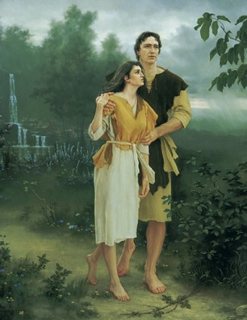
Commandment To Adam
What commandment did the Lord give Adam?
The Lord commanded Adam not to eat the fruit of the tree of the knowledge of good and evil.
What did the Lord say would happen if Adam transgressed this commandment?
Adam would die. From the day of his transgression Adam was subject to physical and spiritual death
Spiritual death is being removed from God’s presence
D&C 29:40-41

Slide 12
Spiritual Death-Physical
The first is a result of the Fall and is temporary.
Physical Death—separation of the spirit from the body
“Yea, behold, this death bringeth to pass the resurrection, and redeemeth all mankind from the first death—that spiritual death; for all mankind, by the fall of Adam being cut off from the presence of the Lord, are considered as dead, both as to things temporal and to things spiritual.”
Helaman 14:16
Who experiences the consequences of Adam’s transgression?
All Mankind
D&C 29:40-41

Slide 13
Consequences of Our Choices
In what ways do we become subject to the will of the devil when we choose to rebel against God?
Why do you think the term “spiritual death” is a good description of separation from Heavenly Father?
How would you describe the feelings that we experience after we use our agency to go against Heavenly Father’s will?
D&C 29:40-41; Alma 41:10-11; 42:9, 14

Slide 14
Consequences of Transgression
The second is a result of unrepented sins and will be permanent for those who fail to repent and be obedient.
All people will return to God’s presence for judgment, but not all people will be worthy to dwell in His presence forever
“If so, wo shall come upon you; but if not so, then cast about your eyes and begin to believe in the Son of God, that he will come to redeem his people, and that he shall suffer and die to atone for their sins; and that he shall rise again from the dead, which shall bring to pass the resurrection that all men shall stand before him, to be judged at the last and judgment day, according to their works.”
Alma 33:22
D&C 29:42

Slide 15
Redemption through God’s Only Begotten Son
What has Jesus Christ done to make redemption possible even after we have made poor choices?
What would you share about Heavenly Father and Jesus Christ that could give someone hope who feels they are too far gone?
What examples could you share to demonstrate the redeeming, forgiving nature of Heavenly Father and Jesus Christ?
D&C 29:42-43; 2 Nephi 2:6-9

Slide 16
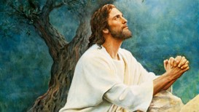
Overcoming
“But behold, the resurrection of Christ redeemeth mankind, yea, even all mankind, and bringeth them back into the presence of the Lord.”
Helaman 14:17
Through His Atonement, Jesus Christ offers forgiveness and eternal life to all those who exercise faith in Him and repent of their sins.
D&C 29:42

Slide 17
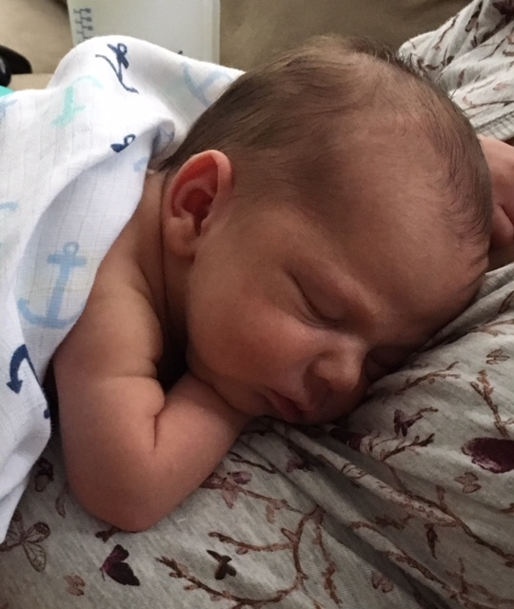
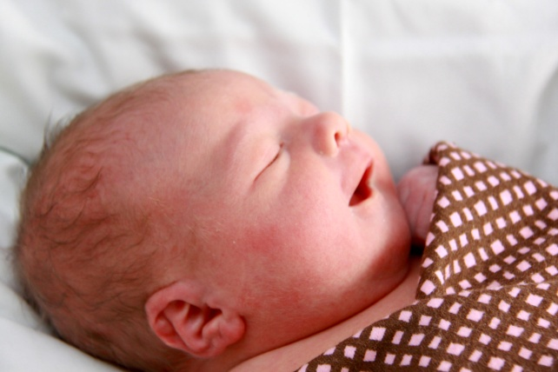
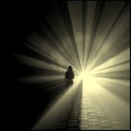
Immortality
Although we lived in God’s presence before we were born, each of us needed to come to earth, receive a physical body, and learn through experience to use our agency to follow Jesus Christ.
Our spiritual state when we receive eternal life will be greater than the spiritual state we experienced in the premortal spirit world.
“Immortality is to live forever as a resurrected being. Through the Atonement of Jesus Christ, everyone will receive this gift. Eternal life, or exaltation, is to inherit a place in the highest degree of the celestial kingdom, where we will live in God’s presence and continue as families.
Like immortality, this gift is made possible through the Atonement of Jesus Christ. However, it requires our ‘obedience to the laws and ordinances of the Gospel.”
True to the Faith
D&C 29:43-44

Slide 18
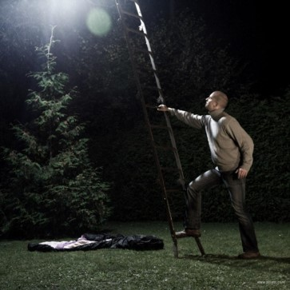
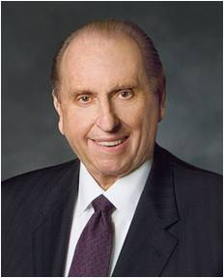
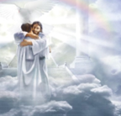
“Don’t put your eternal life at risk. If you have sinned, the sooner you begin to make your way back, the sooner you will find the sweet peace and joy that come with the miracle of forgiveness.
“… You are of a noble birthright. Eternal life in the kingdom of our Father is your goal. Such a goal is not achieved in one glorious attempt but rather is the result of a lifetime of righteousness, an accumulation of wise choices, even a constancy of purpose. As with anything really worthwhile, the reward of eternal life requires effort.
“… May we be filled with gratitude for the right of choice, accept the responsibility of choice, and ever be conscious of the results of choice.”
President Thomas S. Monson

Slide 19
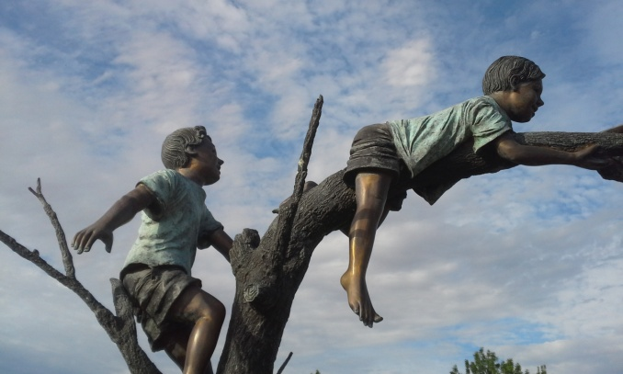
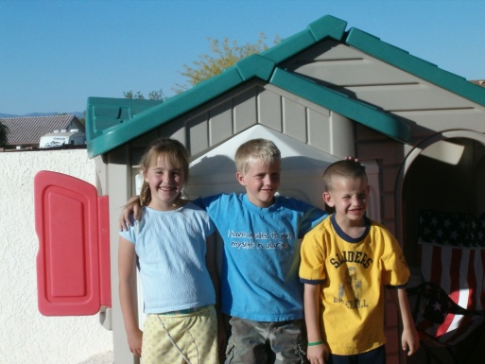
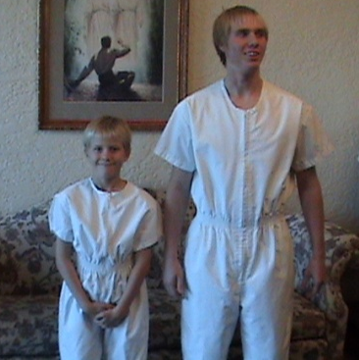
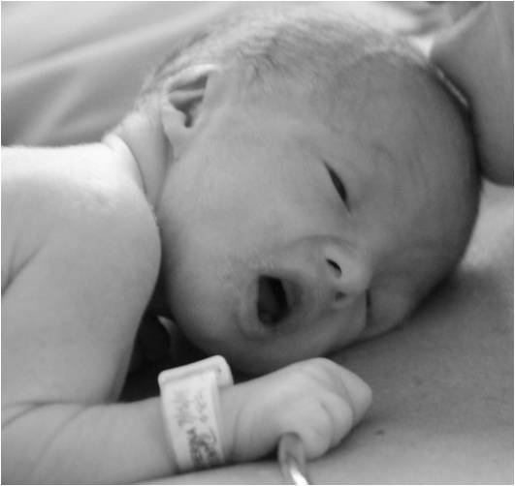
Little Children
The consequences of transgressing God’s laws are different for little children and for others who are not accountable before God.
What does this mean for little children who die before they reach the age of eight?
They are saved in the celestial kingdom.
Little children begin to become accountable before the Lord at age eight (D&C 68:25)
“And I also beheld that all children who die before they arrive at the years of accountability are saved in the celestial kingdom of heaven.”
D&C 137:10
D&C 29:46-50

Slide 20
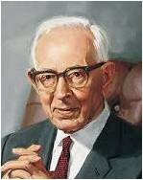
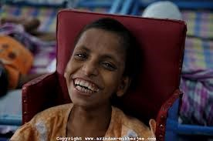
“The Church of Jesus Christ of Latter-day Saints considers all deficient children with retarded capacity to understand, just the same as little children under the age of accountability.
They are redeemed without baptism and will go to the celestial kingdom of God, there, we believe, to have their faculties or other deficiencies restored according to the Father’s mercy and justice.”
President Joseph Fielding Smith
D&C 29:50

Slide 21
Sources:
Video:
Physical and Spiritual Death(1:48)
Joseph Smith (History of the Church, 4:595–96.)
Otten and Caldwell Sacred Truths of the Doctrine and Covenants pg. 141
Robert D. Hales, “Agency: Essential to the Plan of Life,” Ensign or Liahona, Nov. 2010, 24
(Smith and Sjodahl, Commentary, p. 156.) Student Manual Religion 324-325
Tree art: a new papercut by Isaac Brynjegard-Biali Tree of Knowledge of Good and Evil
(True to the Faith: A Gospel Reference [2004], 52).
Presentation by ©http://fashionsbylynda.com/blog/
President Thomas S. Monson (“The Three Rs of Choice,” Ensign or Liahona, Nov. 2010, 69–70).
President Joseph Fielding Smith (Answers to Gospel Questions, 3:21.)
Presentation by ©http://fashionsbylynda.com/blog/

Slide 22
Judgment of God: D&C 29:30
He will judge them, ‘not according to what they have not, but according to what they have,’ those who have lived without law, will be judged without law, and those who have a law, will be judged by that law. We need not doubt the wisdom and intelligence of the Great Jehovah; He will award judgment or mercy to all nations according to their several deserts, their means of obtaining intelligence, the laws by which they are governed, the facilities afforded them of obtaining correct information, and His inscrutable designs in relation to the human family; and when the designs of God shall be made manifest, and the curtain of futurity be withdrawn, we shall all of us eventually have to confess that the Judge of all the earth has done right.” Joseph Smith (History of the Church, 4:595–96.)
Janne Mattson Sjödahl (29 November 1853 – 23 June 1939) was a Swedish convert to The Church of Jesus Christ of Latter-day Saints (LDS Church) and was the author of influential commentaries on LDS Church scriptures. Sjödahl was among the first commentators to advance a "limited geography model" for the theorized geography of the Book of Mormon
Upon settling in Manti, Sjödahl became the editor of the Manti Sentinel newspaper.
When the LDS Church's Manti Utah Temple was completed in May 1888, Sjödahl became the first individual to receive his Endowment in the new temple. On 30 May 1888, Sjödahl and Christina Christofferson were married in the Manti Temple by Apostle Francis M. Lyman ;they were the first couple married in the new temple. His second wife died in 1910.
In 1888, Sjödahl completed a church-approved translation of the LDS Church's Doctrine and Covenants into Swedish. In 1927, Sjödahl translated the Pearl of Great Price into Swedish, and in 1935 he completed the third revised translation of the Book of Mormon nto Swedish.
Upon the completion of the translation, Sjödahl was asked by church president Wilford Woodruff to go on a mission to Palestine.
Read more wikipedia
Salvation of little children before they become accountable before God: Elder Bruce R. McConkie taught:
“Among all the glorious gospel verities given of God to his people there is scarcely a doctrine so sweet, so soul satisfying, and so soul sanctifying, as the one which proclaims—Little children shall be saved. They are alive in Christ and shall have eternal life. For them the family unit will continue, and the fulness of exaltation is theirs. No blessing shall be withheld. They shall rise in immortal glory, grow to full maturity, and live forever in the highest heaven of the celestial kingdom—all through the merits and mercy and grace of the Holy Messiah, all because of the atoning sacrifice of Him who died that we might live …
“Are all little children saved automatically in the celestial kingdom?
“To this question the answer is a thunderous yes, which echoes and re-echoes from one end of heaven to the other. Jesus taught it to his disciples. Mormon said it over and over again. Many of the prophets have spoken about it, and it is implicit in the whole plan of salvation. If it were not so the redemption would not be infinite in its application. And so, as we would expect, Joseph Smith’s Vision of the Celestial Kingdom contains this statement: ‘And I also beheld that all children who die before they arrive at the years of accountability are saved in the celestial kingdom of heaven.’ [D&C 137:10] …
How and why are they saved?
“They are saved through the atonement and because they are free from sin. They come from God in purity; no sin or taint attaches to them in this life; and they return in purity to their Maker. Accountable persons must become pure through repentance and baptism and obedience. Those who are not accountable for sins never fall spiritually and need not be redeemed from a spiritual fall which they never experienced. Hence the expression that little children are alive in Christ. ‘Little children are redeemed from the foundation of the world through mine Only Begotten,’ the Lord says. (D&C 29:46)” (“The Salvation of Little Children,” Ensign, Apr. 1977, 3, 4–5).
Blessings Through the Fall:
Adam and Eve [through the Fall] … became mortal. Happily for us, they could also beget children and fulfill the purposes for which the world was created. … Other blessings came to us through the Fall. It activated two closely coupled additional gifts from God, nearly as precious as life itself—agency and accountability. (Russell M. Nelson, “Constancy amid Change,” Ensign, Nov. 1993, 34)
D&C 29:42 Choosing Eternal Joy:
At the heart of God’s plan for your happiness is your power to choose. Of course, your Heavenly Father wants you to choose eternal joy with Him, and He will help you to achieve it, but He would never force it upon you. …
When you have important choices to make, Jesus Christ and His restored gospel are the best choice. (Dieter F. Uchtdorf, “Jesus Christ Is the Strength of Youth,” Liahona, Nov. 2022, 10)

Slide 23
Before and After the Fall
Before the Fall—2 Nephi 22-23
No physical death, Adam and Eve would have lived forever if they had not transgressed
No Spiritual death, they lived in God’s presence
No progression toward exaltation possible
They could not have children
They were innocent, knowing neither good nor evil, joy nor misery
After the Fall
All things became mortal and could die physically (2 Nephi 9:6)
Adam and Eve were cast out of god’s presence and became spiritually dead (D&C 29:40-42)
Eternal progression according to Heavenly Father’s plan became possible (Moses 5:11)
They could have children (Moses 4:22; 5:11)
They knew good and evil and could experience joy and misery (Moses 5:11)
D&C 29:30-50

