Slide 1
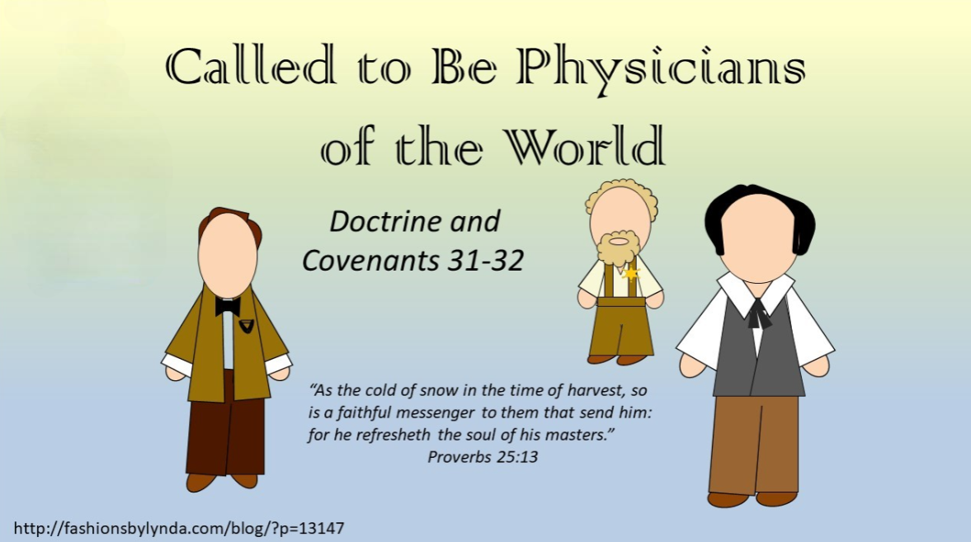

Slide 2
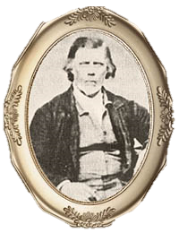
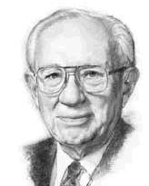
The Calling
The Lord calls Thomas B. Marsh to preach the gospel and help establish the Church
Through our faithfulness, our family members may be blessed to believe and know the truth
“You will bless the lives of those you teach, and their posterity after them. You will bless your own life. You will bless the lives of your family, who will sustain you and pray for you.”
President Gordon B. Hinckley
D&C 31:1-8

Slide 3
Thomas B. Marsh
He was born November 1, 1800, in Acton, Massachusetts
He became acquainted with Martin Harris, while on a visit to Palmyra, who gave him a sheet containing the first 16 pages of the Book of Mormon
He and his wife read, grew a testimony and he was baptized by David Whitmer on September 3, 1830, and ordained an elder later
He was called to the Quorum of the Twelve and served as president
He was called on a mission to Canada with Joseph Smith and Sidney Rigdon
In 1838 his wife, Elizabeth, and the wife of George W. Harris, Lucinda, had a dispute and there became a rift between Thomas and the priesthood
He was excommunicated in 1839
He made his way to Salt Lake City in 1857, confessed his sins, and received full fellowship as a member of the Church
He wrote an autobiography in 1864, recounting his Church service and rebellion. It was published in the Millennial Star and he died in January of 1866
Section 31 and 112 are dedicated to him
Who’s Who & Smith and Sjodahl

Slide 4
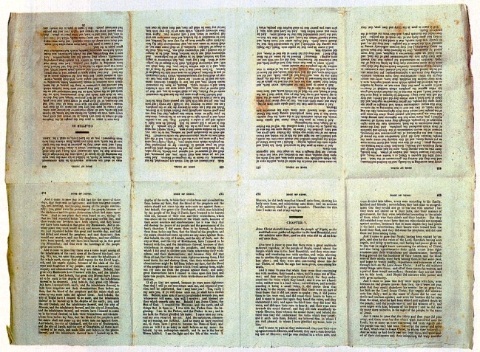
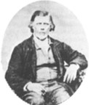
Guided by the Spirit
While living in Boston, Massachusetts, in 1829, Thomas B. Marsh concluded that none of the churches he knew of were consistent with the teachings of the Bible. He wrote,
“I believed the Spirit of God dictated me to make a journey west.”
He departed from his wife, Elizabeth, and their young family to search for the truth.
After a three-month journey, Thomas was traveling home when he “heard of [a] Golden Book found by a youth named Joseph Smith.”
He made his way to Palmyra, New York, where he met Martin Harris. The printer gave Thomas a proof sheet containing the first sixteen pages of the Book of Mormon.
Thomas later wrote, “After arriving home … I showed my wife the sixteen pages of the Book of Mormon … with which she was well pleased, believing it to be the work of God.”
About a year later, after learning about the organization of the Church, Thomas and his family moved to Palmyra. While living in the area he was baptized near Fayette and ordained an elder by Oliver Cowdery in September 1830.
Thomas B. Marsh

Slide 5
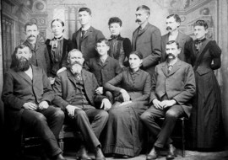

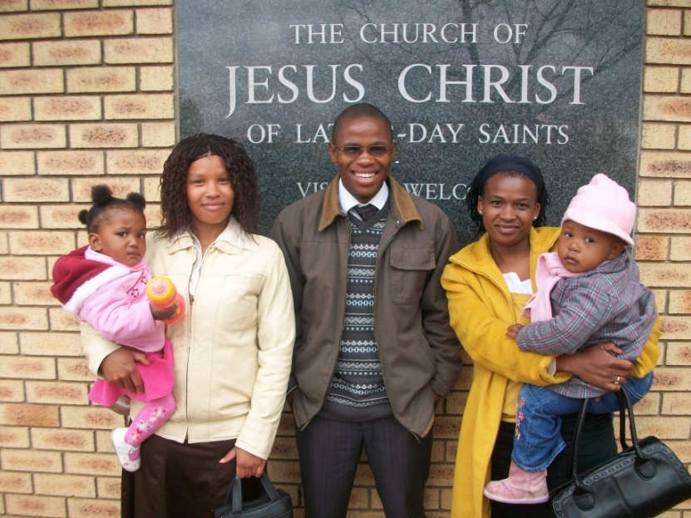
Blessings of Missionary Work
What blessings would come to those whom Thomas would teach?
How would Thomas be blessed for his missionary service?
How would his family be blessed?
How has another person’s missionary service blessed your life or the life of someone you know?
D&C 31:1-2

Slide 6
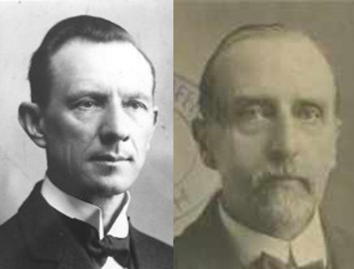
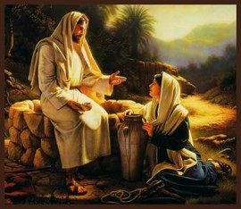
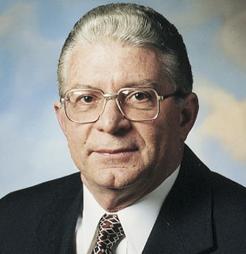
Faithful
“As long as Thomas B. Marsh was faithful he was an eloquent speaker. At the time of the troubles in Clay County, Mo., he was elected a member of a committee to lay the grievances of the Saints before the authorities of the State.
On that occasion he spoke so impressively that General Atchison, who was present, shed tears, and the meeting passed resolutions to assist the Saints in finding a new location.”
Smith and Sjodahl
If we daily exercise faith, meekness, charity, and lowliness in heart, confessing that Jesus is the Christ, and accepting His Atonement, we will be blessed with the strength and hope to face and overcome the trials and pains of this life.
Elder Adhemar Damiani
D&C 31:3-4

Slide 7
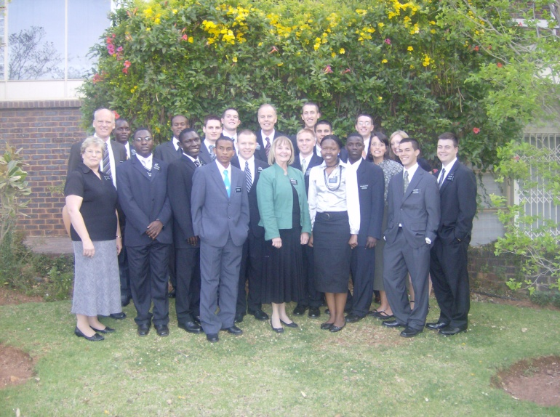

Thrust In Your Sickle
The success of the servant is based on his efforts; D&C 31:5
The Church is to be strengthened and prepared through the gathering.
“The field is white already to harvest”
1. This is the last time servants will be called. (It is the eleventh hour of mortal time before the Second Coming.)
2. The servants are to labor and reap with all their might.
3. The faithful will receive great blessings.
See also D&C 33:3
D&C 31:5-6

Slide 8




Be Patient
D&C 31:9

Slide 9


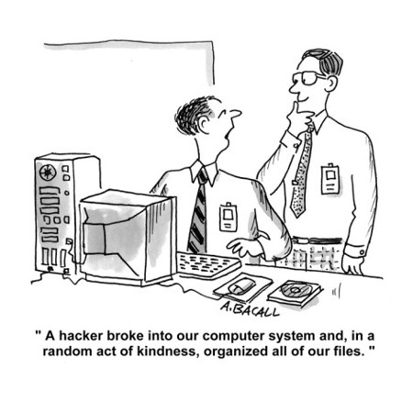
Revile Not
D&C 31:9

Slide 10


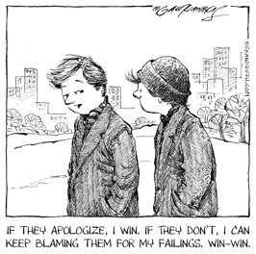
Govern House in Meekness
D&C 31:9

Slide 11
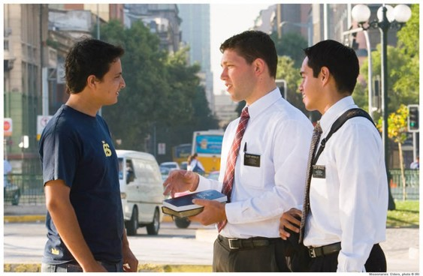
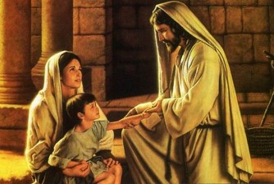
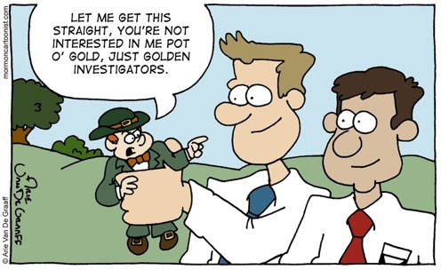
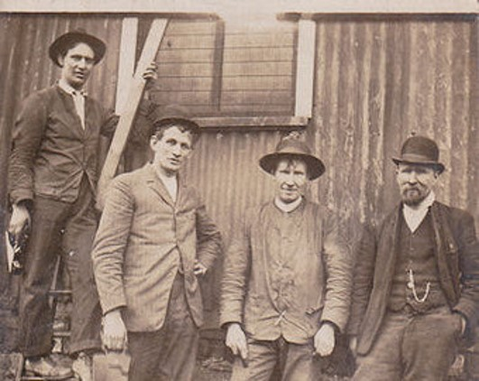
Physician to the World
D&C 31:10

Slide 12
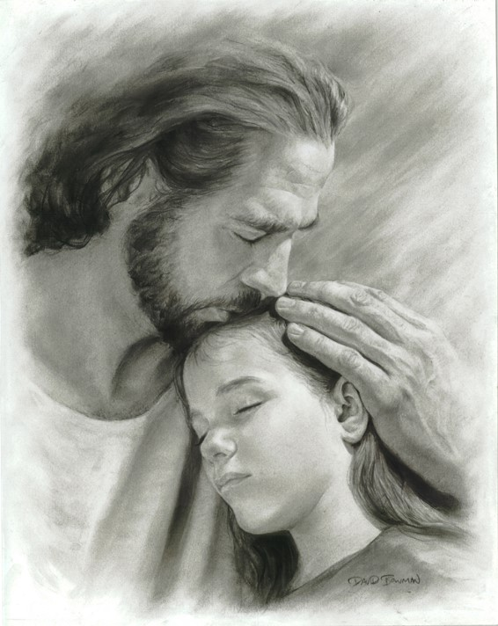
Be Guided by the Comforter
D&C 31:11

Slide 13
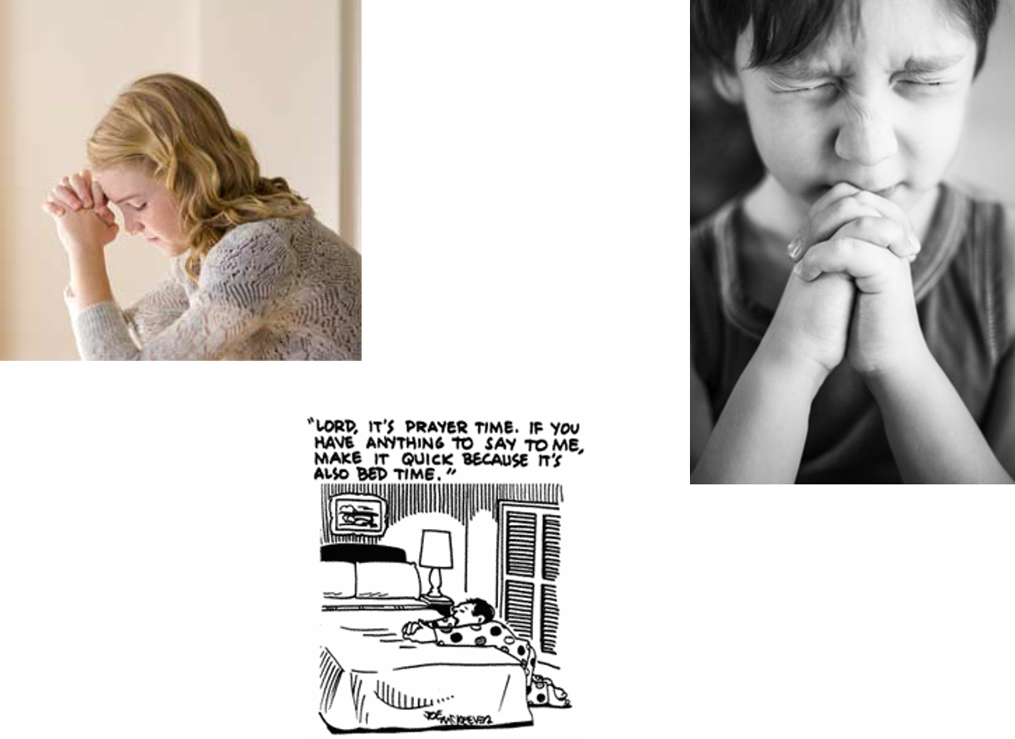
Pray Always
D&C 31:12

Slide 14
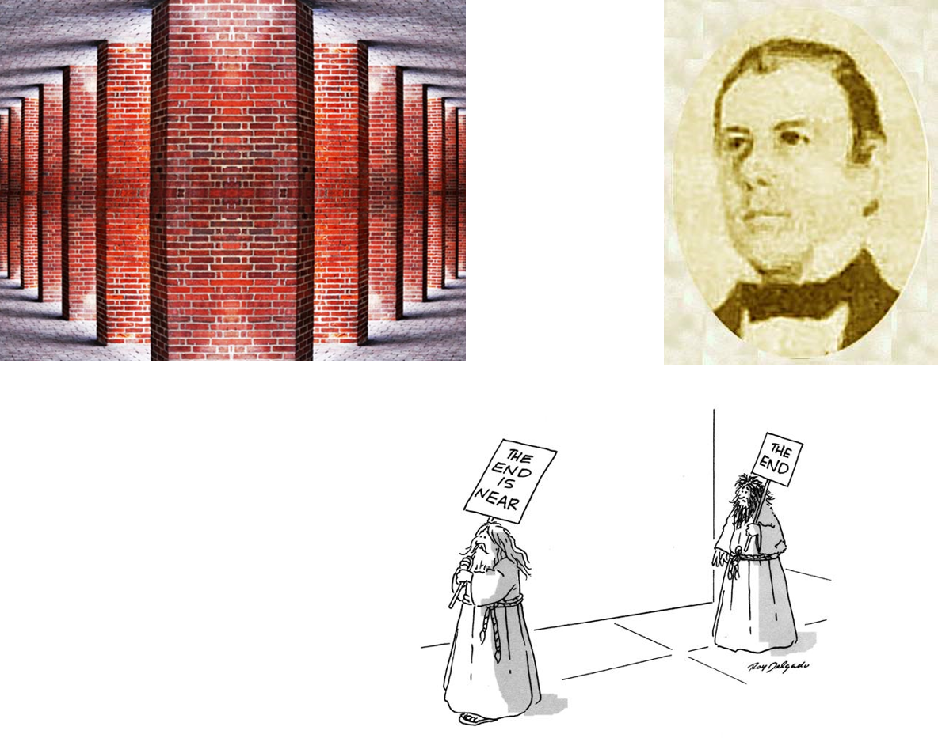
Faithful To the End
D&C 31:13

Slide 15
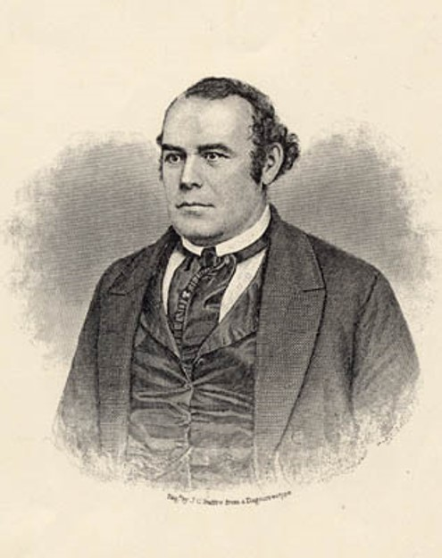
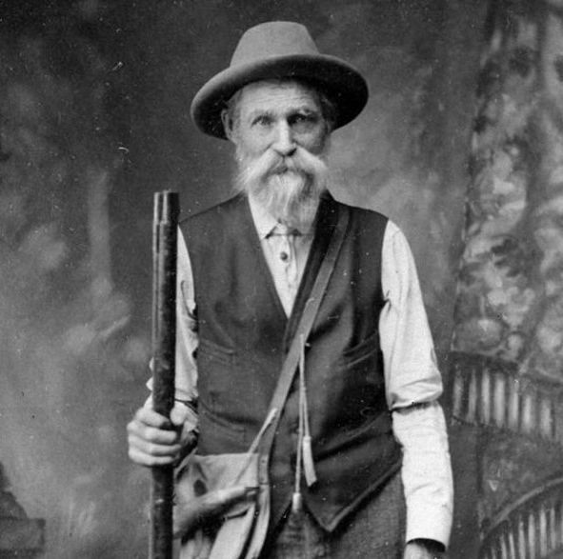
Calling of Parley P. Pratt and Ziba Peterson
The prophet Joseph Smith received revelations in the fall 1830 calling Oliver Cowdery, Peter Whitmer Jr., Parley P. Pratt and Ziba Peterson on a mission to the Lamanites -- the native Americans then living in the Indian territories bordering the state of Missouri.
Leaving in late October, they arrived at a village in Ohio called Kirtland; here they would stay for four weeks, baptizing some one hundred converts, before continuing on to Missouri.
Photo of unknown farmer:
Not Ziba Peterson
D&C 33:1-3

Slide 16
Parley P. Pratt
He was born on April 12, 1807, in Burlington, New York
He read the Book of Mormon all day… “and his joy was full.”
He was baptized by Oliver Cowdery in September 1830 and ordained an elder soon after
He converted his brother Orson and called to serve with others on a mission to the Lamanites in Ohio and Missouri
He was also sent as a missionary to the “Shakers” in Ohio, and served in England and South America
He directed the School of the Prophets and participated in Zion’s Camp
He was ordained an Apostle in 1835
His first wife, Thankful Halsey Pratt, died following childbirth in March 1837
He was imprisoned unjustly in 1838-1839 for a time
While serving a mission in Arkansas, he was murdered in 1857—he is considered a martyr
Who’s Who

Slide 17

Ziba Peterson
He was baptized as a young man on April 18, 1830, and ordained an elder
He was called to serve a mission among the Lamanites along with parley P. Pratt, Oliver Cowdery and Peter Whitmer Jr.
He was chastened later, by the Lord, for hiding his sins
He withdrew himself from fellowship in the church and was excommunicated on June 25, 1833 (D&C 58:60)
He moved to California with his family in 1848 where he became the sheriff in a mining community, called Hangtown, where he is buried
The town changed the name to Placerville in 1853
D&C 33:1-3

Slide 18
Sources:
Video:
Sharing Your Light (2:55)
Who’s Who by Ed J. Pinegar and Richard J. Allen pg. 95-96, 114, 117-118
Presentation by ©http://fashionsbylynda.com/blog/
Thomas B. Marsh, “History of Thomas Baldwin Marsh,” Millennial Star, June 11, 1864, 375).
President Gordon B. Hinckley (“Of Missions, Temples, and Stewardship,” Ensign, Nov. 1995, 52).
Belinda DeLong Decker Family Portrait 1830
(Smith and Sjodahl, Commentary, p. 165.)
Elder Adhemar Damiani Be of Good Cheer and Faithful in Adversity April 2005 Gen.Conf.
For Further Reading on Parley P. Pratt see The Extraordinary Life of Parley P. Pratt
BY MATTHEW J. GROW April 2007 Ensign
http://fashionsbylynda.com/blog/?p=13147

Slide 19
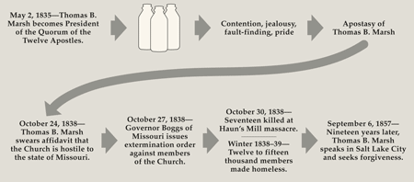
Thomas B. Marsh
Few stories from Church history have been used as a cautionary tale as often as that of Thomas B. Marsh. The first to serve as president of the Quorum of the Twelve Apostles, Marsh left the Church in 1838 and later repented, returning to full fellowship in 1857. His importance in the early Church is evidenced by his being the sole recipient of two revelations in the Doctrine and Covenants and having been specifically instructed in four others.
…Also contributing to his deepening dissatisfaction was the infamous “cream strippings” incident, which occurred in August or September 1838, involving Marsh’s wife, Elizabeth, and Lucinda Harris, wife of George W. Harris. According to George A. Smith, the women had agreed to exchange milk from their cows for making cheese. But counter to their agreement, Elizabeth allegedly kept the cream strippings—the richer part of the milk that rises to the top—before sending the rest of the milk to Lucinda. According to Smith, the matter went before the Teacher’s Quorum, then the bishop, and then the high council, all of whom found Elizabeth to be at fault. Marsh, not satisfied, appealed to the First Presidency, who agreed with the earlier decisions. Further offended by this chain of events, the already frustrated Marsh was said to have declared “that he would sustain the character of his wife, even if he had to go to hell for it.”
For more information: http://history.lds.org/article/revelations-in-context-doctrine-and-covenants-thomas-marsh?lang=eng
Be Faithful:
In very large measure each of us holds the key to the blessings of the Almighty upon us. If we wish the blessing, we must pay the price.
A part of that price lies in being faithful.
Be faithful to the gospel. Be faithful to the Church. We have all about us those who are seeking to undermine it, to look for weaknesses in its early leaders, to find fault with its programs, to speak critically of it. I give you my testimony that it is the work of God, and those who speak against it are speaking against him.
Be faithful to him. He is the one true source of your strength. He is your Father in Heaven. He lives. He hears and answers prayers. Be faithful to God.
“If Thou Art Faithful”
GORDON B. HINCKLEY oct. 1984 Gen. conf
Richard B. Zeba Peterson:
Birth 1805 New York
Death: May 1849 Placerville, El dorado county California USA
The First Sherrif of Hangtown
Ziba Peterson was an excommunicated early Mormon offical who came, with his family to California in 1846 with the Charles Hopper wagon train from Miissouri. They stopped in Dry Diggins. By the fall of 1847 Ziba had been made town sherrif.
On 1-18-1848 4 men were arrested for larceny. During the trial it was discovered that 3 of the men had also killed a man on Weaver's Creek. The three men were named Pepi, Antoine, And Tehal. The jury found them guilty and ordered that they be hung. Shortly afterwards Ziba took the three men and hung them.
From 1848 to 1854 Dry Diggins was known as Hangtown. In 1853 the town changed its name to Placerville.
In the spring of 1849 Ziba died and was buried in the Hangtown Cemetery.
Part of the Old Placerville City Cemetery is the Hangtown Cemetery.
http://www.findagrave.com/cgi-bin/fg.cgi?page=gr&GRid=57755670
It is not our purpose to judge Thomas B. March —we leave that in the hands of our Eternal Judge.
Lessons learned:
The Lord had foreseen the potential problems and had given pertinent counsel by way of the revelation years before. Had that counsel been heeded, the problem would have been averted.
Had Brother Marsh followed the Lord’s counsel, he would have been patient with the decisions of the priest hood leaders. He would not have reviled against them. Instead, he would have set his own house in order and governed it in meekness. Thus he would have been faithful to the end as he sought guidance and received direction from the Lord.
Story of Interest
The United Society of Believers in Christ’s Second Appearing, known as the Shakers, was a religious sect founded in the 18th century in England, having branched off from a Quaker community. They were known as "Shaking Quakers" because of their ecstatic behavior during worship services. They experienced messages from God during silent meditations and became known as "Shaking Quakers" because of the ecstatic nature of their worship services, believing in the renunciation of sinful acts and that the end of the world was near.
Shakers today are mostly known for their celibate and communal lifestyle, pacifism, and their model of equality of the sexes, which they institutionalized in their society in the 1780s. They are also known for their simple living, architecture and furniture.

Slide 20
Parley P. Pratt and the Dog:
He was locked in a public house overnight, the prison being several miles away.
In the morning an officer (Mr. Peabody) took him to breakfast ready to conduct him to prison.
His companions stopped by and he told them to go ahead, that he would join them later.
Here are Pratt’s own words on what happened next:
“After sitting awhile by the fire in charge of the officer, I requested to step out. I walked out into the public square accompanied by him.
“Said I, ‘Mr. Peabody, are you good at a race?’ ‘No,’ said he, ‘but my big bull dog is, and he has been trained to assist me in my office these several years; he will take any man down at my bidding.’
“’Well, Mr. Peabody, you compelled me to go a mile, I have gone with you two miles. You have given me an opportunity to preach, sing, and have also entertained me with lodging and breakfast. I must now go on my journey; if you are good at a race you can accompany me. I thank you for all your kindness–good day, sir.’
“I then started on my journey, while he stood amazed and not able to step one foot before the other. Seeing this, I halted, turned to him and again invited him to a race. He still stood amazed. I then renewed my exertions, and soon increased my speed to something like that of a deer.
“He did not awake from his astonishment sufficiently to start in pursuit till I had gained, perhaps, two hundred yards. I had already leaped a fence, and was making my way through a field to the forest on the right of the road. He now came hallowing after me, and shouting to his dog to seize me. The dog, being one of the largest I ever saw, came close on my footsteps with all his fury; the officer behind still in pursuit, clapping his hands and hallooing, ‘Stu-boy, Stu-boy–take him–watch–lay hold of him, I say–down with him,’ and pointing his finger in the direction I was running.
“The dog was fast overtaking me, and in the act of leaping upon me, when, quick as lightning, the thought struck me, to assist the officer, in sending the dog with all fury to the forest a little distance before me. I pointed my finger in that direction, clapped my hands, and shouted in imitation of the officer. The dog hastened past me with redoubled speed towards the forest; being urged by the officer and myself, and both of us running in the same direction.
“Gaining the forest, I soon lost sight of the officer and dog, and have not seen them since.”
Chapter 7 of Autobiography
In the early Latter-Day Saint movement, the School of the Prophets (also called the "school of the elders" or "school for the Prophets") was a select group of early leaders who began meeting on January 23, 1833, in Kirtland, Ohio under the direction of Joseph Smith for both theological and secular learning.
A revelation in the "Doctrine and Covenants" begins by commanding that a house be prepared for the Presidency of the School of the Prophets. (D&C 88:127-141)
The School is to instruct all the officers of the Church in all things expedient. This revelation goes on to describe how the meetings of the School are to begin—including a special salutation and the washing of the feet of all members of the School. Another D&C revelation (D&C 90) reveals that the "keys" of the School of the Prophets have been given to the church Presidency "That thereby they [the church] may be perfected in their ministry for the salvation of Zion, and of the nations of Israel, and of the Gentiles, as many as will believe. That through your administration they may receive the word, and through their administration the word may go forth unto the ends of the earth, unto the Gentiles first, and then, behold, and lo, they shall turn unto the Jews. And then cometh the day when the arm of the Lord shall be revealed in power in convincing the nations, the heathen nations, the house of Joseph, of the gospel of their salvation."
The first meeting of the school was held at the home-based store owned by Newel K. Whitney. The school provided a setting for spiritual experiences and in-depth discussions of gospel principles. A series of seven lectures presented at the school were published as part of the Doctrine and Covenants in 1835 and later came to be known as the "Lectures on Faith." Another branch of this school existed under the direction of Parley P. Pratt in Independence, Missouri for a short while. Though the school went into a sort of recess, it is apparent Joseph Smith planned to revive it after the completion of the temple at Kirtland, Ohio.
Brigham Young began several schools of the Prophets during his tenure as church president, beginning in 1868 in Salt Lake City, Utah, and spreading to Provo, Logan, Brigham City, Spanish Fork, Nephi, Ephraim, American Fork, and Ogden. His successor, John Taylor, also organized such schools in Salt Lake City and St. George in 1883.
Wikipedia
More Information on Thomas B. Marsh:
https://history.lds.org/article/revelations-in-context-doctrine-and-covenants-thomas-marsh?lang=eng
More Information on Ziba Peterson
https://www.lds.org/ensign/1978/09/challenge-to-greatness-the-nineteenth-century-saints-in-new-york?lang=eng

