Slide 1
Doctrine and Covenants 35
A Greater Work
“But God hath chosen the foolish things of the world to confound the wise; and God hath chosen the weak things of the world to confound the things which are mighty;”
1 Corinthians 1:27
Presentation by ©http://fashionsbylynda.com/blog/

Slide 2
Background History
1830
Within six months of the Church’s organization, Oliver Cowdery and Peter Whitmer Jr. were called to preach the gospel to the American Indians.
Ziba Peterson and Parley P. Pratt were called soon thereafter to accompany them.
The
Book
of
Mormon
On their way to the western borders of Missouri, they stopped in Mentor, Ohio, and Kirtland, Ohio, where they shared the message of the restored gospel with Elder Pratt’s friend and former minister, Sidney Rigdon
In a short time more than 100 people, including Sidney Rigdon and many members of his congregation, were baptized. This more than doubled the Church’s total membership.

Slide 3
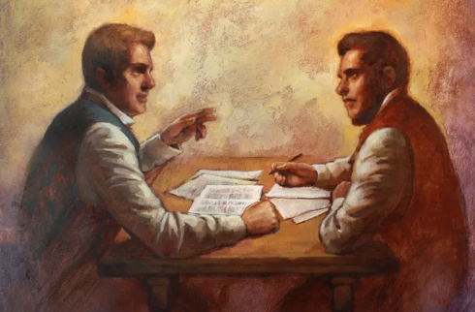
Revision
In the summer of 1830, the Prophet Joseph Smith began working on an inspired revision, or translation, of the King James Bible. He considered this project an important part of his calling as a prophet of God.
Soon after the Book of Mormon was published in 1830, the Lord directed Joseph Smith to begin a translation of the Bible.
Joseph Smith looked at original Hebrew and Greek writings to make a new English translation of the Bible.
The Lord revealed the books of Moses and Joseph Smith—Matthew in the Pearl of Great Price as part of the Joseph Smith Translation of the Bible.
The Lord revealed some of the doctrinal truths taught by The Church of Jesus Christ of Latter-day Saints to Joseph Smith as he translated the Bible.
The Lord has blessed your life through the Joseph Smith Translation.
Manual

Slide 4
Sidney Rigdon
He was born on February 19, 1793, near St. Clair, Pennsylvania
He was an accomplished orator, a Baptist minister, and later one of the founders of the Campbellite movement. He was a journeyman tanner
He was well versed in the Bible
At one point in time he had Parley P. Pratt in his audience, and later Parley P. Pratt introduced him to the Book of Mormon
He was baptized on November 14, 1830
He served as a scribe for Joseph Smith who was translating the inspired version of the Bible and participated in several revelations
He was a spokesman and defender for the cause of Zion
He suffered persecutions, even tarring and feathering, along with Joseph in 1832
Who’s Who

Slide 5
One Eternal Round
“God governs by law—wholly, completely, invaryingly, and always. He has ordained that identical results always flow from the same causes.
There is no respect of persons with him, and he is a Being ‘with whom is no variableness, neither shadow of turning.’ ([James] 1:17; D. & C. 3:1–2.)
Hence, the Lord’s ‘course is one eternal round, the same today as yesterday, and forever.’ (D. & C. 35:1.)” Bruce R. McConkie
D&C 35:1

Slide 6
Your Plan for Life
What does the Lord know about your plan for your life?
Priesthood Callings/Young Women Callings
Baptism/
Ordinations
Education/
Mission
Birth
Marriage
Jobs/Family
Death
The Lord knows us and has a work for each of us to do

Slide 7
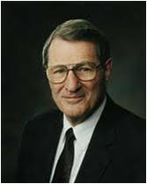
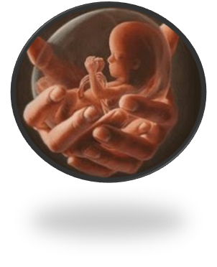
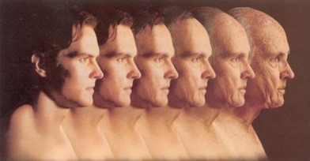
The Spirit of Truth
“I testify to you that God has known you individually … for a long, long time.
He has loved you for a long, long time. … He knows your names and all your heartaches and your joys!”
Neil A. Maxwell
“Ye were also in the beginning with the Father; that which is Spirit, even the Spirit of truth;”
D&C 93:23
Through the Joseph Smith Translation of the Bible, Jesus Christ revealed additional truths to help lead us to salvation.
D&C 35:1-2

Slide 8
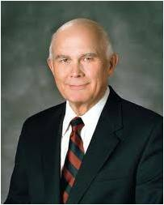
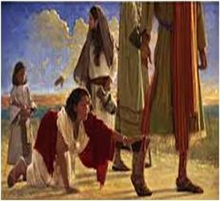
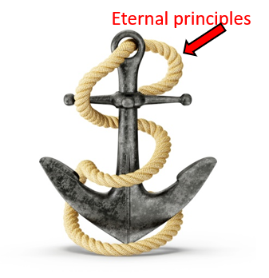
“Faith and trust in the Lord give us the strength to accept and persist, whatever happens in our lives. …
… Do not rely on planning every event of your life—even every important event. Stand ready to accept the Lord’s planning and the agency of others in matters that inevitably affect you.
Plan, of course, but fix your planning on personal commitments that will carry you through no matter what happens.
Anchor your life to eternal principles, and act upon those principles whatever the circumstances and whatever the actions of others.
Then you can await the Lord’s timing and be sure of the outcome in eternity.”
Dallin H. Oaks

Slide 9
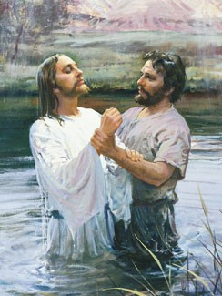
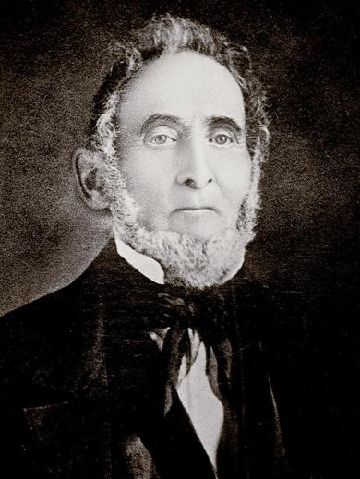
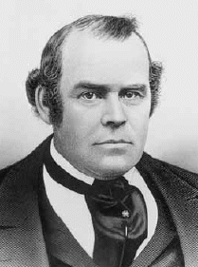
Forerunner
How did John the Baptist prepare the way for the coming of Jesus Christ?
Before Sidney Rigdon was introduced to the gospel he was prepared…He was very knowledgeable of the scriptures (Bible)…he had previously been engaged in preaching to congregations…
“…when I found he preached faith in Jesus Christ, repentance towards God, and baptism for remission of sins, with the promise of the gift of the Holy Ghost to all who would come forward, with all their hearts, and obey this doctrine!”
Parley P. Pratt
D&C 35:4-6

Slide 10
The Greater Work
Sidney Rigdon would help others receive baptism and the gift of the Holy Ghost through the proper authority.
“…At length Mr. Rigdon and many others became convinced that they had no authority to minister in the ordinances of God; and that they had not been legally baptized and ordained. They, therefore, came forward and were baptized by us, and received the gift of the Holy Ghost by laying on of hands, and prayer in the name of Jesus Christ.”
Parley P. Pratt
D&C 35:4-6

Slide 11
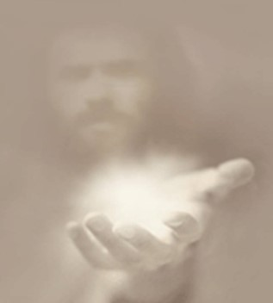
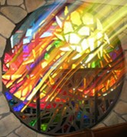
According to Our Faith
The Lord will work miracles, signs, and wonders according to the faith of those who believe on His name.
Miracles are not given as a foundation for faith, but to confirm the faith that has been built already upon the Word of God.
The promise is given that those who, in faith, ask for the gift of miracles shall cast out devils and heal the sick, but without faith no other miraculous manifestation shall be given than the desolation of Babylon.
Smith and Sjodahl
D&C 35:7-11

Slide 12
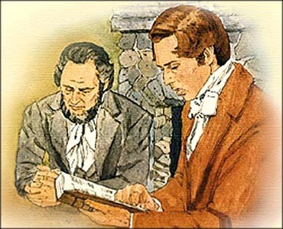
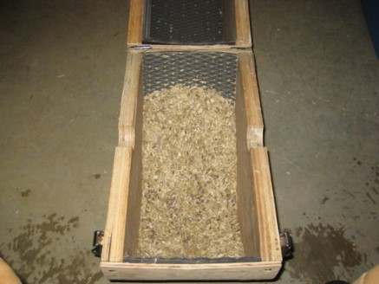
The Weak
Who does the Lord call to assist in His work?
In what ways could those whom the Lord calls to assist in His work be considered “the weak things of the world”?
God will use those who are humble (weak) and those who puts their trust in Him
Why might those whom the world considers weak be good candidates to help the Lord accomplish His work?
Threshing is the process by which a grain, such as wheat, is separated from its stalk and husk. The grain is kept, and the stalk and husk are discarded.
D&C 35:13

Slide 13
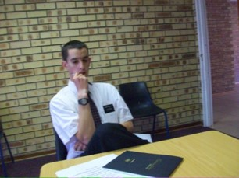
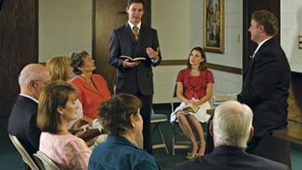
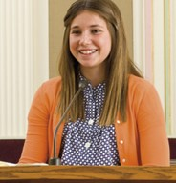
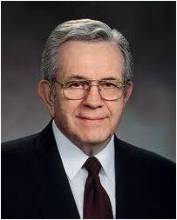
Our Weaknesses
How could this truth help someone who feels nervous about serving a mission?
How could it help someone who has been asked to teach at church but feels inadequate?
How could it help someone who feels prompted to share the gospel but isn’t sure what to say or do?
“The Church has no professional clergy. The call to leadership positions worldwide is drawn from the congregation. …
“Everything that is done in the Church—the leading, the teaching, the calling, the ordaining, the praying, the singing, the preparation of the sacrament, the counseling, and everything else—is done by ordinary members, the ‘weak things of the world’”
President Boyd K. Packer
D&C 35:13

Slide 14
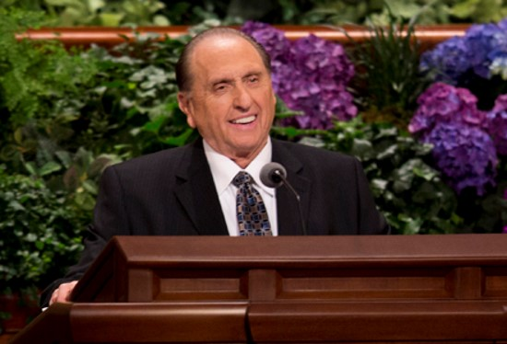
Gird Up Your Loins
“Some of you may be shy by nature or consider yourselves inadequate to respond affirmatively to a calling.
Remember that this work is not yours and mine alone.
It is the Lord’s work, and when we are on the Lord’s errand, we are entitled to the Lord’s help.
Remember that the Lord will shape the back to bear the burden placed upon it”
President Thomas S. Monson
D&C 35:13-14

Slide 15
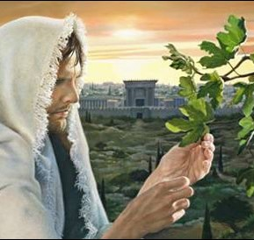
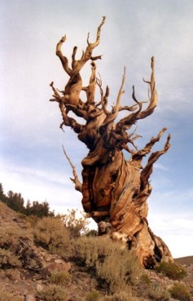
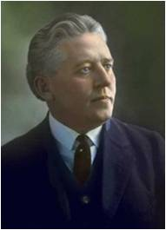
Parable of the Fig Tree
“When Jesus spoke to his disciples in answer to their query: ‘Show us when the end of the world shall come, and the time of thy coming’ [Matthew 24:3], he spoke of certain signs that would indicate the time of his coming, the very signs that the world, if they only had eyes to see, could be beholding today: Said he: judge the matter even as you would judge the coming of spring.
When you see the fig tree putting forth its leaf, ye know that summer is near, and so when you see these signs, you may know that the coming of the Son of man is nigh at hand.”
Melvin J. Ballard
Figs are one of the oldest cultivated crops, predating even the growing of wheat, and were enjoyed by the ancient Egyptians, Romans and Greeks.
D&C 35:16

Slide 16
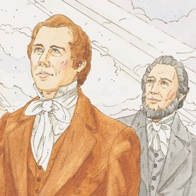
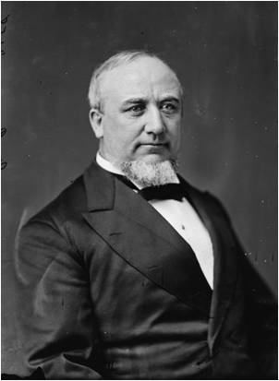
Counsel and Commandments
“Watch over him (Joseph Smith) that his faith fail not,” “tarry with him,” and “forsake him not.”
“To Sidney He gave a special command that he should write for Joseph.
The Lord made known to Sidney what Joseph already understood—that the Scriptures should be given, even as they were in God’s own bosom, to the salvation of His elect.
And soon after this time, Joseph began a new translation of the scriptures. While he labored, many truths, buried through scores of ages, were brought forth to his understanding, and he saw in their purity and holiness all the doings of God among His children, from the days of Adam unto the birth of our Lord and Savior.”
Elder George Q. Cannon
D&C 35:17-20

Slide 17
Revise and Restore
One of Sidney’s duties was to be a scribe for Joseph Smith. Joseph’s previous scribes, Oliver Cowdery and John Whitmer, had been called on missions.
The translation of the Book of Mormon was complete by this time, but the Lord had commanded Joseph to restore or revise portions of the King James Version of the Bible that had been lost or changed.
Joseph needed a scribe to assist with this work.
Bible Dictionary,
Joseph Smith Translation.
D&C 35:20-23

Slide 18
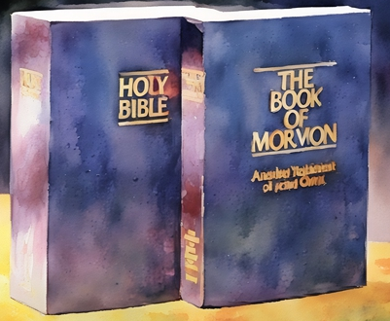
Plain and Precious
Wherefore, thou seest that after the book hath gone forth through the hands of the great and abominable church, that there are many plain and precious things taken away from the book, which is the book of the Lamb of God.
And after these plain and precious things were taken away it goeth forth unto all the nations of the Gentiles; and after it goeth forth unto all the nations of the Gentiles, yea, even across the many waters which thou hast seen with the Gentiles which have gone forth out of captivity, thou seest—because of the many plain and precious things which have been taken out of the book, which were plain unto the understanding of the children of men, according to the plainness which is in the Lamb of God—because of these things which are taken away out of the gospel of the Lamb, an exceedingly great many do stumble, yea, insomuch that Satan hath great power over them.
1 Nephi 13:28-29
The Book of the Lamb refers to the Lamb's Book of Life and Revelation, which contains a central message about Jesus Christ

Slide 19
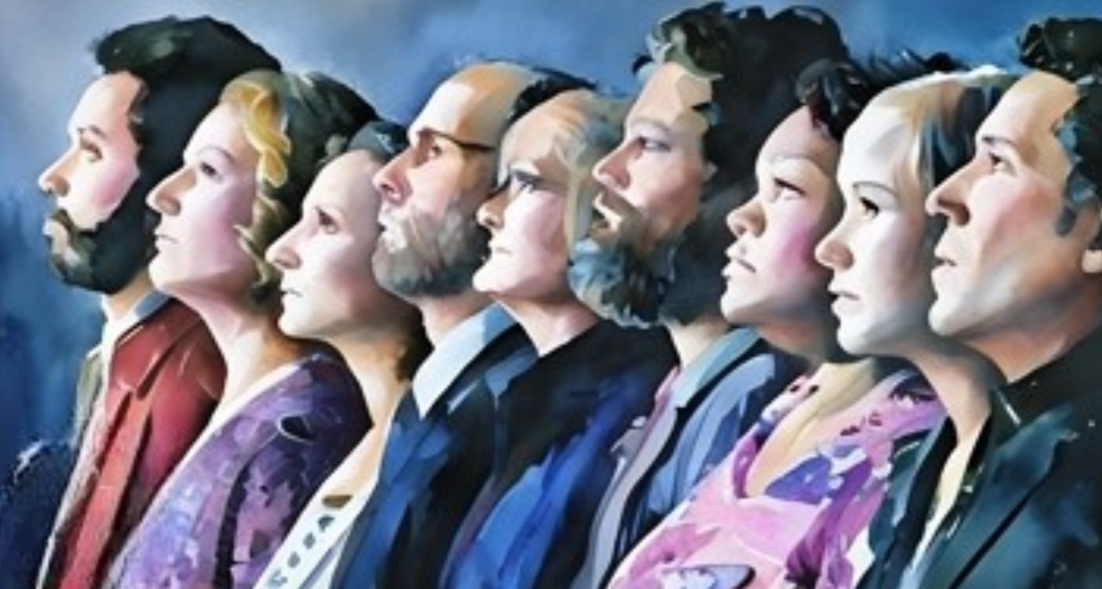
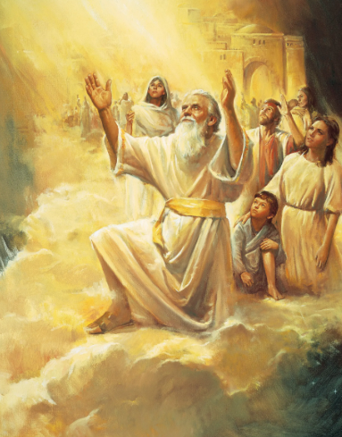
Revelations
The Lord’s revelations in the Joseph Smith Translation led to further revelations in the Doctrine and Covenants.
Enoch and establishing Zion
Moses 7:18-21
Questions about heaven and hell and the three degrees of glory
John 5:29; D&C 76
How to return to live with Jesus Christ and Heavenly Father
D&C 76:22-24, 50-53, 58-62
Instructions for the Saints to become a Zion people
D&C 38, 42, 45

Slide 20
More Sidney Rigdon
He served with Joseph Smith on missions to Canada and New York Stake and is mentioned 13 times in the introductory sections of the D&C
The Lord saw great promise in him as the forerunner of the Restoration
The revelation of the degrees was given to Joseph Smith and him jointly
He participated in the land of Zion and he is mentioned as a counselor to the Prophet
Because of pride he severed from the church on August 13, 1843 and moved to Pittsburg, but was later reinstated
Following the martyrdom of Joseph he returned to Nauvoo in response to a vision and claimed that he should be “guardian” over the Church
But the “mantel” fell to Brigham Young. In short, with Sidney’s disagreement he was excommunicated in 1844
He formed his own church called “The Rigdonites” in which followers soon left. He lived in Pennsylvania and New York and died in Friendship, New York on July 14, 1876
Who’s Who

Slide 21
Sources:
Videos:
Our True Identity (3:38)
The Lord Will Help Us (0:33)
Rise To Your Call (1:57
Bruce R. McConkie Mormon Doctrine, pp. 545–46.
Who’s Who in the Doctrine and Covenants by Ed J. Pinegar and Richard J. Allen pgs. 121-124
Neil A. Maxwell (“Remember How Merciful the Lord Hath Been,” Ensign or Liahona, May 2004, 46).
Dallin H. Oaks (“Timing,” Ensign, Oct. 2003, 17).
Presentation by ©http://fashionsbylynda.com/blog/
Parley P. Pratt Autobiography of Parley P. Pratt Chapter 5, 7
Hyrum M. Smith and Janne M. Sjodahl Doctrine and Covenants Commentary pg. 185
President Boyd K. Packer “The Weak and the Simple of the Church,” Ensign or Liahona, Nov. 2007, 6–7.
President Thomas S. Monson (“To Learn, to Do, to Be,” Ensign or Liahona, Nov. 2008, 62).
Melvin J. Ballard, in Conference Report, Oct. 1923, p. 32.)
Elder George Q. Cannon (Life of Joseph Smith, pp. 83–84.)
(See Bible Dictionary, “Joseph Smith Translation.”)
Presentation by ©http://fashionsbylynda.com/blog/

Slide 22
Forerunner Sidney Rigdon:
President Joseph Fielding Smith showed how Sidney Rigdon had been prepared long before the missionaries came to Ohio and met him: “The Lord told Sidney that he had looked upon him and his works, having reference to his ministry as a Baptist and later as one of the founders of the ‘Disciples’ with Alexander Campbell and Walter Scott. During those years the hand of the Lord was over him and directing him in the gathering of many earnest souls who could not accept the teachings of the sects of the day. His prayers in which he sought further light than the world was able to give, were now to be answered. The Lord informed him that he had been sent to prepare the way, and in the gathering of his colony and the building up of his congregation in and around Kirtland, the hand of the Lord was directing him, and the way for the reception of the fulness of truth was being prepared. It should be carefully noted that a great number of forceful, intelligent men who became leaders in the Church had been gathered by Sidney Rigdon, with the help of the Lord, in this part of the land. Without any question, the Spirit of the Lord had rested upon these men, as it did on Sidney Rigdon and Parley P. Pratt, to direct them to gather in Kirtland at that early day. When, therefore, Parley P. Pratt, Ziba Peterson and their companions came to Kirtland they found the way prepared for them through the preaching, very largely, of Sidney Rigdon, so that it was not a difficult matter for these missionaries to convince this group of the truth. While Sidney was preaching and baptizing by immersion without authority, which the Lord informed him in this revelation, yet it all resulted in good when the Gospel message reached them. These men were not only convinced and ready for baptism, but were in a condition by which the Priesthood could be given them, and this was done.” (Church History and Modern Revelation, 1:160.)
Feeling Inadequate: D&C 35:13
Elder Joseph B. Wirthlin of the Quorum of the Twelve Apostles offered the following encouragement to those who feel too inadequate or weary to assist in the Lord’s work:
“For you members of the Church who hold back because of feelings of inadequacy, I plead with you to step forward, put your shoulder to the wheel, and push. Even when you feel that your strength can add little, the Church needs you. The Lord needs you. Remember that the Lord often chooses ‘the weak things of the world’ to accomplish His purposes. [D&C 1:19.]
“To all who are weary, let the comforting words of the Savior console you: ‘Come unto me, all ye that labour and are heavy laden, and I will give you rest.’ [Matthew 11:28.] Let us rely on that promise. The power of God can infuse our spirits and bodies with energy and vigor. I urge you to seek this blessing from the Lord.
“Draw near to Him, and He will draw near to you, for He has promised that ‘they that wait upon the Lord shall renew their strength; they shall mount up with wings as eagles; they shall run, and not be weary; and they shall walk, and not faint.’ [Isaiah 40:31.] …
“Remember, sometimes those who start out the slowest end up going the farthest” (“Concern for the One” Ensign or Liahona, May 2008, 19).
The salt sermon was an oration delivered on June 17, 1838 by Mormon leader, Sidney Rigdon, against Mormon dissenters. Rigdon was First Counselor in the First Presidency of the Church of Jesus Christ of Latter Day Saints, and often acted as spokesman for Joseph Smith, Jr.. The dissenters included Book of Mormon witnesses Oliver Cowdery, David Whitmer, and John Whitmer, and other leaders including William Wines Phelps.
According to Rigdon, the dissenters were like the "salt" spoken of by Jesus in the Gospel of Matthew (part of the metaphors of Salt and Light in the Sermon on the Mount): "If the salt have lost its savor, wherewith shall it be salted? It is thenceforth good for nothing, but to be cast out, and to be trodden under foot of men." Two days after Rigdon preached the Salt Sermon, eighty Latter-day Saints signed a statement (the so-called Danite Manifesto) warning the dissenters to "depart, or a more fatal calamity shall befall you."
The dissenters and their families interpreted these words as threats, and they quickly left Caldwell County, Missouri. Their stories helped stir up anti-Mormon feeling in northwestern Missouri and contributed to the outbreak of the 1838 Mormon War.
The Salt Sermon is often confused with Rigdon's July 4th Oration.
Wikipedia
“About this time one Mr. Sidney Rigdon came into the neighborhood as a preacher, and it was rumored that he was a kind of Reformed Baptist, who, with Mr. Alexander Campbell, of Virginia, a Mr. Scott, and some other gifted men, had dissented from the regular Baptists, from whom they differed much in doctrine. At length I went to hear him, and what was my astonishment when I found he preached faith in Jesus Christ, repentance towards God, and baptism for remission of sins, with the promise of the gift of the Holy Ghost to all who would come forward, with all their hearts, and obey this doctrine!”
Autobiography of Parley P. Pratt
(1807-1857) Chapter 5

Slide 23
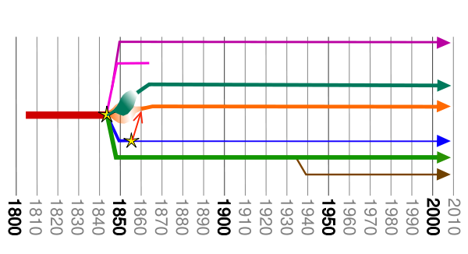
Main Branches of Latter-day Saints Movement Main branches of the Latter-Day Saint movement
The Latter-Day Saint movement- William Bickerton
Sidney Rigdon “Rigdonites”
Granville Hedrick: Church of Christ (Temple Lot)
Joseph Smith III community of Christ
James Strang: Church of Jesus Christ of Latter Day Saints
The Church of Jesus Christ of Latter-day Saints—Brigham Young
Fundamentalist Church of Jesus Christ of Latter-Day Saints
Name | Organized by | Date | Split off / Continuation of | Current status | Notes
Church of Jesus Christ of the Children of Zion | Sidney Rigdon | 1844 | Church of Jesus Christ of Latter Day Saints | Dissolved by 1847 | Originally also used the name "Church of Christ". Also known as Rigdonites.
The Church of Jesus Christ (Bickertonite) | William Bickerton | 1862 | Organized by former members of the Church of Jesus Christ of the Children of Zion (Rigdonites), by then defunct | 12,136 as of 2007; headquarted in Monongahela, Pennsylvania | Adherents commonly referred to as Bickertonites (church actively opposes use of this term).
Reorganized Church of Jesus Christ (Bickertonite) | Half of the Bickertonite Quorum of Twelve Apostles | 1907 | Church of Jesus Christ (Bickertonite) | Defunct | Dispute over nature of life in the millennium split Bickertonite Quorum of the Twelve in two; later merged with the Primitive Church of Jesus Christ (Bickertonite)
Primitive Church of Jesus Christ (Bickertonite) | James Caldwell | 1914 | Church of Jesus Christ (Bickertonite) | Defunct | Rejected the First Presidency as a valid leadership organization of the church; later merged with theReorganized Church of Jesus Christ (Bickertonites).
Churches tracing their leadership through Rigdon
More:
http://sidneyrigdon.com/RigHist/RigHist2.htm

Slide 24
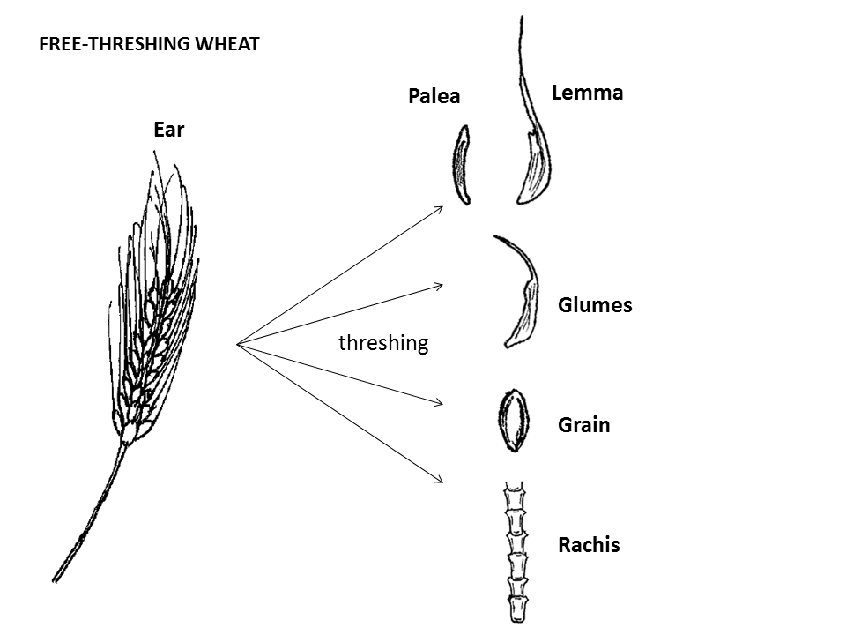
More interesting stuff…
When the harvested crops are threshed, hulled wheat grains remain encased in their tightly adhering spikelets, whereas the grains of free-threshing wheat fall free from the chaff immediately upon threshing.

