Slide 1

Doctrine and Covenants 36-37
The First Bishop
Presentation by ©http://fashionsbylynda.com/blog/

Slide 2
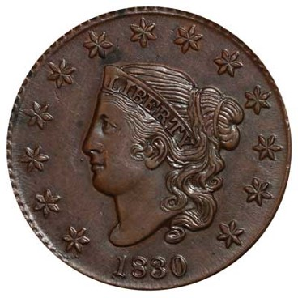
Background
1830
On December 9, 1830, two days before Edward Partridge was baptized, the Lord gave him a revelation through the Prophet Joseph Smith.
In this revelation, which is now recorded in Doctrine and Covenants 36, the Lord forgave Edward Partridge of his sins and called him to preach the gospel.
The Lord also issued a commandment for all priesthood holders to preach the gospel.

Slide 3
Edward Partridge
He was born on August 27, 1793, at Pittsfield, Massachusetts, grandson of Massachusetts Congressman Oliver Partridge
He owned a hat-making factory in Painesville, Ohio
His wife, Lydia, was baptized by the missionaries before Edward embraced the restored gospel, but was fully persuaded when he and Sidney Rigdon visited the Prophet in 1830
He was baptized on December 11, 1830, by Joseph Smith
He was called by revelation in February of 1831 to become the first bishop
He was instructed in May 1831 to serve the stewardship and housing needs of the Saints moving to Kirtland, Ohio
He was persecuted and imprisoned in Missouri
He passed away on May 27, 1840, at the age of 46 in Nauvoo
Who’s Who

Slide 4
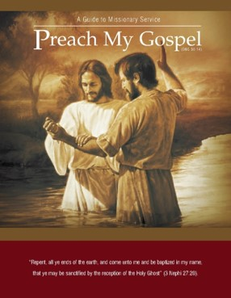
What Do You Need?
The
Book
of
Mormon
ANOTHER TESTAMENT
OF JESUS CHRIST

Slide 5
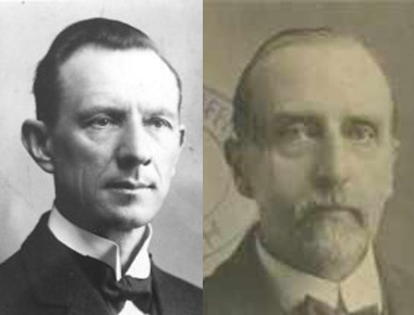
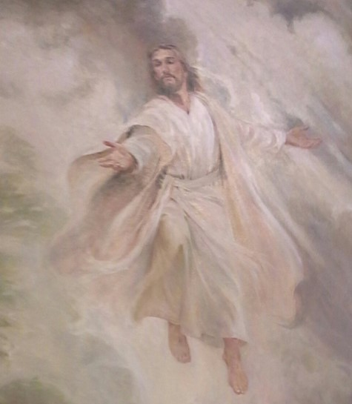
Mighty One of Israel
“Therefore saith the Lord, the Lord of hosts, the mighty One of Israel,”
Isaiah 1:24
It means Jehovah, the Lord of Hosts, who led His people out of Egypt, with a strong arm.
While the ‘mighty one’ of Assyria was a winged bull, and while earthly kingdoms adopt images of eagles, lions, etc., as emblems of strength, the ‘Mighty One’ of the Kingdom of God is Jehovah.”
Smith and Sjodahl
D&C 36:1

Slide 6
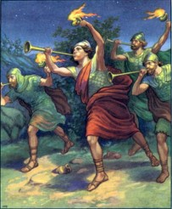
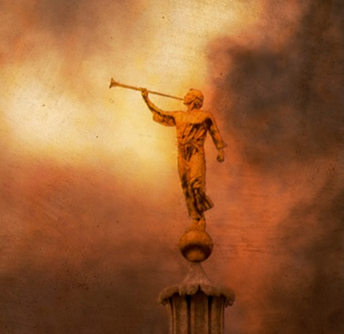
Voice of a Trump
Trumpets were used anciently to sound an alarm, to signal for battle, or to announce the coming of royalty.
The sounding of trumpets, therefore, symbolizes heralding or announcing something highly significant.
The sound of a trumpet is loud and clear and draws the attention of those within its range.
Edward Partridge was called to preach in that manner—not quietly or timidly, but boldly, with clarity and authority.
D&C 36:1

Slide 7
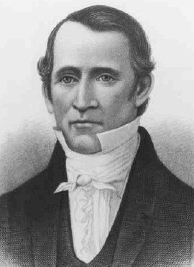
Laying on of Hands
Edward Partridge, who had just been baptized, was promised in this verse the gift of the Holy Ghost, which is given by the laying on of hands.
He was also called into the ministry.
The spirit and authority to fill such calls is similarly given by the laying on of hands.
D&C 36:2

Slide 8
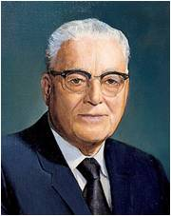
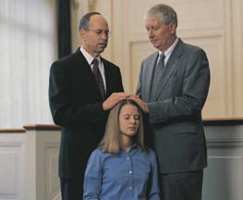
“The Lord here is saying that when one of his authorized servants puts his hands by authority upon the head of one to be blessed, it is as though he himself was putting his hand on with them to perform that ordinance.
So we begin to see how he manifests his power among men through his servants to whom He has committed the keys of authority.”
Elder Harold B. Lee
D&C 36:2

Slide 9
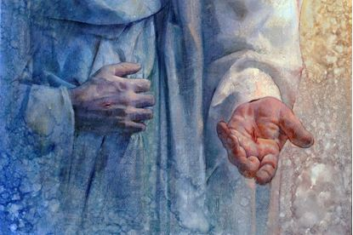
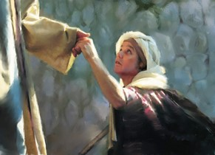
Peaceable Things of the Kingdom
Jesus gives the gift of peace.
Not the peace of the world –the inner peace that comes from the knowledge that one has found the truth, has had his sins remitted, and is on the path that leads to eternal life.
Youngsung Kim
“Peace I leave with you, my peace I give unto you: not as the world giveth, give I unto you. Let not your heart be troubled, neither let it be afraid.”
John 14:27
D&C 36:2

Slide 10
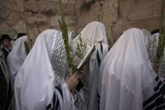

Hosanna
A word from Hebrew that means “please save us” and is used in praise and supplication.
At the Feast of Tabernacles, which celebrated the Lord’s deliverance of Israel into the promised land, people chanted the words of Psalm 118 and waved palm branches. At the Lord’s triumphal entry into Jerusalem, the multitudes cried “Hosanna” and spread palm branches for Jesus to ride upon, thus demonstrating their understanding that Jesus was the same Lord who had delivered Israel anciently
(Ps. 118:25–26; Matt. 21:9, 15; Mark 11:9–10; John 12:13).
These people recognized Christ as the
long-awaited Messiah.
The word Hosanna has become a celebration
of the Messiah in all ages
(1 Ne. 11:6; 3 Ne. 11:14–17).
Guide to Scriptures
D&C 36:3

Slide 11
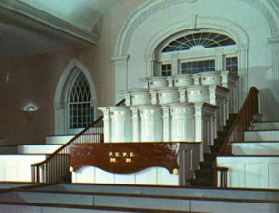

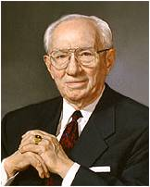
Hosanna Shout
The hosanna shout was included in the
dedication of the Kirtland Temple (D&C 109:79) and is now a part of the dedication of modern temples.
“I will now demonstrate the shout. Each one takes a clean white handkerchief, holding it by one corner, and waves it while saying in unison, “Hosanna, Hosanna, Hosanna to God and the Lamb,” repeated three times, followed by “Amen, Amen, and Amen.”
President Gordon B. Hinckley
D&C 36:3

Slide 12
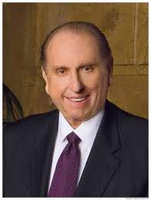

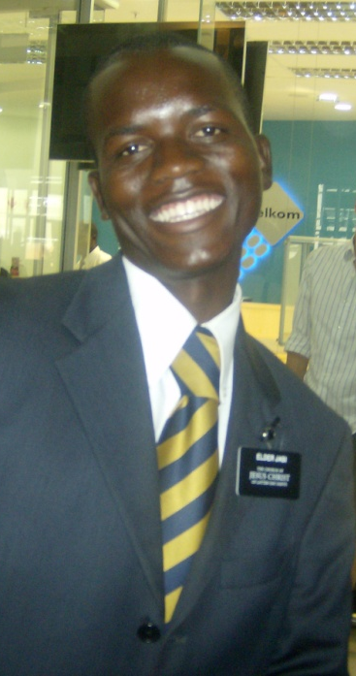

Priesthood Holders—Called to Preach
“I repeat what prophets have long taught—that every worthy, able young man should prepare to serve a mission. Missionary service is a priesthood duty—an obligation the Lord expects of us who have been given so very much.”
President Thomas S. Monson
What do priesthood holders need to do before they are ordained and sent forth to preach the gospel?
How can a young man show the Lord that he embraces the commandment to preach the gospel?
Who do you know who has embraced the commandment to preach the gospel?
D&C 36:4-8

Slide 13
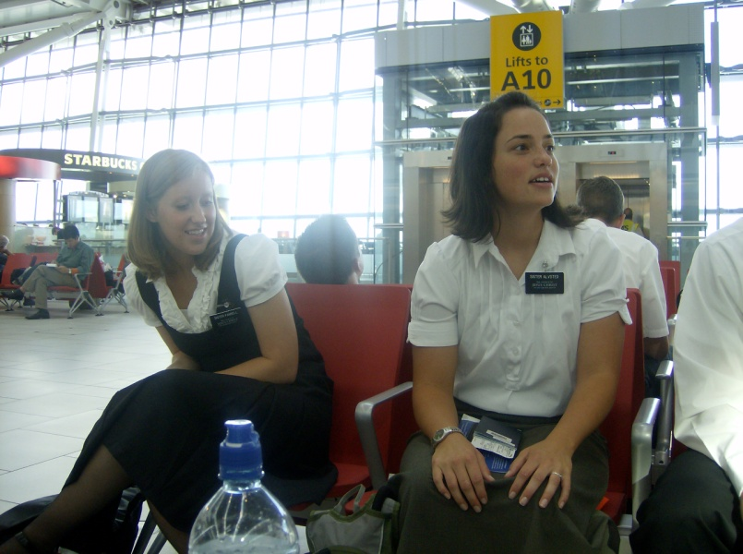
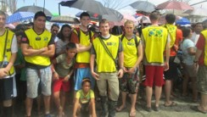
Sister Missionaries
“A word to you young sisters: while you do not have the same priesthood responsibility as do the young men to serve as full-time missionaries, you also make a valuable contribution as missionaries, and we welcome your service”
President Thomas S. Monson
How can you “embrace” calling with “singleness of heart”
Being committed to his calling
Serving with sincerity and integrity.
D&C 36:4-8

Slide 14
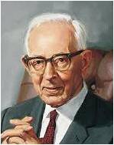

Untoward Generation
Referring to people in the days following the Savior’s Death
“And with many other words did he testify and exhort, saying, Save yourselves from this untoward generation.”
Acts 2:40
An untoward people is an unruly, rebellious people whose lives are not turned toward the Lord.
President Joseph Fielding Smith, in reference to those of the latter days said, “This is an untoward generation, walking in spiritual darkness.”
(Church History and Modern Revelation, 1:163).
D&C 36:6

Slide 15
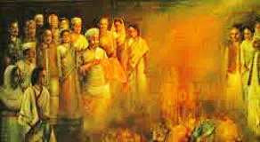

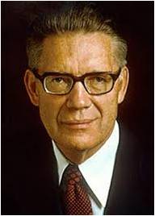
Come Forth Out of the Fire
“And others save with fear, pulling them out of the fire; hating even the garment spotted by the flesh.”
Jude 1:23
“To stay the spread of disease in ancient Israel, clothing spotted by contagious diseases was destroyed by burning. (Lev. 13:47–59; 15:4–17.)
And so with sin in the Church, the saints are to avoid the remotest contact with it; the very garments, as it were, of the sinners are to be burned with fire, meaning that anything which has had contact with the pollutions of the wicked must be shunned.
And so also with those yet in the world who are invited to join the kingdom.”
Bruce R. McConkie
D&C 36:6

Slide 16
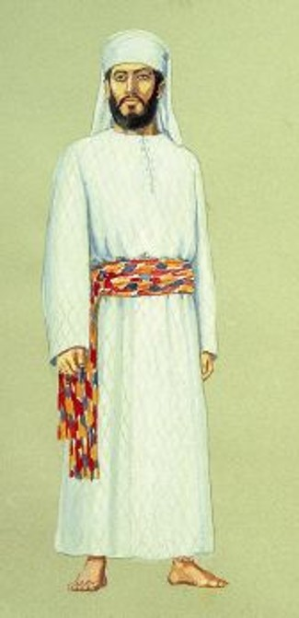
Gird Up Your Loins
In Biblical language, to ‘gird up the loins’ is to prepare for a journey, or for work.
The Hebrews wore girdles [sashes] when traveling, and when at work.
On such occasions they girt their clothes about them [by tucking them under the sash] to ensure free movement of the limbs.
The servants of the Lord must be prepared to do His work, and to go when He calls.”
Smith and Sjodahl
D&C 36:6

Slide 17
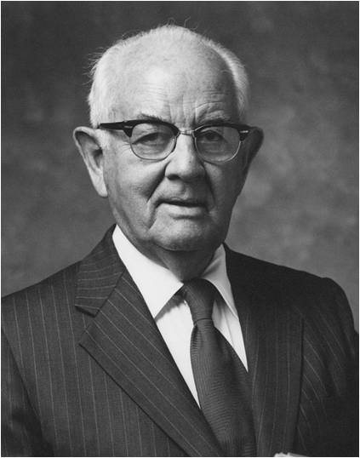
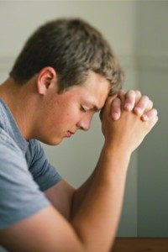

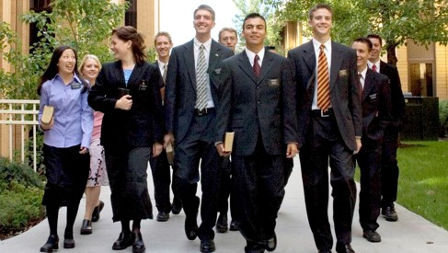
Gird Up Your Loins--Today
“I feel that when we have done all in our power that the Lord will find a way to open doors. …
“But I can see no good reason why the Lord would open doors that we are not prepared to enter. …
“When I ask for more missionaries, I am not asking for more testimony-barren or unworthy missionaries. I am asking that we start earlier and train our missionaries better in every branch and every ward in the world. That is another challenge—that the young people will understand that it is a great privilege to go on a mission and that they must be physically well, mentally well, spiritually well, and that ‘the Lord cannot look upon sin with the least degree of allowance.’
“I am asking for missionaries who have been carefully indoctrinated and trained through the family and the organizations of the Church, and who come to the mission with a great desire.”
President Spencer W. Kimball
D&C 36:6

Slide 18
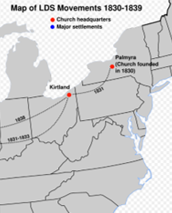
Background
1830—about 200 members
Shortly after receiving Doctrine and Covenants 36, Joseph Smith received the revelation contained in Doctrine and Covenants 37, in which the Lord commanded the Saints to leave New York and gather to Ohio.
Missionary efforts had been extended westward to Kirtland, Ohio, and to the borders of Missouri

Slide 19
Missionary Efforts
By the time of this revelation (section 37), such notable leaders as Parley P. Pratt, Orson Pratt, Sidney Rigdon, Thomas B. Marsh , and Edward Partridge had joined the Church. Revelations had poured down from heaven as the Prophet Joseph Smith received guidance for individual Saints, direction in revising the Bible, and the records of Moses and Enoch.
ת

Slide 20
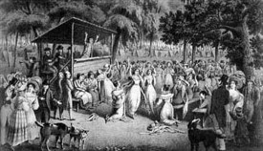
And Persecutions
... But Satan’s efforts were unrelenting. Persecution raged, and the Prophet was arrested a number of times on false charges. Now, in December 1830, the voice of the Lord was heard again. But this time the Lord’s will was that Joseph cease revising the Bible and move to Ohio.
Section 37 is the first revelation directing the Saints to gather to a central place. In it the Lord charted a westward course for the restored Church.

Slide 21

Not…Translate Any More
The Prophet Joseph had, of course, finished the translation of the Book of Mormon. But though his work on the Bible was very important, the need to move to Ohio “because of the enemy” took priority.
The work on the revision of the Bible was continued later in Ohio, mainly at the home of John Johnson.
D&C 37:1

Slide 22
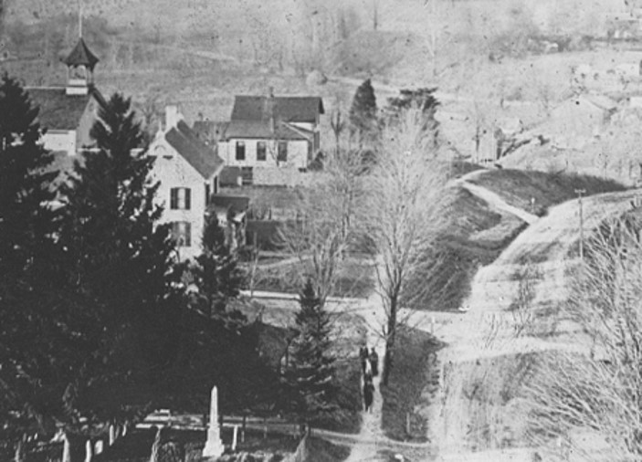
Colesville
“The call to the Ohio was for two reasons. The opposition to the Church in and around Fayette had become bitter. There had been many converts made among the followers of Sidney Rigdon in Kirtland, and the spirit there was friendly.
The trend of the Church was ever westward; as persecution arose, and it became necessary to seek protection, the Church moved farther and farther west. The Lord had a design in this.
The place of the City of Zion was west and
it was necessary that eventually the Church
be located there, although it would not be
a permanent residence until Zion is
redeemed.
Not only were Joseph Smith and Sidney
Rigdon commanded to go to Ohio, but
this came as a command to the entire
Church.”
Joseph Fielding Smith

Slide 23
Assemble in Ohio
Oliver Cowdery had been on a mission to the Lamanites since 15 October 1830
This mission took him and his companions on a fourteen-hundred-mile journey through New York and Ohio to Missouri.
The Saints were commanded to move to Ohio in preparation to receive further instructions concerning the establishment of Zion after Oliver Cowdery’s return from “the borders by the Lamanites”
This move to Ohio was in preparation to receive further instructions concerning the establishment of Zion.
Ultimately, Oliver Cowdery did not return, but he sent Parley P. Pratt in his stead.
Student Manual
D&C 37:3

Slide 24
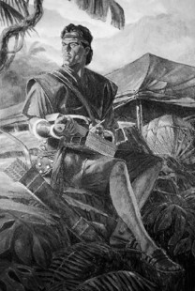
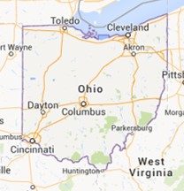
Escaping the Enemy
“But behold, their anger did increase against me, insomuch that they did seek to take away my life…. And it came to pass that the Lord did warn me, that I, Nephi, should depart from them and flee into the wilderness, and all those who would go with me.”
2 Nephi 5:2,5
“Wherefore, for this cause I gave unto you the commandment that ye should go to the Ohio; and there I will give unto you my law; and there you shall be endowed with power from on high;”
D&C 38:32

Slide 25

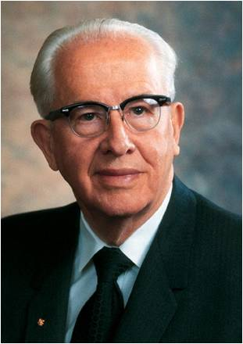
How Can You Escape Your Enemies?
“There may come persecution: there may come opposition;…Your motives may be attacked. But if we place our trust in the Almighty and do that which is right, there will come an inner assurance, an inner calm, a peace that will bring joy and happiness to our souls.”
Ezra Taft Benson

Slide 26

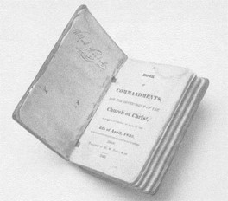
The Last Revelation
Section 37 is the last revelation given to Joseph Smith in 1830
“Behold, here is wisdom, and let every man choose for himself until I come. Even so. Amen.”
D&C 37:4

Slide 27
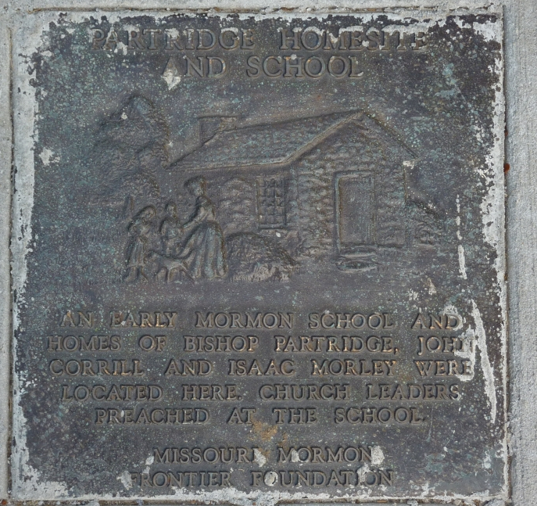
Sources:
Videos:
Stay within the Lines (5:09)
A Priesthood Duty (2:01
Hyrum M. Smith and Janne M. Sjodahl, Doctrine and Covenants Commentary pg. 191, 201
Elder Harold B. Lee (Be Secure in the Gospel of Jesus Christ, Brigham Young University Speeches of the Year [Provo, 11 Feb. 1958], p. 6.)
President Gordon B. Hinckley This Great Millennial Year Oct. 2000 Gen. Conf
President Thomas S. Monson Ensign or Liahona, Nov. 2010, 5–6).
President Thomas S. Monson (“As We Meet Together Again,” 6).
Bruce R. McConkie (Doctrinal New Testament Commentary, 3:428.)
President Spencer W. Kimball (“When the World Will Be Converted,” Ensign, Oct. 1974, p. 7.)
Joseph Fielding Smith (Church History and Modern Revelation, 1:163.)
(See also Doctrine and Covenants Student Manual, 2nd ed. [Church Educational System manual, 2001], 74.)
Presentation by ©http://fashionsbylynda.com/blog/
Ezra Taft Benson CR April 1954
Presentation by ©http://fashionsbylynda.com/blog/

Slide 28
Elder Jeffrey R. Holland: D&C 36:1
“In this battle between good and evil, you cannot play for the adversary whenever temptation comes along and then expect to suit up for the Savior at temple and mission time as if nothing has happened. … God will not be mocked. …
“… The Lord has drawn lines of worthiness for those called to labor with Him in this work. No missionary can be unrepentant of sexual transgression or profane language or pornographic indulgence and then expect to challenge others to repent of those very things! … The Spirit will not be with you, and the words will choke in your throat as you speak them. You cannot travel down what Lehi called ‘forbidden paths’ [1 Nephi 8:28] and expect to guide others to the ‘strait and narrow’ [2 Nephi 31:18] one—it can’t be done” (“We Are All Enlisted,” Ensign or Liahona, Nov. 2011, 45).
“Whoever you are and whatever you have done, you can be forgiven. Every one of you … can leave behind any transgression with which you may struggle. It is the miracle of forgiveness; it is the miracle of the Atonement of the Lord Jesus Christ. But you cannot do it without an active commitment to the gospel, and you cannot do it without repentance where it is needed. I am asking you … to be active and be clean. If required, I am asking you to get active and get clean” (“We Are All Enlisted,” 45).
At the Feast of Tabernacles, which celebrated the Lord’s deliverance of Israel into the promised land, people chanted the words of Psalm 118 and waved palm branches. At the Lord’s triumphal entry into Jerusalem, the multitudes cried “Hosanna” and spread palm branches for Jesus to ride upon, thus demonstrating their understanding that Jesus was the same Lord who had delivered Israel anciently (Ps. 118:25–26; Matt. 21:9, 15; Mark 11:9–10; John 12:13). These people recognized Christ as the long-awaited Messiah. The word Hosanna has become a celebration of the Messiah in all ages (1 Ne. 11:6; 3 Ne. 11:14–17). The hosanna shout was included in the dedication of the Kirtland Temple (D&C 109:79) and is now a part of the dedication of modern temples.
Women Missionaries:
President Ezra Taft Benson said:
“Remember, young women, you may also have the opportunity to serve a full-time mission. … Some of our finest missionaries are young sisters” (“To the Young Women of the Church,” Ensign, Nov. 1986, 83).
President Gordon B. Hinckley taught:
“We need some young women. They perform a remarkable work. They can get in homes where the elders cannot.
“… The First Presidency and the Council of the Twelve are united in saying to our young sisters that they are not under obligation to go on missions. I hope I can say what I have to say in a way that will not be offensive to anyone. Young women should not feel that they have a duty comparable to that of young men. Some of them will very much wish to go. If so, they should counsel with their bishop as well as their parents” (“Some Thoughts on Temples, Retention of Converts, and Missionary Service,” Ensign, Nov. 1997, 52).
For a view of the members who were baptized before Sept. 1830 visit this site:
http://mormonhistoricsites.org/wp-content/uploads/2013/05/NJ1_Platt4.pdf

