Slide 1
Doctrine and Covenants 37-38:1-16
Gathering to Ohio
“And God said unto Moses, I AM THA I AM: and he said, Thus shalt thou say unto the children of Israel, I AM hath sent me unto you.”
Exodus 3:14
Presentation by ©http://fashionsbylynda.com/blog/

Slide 2
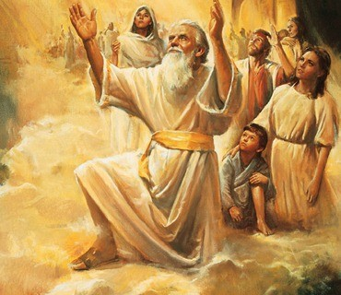
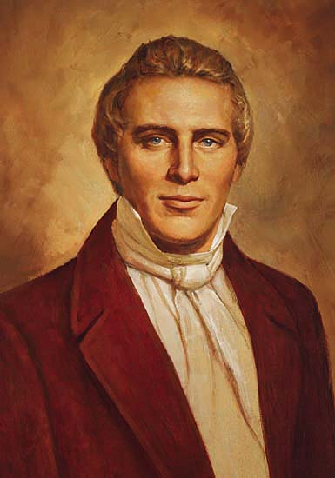
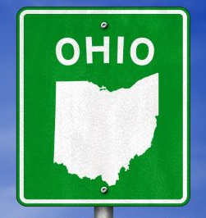
Background
1831
Members of The Church of Jesus Christ of Latter-day Saints gather together in many ways. The first instance for Church members to gather in one body came when the Lord commanded His people to gather “to the Ohio” (D&C 37)
During the month of December 1830, Joseph Smith received by revelation the remainder of the book of Moses, specifically with the establishment of Zion in Enoch’s day. (Moses 6-7)
In January 1831 the Saints received instructions from the Lord before Zion could be built. He gave His law and order of Zion.
Then Section 38 was revealed during the third conference and why he moved the Saints to Ohio.
Church members in New York and other areas made great sacrifices to gather in Ohio.

Slide 3
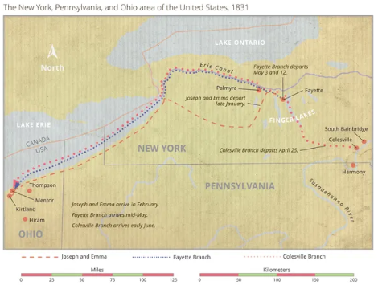
The Lord gathers His people to protect them and to strengthen them spiritually.

Slide 4
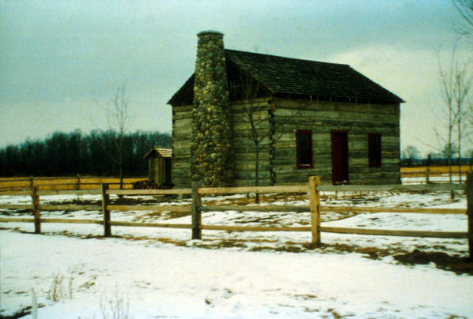
Meeting at Home of Peter Whitmer Sr.
January 2, 1831
Why do you think it might have been difficult for some of the Saints to obey the commandment to leave New York and gather to Ohio?
Not everyone at the conference understood the wisdom of this commandment.
Some would not accept it as the word of the Lord, and others were reluctant to leave their prosperous farms and comfortable circumstances for the uncertainties of a new place.
There was a real possibility that many would lose money on their property and that some might even be unable to sell their property.

Slide 5
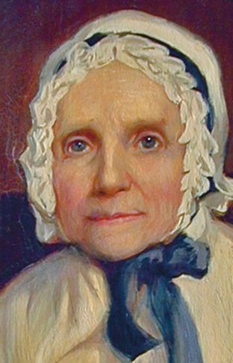
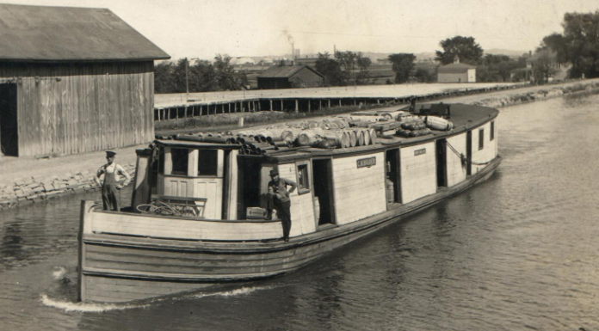
The Fayette Branch
Lucy Mack Smith led the Fayette Branch. They traveled by boat along the Erie Canal and across Lake Erie. When they arrived at the lake, thick ice in the harbor prevented their progress. The discouraged Saints were cold and hungry, and they began to argue. Lucy cried out to them:
“Where is your faith? Where is your confidence in God?
If you will all of you raise your desires to heaven, that the ice may be broken up and we be set at liberty, as sure as the Lord lives, it will be done.”
Immediately Lucy heard a thunderous noise. The ice in the harbor was broken up enough to enable their boat to pass through. The grateful Saints came together in prayer. They traveled safely to Kirtland, Ohio.
Saints, 1:121–23

Slide 6
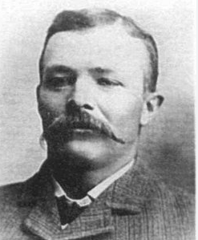
The Colesville Branch
Newel Knight led the Colesville Branch. While Newel was away, his aunt Electa Peck fell and broke her shoulder.
A surgeon tried to relieve her pain and said it would be a miracle if she could travel within a few weeks.
Electa dreamed that Newel returned and laid his hands on her and that she was made whole. When Newel returned, he heard what had happened to his aunt and went to see her.
She requested that he bless her. Newel approached the bed, rebuked the pain in the name of Jesus Christ, and commanded Electa to be made whole.
The next morning Electa arose, got dressed, and continued the journey.
Newel Knight, The Rise of the Latter-day Saints: The Journals and Histories of Newel Knight, ed. Michael Hubbard MacKay and William G. Hartley [2019], 32–33

Slide 7
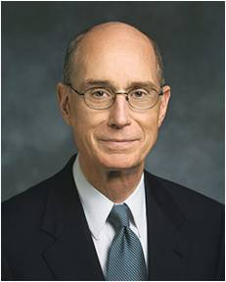
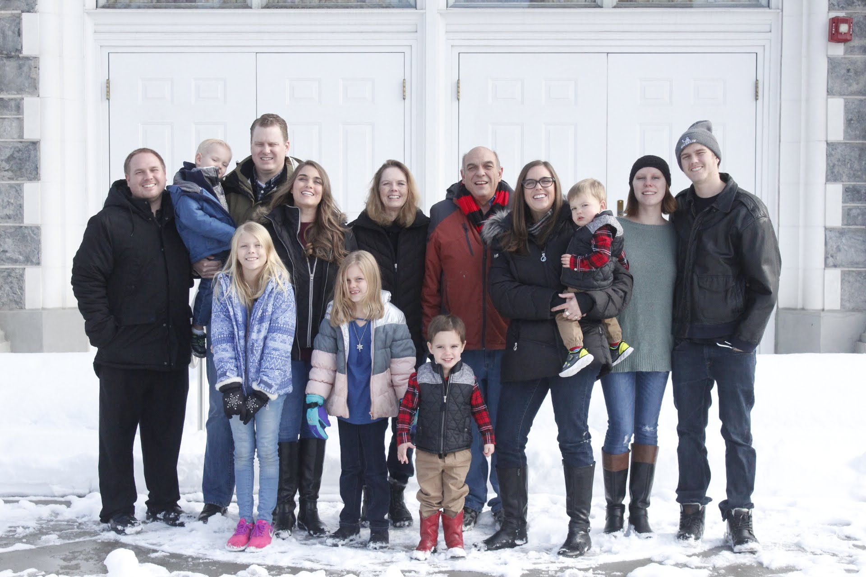
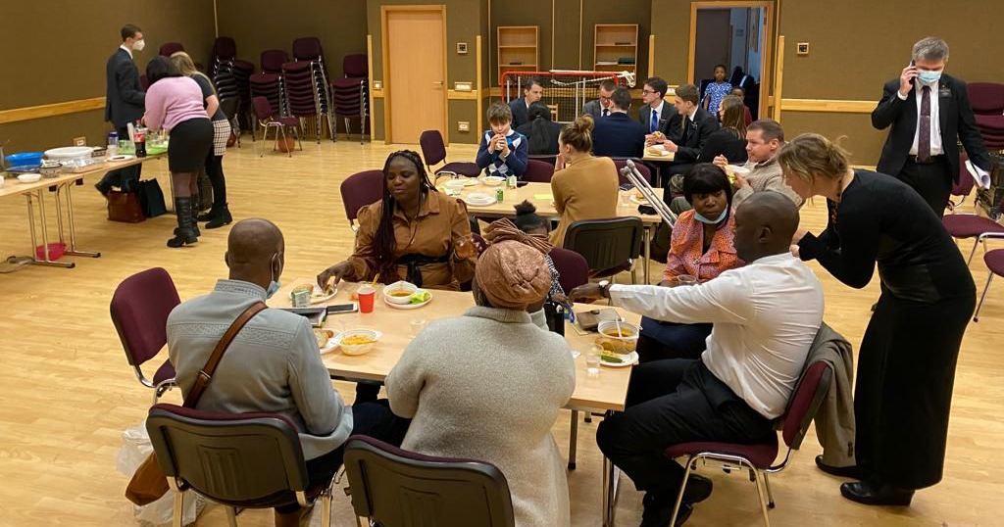
Commanded to Gather
We know from experience that joy comes when we are blessed with unity. … [Our Heavenly Father’s] desire is to grant us that sacred wish for unity out of His love for us.
He cannot grant it to us as individuals. The joy of unity He wants so much to give us is not solitary. We must seek it and qualify for it with others. It is not surprising then that God urges us to gather so that He can bless us.
He wants us to gather into families. He has established classes, wards, and branches and commanded us to meet together often. In those gatherings, which God has designed for us, lies our great opportunity.
We can pray and work for the unity that will bring us joy and multiply our power to serve.
Henry B. Eyring

Slide 8
Doctrine and Covenants 38:1-16

Slide 9
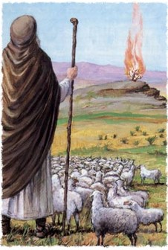
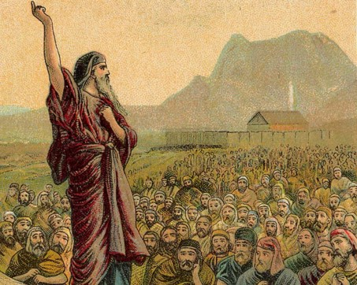
I Am—He is in Their Midst
“When Moses was tending the flocks of his father-in-law, Jethro, at Horeb, the mountain of God, the Lord appeared to him in a flaming bush and gave him commandment to go to Egypt and lead Israel from bondage.
Moses said to the Lord: ‘Behold, when I come unto the children of Israel, and shall say unto them, The God of our Fathers hath sent me unto you; and they shall say to me, What is his name? what shall I say unto them?
And God said unto Moses, I am that I am; and he said, Thus shalt thou say unto the children of Israel, I Am hath sent me unto you.’ …
D&C 38:1-3

Slide 10
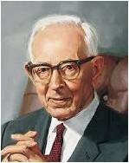
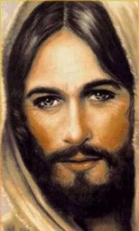
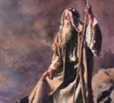
I Am—Omnipotent, Omnipresent, Omniscient
“The name given to Moses is the same as given by Jesus Christ to the Jews and the meaning of it is expressed in the saying that God is ‘omnipotent, omnipresent, and omniscient; without beginning of days or end of life; and that in Him every good gift and every good principle dwell.’
Jesus declared to the Jews that which they were incapable of understanding, which is that the great I Am who appeared to Moses, was himself, and that he was God and gave commandments to Abraham.”
Joseph Fielding Smith
“Jesus said unto them, Verily, verily, I say unto you, Before Abraham was, I am.”
John 8:58
Omnipotent--unlimited power
Omnipresent--present everywhere at the same time
Omniscient--knowing everything.
D&C 38:1-3

Slide 11
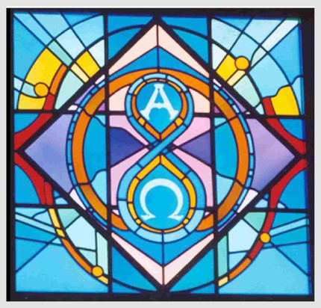
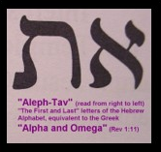
Alpha and Omega
Alpha and omega are the first and last letters of the Greek alphabet, which was used widely at the time of Christ’s mortal ministry.
The expression “Alpha and Omega” is thus the equivalent of the English expression “from A to Z.”
These words, the first and last letters of the Greek alphabet, are used figuratively to teach the timelessness and eternal nature of our Lord’s existence, that is, that ‘from eternity to eternity he is the same, and his years never fail.’”
Bruce R. McConkie
“From eternity to eternity he is the same, and his years never fail.”
D&C 76:4
D&C 38:1

Slide 12
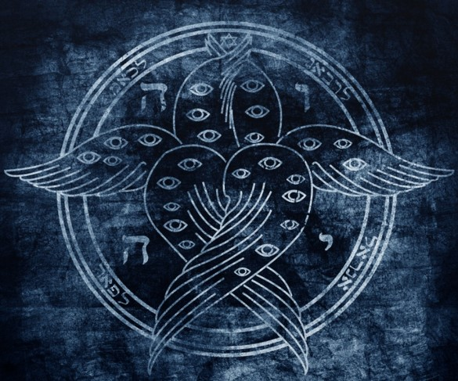
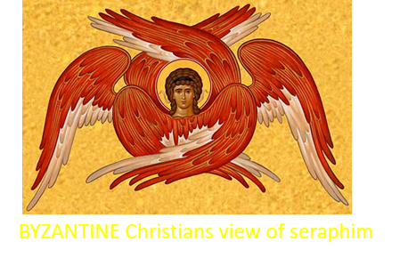
Seraphs—Hosts of Heaven
“Seraphs are angels who reside in the presence of God. … it is clear that seraphs include the unembodied spirits of pre-existence, for our Lord ‘looked upon the wide expanse of eternity, and all the seraphic hosts of heaven, before the world was made.’
Whether the name seraphs also applies to perfected and resurrected angels is not clear. …
“In Hebrew the plural of seraph is seraphim.”
Bruce R. McConkie
“Above it stood the seraphim; each one had six wings; with twain he covered his face, and with twain he covered his feet, and with twain he did fly.”
2 Nephi 16:2
D&C 38:1

Slide 13
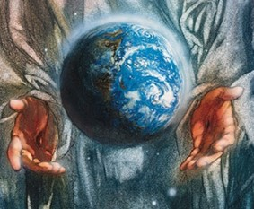
Christ the Creator
“Under the direction of his Father, Jesus Christ created this earth. No doubt others helped him, but it was Jesus Christ, our Redeemer, who, under the direction of his Father, came down and organized matter and made this planet, so that it might be inhabited by the children of God.”
Joseph Fielding Smith
“Jesus said unto them, Verily, verily, I say unto you, Before Abraham was, I am.”
John 8:58
D&C 38:3

Slide 14
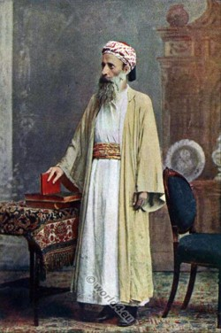
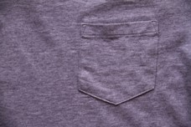
Zion of Enoch
To be “in the bosom” of someone is a Hebrew idiom. Anciently people wore loose robes bound around the waist with a sash.
The cloth above the sash formed a pocket in which people might carry objects of all kinds, even small children.
Something carried in this way was close to the chest or bosom, so the phrase “to be in the bosom of” implied a close and favored relationship.
Student Manual
“And it came to pass, that the beggar died, and was carried by the angels into Abraham’s bosom: the rich man also died, and was buried.”
Luke 16:22
D&C 38:4

Slide 15
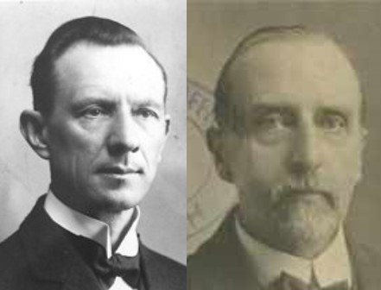
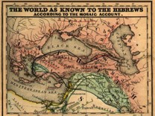
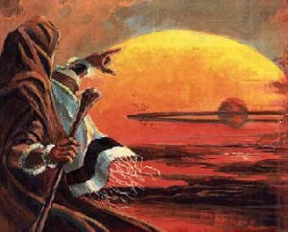
United in All
“Enoch, the seventh from Adam (Jude 14) built a city called Zion, after the people of God, so named by the Lord, because they were united, righteous, and prosperous.
This city of Enoch flourished for three hundred and sixty-five years and then the Lord, by some process not known to us, took it with all its inhabitants, ‘to His bosom,’ thus saving them from destruction in the flood that was to come.
‘And from thence went forth the saying, Zion is fled’ (… Moses 7:18, 19, 68, 69).”
Smith and Sjodahl
D&C 38:4

Slide 16
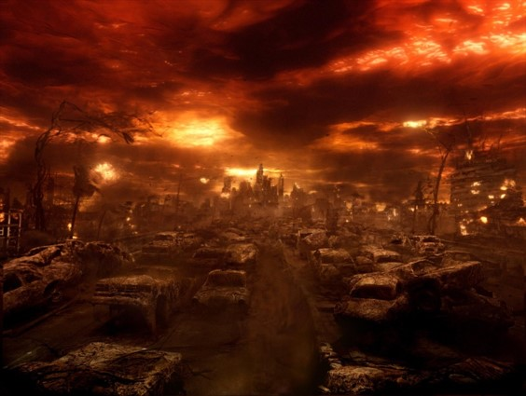
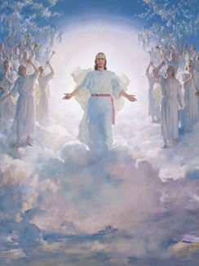
Those Who Face Doom
“When Christ comes the second time it will be in the clouds of heaven, and it shall be the day of vengeance against the ungodly, when those who have loved wickedness and have been guilty of transgression and rebellion against the laws of God will be destroyed.
All during the ministry of Christ wickedness ruled and seemed to prevail, but when he comes in the clouds of glory as it is declared in this message of Malachi to the world, and which was said by Moroni to be near at hand, then Christ will appear as the refiner and purifier of both man and beast and all that pertains to this earth, for the earth itself shall undergo a change and receive its former paradisiacal glory.”
President Joseph Fielding Smith
D&C 38:5-8

Slide 17
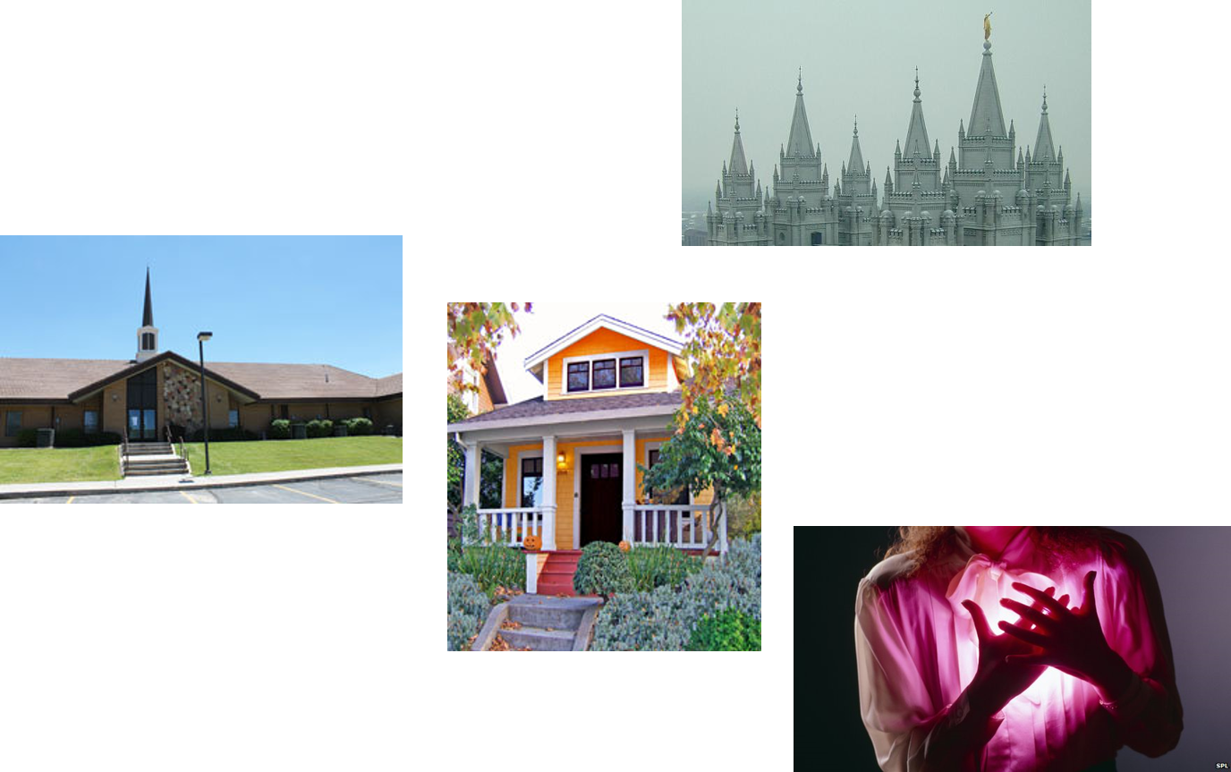
I Am In Your Midst
Where the sacred places are in your life—there will the Savior will be also
D&C 38:7-8

Slide 18
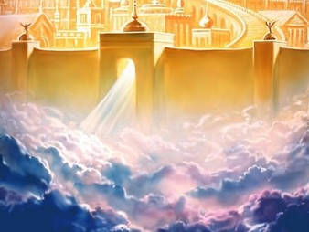
The Kingdom
“He has given to us the kingdom. He has made us the promise that the enemy of the kingdom shall not overcome. We may have trouble. We have had trouble. We may meet with opposition, but that opposition shall fail in its endeavor to destroy the work of God.
“The gospel has been restored, and the kingdom given to his saints according to the prophecy of Daniel. It is not again to be removed, destroyed, or given to other people, and in his own way and time he is going to break down all other systems, that his kingdom may prevail and that he may come and reign as Lord of lords and King of kings upon the face of the whole earth.
D&C 38:9, 15

Slide 19
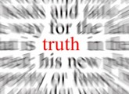
Truth Will Prevail
“The Lord has called attention to the fact that he is going to destroy systems and organizations and combinations that are false. And how is he going to do it?
By giving their members the truth, if they will receive it; by giving them the privilege of coming out of those organizations to receive the truth and have every opportunity to come into his kingdom, for his hand is outstretched ready to greet them.
If they will not come; if they will not receive his message; then, of course, they must fall with their systems.
Truth will prevail; truth will stand when all else is removed, and it is destined to cover the face of the earth.”
President Joseph Fielding Smith
D&C 38:9, 15

Slide 20
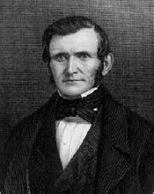
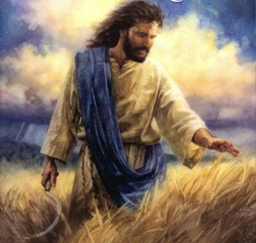
Angels Waiting to Reap
The imagery of angels waiting to reap down the fields comes from the parable of the wheat and the tares.
“It certainly is time that we prepare ourselves for that which is to come. Great things await this generation—
This causes silence to reign, and all eternity is pained. The angels of God are waiting to fulfill the great commandment … to go forth and reap down the earth because of the wickedness of men…
Why there is more wickedness, a thousand times over, in the United States now, than when that revelation was given?”
Elder Wilford Woodruff
“Let both grow together until the harvest: and in the time of harvest I will say to the reapers, Gather ye together first the tares, and bind them in bundles to burn them: but gather the wheat into my barn.”
Matthew 13:30
D&C 38:10-12

Slide 21
The Lord Asks Us to Be Strong
How can keeping the Lord’s commandments protect us?
When have you felt that you were protected by keeping a commandment?
The Lord can warn us of danger and give us commandments for our protection.
D&C 38:13-16

Slide 22
Sources:
“You Can Do This as a Quorum or Class” (4:04; watch from time code 0:10 to 2:14).
“Why Am I Here?” (4:10).
“The Needs before Us” (11:57; watch from time code 5:59 to 8:25).
President Joseph Fielding Smith (Church History and Modern Revelation,1:165–66; see also Exodus 3:14; D&C 39:1.)
Presentation by ©http://fashionsbylynda.com/blog/
Henry B. Eyring, “Our Hearts Knit as One,” Ensign or Liahona, Nov. 2008, 69
Bruce R. McConkie (Mormon Doctrine, p. 31, 702-3)
Doctrine and Covenants Student Manual Religion 324-325
Hyrum M. Smith and Janne M. Sjodahl, Commentary, p. 199
President Joseph Fielding Smith (Doctrines of Salvation, 1:74; 3:11; 1:241)
Elder Wilford Woodruff (In Journal of Discourses,18:128.)
Presentation by ©http://fashionsbylynda.com/blog/

Slide 23
Omniscient:
Some have questioned whether God is omniscient, that is, whether He knows all things. They say that He knows all things relative to man but that He Himself is still learning. This scripture shows that God has all knowledge (see also 2 Nephi 9:20; D&C 88:41; 130:7; Moses 1:6).
Knowledge brings power, and to say that God is limited in knowledge is to limit His power. This principle is taught in Lectures on Faith, compiled under the direction of the Prophet Joseph Smith: “Without the knowledge of all things, God would not be able to save any portion of his creatures; for it is by reason of the knowledge which he has of all things, from the beginning to the end, that enables him to give that understanding to his creatures by which they are made partakers of eternal life; and if it were not for the idea existing in the minds of men that God had all knowledge it would be impossible for them to exercise faith in him.” (4:43; see also Enrichment D in the Appendix) Student Manual Religion 324-325
I am in your midst:
President Harold B. Lee said: “I have a session with the missionary groups as they go out, in the temple, where they are permitted to ask intimate questions that wouldn’t be proper to be discussed elsewhere. They sometimes ask, Could you tell us a certain place in the temple where the Savior has been seen? My answer is, ‘Keep in mind that this is the house of the Lord; this is the place that we try to keep as pure and holy and sacred as any building we have. This is the most likely place he would come when he comes on earth. Don’t ask for a certain place because he has walked these halls. How do you know but what he is here in your midst?” (In Conference Report, British Area Conference 1971, pp. 135–36; or Ensign, Nov. 1971, pp. 12–13.)
Keeping the commandments:
President George Albert Smith taught:
“When I was a child I recognized, or thought I did, that the commandments of the Lord were His laws and regulations for my guidance. I thought I recognized in the disobedience to those laws that punishment would follow. … But as I grew older I have learned the lesson from another viewpoint, and now to me the laws of the Lord … are but the sweet music of the voice of our Father in heaven in His mercy to us. They are but the advice and counsel of a loving parent, who is more concerned in our welfare than earthly parents can be, and consequently that which at one time seemed to bear the harsh name of law to me is now the loving and tender advice of an all-wise Heavenly Father. And so I say it is not hard for me to believe that it is best for me to keep the commandments of God” (Teachings of Presidents of the Church: George Albert Smith [2011],193–94).

