Slide 1
Assess Your Learning
Physical and Spiritual Growth
Presentation by ©http://fashionsbylynda.com/blog/

Slide 2
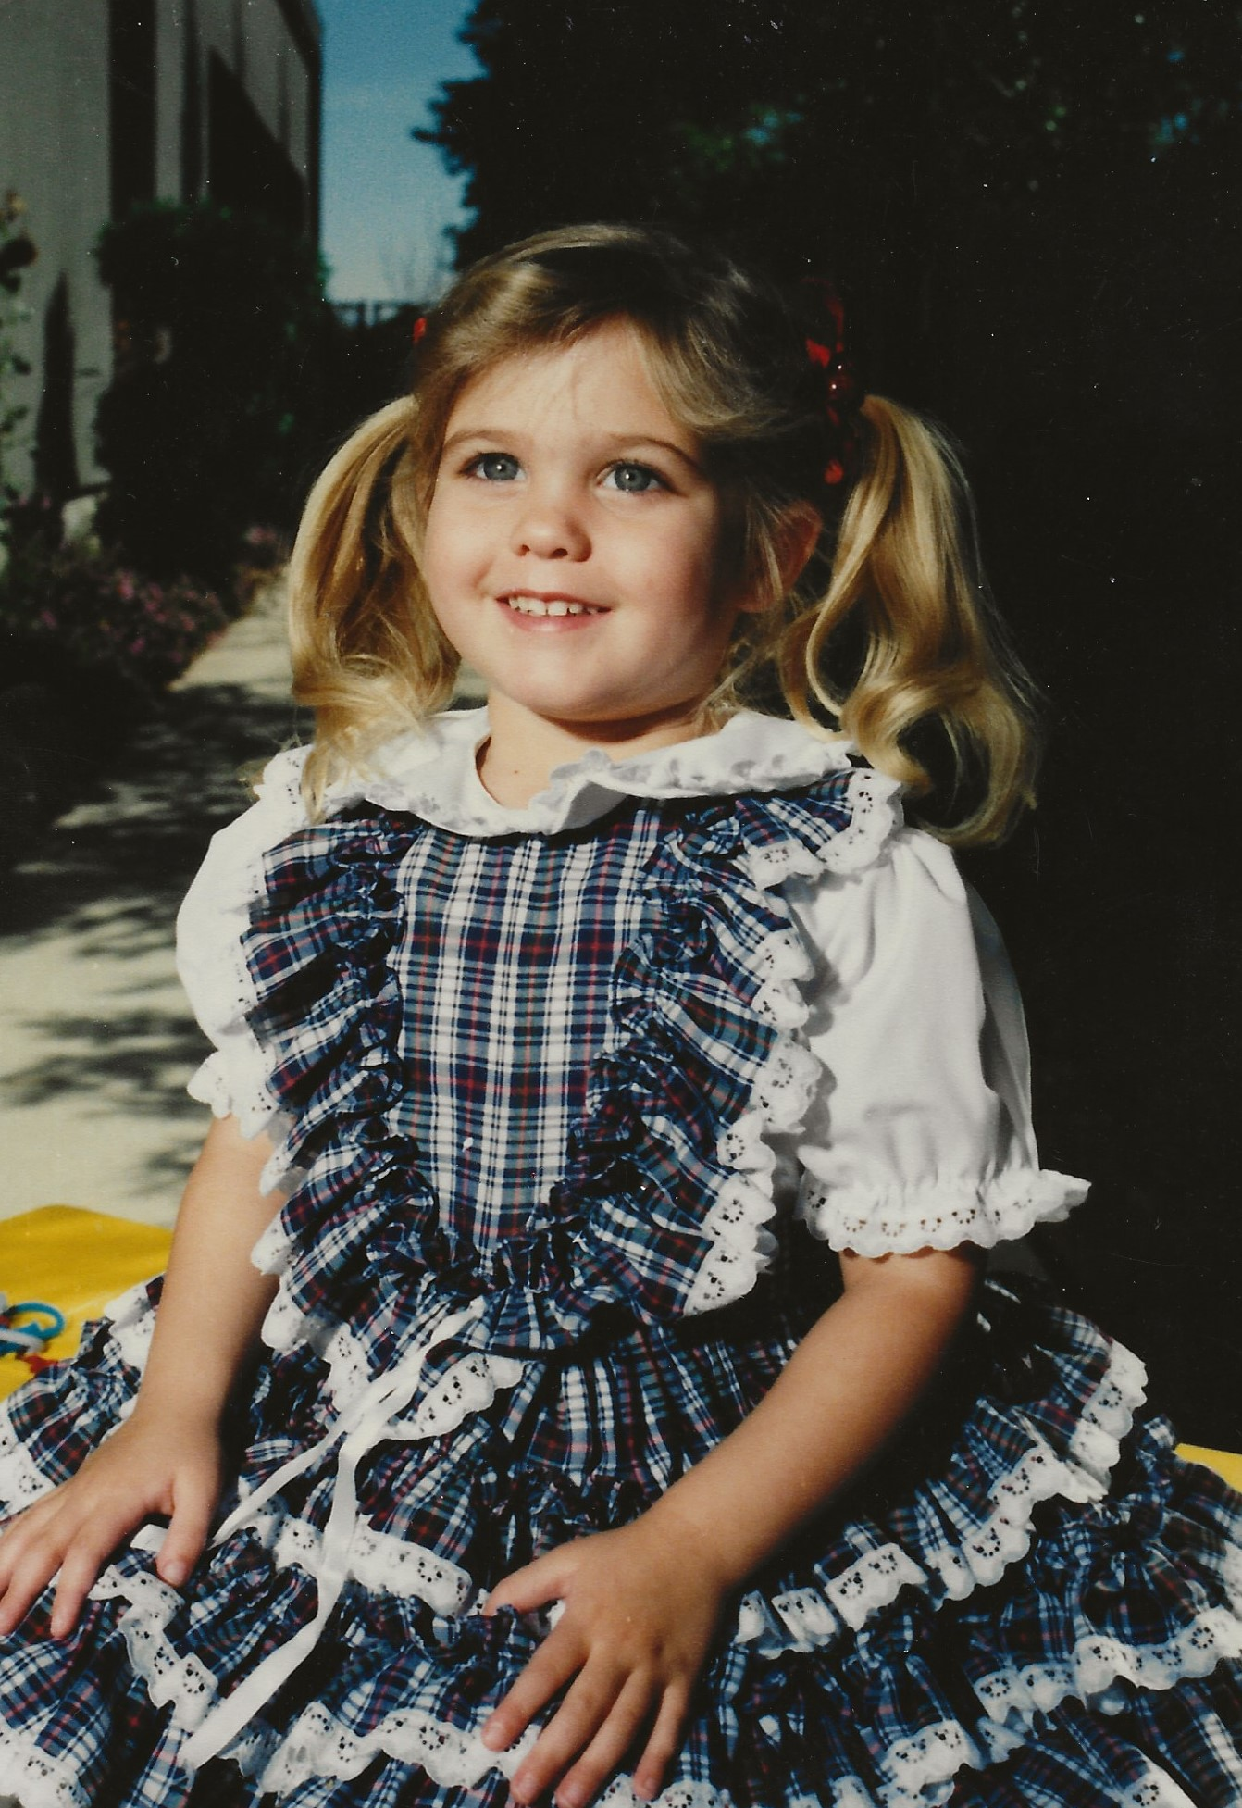
Physical Growth
How can pictures of ourselves help us recognize ways that we may have changed or grown?
What are some other ways to recognize growth?

Slide 3
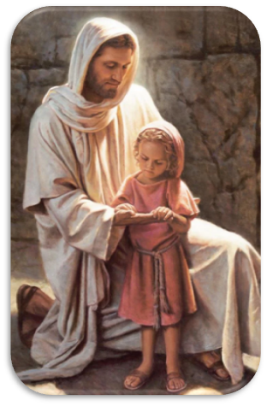
Spiritual Growth
Becoming More Like the Savior
And now behold, I ask of you, my brethren of the church, have ye spiritually been born of God? Have ye received his image in your countenances? Have ye experienced this mighty change in your hearts?
Alma 5:14
You have the potential to grow and become more like Jesus Christ.

Slide 4
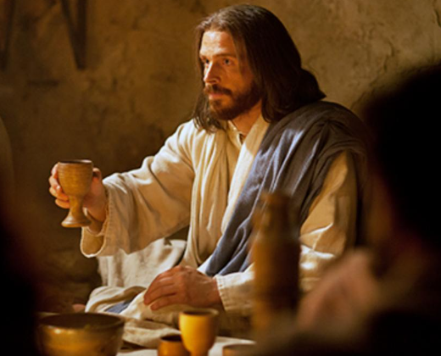
Ordinance of the Sacrament
Prayers offered to bless the bread and water
What we promise Heavenly Father
What Heavenly Father promises us
The attitudes we demonstrate when
partaking of the sacrament
The central focus on Jesus Christ

Slide 5
What are some scriptures we have studied recently that emphasize the importance of following the prophet?
What are your current feelings about following the Lord’s chosen prophet? What do you think has most impacted your feelings about following the Lord’s prophets?
How do you think following the prophet can help you become more like Jesus Christ?

Slide 6
Sharing the Gospel
What have you done recently to share the gospel with someone? How do you feel it went?
What obstacles have you faced as you have tried to share the gospel of Jesus Christ in natural and normal ways?
What are you learning about sharing the gospel of Jesus Christ?

Slide 7
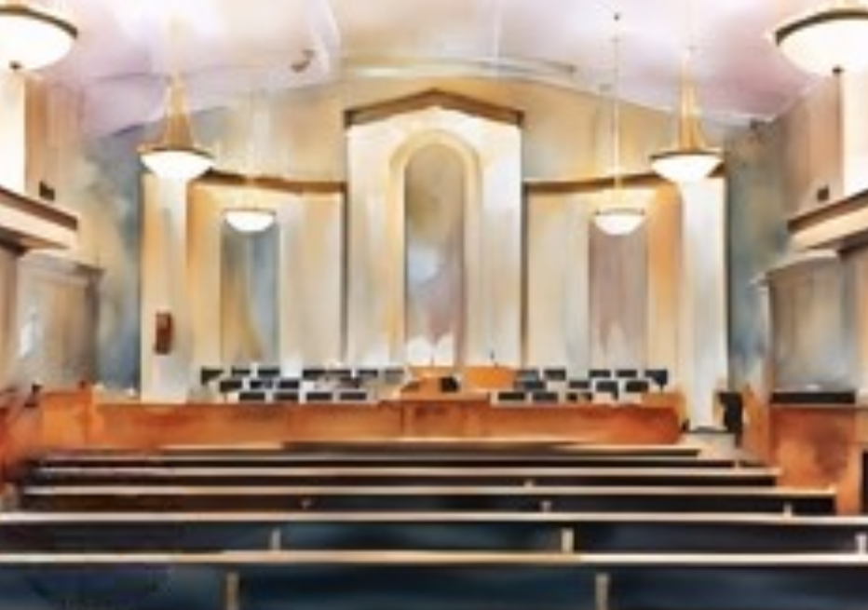
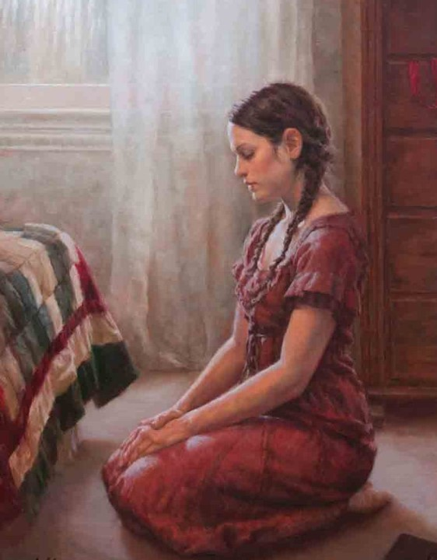
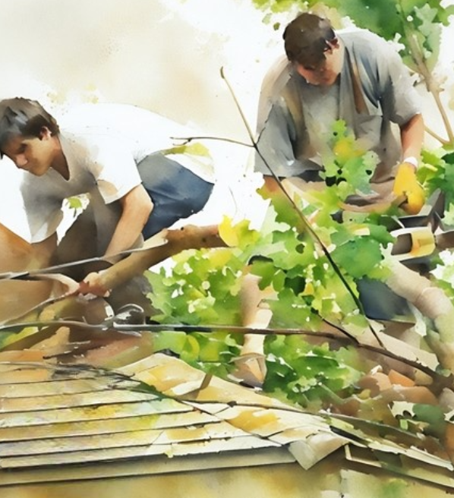
Developing Your Spiritual Growth
A Lifetime Quest
Purposeful attendance at sacrament meeting: The sacrament brings us closer to the Atonement of Jesus Christ. It reminds us of who Christ is and our dependency on Him. It is no wonder that a lot of emphasis has been put on this subject by Church leaders recently.
Daily scripture study: Helps us to hear the voice of the Lord encouraging us to make righteous choices.
Daily prayer: Teaches us to be humble as we kneel to thank and ask the Lord. This dependency becomes strong as our spirituality continues to grow.
Acts of service: King Benjamin, a Book of Mormon prophet, taught, “when ye are in the service of your fellow beings ye are only in the service of your God.”² Every adult member of the Church has plenty of opportunities to provide service.
Justin Burton Kunz
Developing Spiritually
By Elder Khumbulani D. Mdletshe
Area Seventy

